Slide 1
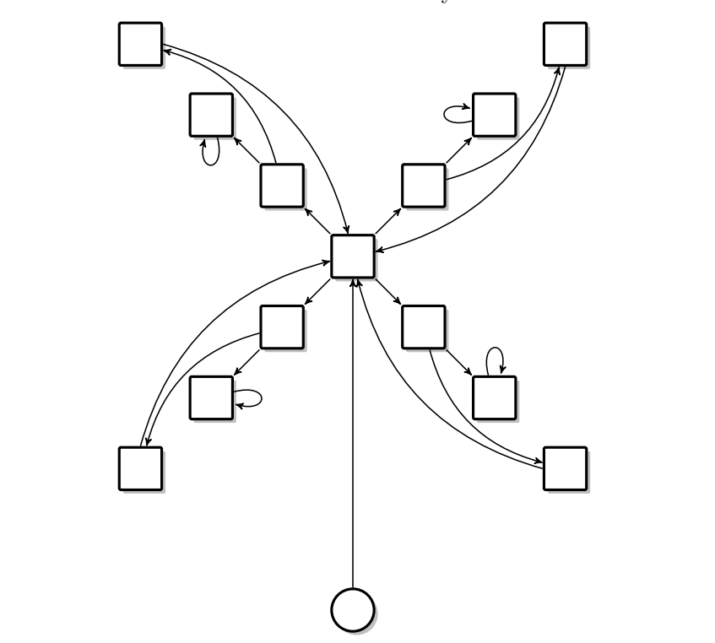
INFINITE GAMES
Aman Raj (170101006)
Mayank Wadhwani (170101038)

Slide 2
Motivation
Programs for non-terminating systems
e.g. controller regulating the anti-lock brake in a car, controller to regulate temperature of a system
Lead to emergence of so-called reactive systems
Interaction between the system and its environment
We model them by a finite graph and find winning strategies

Slide 3
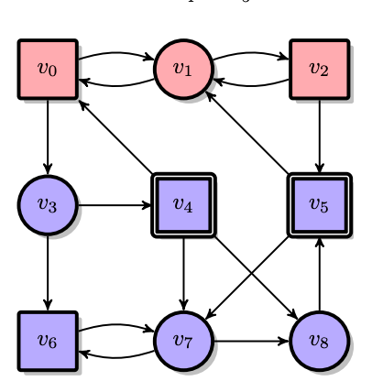
Essential Terminologies
Arena
Play
Strategy
Positional Strategy
Determinacy

Slide 4
Essential Terminologies
Arena: A = ( V , V0 , V1 , E )
Play
Strategy
Positional Strategy
Determinacy

Slide 5
Essential Terminologies
Arena
Play = infinite sequence
Ex. v0, v1, v2, v1 , v0 , v1 , …....
Strategy
Positional Strategy
Determinacy

Slide 6
Essential Terminologies
Arena
Play
Strategy: function V*Vi -> V
Positional Strategy
Determinacy

Slide 7
Essential Terminologies
Arena
Play
Strategy
Positional Strategy: strategy depends only on current state (no history component)
For red: f(vo) = v1, f(v2) = v1
Determinacy

Slide 8
Essential Terminologies
Arena
Play
Strategy
Positional Strategy
Determinacy
W0(V) union W1(V) = V

Slide 9
Examples of Games with Uniform Positional Strategy
Reachability games
Büchi games
Parity games

Slide 10
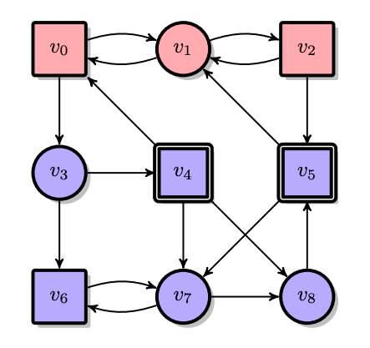
Reachability Games
Intro
Given, R ⊆ V be a subset of A’s vertices, here R = {v_{4,} v₅}
Player 0’s goal is to reach R at least once
Player 1 tries to avoid reaching R
Reach(R) = {v₀,v₁,…,∈ V^{w}| ∃ i: v_{i} ∈ R}

Slide 11
Reachability Games (Cont.)
Attractor
Attr₀(R) or 0-attractor of R : All vertices from where Player 0 can attract the token to R
Construction of the attractor is hierarchical
Vertex v is added to attractor if: {v ∈ V_{i} | some successor of v ∈ R} or {v ∈ V_{1−i} | all successors of v ∈ R}

Slide 12
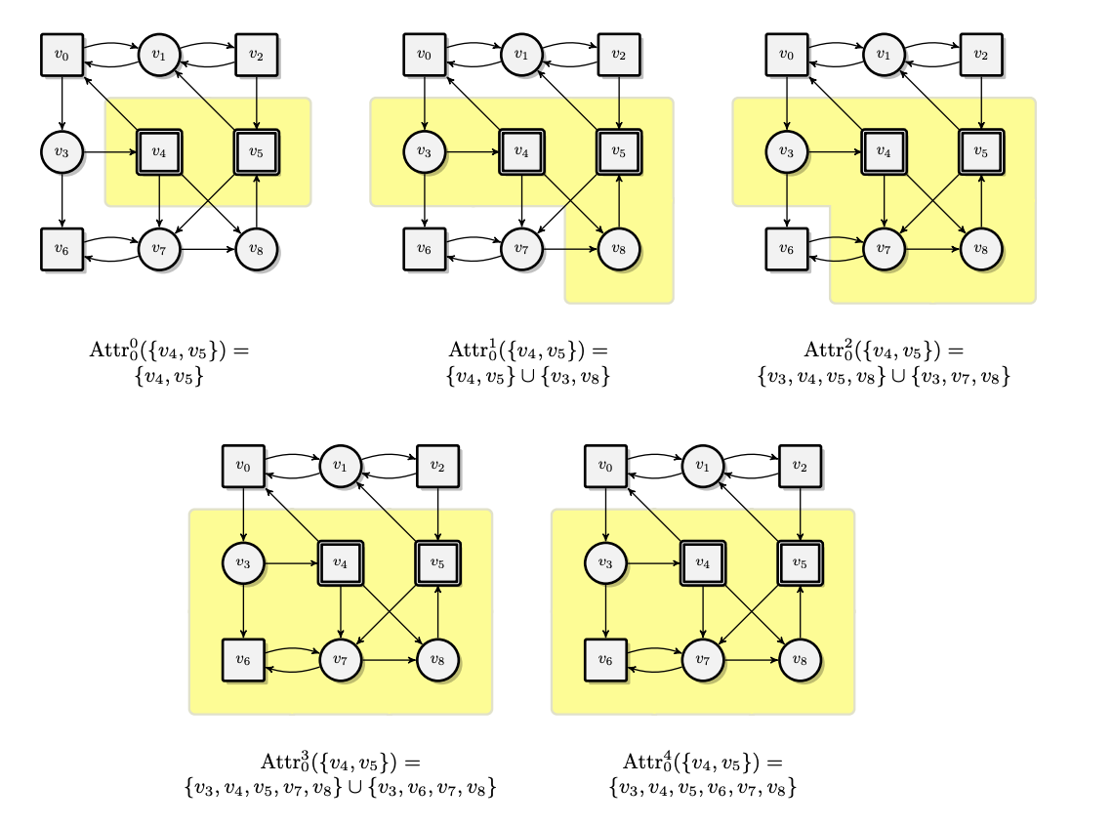
Reachability Games (Cont.)

Slide 13
Reachability Games (Cont.)
Solution
W₀(G) = Attr₀(R) and
W₁(G) = V \ Attr₀(R)
Uniform positional winning strategies for both players
Player 0 can enforce a win from every vertex in W₀(G)
Player 1 can enforce a win by keeping the token in W₁(G)

Slide 14
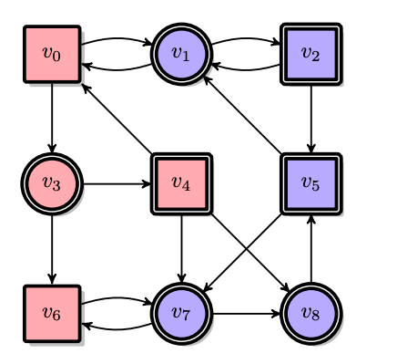
Safety Games
Dual of reachability games
Player 0 is not allowed to leave a specific region S of safe vertices.
While, Player 1’s goal is to reach V \ S.
Safe(S) = {v₀,v₁,…,∈ V^{w} | ∀ i: v_{i} ∈ S}
We can turn a safety game into a reachability game

Slide 15
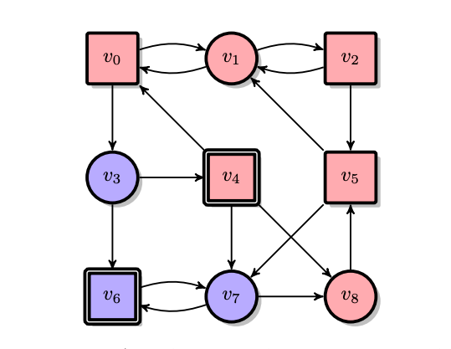
Büchi Games
So far: Visit even once, done. Future irrelevant
Büchi games-> there must be some element in a given set F that should be visited infinite times.

Slide 16
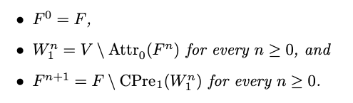
Büchi Games
So far: Visit even once, done. Future irrelevant
Büchi games-> there must be some element in a given set F that should be visited infinite times.
Approach: start with F, and move according to following recurrence

Slide 17
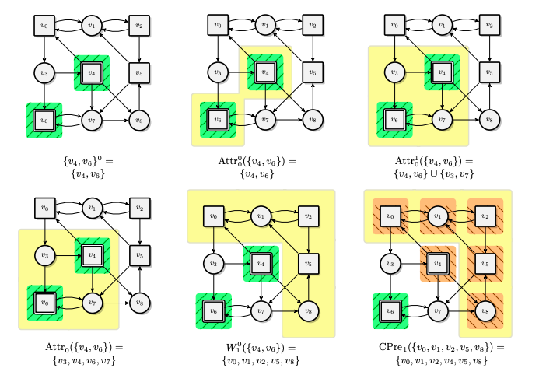
Büchi Games (Example)

Slide 18
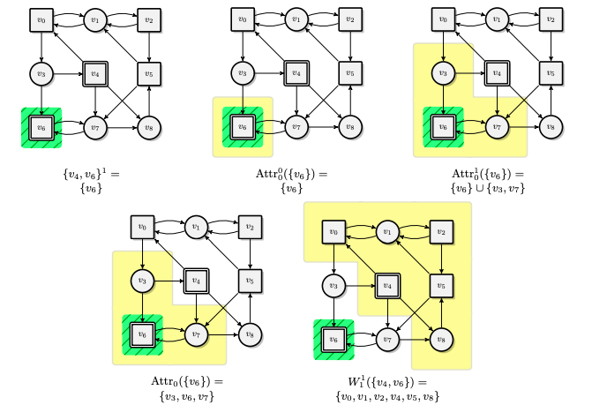
Büchi Games (Example explained)

Slide 19
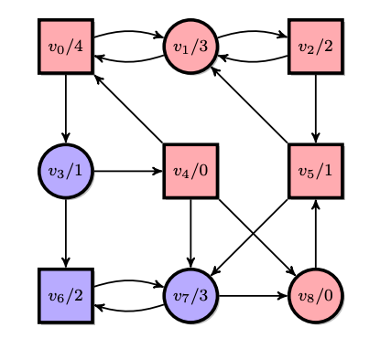
Parity Games
Intro
Generalization of Büchi games
Vertices of the arena are colored by natural numbers
Player i wins a play ρ if, and only if, the minimal color seen infinitely often in ρ has parity i.
Parity(Ω) = { ρ ∈ V^{ω} | min Inf(Ω(ρ₀)Ω(ρ₁)Ω(ρ₂) · · ) is even }

Slide 20
Parity Games
Solution
Can be solved using recursive algorithm involving computing attractors
Exponential upper bound on the running time

Slide 21
Finite-state Strategies and Reductions
Finite-state Strategies
Reductions
Weak muller games
Muller games
Limits on Reductions

Slide 22
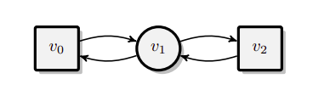
Finite-state Strategies
Example:
Let game with F = V

Slide 23
Finite-state Strategies
Memory Structure Let A = (V, V0, V1, E) be an arena. A memory structure M = (M, init, upd) for A.

Slide 24
Finite-state Strategies
Memory Structure Let A = (V, V0, V1, E) be an arena. A memory structure M = (M, init, upd) for A.
Init: V -> M

Slide 25
Finite-state Strategies
Memory Structure Let A = (V, V0, V1, E) be an arena. A memory structure M = (M, init, upd) for A.
Init: V -> M
Upd: M * V -> M

Slide 26
Finite-state Strategies
Memory Structure Let A = (V, V0, V1, E) be an arena. A memory structure M = (M, init, upd) for A.
Next Move function
Init: V -> M
Upd: M * V -> M
nxt: Vi * M -> V satisfying (v, nxt(v,m) ) belongs to E

Slide 27
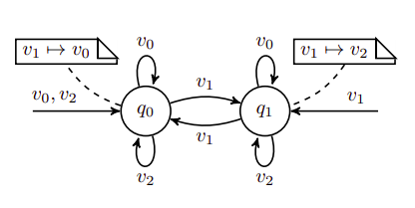
Finite-state Strategies
If some strategy requires a memory structure and some next move function, it is finite state strategy.
All early games (that are positional strategy-based games) like Büchi, reachability can also be implemented by finite state strategy

Slide 28
Reductions
Aim is to obtain a new game G' where Player 0 is known to have a positional winning strategy.
Reducing G to G' simplifies the winning condition
But increases the size because of memory structure
ρ ∈ Win if, and only if, ext(ρ) ∈ Win'.

Slide 29
Weak Muller Game
Let A = (V, V0, V1, E) be an arena and let F ⊆ 2 ^{V} be a family of subsets of A’s vertices. Then, the weak Muller condition wMuller(F) is defined as : wMuller(F) := {ρ ∈ V ^{ω} | Occ(ρ) ∈ F} We call a game G = (A, wMuller(F)) a weak Muller game.

Slide 30
Weak Muller Game (Reduction)
Weak Muller games are reducible to weak max-parity games
wMaxParity(Ω) := {ρ ∈ V ^{ω} | max Occ(Ω(ρ0)Ω(ρ1)Ω(ρ2)· · ·) is even}.
Player i wins a play, if the parity of the maximal color occurring during the play is i
Ω(v, S) = ( 2 · |S| if S ∈ F, ( 2 · |S| − 1 if S does not ∈ F.
As the set of visited vertices increases until it gets stationary at some point, larger sets are assigned larger colors than smaller sets.

Slide 31
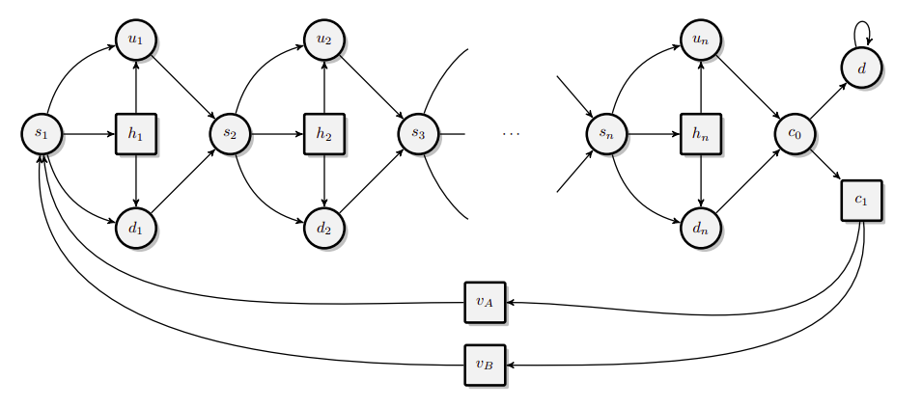
Weak Muller Game (Family)
There exists a family Gn = (An, wMuller(Fn)) of weak Muller games, each having a designated vertex v, such that • |An| ∈ O(n) and |Fn| = 2, • Player 0 has a finite-state winning strategy from v, but • Player 0 has no finite-state winning strategy from v with less than 2^n states.

Slide 32
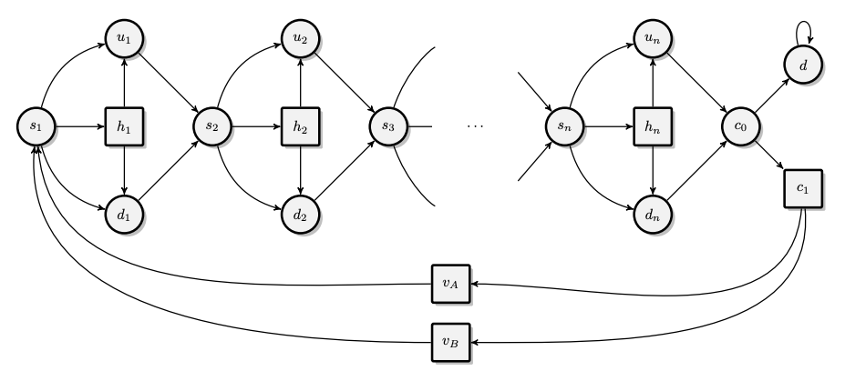
Family of Weak Muller games

Slide 33
Limits on Reduction
A Büchi condition is harder than a reachability condition
Intuitively, In a Büchi game, vertices from F have to be visited infinitely often while in a reachability game it suffices to visit R once, which is a much weaker condition.
Reductions cannot go “down” the hierarchy: A complicated language cannot be reduced to a simpler one.

Slide 34
Rabin's Theorem
Infinite Tree
S2S
Parity Tree Automata
Rabin's theorem

Slide 35
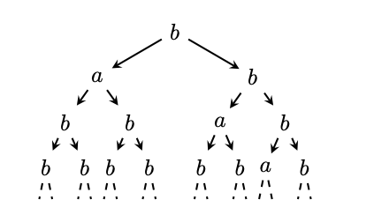
Infinite Tree
A tree over an alphabet Σ is a mapping t: B ∗ → Σ
Ex:
te(w) = ( a if w = 1∗0,
( b otherwise.

Slide 36
S2S
The Monadic Second-Order Logic of Two Successors
Syntax of S2S
If $ is a formula, then Complement, union, intersection, quantification, also formula
Sentence is a formula without free variables
Solution in from of trees which satisfy the sentence

Slide 37
S2S (Cont.)
Satisfiability problem for S2S
Translates a sentence ϕ into an automaton A_{ϕ} recognizing exactly the trees satisfying ϕ
Typically simpler to solve

Slide 38
S2S (Cont.)
Semantics of S2S
t, µ |= ¬ϕ if, and only if, it is not the case that t, µ |= ϕ.
t, µ |= ϕ ∧ ϕ' if, and only if, t, µ |= ϕ and t, µ |= ϕ' .
t, µ |= ϕ ∨ ϕ' if, and only if, t, µ |= ϕ or t, µ |= ϕ' .
t, µ |= ∃xϕ if, and only if, t, µ[x→ w] |= ϕ for some w ∈ B ∗ .
t, µ |= ∀xϕ if, and only if, t, µ[x→ w] |= ϕ for all w ∈ B ∗ .
And so on......

Slide 39
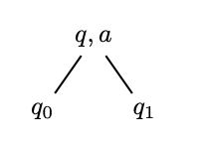
Parity Tree Automata
A parity tree automaton A = (Q, Σ, qI , ∆, Ω)

Slide 40
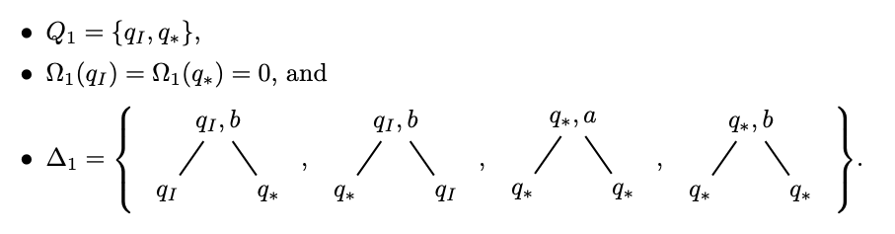
Parity Tree Automata (An example)
L1 = {t: B ∗ → {a, b} | t|π = b ω for some path π}, the language of trees containing a path labelled with b ω

Slide 41
Thank You

