Slide 1
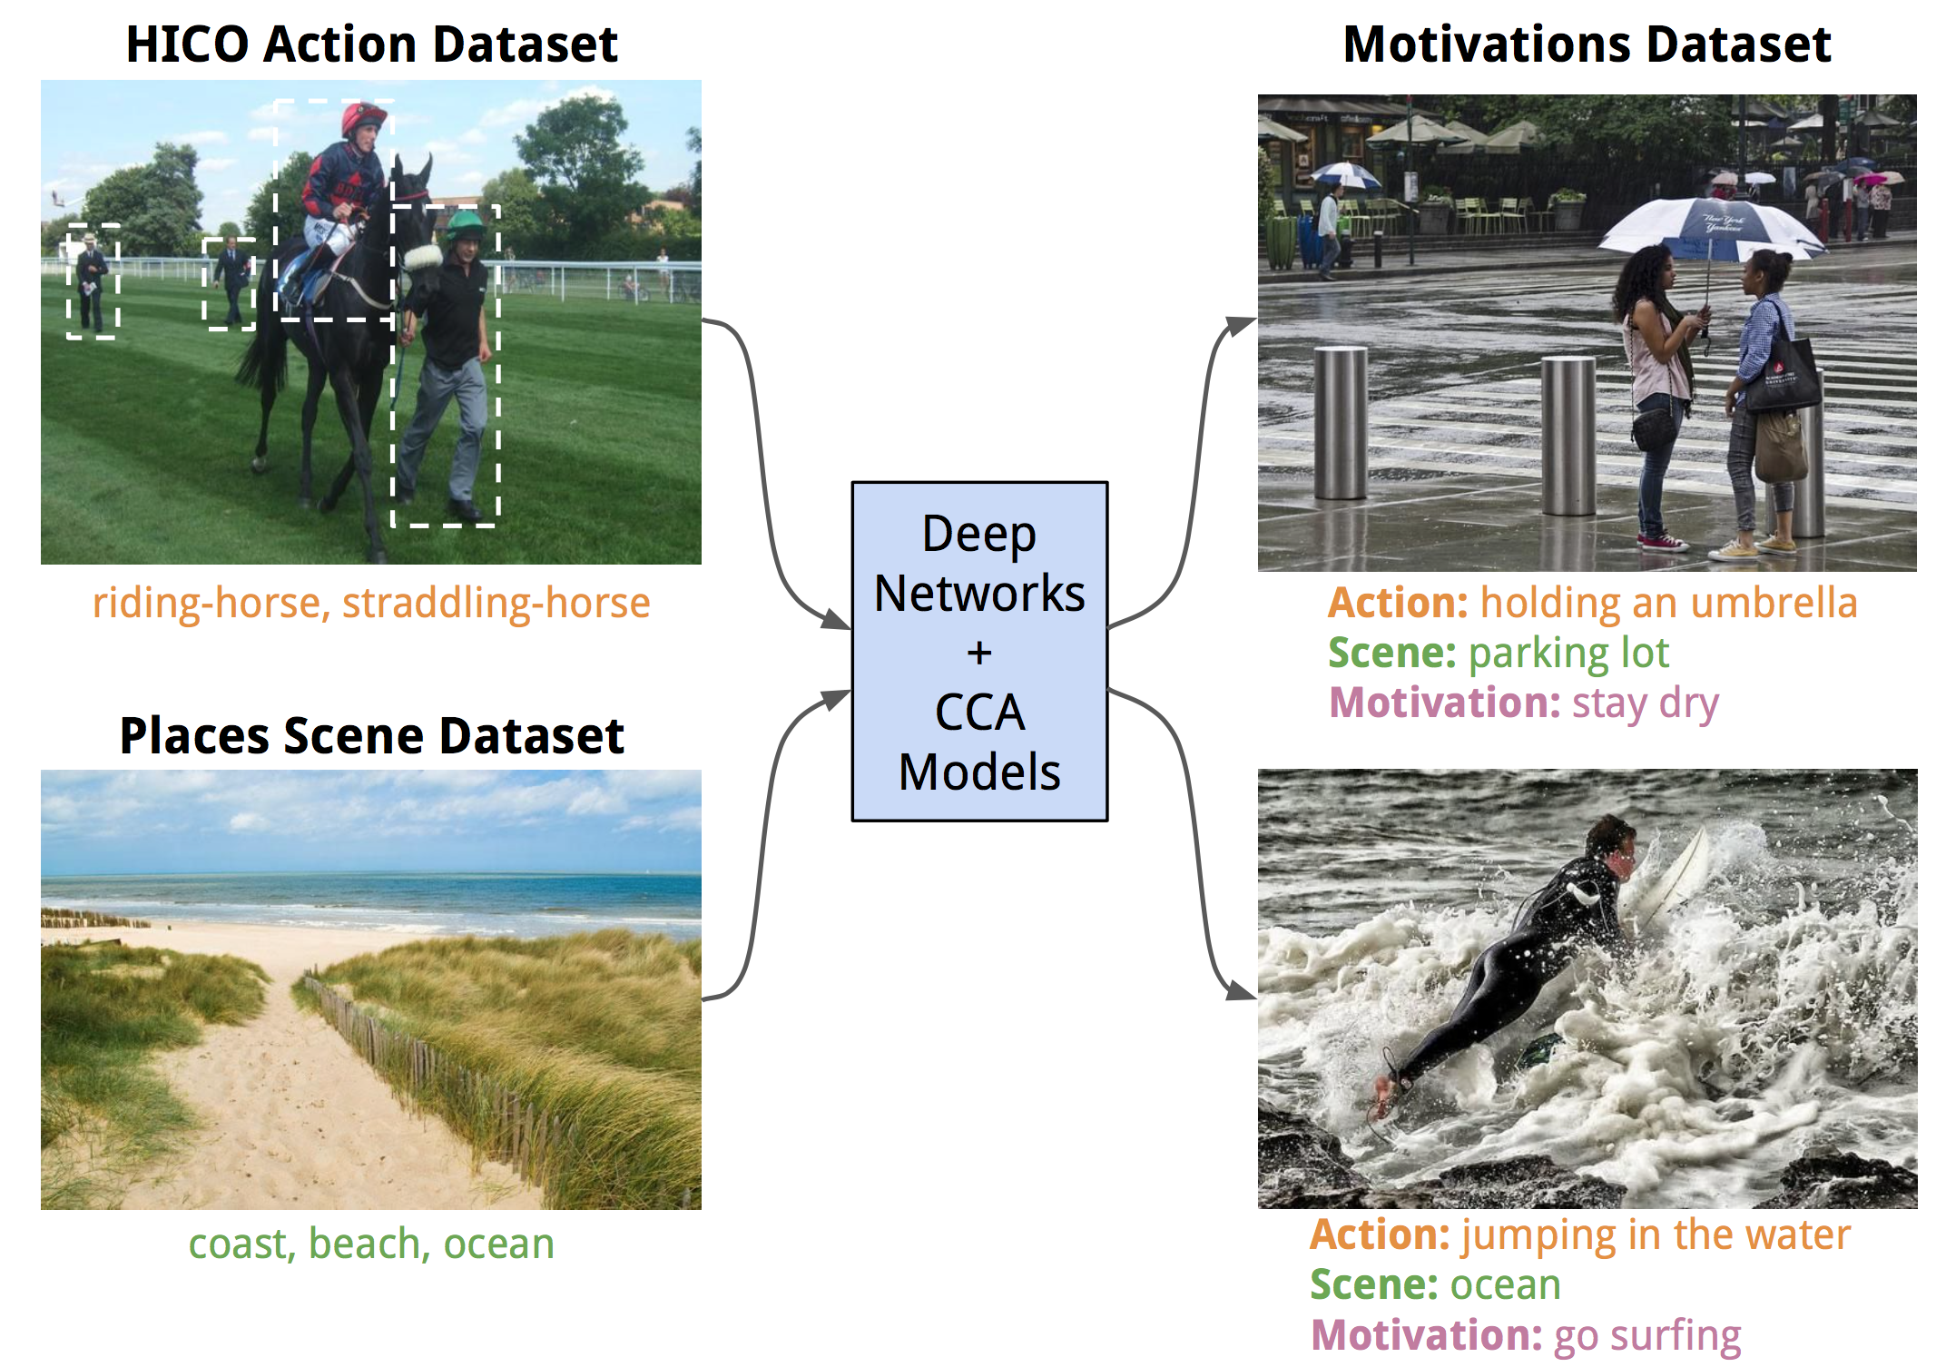
High-level Cues for Predicting Motivations
Arun Mallya and Svetlana Lazebnik University of Illinois at Urbana-Champaign
Action Predictions (600-d) from Fusion net (Mallya and Lazebnik, ECCV 2016) trained on HICO.
Scene Predictions (365-d) from VGG-16 trained on Places (Zhou et al, NIPS 2014).
Image Embedding of size (600+365) v/s 8192 in prior work.
Sentence Embeddings (4800-d) using Skip-Thought Vectors (Kiros et al, NIPS 2015).
3 nCCA models for retrieval with 300-d embeddings, one for each prediction type.
Vondrick et al, CVPR 2016
Train/Val/Test
set of size
6133/1532/2526

Slide 2
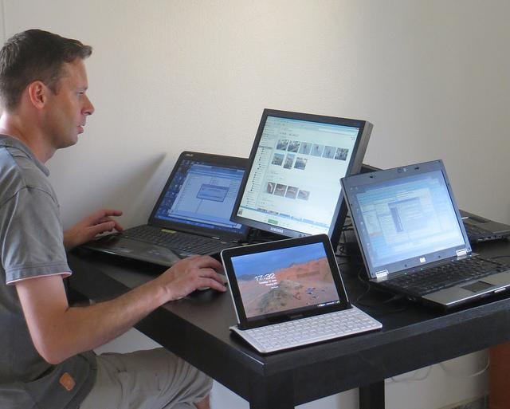
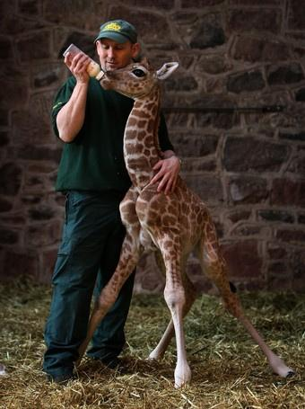
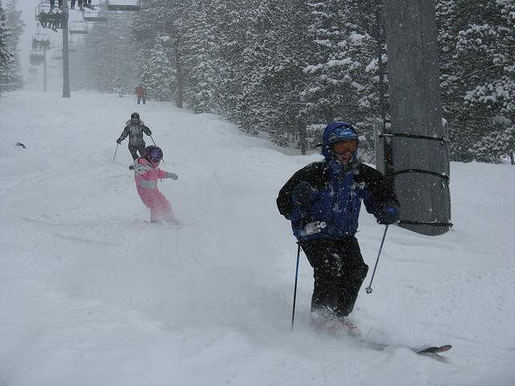
Intermediate Predictions and Results
read-laptop type-on-laptop hold-laptop | computer-room home-office physics-lab
watch-giraffe feed-giraffe pet-giraffe | stable rodeo-arena barndoor
wear-skis stand-on-skis ride-skis | ski-slope igloo ski-resort
Ground Truth looking at computer screen home office do work | Prediction typing on a computer meeting work
Ground Truth bottle zoo feeding a baby giraffe | Prediction feeding a giraffe zoo care for giraffe
Ground Truth skiing ski resort get down the hill | Prediction skiing resort have fun

Slide 3
Numbers and Takeaways
Method | Motivation |  |  | Action |  |  | Scene
 | Median Rank | Recall @1 | Recall @10 | Median Rank | Recall @1 | Recall @10 | Median Rank | Recall @1 | Recall @10
Sentences replaced with cluster centers — #Clusters (Motivation, Action, Scene): (256, 100, 100)
SSVM - Image + Person fc7 + Language Model [1] | 28 | — | — | 14 | — | — | 3 | — | —
CCA - ImageNet VGG fc7 | 19 | 9.0 | 38.8 | 11 | 14.5 | 49.0 | 3 | 35.2 | 72.2
CCA - Action & Scene cues | 14 | 12.0 | 44.9 | 8 | 18.6 | 56.3 | 3 | 33.4 | 73.8
Sentences used as-is — #Sentences: 2526
CCA - ImageNet VGG fc7 | 171 | 0.9 | 7.7 | 187 | 1.3 | 9.5 | 116 | 1.1 | 7.9
CCA - Action & Scene cues | 130 | 1.4 | 12.0 | 117 | 1.8 | 13.2 | 113 | 1.0 | 8.8
High-level cues provide a compact image representation and are more informative than generic VGG features.
High-level cues increase model interpretability and allow us to diagnose and understand errors.
In spite of advances, there is scope for improving action and scene predictions.
CCA gives good generalization compared to complex methods on small datasets.

