Slide 1


A Hacker’s Guide to Speculative Decoding in vLLM
CUDA MODE talk by Cade Daniel

Slide 2

Introductions
Working on LLM inference in vLLM
Software Engineer at Anyscale
Previously, model parallelism systems at AWS
https://arxiv.org/abs/2111.05972
Feel free to reach out!
https://x.com/cdnamz

Slide 3
Topics
vLLM’s core principles
Spec decode background
Spec decode framework intro (for contributors)
Future contribution ideas
Q&A (30min)

Slide 4
vLLM’s core principles
Ease-of-use
Great performance
Hardware agnosticity

Slide 5



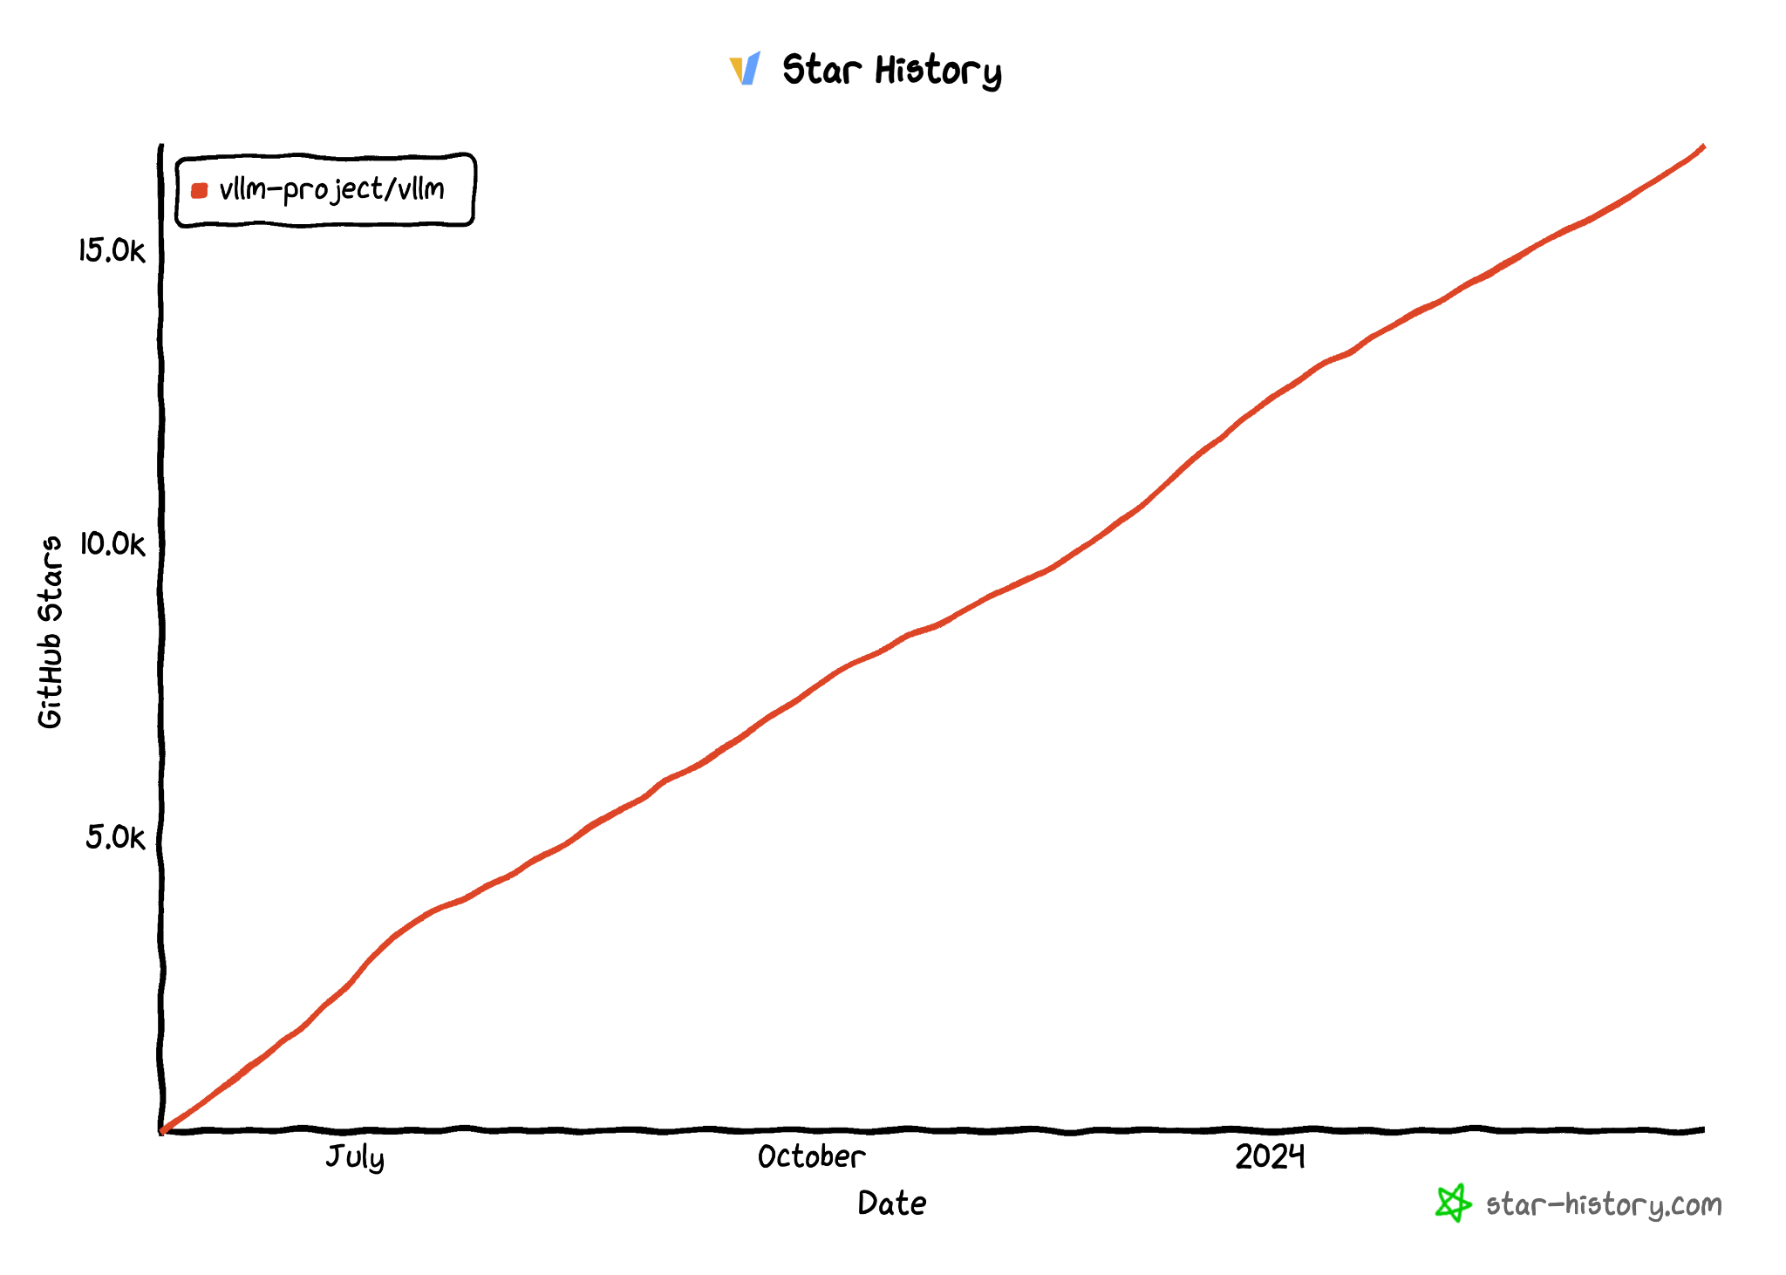
Easy-to-use
https://github.com/vllm-project/vllm
$ pip install vllm
17K Stars

Slide 6
Great performance
Performance features
PagedAttention/tensor parallelism
Optimized multi-LoRA
Chunked prefill
Automatic prefix caching
Guided decoding
Quantization (fp8 WIP, and others)
Pipeline-parallelism (WIP)
Prefill disaggregation (WIP)
More contributions welcome!

Slide 7
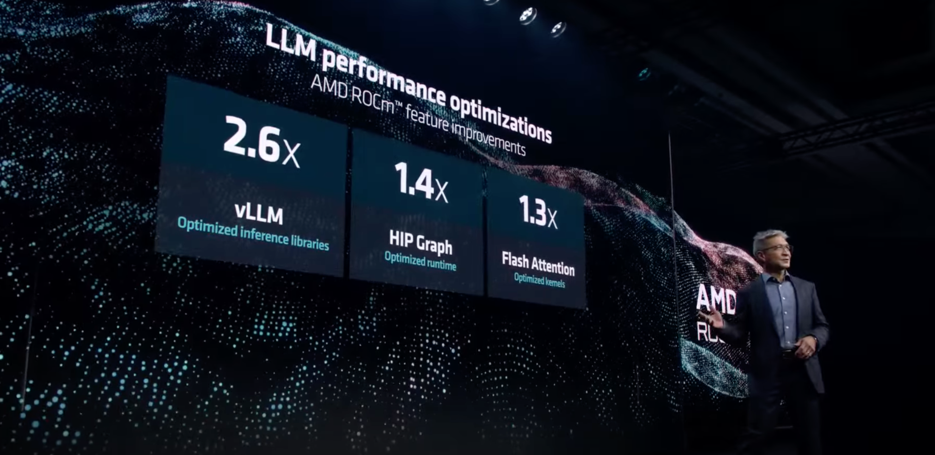
Hardware agnosticity
Current backends:
NVIDIA, AMD, Inferentia, TPU (WIP), CPU
Source: AMD Presents: Advancing AI
‹#›

Slide 8
Topics
vLLM’s core principles
Spec decode background
Spec decode framework intro (for contributors)
Future contribution ideas
Q&A (30min)

Slide 9
Spec decode background
Recommended reading: Andrej Karpathy’s tweet on speculative decoding
https://x.com/karpathy/status/1697318534555336961
Memory-boundedness
In memory-bound LLM inference, the full GPU compute capacity is underutilized
The unused compute can be used, if we can find a way to use it
Not all parameters required for every token
Do we really need 70B parameters to answer “What is the capital of California”? Probably not…
Idea:
Try to predict what large model will say
Get probabilities of predictions
Use heuristic to accept or rejection the predictions based on probabilities

Slide 10
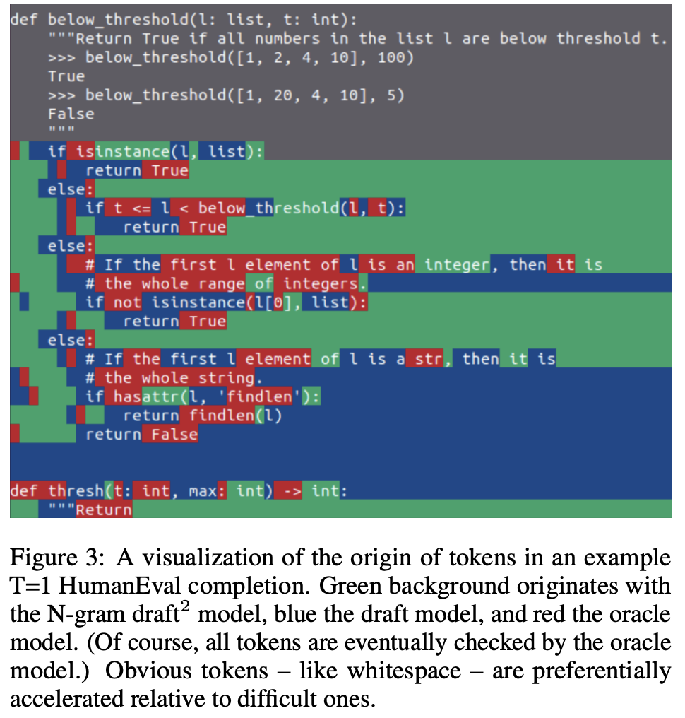
Spec decode background
Source: “Accelerating LLM Inference with Staged Speculative Decoding” https://arxiv.org/pdf/2308.04623

Slide 11
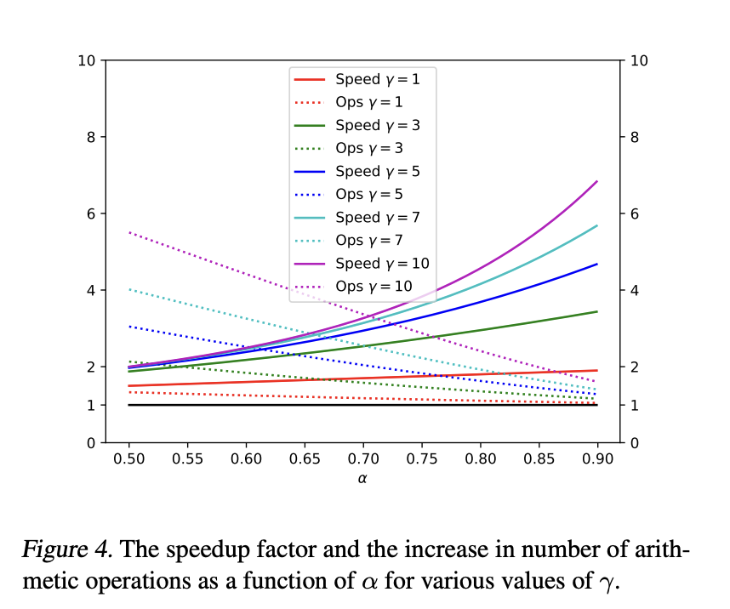
How to evaluate speedup?
Recommended reading: “Fast Inference from Transformers via Speculative Decoding” https://arxiv.org/pdf/2211.17192

Slide 12
How to evaluate speedup?
Simplified version:
Inter-token latency = step time / number of tokens per step in expectation
Example without speculative decoding: 30ms / 1 → 1 token per 30ms
Example with speculative decoding: 40ms / 2.5 → 1 token per 16ms
Key factors
How long does it take to propose?
How accurate are the proposals?
How long does it take to verify / other spec framework overheads?
In practice:
https://github.com/vllm-project/vllm/blob/main/vllm/spec_decode/metrics.py
Acceptance rate – “How aligned is the proposal method with the target model?”
System efficiency – “How efficient is the deployment compared to 100% acceptance rate?”

Slide 13
Losslessness
Is the output of speculative decoding different than the target model?
TL;DR No if using rejection sampling, subject to hardware numerics
Diagram https://github.com/vllm-project/vllm/pull/2336
Yes if using lossly sampling technique, e.g. Medusa’s typical acceptance (but higher acceptance rate!)
Recommended reading (proof of losslessness): Accelerating Large Language Model Decoding with Speculative Sampling

Slide 14
Topics
vLLM’s core principles
Spec decode background
Spec decode framework intro (for contributors)
Future contribution ideas
Q&A (30min)

Slide 15
Current status in vLLM
Spec decode framework is complete with correctness tests
Supports draft model, ngram, Medusa (soon), IBM’s MLPSpeculator (soon)
Other features like skipping speculation for some sequences, dynamic speculative decoding
Missing performance optimizations to achieve Anyscale’s internal fork performance
https://github.com/vllm-project/vllm/issues/4630
Llama2 70B 50% ITL reduction on BS=1..8 with temperature 1.0

Slide 16
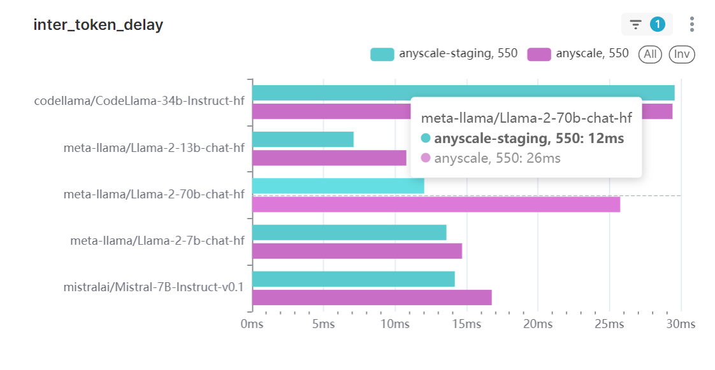
Current status in vLLM

Slide 17
Spec decode framework
SpecDecodeWorker
Proposers (ngram, draft model)
Scorer (top-1 scoring)
Verifier (rejection sampling)

Slide 18
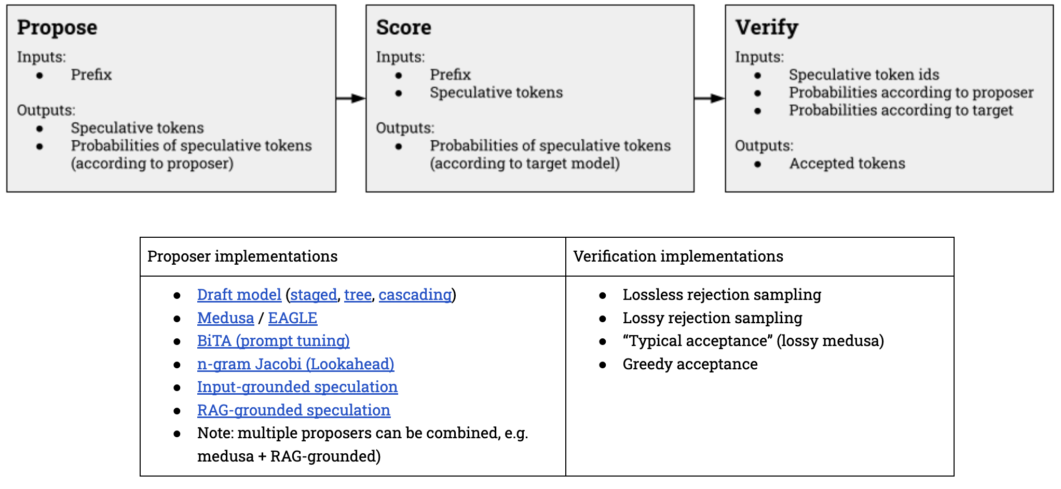
Spec decode framework

Slide 19
Spec decode framework: links
SpecDecodeWorker
https://github.com/vllm-project/vllm/blob/37464a0f745a0204da7443d2a6ef4b8f65e5af12/vllm/spec_decode/spec_decode_worker.py#L1
Proposers
Draft model proposer https://github.com/vllm-project/vllm/blob/37464a0f745a0204da7443d2a6ef4b8f65e5af12/vllm/spec_decode/multi_step_worker.py#L1
Ngram proposer https://github.com/vllm-project/vllm/blob/37464a0f745a0204da7443d2a6ef4b8f65e5af12/vllm/spec_decode/ngram_worker.py#L1
Verifier
Rejection sampler https://github.com/vllm-project/vllm/blob/37464a0f745a0204da7443d2a6ef4b8f65e5af12/vllm/model_executor/layers/rejection_sampler.py#L1
WIP typical acceptance https://github.com/vllm-project/vllm/issues/5015

Slide 20
Spec decode framework: top1 vs top-k “tree attention”
Top-1: proposal method suggests 1 token per sequence per slot
Top-k: proposal method suggests k tokens per sequence per slot
Recommended reading
https://sites.google.com/view/medusa-llm
https://arxiv.org/pdf/2305.09781
https://www.together.ai/blog/sequoia
Currently only top-1 proposal and scoring is supported
Top-k is a future work
Most aggressive speedups require top-k attention masking
FlashInfer going to support masking
https://github.com/vllm-project/vllm/issues/3960

Slide 21
Spec decode framework: “Bonus token” and “recovered token”
Recommended reading: https://arxiv.org/pdf/2302.01318
Bonus token: All speculative tokens may be accepted. We can sample from target model distribution normally in this case
→ we get an additional token in the happy-path!
Recovered token: If all tokens are rejected, we can use math trick to sample a correct token from the target model distribution
→ We always get >=1 token
Logic is in rejection sampler / SpecDecodeWorker
https://github.com/vllm-project/vllm/blob/37464a0f745a0204da7443d2a6ef4b8f65e5af12/vllm/model_executor/layers/rejection_sampler.py#L210

Slide 22
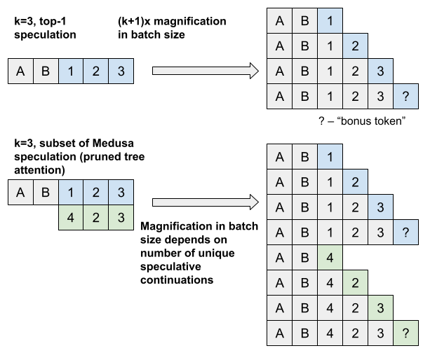
Spec decode framework: “Bonus token” and “recovered token”

Slide 23
Spec decode framework: “Bonus token” and “recovered token”
Recommended reading: https://arxiv.org/pdf/2302.01318
Bonus token: All speculative tokens may be accepted. We can sample from target model distribution normally in this case
→ we get an additional token in the happy-path!
Recovered token: If all tokens are rejected, we can use math trick to sample a correct token from the target model distribution
→ We always get >=1 token
Logic is in rejection sampler / SpecDecodeWorker
https://github.com/vllm-project/vllm/blob/37464a0f745a0204da7443d2a6ef4b8f65e5af12/vllm/model_executor/layers/rejection_sampler.py#L210

Slide 24
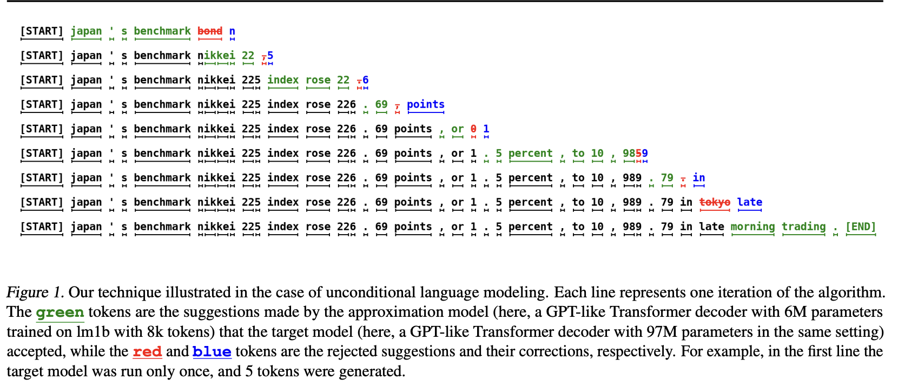
Spec decode framework: “Bonus token” and “recovered token”
https://arxiv.org/pdf/2211.17192

Slide 25
Lookahead scheduling
Problem: Scoring speculative tokens generates KV. How can we save accepted KV to skip regeneration and reduce FLOPs requirements?
Recommended reading: What is lookahead scheduling in vLLM?
TL;DR:
vLLM’s scheduler allocates additional space for KV
The SpecDecodeWorker uses the space to store KV of speculative tokens
Accepted token KV is stored correctly

Slide 26
Dynamic speculative decoding
Problem: As batch size increases, spare FLOPs is reduced. How can we ensure spec decode performs no worse than no spec decode?
Recommended reading: https://github.com/vllm-project/vllm/issues/4565
Work by Lily Liu and Cody Yu
TL;DR
Based on the batch size, adjust which sequences have speculations (or disable spec dec altogether)
Future work: per-sequence speculation length

Slide 27
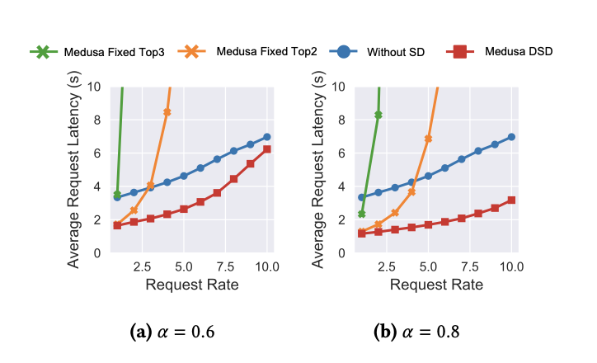
Dynamic speculative decoding
Source: Xiaoxuan Liu

Slide 28
Dynamic speculative decoding
Problem: As batch size increases, spare FLOPs is reduced. How can we ensure spec decode performs no worse than no spec decode?
Recommended reading: https://github.com/vllm-project/vllm/issues/4565
Work by Lily Liu and Cody Yu
TL;DR
Based on the batch size, adjust which sequences have speculations (or disable spec dec altogether)
Future work: per-sequence speculation length

Slide 29
Batch expansion
Problem: How to support scoring when PagedAttention only supports 1 query token per sequence?
Recommended reading: Optimizing attention for spec decode can reduce latency / increase throughput
TL;DR
We create “virtual sequences” in SpecDecodeWorker each with 1 query token
This expands the batch (and duplicates KV loads in the attention layers)
We can remove this with an attention kernel which supports PagedAttention + multiple query tokens per sequence
Contact https://github.com/LiuXiaoxuanPKU for more information

Slide 30
Batch expansion

Slide 31
Batch expansion
Problem: How to support scoring when PagedAttention only supports 1 query token per sequence?
Recommended reading: Optimizing attention for spec decode can reduce latency / increase throughput
TL;DR
We create “virtual sequences” in SpecDecodeWorker each with 1 query token
This expands the batch (and duplicates KV loads in the attention layers)
We can remove this with an attention kernel which supports PagedAttention + multiple query tokens per sequence
Contact https://github.com/LiuXiaoxuanPKU for more information

Slide 32
Testing
Problem: How can we validate correctness of spec decode?
TL;DR:
E2E: When temperature==0, we expect equality with and without spec decode
Rejection sampler unit tests (output distribution does not change regardless of draft/target probabilities))
You can rely on these tests when contributing
https://github.com/vllm-project/vllm/tree/main/tests/spec_decode
https://github.com/vllm-project/vllm/tree/main/tests/spec_decode/e2e

Slide 33
Topics
vLLM’s core principles
Spec decode background
Spec decode framework intro (for contributors)
Future contribution ideas
Q&A (30min)

Slide 34
Future contribution ideas
More engineering
Retrieval-acceleration https://arxiv.org/html/2401.14021v1
Chunked prefill + spec decode
Prefix caching + spec decode
Guided decoding + spec decode
Inferentia / TPU / CPU support
More modeling
Meta-model for speculation length
Meta-model for speculation type
Large / mixed engineering+modeling
Multi-LoRA draft model (specialize to domains)
Online learning draft model https://arxiv.org/abs/2310.07177
Batched parallel decoding https://github.com/vllm-project/vllm/issues/4303

Slide 35
Thank you!
Many people contributed
Lily Liu, Cody Yu, Antoni Baum, vLLM creators, Vikas Ummadisetty, Chen Shen, Sang Cho
Many others

Slide 36
Topics
vLLM’s core principles
Spec decode background
Spec decode framework intro (for contributors)
Future contribution ideas
Q&A (30min)

