Slide 1
Lecture 9: Reductions
Mark Saroufim

Slide 2
Follow along
Chapter 10 of PMPP book
Locally or remotely https://lightning.ai/
git clone https://github.com/cuda-mode/lectures
cd lecture9
nvcc -o sum *.cu
ncu sum

Slide 3
What’s a reduction
Operations that reduce the output size
Most typical take a vector and produce a scalar
min, max, argmax, argmin norm, sum, prod, mean, unique
Demo: torch_reductions.py

Slide 4
Reductions are everywhere
Mean/Max pooling
Classification: Argmax
Loss calculations
Softmax normalization

Slide 5
Reductions in PyTorch
https://github.com/pytorch/pytorch/blob/main/aten/src/ATen/native/cuda/ReduceOps.cpp
>>> a = torch.randn(1, 3)
>>> a
tensor([[ 0.6763, 0.7445, -2.2369]])
>>> torch.max(a)
tensor(0.7445)

Slide 6
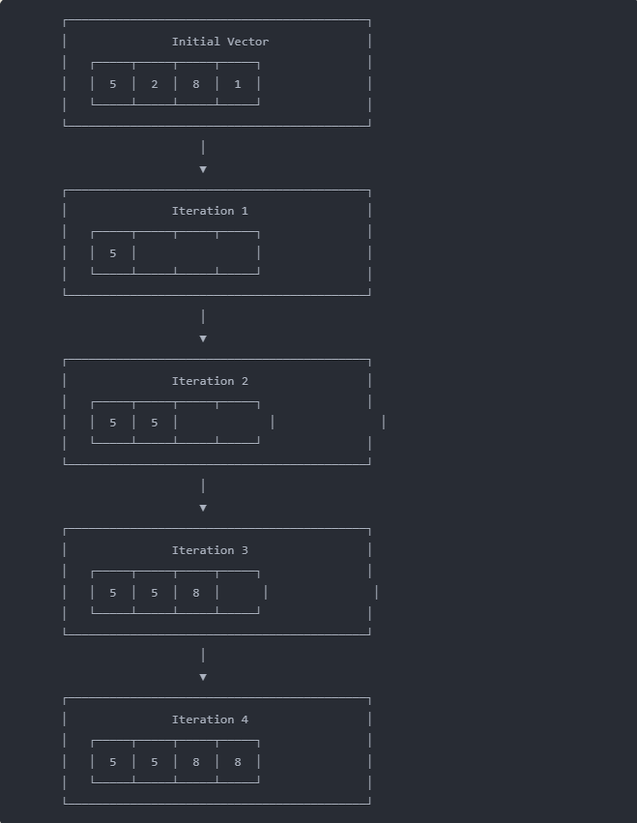
Serial reduction example
Max operation
Go through elements 1 by 1
Compare new number to old max if greater then update

Slide 7
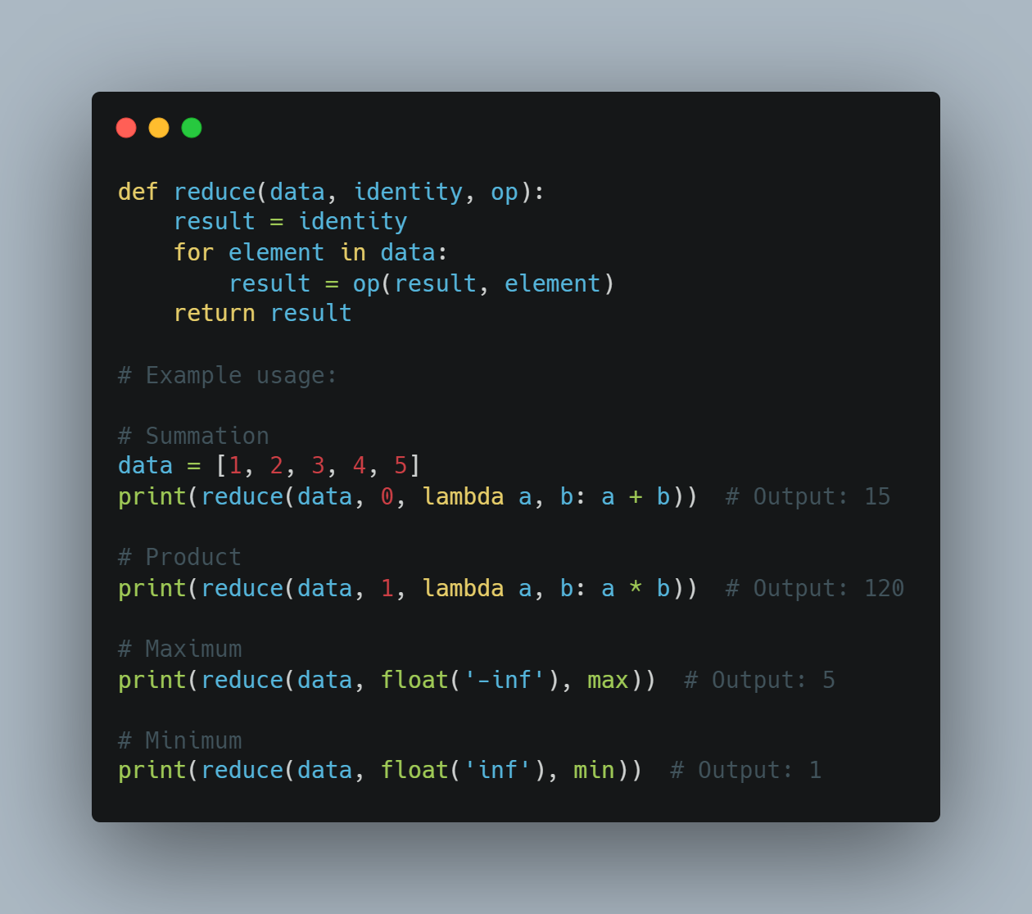
More general formulation
https://gist.github.com/msaroufim/a062aa0b08a4cc57e02db634a67c6b20

Slide 8
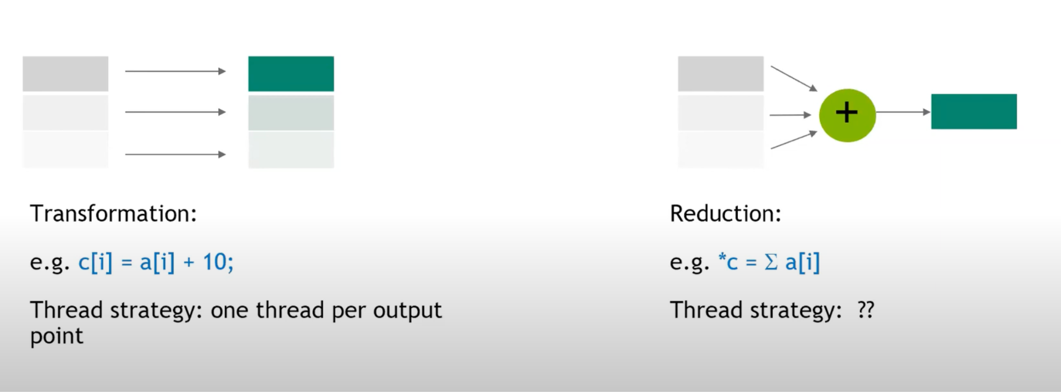
Transformation vs reduction
What should the thread strategy be?
Output size < Input size that’s why we call them reductions
https://www.youtube.com/watch?v=D4l1YMsGNlU&t=1763s

Slide 9
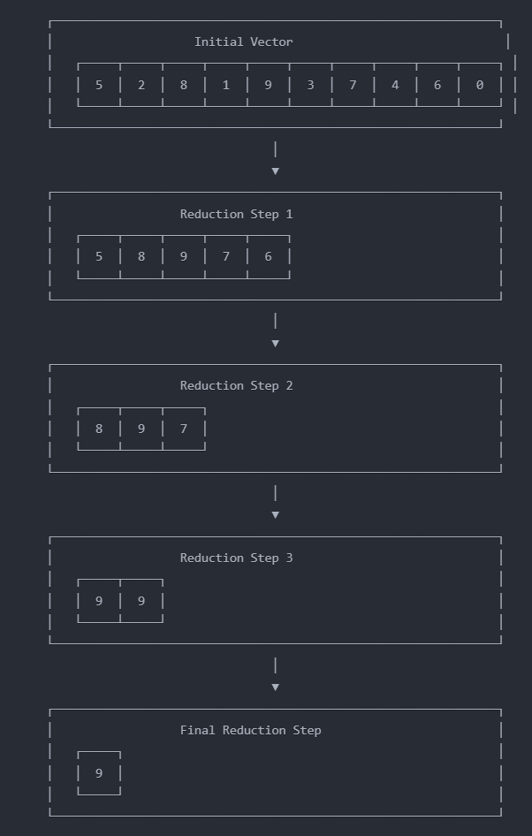
Parallel Reduction visualization
At each step take a pair of elements and compute their max and store the new max in new vector
Continue until there is 1 element in the vector
O(log n) steps

Slide 10
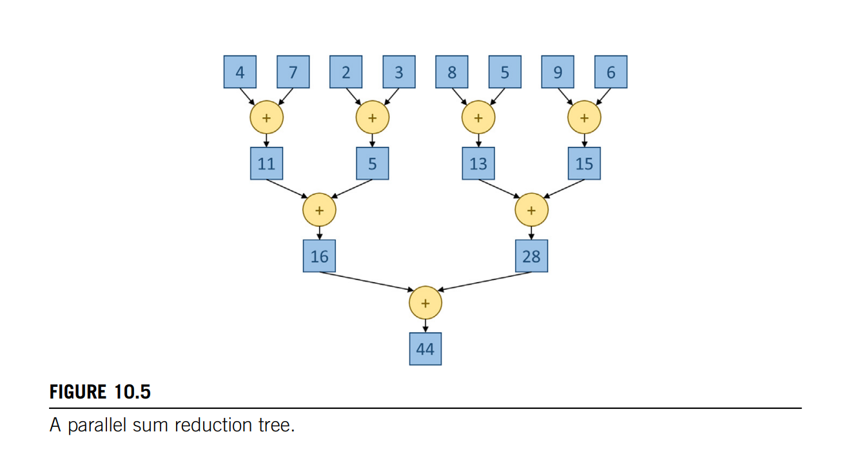
Reduction Trees:

Slide 11
Non determinism and accuracy
torch.use_deterministic_algorithms(True)
Demo
nondeterminism.py
accuracy.py

Slide 12
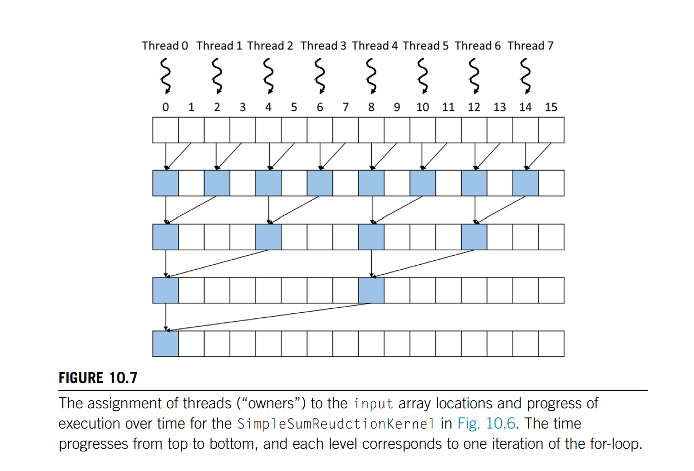
Reduction Kernel
A lot of threads will be inactive :(
A lot of warps (groups of 32 threads) will be inactive :(
Let’s check ncu -set full
simple_reduce.cu

Slide 13
Remember the performance checklist
Lecture 8!
Control divergence
Memory divergence
Minimize global memory access
Thread coarsening

Slide 14
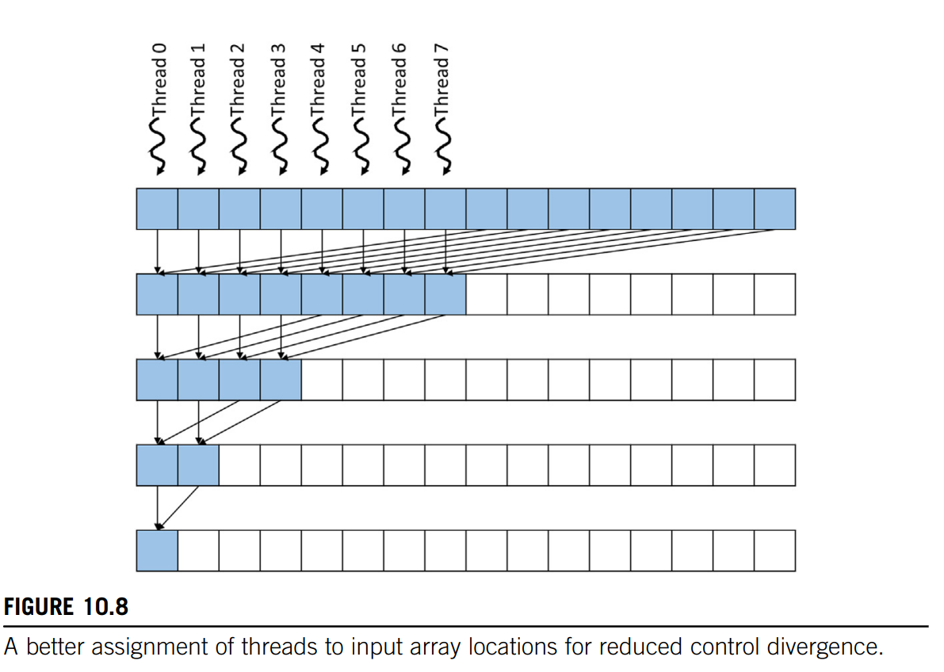
Minimize Control Divergence
Ensure threads and their owned positions remain close together as time progresses
Quiz: Which other problem does this fix?
control_divergence_reduce

Slide 15
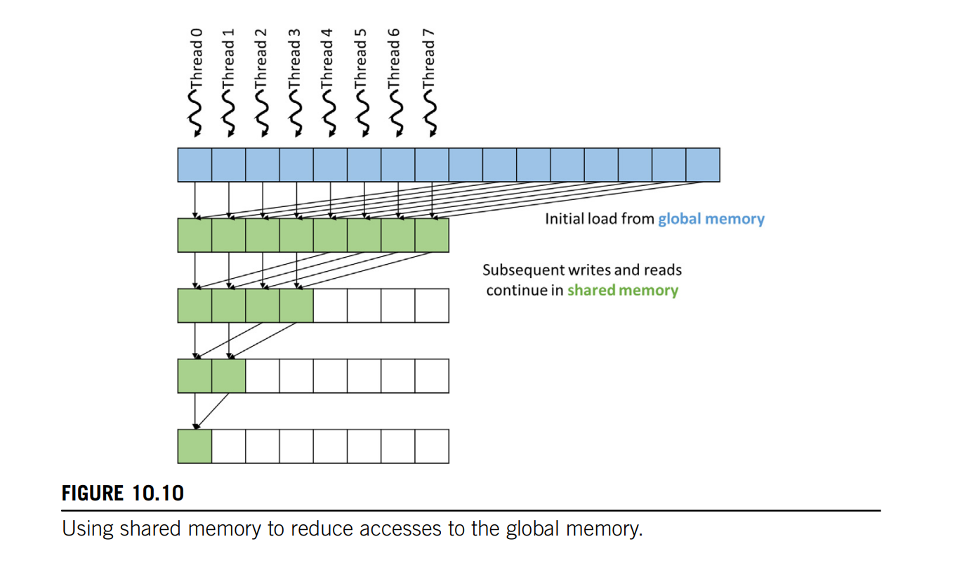
Minimize Global Memory ACcess
shared_reduce.cu

Slide 16
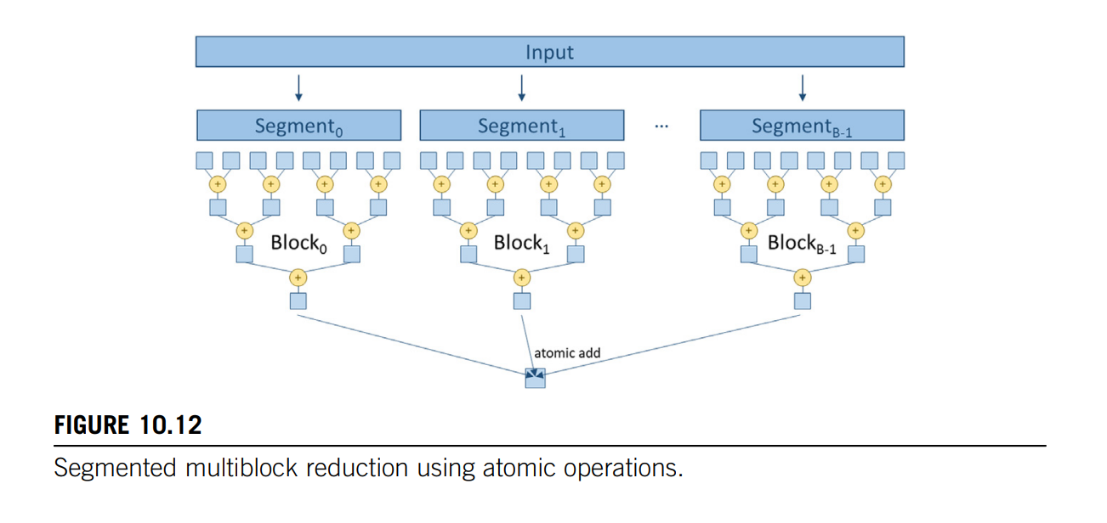
Hierarchical reduction
Let’s try running input size 4096
segment_reduce.cu

Slide 17
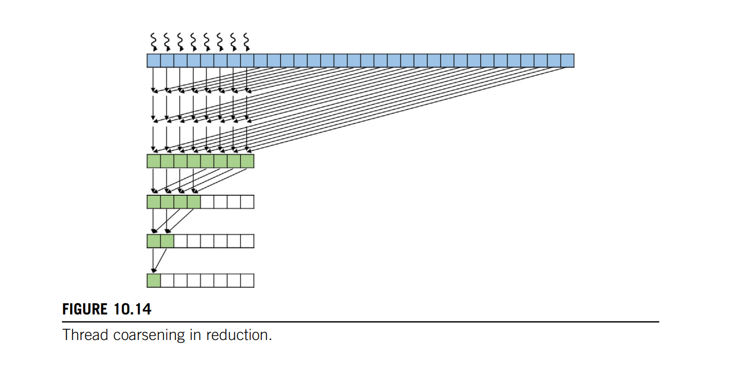
Thread Coarsening (Andreas’ favorite optimization)
reduce_coarsening.cu

Slide 18
Next steps
Lecture 1-8 gave you everything you need to start writing, profiling and shipping kernels in PyTorch so start picking a project - Look for collaborators in #general to stay motivated
Next Lecturer is Oscar who will talk about shipping production CUDA libraries
Looking for lecturers interested in covering prefix sum (scan) and NCCL

Slide 19
Bonus slides: Reductions in the real world

Slide 20
Example of reductions
User facing ops
How reductions are implemented in PyTorch
https://github.com/pytorch/pytorch/blob/4b494d075093096d822b9d614e2719a0e821c6af/aten/src/ATen/native/cuda/ReduceMaxValuesKernel.cu#L53
https://github.com/pytorch/pytorch/blob/main/aten/src/ATen/native/cuda/Reduce.cuh
https://github.com/pytorch/pytorch/blob/main/aten/src/ATen/native/metal/ops/MetalReduce.mm
CPP style of CUDA (Might need its own lecture)

Slide 21
Key ideas
Implementation is accumulator and reduction op agnostic
TensorIterator to iterate over tensor elements
ReduceConfig: Has kernel launch parameters like block size and number of threads, grid etc.. and its set in setReduceConfig
Reduce_kernel is where it gets launched
Reduction strategies: thread level, block level x,y, or global reduce
Vectorization: Over input and/or output

Slide 22
torch.compile!
To the notebook - reduce_compile.py
Look out for
ReductionHint
tl.sum
triton_heuristics

Slide 23
Triton
https://github.com/openai/triton/blob/main/lib/Conversion/TritonGPUToLLVM/ReduceOpToLLVM.cpp
// First reduce all the values along axis within each thread.
reduceWithinThreads(helper, srcValues, accs, indices, rewriter);
// Then reduce across threads within a warp.
reduceWithinWarps(helper, accs, rewriter);

