Slide 1



Apache Flink: Stateful Computations over Data Streams
Mohammad Najafimehr & Pooria Mosalanezhad
Yazd University
Dec. 2019

Slide 2
Outline
What is Apache Flink?
Flink features, capabilities and services
Working mechanism and architecture of Flink
Fault tolerance handling in Flink
Flink usage in well-known companies
Flink vs other similar computing frameworks

Slide 3

What is Apache Flink?
Data Stream Processing
realtime results from data streams
Batch Processing
process static and historic data
Event-driven
Applications
data-driven actions and services
Stateful Computations Over Data Streams

Slide 4


Apache Flink in a Nutshell
Queries
Application
Applications
Streams
Database
Devices
Stream
etc.
Historic Data
File / Object Storage

Slide 5
Everything Streams
Considering any kind of data as a stream of events
Machine logs
Credit card transactions
Sensor measurements
User interactions on a website or mobile application

Slide 6
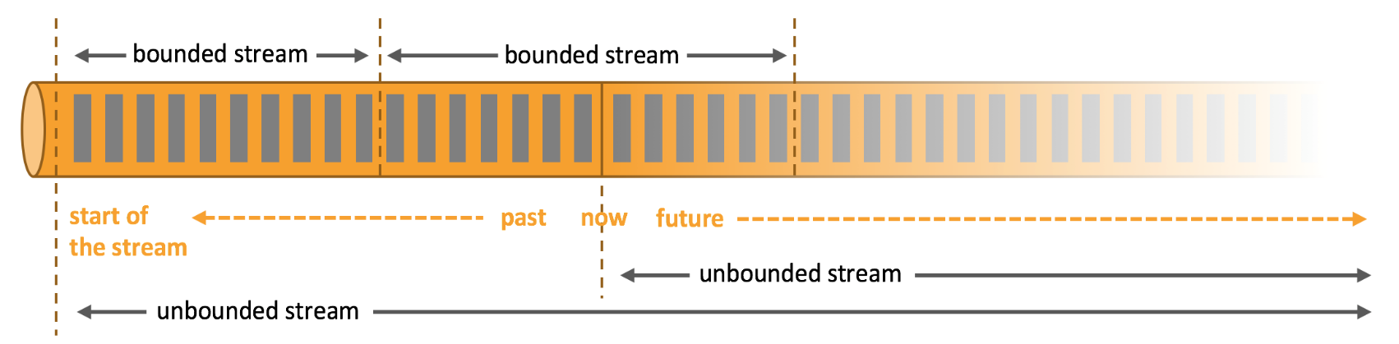
Different Stream Types
Unbounded stream
Promptly handling events after being ingested
Need to have a specific order in ingested events
Impossible to wait for the arrival of all input data: A start but no defined end
Bounded stream (batch processing)
A defined start and end
Ingesting all data, then performing computations
No need to have ordered ingestion: Feasibility of having sorted data

Slide 7
Fault Tolerance Semantics
At-most-once: No guarantee
Zero or one effect of each incoming event in the final results
Possibility of event loss
At-least-once: delivery guarantee
One or more effect of each incoming event in the final results
No event loss
Exactly-once: Highest guarantee
exactly once effect of each incoming event in the final results, Even in case of failures
No duplicate data
Apache Storm
Apache Flink

Slide 8
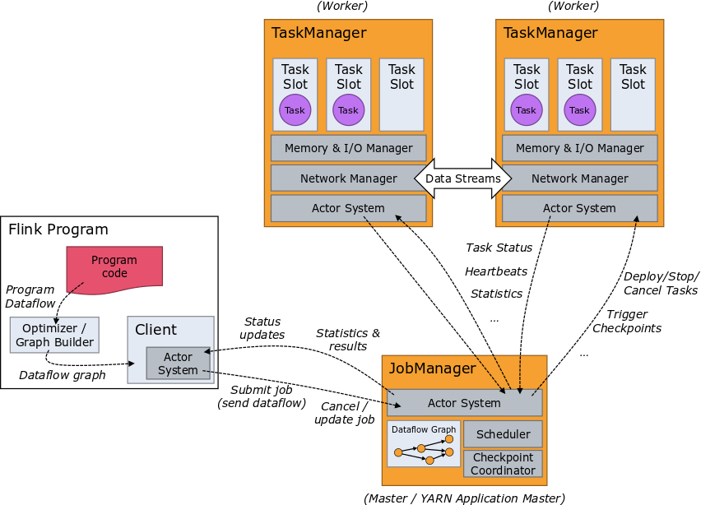
Flink Architecture

Slide 9
Parallel Stateful Streaming Execution
Filter / Transform
State read/write
Source
Sink

Slide 10
Scalable embedded state
Access at memory speed &
scales with parallel operators

Slide 11
Rolling back computation
Re-processing
Re-load state
Reset positions
in input streams

Slide 12
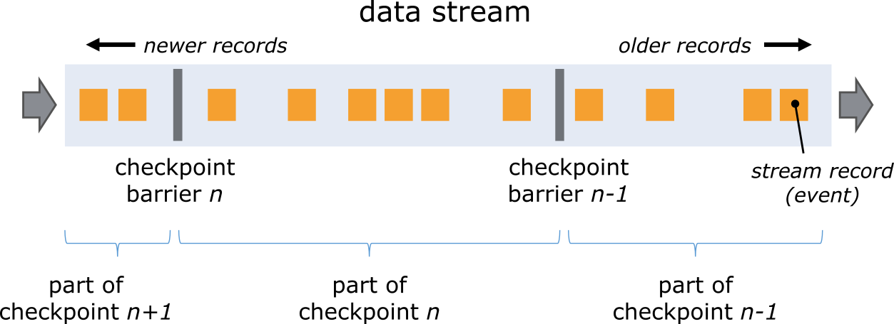

Slide 13
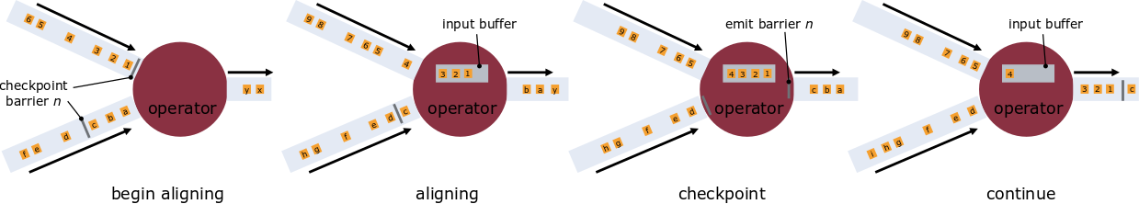

Slide 14
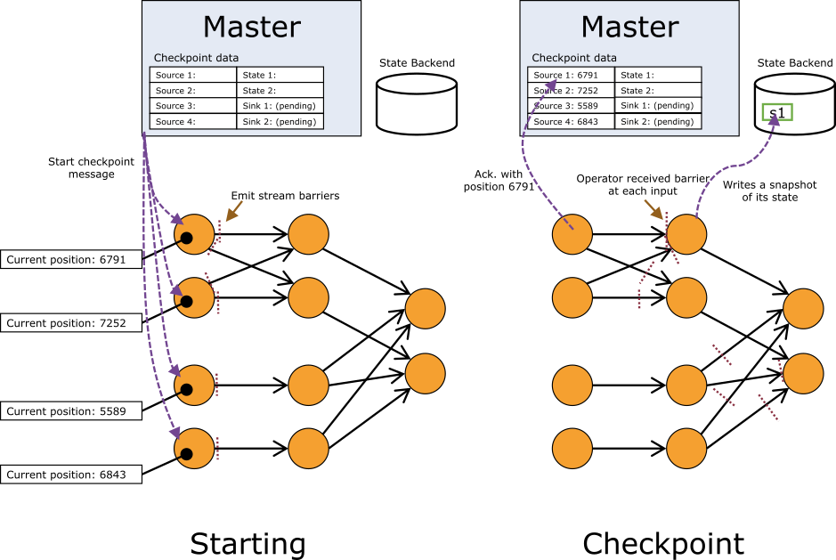

Slide 15
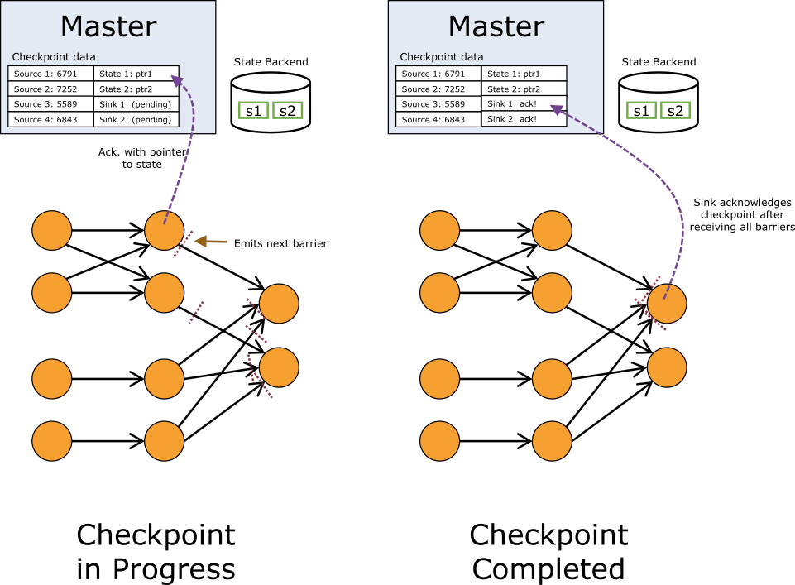

Slide 16

Powerful Abstractions
Layered abstractions to navigate simple to complex use cases
High-level Analytics API
Stream SQL / Tables (dynamic tables)
val stats = stream
.keyBy("sensor")
.timeWindow(Time.seconds(5))
.sum((a, b) -> a.add(b))
Stream- & Batch Data Processing
DataStream API (streams, windows)
Stateful Event- Driven Applications
Process Function (events, state, time)
def processElement(event: MyEvent, ctx: Context, out: Collector[Result]) = {
// work with event and state
(event, state.value) match { … }
out.collect(…) // emit events
state.update(…) // modify state
// schedule a timer callback
ctx.timerService.registerEventTimeTimer(event.timestamp + 500)
}

Slide 17
DataStream API
val lines: DataStream[String] = env.addSource(new FlinkKafkaConsumer011(…))
val events: DataStream[Event] = lines.map((line) => parse(line))
val stats: DataStream[Statistic] = stream
.keyBy("sensor")
.timeWindow(Time.seconds(5))
.sum(new MyAggregationFunction())
stats.addSink(new RollingSink(path))
Source
Transformation
Windowed Transformation
Sink
Streaming Dataflow
Source
Transform
Window (state read/write)
Sink

Slide 18
Number of visitors in last hour by country: DataStream<LogEvent> stream = env .addSource(new FlinkKafkaConsumer(...)); // create stream from Kafka .keyBy("country"); // group by country .timeWindow(Time.minutes(60)) // window of size 1 hour .apply(new CountPerWindowFunction()); // do operations per window

Slide 19
High Level: SQL API
Query
start of the stream
past
now
future
SELECT campaign, TUMBLE_START(clickTime, INTERVAL ’1’ HOUR),COUNT(ip) AS clickCnt
FROM adClicks
WHERE clickTime > ‘2017-01-01’
GROUP BY campaign, TUMBLE(clickTime, INTERVAL ‘1’ HOUR)

Slide 20
Compare Frameworks

Slide 21
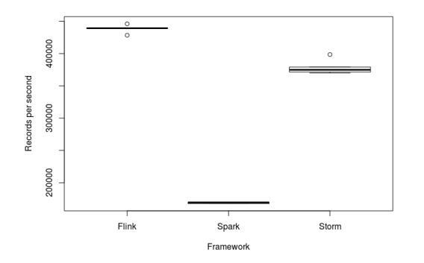
Throughput. (5 runs per Framework)
If throughput is important, Flink seems to give the best results.
Ref: Karakaya, Ziya, Ali Yazici, and Mohammed Alayyoub. "A comparison of stream processing frameworks." 2017 International Conference on Computer and Applications (ICCA). IEEE, 2017.

Slide 22
Benchmark task: counting!
Count ad impressions grouped by campaign
Our streaming benchmark simulates an advertisement analytics pipeline. In this pipeline, there are a number of advertising campaigns, and a number of advertisements for each campaign. The job of the benchmark is to read various JSON events from Kafka, identify the relevant events, and store a windowed count of relevant events per campaign into Redis. These steps attempt to probe some common operations performed on data streams.

Slide 23
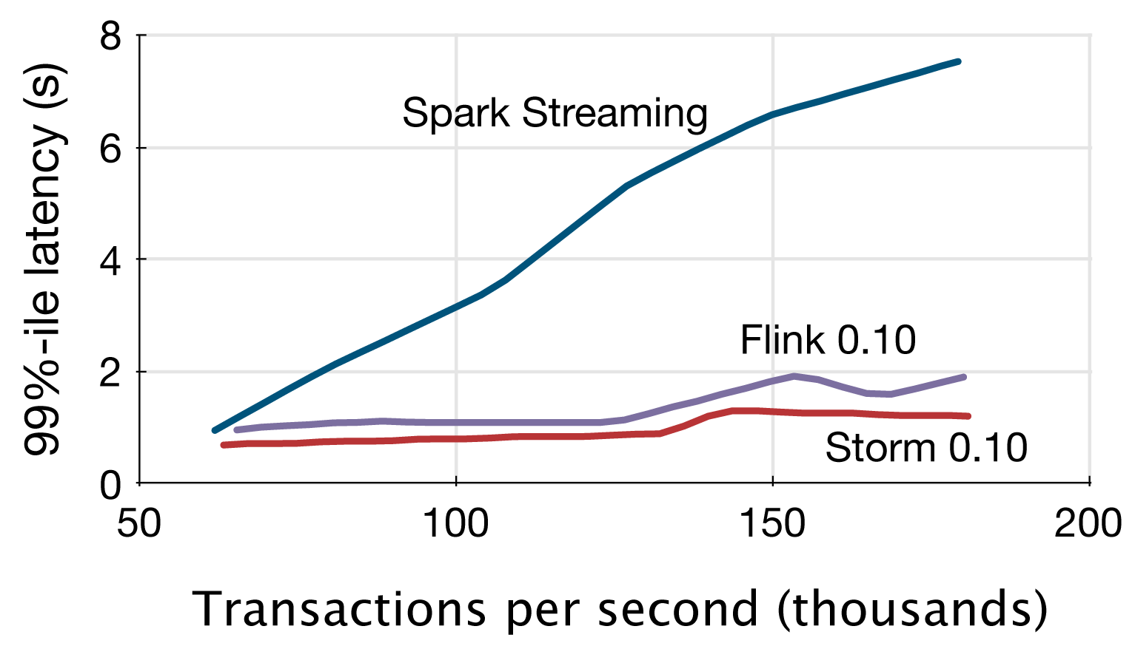
Latency. Yahoo! streaming benchmark.
https://github.com/yahoo/streaming-benchmarks
Ref: Chintapalli, Sanket, Derek Dagit, Bobby Evans, Reza Farivar, Thomas Graves, Mark Holderbaugh, Zhuo Liu et al. "Benchmarking streaming computation engines: Storm, flink and spark streaming." In 2016 IEEE international parallel and distributed processing symposium workshops (IPDPSW), pp. 1789-1792. IEEE, 2016
Notes:
The x-axis is throughput in thousands of events per second, and the y-axis is the 99th percentile end-to-end latency (meaning that 99% of events arrive within this latency) in seconds for the given throughput.

Slide 24
Yahoo! streaming benchmark
Yahoo! benchmark is a great starting point to understand engine behavior.
But
Yahoo! benchmark was limited in two dimensions:
Stoping the benchmark at very low throughputs (170,000 events per second aggregate)
Lack of fault tolerant jobs in the benchmark

Slide 25
Knowing that Flink can achieve much higher throughputs, we decided to extend the benchmark as follows:
We re-implemented the Flink job to use Flink’s native window mechanism so that it provides exactly-once guarantees (the Flink job in the original Yahoo! benchmark was not making use of Flink’s native state, but was rather modeled after the Storm job)
We tried to push the throughput further by re-implementing the data generator to pump out events faster
We focused on Flink and Storm, as these were the only frameworks that could provide acceptable latency in the original benchmark

Slide 26
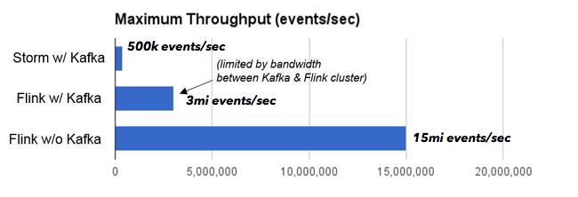
The Storm job was bottlenecked on CPU, while the Flink job was bottlenecked on the network bandwidth between the machines running Kafka and the machines running Flink

Slide 28
Average Throughput (two different programs)
Measuring the throughput of Flink and Storm in a 30-node cluster of a total of 120 cores.
a parallel streaming grep task, which searches the stream for events that contain a string matching a regular expression
a different job, which performs a stream grouping by key, thereby shuffling the stream through the network
Notes:
The grep application is embarrassingly parallel and scales trivially across the partitioned streams.
Flink achieves a sustained throughput of 1.5 million elements per second per core for the grep job. This brings the aggregate throughput in the cluster to 182 million elements per second. The measured latency for Flink is zero, as the job does not involve network and no micro-batching is involved. When turning on Flink’s fault tolerance mechanism by taking a checkpoint every 5 seconds we only see a very slight degradation (less than 2%) in throughput. Fault tolerance does not introduce any latency.

Slide 29
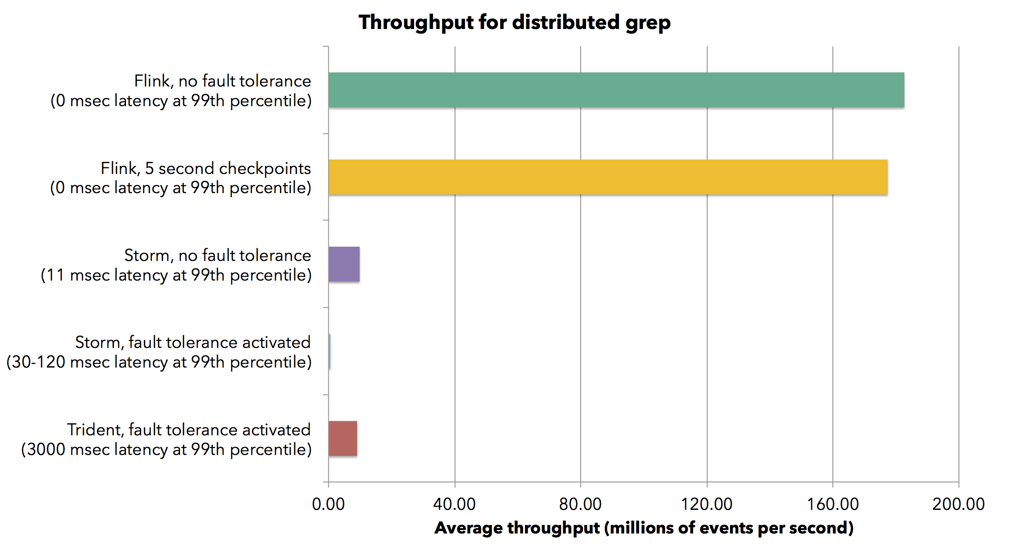
Average Throughput(grep task Results)
Flink throughput in the cluster to 182 million elements per second
Storm throughput in the cluster is 0.57 million elements per second

Slide 30
Average Throughput(grep task Results)
Flink throughput:
1.5 million elements per second per core for the grep job with zero latency as the job does not involve network
Storm throughput with acknowledgments: (without any delivery guarantees)
82,000 elements per second per core with latency of about 10 milliseconds in the 99-th percentile
Storm throughput without acknowledgments: (guaranteeing at least one delivery)
falls to 4,700 elements per second per core with increasing latency to 30-120 milliseconds.

Slide 31
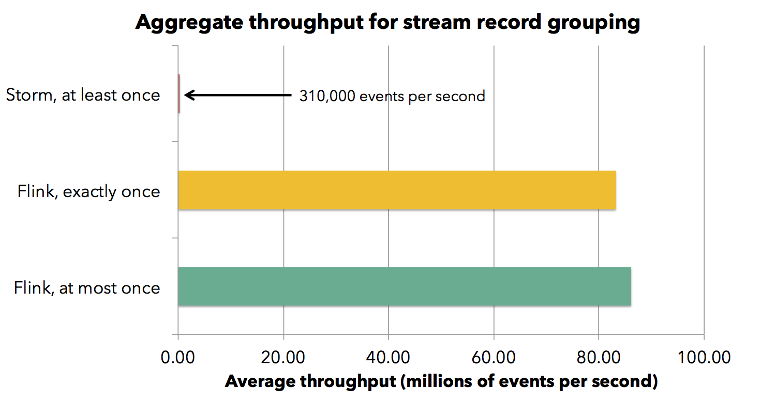
Average Throughput(stream record grouping)
Result of running the job in a cluster of 30 machines with the same system configuration as before

Slide 32
Average Throughput(stream record grouping)
Flink throughput:
720,000 events per second per core falling to 690,000 with checkpointing activated
Storm throughput:
2,600 events per second per core with at least once guarantees

Slide 34
Average Throughput
Measuring the throughput of Flink and Storm for two different programs in a 30-node cluster of a total of 120 cores.
a different job, which performs a stream grouping by key: shuffling the stream through the network
Throughput Results:
Flink throughput = 720,000 events per second per core
Storm throughput = 2,600 events per second per core
Notes:
The grep application is embarrassingly parallel and scales trivially across the partitioned streams.
Flink achieves a sustained throughput of 1.5 million elements per second per core for the grep job. This brings the aggregate throughput in the cluster to 182 million elements per second. The measured latency for Flink is zero, as the job does not involve network and no micro-batching is involved. When turning on Flink’s fault tolerance mechanism by taking a checkpoint every 5 seconds we only see a very slight degradation (less than 2%) in throughput. Fault tolerance does not introduce any latency.

Slide 36
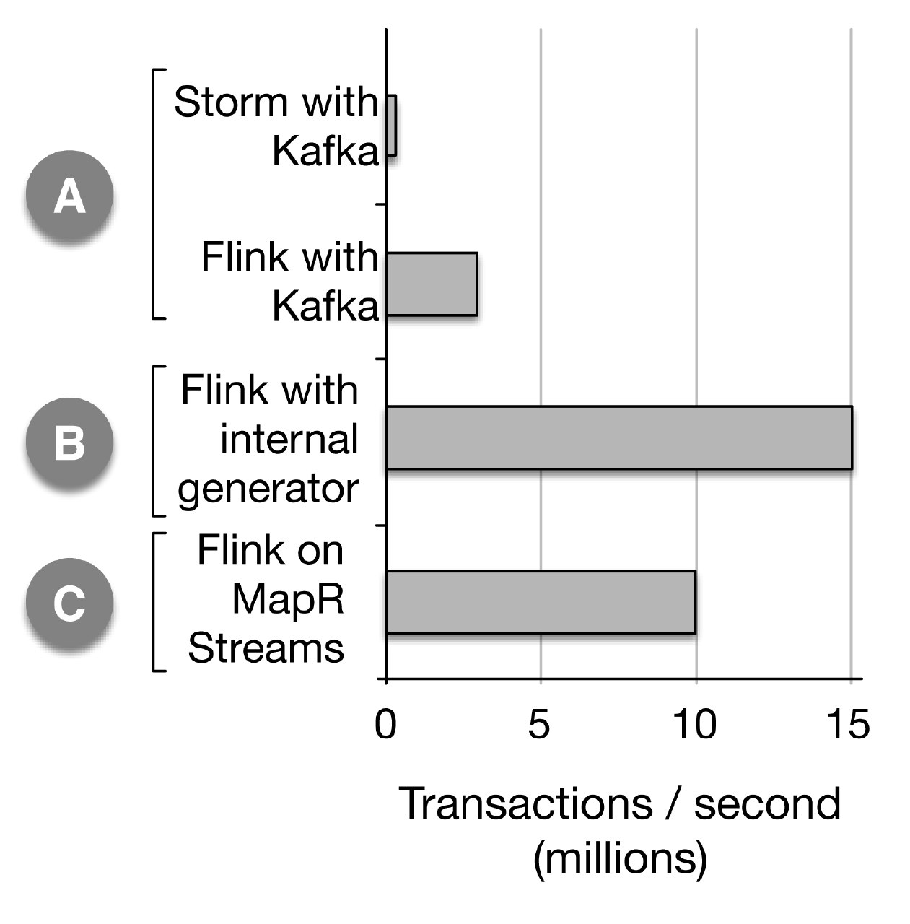
Results using the higher-volume data generator: (A) When using Storm with Kafka, the benchmark application can sustain 400,000 events per second and is CPU-bound, whereas in the case of Flink with Kafka, the application can sustain 3 million events per second and is network-bound. (B) By removing the streaming component to avoid the network bottleneck, the Flink application can sustain 15 million events per second. (C) An additional test was done with the streaming transport component provided by MapR Streams and 10 high-performance nodes (different hardware from A and B); the Flink application can sustain 10 million events per second.

Slide 37
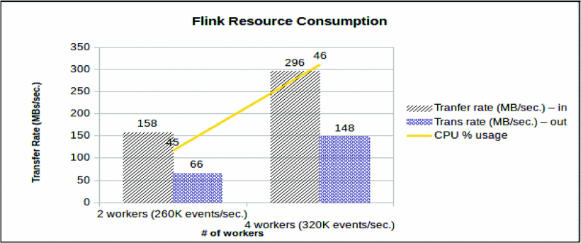
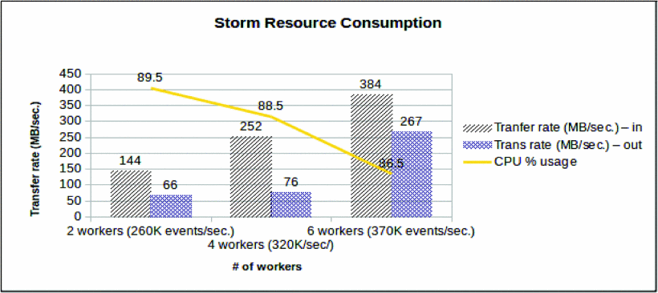
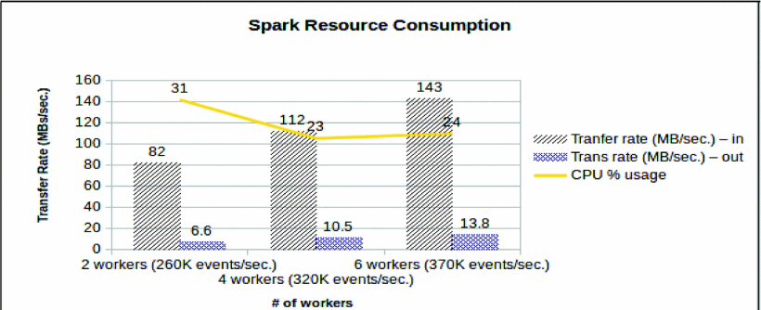
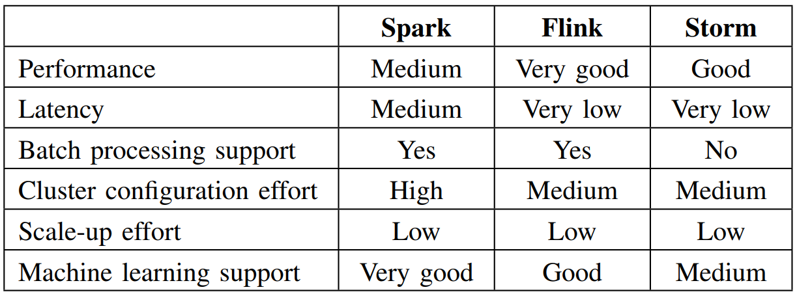
Network Transfer & CPU Usage
Ref: Karakaya, Ziya, Ali Yazici, and Mohammed Alayyoub. "A comparison of stream processing frameworks." 2017 International Conference on Computer and Applications (ICCA). IEEE, 2017.

Slide 38
Network Transfer & CPU Usage
Storm has the most CPU usage

