Slide 1


Apache Flink
Stateful Computations over Data Streams
Mohammad Najafimehr Pooria Mosallanezhad
Yazd University
Dec. 2019

Slide 2
Outline
Introduction of Apache Flink
Flink features, capabilities and services
Working mechanism and architecture of Flink
Fault tolerance handling in Flink
Flink usage in well-known companies
Flink vs other similar computing frameworks

Slide 3






Flink Introduction
Apache Flink: A framework and distributed processing engine
Started as a research project named Stratosphere
A research project to develop the next generation Big Data analytics platform
Performed at some universities in Berlin, Germany
Developed as an Apache project in 2014 under the name Apache Flink
Paris Carbone KTH & SICS Sweden
Asterios Katsifodimos TU Berlin & DFKI
Stephan Ewen Data Artisans
Volker Markl TU Berlin & DFKI
Seif Haridiy KTH & SICS Sweden
Kostas Tzoumas
Data Artisans

Slide 4

Flink’s Extensive Features Set
Stateful computation over data streams
Running in all common cluster environments: Yarn, Mesos, …
Supporting both stream and batch processing
Supporting event-time processing semantic
FlinkML library for machine learning, and Gelly for graph-processing
Java, Scala and Python API
Data Stream Processing
realtime results from data streams
Batch Processing
process static and historic data
Event-driven
Applications
data-driven actions and services

Slide 5


Apache Flink Overview
Application
Applications
Streams
Database
Devices
Stream
etc.
Historic Data
File / Object Storage

Slide 6
Assuming Everything as Streams
Considering any kind of data as a stream of events
Machine logs
Credit card transactions
Sensor measurements
User interactions on a website or mobile application

Slide 7
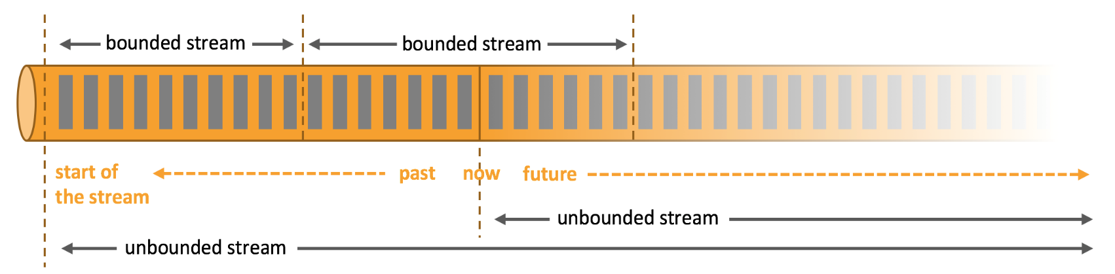
Different Stream Types
Unbounded stream
Promptly handling events after being ingested
Need to have a specific order in ingested events
Impossible to wait for the arrival of all input data: A start but no defined end
Bounded stream (batch processing)
A defined start and end
Ingesting all data, then performing computations
No need to have ordered ingestion: Feasibility of having sorted data

Slide 8
Three Stream Processing Semantics
At-most-once: No guarantee
Zero or one effect of each incoming event in the final results
Possibility of event loss
At-least-once: Medium guarantee
One or more effect of each incoming event in the final results
No event loss
Exactly-once: Highest guarantee
Exactly once effect of each event in the final results, Even in case of failures
No duplicate data

Slide 9
Three Stream Processing Semantics
At-least-once: Medium guarantee
Apache Storm
Exactly-once: Highest guarantee
Apache Flink

Slide 10

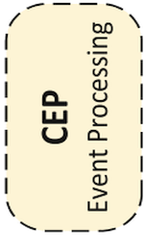
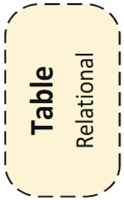
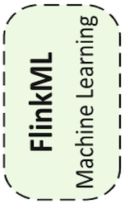
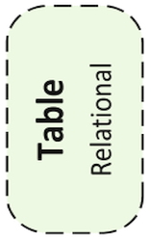
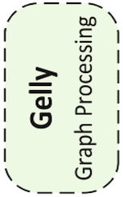
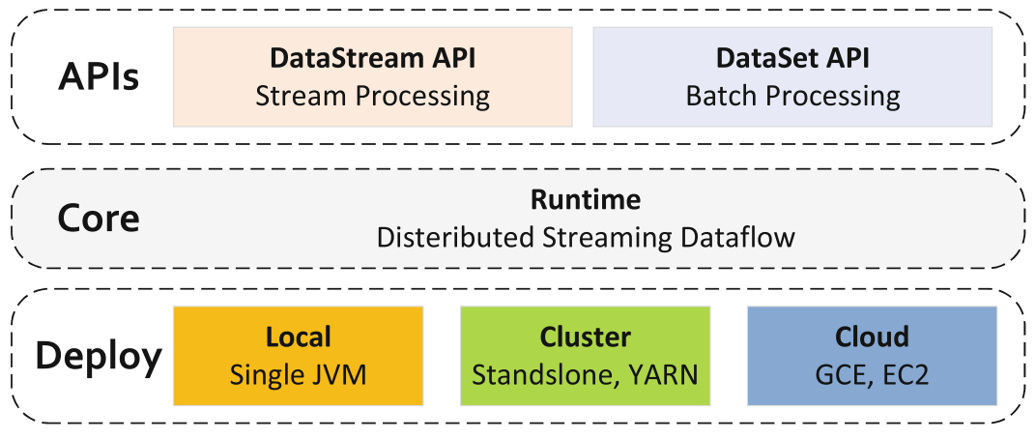
Components, APIs, and libraries

Slide 11
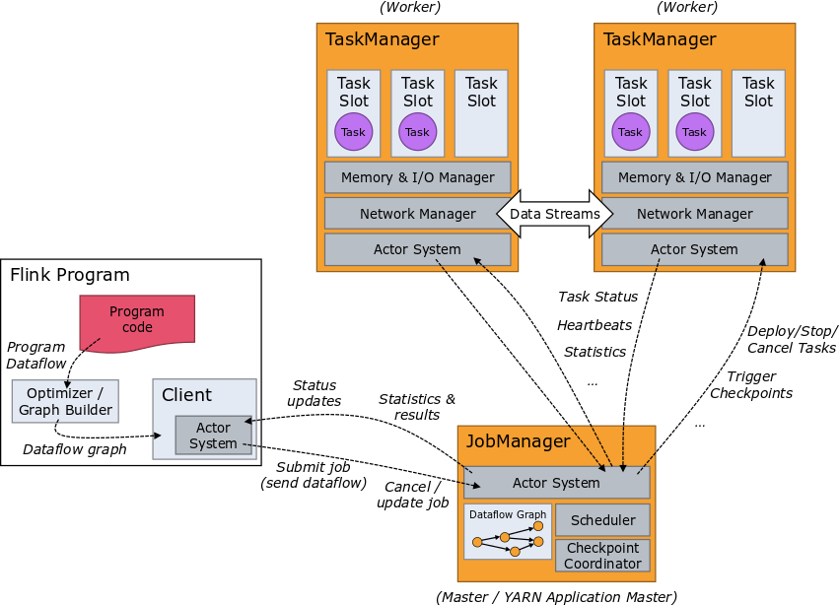
Flink Architecture

Slide 12
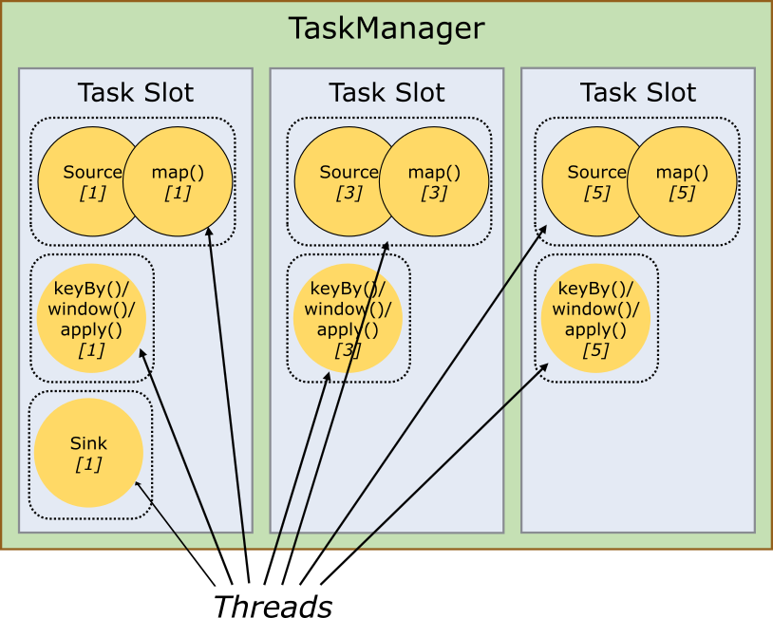
Deep Looking at the TaskManager
TaskManager (Worker): a JVM process
Executing one or more subtasks (task slots) in separate threads
Task Slot: Fixed subset of resources of the TaskManager
Dedicated Certain amount of memory
Shared TCP connections (multiplexing)

Slide 13
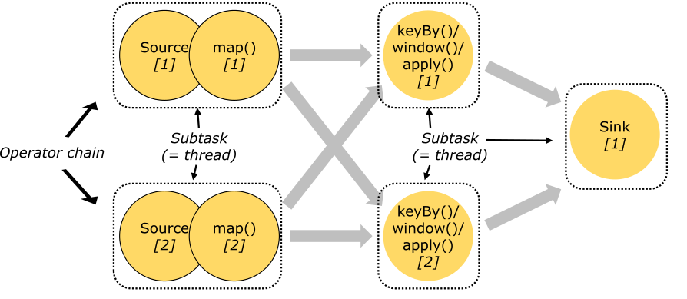
Operator Chaining
Useful optimization: Chaining operators together into one task
Reducing the overhead of thread-to-thread handover
Increasing overall throughput
Decreasing latency

Slide 14
Parallel Stateful Streaming Execution
Filter / Transform
State read/write
Source
Sink

Slide 15
Fault Tolerance: Checkpointing
Scalable embedded state
Access at memory speed &
scales with parallel operators
State backend

Slide 16
Fault Tolerance: Checkpointing (Cont.)
State backend: A configurable place (the master node, S3 or HDFS)
Two portions of checkpoint:
The current state of the application
The position in the input stream
Two types of state:
User-defined state: Created and modified directly by the transformations
An example: mapWithState()
System state: Data buffers in the operator’s computation
An example: window()
State backend

Slide 17
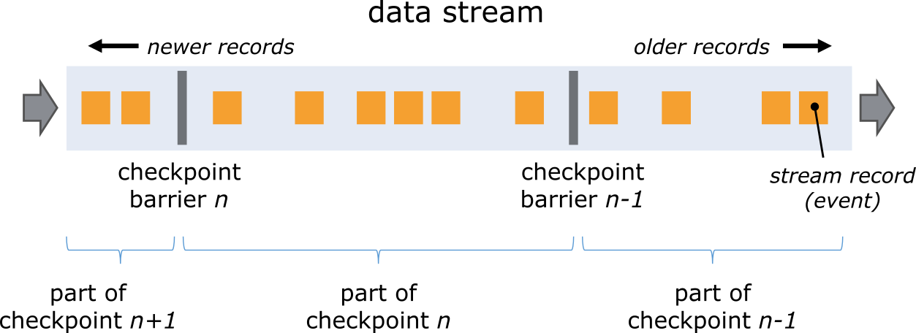
Fault Tolerance: Barriers

Slide 18
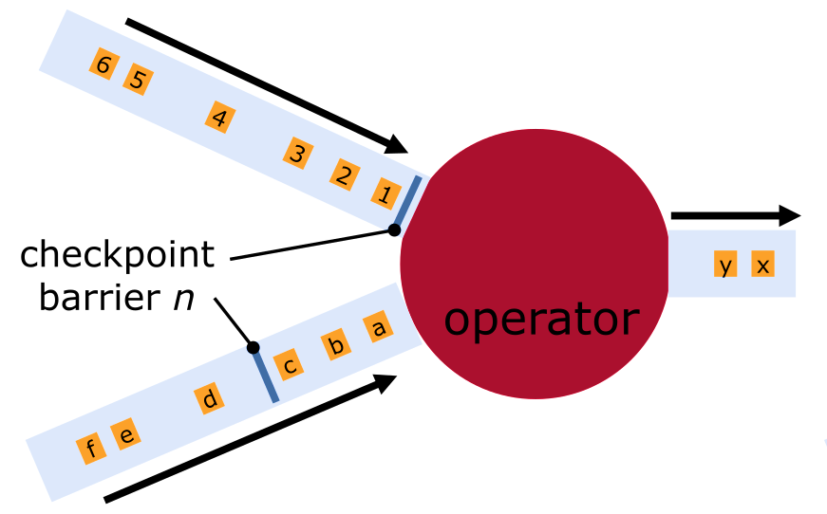
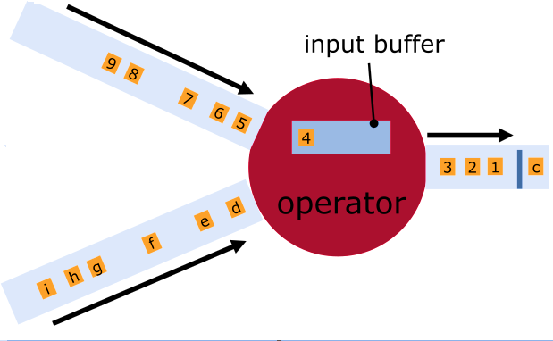
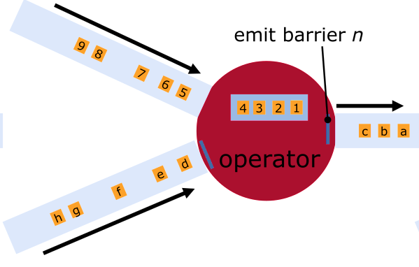
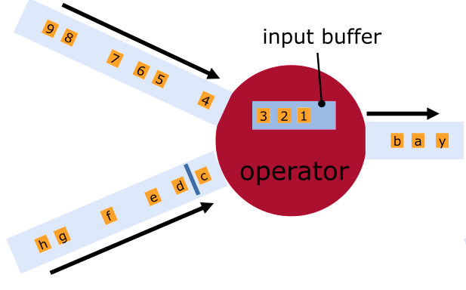
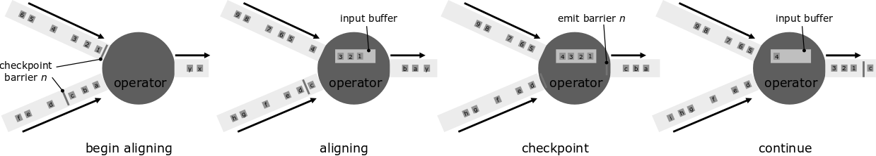
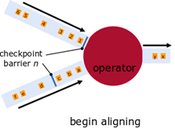
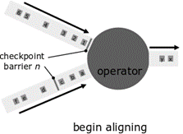
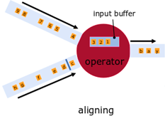
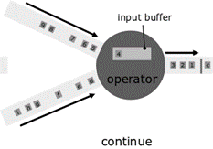
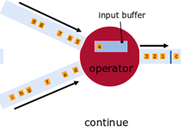
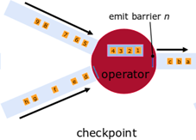
Fault Tolerance: Aligning on Barriers

Slide 19
Fault Tolerance: Recovery
Re-load state
Reset positions
in input streams

Slide 20
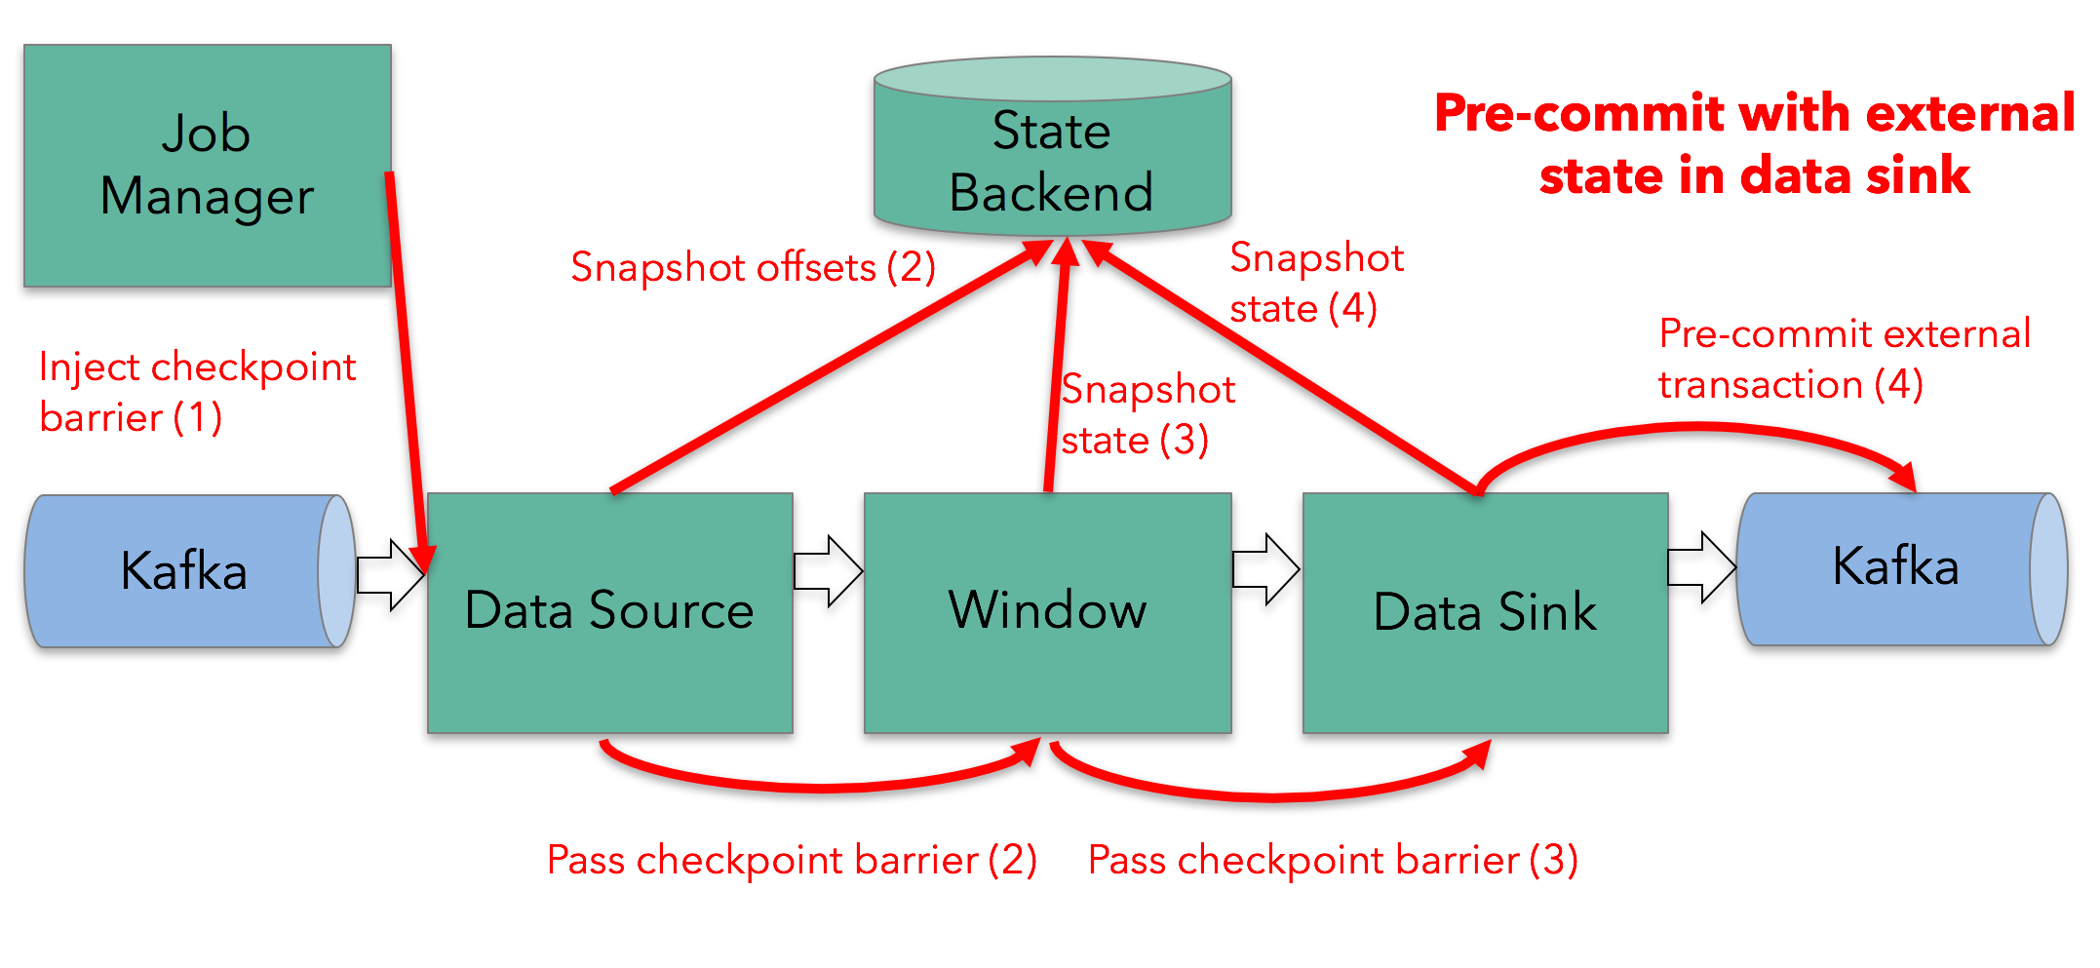
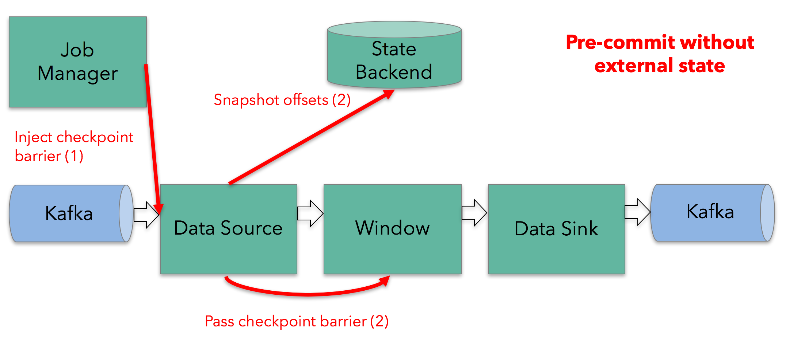
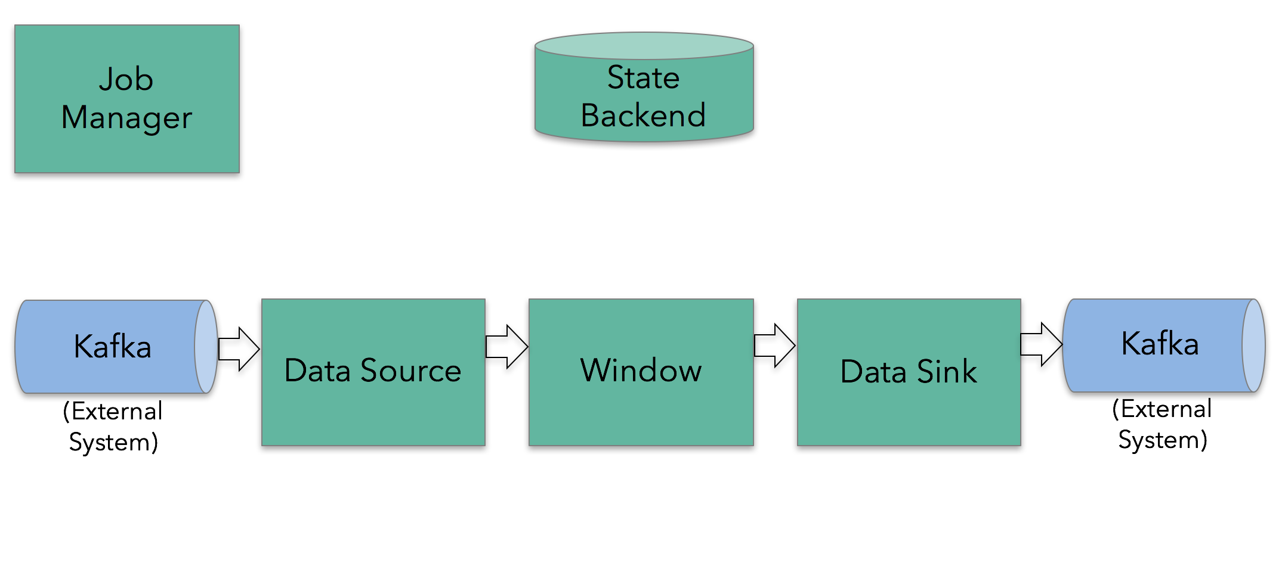
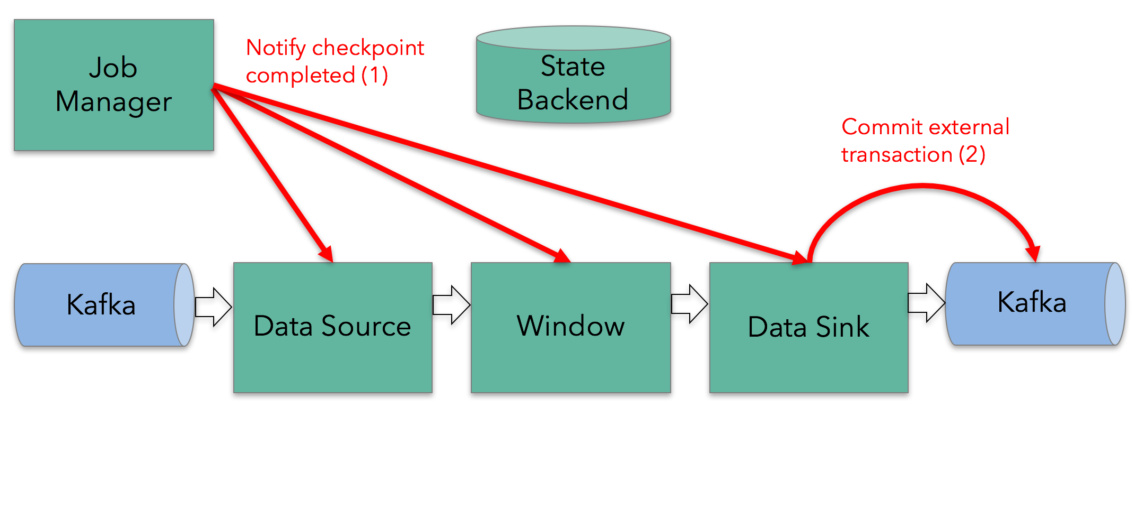
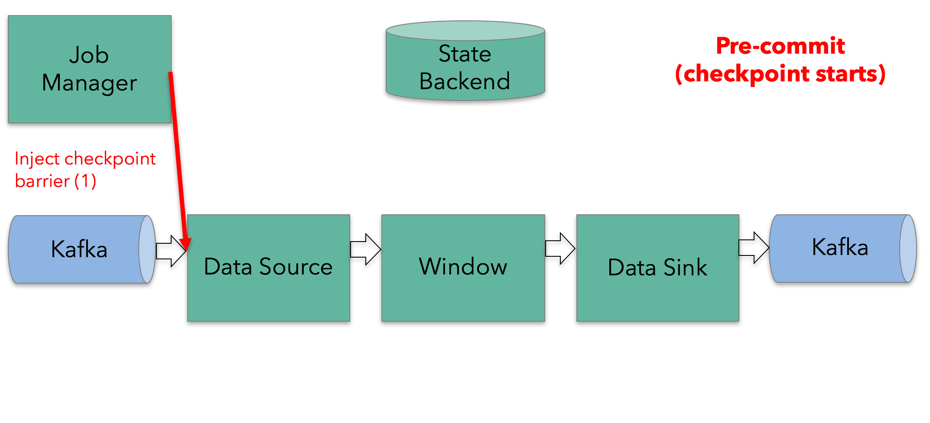
End-to-End Exactly-Once
Two-phase Commit Protocol
Notes:
To provide end-to-end exactly-once semantics–that is, semantics that also apply to the external systems that Flink writes to in addition to the state of the Flink application–these external systems must provide a means to commit or roll back writes that coordinate with Flink’s checkpoints.
Flink’s TwoPhaseCommitSinkFunction utilizes the two-phase commit protocol to provide end-to-end exactly-once semantics.

Slide 21
Different Times in Stream Processing
Processing time: System time of the machines
Event time: occurred time of each individual event
Assigned in the producing device.
Embedded within the records before entering Flink
Ability to extract event timestamp from each record in Flink

Slide 22
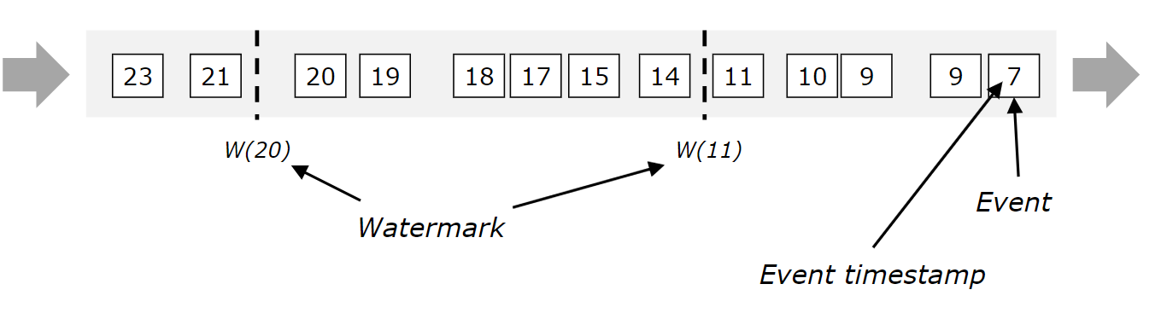
Event Time Processing
Watermark: The mechanism to measure progress in event time
Watermark(t): No emitting elements with a timestamp t’ <= t
Late elements: violating the watermark condition due to delay
Allowed lateness: Waiting threshold for arriving late elements

Slide 23
Anatomy of a Flink Program
Same basic parts in all programs
Obtain an execution environment
val env = StreamExecutionEnvironment.getExecutionEnvironment
Load/create the initial data
env.readTextFile("file:///path/to/file")
Specify transformations on this data
Specify where to put the results of your computations
Trigger the program execution
by calling execute()

Slide 24
DataStream API
val lines: DataStream[String] = env.addSource(new FlinkKafkaConsumer(…))
val events: DataStream[Event] = lines.map((line) => parse(line))
val stats: DataStream[Statistic] = stream
.keyBy("sensor")
.timeWindow(Time.seconds(5))
.sum(new MyAggregationFunction())
stats.addSink(new FlinkKafkaProducer(…))
Source
Transformation
Windowed Transformation
Sink
Streaming Dataflow
Source
Transform
Window (state read/write)
Sink

Slide 25
WordCount Example
case class Word (word: String, frequency: Int)
DataSet API (batch):
val lines: DataSet[String] = env.readTextFile(...)
lines.flatMap {line => line.split(" ").map(word => Word(word,1))}
.groupBy("word").sum("frequency")
.print()
DataStream API (streaming):
val lines: DataStream[String] = env.fromSocketStream(...)
lines.flatMap {line => line.split(" ").map(word => Word(word,1))}
.window(Count.of(1000))
.groupBy("word").sum("frequency")
.print()

Slide 26
Data Sources
Origin input of the program
Stream sources examples from the StreamExecutionEnvironment
File-based:
readTextFile(path): Reads line-by-line and returns them as Strings
Socket-based:
socketTextStream(): Elements can be separated by a delimiter
Collection-based:
fromCollection(Seq): Creates a data stream from the Java.util.Collection
Custom:
addSource(sourceFunction): Custom sources by implementing the SourceFunction
Notes:
IMPLEMENTATION:
Under the hood, Flink splits the file reading process into two sub-tasks, namely directory monitoring and data reading. Each of these sub-tasks is implemented by a separate entity. Monitoring is implemented by a single, non-parallel (parallelism = 1) task, while reading is performed by multiple tasks running in parallel. The parallelism of the latter is equal to the job parallelism. The role of the single monitoring task is to scan the directory (periodically or only once depending on the watchType), find the files to be processed, divide them in splits, and assign these splits to the downstream readers. The readers are the ones who will read the actual data. Each split is read by only one reader, while a reader can read multiple splits, one-by-one.

Slide 27
Data Sinks
Consuming DataStreams and flushing them to the target system
files, sockets, external systems, or print them
Encapsulating output formats on the DataStreams:
print(): Printing on the standard out stream
addSink(): Invoking a custom sink function
writeAsText(): Writing elements line-wise as Strings
writeAsCsv(): Writing tuples as comma-separated value files
writeToSocket(): Writing to a socket according to a SerializationSchema

Slide 28
Important Transformations
dataStream.map { x => x * 2 }
dataStream.filter { _ != 0 }
dataStream.keyBy(“key")
dataStream.keyBy("key").window(TumblingEventTimeWindows.of(Time.seconds(5)))
keyedStream.reduce { _ + _ }
keyedStream.min("key")
keyedStream.sum("key")
windowedStream.max("key")
dataStream.join(otherStream)
dataStream.union(otherStream1, otherStream2, ...)
dataStream.shuffle() // Partitions elements randomly according to a uniform distribution
dataStream.broadcast() // Broadcasts elements to every partition
dataStream.assignTimestamps { timestampExtractor } // Extracts timestamps from records

Slide 29



Flink in Practice
Rolling back and replaying a video, a critical element in the video streaming model
Using Apache Flink in part to power its Java application capability
Flink’s variation (Blink)
Machine learning, search and online recommendation

Slide 30






























Flink in Practice(Cont.)
29

Slide 31
Compare Frameworks: Throughput
Application: Anomaly detection
Dataset: power consumption dataset and weather dataset
Cluster: 3 servers nodes, 1 master, 2 worker (Kafka on master)
Ref: Lipčák, Peter, Martin Macak, and Bruno Rossi. "Big Data Platform for Smart Grids Power Consumption Anomaly Detection." 2019 Federated Conference on Computer Science and Information Systems (FedCSIS). IEEE, 2019.

Slide 32
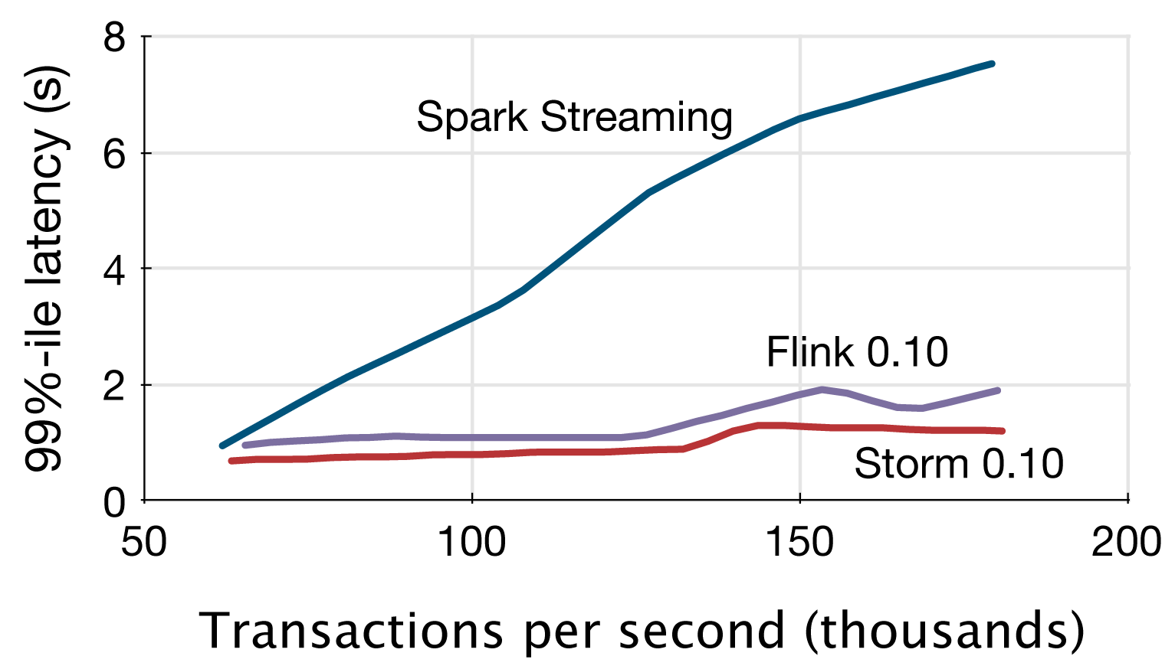
Latency: Yahoo! streaming benchmark
Count ad impressions grouped by campaign
Reading various JSON events from Kafka
https://github.com/yahoo/streaming-benchmarks
Ref: Chintapalli, Sanket, Derek Dagit, Bobby Evans, Reza Farivar, Thomas Graves, Mark Holderbaugh, Zhuo Liu et al. "Benchmarking streaming computation engines: Storm, flink and spark streaming." In 2016 IEEE international parallel and distributed processing symposium workshops (IPDPSW), pp. 1789-1792. IEEE, 2016

Slide 33
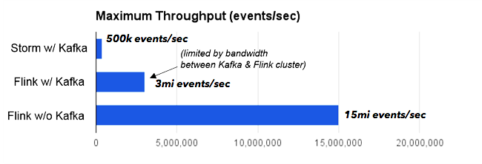
Extended Yahoo! Benchmark by Data Artisans
Yahoo! benchmark limitations:
Stoping the benchmark at very low throughputs
170,000 events per second
Notes:
The Storm job was bottlenecked on CPU, while the Flink job was bottlenecked on the network bandwidth between the machines running Kafka and the machines running Flink.
To eliminate that bottleneck
(which had nothing to do with Kafka, but was just the available cluster setup),
we moved the data generator inside the Flink cluster. In that setting, Flink could scale to 15 million events per second.

Slide 34
Thanks!

