Slide 1
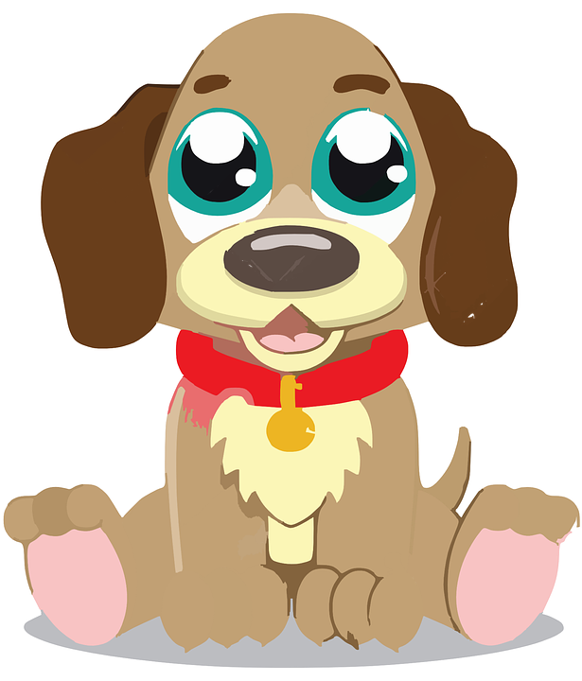

ShelterHelp
Team B10
Zulkifl Arefin
Nabil Ahmed
Jeton Koka
Raj Ramrup
Mohammed Mahmud

Slide 2
Team B10
Project Manager: Mohammed Mahmud
Agile Coach: Nabil Ahmed
Scrum Master: Zulkifl Arefin
Lead Developer: Jeton Koka
Quality Assurance: Raj Ramrup

Slide 3
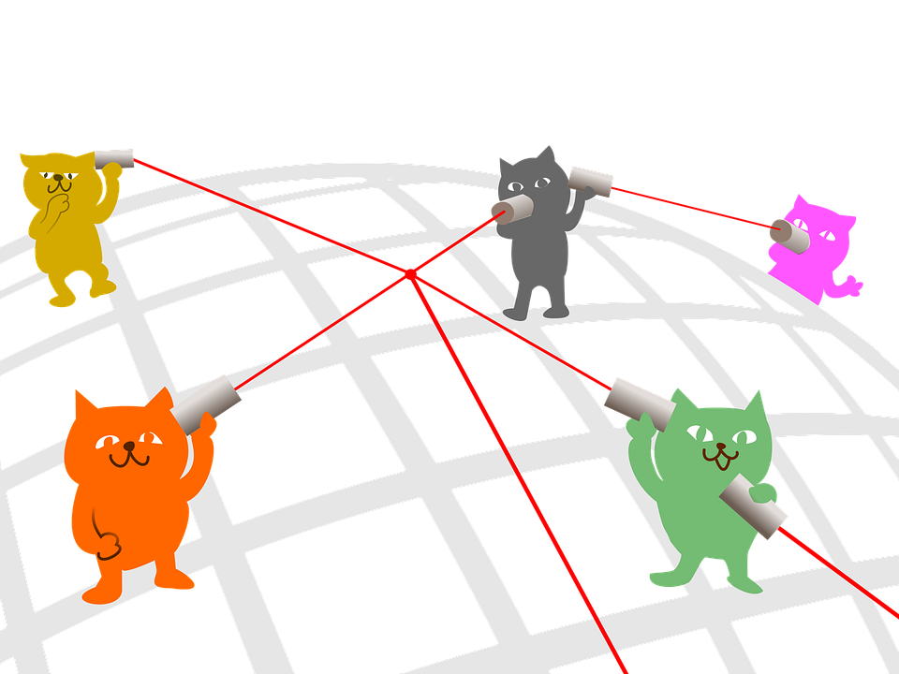
Status Quo
Shelters lack a communication channel between each other
Most shelters have internal information and the distribution method of this information is outdated

Slide 4

Consequences
Issues that arise:
Overcrowding at shelters
Certain shelters lack resources to aid animals
Information lost between shelters

Slide 5
Client Vexation
Shelters forced to kill animals due to negligence and lack of succor
Sharon Gray, the head of an Animal Rescue and Foster Program in Greensboro, North Carolina mentioned:
She and other rescues try to get an animal out but have to wait days if not weeks to do so due to lack of communication or information.
Notes:
http://myfox8.com/2017/08/31/some-rescue-organizations-frustrated-with-guilford-county-animal-shelter-operation/
Succor - assistance and support in times of hardship and distress.

Slide 6
Startling Facts
An animal shelter in Cleveland in 2010 euthanized 5500 out of 6900 dogs brought in
50% of these euthanizations were due to overcrowding
The rest of the euthanizations were due to lack of proper care for sick animals
Notes:
Cleveland 5500-6900 dogs were euthanized http://www.timesfreepress.com/news/georgia/story/2010/feb/01/animal-shelters-face-tough-problems/3893/

Slide 7
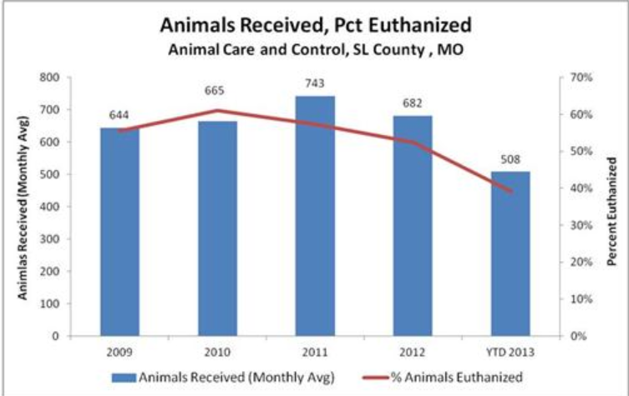
Startling Facts
Notes:
http://fox2now.com/2013/04/25/fox-files-area-animal-shelter-euthanasia-rates/

Slide 8

Balancing Shelters
Using these statistics, we want to come up with a solution that can:
Properly distribute animals across shelters to balance shelter capacities in the region
Educate consumers to ultimately drive higher animal adoption rates

Slide 9
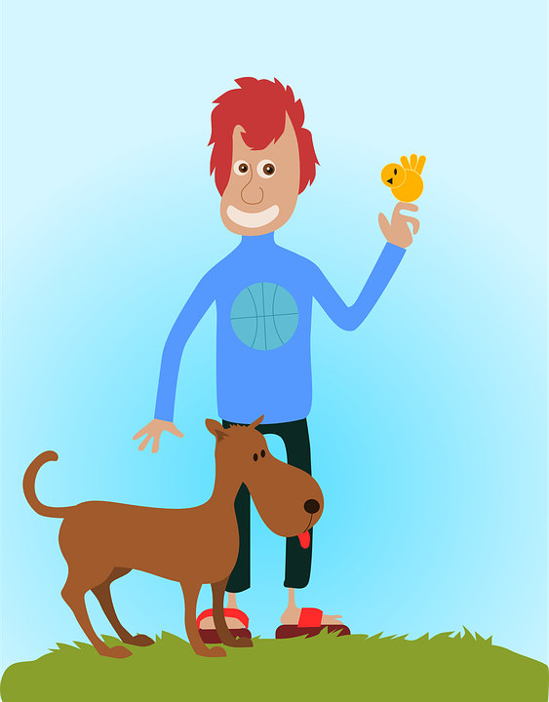
Shelter Availability
Also using these statistics:
Make people aware of shelter availability
When users find stray animals they can take them to:
Shelters that are not full
Shelters that handle spaying and neutering

Slide 10
Overcrowded Hospitals
When a human hospital gets overcrowded, people are transferred to a less crowded one
Overcrowded human hospitals require transfers to balance patient loads
Certain hospitals provide exclusive accommodations that are inaccessible elsewhere in the area.

Slide 11


Introducing ShelterHelp!
A web application that can:
Create an interface for animal shelters to communicate
Can show inventory information, medical policies, and other information to each other
Can request animal transfers from specific shelters
Save animal lives!

Slide 12
Animal Shelters Molded
Take all animal shelter information, convert it to the same format and store it in our database
Have an interface for shelters to view other shelters
View other shelter’s animal capacity
Organize transfer of resources and animals

Slide 13
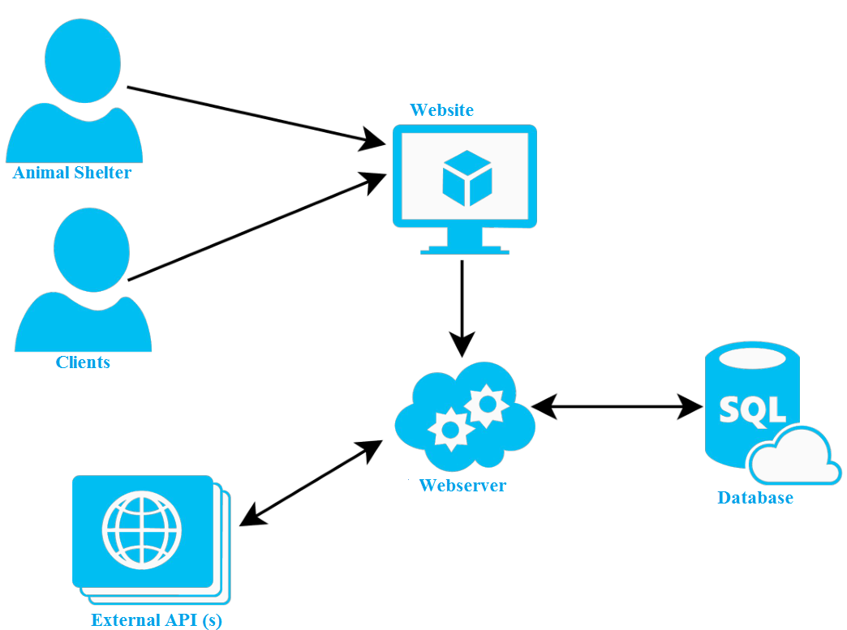
The Component Architecture

Slide 14
Animals Saved, Humans Happy!
With proper communication and consistent storage of information:
Animals will not need to be killed as often
Shelter workers are less stressed
Animals can get the proper care when sick

Slide 15
5 Major Functions
Feature: Transfer
Short Description: Allow shelters to transfer an animal to another shelter
Requirements: Shelters must be allowed to submit a transfer request to any other shelter. Shelters must be allowed to deny or approve any incoming transfer request. One a transfer is complete the animal must be moved from the source shelter to the destination shelters inventory.
Feature: Favorite
Short Description: Allow adopters to favorite an animal so that may revisit
them quickly
Requirements: Adopters must be able to favorite any animal they desire. Adopters must be able to view their favorite animals in a convenient manner, faster way than can reach all other animals. Adopters must be able to request an adoption for any animal they favorite.

Slide 16
Feature: Filter
Short Description: Animals should be recommended to adopters based on information about the adopter
Requirements: Adopters must be given a set of animals that are predicted to compatible with them. Adopters must be able to favorite or request an adopt any of these animals.
Feature: Stats
Short Description: Shelters should be able to quickly visualize the current and max capacities of other shelters
Requirements: Shelters must be able to view how full other capacities are in an easy to understand and visual manner
Feature: Adopt
Short Description: Adopters should be able to adopt animals from shelters
Requirements: Adopters must be able to request an adoption with a shelter. Adopters must be able to view the status of their pending adoption request.

Slide 17
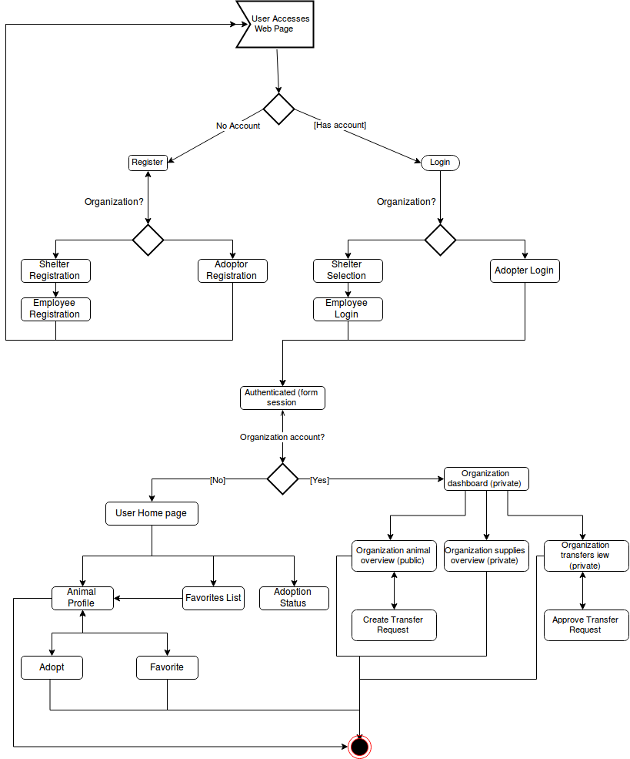
Activity Diagram

Slide 18
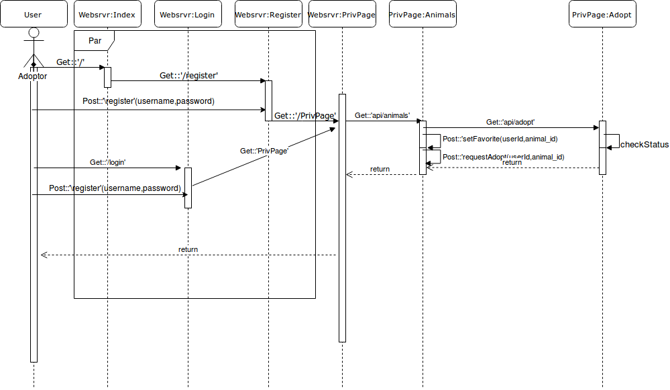
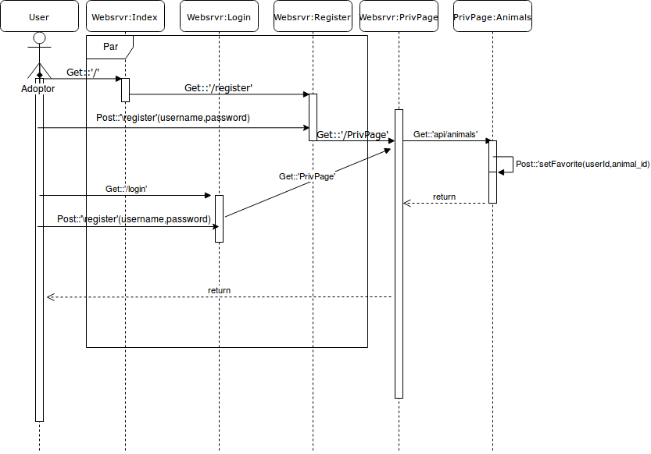
Sequence Diagram for Adoption
Sequence Diagram for Favorites

Slide 19
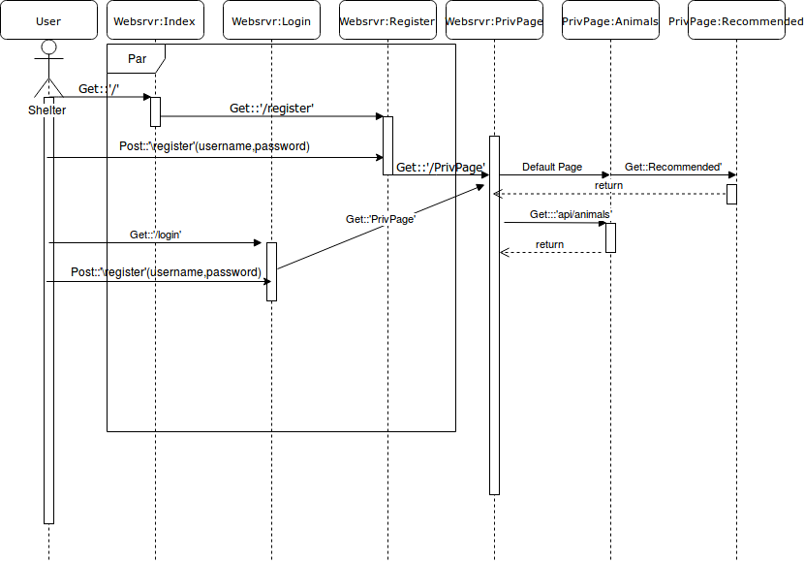
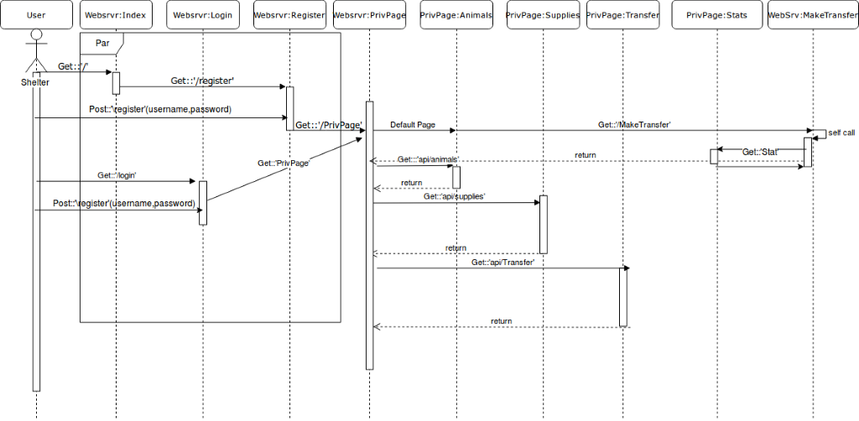
Sequence Diagram for Matching
Sequence Diagram for Stats

Slide 20
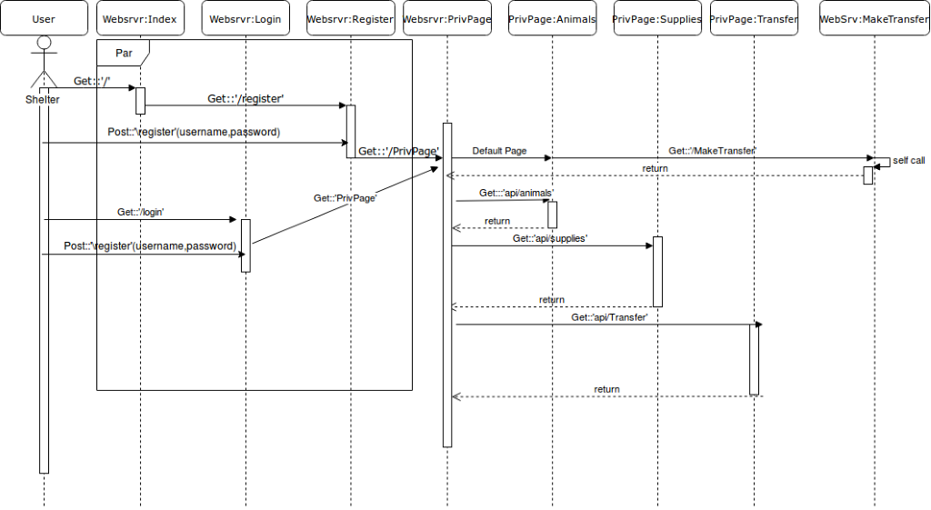
Sequence Diagram for Transfer

Slide 21
And now for the demo!!!!

Slide 22

Future Work
Use machine learning to build a smarter recommendation system for animal matching.
Take into account Health accommodations necessary

Slide 23
Post Implementation Review
What we did right:
Clear and Constant Communication:
We always communicated through Slack whenever we had to complete an artifact
Whenever anyone had any doubts about of how something would work or if an idea was actually viable they would speak up and have their opinion heard so the team could explain or change the idea
What we did wrong:
Documents were not thorough enough
Should have made more frequent in-person meetings
What we would change:
Earlier submission
Regular group reviews

Slide 24
Questions/Comments?

