Slide 1
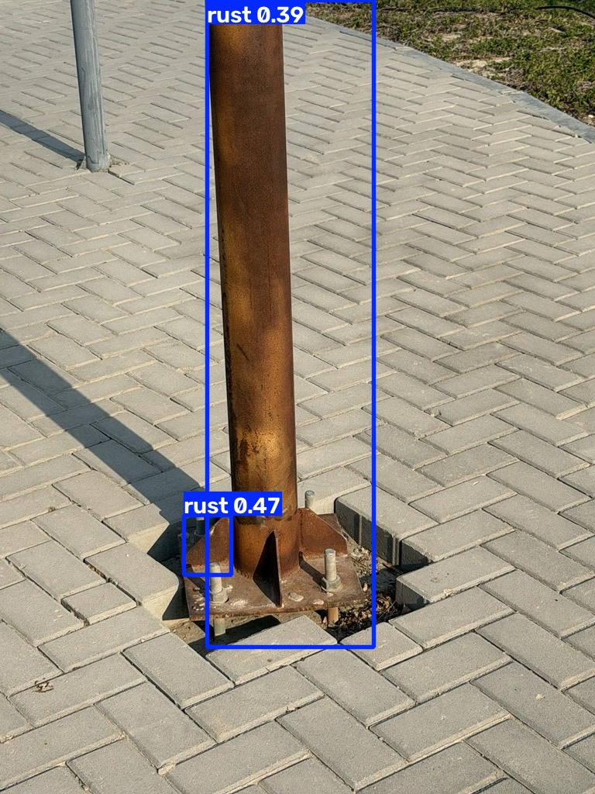
Steel rust detection
YOLOv8 inspection prototype
Mohammad Mango
Module 4, Unit 3
Computer Vision
24 September 2026
Candidate rust regions for human review
1
Photo: Mohammad Mango. Baseline predictions, run 20260923_132304.
Notes:
Author photograph and saved YOLOv8 predictions from training run 20260923_132304. Personal photographs provide qualitative evidence only.

Slide 2
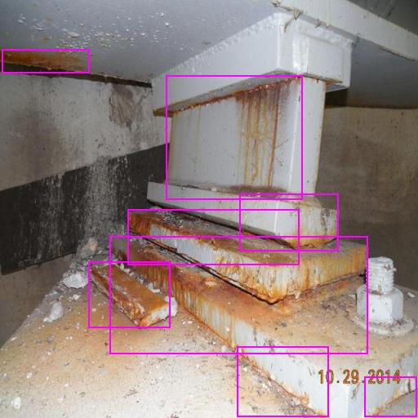
Dataset and labeling policy
440 images
4,107 stored boxes
One class: rust
352 training / 88 validation
Seed 42 fixes the split.
No independent test set.
Tight boxes around visible rust.
Exclude paint, dirt and concrete stains.
Inherited broad boxes remain a limitation.
Source annotation example
2
Dataset: University of Tebessa / adapted Roboflow v1. Export license: CC BY 4.0.
Notes:
Dataset images: University of Tebessa, via Mohammad Mango adapted Roboflow version 1. Export declares CC BY 4.0. https://universe.roboflow.com/university-of-tebessa/corrosion-eh3ms Original split 353/44/43. Combine validation and test, move one seeded training image into validation. Stored boxes 3400/707. Loader removes one duplicate train label. Auto-orientation and stretch512, no export augmentation.

Slide 3
Reproduction and training
Public Release ZIP + SHA256
Version 1, fixed YOLOv8 export
No dataset API key or Drive mount
YOLOv8n, 30 epochs
512 px, batch 16, seed 42
Ultralytics 8.3.221, Tesla T4
Training run: 23 September 2026
207.98 seconds for the training call
Author confirmed a fresh GitHub-to-Colab run
CPU inference also completed on 24 September.
45.45 seconds after setup, using the published best.pt.
Inference reuses trained weights and performs zero training epochs.
3
Records: baseline 20260923_132304 and CPU inference 20260924_074023.
Notes:
https://github.com/mnmango88/steel-rust-detection/releases/tag/v1.0 Baseline run 20260923_132304 and CPU run 20260924_074023. Durations exclude earlier package installation. See README for full checksums.

Slide 4
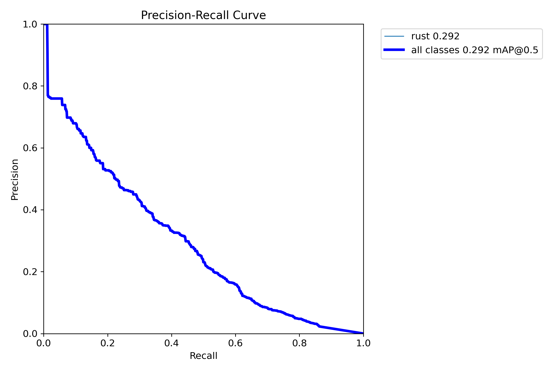
Validation performance
Metric | Result
Precision | 35.51%
Recall | 36.49%
mAP50 | 29.23%
mAP50-95 | 12.24%
88 images / 707 instances. Stricter overlap requirements reduce mAP.
Substantial missed regions and false detections limit practical use.
4
Source: results/metrics.csv and validation/BoxPR_curve.png, baseline run.
Notes:
Saved standalone results/metrics.csv and results/validation/BoxPR_curve.png. Prediction evidence uses confidence 0.25. Validation P/R use the Ultralytics validation operating point.

Slide 5
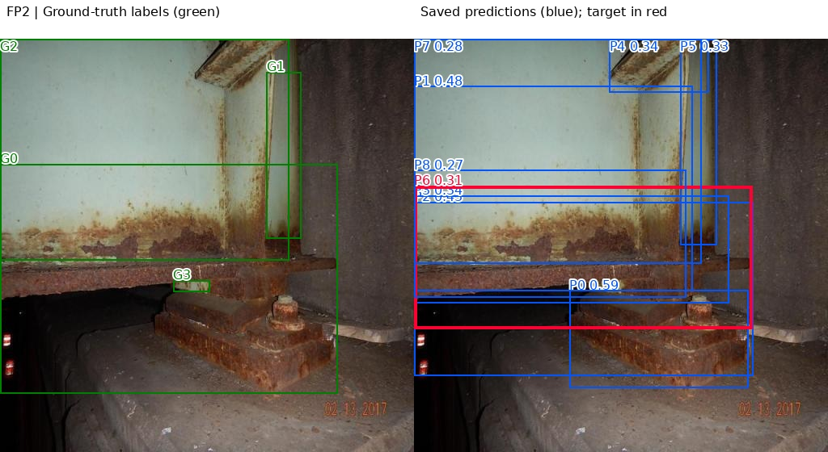
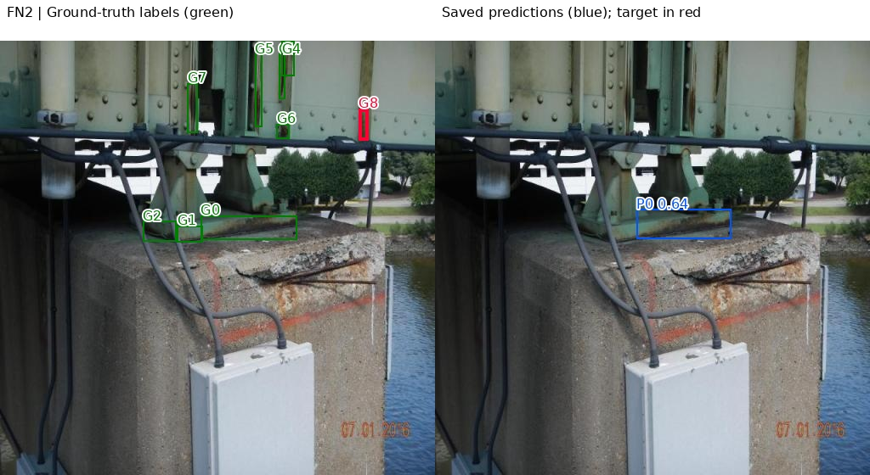
Error analysis
Duplicate detection
Missed thin rust region
An extra box matches a region
already assigned to another prediction.
The model misses the narrow upper
region at confidence 0.25.
5
Dataset: University of Tebessa / CC BY 4.0. Diagnostic overlays: project error analysis.
Notes:
Dataset images: University of Tebessa, via Mohammad Mango adapted Roboflow version 1. Export declares CC BY 4.0. https://universe.roboflow.com/university-of-tebessa/corrosion-eh3ms Diagnostic overlays added. Red highlights selected error, green inherited labels, blue predictions. Confidence-ordered one-to-one IoU>=0.50 matching. Full 3 FP and 3 FN cases: docs/error_analysis.md and results/evidence/error_analysis/cases.csv. Causes are hypotheses.

Slide 6
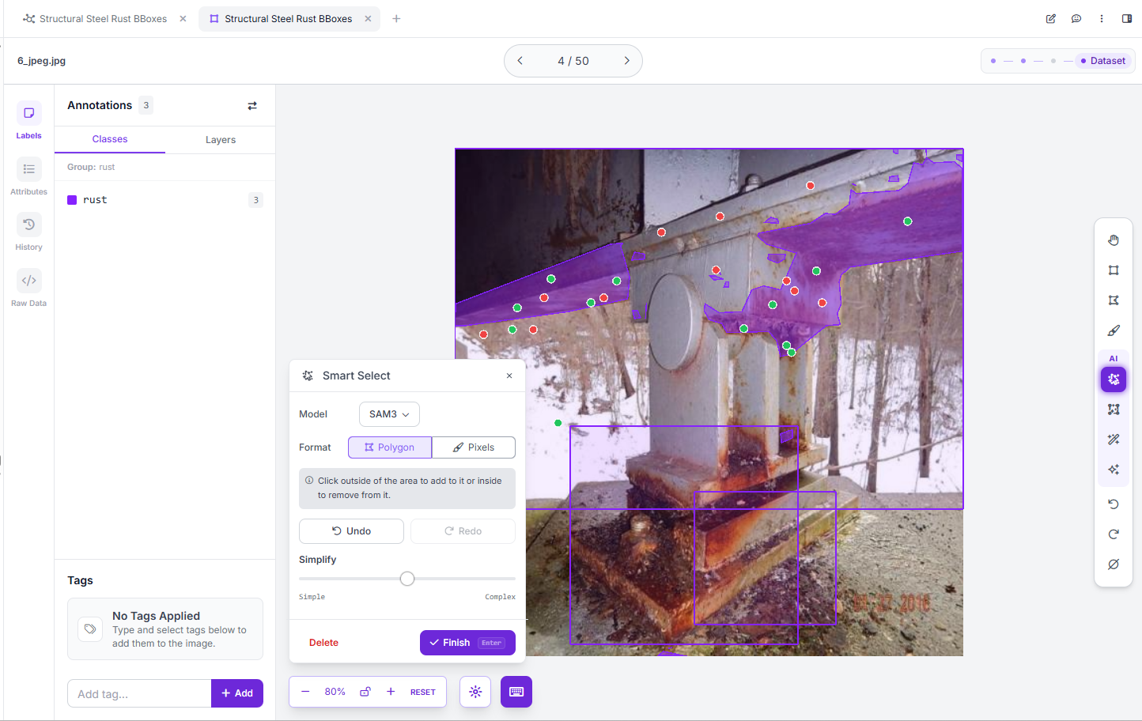
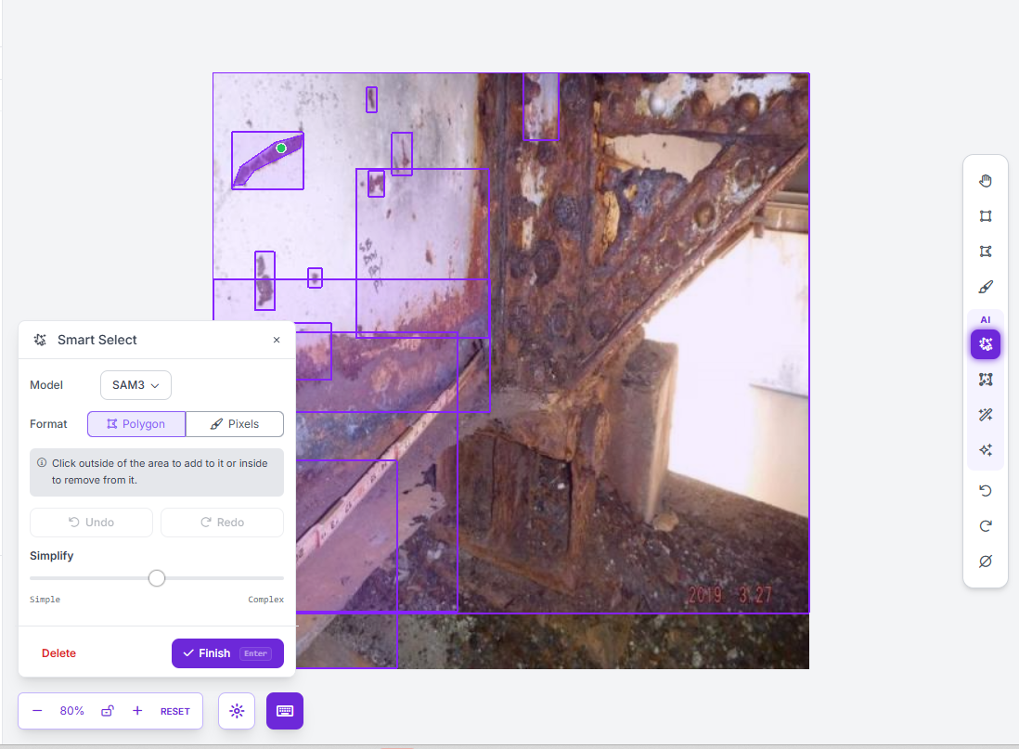
SAM3 annotation exploration
Complex corrosion: repeated corrections
still leave imperfect boundaries.
Isolated patch: one point produces
a visually close starting polygon.
Two qualitative trials. No mask accuracy score or retraining claim.
6
Author screenshots, Roboflow Smart Select SAM3. Dataset: University of Tebessa / CC BY 4.0.
Notes:
Author screenshots, Roboflow Smart Select UI model SAM3, Polygon output, 24 September 2026. Images 6_jpeg.jpg and 327_jpeg.jpg. Preview polygons do not modify the previously frozen release ZIP. Dataset images: University of Tebessa, via Mohammad Mango adapted Roboflow version 1. Export declares CC BY 4.0. https://universe.roboflow.com/university-of-tebessa/corrosion-eh3ms

Slide 7
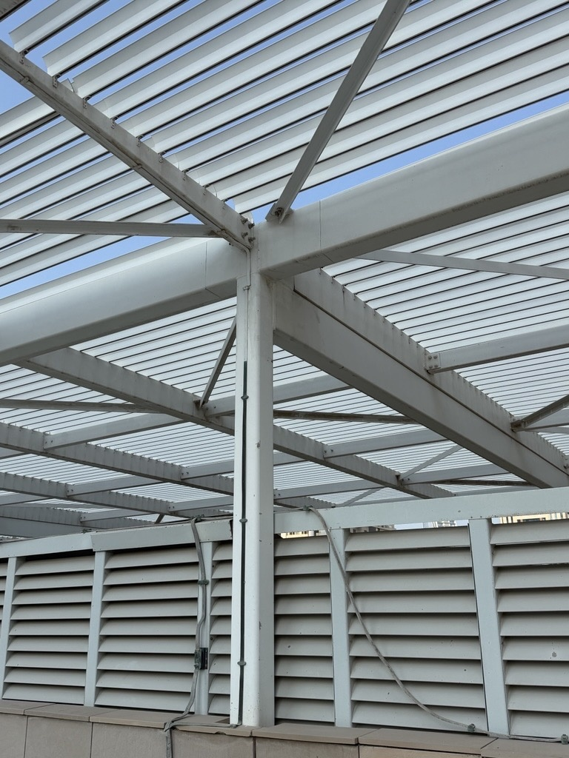
New photographs and responsible use
Five author photographs from public places
provide qualitative checks.
No independent ground-truth labels.
No detections cannot establish healthy steel.
Photos cannot establish corrosion depth
or structural safety.
Human inspection remains essential.
Example with no detections at confidence 0.25
7
Photo: Mohammad Mango. Qualitative inference example, baseline run.
Notes:
Author supplied photographs, public-street photography permission reported by author. Public project must exclude private client images and preserve source attribution. Separate software and photo licensing documentation remains a repository completion task.

Slide 8
Priorities and conclusion
1 Audit similar images and split by structure/site
Reduce leakage risk before measuring generalization to new sites.
2 Standardize rust-patch annotations
Resolve duplicate boxes and broad component-sized labels.
3 Add difficult examples and verified negatives
Target small rust, shadows, red paint and healthy or dirty steel.
Academic baseline completed. Further data work is proposed.
8
Project: github.com/mnmango88/steel-rust-detection
Notes:
Project and full evidence: https://github.com/mnmango88/steel-rust-detection . Proposed improvements have not yet been tested. Low baseline metrics do not support autonomous inspection decisions.

