Slide 1
Concentric Tube Continuum Robot (CTCR) Deep Learning
By: Michael Marinaccio

Slide 2

Overview
CTCR developed by Continuum Robotics Laboratory in Toronto, Canada
Three tube CTCR
Collected position/orientation information for each section
Collected joint space and previous joint space configuration information
Released first public CTCR dataset
Mentions room for improvement on deep learning methods without physics-based modeling

Slide 3
Goals
Utilize dataset to develop feedforward neural network model
Develop model that learns patterns/parameters from dataset without physics-based modeling
Feedforward Neural Network (FNN) analysis
Analyze effects of different architecture on accuracy:
Preprocessing
Loss Functions
Activation Functions
Batch Size

Slide 4
Contribution
Analyze different FNN architectures to provide a better understanding of the given dataset
What does and doesn’t work well with dataset?
Provide insight into how dataset behaves with FNN
Help develop knowledge as to how CTCR deep learning can progress
Developed model that accurately predicts end effector position/orientation given other frame position/orientation information (forward kinematics)

Slide 5
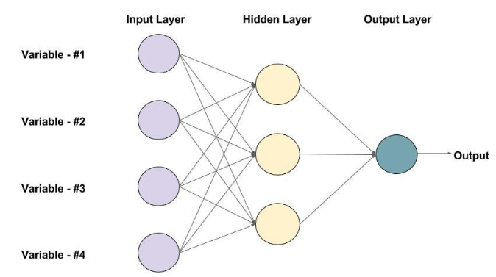
Feedforward Neural Network
What is it?
Neural network model where information flows from input to output
No feedback loop
Good for regression based prediction
Fully connected means all outputs of each layer are connected to every neuron as input of next layer
Consists of:
Input Layer - Input data / batching
Hidden Layer - Where learning takes place, activation functions provide probabilistic calculations for neurons
Output of Layer=Activation(∑i=1,n(Input_{i}×Weight_{i}​)+Bias)
Output Layers - Prediction layer
Compute Loss, gradients, and backpropagate to adjust weights

Slide 6
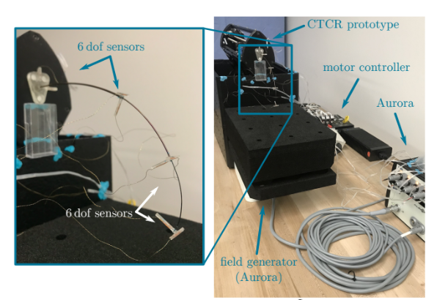
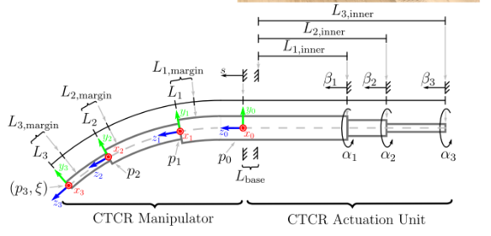
Dataset
100,000 data points collected
Eight sequences of 12500 points
6 DOF sensors placed at each distal end of each tube
Electromagnetic tracking system used called Aurora
Includes:
six absolute joint values
six relative joint values
pose of the base
pose of the proximal sensor attached to the outermost tube
pose of the sensor attached to the middle tube
pose of the distal sensor attached to the most inner tube

Slide 7
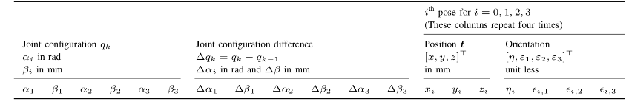
Dataset
What are the publishers interested in predicting?
Four Items:
x = [x1, y1, z1, x2, y2, z2, x3, y3, z3, η, ε1, ε2, ε3]⊤ (6)
xpose = [x3, y3, z3, η, ε1, ε2, ε3]⊤ (7)
xposition = [x3, y3, z3]⊤ (8)
xthree-points = [x1, y1, z1, x2, y2, z2, x3, y3, z3]⊤ (9)

Slide 8
Continuum Robotic Laboratory Model
Continuum Robotic Laboratory Model
Fully-Connected Feedforward Network (FFN) used
PyTorch
ReLU Activation
200 Activations in Hidden Layer
Batch Size = 128
Learning Rate = 0.0005
Trained for 1000 Epochs
ADAM Optimizer
Inputs:
q = [γ1,1, γ1,2, β1,U , γ2,1, γ2,2, β2,U , γ3,1, γ3,2, β3,U ]⊤ (5)
Scaled between -1 and 1

Slide 9
My Approach
Want to predict xpose
Inputs: [x0, y0, z0, x1, y1, z1, x2, y2, z2, ηi, εi,0, εi,1, εi,2]
Outputs: [x3, y3, z3, η, ε1, ε2, ε3]⊤
Analyze various aspects of the architecture and choose highest performing ones for final model

Slide 10
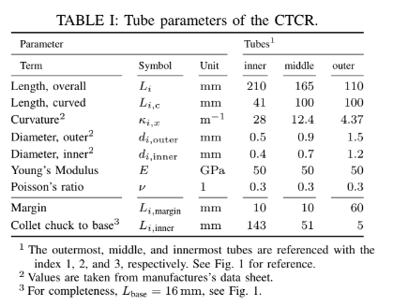
Error Calculations
Focus solely on Position and Orientation prediction of end effector
x_{real} = ground truth value
X_{pred} = predicted value
Three Important Measures of Error:
Translational Error (Euclidean Distance): e_{t,i} = √(x_{real} - x_{pred})² + (y_{real} - y_{pred})² + (z_{real} - z_{pred})²
Rotational Error: e_{Θ} = min{2arcocs(n_{real}n_{pred}+ɛ_{3,1real}ɛ_{3,1pred}+ɛ_{3,2real}ɛ_{3,2pred}+ɛ_{3,3real}ɛ_{3,3pred}), 2arcocs(n_{real}n_{pred}-ɛ_{3,1real}ɛ_{3,1pred}-ɛ_{3,2real}ɛ_{3,2pred}-ɛ_{3,3real}ɛ_{3,3pred})}
Tolerance Measurement: Correct prediction = x_{pred} within +- tolerance
Acceptable Tolerance calculated by:
i=0 -> 16mm (stated for base length at bottom of Table I)
i=1 -> 210+165+110mm = 485mm
i=2 -> 210+165+110mm = 485mm
i=3 -> 210+165+110mm = 485mm
Total Length -> 1471 mm about 57.91 inches
1471mm * 0.01 = 14.71 mm, 1% of total length

Slide 11
Preprocessing
100,000 total data rows
Train Set: 80,000 rows
Validation Set: 10,000 rows
Test Set: 10,000 rows
Split into X and y data structures
X_train, y_train
X_val, y_val
X_test, y_test
X contains 21 features corresponding to [x_{i}, y_{i}, z_{i}, n_{i}, ɛ_{i,1}, ɛ_{i,2}, ɛ_{i,3}] for i=0 to end effector-1 frame
y contains 7 output values for prediction corresponding to [x₃, y₃, z₃, n₃, ɛ_{3,1}, ɛ_{3,2}, ɛ_{3,3}]

Slide 12
Hardware/Software
Microsoft Windows 10
AMD Ryzen 5 3600 (3.6GhZ) 6 core CPU
Ripjaws 16GB DDR4-3600 RAM
NVIDIA GeForce GTX 1660 TI Graphics Card

Slide 13
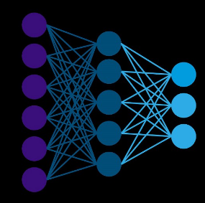
Feature Splitting Analysis
Interested in exploring the effect of:
Utilizing all or only some features for input
Proportionate sampling from each 12,500 row section
Each 12,500, take 10,000 for train, 1250 for validation, 1250 for test
Trained Model for 100, 500, and 1000 epochs for all combinations, Leaky ReLU Activation
Model Architecture:
21 or 33 Inputs
6 Hidden Layers: h1=64, h2=96, h3=50, h4=25, h5=18, h6=15
7 Outputs as x_{pose}

Slide 14
Feature Splitting Results
100 Epochs
Tolerance | Some, Yes | Some, No | All, Yes | All, No
1 | 59.11571429 | 59.07285714 | 59.54142857 | 59.55142857
2.5 | 62.03428571 | 61.91142857 | 63.15857143 | 63.08571429
5 | 67.01 | 66.89714286 | 69.02 | 68.84285714
14.71 | 84.35857143 | 84.68428571 | 84.95857143 | 85.01714286
50 | 99.59285714 | 99.63 | 99.62 | 99.62857143
500 Epochs
Tolerance | Some, Yes | Some, No | All, Yes | All, No
1 | 60.69285714 | 61.89857143 | 72.92 | 71.26714286
2.5 | 68.40857143 | 70.20571429 | 89.54571429 | 87.13142857
5 | 80.13571429 | 78.22428571 | 98.04285714 | 97.65857143
14.71 | 99.07428571 | 98.12428571 | 100 | 99.99857143
50 | 100 | 100 | 100 | 100
1000 Epochs
Tolerance | Some, Yes | Some, No | All, Yes | All, No
1 | 65.55857143 | 65.52571429 | 73.54428571 | 68.25285714
2.5 | 76.24142857 | 76.53 | 93.69428571 | 88.07857143
5 | 86.18571429 | 86.13571429 | 99.80857143 | 99.40285714
14.71 | 98.73714286 | 99.39857143 | 100 | 100
50 | 100 | 100 | 100 | 100

Slide 15
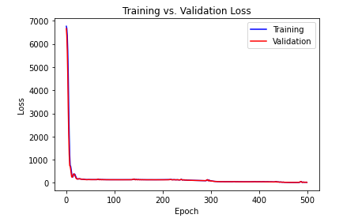
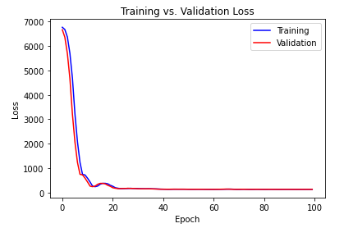
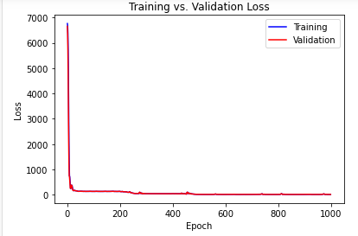
Feature Splitting Results
Some Features, Splitting Example

Slide 16
Loss Functions Analysis
Interested in exploring the effect of:
Different Loss Functions
Huber Loss, Smooth L1, MAE, MSE
Trained Model for 100, and 500, epochs for all combinations
Model Architecture:
21 Inputs
6 Hidden Layers: h1=64, h2=96, h3=50, h4=25, h5=18, h6=15
7 Outputs as x_{pose}

Slide 17
Loss Functions Results
100 Epochs
Tolerance | MSE | Smooth L1 | Huber Loss | MAE
1 | 12.88857143 | 42.53571429 | 44.37142857 | 17.11285714
2.5 | 30.53571429 | 61.18142857 | 61.91 | 57.18714286
5 | 53.85142857 | 65.23857143 | 66.79 | 64.51714286
14.71 | 87.68857143 | 79.06857143 | 82.64428571 | 78.68285714
50 | 99.80714286 | 99.59 | 99.64714286 | 99.61142857
500 Epochs
Tolerance | MSE | Smooth L1 | Huber Loss | MAE
1 | 15.62714286 | 61.72571429 | 64.15285714 | 63.34
2.5 | 36.06571429 | 67.85857143 | 74.52 | 69.71428571
5 | 60.92 | 75.74857143 | 85.05714286 | 76.14857143
14.71 | 94.42428571 | 93.78714286 | 99.11857143 | 90.19285714
50 | 100 | 100 | 100 | 99.62571429

Slide 18
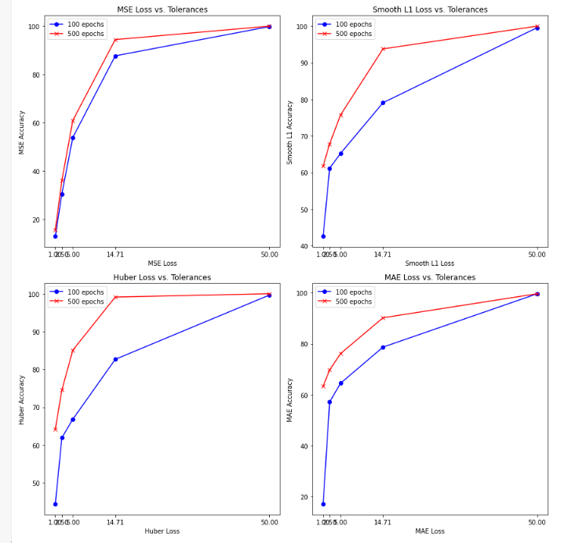
Loss Functions Results

Slide 19
Activation Functions Analysis
Interested in exploring the effect of:
Different Activation Functions
Leaky ReLU, ReLU, Parametric ReLU (PReLU), and Tanh
Trained Model for 100, and 500, epochs for all combinations
Batch Size: 32; Learning Rate: 0.01, Adam Optimizer, MSE Loss, Kaiming Weight Init
Model Architecture:
21 Inputs
Batch and Layer Normalization
6 Hidden Layers: h1=64, h2=96, h3=50, Dropout(0.2), h4=25, h5=18, Dropout(0.2), h6=15
7 Outputs as x_{pose}

Slide 20
Activation Functions Results
Activation Function | Epochs | Training Loss | Validation Loss
ReLU | 100 | 18.53024435 | 63.95670203
LeakyReLU | 100 | 83.27457832 | 71.66801003
PReLU | 100 | 12.75964283 | 37.26969125
Tanh | 100 | 147.2628821 | 147.8721449
Activation Function
Tolerance | ReLU | Leaky ReLU | PReLU | TanH
1 | 60.08714286 | 60.16 | 61.14571429 | 59.02
2.5 | 64.43 | 65.23428571 | 67.21285714 | 61.62428571
5 | 70.95 | 72.26857143 | 76.54857143 | 65.96428571
14.71 | 88.95714286 | 89.06285714 | 94.55857143 | 81.48428571
50 | 100 | 100 | 100 | 99.61285714

Slide 21
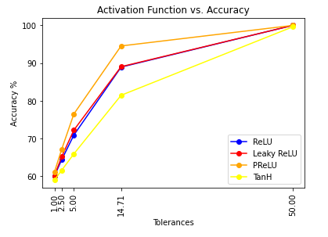
Activation Functions Results

Slide 22
Batch Size Analysis
Interested in exploring the effect of:
Different batch sizes
Leaky ReLU
Trained Model for 100 epochs for each batch size
Learning Rate: 0.01, Adam Optimizer, MSE Loss, Kaiming Weight Init
Model Architecture:
21 Inputs
Batch and Layer Normalization
6 Hidden Layers: h1=batch size, h2=96, h3=50, Dropout(0.2), h4=25, h5=18, Dropout(0.2), h6=15
7 Outputs as x_{pose}

Slide 23
Batch Size Results
Batch Size
Tolerance | 32 | 64 | 128
1 | 60.16 | 58.70714286 | 61.79857143
2.5 | 65.23428571 | 61.19285714 | 68.23857143
5 | 72.26857143 | 65.40714286 | 76.64714286
14.71 | 89.06285714 | 84.91857143 | 91.63714286
50 | 100 | 99.95285714 | 100

Slide 24
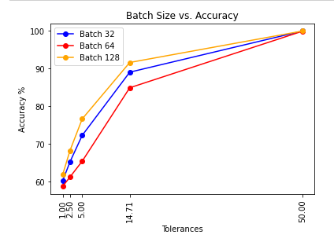
Batch Size Results

Slide 25
Final Model Analysis
Two Designs (1 and 2)
Batch Size - 128
150 and 500 epochs each
Data Splitting
Kaiming Weight Initialization
PReLU Activation
Smooth L1 Loss and MSE Loss for each
Adam Optimizer
Learning Rate - 0.001
Dropout Rate - 0.2

Slide 26
Design 1
Model Architecture:
21 Inputs
Batch and Layer Normalization
7 Hidden Layers: h1=128, h2=96, h3=50, Dropout(0.2), h4=30, h5=25, Dropout(0.2), h6=18, h7=15
7 Outputs as x_{pose}

Slide 27
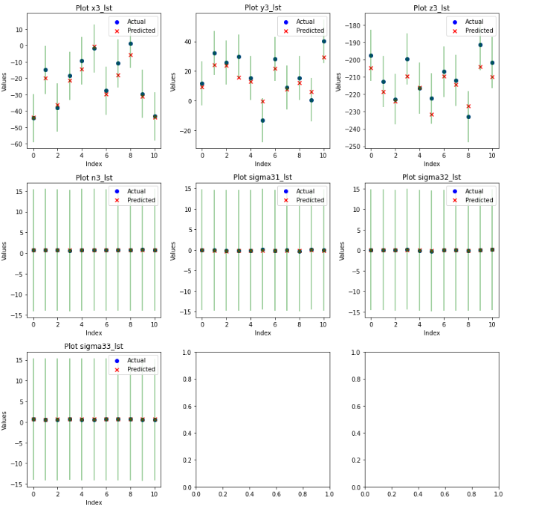
Design 1 Results

Slide 28
Design 2
Model Architecture:
21 Inputs
Batch and Layer Normalization
13 Hidden Layers: h1=128, h2=96, h3=50, Dropout(0.2), h4=30, h5=25, Dropout(0.2), h6=18, h7=15, Dropout(0.2), h8=96, h9=50, Dropout(0.2), h10=30, h11=25, Dropout(0.2), h12=18, h13=15
7 Outputs as x_{pose}

Slide 29
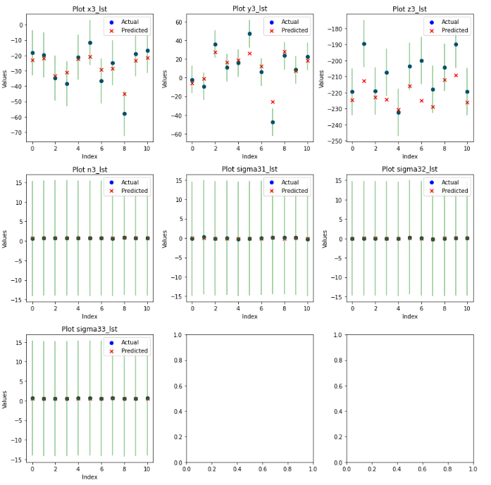
Design 2 Results

Slide 30
Hyperparameter Tuning
| Learning Rate | Dropout Rate | Final Training Loss | Final Validation Loss |
|----------------|---------------|-----------------------|--------------------------------------------|
| 0.1 | 0.2 | 5644.41 | 4965.89 |
| 0.1 | 0.3 | 5644.41 | 4965.89 |
| 0.1 | 0.4 | 5644.41 | 4965.89 |
| 0.1 | 0.5 | 5644.41 | 4965.89 |
| 0.01 | 0.2 | 1.02 | 4.64 |
| 0.01 | 0.3 | 1.02 | 4.64 |
| 0.01 | 0.4 | 1.02 | 4.64 |
| 0.01 | 0.5 | 1.02 | 4.64 |
| 0.001 | 0.2 | 0.96 | 4.04 |
| 0.001 | 0.3 | 0.96 | 4.04 |
| 0.001 | 0.4 | 0.96 | 4.04 |
| 0.001 | 0.5 | 0.96 | 4.04 |

Slide 31
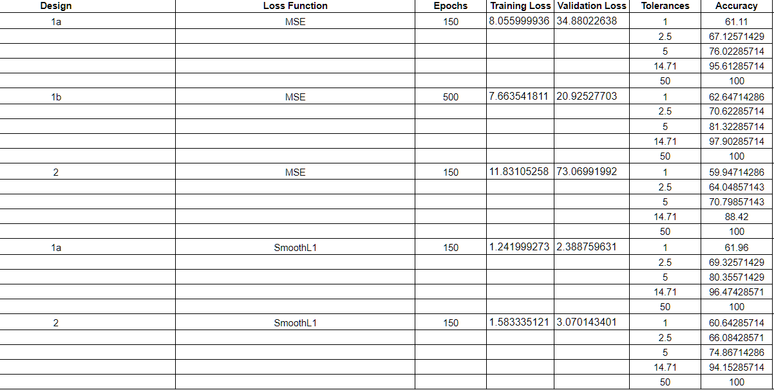
Design Comparison

Slide 32
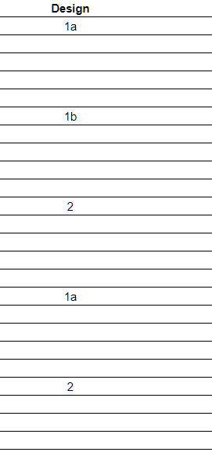
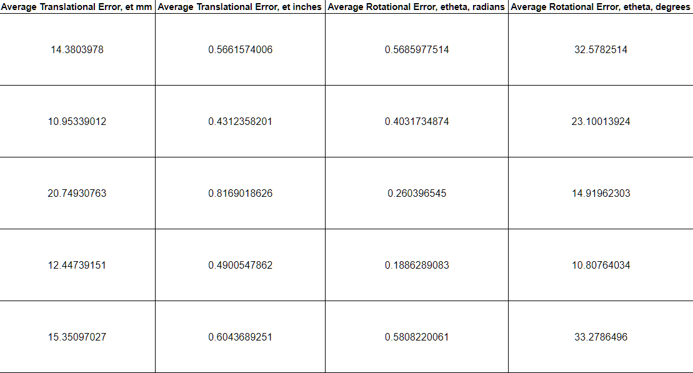
Design Comparison

Slide 33
Final Model
Design 1a
Batch Size - 128
150 Epochs
Data Splitting
Smooth L1 Loss
Kaiming Weight Initialization
Adam Optimizer
Learning Rate - 0.001
Dropout Rate - 0.2

Slide 34
Final Model Results
Tolerance - 14.71
Total: 70000; Correct: 67532; Incorrect: 2468; Accuracy: 0.9647428571428571 - 96.47428571428571%
Correct Counts:
x3: 9997 - Percent of Total: 14.281428571428572%
y3: 8801 - Percent of Total: 12.572857142857144%
z3: 8734 - Percent of Total: 12.477142857142857%
n3: 10000 - Percent of Total: 14.285714285714285%
ɛ_{3,1}: 10000 - Percent of Total: 14.285714285714285%
ɛ_{3,2}: 10000 - Percent of Total: 14.285714285714285%
ɛ_{3,3}: 10000 - Percent of Total: 14.285714285714285%
Incorrect Counts:
x3: 3 - Percent of Total: 0.004285714285714286%
y3: 1199 - Percent of Total: 1.7128571428571426%
z3: 1266 - Percent of Total: 1.8085714285714285%
n3: 0 - Percent of Total: 0.0%
ɛ_{3,1}: 0 - Percent of Total: 0.0%
ɛ_{3,3}: 0 - Percent of Total: 0.0%
ɛ_{3,3}: 0 - Percent of Total: 0.0%

Slide 35
Final Model Results

Slide 36
Final Model Results
Design | Loss Function | Epochs | Training Loss | Validation Loss | Tolerances | Accuracy | Average Translational Error, et mm | Average Translational Error, et inches | Average Rotational Error, etheta, radians | Average Rotational Error, etheta, degrees
1a | SmoothL1 | 150 | 1.241999273 | 2.388759631 | 1 | 61.96 | 12.44739151 | 0.4900547862 | 0.1886289083 | 10.80764034
 |  |  |  |  | 2.5 | 69.32571429
 |  |  |  |  | 5 | 80.35571429
 |  |  |  |  | 14.71 | 96.47428571
 |  |  |  |  | 50 | 100

Slide 37
Future Work
Analyze different architectures other than FNN
Recurrent Neural Network (RNN)
Gradient Boosting Machine (GBM)
Test other predictions on current model
x, x_{position}, x_{three-points} and/or joint (previous or current) space prediction
Collect data with other CTCR’s and train on other datasets for better model
Utilize better hardware to train more complex model

Slide 38
Conclusion
Developed FNN to accurately predict end effector position and orientation
<0.5 in accuracy on average for position
<11 degrees on average for orientation
Gained insight as to how dataset behaves with:
Feature Splitting (preprocessing)
Loss Functions (Huber, SmoothL1, MAE, and MSE)
Activation Functions (ReLU, Leaky ReLU, PReLU, and TanH)
Batch Size Differences (32, 64, 128)
Help support deep learning is capable of capturing patterns / behavior of CTCR

Slide 39
References
[1] ContinuumRoboticsLab, “ContinuumRoboticsLab/CRL-dataset-CTCR-pose,” GitHub, https://github.com/ContinuumRoboticsLab/CRL-Dataset-CTCR-Pose (accessed Dec. 5, 2023).
[2] A Dataset and Benchmark for Learning the Kinematics of Concentric Tube Continuum Robots. YouTube, 2022.
[3] R. M. Grassmann, R. Z. Chen, N. Liang and J. Burgner-Kahrs, "A Dataset and Benchmark for Learning the Kinematics of Concentric Tube Continuum Robots," 2022 IEEE/RSJ International Conference on Intelligent Robots and Systems (IROS), Kyoto, Japan, 2022, pp. 9550-9557, doi: 10.1109/IROS47612.2022.9981719.
[4] R. Grassmann, V. Modes and J. Burgner-Kahrs, "Learning the Forward and Inverse Kinematics of a 6-DOF Concentric Tube Continuum Robot in SE(3)," 2018 IEEE/RSJ International Conference on Intelligent Robots and Systems (IROS), Madrid, Spain, 2018, pp. 5125-5132, doi: 10.1109/IROS.2018.8594451.

