Slide 1
ENVIRONMENTAL RISK IDENTIFICATION & ASSESSMENT TOOL
For Glencore's Group Responsible Sourcing team
A geopolitics-of-energy lens on critical-mineral supply chains
Glencore × NYU SPS Center for Global Affairs Consulting Practicum
Spring 2026
Notes:
[Speaker 1, 30 sec] Welcome. We're presenting an environmental risk identification tool we built for the Glencore Responsible Sourcing team. Our framing is the geopolitics of the energy transition — the minerals we need for batteries and grids are concentrated in jurisdictions where environmental due diligence is hardest. We'll walk through the scope, the geopolitical context, the tool itself, a case study, and how it fits Glencore's existing workflow.

Slide 2
Scope of Work
Glencore × NYU SPS Consulting Practicum — Environmental Due Diligence Framework Development
The challenge
Integrate environmental risk into Glencore's existing human-rights-focused due diligence framework. 200,000+ goods & services suppliers and 1,000+ metals & minerals suppliers; small assessment team that is not a subject-matter expert across every risk type. → Scalable, risk-based approach essential.
Project objective
Key research questions
• Develop a practical, risk-based environmental due-diligence guideline and process workflow
• Build on Glencore's saliency-based risk framework
• Account for very limited assessor resources
• Inform compliance with EU CSRD, CSDDD, EU Battery Regulation, and the Consolidated Mining Standard Initiative
• How do we assess severity of environmental risk?
• How do we prioritize among competing concerns?
• How do we translate risk identification into actionable due diligence with a small team?
• How does sector + jurisdiction influence prioritization (water scarcity, protected areas, hazardous materials)?
Deliverables
Anchor frameworks
• 1. Environmental Due Diligence Guideline
• 2. End-to-end process workflow (visual)
• 3. This presentation + tool prototype
• OECD Handbook on Environmental DD in Mineral Supply Chains (2023)
• RMI Supply Chain DD Plus Module (April 2025)
• UNDP HRDD and the Environment: A Practical Tool for Business
• Glencore's saliency-based risk framework + SCDD M&M Procedure
Source: Glencore × NYU Consulting Practicum project brief, NYU SPS Center for Global Affairs, 2026.
Glencore × NYU SPS Center for Global Affairs Consulting Practicum
2 / 7
Notes:
[Speaker 1, 1 min] Glencore — a global producer, processor, and marketer of transition-enabling metals and minerals — partnered with NYU's Center for Global Affairs to address a specific challenge: their existing due-diligence framework is human-rights-focused, but emerging EU regulation (CSRD, CSDDD, the Battery Regulation, the Consolidated Mining Standard) demands integrated environmental risk assessment. The operational constraint is acute: Glencore screens over 200,000 goods and services suppliers and 1,000+ metals and minerals suppliers with a very small team that cannot be subject-matter experts across every risk type. So scalability and a risk-based approach are essential. We anchored our work in the OECD Environmental DD Handbook, the RMI Plus Module, the UNDP Practical Tool for Business, and Glencore's own saliency framework. The deliverables are the guideline document, the end-to-end workflow, and what we'll show you today: a working tool prototype that operationalizes Tier 1. I'll now hand to [Speaker 2] for the geopolitical framing.

Slide 3
Why this matters now
The energy transition is mineral-intensive — and supply is concentrated
4–6×
74%
48%
72%
IEA: critical-mineral demand growth by 2040 under net-zero scenarios
Cobalt — DRC share of 2023 global production (USGS MCS 2024)
Nickel — Indonesia share of 2023 global production
Platinum — South Africa share of 2023 global production
Two trends collide
• (a) The energy transition runs through critical minerals.
• Cobalt + nickel for batteries · copper for grid · REEs for wind turbines · platinum for fuel cells. The IEA estimates 4–6× demand growth by 2040.
• (b) Production is concentrated — and concentration overlaps with high-risk jurisdictions.
• The US 2022 Critical Minerals List, the EU Critical Raw Materials Act (2024), and the IRA all flag the same supply-concentration risk. For an operator like Glencore, that is the operational reality, not an abstraction.
Sources: IEA Critical Minerals Outlook 2024 (iea.org); USGS Mineral Commodity Summaries 2024 (pubs.usgs.gov/periodicals/mcs2024); USGS 2022 Critical Minerals List; EU Critical Raw Materials Act 2024.
Glencore × NYU SPS Center for Global Affairs Consulting Practicum
3 / 7
Notes:
[Speaker 2, 1 min 30] The energy transition isn't just a story about renewable electricity — it's a mineral story. The IEA forecasts 4 to 6 times demand growth for cobalt, nickel, copper, and rare earths by 2040 under a net-zero scenario. But supply is highly concentrated: 74 percent of cobalt comes from the DRC, almost half of nickel from Indonesia, 72 percent of platinum from South Africa. And here's the critical geopolitical insight — the US 2022 Critical Minerals List, the EU's Critical Raw Materials Act, and the Inflation Reduction Act are all responding to the same problem: every Western government is now treating supply-chain concentration as a national-security risk. For an operator like Glencore, that's not a thought experiment — it's where they actually buy and sell every day.

Slide 4
The CAHRA × Critical Minerals overlap
Where the energy transition's supply chain meets Glencore's high-risk list
Commodity
Top producer
Share
CAHRA
Critical?
Cobalt
DRC
74%
All regions
Yes
Nickel
Indonesia
48%
All regions
Yes
Platinum
South Africa
72%
—
Yes
Manganese alloys
South Africa / Gabon
36% + 23%
—
Yes
Ferrochrome
South Africa
44%
—
Yes
Aluminum
China (smelting)
59%
Xinjiang
Yes
Zinc
China
33%
Xinjiang
Yes
Copper
Chile / Peru / DRC
23 + 10 + 13%
DRC: All regions
—
Of the 8 USGS-Critical Minerals in Glencore's portfolio, every single one has a top-3 producer that touches the CAHRA list. The energy transition cannot be decoupled from high-risk jurisdictions — managing environmental risk in those countries is non-optional.
Sources: USGS MCS 2024; USGS 2022 Critical Minerals List (usgs.gov/news/national-news-release/us-geological-survey-releases-2022-list-critical-minerals); Glencore CAHRA List 2025 (updated 27.02.2025).
Glencore × NYU SPS Center for Global Affairs Consulting Practicum
4 / 7
Notes:
[Speaker 2, 1 min 30] If we map Glencore's CAHRA list against the US 2022 Critical Minerals List, the overlap is striking. Cobalt — 74 percent DRC, all of which is CAHRA-flagged. Nickel — 48 percent Indonesia, all CAHRA. Platinum — 72 percent South Africa. Aluminum smelting — 59 percent China, with Xinjiang flagged. The point isn't that any specific country is bad; it's that the geographic concentration of energy-transition minerals systematically pushes Western buyers into jurisdictions where environmental governance is weak or contested. That's the operational gap our tool addresses. Now I'll hand to [Speaker 1] for the tool itself.

Slide 5
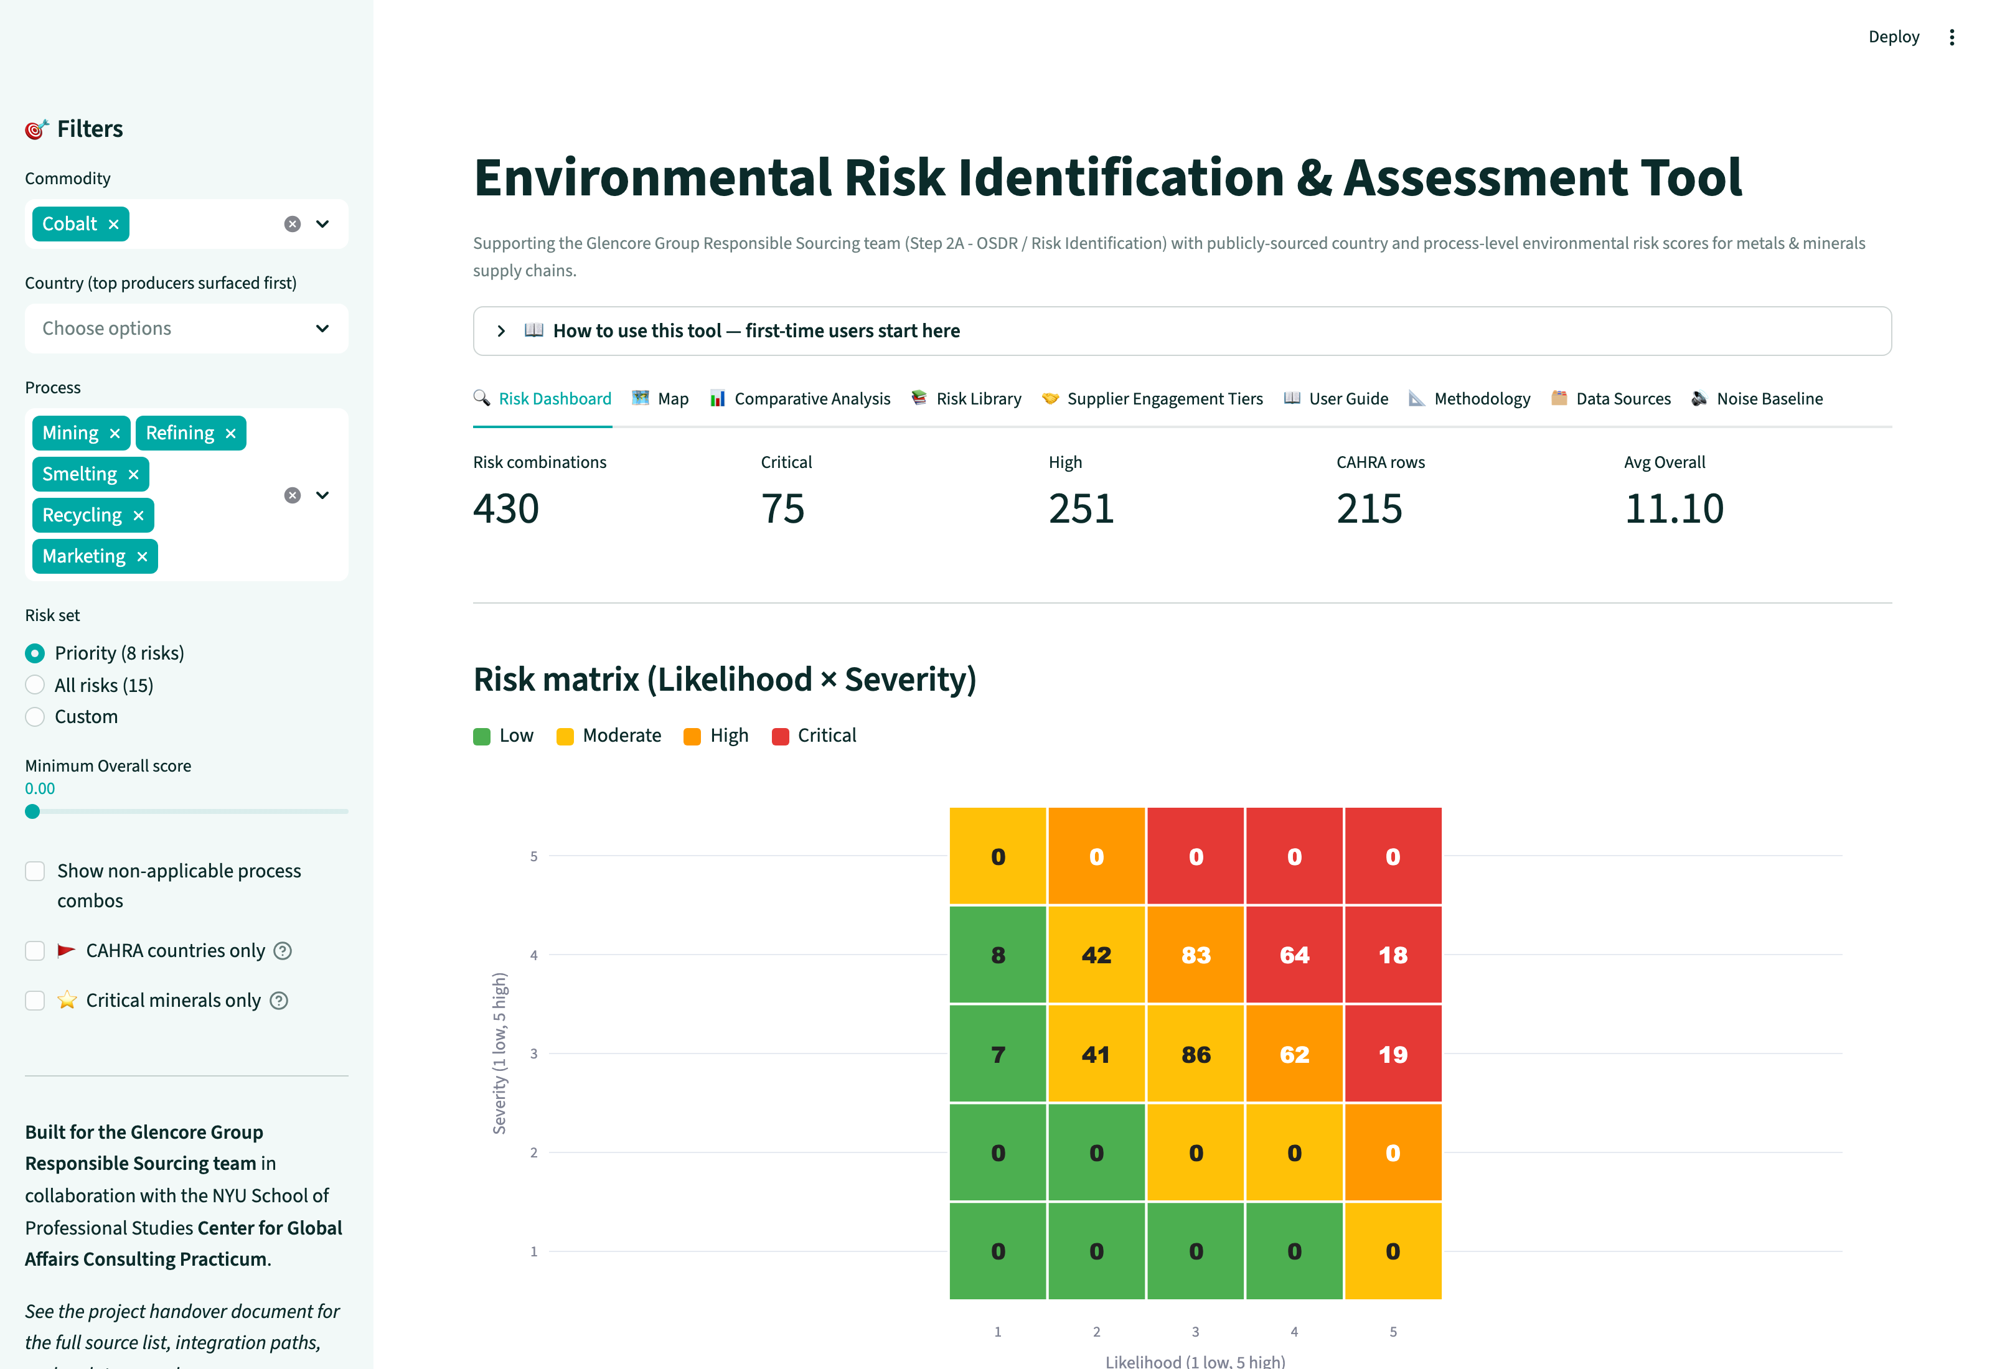
The tool
Pivot-style filter → ranked risks · Likelihood × Severity heatmap · drill-down audit trail
What it does
• Filters: commodity, country, process, risk type — top producers surfaced first
• 8 priority risks (15 total) scored as Likelihood × Severity = Overall (1–25)
• Bucketed Low / Moderate / High / Critical with consistent palette across the table, heatmap, choropleth, and Excel companion
• Drill-down panel exposes raw indicator + source URL for every score → auditable for CSRD / CSDDD
• 8 tabs: Dashboard · Map · Comparative Analysis · Risk Library · SCDD Tiers · User Guide · Methodology · Data Sources
Live tool: streamlit.app · Repo: github.com/mnmarkovitz/glencore_enviro_risk_tool
Glencore × NYU SPS Center for Global Affairs Consulting Practicum
5 / 7
Notes:
[Speaker 1, 1 min] This is the tool. An analyst opens it, picks a commodity in the sidebar — let's say cobalt — and the country dropdown automatically prioritizes the top producers from the USGS Mineral Commodity Summaries. They pick a process — mining, refining, smelting, recycling, or marketing — and they get back a ranked table of every environmental risk that applies, plus a 5-by-5 Likelihood-by-Severity heatmap. Click any row and you see the raw indicator value with its source URL, so an audit can trace every number back to its public data point.

Slide 6
Methodology
Reproducible scoring from public datasets · No analyst gut-feel
Two formulas
Low
Moderate
High
Critical
Likelihood = 0.4 × Process Intrinsic + 0.6 × Country Hazard → 1–5
Severity = 0.5 × Ecological Sensitivity + 0.5 × Regulatory Strict. → 1–5
Overall = Likelihood × Severity → 1–25
Buckets: 1–4 Low · 5–9 Moderate · 10–14 High · 15–25 Critical
Why country weight > process weight (0.6 vs 0.4)?
Process determines whether a risk is possible at all (no tailings in trading), but country context determines whether a capable process actually causes harm. Two copper mines — Chile's Atacama and Zambia's Copperbelt — have the same Process Intrinsic score for water depletion (5), but very different realized risk: Aqueduct rates Atacama 5 (Extremely High) vs Zambia 2.
Public datasets feeding the scores
WRI Aqueduct · Yale EPI 2024 · WHO PM2.5 DB · IUCN Red List · WDPA · Global Forest Watch · Global Tailings Portal · USGS MRDS · USGS Critical Minerals Atlas · Global Energy Monitor · ISRIC SoilGrids · World Bank WGI · INFORM Risk · Glencore CAHRA List 2025
All weights and bucket thresholds editable in scoring_weights.csv. Full methodology: github.com/mnmarkovitz/glencore_enviro_risk_tool/blob/main/docs/METHODOLOGY.md
Glencore × NYU SPS Center for Global Affairs Consulting Practicum
6 / 7
Notes:
[Speaker 1, 1 min] Two formulas. Likelihood is 40 percent process intensity — does the process even cause this risk — and 60 percent country hazard, drawn from a specific public dataset for each risk: Aqueduct for water, IUCN for species, GFW for deforestation, SoilGrids for soil, and so on. Severity is half ecological sensitivity, half regulatory strictness — because the tool measures penalty exposure, not pure ecological damage. Overall is L times S, bucketed into Low, Moderate, High, and Critical. Importantly, every single weight is in an editable CSV — Glencore can change the balance whenever they want without touching code. I'll hand to [Speaker 2] for the case study.

Slide 7
Geopolitics deep dive — DRC × Cobalt × Mining
Why this combination is the canonical stress-test for the energy transition
74%
All regions
~2 of 5
Tier 2
DRC's share of global cobalt mine production (USGS MCS 2024)
Glencore CAHRA flag — every Congolese province is high-risk
of every EV battery's cathode chemistry depends on cobalt
auto-trigger: any DRC supplier escalates immediately under SCDD M&M procedure
Why DRC × cobalt is structurally exposed
• Energy transition concentration: cobalt for EV batteries, grid storage. IEA forecasts demand 6× by 2040.
• Geographic concentration: DRC produces ~74%; refining ~70% China-controlled. Western buyers face cross-strait + cross-border policy exposure.
• EU Battery Regulation (EU 2023/1542) and the U.S. Inflation Reduction Act both treat cobalt traceability and DD as compliance gating items for market access.
• Artisanal & small-scale mining (ASM) supplies ~15-30% of DRC cobalt — child labor and fatality risk make environmental + human-rights DD inseparable.
• Acidic tropical Oxisols → highest soil-pollution vulnerability in the dataset; spilled heavy metals mobilize fast (ISRIC SoilGrids vulnerability ≈ 4.3 / 5).
Live tool view: DRC × Cobalt × Mining → 3 Critical risks
What the analyst gets in 10 minutes: ranked risks (Tailings · Soil pollution · Biodiversity → all Critical), KPIs for the SAQ, supplier-type categories, every score auditable to a public dataset URL.
Glencore × NYU SPS Center for Global Affairs Consulting Practicum
7 / 7
Sources: USGS MCS 2024 · Glencore CAHRA List 2025 · IEA Critical Minerals Outlook 2024 · ISRIC SoilGrids 2.0 · IUCN Red List · Global Forest Watch · Global Tailings Portal · EU Battery Regulation 2023/1542 · U.S. IRA (Public Law 117–169).
Notes:
[Speaker 2, 2 min — geopolitics deep dive] DRC × cobalt × mining is the single best case study to show why this tool matters in the geopolitics of the energy transition. Three layers stack here. First, energy-transition concentration: every electric vehicle battery cathode chemistry except LFP relies on cobalt, and the IEA forecasts 6× demand growth by 2040. Second, geographic concentration: 74 percent of mine production is in the DRC, and 70 percent of refining is in China — so a Western buyer is dependent on a single high-risk source country plus a single processing chokepoint that is itself subject to escalating U.S.–China trade restrictions. Third, regulatory pressure: the EU Battery Regulation that came into force in 2023 and the U.S. Inflation Reduction Act both treat cobalt traceability and environmental due diligence as gating items for market access. So this isn't optional — Glencore needs auditable Tier-1 evidence per supplier. The tool surfaces three Critical risks for any DRC cobalt mine: tailings, soil pollution — because DRC's tropical Oxisols mobilize heavy metals fast — and biodiversity loss. Every score links back to a public dataset, which is exactly what an EU CSDDD or CSRD audit will demand. That collapses a multi-day OSDR exercise into about ten minutes per supplier — and that's the scalability gap Glencore's small assessment team needs filled.

