Slide 1


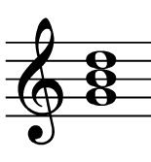
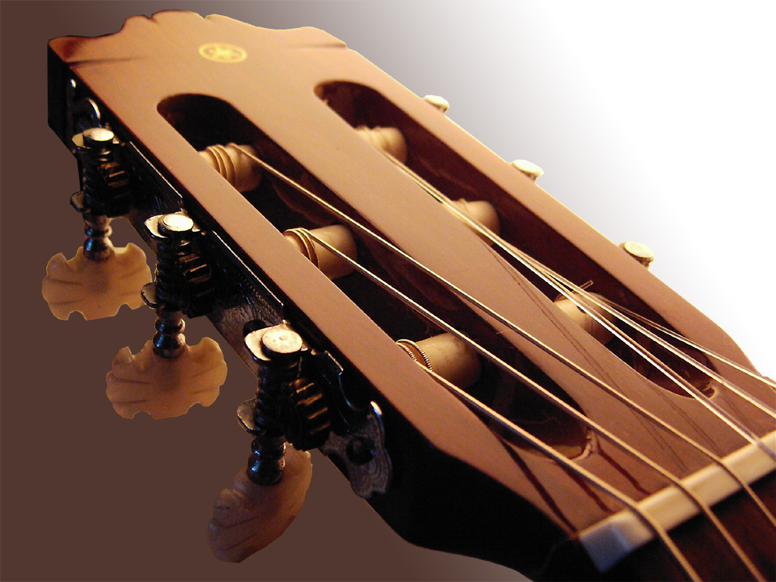
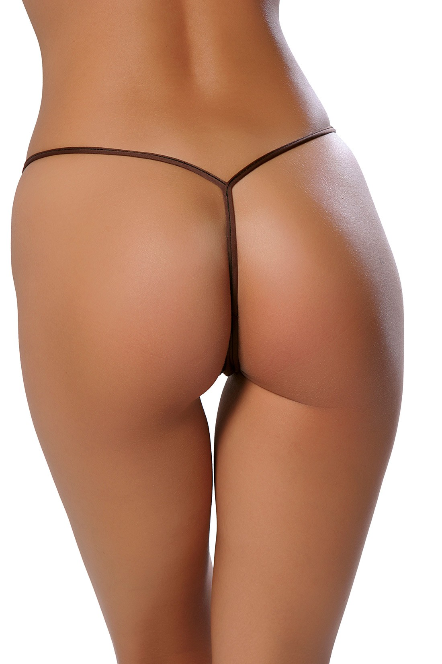
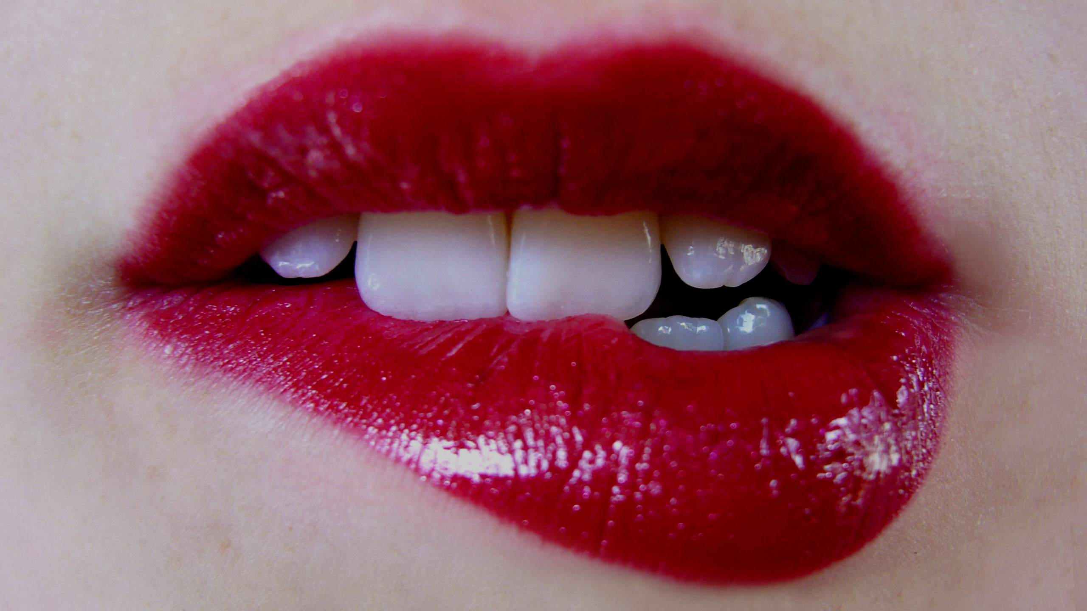
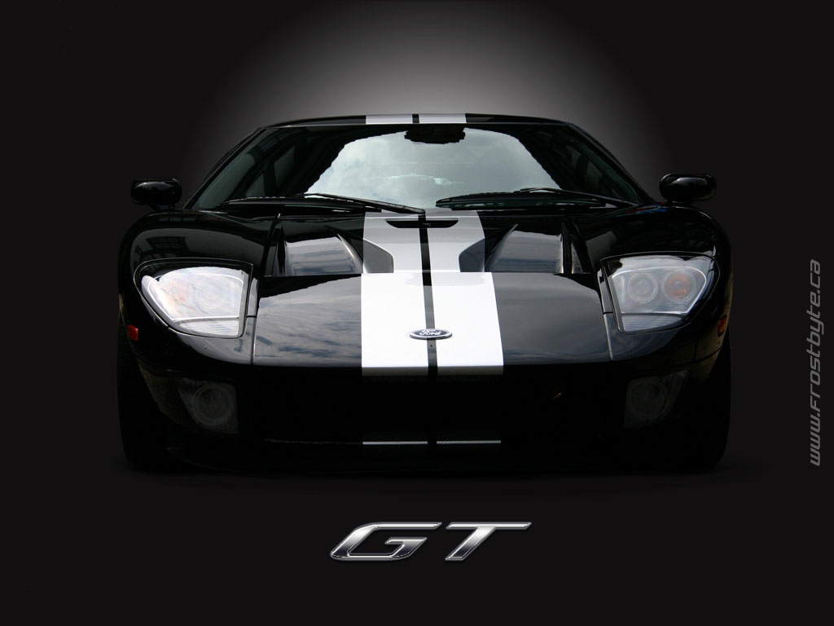
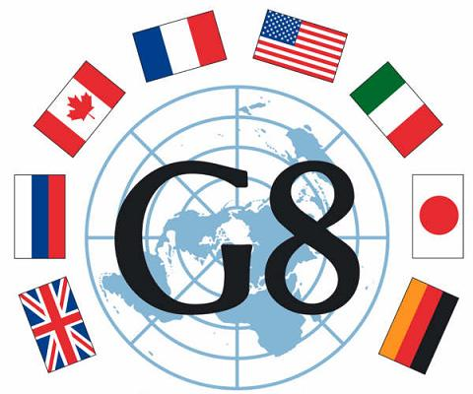

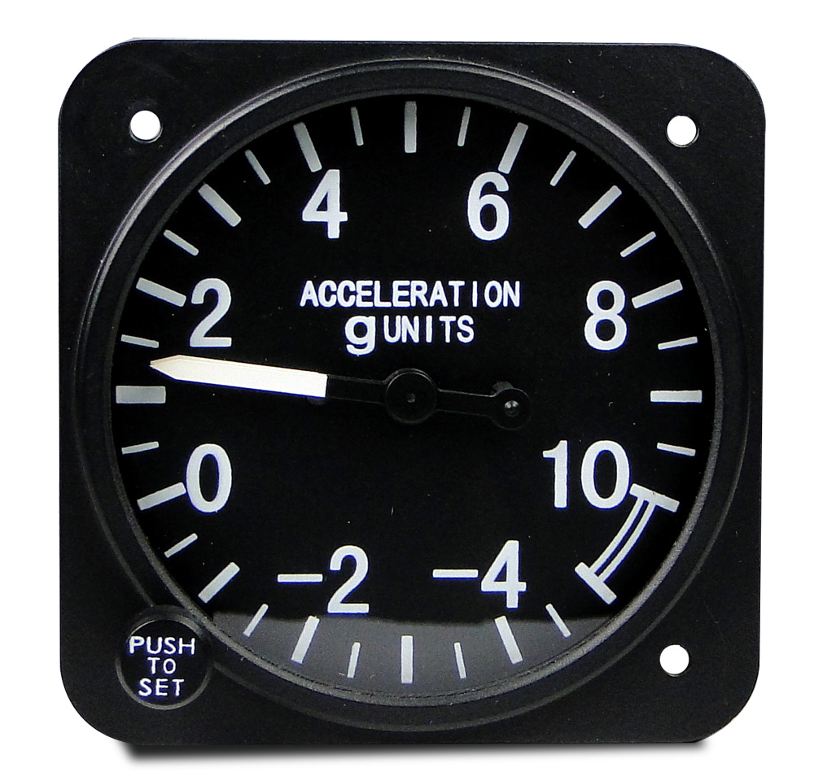
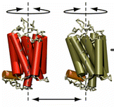

When all the g_’s
are not enough
Manuel N. Melo

Slide 2


Facts of MD data analysis
GROMACS has a vast array of analysis tools.
Users have even vaster arrays of analysis problems.
Design of custom analysis tools
Detect pore formation?
Quantify permeabilization?
Angle of a bond with z-axis?
Advanced structure alignment/clustering?

Slide 3
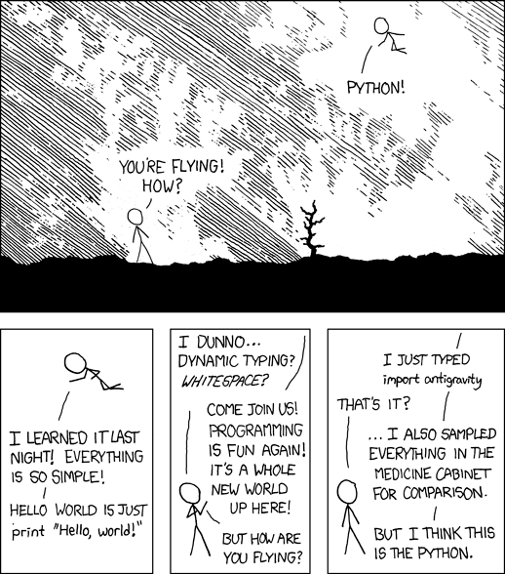
PYTHON
Geared towards readability and naturality.
“Good Python code reads like pseudocode”
“[With Python] it's very simple to do simple things”
Fully Object-Oriented
if you want it to be.
Most time spent writing useful code, instead of boilerplate.
SLOW

Slide 4
NUMPY
Python:
[ i*3 for i in list1 ]
Efficient data storage and manipulation (mostly n-dimensional arrays)
Python+NumPy:
3*array1
Array iteration and broadcasting implemented in C.
>20x faster on a 100 element list/array.
Efficient use requires a different approach to iteration.
Python:
for i,val in enumerate(list1):
if val > maxval:
list2[i] = maxval
else:
list2[i] = val
Multidimensional operations are extremely simple.
Python+NumPy:
array2 = numpy.where(array1 > maxval, maxval, array1)

Slide 5
MDAnalysis
Python package for reading MD trajectories and performing different analyses.
It does now!
“MDAnalysis exposes trajectory data transparently as NumPy arrays and as such it is easily extensible.”
Does not read .tpr files (no mass or connectivity information)
Can read several formats (GRO, TRR and XTC included)
BUT
grp = syst.selectAtoms("byres (name C2 and resname CHOL and around 10 name C4B)")
grp.coordinates()
grp.centerOfGeometry()
...
for frame in syst.trajectory:
a = grp.coordinates()
...

Slide 6
The best of all worlds: MDreader
Class inheriting from MDAnalysis and argparse
Automates and standardizes the very frequent tasks of asking for trajectory files, index files, and choosing output files.
If needed, all the flexibility of the parent classes is available.
STILL
Does not read .tpr files
(no mass or connectivity information)

Slide 7
Future development
Depends on your feedback
Solve the trajectory length problem
Parallelization? (seems easier to be implemented from the user side)

Slide 8
Big Thanks
Jan Domanski
Tsjerk Wassenaar

Slide 9
85
St
abilizing
85
St
erols
Manuel Nuno Melo

Slide 10
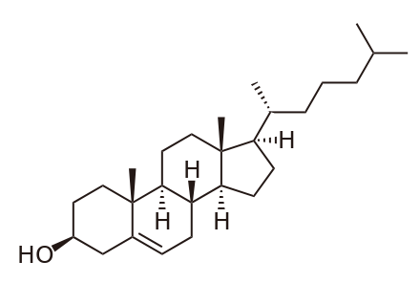
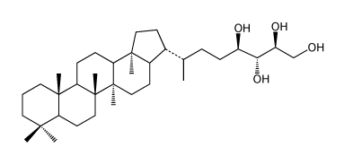
Hopanoids
bacteriohopanetetrol
cholesterol
Involved in different kinds of bacterial membrane adaptations
namely, robustness to ethanol accumulation.

Slide 11
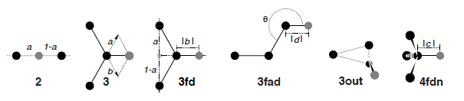
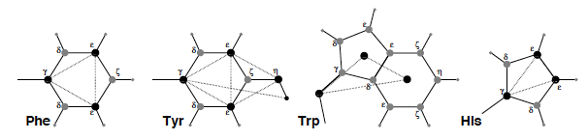
Virtual interaction sites

Slide 12
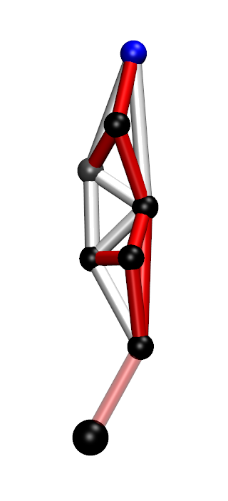
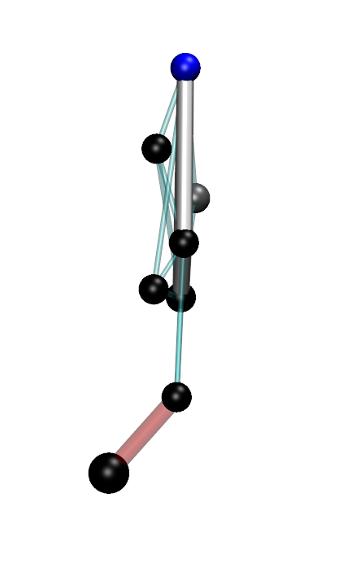
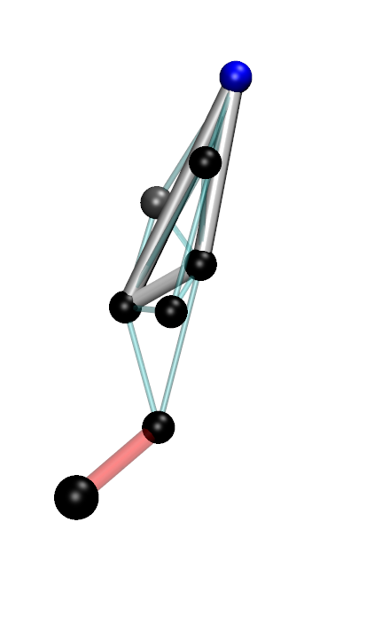
What I did
Chose three atoms for my frame
Obtained the average positions of the remaining four atoms relative to the frame
Defined those four atoms as different virtual sites

Slide 13
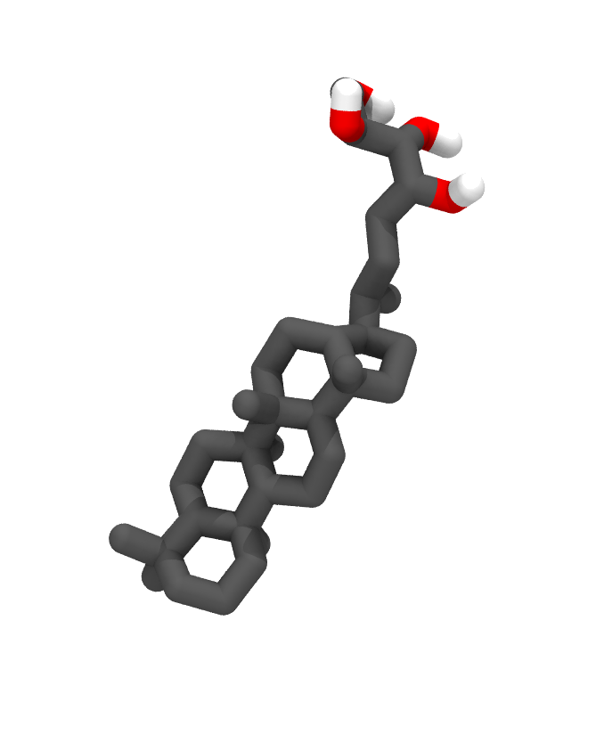
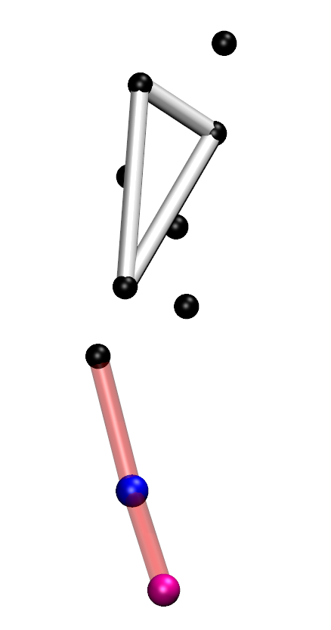
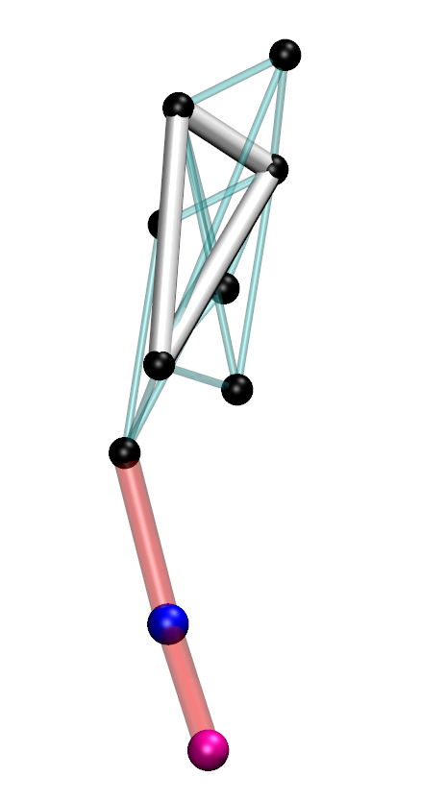
CG parameterization
Started from an existing atomistic topology
Chose a mapping scheme
and a frame for virtual sites
Constructed virtual sites from the average positions of a mapped atomistic simulation

Slide 14
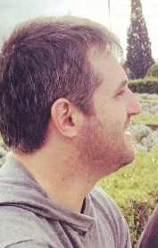
But then the French…
Yeah, cool. But my huge bilayer system with many cholesterol molecules still crashes at 40fs.

Slide 15
Hinge

Slide 16
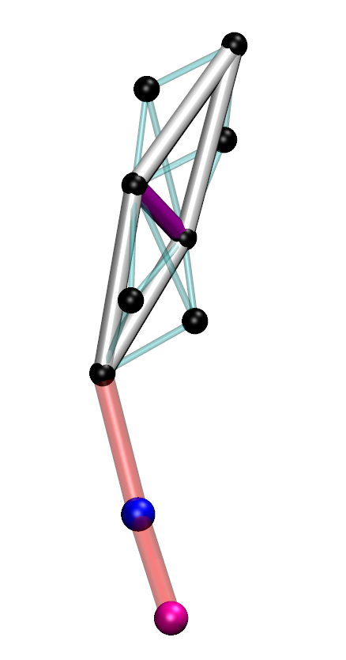
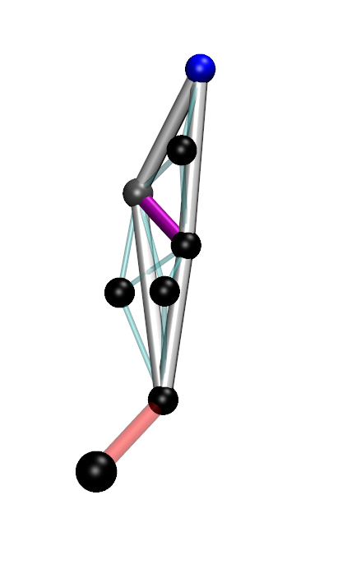
Is the bonded structure too rigid?
cholesterol
bacteriohopanetetrol

Slide 17
Cholesterol
Bacteriohopanetetrol
Stable topology with
Confirm/tune partitioning behavior
Fewer constraints
No stiff bonds
One dihedral potential (still softer than the ones in the original topology)
Should check if other important properties are preserved

Slide 18
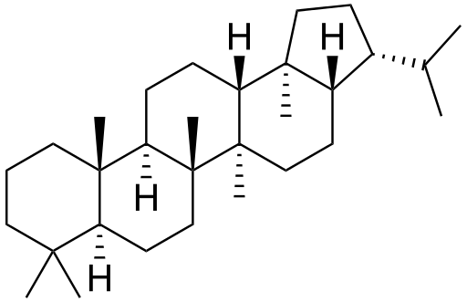
bacteriohopanetetrol
hopane
All C1/SC1 beads

Slide 19
ΔG_{HD→W}
GROMOS54A7 basis from bacteriohopanetetrol
Martini: 6 SC1 beads, 2 C1
MBAR 11 steps HD
21 steps W
MBAR 11 steps HD
11 steps W
 | ΔG_{HDsolv} | ΔG_{Wsolv} | ΔG_{HD→W}
GROMOS54A7 | -72.57 ± 0.11 | 5.56 ± 0.09 | 78.13 ± 0.20
Martini | -119.04 ± 0.55 | -4.58 ± 0.46 | 114.46 ± 1.01

Slide 20
 | ΔG_{HDsolv} | ΔG_{Wsolv} | ΔG_{HD→W}
GROMOS54A7 | -72.57 ± 0.11 | 5.56 ± 0.09 | 78.13 ± 0.20
Martini | -119.04 ± 0.55 | -4.58 ± 0.46 | 114.46 ± 1.01
7-bead | -99.33 ± 0.53 | 2.01 ± 0.43 | 101.34 ± 0.97
6-bead | -78.28 ± 0.47 | 11.73 ± 0.39 | 90.02 ± 0.86
0.7 scaling | -76.47 ± 0.54 | 14.72 ± 0.41 | 91.19 ± 0.94
0.5 scaling | -50.64 ± 0.41 | 27.19 ± 0.37 | 77.83 ± 0.78
Volume scaling | -65.59 ± 0.45 | 22.15 ± 0.40 | 87.74 ± 0.85

Slide 21
