Slide 1



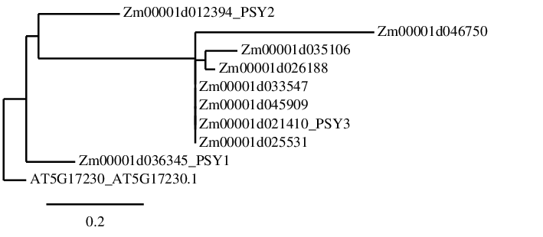
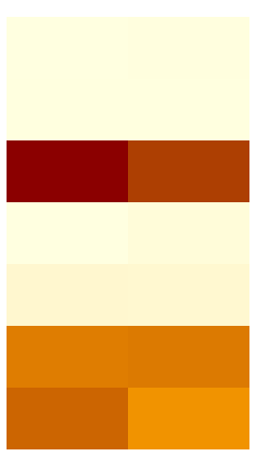
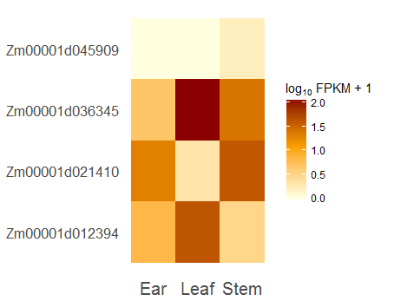
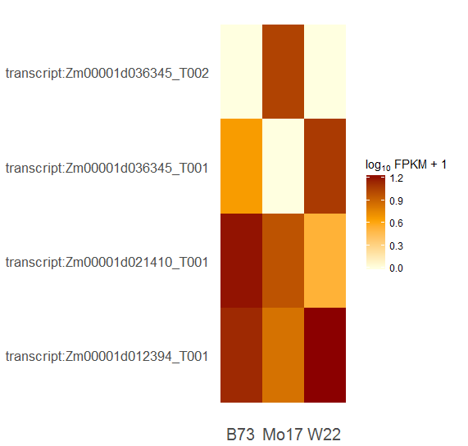

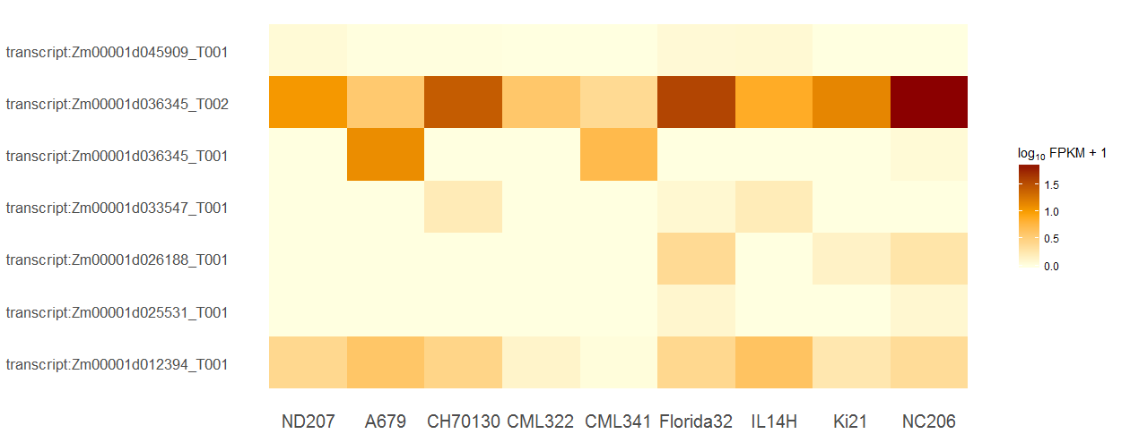
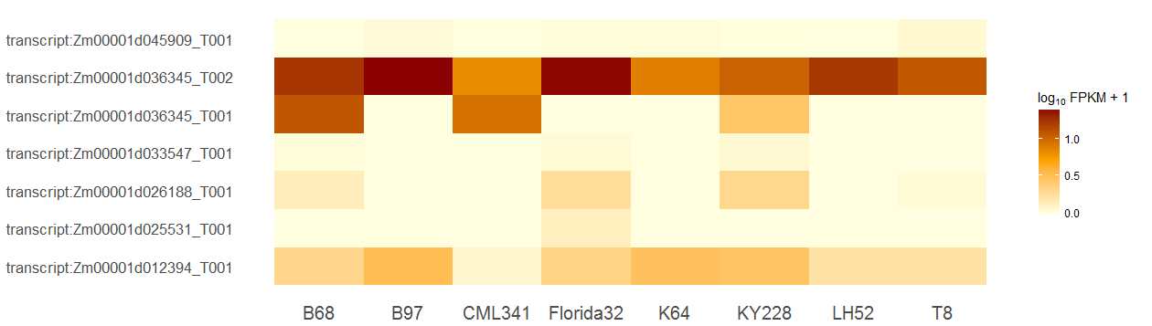
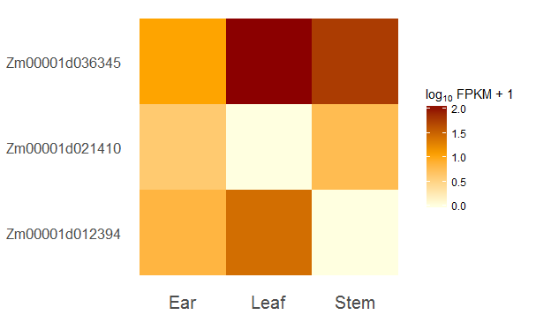
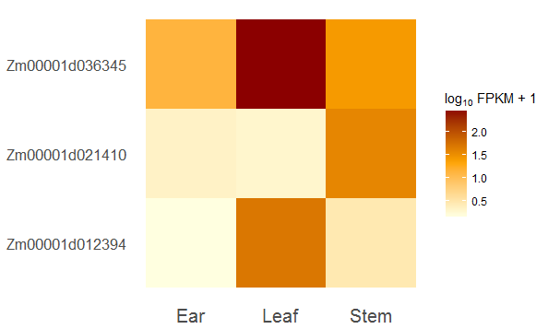
The Evolutionary History and Transcriptomic Analysis of The Phytoene Synthase Gene Family and Related Paralogs In Maize
Megan Neveau, Diane Janick-Buckner, Brent Buckner
Department of Biology, Truman State University, Kirksville, MO 63501
Abstract
Phylogenetic Tree and Protein Models
WT vs rgd378 (RNASeq)
In plants carotenoids are yellow-orange pigments that protect chlorophyll from photooxidation and serve as accessory light harvesting pigments. The phytoene synthase (psy) gene family encodes enzymes that catalyze the condensation of two molecules of geranylgeranyl pyrophosphate into phytoene, which is the first committed step in carotenoid biosynthesis. In maize, phytoene synthase is encoded by three subfunctionalized genes psy1, psy2 and psy3 that have been well characterized. The maize genome database identifies an additional 5 gene models as phytoene synthase. Our phylogenetic and bioinformatics analyses do not support annotating these 5 gene models as phytoene synthase. Using publicly available RNASeq data sets, we analyzed the expression of psy1, psy2 and psy3 as well as the other gene family members in various tissues and inbred maize lines. Significant differences in the expression of psy genes among the inbred lines and tissues were identified.
Zm00001d046750
Zm00001d045909
Zm00001d036345 (psy1)
Zm00001d033547
Zm00001d012394 (psy2)
Zm00001d026188
Zm00001d021410 (psy3)
0.98
0.72
RNA-seq analyses were performed using the Tuxedo workflow at CyVerse’s Discovery Environment (http://www.cyverse.org/discovery- environment) and the maize reference genome AGPv4. Genes names highlighted in red are statistically different in WT as compared to rgd378 (q < 0.05).
WT rgd378
Length (AA)
Shoot Apical Meristem (RNASeq)
Introduction
0 100 200 300 400 500 600 700 800 900
Zm00001d012394_PSY2
Zm00001d046750
VWCRRTDELVDGPNA
Active Site Lid
Zm00001d036345_PSY1_T1
Zm00001d036345_PSY1_T1
Zm00001d012394_PSY2
Zm00001d021410_PSY3
Carotenoid Pathway
The first step in the carotenoid pathway is the condensation of two Geranylgeranyl pyrophosphate (GGP) molecules by PSY to form phytoene (Nisar et. al). Four double bonds are introduced to phytoene to form tetra-cis-lycopene via two dehydrogenation reactions catalyzed by the enzymes phytoene desaturase (PDS) and ζ-carotene desaturase (ZDS) (). Lycopene can be cyclized by lycopene 𝛽-cyclase (𝛽-LCY) or lycopene ε-cyclase (ε-LCY) (). This is an essential step in generating carotenoid diversity. If two 𝛽-rings form, 𝛽-carotene and its derivatives can be produced and if one 𝛽-ring and one ε-ring form, α-carotene and its derivatives can be produced ().
Zm00001d035106
YCYYVACTVGLM
Substrate Binding Site
Geranylgeranyl pyrophosphate
OPP
Zm00001d026188
LALGIANQLTNILRDVGEDARRGR
Related Sequence
PSY
Zm00001d033547
LDEIEANDYNNFTKRAYVGKGKK
RNA-seq analyses were performed using the Tuxedo workflow at CyVerse’s Discovery Environment (http://www.cyverse.org/discovery- environment) and the maize reference genome AGPv4. Genes names highlighted in red are statistically different in WT as compared to rgd378 (q < 0.05).
15-cis-phytoene
Zm00001d045909
B73 Mo17 W22
ζ-carotene
Zm00001d021410_T_PSY1
α-carotene
Lycopene
β-carotene
Zm00001d036345_PSY1
Zm00001d025531
Lutein
Zeaxanthin
jlk
Violaxanthin
Arabidopsis AT5G17230.01
Neoxanthin
RNASeq Analysis Pipeline
Zeaxanthin and lutein, derivatives of 𝛽-carotene and α-carotene respectively, are xanthophylls, some of the main carotenoid pigments in plant photosystems. () 𝛽-carotene is converted to zeaxanthin via two hydroxylation reactions catalyzed by 𝛽-hydroxylase. The only difference in conversion of α-carotene to lutein is that one of the hydroxylation reactions is catalyzed by ε-hydroxylase. Further derivatives of the 𝛽-carotene branch are antheraxanthin and violaxanthin, formed from the hydroxylation of 𝛽-rings of zeaxanthin via Zeaxanthin epoxidase (ZEP), and neoxanthin, converted from violaxanthin via neoxanthin synthase (NXS) ().
C₄₀ carotenoids are cleaved into apocarotenoids via carotenoid cleavage dioxygenases (CCD) and epoxycarotenoid dioxygenases (NCED). This cleavage produces 2 phytohormones, strigolactones and abscisic acid, as well as various volatiles and scents ().
Read Alignment onto
Maize Reference Genome
Splice Site Discovery
Illumina
Sequencing
Bowtie/TopHat Alignment
Reads Assembled
into Transcripts
Generate Transcript
Reference
Differential Expression
RNA Sequencing Reads
(100 bp) .fastq files
Cufflinks
Cuffmerge
Cuffdiff
(compare RPKM)
Reference Genome
(.fa file)
Gene Annotation
(.gtf file)
CummeRbund
Inputs
Visualization
Inbred Lines (RNASeq)
Zm00001d045909
Zm00001d036345_PSY1_T2
ZM00001d036345_PSY1_T1
Zm00001d033547
Zm00001d026188
Zm00001d025531
Zm00001d012394_PSY2
Zm00001d045909
Zm00001d036345_PSY1_T2
ZM00001d036345_PSY1_T1
Zm00001d033547
Zm00001d026188
Zm00001d025531
Zm00001d012394_PSY2
ND207 A679 CH70130 CML322 CML341 Florida32 IL14H Ki21 NC206
B68 B97 CML341 Florida32 K64 KY228 LH52 T8
RNA-seq analyses were performed using the Tuxedo workflow at CyVerse’s Discovery Environment (http://www.cyverse.org/discovery- environment) and the maize reference genome AGPv4. Genes names highlighted in red are statistically different in B73 compared to Mo17 or W22 samples, or among root zones (q < 0.05).
Above Ground Tissue (RNASeq)
Zm00001d045909
Zm00001d036345_PSY1
Zm00001d021410_PSY3
Zm00001d012394_PSY2
Zm00001d036345_PSY1
Zm00001d021410_PSY3
Zm00001d012394_PSY2
Zm00001d036345_PSY1
Zm00001d021410_PSY3
Zm00001d012394_PSY2
Ear Leaf Stem
Ear Leaf Stem
Ear Leaf Stem
B73
Mo17
W22
RNA-seq analyses were performed using the Tuxedo workflow at CyVerse’s Discovery Environment (http://www.cyverse.org/discovery- environment) and the maize reference genome AGPv4. Genes names highlighted in red are statistically different in B73 compared to Mo17 or W22 samples, or among root zones (q < 0.05).

Slide 2
CuffDiff2_WT_vs_rgd378_AGPv4
Zm00001d036345
Zm00001d012394
Zm00001d021410
Zm00001d025531
Zm00001d033547
Zm00001d026188
Zm00001d046750
Zm00001d035106
Zm00001d035881

Slide 3
CuffDiff2_W22_Ear_Leaf_Stem_AGPv4
Zm00001d036345
Zm00001d012394
Zm00001d021410
Zm00001d025531
Zm00001d033547
Zm00001d026188
Zm00001d046750
Zm00001d035106
Zm00001d035881

Slide 4
CuffDiff2_Mo17_Root_Zones_AGPv4
Zm00001d036345 (MZ:Stele)
Zm00001d012394
Zm00001d021410 (Cortex:Stele, Cortex: MZ)
Zm00001d025531
Zm00001d033547
Zm00001d026188
Zm00001d046750
Zm00001d035106
Zm00001d035881

Slide 5
CuffDiff2_Mo17_Ear_Leaf_Stem_AGPv4
Zm00001d036345 (MZ:Stele)
Zm00001d012394
Zm00001d021410 (Cortex:Stele, Cortex: MZ)
Zm00001d025531
Zm00001d033547
Zm00001d026188
Zm00001d046750
Zm00001d035106
Zm00001d035881

