Slide 1



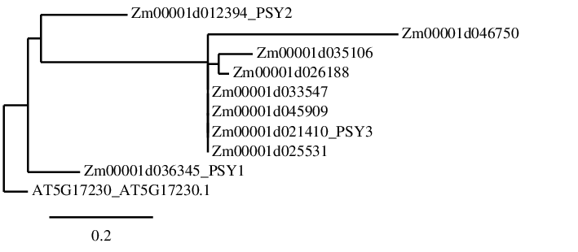
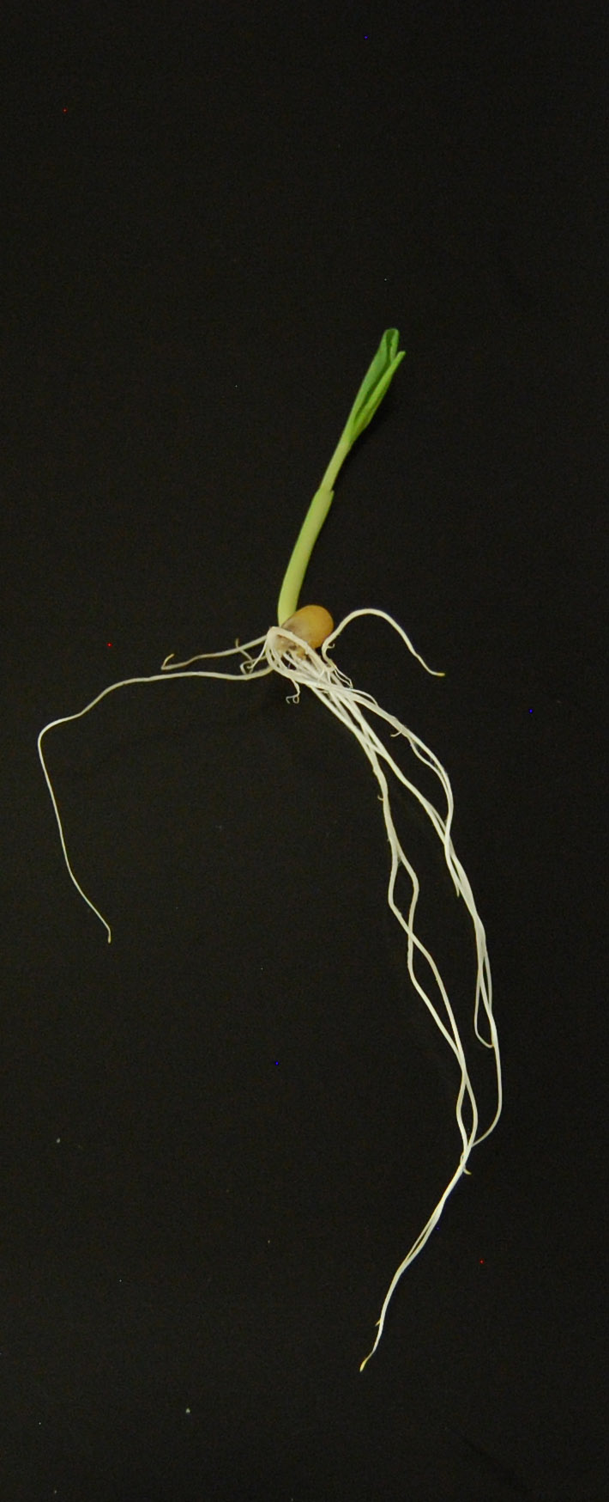
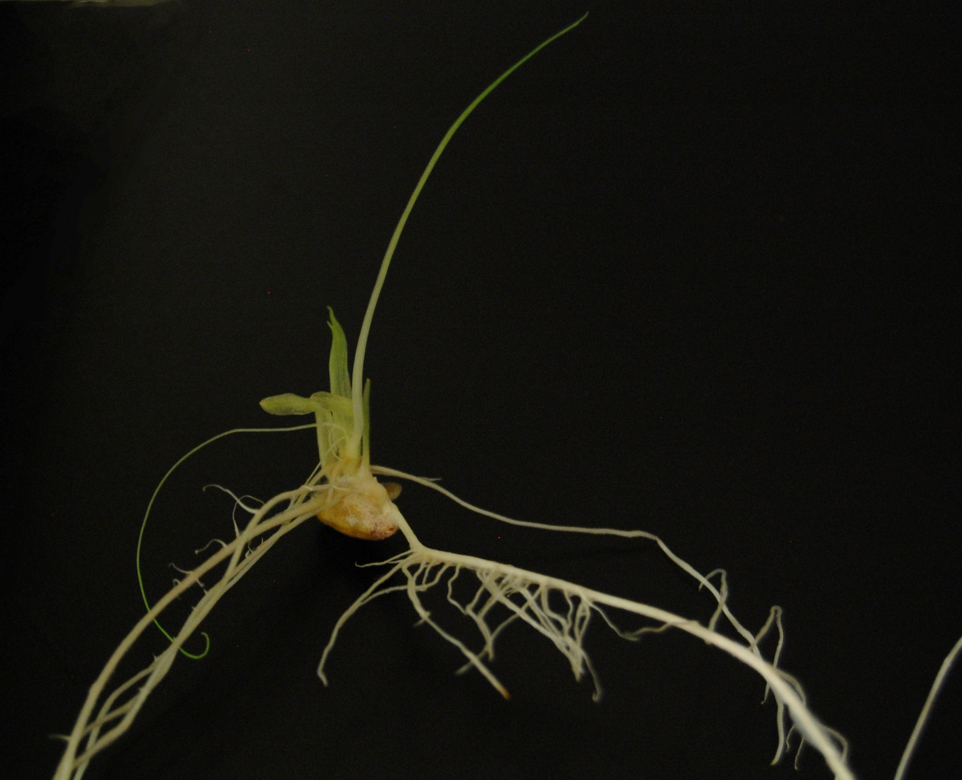
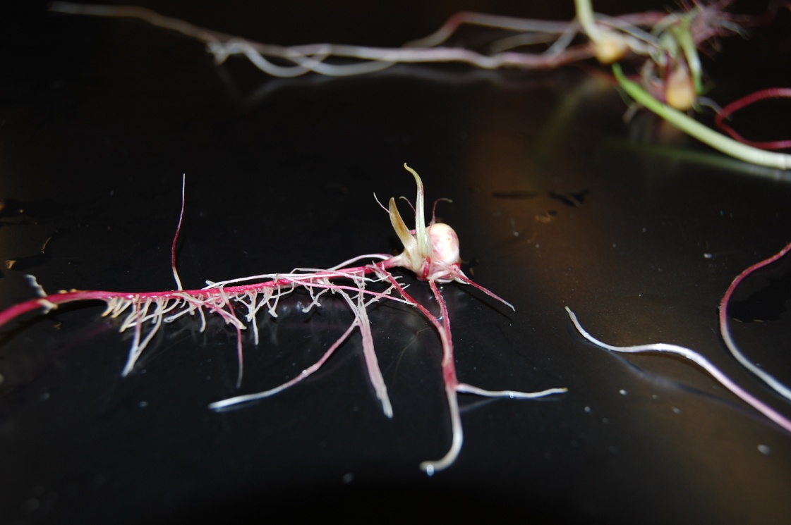
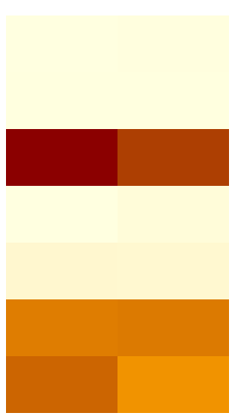
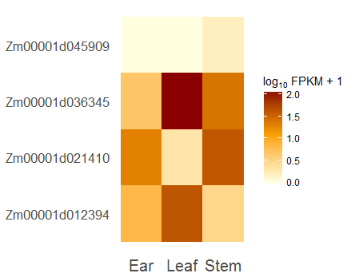
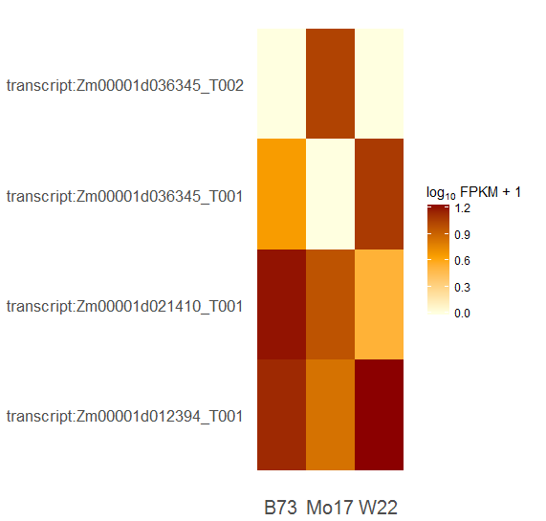

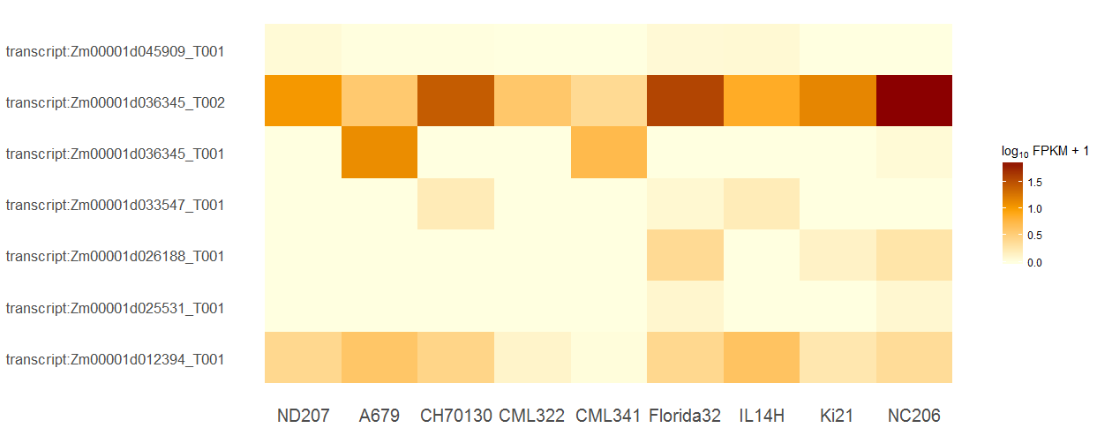
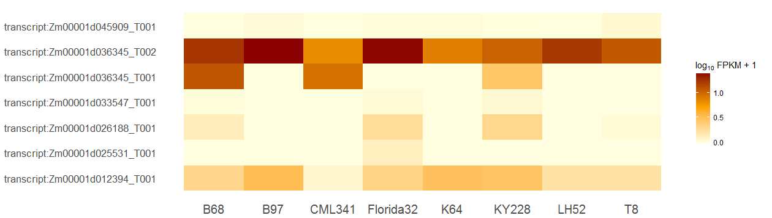
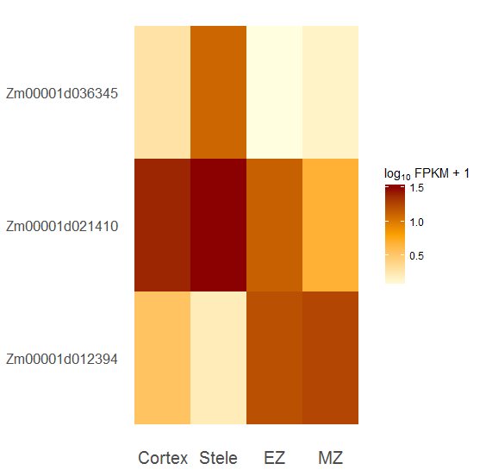
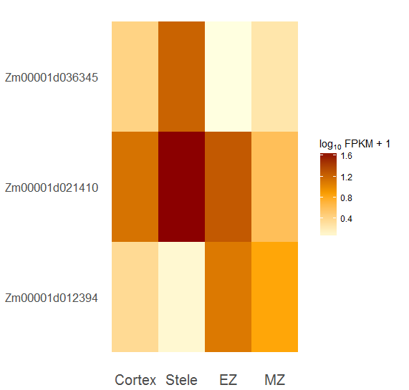
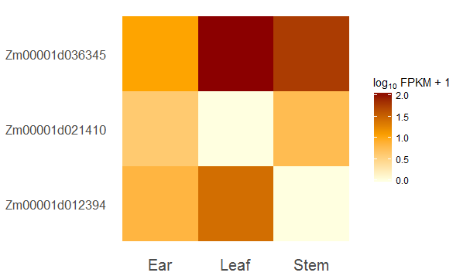
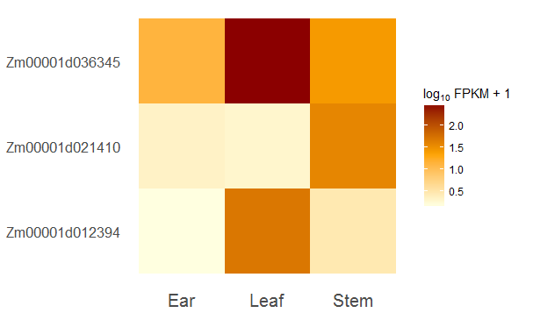
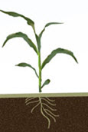
The Evolutionary History and Transcriptomic Analysis of The Phytoene Synthase Gene Family and Related Paralogs In Maize
Megan Neveau, Diane Janick-Buckner, Brent Buckner
Department of Biology, Truman State University, Kirksville, MO 63501
Abstract
Phylogenetic Tree and Protein Models
WT vs rgd378 (RNASeq)
In plants carotenoids are yellow-orange pigments that protect chlorophyll from photooxidation and serve as accessory light harvesting pigments. The phytoene synthase (psy) gene family encodes enzymes that catalyze the condensation of two molecules of geranylgeranyl pyrophosphate into phytoene, which is the first committed step in carotenoid biosynthesis. In maize, phytoene synthase is encoded by three subfunctionalized genes psy1, psy2 and psy3 that have been well characterized. The maize genome database identifies an additional 5 gene models as phytoene synthase. Our phylogenetic and bioinformatics analyses do not support annotating these 5 gene models as phytoene synthase. Using publicly available RNASeq data sets, we analyzed the expression of psy1, psy2 and psy3 as well as the other gene family members in various tissues and inbred maize lines. Significant differences in the expression of psy genes among the inbred lines and tissues were identified.
0.98
0.72
rgd-378 14 Day Plants
Wild-type 14 Day Plant
The EMS-induced maize mutant raggedseedling378 (rgd378) exhibits a variable and quite severe phenotype. Mutant plants have small filamentous leaves and a split coleoptile, or produce no shoot at all. rgd378 plants are highly susceptible to fungal infection and must be grown on germination paper under aseptic conditions.
Zm00001d046750
Zm00001d045909
Zm00001d036345 (psy1)
Zm00001d033547
Zm00001d012394 (psy2)
Zm00001d026188
Zm00001d021410 (psy3)
Length (AA)
RNA-seq analyses were performed using the Tuxedo workflow at CyVerse’s Discovery Environment (http://www.cyverse.org/discovery- environment) and the maize reference genome AGPv4. Genes names highlighted in red are statistically different in WT as compared to rgd378 (q < 0.05).
Introduction
0 100 200 300 400 500 600 700 800 900
Zm00001d012394_PSY2
Zm00001d046750
VWCRRTDELVDGPNA
Active Site Lid
WT rgd378
Carotenoid Pathway
Carotenoids are among of the most abundant pigments found in nature and play important roles in both plants and animals. In addition to their role as accessory light harvesting pigments, carotenoids are structural components of both the antenna complex and reaction center of photosystems. Carotenoids are efficient quenchers of singlet oxygen, as well as other reactive oxygen species, that are generated during the process of photosynthesis (Tripathy and Oelmüller 2012).
Zm00001d035106
YCYYVACTVGLM
Substrate Binding Site
2 Geranylgeranyl pyrophosphate
OPP
Zm00001d026188
LALGIANQLTNILRDVGEDARRGR
Related Sequence
Shoot Apical Meristem (RNASeq)
PSY
Zm00001d033547
LDEIEANDYNNFTKRAYVGKGKK
15-cis-phytoene
PDS
Zm00001d045909
Zm00001d036345_PSY1_T1
Zm00001d036345_PSY1_T1
Zm00001d012394_PSY2
Zm00001d021410_PSY3
9,15-cis-phytofluene
Zm00001d021410_T_PSY1
PDS
Plants were grown under standard conditions with 10-hr day cycles in Percival A100 growth chambers. Plants were harvested 14 days after planting and quickly trimmed to small SAM-containing cassettes and fixed in FAA on ice, overnight. RNA was extracted from SAM-enriched apices (SRP055871, Leiboff et. al 2015)
9,15,9’ –tri-cis-ζ-carotene
Zm00001d025531
ZISO
9,9’ –di-cis-ζ-carotene
ZDS
Zm00001d036345_PSY1
7,9,9’-tri-cis-neurosporene
jlk
ZDS
Arabidopsis AT5G17230.01
7,9,7’,9’-tetra-cis-lycopene
CRTISO
All-trans-lycopene
LYCE
LYCB
B73 Mo17 W22
δ-carotene
γ-carotene
LYCB
LYCB
RNA-seq analyses were performed using the Tuxedo workflow at CyVerse’s Discovery Environment (http://www.cyverse.org/discovery- environment) and the maize reference genome AGPv4. Genes names highlighted in red are statistically different between the three inbred lines(q < 0.05).
HYDB
α-carotene
CYP97C
β-carotene
RNASeq Analysis Pipeline
Zeinoxanthin
α -cryptoaxnthin
HYDB
CYP97C
β -cryptoaxnthin
Lutein
HYDB
HYDB
Lutein
Zeaxanthin
Read Alignment onto
Maize Reference Genome
Splice Site Discovery
Root Zones (RNASeq)
VDE
ZEP
Illumina
Sequencing
Reads Assembled
into Transcripts
Generate Transcript
Reference
Antheraxanthin
Differential Expression
VDE
ZEP
RNA Sequencing Reads .fastq files
Bowtie/TopHat Alignment
Cufflinks
Cuffmerge
Cuffdiff
(compare RPKM)
Violaxanthin
The plant hormones abscisic acid and strigolactones, which modulate developmental and stress processes, are derived from carotenoid precursors (Al-Babili and Bouwmeester et al. 2015; Hou et al. 2016; Vishwakarma et al. 2017; Zwanenburg et al. 2016).
The first step in the carotenoid pathway is the condensation of two geranylgeranyl pyrophosphate (GGP) molecules by phytoene synthase (PSY) to form phytoene (Figure 1) (Nisar et al. 2015). Since the formation of phytoene by PSY is the first committed step in the synthesis of carotenoids, the regulation of its gene expression is key due to its activity providing the starting material for the production of subsequent carotenoids and apocaroteinoids. Factors that influence psy gene expression include stage of development, ABA levels, light, salt, drought, temperature and photoperiod. In maize, PSY is encoded by three subfunctionalized genes psy1, psy2 and psy3 (Buckner et al. 1996; Li et al., 2008; Li et al. 2009). psy1 expression significantly increases during maize endosperm development and is correlated with the accumulation of carotenoids in endosperm tissue (Li et al. 2009). Conversely, psy3 expression in maize roots is influenced by ABA in a positive feedback loop, which results in increased carotenoid synthesis and ABA production under drought and salt stress conditions (Li et al., 2008).
The purpose of this study was to characterize the psy gene family in maize and to analyze the expression of psy1, psy2 and psy3 as well as the other gene family members in various tissues and inbred maize lines.
Root Hair
Zone
Cortex
Primary roots of 5 day old B73 and Mo17 seedlings were dissected into four separate root tissues. The bottom 3 mm included the meristematic zone (MZ) and root cap. The elongation zone (EZ) included the area in between the MZ and the root hair zone. Cortex and stele tissues were dissected from the root hair zone and analyzed separately. Dissected tissue from 14 roots was pooled for each of the four biological replicates for each inbred line (SRA100745; Paschold et al. 2014).
Reference Genome
(.fa file)
+
+
Gene Annotation
(.gtf file)
CummeRbund
Elongation
Zone (EZ)
Stele
Inputs
Visualization
Meristematic
Zone (MZ)
14 Day Apex (RNASeq)
Zm00001d045909
Zm00001d036345_PSY1_T2
ZM00001d036345_PSY1_T1
Zm00001d033547
Zm00001d026188
Zm00001d025531
Zm00001d012394_PSY2
Zm00001d045909
Zm00001d036345_PSY1_T2
ZM00001d036345_PSY1_T1
Zm00001d033547
Zm00001d026188
Zm00001d025531
Zm00001d012394_PSY2
Zm00001d036345_PSY1
Zm00001d012394_PSY2
Zm00001d021410_PSY3
Zm00001d036345_PSY1
Zm00001d012394_PSY2
Zm00001d021410_PSY3
Cortex Stele EZ MZ
Cortex Stele EZ MZ
B73
Mo17
ND207 A679 CH70130 CML322 CML341 Florida32 IL14H Ki21 NC206
B68 B97 CML341 Florida32 K64 KY228 LH52 T8
RNA-seq analyses were performed using the Tuxedo workflow at CyVerse’s Discovery Environment (http://www.cyverse.org/discovery- environment) and the maize reference genome AGPv4. Genes names highlighted in red are statistically different among root zones (q < 0.05).
RNA-seq analyses were performed using the Tuxedo workflow at CyVerse’s Discovery Environment (http://www.cyverse.org/discovery- environment) and the maize reference genome AGPv4. Genes names highlighted in red are statistically different among inbred lines (q < 0.05).
Above Ground Tissue (RNASeq)
Summary
Zm00001d045909
Zm00001d036345_PSY1
Zm00001d021410_PSY3
Zm00001d012394_PSY2
Zm00001d036345_PSY1
Zm00001d021410_PSY3
Zm00001d012394_PSY2
Zm00001d036345_PSY1
Zm00001d021410_PSY3
Zm00001d012394_PSY2
References
Ear Leaf Stem
Ear Leaf Stem
Ear Leaf Stem
Al-Babili S, Bouwmeester HJ. (2015) Annual Review of Plant Biology. 66: 161-186 Buckner et. al (1996) Genetics. 143: 479-88. Hou et al. (2016) Trends Plant Sci. 21: 792-803. Li et al. (2009) Plant Signal Behav. 4: 208–211. Li et al. (2008) Plant Physiol. 147: 1334–1346. Nisar et al. (2015). Molecular Plant. 8: 68-82.
Narendra T. (2007) Plant Signal Behav. 2: 135–138. Tripathy BC, Oelmüller R. (2012) Plant Signal Behav. 7: 1621-33. Zwanenburg et al. (2016) Planta. 243: 1311-26. Vishwakarma et al.(2017) Front Plant Sci. 2017; 8: 161. Li et al. (2009) Plant Signal Behav. 4: 208–211. Li et al. (2008) Plant Physiol. 147: 1334–1346. Zwanenburg et al. (2016) Planta. 243: 1311-26.
B73
Mo17
W22
Maize plants were grown for up to 6 weeks with a 12 hour dark light cycle in a growth chamber, then transplanted to the field. Both leaf and stem (including the shoot apical meristem) were collected at the v4 leaf stage. Ears that weighed between 50 and 100 milligrams were included in the analysis. Tissue from fifteen plants were pooled for each biological sample and two biological replicates were prepared per inbred line (SRX710894-711341; Lemmon et al., 2014).
RNA-seq analyses were performed using the Tuxedo workflow at CyVerse’s Discovery Environment (http://www.cyverse.org/discovery- environment) and the maize reference genome AGPv4. Genes names highlighted in red are statistically different among above ground tissues(q < 0.05).
Image from: https://www.pioneer.com/home/site/us/agronomy/library/n-uptake-corn/

