Slide 1

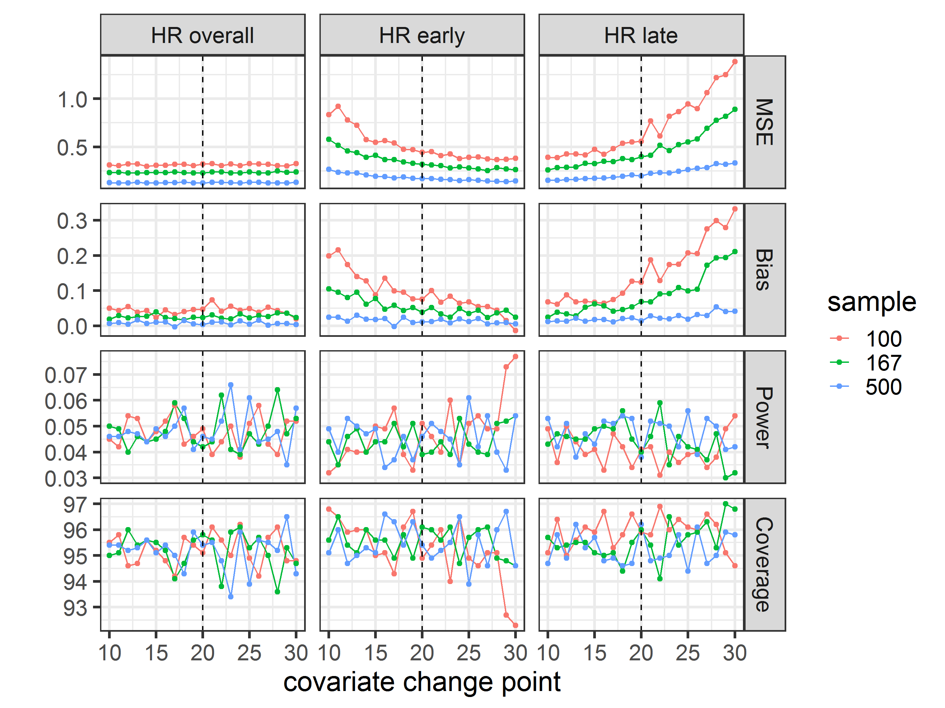
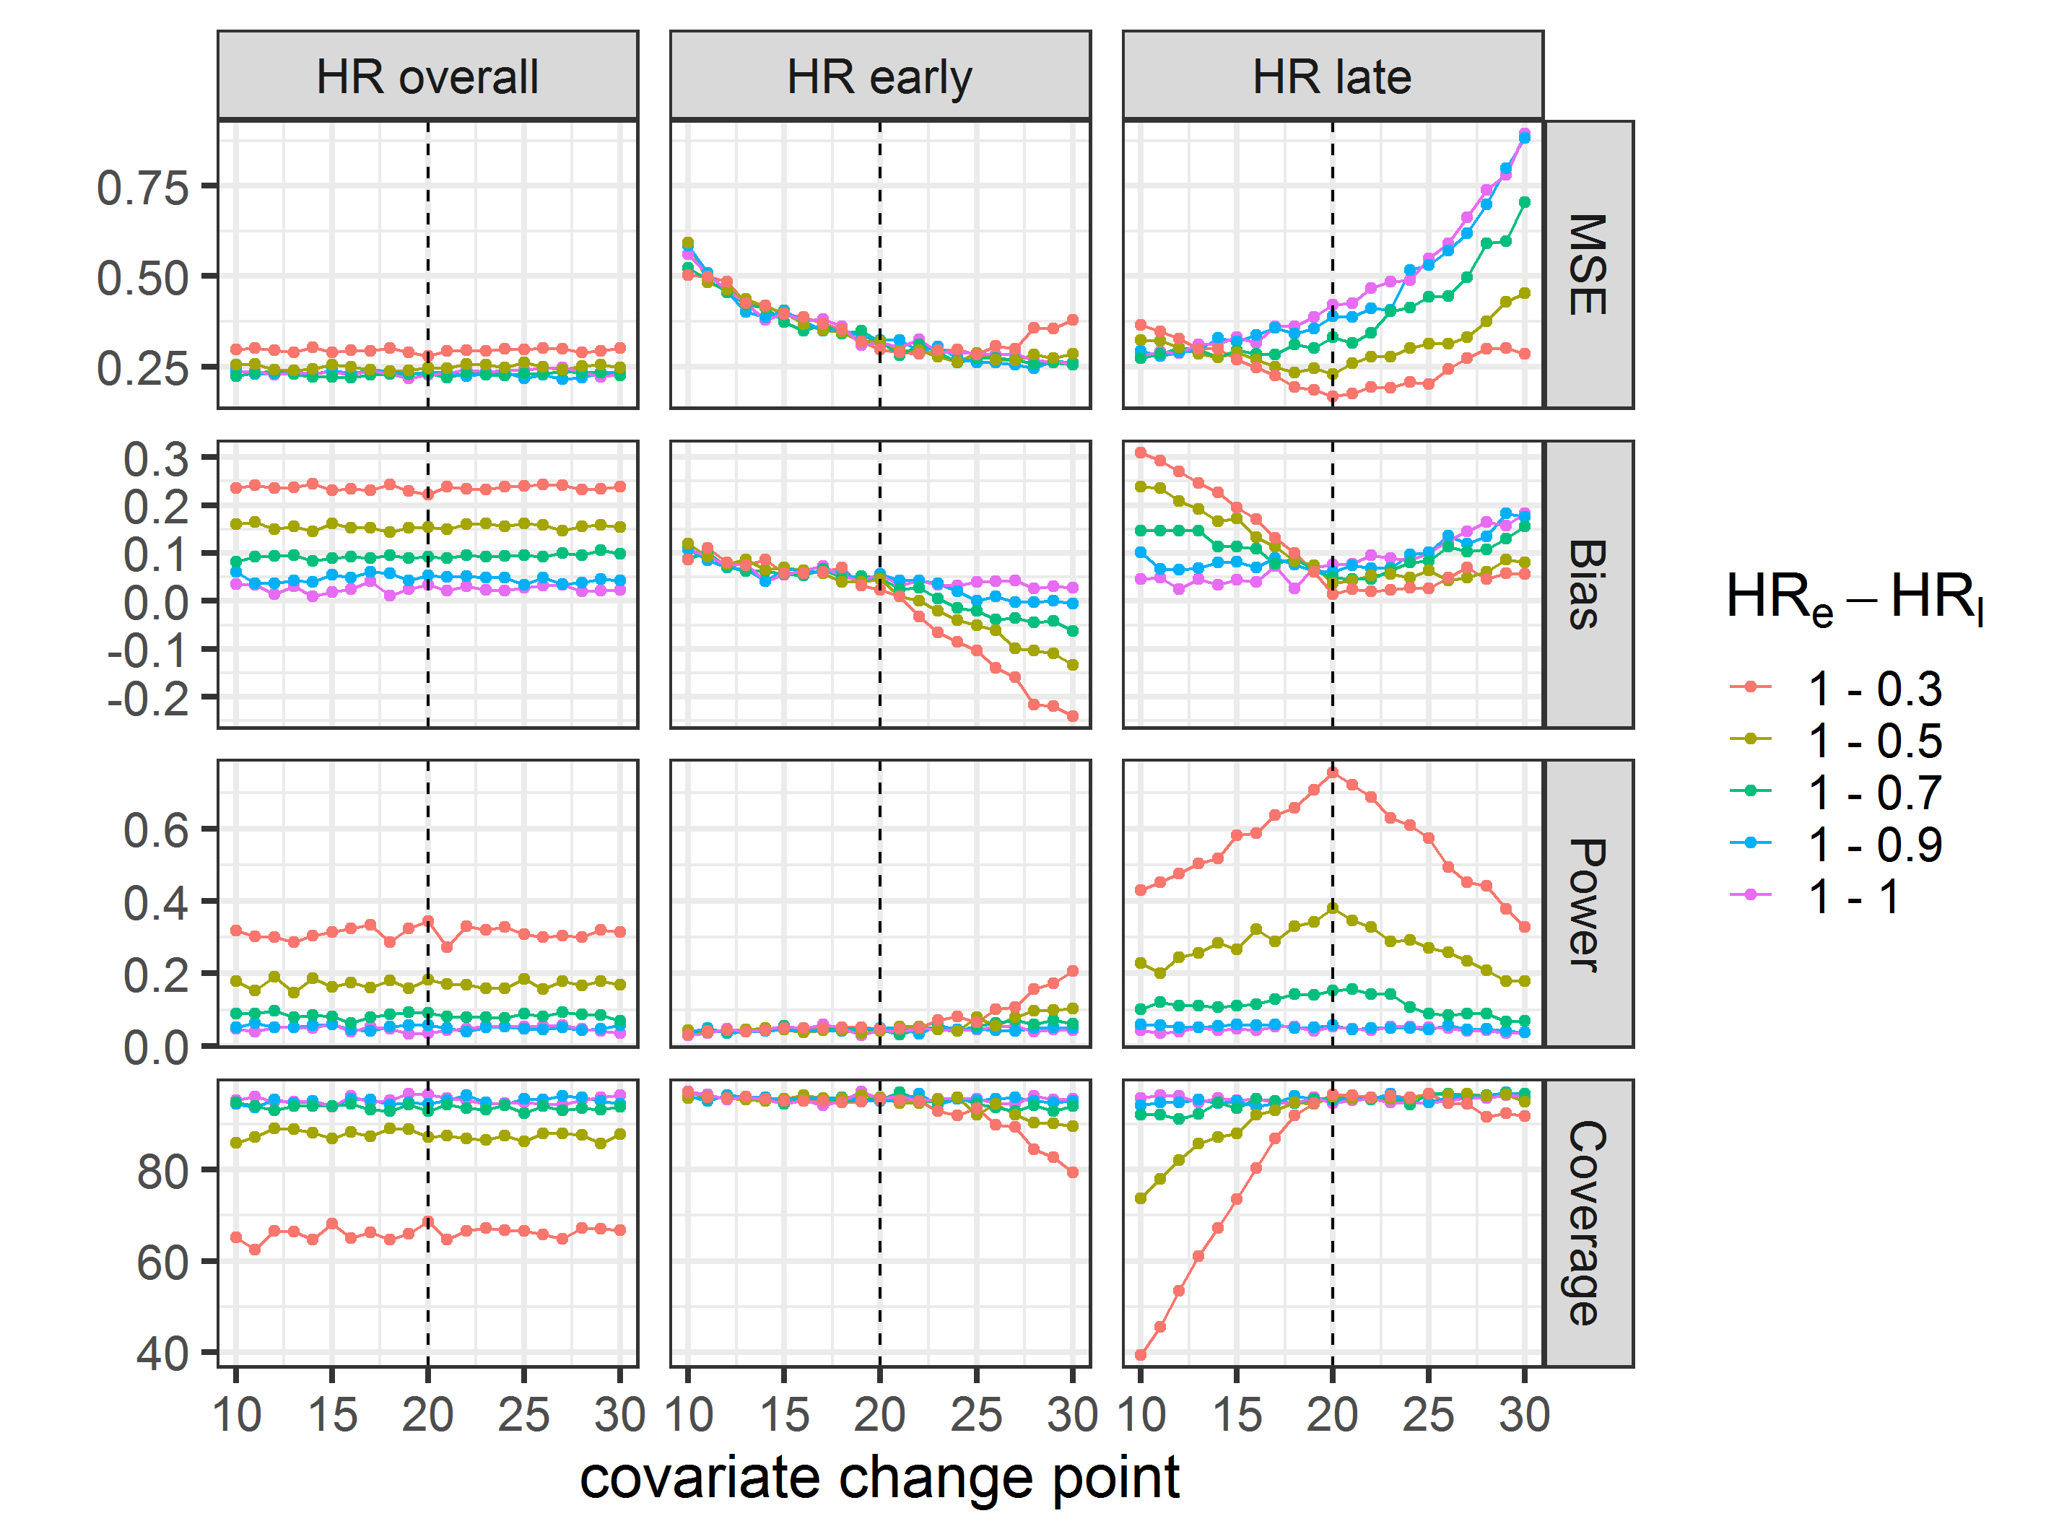
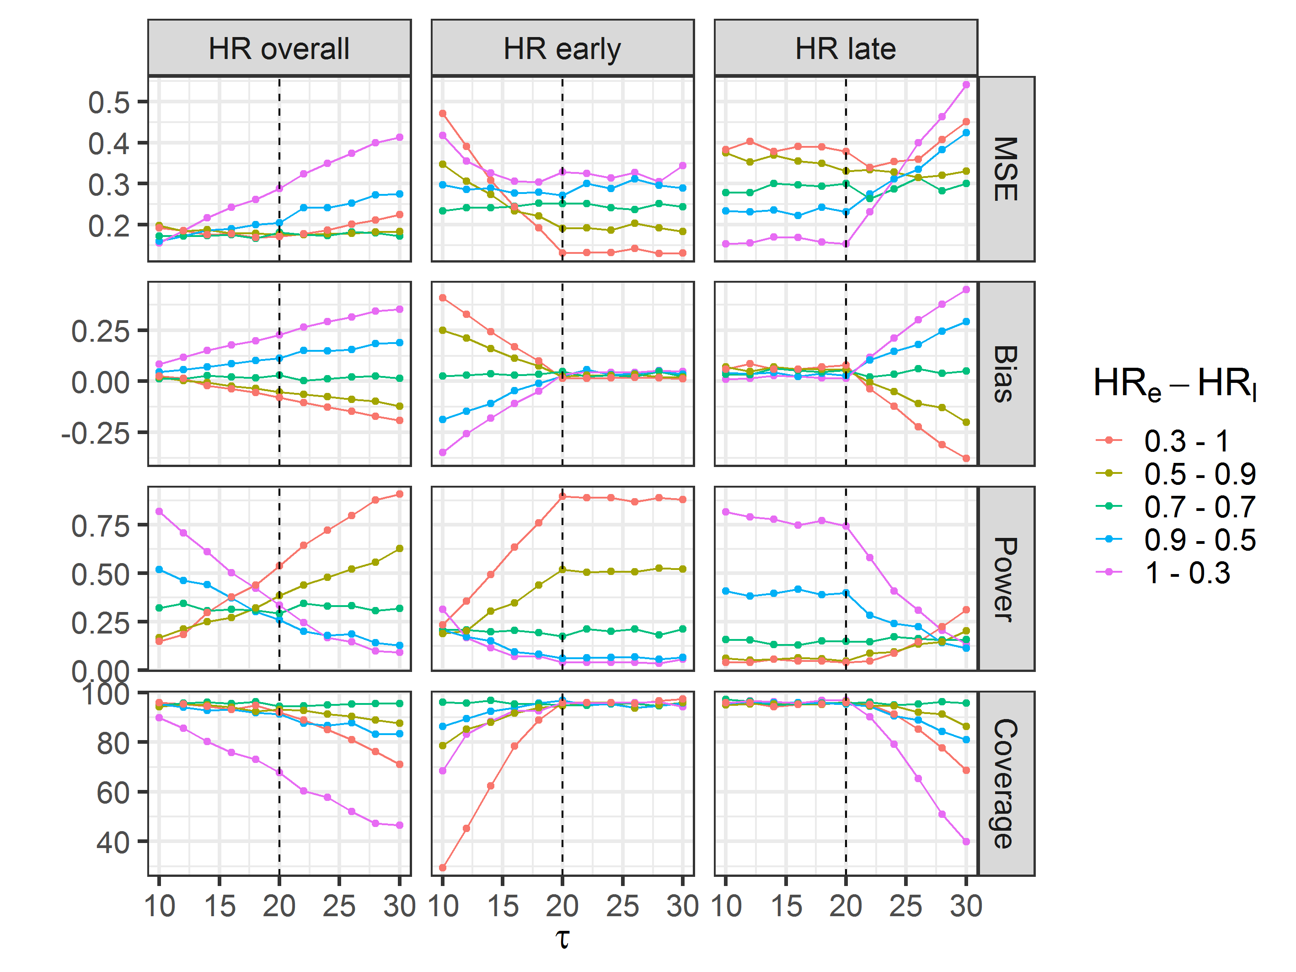





SIMULATIONS
Statistical Analysis
Using a time-varying covariate
in the Cox proportional hazards model discerns early/late treatment efficacy. Use with caution.
Use of time-varying covariate in assessing disease remission in the early and late phases of treatment with application to RITAZAREM trial.
Marianna Nodale
BACKGROUND
RITAZAREM, an open-label, multi-centre RCT, aims to assess the efficacy of rituximab compared to the current standard of care in the prevention of relapse in ANCA-associated vasculitis.
Design: N = 170 patients, 1:1 allocation, 90% power at α = 5% for HR = 0.42.
Outcome: time to disease relapse.
Primary analysis: Cox proportional hazard model for overall efficacy & time-varying covariate to investigate during/post treatment efficacy.
RESULTS
Simulations (n=1000) investigate the operational characteristics of the model under a variety of assumptions:
Null hypothesis
Constant overall efficacy
Early efficacy
Late efficacy
Different early/late efficacy
Wrong change point τ
A
C
METHODS
Censoring and relapse times simulated with a Weibull distribution (sample N = 167, 83 events).
Simulated HR_{early} ≠ HR_{late} ∈ (0.3-0.9)
True change point for HR τ = 20.
Relapse times after change point simulated with a conditional Weibull distribution.
DISCUSSION
First point
Second point
Third point
F
Take a picture
to download
the full paper
NHS Foundation Trust

Slide 2
SIMULATIONS
Statistical Analysis
Main finding goes here, translated into plain English. Emphasize the important words.
Use of time-varying covariate in assessing disease remission in the early and late phases of treatment with application to RITAZAREM trial.
AMMO BAR
Delete this and replace it with your…
Extra Graphs
Extra Correlation tables
Extra Figures
Extra nuance that you’re worried about leaving out.
Keep it messy! This section is just for you.
Marianna Nodale
BACKGROUND
Just give context for the gap you’re filling
You’re not going to get yelled at if you don’t cite the 5 papers from 1937 that defined this construct. They’ll download your paper if they want that.
METHODS
N = ###,
Collected this
Tested with X statistical test
RESULTS
Graph or table with essential results only.
All the other correlations in the ammo bar.
DISCUSSION
“If this result actually generalized and I didn’t have to humbly disclaim the possibility of a thousand confounds and limitations, it would imply that….”
Take a picture
to download
the full paper
NHS Foundation Trust

