Slide 1
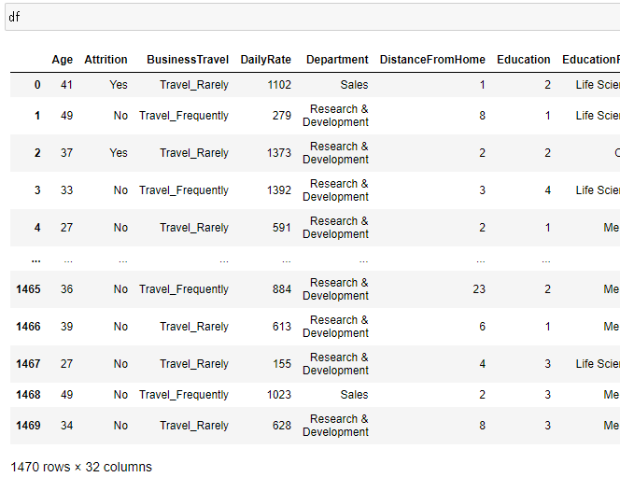
Jupyter Notebook で確認

Slide 2
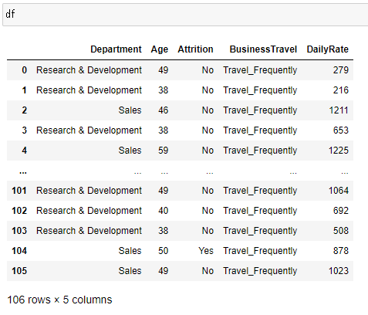
Jupyter Notebook で確認

