Slide 1
ShiftOne - Factory Shift Manager
A Web-Based Attendance & Shift Tracking System for Factory Workers
Presented by: MANOJKUMAR
Date: 31-03-26

Slide 2
What is ShiftOne?
ShiftOne is a full-stack web application built to digitize and streamline factory attendance and shift tracking. It replaces manual logbooks with a secure, role-based platform where workers sign in and sign off, supervisors monitor attendance, and admins manage the users efficiently.

Slide 3
Technologies Used
Layer
Technology
Frontend
Angular 19, TypeScript
Backend API
ASP.NET Core (.NET 8), C#
OCR Service
Python, FastAPI, PaddleOCR
Database
Microsoft SQL Server
Authentication
JWT Access Tokens + Refresh Tokens
Architecture
Clean Architecture (Domain, Application, Infrastructure, API)

Slide 4
How It All Connects
The system's core components are designed for robust and efficient operation, following a Clean Architecture approach with clear separation into Domain, Application, Infrastructure, and API layers.
Angular Frontend: Communicates with the backend via RESTful APIs.
ASP.NET Core Backend: Handles business logic, authentication, and data access through stored procedures.
Python OCR Microservice: Extracts employee details (name, email, phone, role) from scanned registration forms.
SQL Server Database: Stores user profiles, attendance records, and authentication tokens.

Slide 5
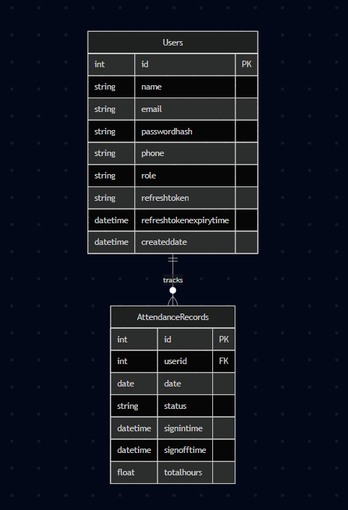
Database Design
Users Table
Stores employee profile: ID, Name, Email, Password Hash, Phone, Role
Supports refresh token storage for session management
Attendance Records Table
Tracks: User ID, Date, Status, Sign-In Time, Sign-Off Time, Total Hours
Foreign key relationship with Users table
Unique constraint prevents duplicate records per user per day
Stored Procedures
All database operations use stored procedures for security and performance
Examples: sp_add_attendance, sp_get_active_shift, sp_get_today_attendance_summary, sp_get_monthly_records

Slide 6
Worker Dashboard
Shift Start (Sign-In)
Worker clicks "Sign In" to record the start of their shift.
The system captures the worker's GPS location and verifies they are within the allowed factory radius before allowing
sign-in.
The system checks for an existing record on the same day to prevent duplicate sign-ins.
Sign-in time is captured automatically.
Shift End (Sign-Off)
Worker clicks "Sign Off" to end their shift.
Location verification is performed again to ensure the worker is within the factory premises.
The system calculates total hours worked.
If a worker forgets to sign off, they will be reminded the other day.
Attendance History
Workers can view their personal attendance history with date.

Slide 7
Supervisor Dashboard
Real-Time Monitoring & Reports
View number of currently signed in workers.
Daily attendance summary showing each worker's sign-in time, sign-off time, and total hours.
Filter attendance records by date or date range.
View monthly attendance reports.

Slide 8
Admin Dashboard
User Management
Admin can add, edit, and delete worker and supervisor accounts, and view the complete user directory with roles and contact information.
OCR-Powered Registration
Upload Form: Upload a scanned employee registration form.
Data Extraction: The OCR microservice (PaddleOCR) automatically extracts Name, Email, Phone Number, and Role.
Auto-Fill Form: Extracted data auto-fills the registration form, reducing manual data entry.

Slide 9
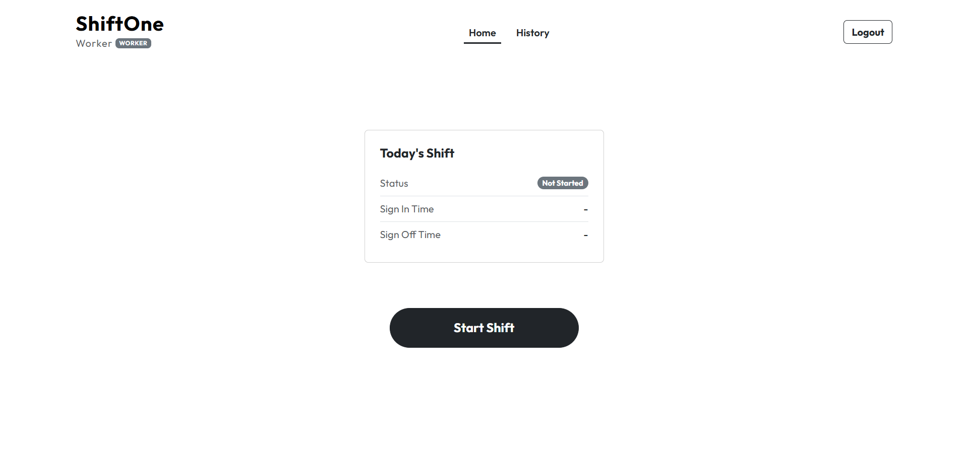
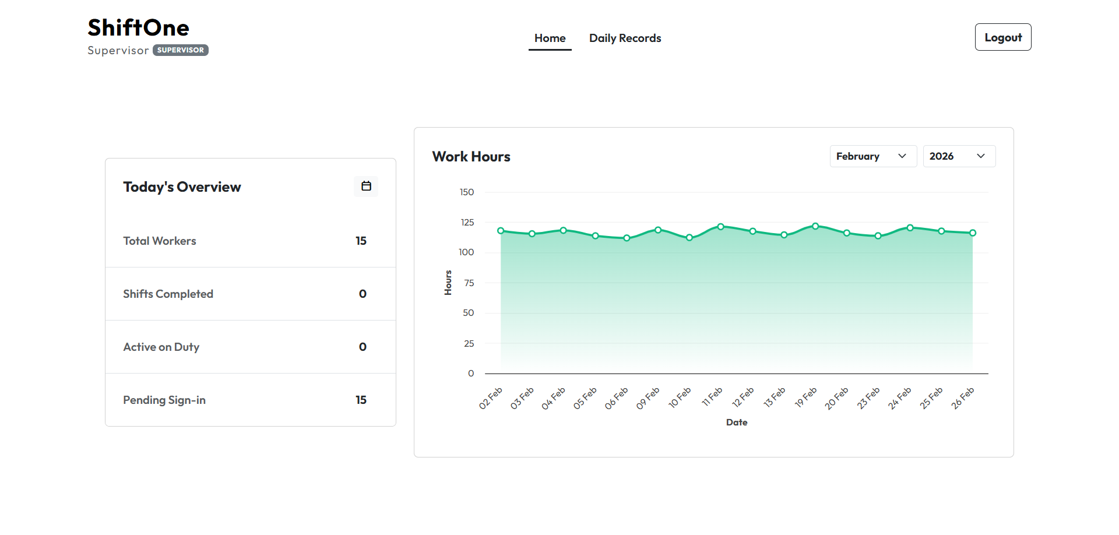
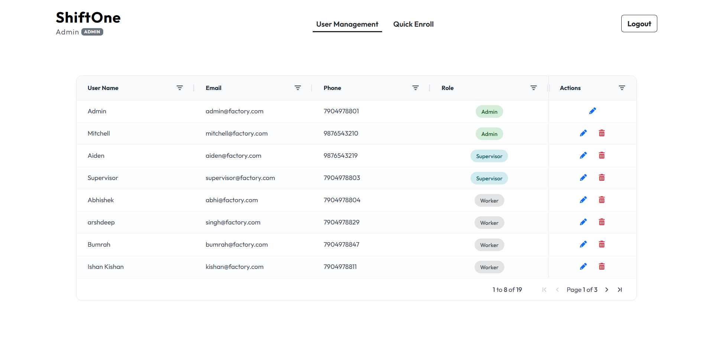
Result

Slide 10
Key Functionalities
Role-Based Access: Dedicated dashboards for Workers, Supervisors, and Admins with JWT-secured login
Digital Sign-In / Sign-Off: Workers record shift start and end times with a single click
Location-Based Verification: GPS geofencing ensures attendance can only be marked from within the factory premises using the Haversine formula
Duplicate Prevention: System blocks multiple sign-ins on the same day
Automatic Hour Calculation: Total shift hours computed instantly on sign-off
Supervisor Dashboard: Real-time view of active workers, daily attendance summary, and date-based filtering
Admin User Management: Add, edit, and delete user accounts from a centralized panel
OCR-Powered Registration: Upload a scanned registration form and PaddleOCR auto-extracts employee details (Name, Email, Phone, Role)
Stored Procedures: All database operations run through 20+ stored procedures for security and performance

Slide 11
Outcomes
A fully functional, end-to-end shift management system
Workers can independently track their attendance digitally
Supervisors gain real-time visibility into workforce attendance
Admins can manage users efficiently with OCR-assisted registration
Eliminated manual attendance tracking and calculation errors
Secure, role-based access ensures data integrity
The modular architecture allows easy addition of new features such as leave management, overtime tracking, or shift scheduling in the future
Future Enhancements
Leave and overtime management modules
Email notification for shift reminders
Advanced analytics and reporting dashboards

Slide 12
Thank You

