Slide 1





Key functions
HW1
func_1
Solve $y=f(x)$
Input
xdata: ndarray (n x 1)
Output
ndarray (n x 1)
func_2
Solve $\left[y\right]=[f\left(x\right)]$
Input
xdata: ndarray (n x 1)
Output
ndarray (2 x n x 1)
func_3
Solve$\left[y\right]=[f\left(x\right)]$
Input
xdata: ndarray (n x 1)
Output
ndarray (3 x n x 1)
func_4
Solve$\left[y\right]=[f\left(x_{1}, x_{2}\right)]$
Input
xdata: ndarray (2 x 1 x n x m)
Output
ndarray (n x m x 2 x 1)
func_5
Solve$\left[y\right]=[f\left(x_{1}, x_{2}\right)]$
Input
xdata: ndarray (2 x 1 x n x m)
Output
ndarray (n x m x 3 x 1)
Callable functions
plotter
Compute injected function and make line or contour plot(s) for resulting ydata
Input
xdata: ndarray (n x 1) or (2 x 1 x n x m)
function: Callable
Output
Figures

Slide 2
Bubble charts
HW1
Callable function
xdata
ydata
plotter
Input
xdata: ndarray (n x 1) or (2 x 1 x n x m)
function: Callable
Output
Figures
xdata
function callable
Figure(s)

Slide 3
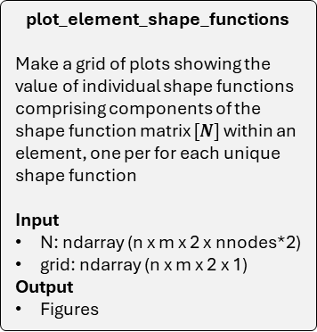
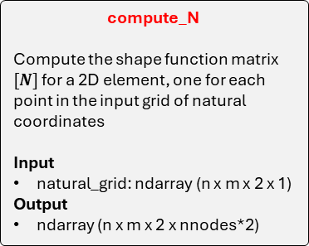
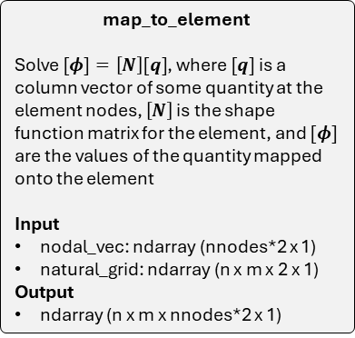
Key functions
HW2
plot_element_shape_functions
Make a grid of plots showing the value of individual shape functions comprising components of the shape function matrix $[N]$ within an element, one per for each unique shape function
Input
N: ndarray (n x m x 2 x nnodes*2)
grid: ndarray (n x m x 2 x 1)
Output
Figures
map_to_element
Solve $[φ]=\left[N\right][q]$, where $[q]$ is a column vector of some quantity at the element nodes, $\left[N\right]$ is the shape function matrix for the element, and $[φ]$ are the values of the quantity mapped onto the element
Input
nodal_vec: ndarray (nnodes*2 x 1)
natural_grid: ndarray (n x m x 2 x 1)
Output
ndarray (n x m x nnodes*2 x 1)
compute_N
Compute the shape function matrix $[N]$ for a 2D element, one for each point in the input grid of natural coordinates
Input
natural_grid: ndarray (n x m x 2 x 1)
Output
ndarray (n x m x 2 x nnodes*2)
make_natural_grid
Construct a 2D array of coordinates in the natural coordinate system from (-1, 1) in each orthogonal direction.
Input
(optional) ngrid: int
Output
ndarray (ngrid x ngrid x 2 x 1)
plot_element_displacement
Make a grid of plots for displacements on the element, one for each component
Input
u: ndarray (n x m x nnodes*2 x 1)
grid: ndarray (n x m x 2 x 1)
Output
Figures

Slide 4



Bubble charts
HW2
$\hat{q}$
plot_element_displacement
Make a grid of plots for displacements on the element, one for each component
Input
u: ndarray (n x m x nnodes*2 x 1)
grid: ndarray (n x m x 2 x 1)
Output
Figures
make_natural_grid
Input
(optional) ngrid: int
Output
ndarray (ngrid x ngrid x 2 x 1)
map_to_element
Input
nodal_vec: ndarray (nnodes*2 x 1)
natural_grid: ndarray (n x m x 2 x 1)
Output
ndarray (n x m x nnodes*2 x 1)
ngrid
$η$
u
grid
$η$
$[N]$
grid
$η$
Figures
compute_N
Input
natural_grid: ndarray (n x m x 2 x 1)
Output
ndarray (n x m x 2 x nnodes*2)
plot_element_shape_functions
Input
N: ndarray (n x m x 2 x nnodes*2)
grid: ndarray (n x m x 2 x 1)
Output
Figures
$[N]$
Figures

Slide 5
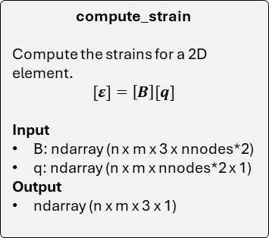
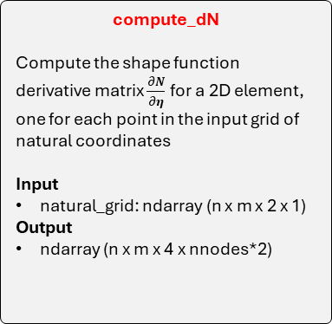
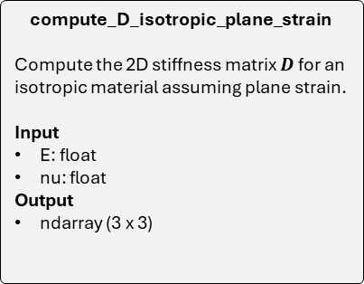
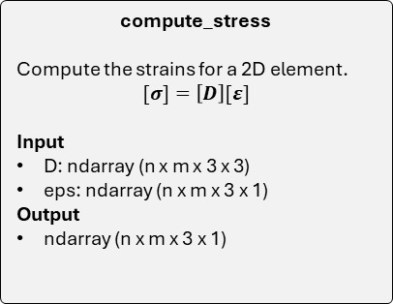
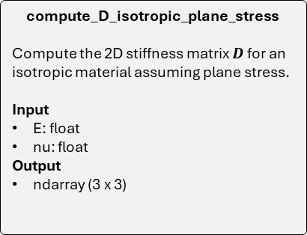
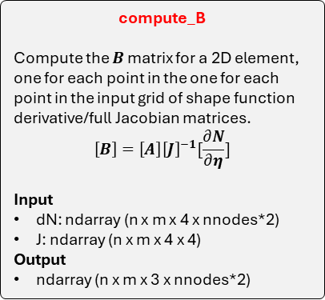
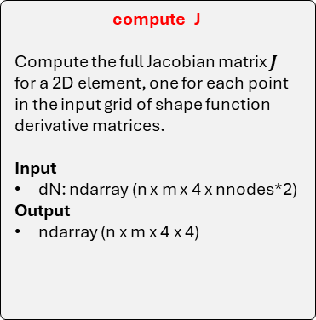
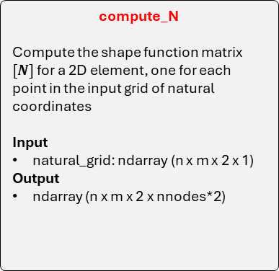
Key functions
HW3
compute_N
Compute the shape function matrix $[N]$ for a 2D element, one for each point in the input grid of natural coordinates
Input
natural_grid: ndarray (n x m x 2 x 1)
Output
ndarray (n x m x 2 x nnodes*2)
compute_dN
Compute the shape function derivative matrix $\frac{∂N}{∂η}$for a 2D element, one for each point in the input grid of natural coordinates
Input
natural_grid: ndarray (n x m x 2 x 1)
Output
ndarray (n x m x 4 x nnodes*2)
compute_J
Compute the full Jacobian matrix $J$ for a 2D element, one for each point in the input grid of shape function derivative matrices.
Input
dN: ndarray (n x m x 4 x nnodes*2)
Output
ndarray (n x m x 4 x 4)
compute_B
Compute the $B$ matrix for a 2D element, one for each point in the one for each point in the input grid of shape function derivative/full Jacobian matrices.
$$\left[B\right]=\left[A\right]{\left[J\right]}^{−1}[\frac{∂N}{∂η}]$$
Input
dN: ndarray (n x m x 4 x nnodes*2)
J: ndarray (n x m x 4 x 4)
Output
ndarray (n x m x 3 x nnodes*2)
compute_D_isotropic_plane_strain
Compute the 2D stiffness matrix $D$ for an isotropic material assuming plane strain.
Input
E: float
nu: float
Output
ndarray (3 x 3)
compute_D_isotropic_plane_stress
Compute the 2D stiffness matrix $D$ for an isotropic material assuming plane stress.
Input
E: float
nu: float
Output
ndarray (3 x 3)
compute_strain
Compute the strains for a 2D element.
$$[ε]=\left[B\right][q]$$
Input
B: ndarray (n x m x 3 x nnodes*2)
q: ndarray (n x m x nnodes*2 x 1)
Output
ndarray (n x m x 3 x 1)
compute_stress
Compute the strains for a 2D element.
$$[σ]=\left[D\right][ε]$$
Input
D: ndarray (n x m x 3 x 3)
eps: ndarray (n x m x 3 x 1)
Output
ndarray (n x m x 3 x 1)

Slide 6
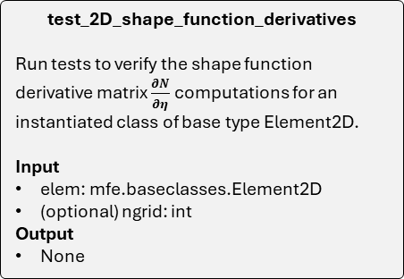
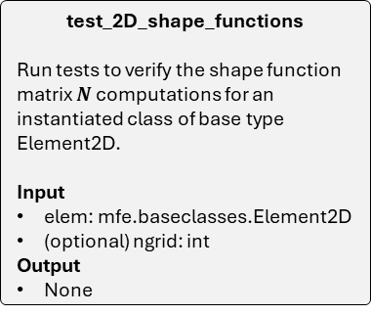
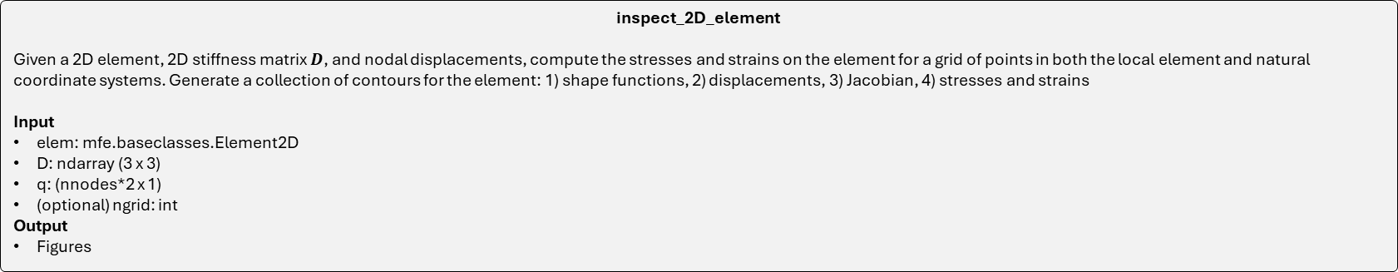
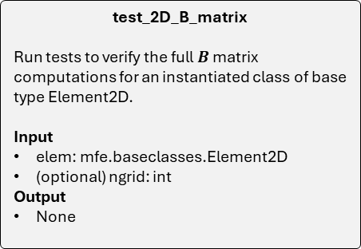
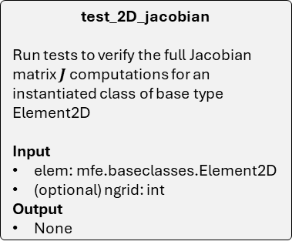
Key unit test functions
HW3
test_2D_jacobian
Run tests to verify the full Jacobian matrix $J$ computations for an instantiated class of base type Element2D
Input
elem: mfe.baseclasses.Element2D
(optional) ngrid: int
Output
None
test_2D_B_matrix
Run tests to verify the full $B$ matrix computations for an instantiated class of base type Element2D.
Input
elem: mfe.baseclasses.Element2D
(optional) ngrid: int
Output
None
test_2D_shape_functions
Run tests to verify the shape function matrix $N$ computations for an instantiated class of base type Element2D.
Input
elem: mfe.baseclasses.Element2D
(optional) ngrid: int
Output
None
test_2D_shape_function_derivatives
Run tests to verify the shape function derivative matrix $\frac{∂N}{∂η}$ computations for an instantiated class of base type Element2D.
Input
elem: mfe.baseclasses.Element2D
(optional) ngrid: int
Output
None
inspect_2D_element
Given a 2D element, 2D stiffness matrix $D$, and nodal displacements, compute the stresses and strains on the element for a grid of points in both the local element and natural coordinate systems. Generate a collection of contours for the element: 1) shape functions, 2) displacements, 3) Jacobian, 4) stresses and strains
Input
elem: mfe.baseclasses.Element2D
D: ndarray (3 x 3)
q: (nnodes*2 x 1)
(optional) ngrid: int
Output
Figures

Slide 7








Bubble charts: key functions
HW3
$\hat{u}$
compute_strain
Input
B: ndarray (n x m x 3 x nnodes*2)
q: ndarray (n x m x nnodes*2 x 1)
Output
ndarray (n x m x 3 x 1)
make_natural_grid
Input
(optional) ngrid: int
Output
ndarray (ngrid x ngrid x 2 x 1)
compute_B
Input
dN: ndarray (n x m x 4 x nnodes*2)
J: ndarray (n x m x 4 x 4)
Output
ndarray (n x m x 3 x nnodes*2)
$[B]$
ngrid
$[ε]$
compute_stress
Input
D: ndarray (n x m x 3 x 3)
eps: ndarray (n x m x 3 x 1)
Output
ndarray (n x m x 3 x 1)
$$[σ]$$
$η$
$[J]$
compute_dN
Input
natural_grid: ndarray (n x m x 2 x 1)
Output
ndarray (n x m x 4 x nnodes*2)
compute_J
Input
dN: ndarray (n x m x 4 x nnodes*2)
Output
ndarray (n x m x 4 x 4)
$[D]$
$[\frac{∂N}{∂η}]$
compute_D_isotropic_plane_stress
Input
E: float
nu: float
Output
ndarray (3 x 3)
compute_D_isotropic_plane_strain
Input
E: float
nu: float
Output
ndarray (3 x 3)
Isotropic plane stress
$E$
$ν$
Isotropic plane strain

Slide 8

Bubble charts: unit test functions
HW3
Instance: Element2D class
ngrid
test_2D_shape_functions
Input
elem: mfe.baseclasses.Element2D
(optional) ngrid: int
Output
None
test_2D_shape_function_derivatives
Input
elem: mfe.baseclasses.Element2D
(optional) ngrid: int
Output
None
test_2D_jacobian
Input
elem: mfe.baseclasses.Element2D
(optional) ngrid: int
Output
None
test_2D_B_matrix
Input
elem: mfe.baseclasses.Element2D
(optional) ngrid: int
Output
None
compute_D_isotropic_plane_stress
Input
E: float
nu: float
Output
ndarray (3 x 3)
inspect_2D_element
Input
elem: mfe.baseclasses.Element2D
D: ndarray (3 x 3)
q: (nnodes*2 x 1)
(optional) ngrid: int
Output
Figures
$E$
$ν$
$[D]$
Figures
compute_D_isotropic_plane_strain
Input
E: float
nu: float
Output
ndarray (3 x 3)
Instance: Element2D class
$\hat{q}$
ngrid
Isotropic plane stress
Isotropic plane strain

Slide 9
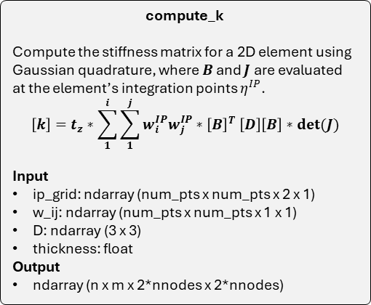
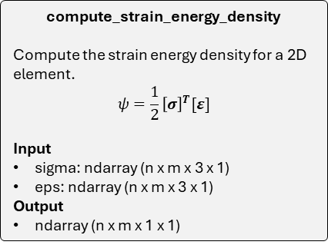
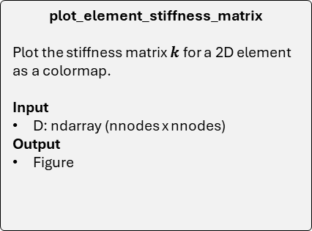
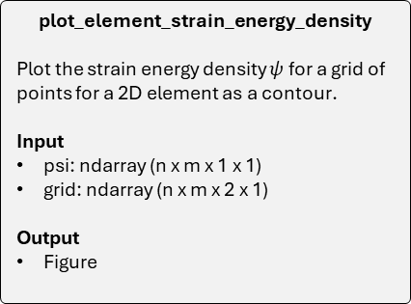
Key functions
HW4
compute_strain_energy_density
Compute the strain energy density for a 2D element.
$$ψ=\frac{1}{2}{\left[σ\right]}^{T}[ε]$$
Input
sigma: ndarray (n x m x 3 x 1)
eps: ndarray (n x m x 3 x 1)
Output
ndarray (n x m x 1 x 1)
make_ip_grid
Make a grid of integration points and their weights for performing gaussian quadrature on a 2D element.
Input
num_pts: int
Output
ndarray (num_pts x num_pts x 2 x 1)
ndarray (num_pts x num_pts x 1 x 1)
compute_k
Compute the stiffness matrix for a 2D element using Gaussian quadrature, where $B$ and $J$ are evaluated at the element’s integration points $η^{IP}$.
$$\left[k\right]=t_{z}∗\sum_{1}^{i}{\sum_{1}^{j}{w_{i}^{IP}w_{j}^{IP}{∗\left[B\right]}^{T}\left[D\right]\left[B\right]∗det(J)}}$$
Input
ip_grid: ndarray (num_pts x num_pts x 2 x 1)
w_ij: ndarray (num_pts x num_pts x 1 x 1)
D: ndarray (3 x 3)
thickness: float
Output
ndarray (n x m x 2*nnodes x 2*nnodes)
plot_element_strain_energy_density
Plot the strain energy density $ψ$ for a grid of points for a 2D element as a contour.
Input
psi: ndarray (n x m x 1 x 1)
grid: ndarray (n x m x 2 x 1)
Output
Figure
plot_element_stiffness_matrix
Plot the stiffness matrix $k$ for a 2D element as a colormap.
Input
D: ndarray (nnodes x nnodes)
Output
Figure

Slide 10






Bubble charts
HW4
num_itg_pts
$[D]$
$t_{z}$
compute_k
Input
ip_grid: ndarray (num_pts x num_pts x 2 x 1)
w_ij: ndarray (num_pts x num_pts x 1 x 1)
D: ndarray (3 x 3)
thickness: float
Output
ndarray (n x m x 2*nnodes x 2*nnodes)
compute_strain_energy_density
Input
sigma: ndarray (n x m x 3 x 1)
eps: ndarray (n x m x 3 x 1)
Output
ndarray (n x m x 1 x 1)
make_ip_grid
Input
num_pts: int
Output
ndarray (num_pts x num_pts x 2 x 1)
ndarray (num_pts x num_pts x 1 x 1)
$[σ]$
$[ε]$
$η^{IP}$
$w^{IP}$
$[ψ]$
$[k]$
plot_element_strain_energy_density
Input
psi: ndarray (n x m x 1 x 1)
grid: ndarray (n x m x 2 x 1)
Output
Figure
plot_element_stiffness_matrix
Input
D: ndarray (nnodes x nnodes)
Output
Figure
$η$ or $x$
Figures
Figures

Slide 11
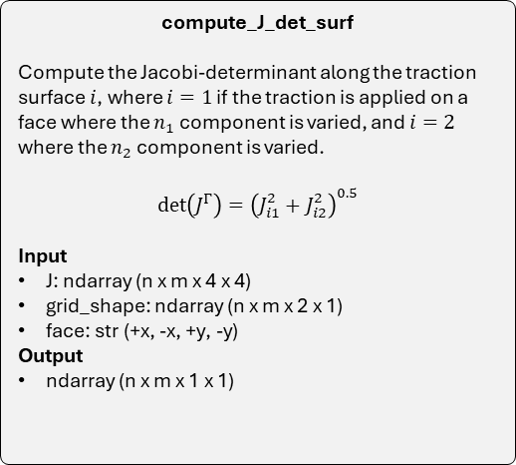
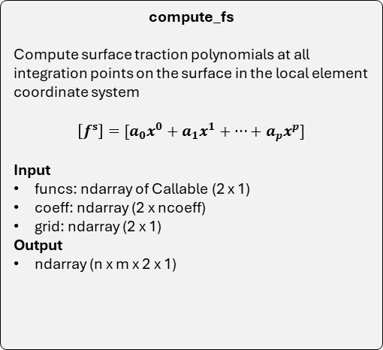
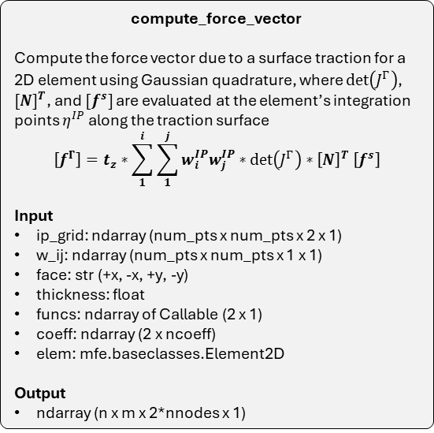
Key functions
HW5
compute_force_vector
Compute the force vector due to a surface traction for a 2D element using Gaussian quadrature, where $\det\left(J^{Γ}\right)$, ${[N]}^{T}$, and $[f^{s}]$are evaluated at the element’s integration points $η^{IP}$ along the traction surface
$$\left[f^{Γ}\right]=t_{z}∗\sum_{1}^{i}{\sum_{1}^{j}{w_{i}^{IP}w_{j}^{IP}{∗\det\left(J^{Γ}\right)∗\left[N\right]}^{T}\left[f^{s}\right]}}$$
Input
ip_grid: ndarray (num_pts x num_pts x 2 x 1)
w_ij: ndarray (num_pts x num_pts x 1 x 1)
face: str (+x, -x, +y, -y)
thickness: float
funcs: ndarray of Callable (2 x 1)
coeff: ndarray (2 x ncoeff)
elem: mfe.baseclasses.Element2D
Output
ndarray (n x m x 2*nnodes x 1)
compute_J_det_surf
Compute the Jacobi-determinant along the traction surface $i$, where $i=1$ if the traction is applied on a face where the $n_{1}$ component is varied, and $i=2$ where the $n_{2}$ component is varied.
$$det\left(J^{Γ}\right)={\left(J_{i1}^{2}+J_{i2}^{2}\right)}^{0.5}$$
Input
J: ndarray (n x m x 4 x 4)
grid_shape: ndarray (n x m x 2 x 1)
face: str (+x, -x, +y, -y)
Output
ndarray (n x m x 1 x 1)
compute_fs
Compute surface traction polynomials at all integration points on the surface in the local element coordinate system
$$\left[f^{s}\right]=[a_{0}x^{0}+a_{1}x^{1}+…+a_{p}x^{p}]$$
Input
funcs: ndarray of Callable (2 x 1)
coeff: ndarray (2 x ncoeff)
grid: ndarray (2 x 1)
Output
ndarray (n x m x 2 x 1)

Slide 12


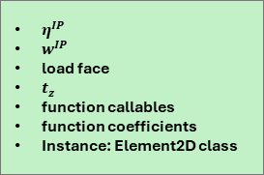



Bubble charts
HW5
$η^{IP}$
$w^{IP}$
load face
$t_{z}$
function callables
function coefficients
Instance: Element2D class
compute_force_vector
Input
ip_grid: ndarray (num_pts x num_pts x 2 x 1)
w_ij: ndarray (num_pts x num_pts x 1 x 1)
face: str (+x, -x, +y, -y)
thickness: float
funcs: ndarray of Callable (2 x 1)
coeff: ndarray (2 x ncoeff)
elem: mfe.baseclasses.Element2D
Output
ndarray (n x m x 2*nnodes x 1)
function callables
function coefficients
$x$-grid
compute_fs
Input
funcs: ndarray of Callable (2 x 1)
coeff: ndarray (2 x ncoeff)
grid: ndarray (2 x 1)
Output
ndarray (n x m x 2 x 1)
$$[f^{Γ}]$$
$[f^{s}]$
$[J]$
load face
grid shape
$det(J^{ Γ})$
compute_J_det_surf
Input
J: ndarray (n x m x 4 x 4)
grid_shape: ndarray (n x m x 2 x 1)
face: str (+x, -x, +y, -y)
Output
ndarray (n x m x 1 x 1)

Slide 13
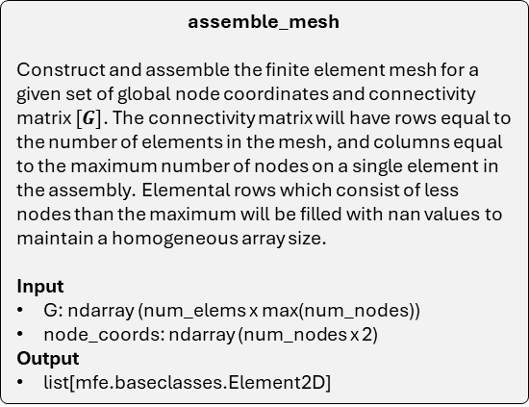
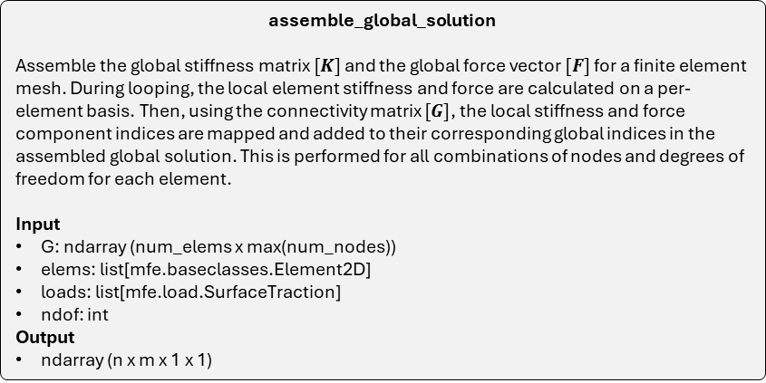
Key functions
HW6
assemble_mesh
Construct and assemble the finite element mesh for a given set of global node coordinates and connectivity matrix $[G]$. The connectivity matrix will have rows equal to the number of elements in the mesh, and columns equal to the maximum number of nodes on a single element in the assembly. Elemental rows which consist of less nodes than the maximum will be filled with nan values to maintain a homogeneous array size.
Input
G: ndarray (num_elems x max(num_nodes))
node_coords: ndarray (num_nodes x 2)
Output
list[mfe.baseclasses.Element2D]
assemble_global_solution
Assemble the global stiffness matrix $[K]$ and the global force vector $[F]$ for a finite element mesh. During looping, the local element stiffness and force are calculated on a per-element basis. Then, using the connectivity matrix $[G]$, the local stiffness and force component indices are mapped and added to their corresponding global indices in the assembled global solution. This is performed for all combinations of nodes and degrees of freedom for each element.
Input
G: ndarray (num_elems x max(num_nodes))
elems: list[mfe.baseclasses.Element2D]
loads: list[mfe.load.SurfaceTraction]
ndof: int
Output
ndarray (n x m x 1 x 1)

Slide 14



Bubble charts
HW6
$\left[G\right]$
global node coordinates
$\left[G\right]$
Surface tractions
ndof
assemble_mesh
Input
G: ndarray (num_elems x max(num_nodes))
node_coords: ndarray (num_nodes x 2)
Output
list[mfe.baseclasses.Element2D]
assemble_global_solution
Input
G: ndarray (num_elems x max(num_nodes))
elems: list[mfe.baseclasses.Element2D]
loads: list[mfe.load.SurfaceTraction]
ndof: int
Output
ndarray (ndof*num_nodes, ndof*num_nodes)
ndarray (ndof*num_nodes, 1)
global element assembly
$$\left[K\right], [F]$$

Slide 15
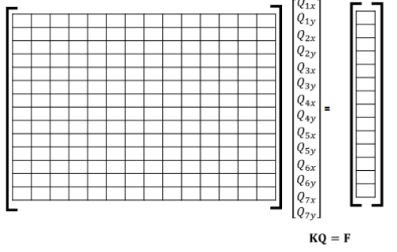
















































Slide 16
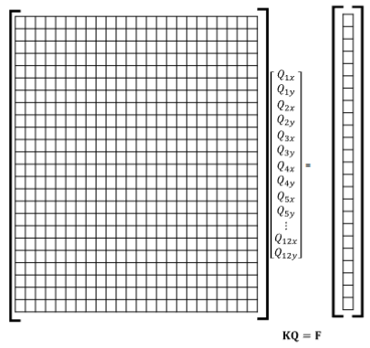




















































































Slide 17
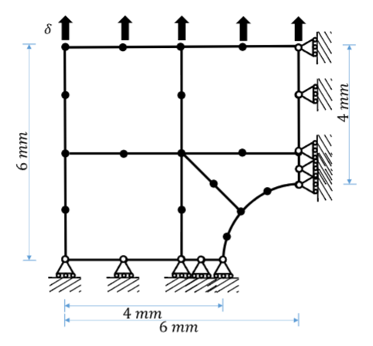


Slide 18
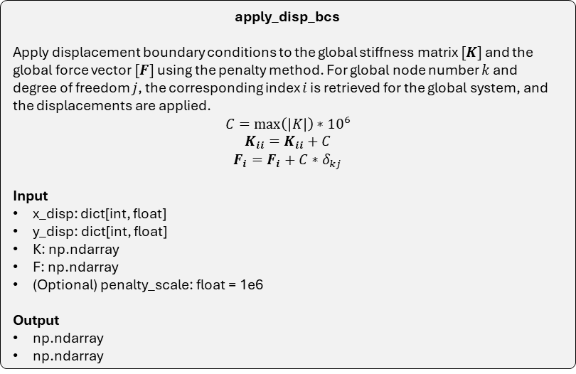
Key functions
HW7
apply_disp_bcs
Apply displacement boundary conditions to the global stiffness matrix $[K]$ and the global force vector $[F]$ using the penalty method. For global node number $k$ and degree of freedom $j$, the corresponding index $i$ is retrieved for the global system, and the displacements are applied.
$$C=\max\left(\left|K\right|\right)∗{10}^{6}$$
$$K_{ii}=K_{ii}+C$$
$$F_{i}=F_{i}+C∗δ_{kj}$$
Input
x_disp: dict[int, float]
y_disp: dict[int, float]
K: np.ndarray
F: np.ndarray
(Optional) penalty_scale: float = 1e6
Output
np.ndarray
np.ndarray
build_assembly_coord_grid
Assemble an array of coordinates for the finite element mesh. For each element, map the nodal global coordinates to a grid of coordinates on the respective element. Then, stack the grid of coordinates together to create the assembly.
Input
G: ndarray (num_elems x max(num_nodes))
elems: list[mfe.baseclasses.Element2D]
natural_grid: np.ndarray (n x m)
Output
ndarray (n x m x 2 x 1)
map_nodal_field_to_assembly
Assemble an array of field values for the finite element mesh. For each element, map the nodal field to a grid of points on the respective element. Then, stack the grid of field values together to create an array of field values on the assembly.
Input
G: ndarray (num_elems x max(num_nodes))
elems: list[mfe.baseclasses.Element2D]
Q: ndarray (ndof*num_nodes x 1)
natural_grid: np.ndarray (n x m)
Output
ndarray (n x m x ndof x 1)

Slide 19

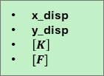
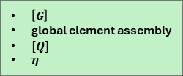

Bubble charts
HW7
x_disp
y_disp
$\left[K\right]$
$[F]$
$\left[G\right]$
global element assembly
$η$
$\left[G\right]$
global element assembly
$[Q]$
$η$
apply_disp_bcs
Input
x_disp: dict[int, float]
y_disp: dict[int, float]
K: np.ndarray
F: np.ndarray
(Optional) penalty_scale: float = 1e6
Output
np.ndarray
np.ndarray
build_assembly_coord_grid
Input
G: ndarray (num_elems x max(num_nodes))
elems: list[mfe.baseclasses.Element2D]
natural_grid: np.ndarray (n x m)
Output
ndarray (n x m x 2 x 1)
map_nodal_field_to_assembly
Input
G: ndarray (num_elems x max(num_nodes))
elems: list[mfe.baseclasses.Element2D]
Q: ndarray (ndof*num_nodes x 1)
natural_grid: np.ndarray (n x m)
Output
ndarray (n x m x ndof x 1)
assembly coordinates
assembly field
Solve $Q={\left[K\right]}^{−1}[F]$
Plot field on assembly

Slide 20
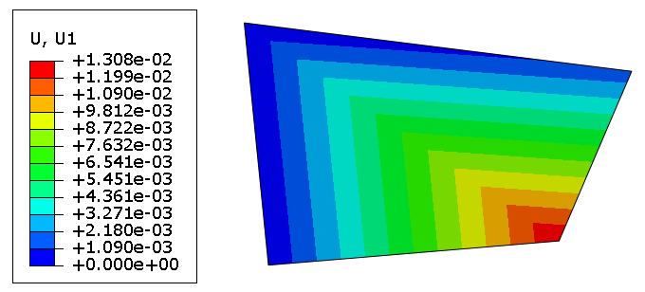
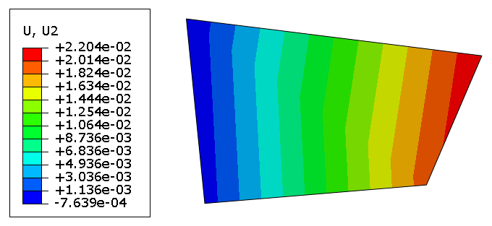

Slide 21
