Slide 1

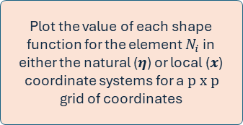
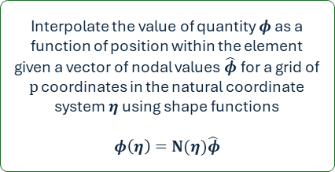




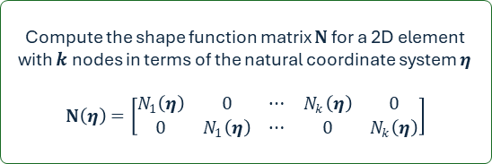






Generic 2D element class
self.shape_n$i$
Compute the value of the shape function for node $i$ as a function of position within the element in terms of the natural coordinate system $η$
$$η=(η_{1}, η_{2})$$
plot_shape_functions
Plot the value of each shape function for the element $N_{i}$ in either the natural ($η$) or local ($x$) coordinate systems for a $p x p$ grid of coordinates
$$N_{i}(η)$$
self.N
Compute the shape function matrix $N$ for a 2D element with $k$ nodes in terms of the natural coordinate system $η$
$$N\left(η\right)=\left[\begin{matrix}N_{1}\left(η\right) & 0 & ⋯ & N_{k}\left(η\right) & 0 \\ 0 & N_{1}\left(η\right) & ⋯ & 0 & N_{k}\left(η\right)\end{matrix}\right]$$
$φ\left(η\right)$: $η$ or $x$ positions within the element
$N_{i}(η)$ or $N_{i}(x)$ within the element
$$η=(η_{1}, η_{2})$$
$$[N_{1}, N_{2}, .., N_{k}]$$
Figure(s)
$$p:grid size$$
$$coord. sys$$
self.get_shape_funcs
$$N(η)$$
Return a list of $k$ shape functions for the element ordered by local node number
self.interpolate
Interpolate the value of quantity $φ$ as a function of position within the element given a vector of nodal values $\hat{φ}$ for a grid of $p$ coordinates in the natural coordinate system $η$ using shape functions
$$φ\left(η\right)=N(η)\hat{φ}$$

Slide 2
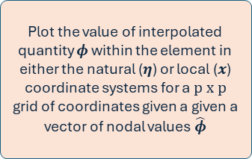



Generic 2D element class
self.shape_n$i$
Compute the value of the shape function for node $i$ as a function of position within the element in terms of the natural coordinate system $η$
$$η=(η_{1}, η_{2})$$
plot_element_field
Plot the value of interpolated quantity $φ$ within the element in either the natural ($η$) or local ($x$) coordinate systems for a $p x p$ grid of coordinates given a given a vector of nodal values $\hat{φ}$
$$N_{i}(η)$$
self.N
Compute the shape function matrix $N$ for a 2D element with $k$ nodes in terms of the natural coordinate system $η$
$$N\left(η\right)=\left[\begin{matrix}N_{1}\left(η\right) & 0 & ⋯ & N_{k}\left(η\right) & 0 \\ 0 & N_{1}\left(η\right) & ⋯ & 0 & N_{k}\left(η\right)\end{matrix}\right]$$
$φ\left(η\right)$: displacements within the element
$φ\left(η\right)$: $η$ or $x$ positions within the element
$φ\left(η\right)$ or $φ\left(x\right):$ displacements within the element
$$η=(η_{1}, η_{2})$$
$$[N_{1}, N_{2}, .., N_{k}]$$
Figure(s)
$$p:grid size$$
$$coord. sys$$
$$q:nodal values$$
self.get_shape_funcs
$$N(η)$$
Return a list of $k$ shape functions for the element ordered by local node number
self.interpolate
Interpolate the value of quantity $φ$ as a function of position within the element given a vector of nodal values $\hat{φ}$ for a grid of $p$ coordinates in the natural coordinate system $η$ using shape functions
$$φ\left(η\right)=N(η)\hat{φ}$$

