Slide 1





func_1
Solve $y=f(x)$
Input
xdata: ndarray (n x 1)
Output
ndarray (n x 1)
func_2
Solve $\left[y\right]=[f\left(x\right)]$
Input
xdata: ndarray (n x 1)
Output
ndarray (2 x n x 1)
func_3
Solve$\left[y\right]=[f\left(x\right)]$
Input
xdata: ndarray (n x 1)
Output
ndarray (3 x n x 1)
func_4
Solve$\left[y\right]=[f\left(x_{1}, x_{2}\right)]$
Input
xdata: ndarray (2 x 1 x n x m)
Output
ndarray (n x m x 2 x 1)
func_5
Solve$\left[y\right]=[f\left(x_{1}, x_{2}\right)]$
Input
xdata: ndarray (2 x 1 x n x m)
Output
ndarray (n x m x 3 x 1)
Callable functions
plotter
Compute injected function and make line or contour plot(s) for resulting ydata
Input
xdata: ndarray (n x 1) or (2 x 1 x n x m)
function: Callable
Output
Figures

Slide 2
Callable function
xdata
ydata
xdata
function callable
plotter
Input
xdata: ndarray (n x 1) or (2 x 1 x n x m)
function: Callable
Output
Figures
xdata
ydata
Figure(s)

Slide 3
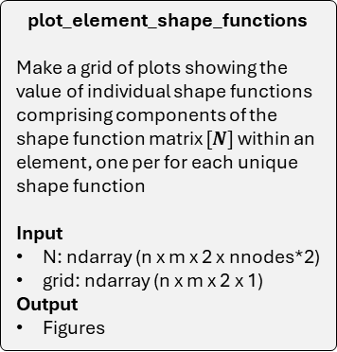
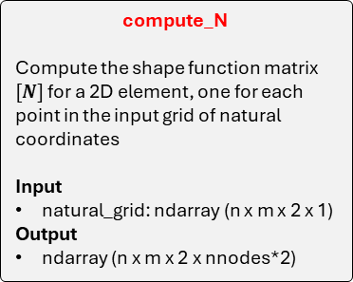
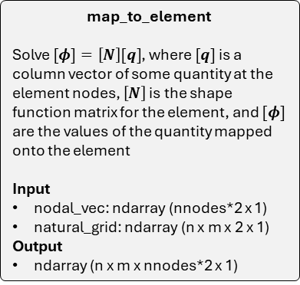
Key functions
HW2
plot_element_shape_functions
Make a grid of plots showing the value of individual shape functions comprising components of the shape function matrix $[N]$ within an element, one per for each unique shape function
Input
N: ndarray (n x m x 2 x nnodes*2)
grid: ndarray (n x m x 2 x 1)
Output
Figures
map_to_element
Solve $[φ]=\left[N\right][q]$, where $[q]$ is a column vector of some quantity at the element nodes, $\left[N\right]$ is the shape function matrix for the element, and $[φ]$ are the values of the quantity mapped onto the element
Input
nodal_vec: ndarray (nnodes*2 x 1)
natural_grid: ndarray (n x m x 2 x 1)
Output
ndarray (n x m x nnodes*2 x 1)
compute_N
Compute the shape function matrix $[N]$ for a 2D element, one for each point in the input grid of natural coordinates
Input
natural_grid: ndarray (n x m x 2 x 1)
Output
ndarray (n x m x 2 x nnodes*2)
make_natural_grid
Construct a 2D array of coordinates in the natural coordinate system from (-1, 1) in each orthogonal direction.
Input
(optional) ngrid: int
Output
ndarray (ngrid x ngrid x 2 x 1)
plot_element_displacement
Make a grid of plots for displacements on the element, one for each component
Input
u: ndarray (n x m x nnodes*2 x 1)
grid: ndarray (n x m x 2 x 1)
Output
Figures

Slide 4



Bubble charts
HW2
$\hat{q}$
plot_element_displacement
Make a grid of plots for displacements on the element, one for each component
Input
u: ndarray (n x m x nnodes*2 x 1)
grid: ndarray (n x m x 2 x 1)
Output
Figures
make_natural_grid
Input
(optional) ngrid: int
Output
ndarray (ngrid x ngrid x 2 x 1)
map_to_element
Input
nodal_vec: ndarray (nnodes*2 x 1)
natural_grid: ndarray (n x m x 2 x 1)
Output
ndarray (n x m x nnodes*2 x 1)
ngrid
$η$
u
grid
$η$
$[N]$
grid
$η$
Figures
compute_N
Input
natural_grid: ndarray (n x m x 2 x 1)
Output
ndarray (n x m x 2 x nnodes*2)
plot_element_shape_functions
Input
N: ndarray (n x m x 2 x nnodes*2)
grid: ndarray (n x m x 2 x 1)
Output
Figures
$[N]$
Figures

Slide 5
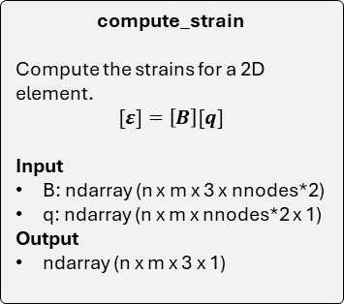
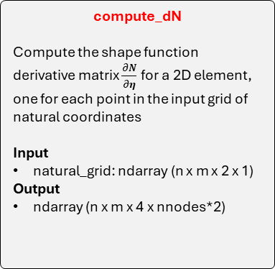
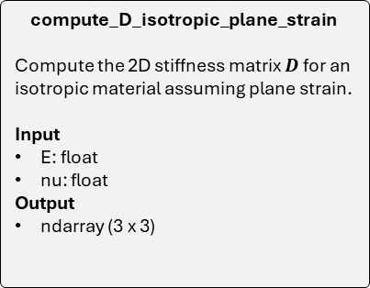
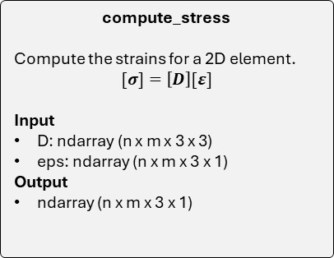
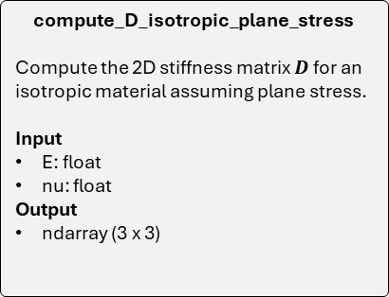
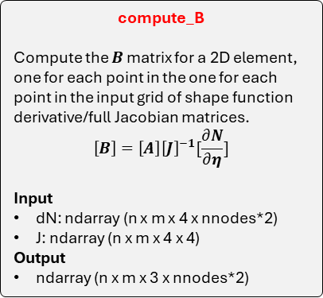
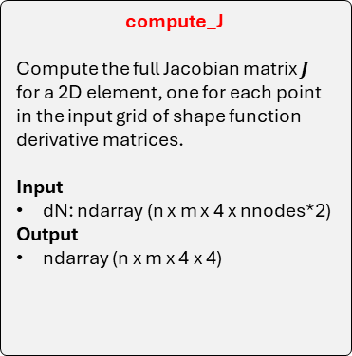
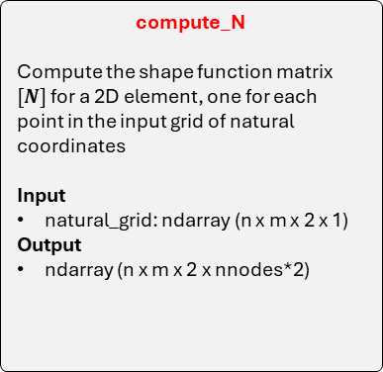
Key functions
HW3
compute_N
Compute the shape function matrix $[N]$ for a 2D element, one for each point in the input grid of natural coordinates
Input
natural_grid: ndarray (n x m x 2 x 1)
Output
ndarray (n x m x 2 x nnodes*2)
compute_dN
Compute the shape function derivative matrix $\frac{∂N}{∂η}$for a 2D element, one for each point in the input grid of natural coordinates
Input
natural_grid: ndarray (n x m x 2 x 1)
Output
ndarray (n x m x 4 x nnodes*2)
compute_J
Compute the full Jacobian matrix $J$ for a 2D element, one for each point in the input grid of shape function derivative matrices.
Input
dN: ndarray (n x m x 4 x nnodes*2)
Output
ndarray (n x m x 4 x 4)
compute_B
Compute the $B$ matrix for a 2D element, one for each point in the one for each point in the input grid of shape function derivative/full Jacobian matrices.
$$\left[B\right]=\left[A\right]{\left[J\right]}^{−1}[\frac{∂N}{∂η}]$$
Input
dN: ndarray (n x m x 4 x nnodes*2)
J: ndarray (n x m x 4 x 4)
Output
ndarray (n x m x 3 x nnodes*2)
compute_D_isotropic_plane_strain
Compute the 2D stiffness matrix $D$ for an isotropic material assuming plane strain.
Input
E: float
nu: float
Output
ndarray (3 x 3)
compute_D_isotropic_plane_stress
Compute the 2D stiffness matrix $D$ for an isotropic material assuming plane stress.
Input
E: float
nu: float
Output
ndarray (3 x 3)
compute_strain
Compute the strains for a 2D element.
$$[ε]=\left[B\right][q]$$
Input
B: ndarray (n x m x 3 x nnodes*2)
q: ndarray (n x m x nnodes*2 x 1)
Output
ndarray (n x m x 3 x 1)
compute_stress
Compute the strains for a 2D element.
$$[σ]=\left[D\right][ε]$$
Input
D: ndarray (n x m x 3 x 3)
eps: ndarray (n x m x 3 x 1)
Output
ndarray (n x m x 3 x 1)

Slide 6
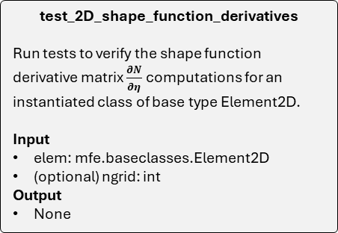
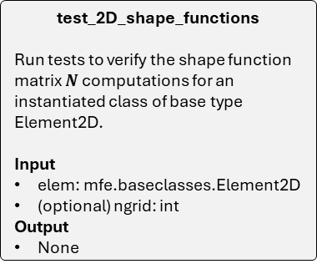
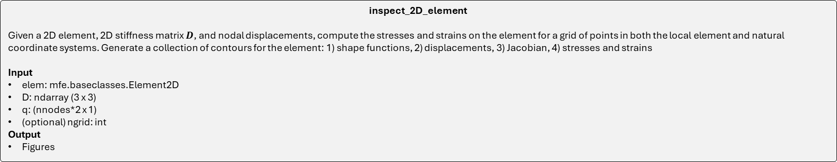
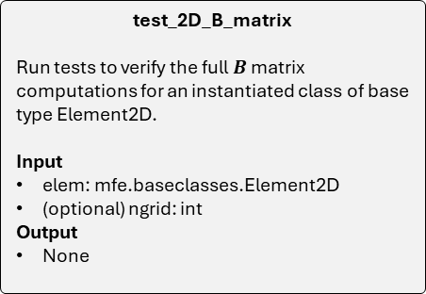
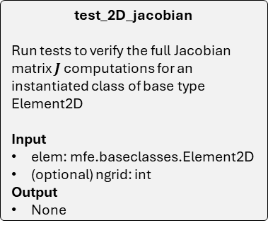
Key unit test functions
HW3
test_2D_jacobian
Run tests to verify the full Jacobian matrix $J$ computations for an instantiated class of base type Element2D
Input
elem: mfe.baseclasses.Element2D
(optional) ngrid: int
Output
None
test_2D_B_matrix
Run tests to verify the full $B$ matrix computations for an instantiated class of base type Element2D.
Input
elem: mfe.baseclasses.Element2D
(optional) ngrid: int
Output
None
test_2D_shape_functions
Run tests to verify the shape function matrix $N$ computations for an instantiated class of base type Element2D.
Input
elem: mfe.baseclasses.Element2D
(optional) ngrid: int
Output
None
test_2D_shape_function_derivatives
Run tests to verify the shape function derivative matrix $\frac{∂N}{∂η}$ computations for an instantiated class of base type Element2D.
Input
elem: mfe.baseclasses.Element2D
(optional) ngrid: int
Output
None
inspect_2D_element
Given a 2D element, 2D stiffness matrix $D$, and nodal displacements, compute the stresses and strains on the element for a grid of points in both the local element and natural coordinate systems. Generate a collection of contours for the element: 1) shape functions, 2) displacements, 3) Jacobian, 4) stresses and strains
Input
elem: mfe.baseclasses.Element2D
D: ndarray (3 x 3)
q: (nnodes*2 x 1)
(optional) ngrid: int
Output
Figures

Slide 7








Bubble charts: key functions
HW3
$\hat{u}$
compute_strain
Input
B: ndarray (n x m x 3 x nnodes*2)
q: ndarray (n x m x nnodes*2 x 1)
Output
ndarray (n x m x 3 x 1)
make_natural_grid
Input
(optional) ngrid: int
Output
ndarray (ngrid x ngrid x 2 x 1)
compute_B
Input
dN: ndarray (n x m x 4 x nnodes*2)
J: ndarray (n x m x 4 x 4)
Output
ndarray (n x m x 3 x nnodes*2)
$[B]$
ngrid
$[ε]$
compute_stress
Input
D: ndarray (n x m x 3 x 3)
eps: ndarray (n x m x 3 x 1)
Output
ndarray (n x m x 3 x 1)
$$[σ]$$
$η$
$[J]$
compute_dN
Input
natural_grid: ndarray (n x m x 2 x 1)
Output
ndarray (n x m x 4 x nnodes*2)
compute_J
Input
dN: ndarray (n x m x 4 x nnodes*2)
Output
ndarray (n x m x 4 x 4)
$[D]$
$[\frac{∂N}{∂η}]$
compute_D_isotropic_plane_stress
Input
E: float
nu: float
Output
ndarray (3 x 3)
compute_D_isotropic_plane_strain
Input
E: float
nu: float
Output
ndarray (3 x 3)
Isotropic plane stress
$E$
$ν$
Isotropic plane strain

Slide 8

Bubble charts: unit test functions
HW3
Instance: Element2D class
ngrid
test_2D_shape_functions
Input
elem: mfe.baseclasses.Element2D
(optional) ngrid: int
Output
None
test_2D_shape_function_derivatives
Input
elem: mfe.baseclasses.Element2D
(optional) ngrid: int
Output
None
test_2D_jacobian
Input
elem: mfe.baseclasses.Element2D
(optional) ngrid: int
Output
None
test_2D_B_matrix
Input
elem: mfe.baseclasses.Element2D
(optional) ngrid: int
Output
None
compute_D_isotropic_plane_stress
Input
E: float
nu: float
Output
ndarray (3 x 3)
inspect_2D_element
Input
elem: mfe.baseclasses.Element2D
D: ndarray (3 x 3)
q: (nnodes*2 x 1)
(optional) ngrid: int
Output
Figures
$E$
$ν$
$[D]$
Figures
compute_D_isotropic_plane_strain
Input
E: float
nu: float
Output
ndarray (3 x 3)
Instance: Element2D class
$\hat{q}$
ngrid
Isotropic plane stress
Isotropic plane strain

Slide 9
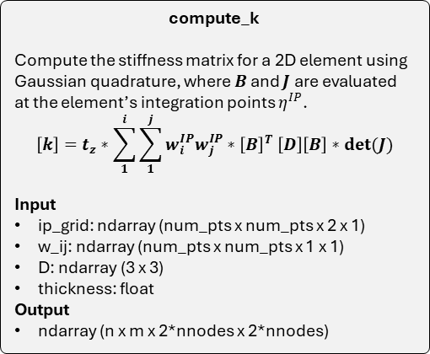
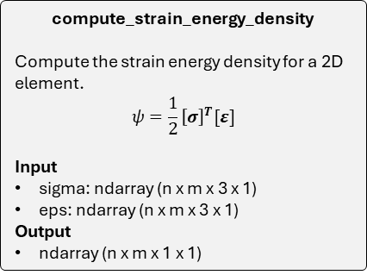
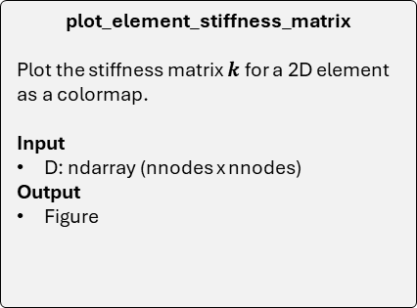
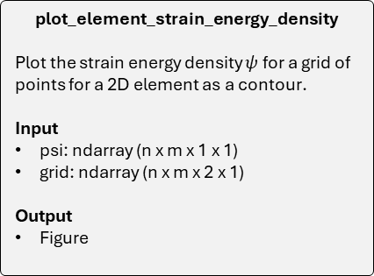
Key functions
HW4
compute_strain_energy_density
Compute the strain energy density for a 2D element.
$$ψ=\frac{1}{2}{\left[σ\right]}^{T}[ε]$$
Input
sigma: ndarray (n x m x 3 x 1)
eps: ndarray (n x m x 3 x 1)
Output
ndarray (n x m x 1 x 1)
make_ip_grid
Make a grid of integration points and their weights for performing gaussian quadrature on a 2D element.
Input
num_pts: int
Output
ndarray (num_pts x num_pts x 2 x 1)
ndarray (num_pts x num_pts x 1 x 1)
compute_k
Compute the stiffness matrix for a 2D element using Gaussian quadrature, where $B$ and $J$ are evaluated at the element’s integration points $η^{IP}$.
$$\left[k\right]=t_{z}∗\sum_{1}^{i}{\sum_{1}^{j}{w_{i}^{IP}w_{j}^{IP}{∗\left[B\right]}^{T}\left[D\right]\left[B\right]∗det(J)}}$$
Input
ip_grid: ndarray (num_pts x num_pts x 2 x 1)
w_ij: ndarray (num_pts x num_pts x 1 x 1)
D: ndarray (3 x 3)
thickness: float
Output
ndarray (n x m x 2*nnodes x 2*nnodes)
plot_element_strain_energy_density
Plot the strain energy density $ψ$ for a grid of points for a 2D element as a contour.
Input
psi: ndarray (n x m x 1 x 1)
grid: ndarray (n x m x 2 x 1)
Output
Figure
plot_element_stiffness_matrix
Plot the stiffness matrix $k$ for a 2D element as a colormap.
Input
D: ndarray (nnodes x nnodes)
Output
Figure

Slide 10






Bubble charts
HW4
num_itg_pts
$[D]$
$t_{z}$
compute_k
Input
ip_grid: ndarray (num_pts x num_pts x 2 x 1)
w_ij: ndarray (num_pts x num_pts x 1 x 1)
D: ndarray (3 x 3)
thickness: float
Output
ndarray (n x m x 2*nnodes x 2*nnodes)
compute_strain_energy_density
Input
sigma: ndarray (n x m x 3 x 1)
eps: ndarray (n x m x 3 x 1)
Output
ndarray (n x m x 1 x 1)
make_ip_grid
Input
num_pts: int
Output
ndarray (num_pts x num_pts x 2 x 1)
ndarray (num_pts x num_pts x 1 x 1)
$[σ]$
$[ε]$
$η^{IP}$
$w^{IP}$
$[ψ]$
$[k]$
plot_element_strain_energy_density
Input
psi: ndarray (n x m x 1 x 1)
grid: ndarray (n x m x 2 x 1)
Output
Figure
plot_element_stiffness_matrix
Input
D: ndarray (nnodes x nnodes)
Output
Figure
$η$ or $x$
Figures
Figures

Slide 11


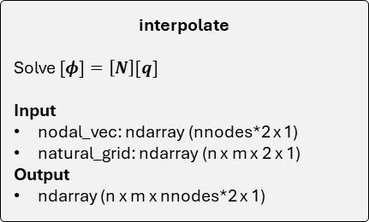


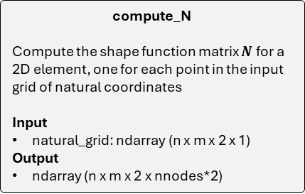
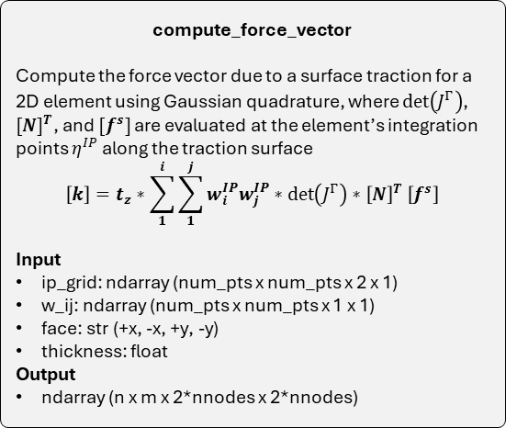

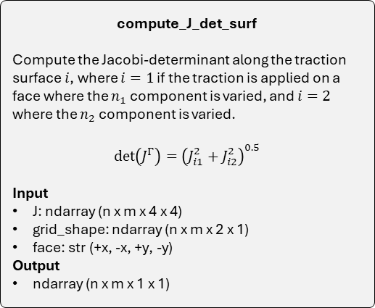

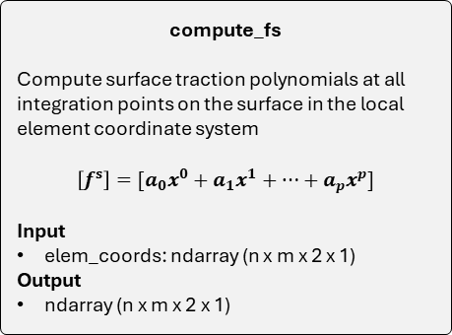

Instance: Element2D base class
compute_N
Compute the shape function matrix $N$for a 2D element, one for each point in the input grid of natural coordinates
Input
natural_grid: ndarray (n x m x 2 x 1)
Output
ndarray (n x m x 2 x nnodes*2)
compute_force_vector
Compute the force vector due to a surface traction for a 2D element using Gaussian quadrature, where $\det\left(J^{Γ}\right)$, ${[N]}^{T}$, and $[f^{s}]$are evaluated at the element’s integration points $η^{IP}$ along the traction surface
$$\left[k\right]=t_{z}∗\sum_{1}^{i}{\sum_{1}^{j}{w_{i}^{IP}w_{j}^{IP}{∗\det\left(J^{Γ}\right)∗\left[N\right]}^{T}\left[f^{s}\right]}}$$
Input
ip_grid: ndarray (num_pts x num_pts x 2 x 1)
w_ij: ndarray (num_pts x num_pts x 1 x 1)
face: str (+x, -x, +y, -y)
thickness: float
Output
ndarray (n x m x 2*nnodes x 2*nnodes)
$N$
$η^{IP}$
face
$t_{z}$
interpolate
Solve $[φ]=\left[N\right][q]$
Input
nodal_vec: ndarray (nnodes*2 x 1)
natural_grid: ndarray (n x m x 2 x 1)
Output
ndarray (n x m x nnodes*2 x 1)
$\det\left(J^{Γ}\right)$
$f^{s}$
$x^{IP}$
$J$
grid_shape
face
compute_J_det_surf
Compute the Jacobi-determinant along the traction surface $i$, where $i=1$ if the traction is applied on a face where the $n_{1}$ component is varied, and $i=2$ where the $n_{2}$ component is varied.
$$det\left(J^{Γ}\right)={\left(J_{i1}^{2}+J_{i2}^{2}\right)}^{0.5}$$
Input
J: ndarray (n x m x 4 x 4)
grid_shape: ndarray (n x m x 2 x 1)
face: str (+x, -x, +y, -y)
Output
ndarray (n x m x 1 x 1)
compute_fs
Compute surface traction polynomials at all integration points on the surface in the local element coordinate system
$$\left[f^{s}\right]=[a_{0}x^{0}+a_{1}x^{1}+…+a_{p}x^{p}]$$
Input
elem_coords: ndarray (n x m x 2 x 1)
Output
ndarray (n x m x 2 x 1)

Slide 12

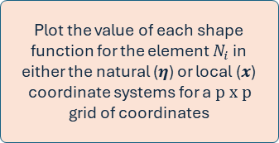
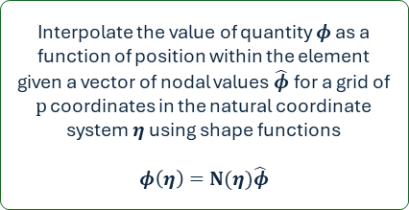




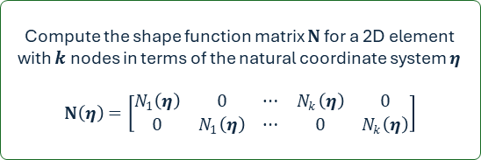






Generic 2D element class
self.shape_n$i$
Compute the value of the shape function for node $i$ as a function of position within the element in terms of the natural coordinate system $η$
$$η=(η_{1}, η_{2})$$
plot_shape_functions
Plot the value of each shape function for the element $N_{i}$ in either the natural ($η$) or local ($x$) coordinate systems for a $p x p$ grid of coordinates
$$N_{i}(η)$$
self.N
Compute the shape function matrix $N$ for a 2D element with $k$ nodes in terms of the natural coordinate system $η$
$$N\left(η\right)=\left[\begin{matrix}N_{1}\left(η\right) & 0 & ⋯ & N_{k}\left(η\right) & 0 \\ 0 & N_{1}\left(η\right) & ⋯ & 0 & N_{k}\left(η\right)\end{matrix}\right]$$
$φ\left(η\right)$: $η$ or $x$ positions within the element
$N_{i}(η)$ or $N_{i}(x)$ within the element
$$η=(η_{1}, η_{2})$$
$$[N_{1}, N_{2}, .., N_{k}]$$
Figure(s)
$$p:grid size$$
$$coord. sys$$
self.get_shape_funcs
$$N(η)$$
Return a list of $k$ shape functions for the element ordered by local node number
self.interpolate
Interpolate the value of quantity $φ$ as a function of position within the element given a vector of nodal values $\hat{φ}$ for a grid of $p$ coordinates in the natural coordinate system $η$ using shape functions
$$φ\left(η\right)=N(η)\hat{φ}$$

Slide 13
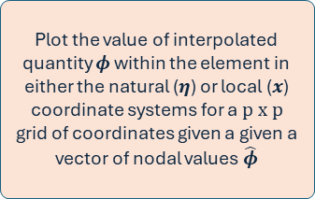



Generic 2D element class
self.shape_n$i$
Compute the value of the shape function for node $i$ as a function of position within the element in terms of the natural coordinate system $η$
$$η=(η_{1}, η_{2})$$
plot_element_field
Plot the value of interpolated quantity $φ$ within the element in either the natural ($η$) or local ($x$) coordinate systems for a $p x p$ grid of coordinates given a given a vector of nodal values $\hat{φ}$
$$N_{i}(η)$$
self.N
Compute the shape function matrix $N$ for a 2D element with $k$ nodes in terms of the natural coordinate system $η$
$$N\left(η\right)=\left[\begin{matrix}N_{1}\left(η\right) & 0 & ⋯ & N_{k}\left(η\right) & 0 \\ 0 & N_{1}\left(η\right) & ⋯ & 0 & N_{k}\left(η\right)\end{matrix}\right]$$
$φ\left(η\right)$: displacements within the element
$φ\left(η\right)$: $η$ or $x$ positions within the element
$φ\left(η\right)$ or $φ\left(x\right):$ displacements within the element
$$η=(η_{1}, η_{2})$$
$$[N_{1}, N_{2}, .., N_{k}]$$
Figure(s)
$$p:grid size$$
$$coord. sys$$
$$q:nodal values$$
self.get_shape_funcs
$$N(η)$$
Return a list of $k$ shape functions for the element ordered by local node number
self.interpolate
Interpolate the value of quantity $φ$ as a function of position within the element given a vector of nodal values $\hat{φ}$ for a grid of $p$ coordinates in the natural coordinate system $η$ using shape functions
$$φ\left(η\right)=N(η)\hat{φ}$$

