Slide 1
Final project
MECH.5130: Theory of Finite Element Analysis
Michael N. Olaya

Slide 2
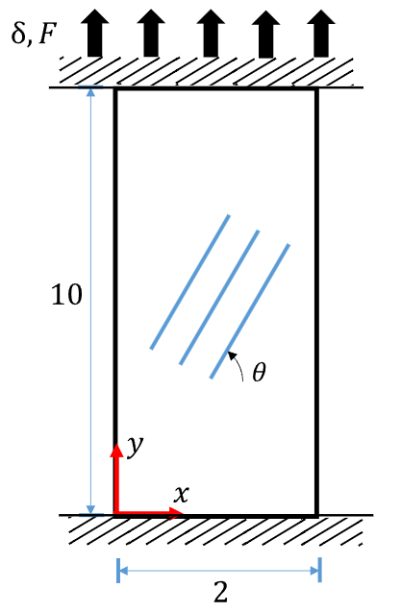
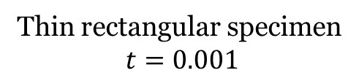
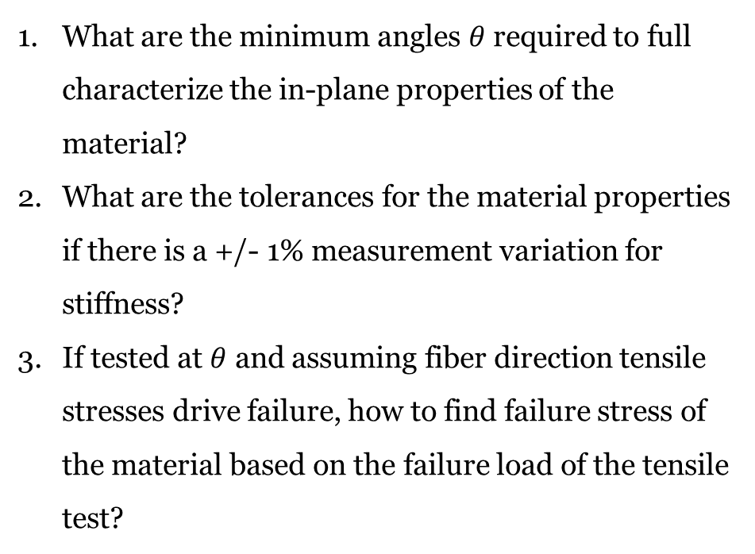
Transversely isotropic materials
What are the minimum angles $θ$ required to full characterize the in-plane properties of the material?
What are the tolerances for the material properties if there is a +/- 1% measurement variation for stiffness?
If tested at $θ$ and assuming fiber direction tensile stresses drive failure, how to find failure stress of the material based on the failure load of the tensile test?
Thin rectangular specimen
$$t=0.001$$

Slide 3
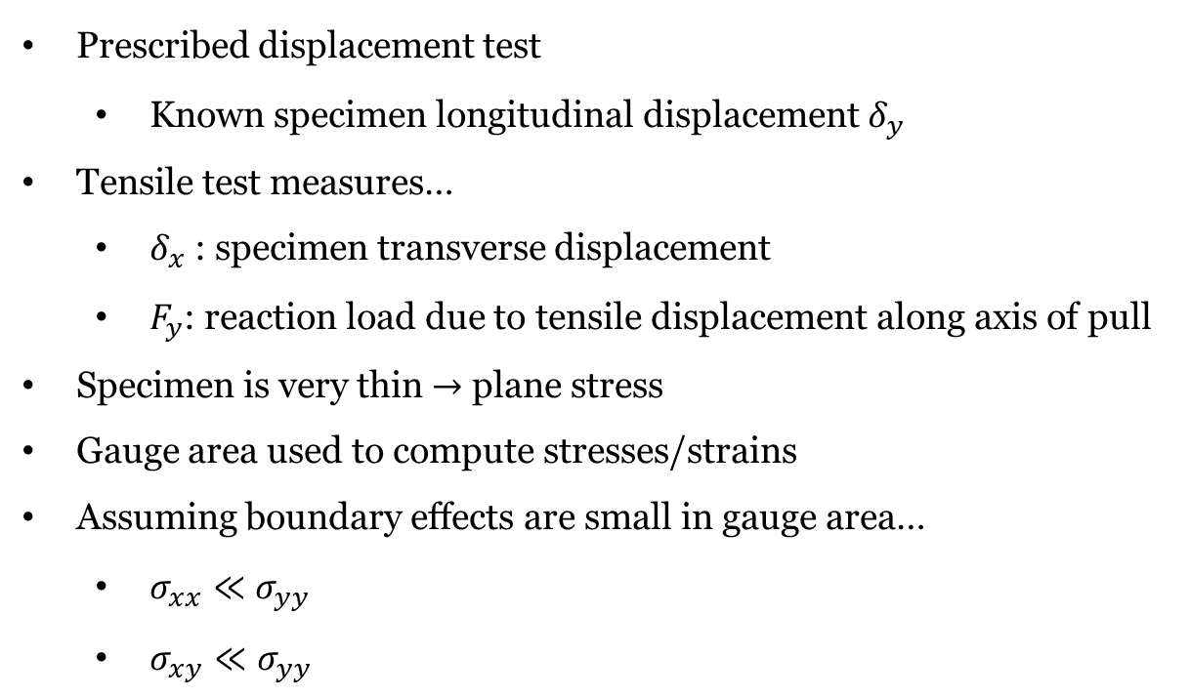
Assumptions
Prescribed displacement test
Known specimen longitudinal displacement $δ_{y}$
Tensile test measures…
$δ_{x}$: specimen transverse displacement
$F_{y}$: reaction load due to tensile displacement along axis of pull
Specimen is very thin $→$ plane stress
Gauge area used to compute stresses/strains
Assuming boundary effects are small in gauge area…
$σ_{xx}≪σ_{yy}$
$σ_{xy}≪σ_{yy}$
1
Gauge area
1

Slide 4
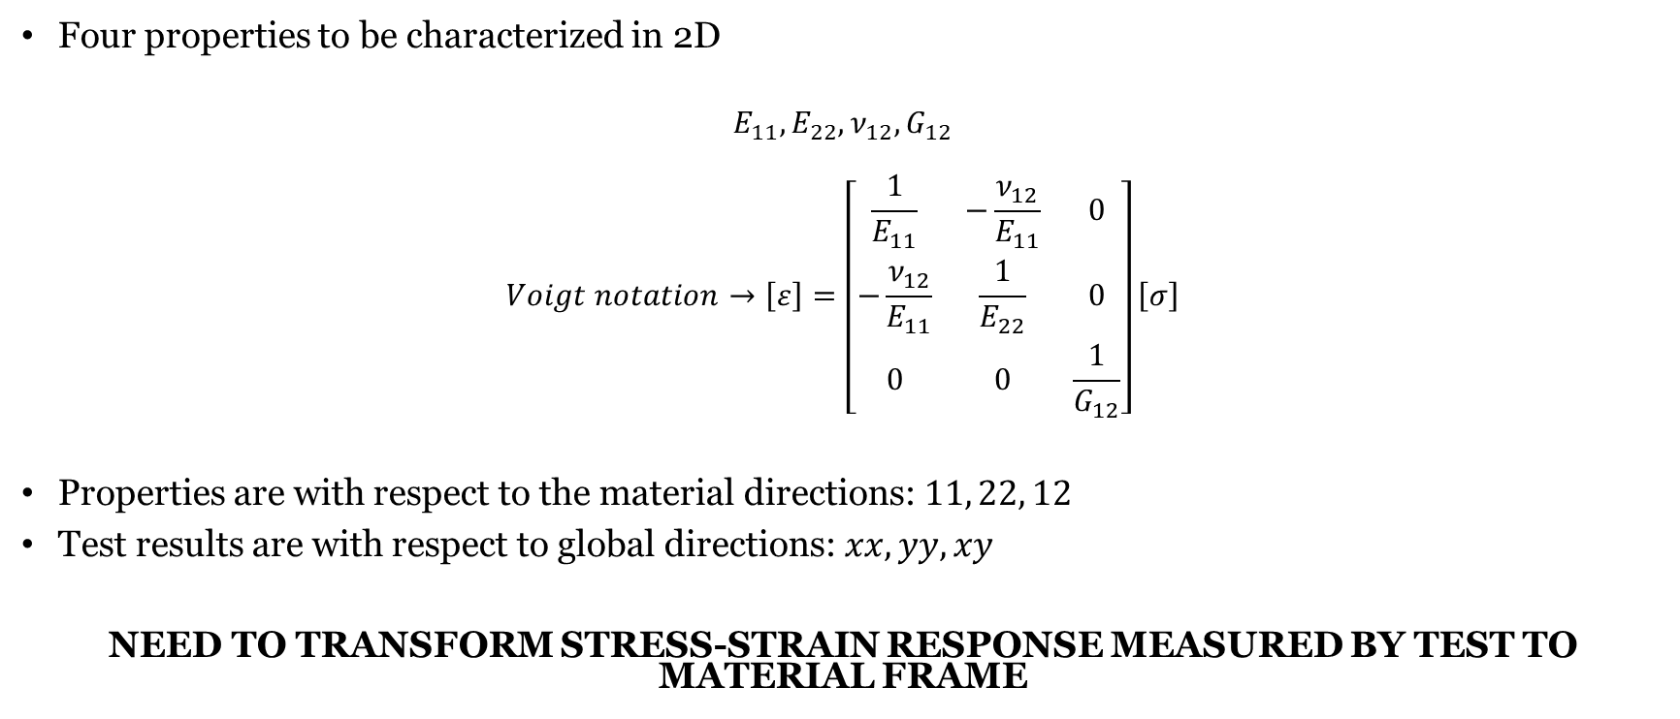
Material properties
Four properties to be characterized in 2D
$$E_{11}, E_{22}, ν_{12},G_{12}$$
$$Voigt notation→\left[ε\right]=\left[\begin{matrix}\frac{1}{E_{11}} & −\frac{ν_{12}}{E_{11}} & 0 \\ −\frac{ν_{12}}{E_{11}} & \frac{1}{E_{22}} & 0 \\ 0 & 0 & \frac{1}{G_{12}}\end{matrix}\right]\left[σ\right]$$
Properties are with respect to the material directions: $11, 22, 12$
Test results are with respect to global directions: $xx, yy, xy$
NEED TO TRANSFORM STRESS-STRAIN RESPONSE MEASURED BY TEST TO MATERIAL FRAME

Slide 5

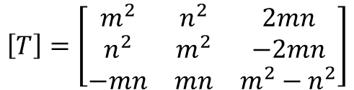






Transforming stress and strain in 2D
Transformation matrix $[T]$
y
2
1
$$m=\cos\left(θ\right), n=\sin\left(θ\right);θ=CCW+$$
$$θ$$
x
$$\left[T\right]=\left[\begin{matrix}m^{2} & n^{2} & 2mn \\ n^{2} & m^{2} & −2mn \\ −mn & mn & m^{2}−n^{2}\end{matrix}\right]$$
Global
(x, y)
Local/material
(1, 2)
Coupling local material properties in local system $[S]$ with stress-strain response in global
$${\left[ε\right]}^{local}=\left[T\right]{\left[ε\right]}^{global}$$
$${\left[σ\right]}^{local}=\left[T\right]{\left[σ\right]}^{global}$$
$${\left[ε\right]}^{local}=\left[S\right][σ]^{local}$$
$$\left[T\right]{\left[ε\right]}^{global}=\left[S\right][σ]^{global}$$

Slide 6

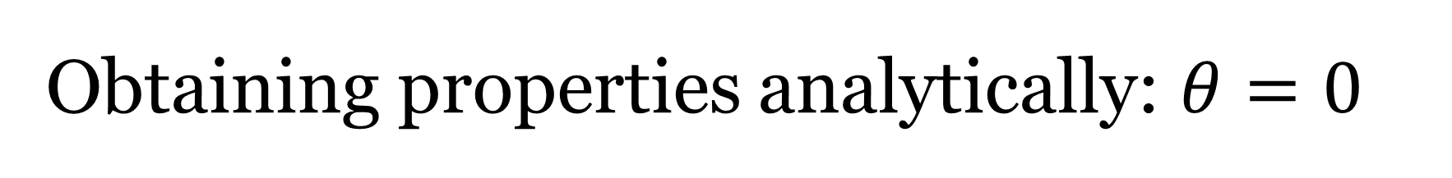
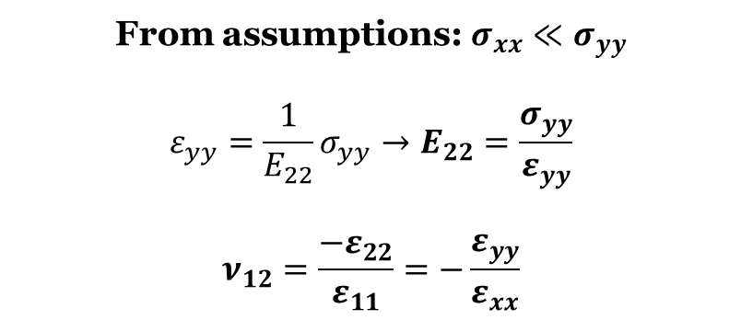
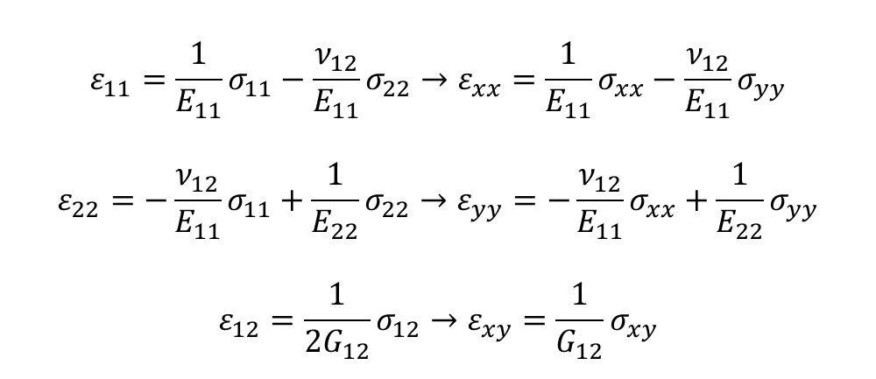
Obtaining properties analytically: $θ=0$
$$θ=0°$$
$$m=\cos\left(0\right)=1, n=\sin\left(0\right)=0$$
$$\left[T\right]=\left[\begin{matrix}1 & 0 & 0 \\ 0 & 1 & 0 \\ 0 & 0 & 1\end{matrix}\right]$$
$$ε_{11}=\frac{1}{E_{11}}σ_{11}−\frac{ν_{12}}{E_{11}}σ_{22}→ε_{xx}=\frac{1}{E_{11}}σ_{xx}−\frac{ν_{12}}{E_{11}}σ_{yy}$$
$$ε_{22}=−\frac{ν_{12}}{E_{11}}σ_{11}+\frac{1}{E_{22}}σ_{22}→ε_{yy}=−\frac{ν_{12}}{E_{11}}σ_{xx}+\frac{1}{E_{22}}σ_{yy}$$
$$ε_{12}=\frac{1}{2G_{12}}σ_{12}→ε_{xy}=\frac{1}{G_{12}}σ_{xy}$$
y
2
From assumptions: $σ_{xx}≪σ_{yy}$
$$ε_{yy}=\frac{1}{E_{22}}σ_{yy}→E_{22}=\frac{σ_{yy}}{ε_{yy}}$$
$$ν_{12}=\frac{−ε_{22}}{ε_{11}}=−\frac{ε_{yy}}{ε_{xx}}$$
x
1
Global
(x, y)
Local/material
(1, 2)

Slide 7

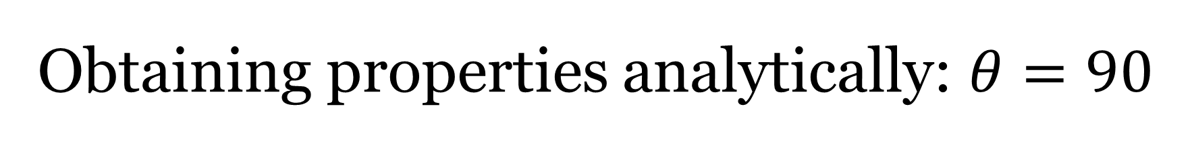
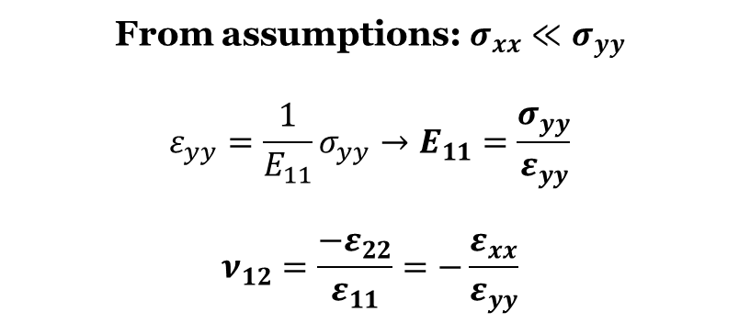
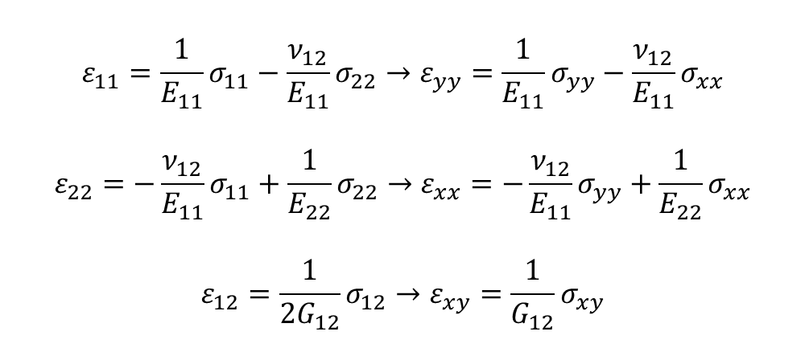
Obtaining properties analytically: $θ=90$
$$θ=90°$$
$$m=\cos\left(90\right)=0, n=\sin\left(90\right)=1$$
$$\left[T\right]=\left[\begin{matrix}0 & 1 & 0 \\ 1 & 0 & 0 \\ 0 & 0 & −1\end{matrix}\right]$$
$$ε_{11}=\frac{1}{E_{11}}σ_{11}−\frac{ν_{12}}{E_{11}}σ_{22}→ε_{yy}=\frac{1}{E_{11}}σ_{yy}−\frac{ν_{12}}{E_{11}}σ_{xx}$$
$$ε_{22}=−\frac{ν_{12}}{E_{11}}σ_{11}+\frac{1}{E_{22}}σ_{22}→ε_{xx}=−\frac{ν_{12}}{E_{11}}σ_{yy}+\frac{1}{E_{22}}σ_{xx}$$
$$ε_{12}=\frac{1}{2G_{12}}σ_{12}→ε_{xy}=\frac{1}{G_{12}}σ_{xy}$$
y
1
From assumptions: $σ_{xx}≪σ_{yy}$
$$ε_{yy}=\frac{1}{E_{11}}σ_{yy}→E_{11}=\frac{σ_{yy}}{ε_{yy}}$$
$$ν_{12}=\frac{−ε_{22}}{ε_{11}}=−\frac{ε_{xx}}{ε_{yy}}$$
x
2
Global
(x, y)
Local/material
(1, 2)

Slide 8

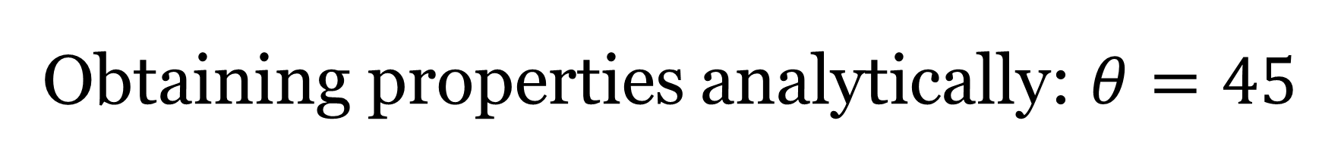
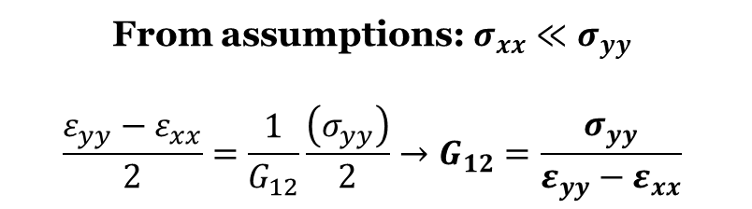
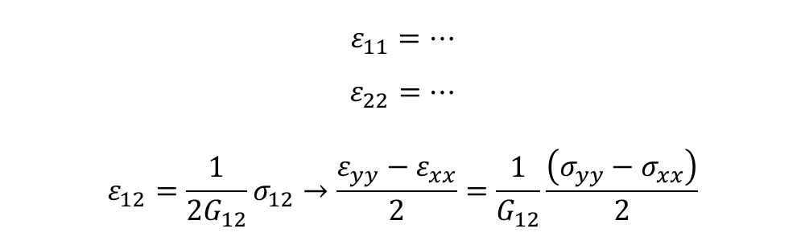
Obtaining properties analytically: $θ=45$
$$θ=45°$$
$$m=\cos\left(45\right)=\frac{\sqrt{2}}{2}, n=\sin\left(45\right)=\frac{\sqrt{2}}{2}$$
$$\left[T\right]=\left[\begin{matrix}0.5 & 0.5 & 1 \\ 0.5 & 0.5 & −1 \\ −0.5 & 0.5 & 0\end{matrix}\right]$$
$$ε_{11}=…$$
$$ε_{22}=…$$
$$ε_{12}=\frac{1}{2G_{12}}σ_{12}→\frac{ε_{yy}−ε_{xx}}{2}=\frac{1}{G_{12}}\frac{\left(σ_{yy}−σ_{xx}\right)}{2}$$
y
From assumptions: $σ_{xx}≪σ_{yy}$
$$\frac{ε_{yy}−ε_{xx}}{2}=\frac{1}{G_{12}}\frac{\left(σ_{yy}\right)}{2}→G_{12}=\frac{σ_{yy}}{ε_{yy}−ε_{xx}}$$
2
1
x
Global
(x, y)
Local/material
(1, 2)

Slide 9
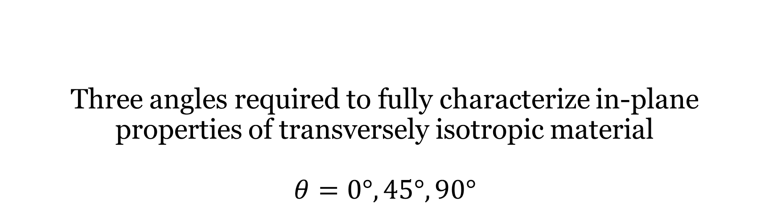
Three angles required to fully characterize in-plane properties of transversely isotropic material $$θ=0°, 45°,90°$$

Slide 10
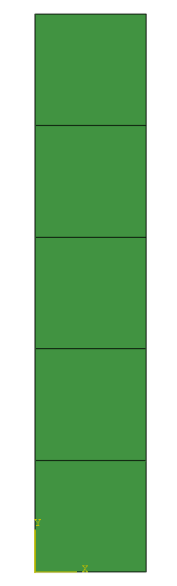
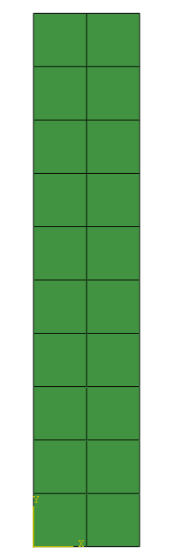
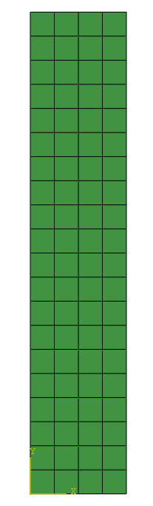
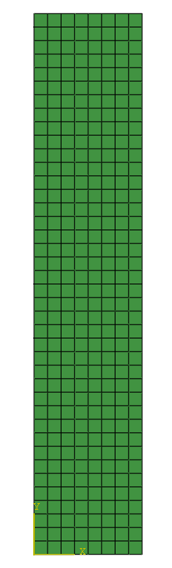
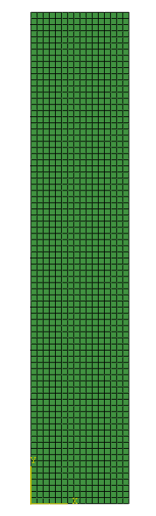
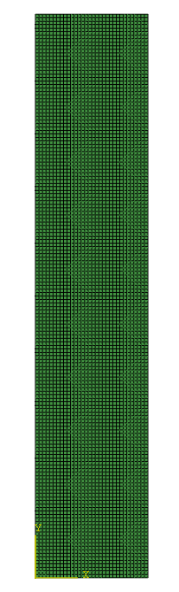
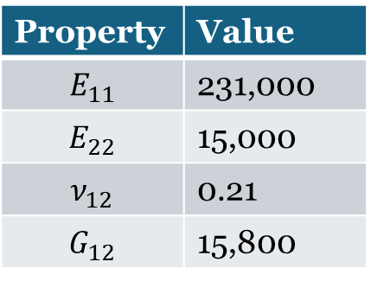
Verification through finite elements
6 finite element models generated with increasing mesh density (linear elements)
Input material properties of AS4-carbon fibers
Property | Value
$$E_{11}$$ | 231,000
$$E_{22}$$ | 15,000
$$ν_{12}$$ | 0.21
$$G_{12}$$ | 15,800
5
20
80
320
1280
5120

Slide 11

Boundary conditions
$δ=0.1$
Thickness = 0.001
Bottom edge
$u_{x}=0, u_{y}=0$
Top edge
$u_{x}=0, u_{y}=δ$
1
Gauge area
1

Slide 12
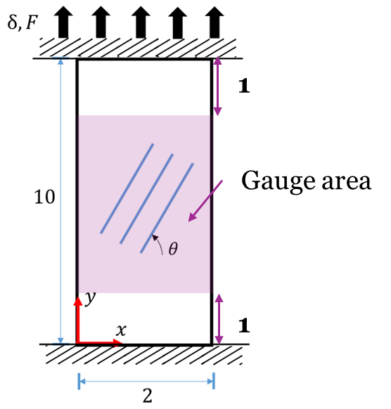
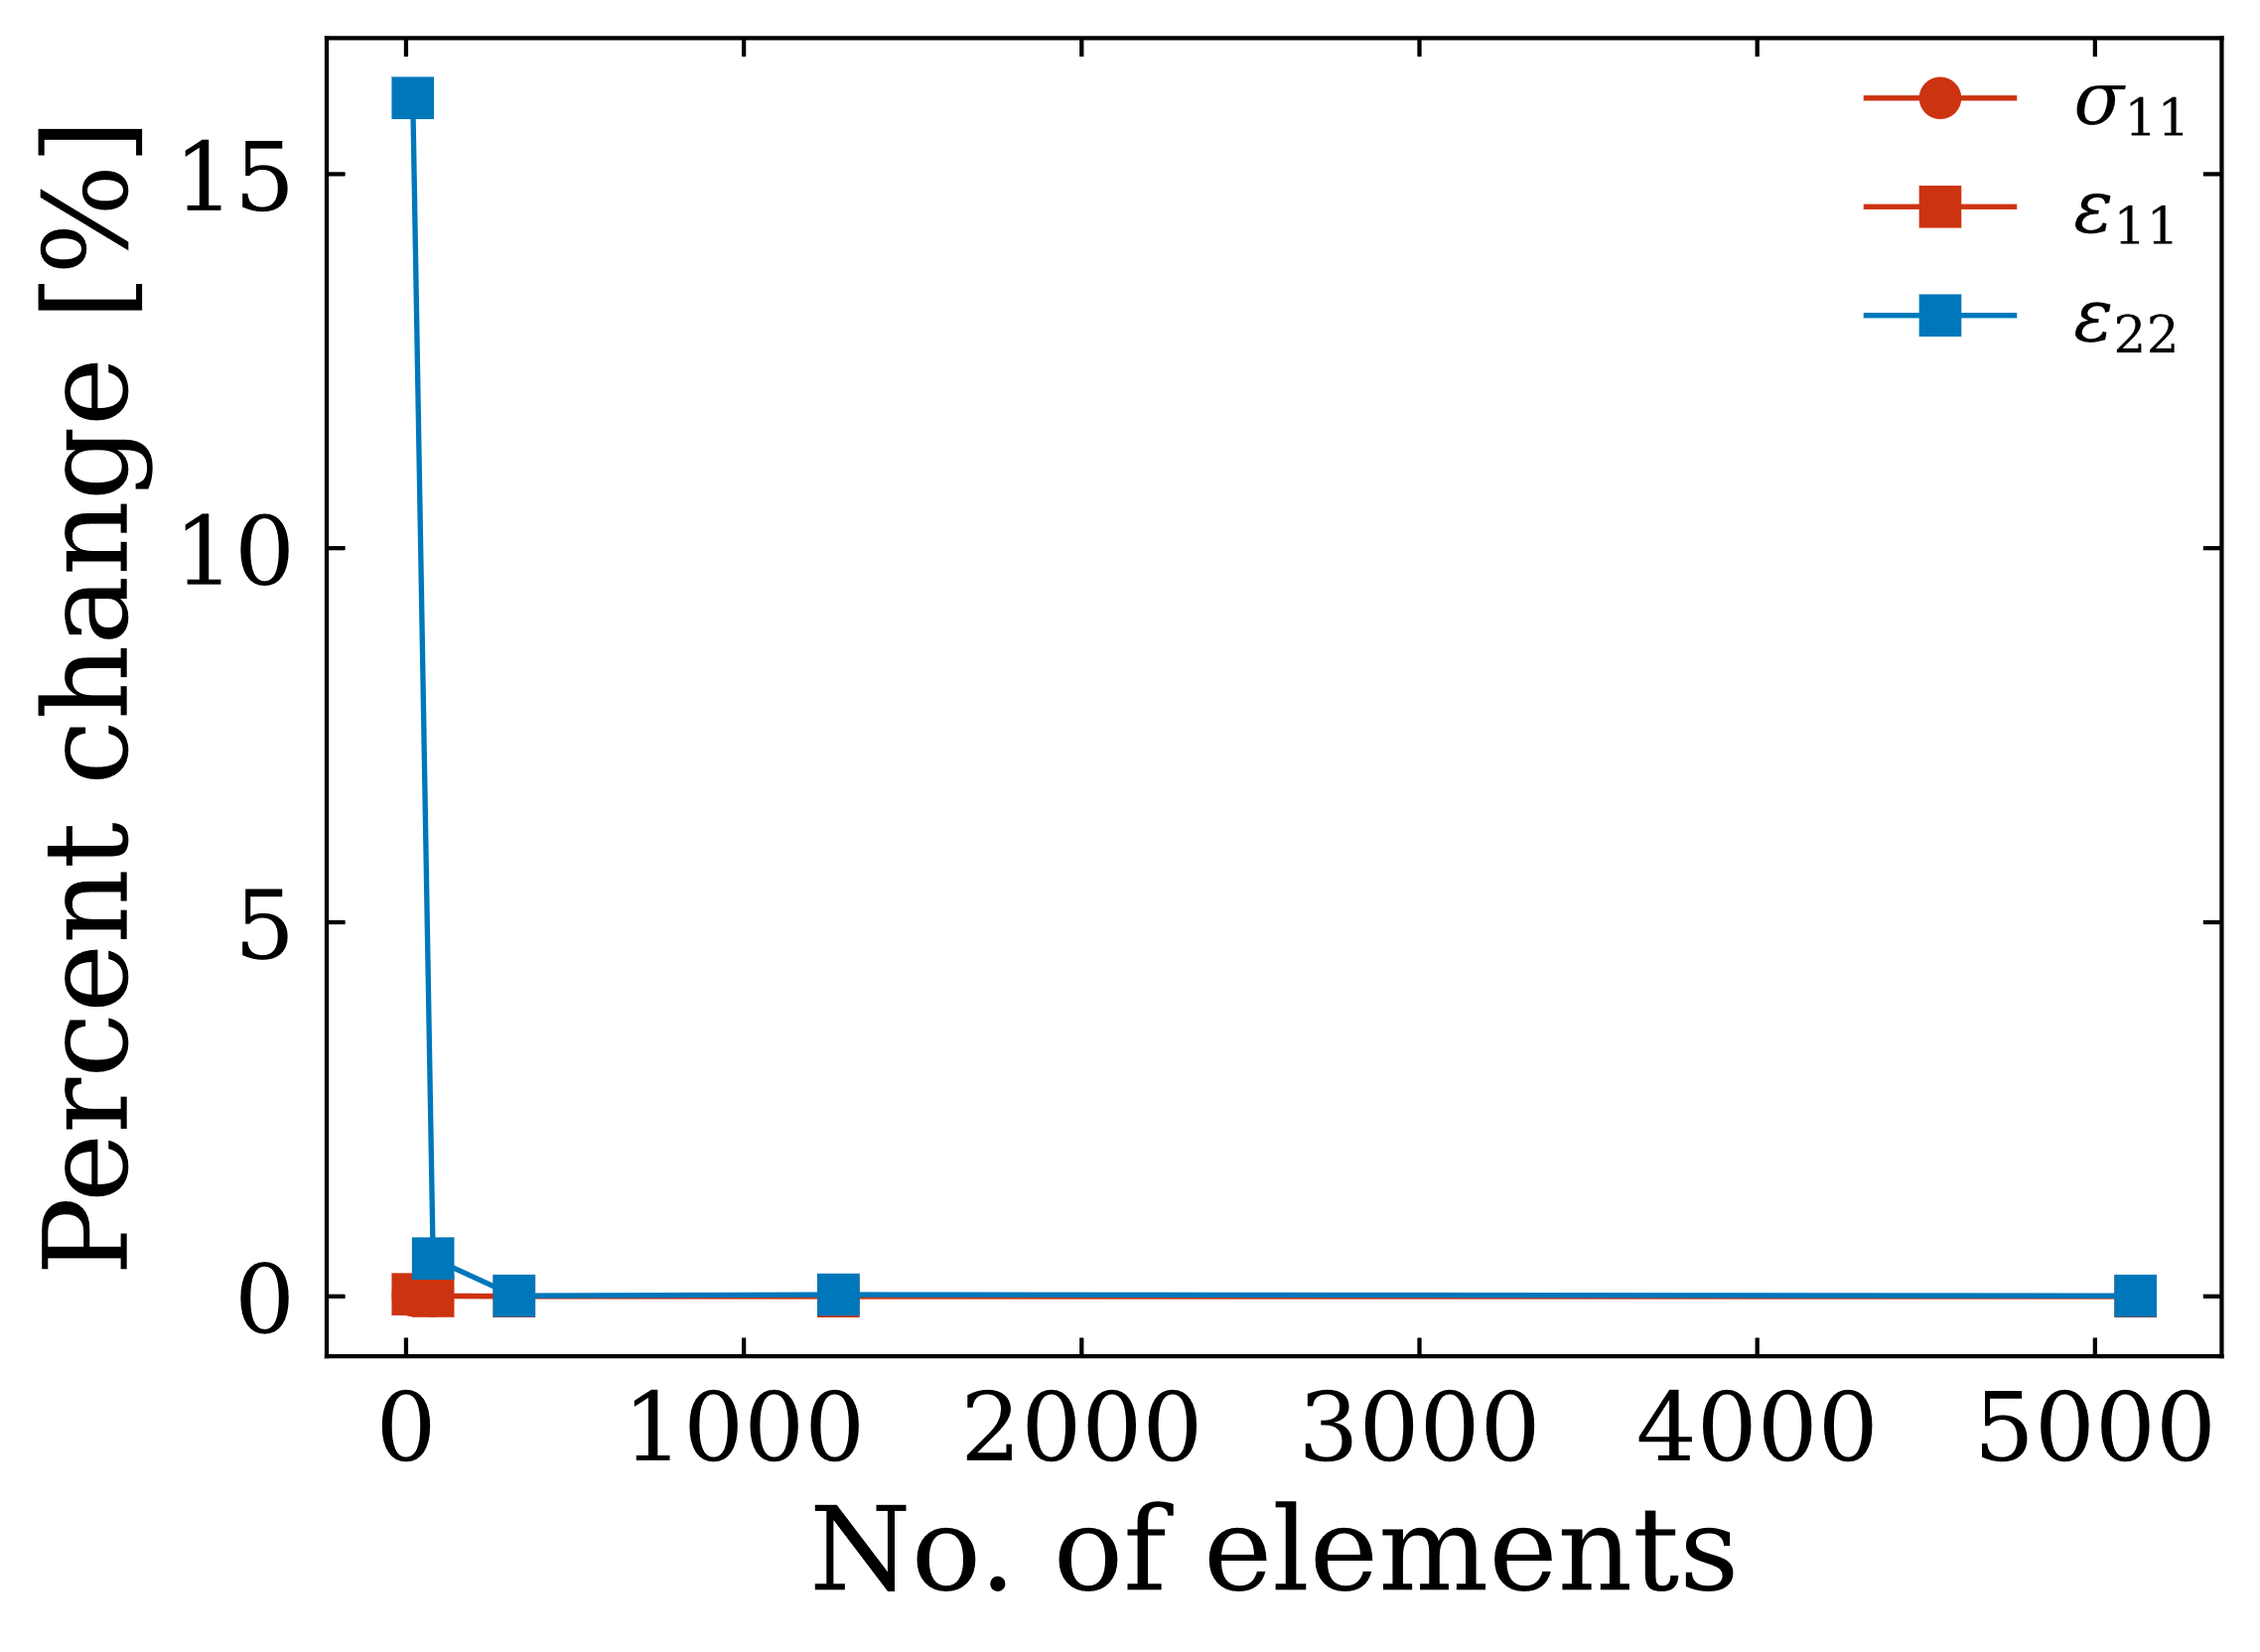
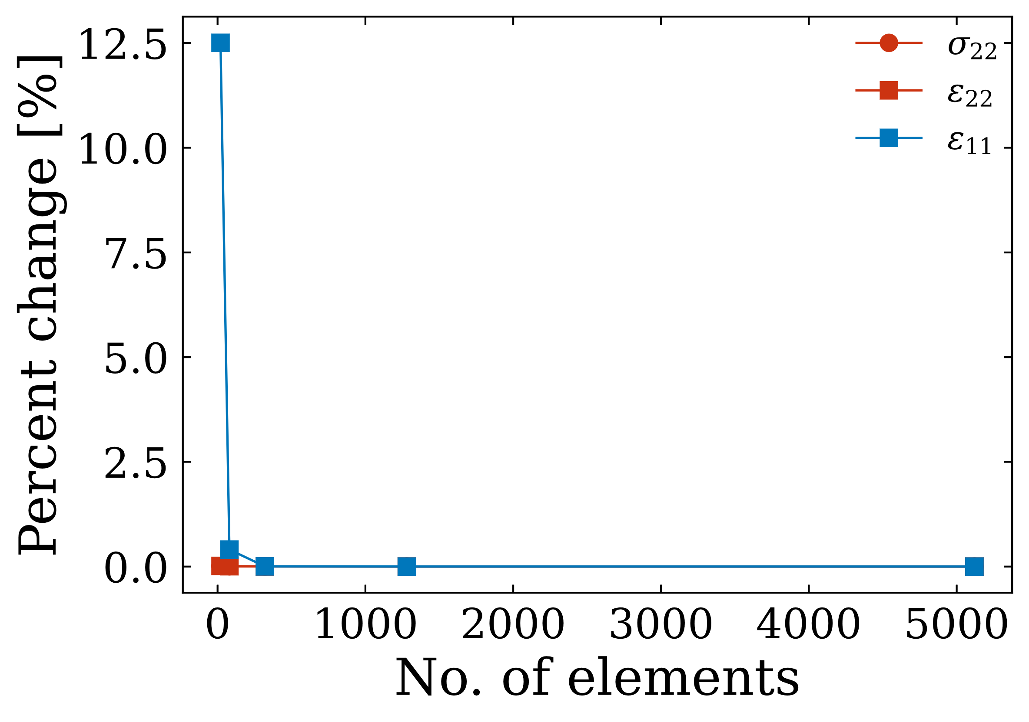
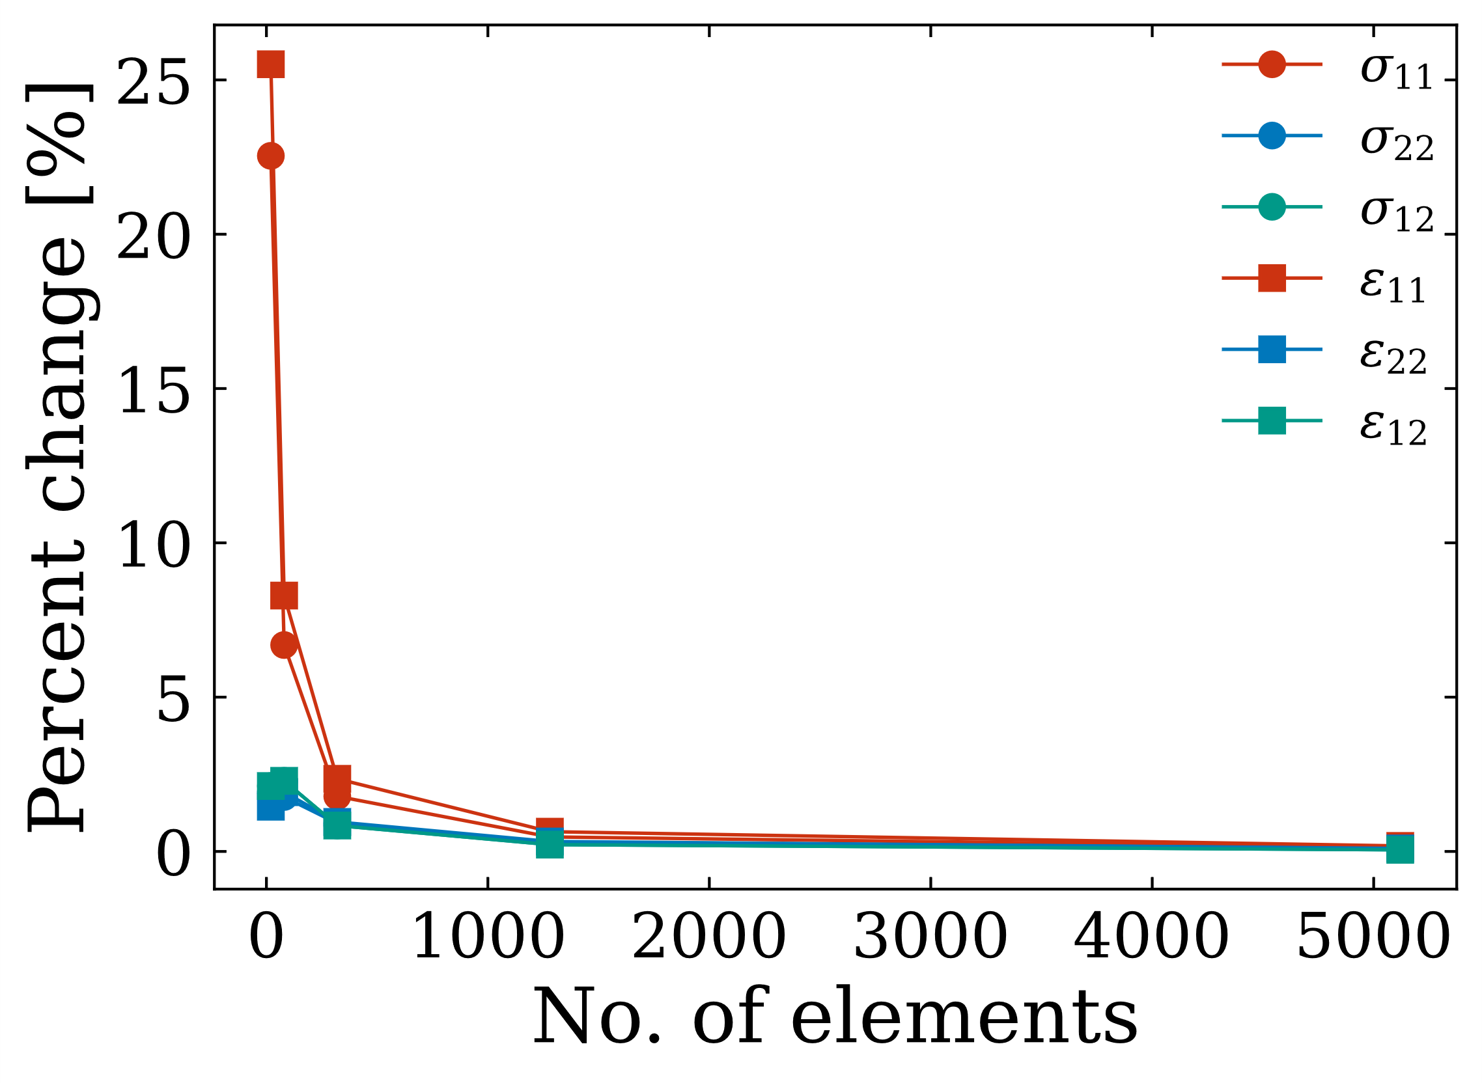



Convergence study
Simulations performed with my FE solver
Results shown are average from gauge area
$$θ=90°$$
$$θ=0°$$
$$θ=45°$$
Stress/strain convergence for all cases (% change < 5%) at approximately 320 elements

Slide 13
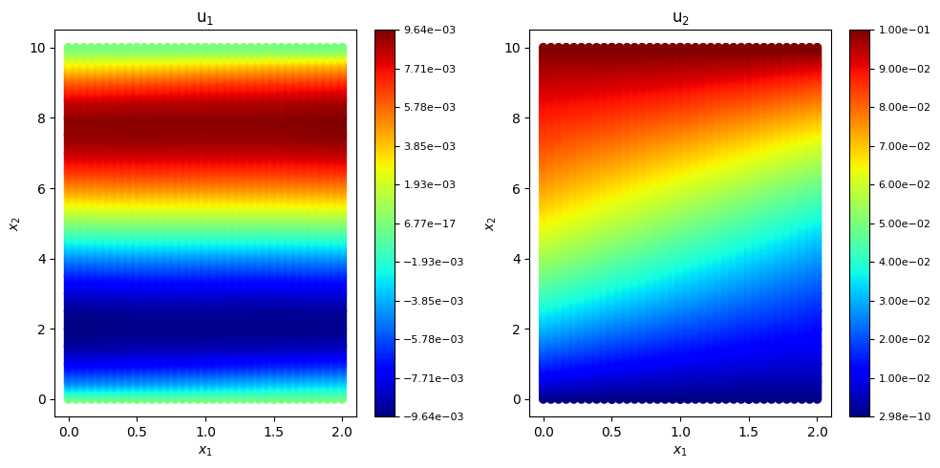
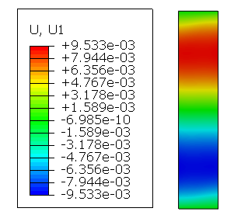
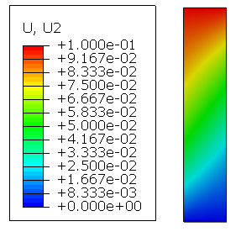

Compared with Abaqus for $θ=45°$

Slide 14
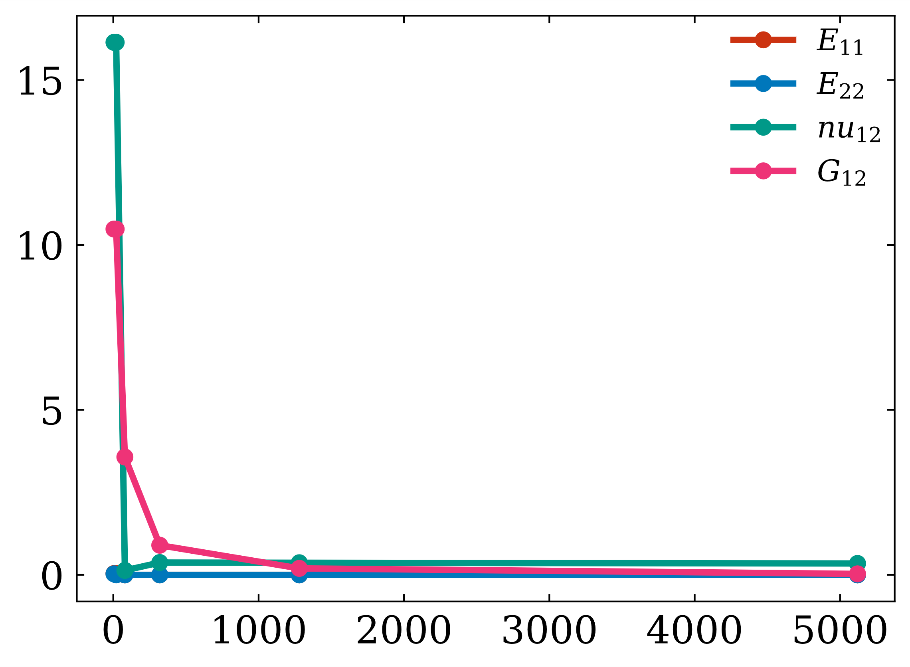
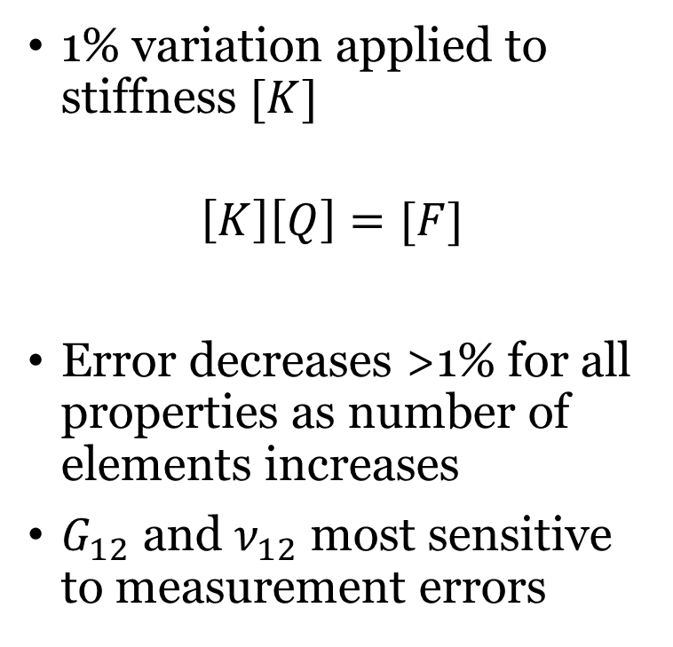
Sensitivity study
1% variation applied to stiffness $[K]$
$$\left[K\right]\left[Q\right]=[F]$$
Error decreases >1% for all properties as number of elements increases
$G_{12}$ and $ν_{12}$ most sensitive to measurement errors

Slide 15
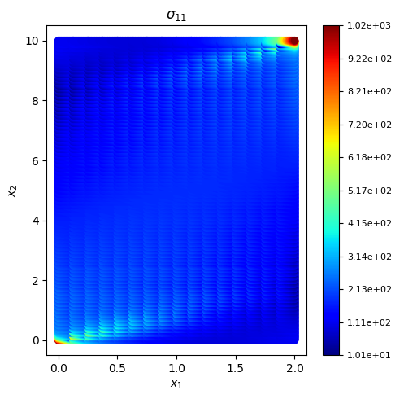
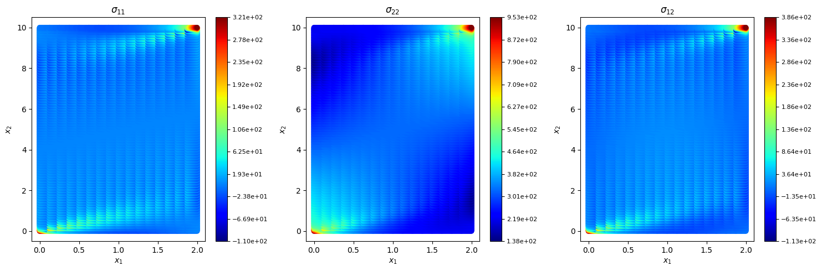



Strength dominated by the fiber direction
Transform to angle $θ$ and get stresses in fiber direction $σ_{11}$
$$σ^{cr}=σ_{11}=σ_{xx}m^{2}+σ_{yy}n^{2}+2σ_{xy}mn$$
$$σ_{xx}$$
$$σ_{yy}$$
$$σ_{xy}$$

Slide 16
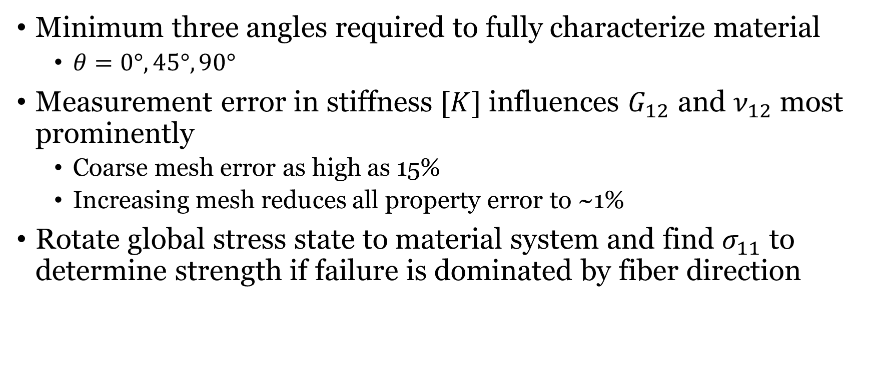
Conclusion
Minimum three angles required to fully characterize material
$θ=0°,45°,90°$
Measurement error in stiffness $[K]$ influences $G_{12}$ and $ν_{12}$ most prominently
Coarse mesh error as high as 15%
Increasing mesh reduces all property error to ~1%
Rotate global stress state to material system and find $σ_{11}$ to determine strength if failure is dominated by fiber direction

Slide 17
Questions

