Slide 1
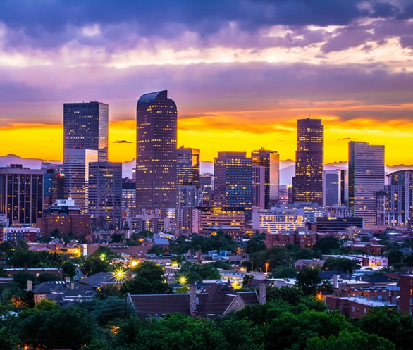
Criminal Weather
Analysis of Crime & Weather in the city of Denver
Melanie Nolker
Lisa Stroh
Kathy Nguyen
April Lagnevall
Haifa Najdawi

Slide 2
Motivation & Summary
Does weather have an impact on a crime?
Find if there is a correlation in non-traffic crime in the city of Denver compared to various weather conditions.
Hypothesis: Weather has an impact on non-traffic crime in Denver.
Null Hypothesis: Weather does not affect non-traffic crime in Denver.

Slide 3
Questions & Data
Is there a correlation between crime & weather?
What type of offenses will be used to analyze crime rates?
What weather conditions will be used to compare to offenses?
Datasets Used:
Crime data: https://www.denvergov.org/opendata/dataset/city-and-county-of-denver-crime
Denver city crime from 1-1-2016 to 9-9-20
Weather data: https://www.worldweatheronline.com/developer/api/docs/historical-weather-api.aspx#qparameter
Weather API = API and pulls weather data for every day from 1/1/2016 to 8/31/2020
pull multiple weather conditions

Slide 4
Data Cleanup & Exploration
Violent Crime:
filter for "Is Crime" = 1
Excluded traffic related offenses
Grouped .csv data by: Occurrence_date & OFFENSE_TYPE_ID
Denver Weather:
avg temperature (F)>>>-
Averaged daily rate
avg precipitation (inches)>>>- avg cloud cover (%)>>>- avg wind speed (mph)

Slide 5
Data Analysis
<answer>
Discuss the steps you took to analyze the data and answer each question you asked in your proposal
Present and discuss interesting figures developed during analysis, ideally with the help of Jupyter Notebook

Slide 6
Discussion
<answer>
Discuss your findings. Did you find what you expected to find? If not, why not? What inferences or general conclusions can you draw from your analysis?

Slide 7
Post Mortem
<answer>
Discuss any difficulties that arose, and how you dealt with them
Discuss any additional questions that came up, but which you didn't have time to answer: What would you research next, if you had two more weeks?

Slide 8
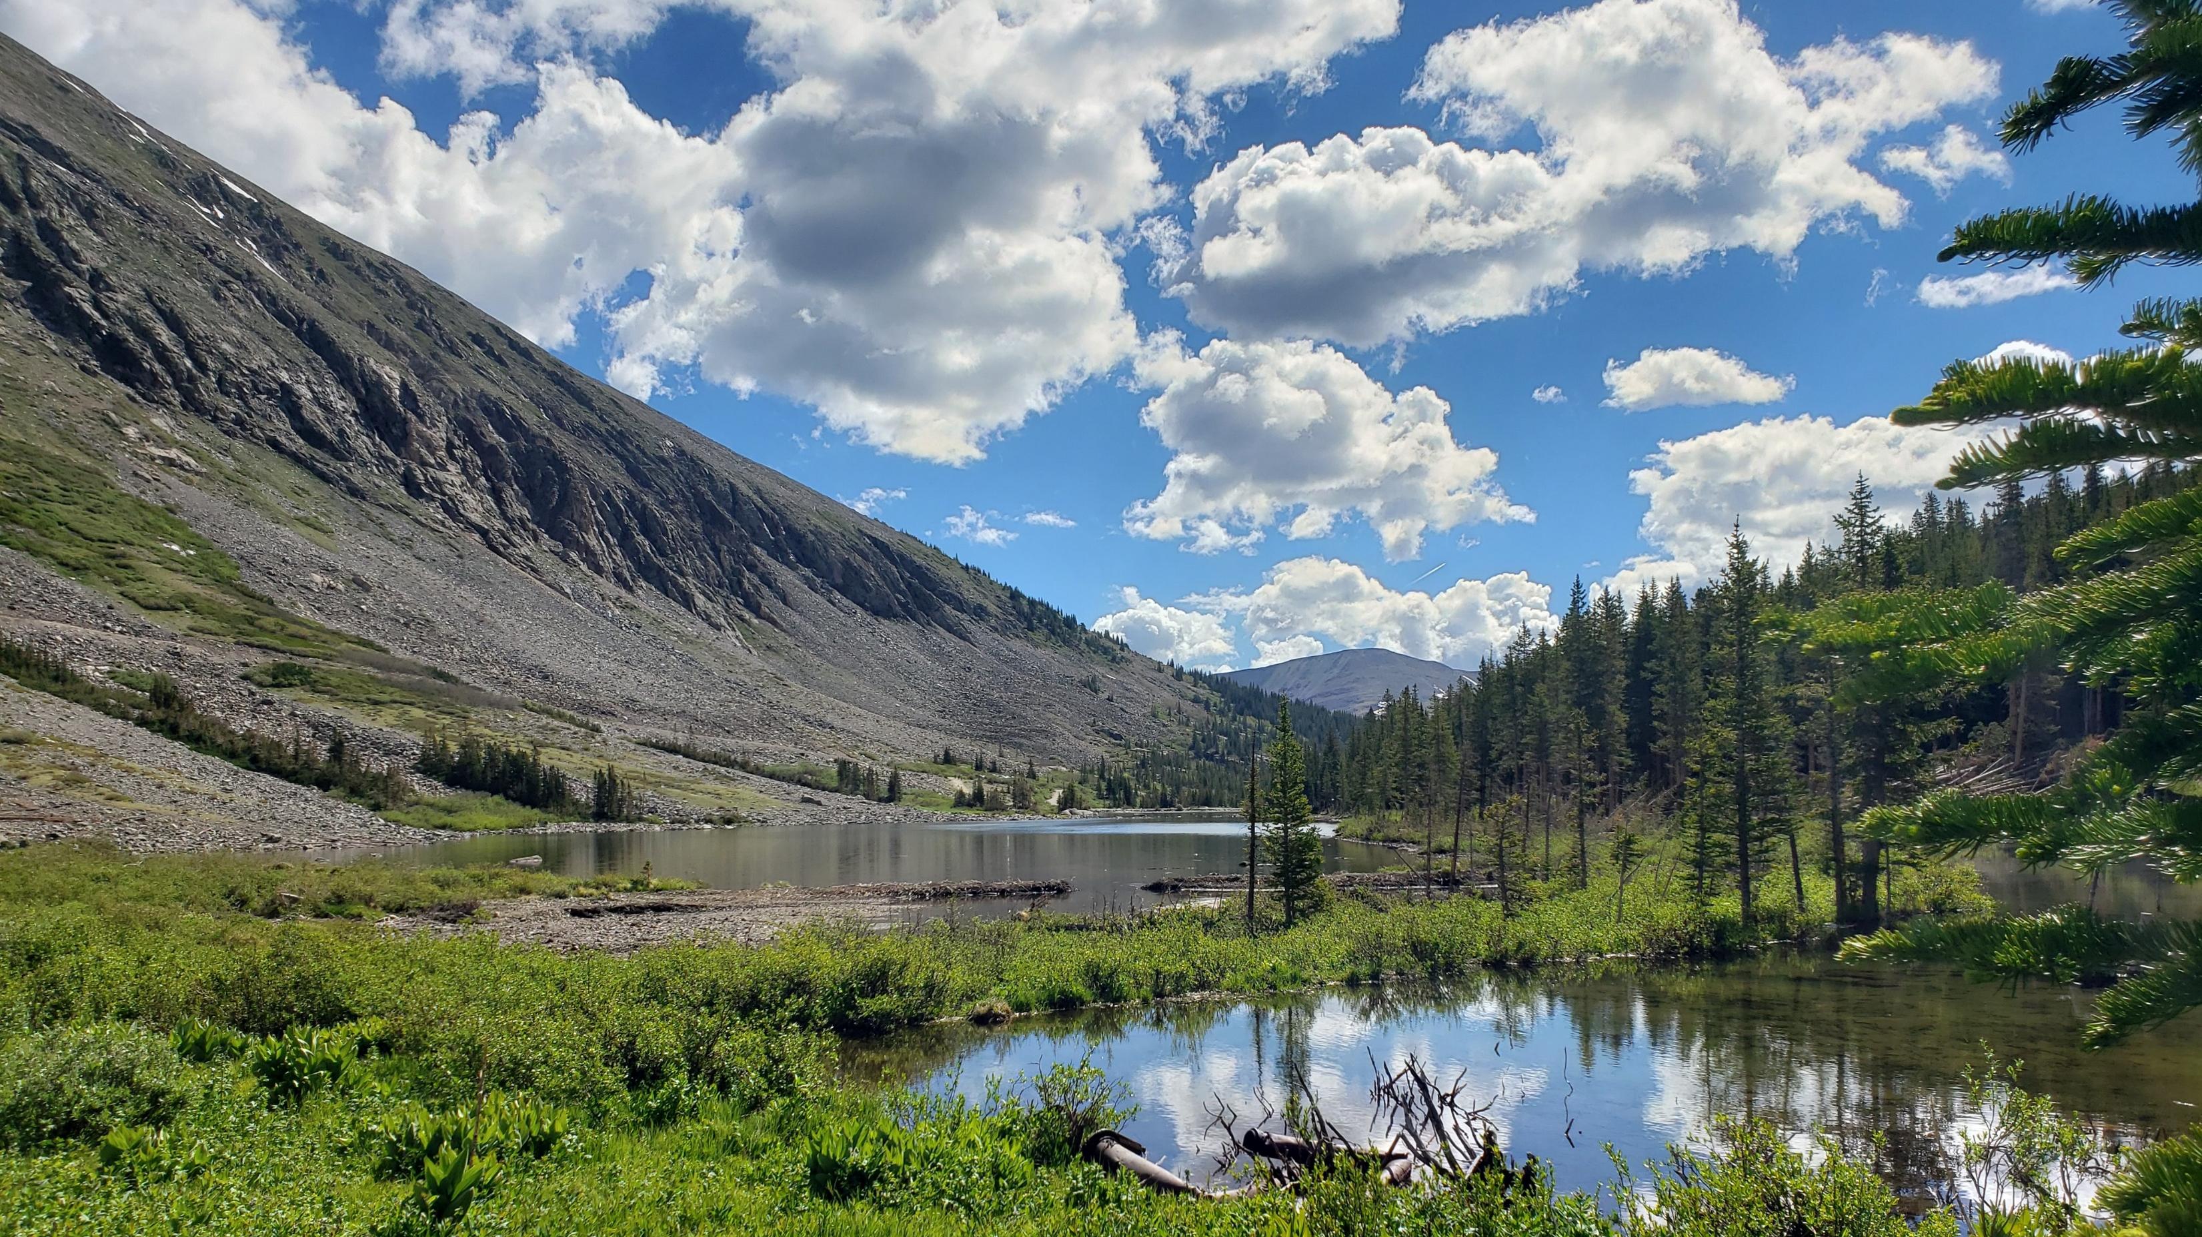
Questions?

