Slide 1
WE WILL START 10:10PM
Lets Join All Members

Slide 2
0.0 TO MERN STACK
The Road Map

Slide 3
Zero to MERN Stack : Step 01
HTML : Form W3School, Tutorials point, JavatPoint
CSS : Form W3School, Tutorials point, JavatPoint
CSS/Style Framework : Bootstrap , Tailwind
Homework: Simple Web Page, Form, Table , Multipage Static Website

Slide 4
Zero to MERN Stack : Step 02
JavaScript :
JavaScript Basic Syntax , Objects, BOM, DOM, Validation, OOPs
Cookies, Events, Exception Handling, Array, Loop, Collection
JavaScript JSON , Ajax
JavaScript Homework :
Login registration, contact, form with validation
Coming soon page, with contact form & count down timer
Realtime currency using free Rest API
Weather app free Rest API

Slide 5
Zero to MERN Stack : Step 03
JavaScript ES6 :
ES6 Functions, Array, Object, Class, String
ES6 Module, Export, Import
Introduce with Node JS

Slide 6
Zero to MERN Stack : Step 04
Node JS Mongo Fundamental :
Node JS server, module
Synchronous Asynchronous
File read, write
Creating routes
Mongo DB Commands, Installation
Node JS MongoDB
Homework:
1. CRUD Practice project with Node JS mongo dB

Slide 7
Zero to MERN Stack : Step 05
Express JS Fundamental :
Express.js Request
Express.js Response
Express.js Get
Express.js Post
Express.js Routing
Express.js Cookies
Express.js File Upload
Express.js Middleware
Homework:
CRUD Practice with Express JS mongo dB
TODO Practice with Express JS mongo dB

Slide 8
Zero to MERN Stack : Step 06
React JS Fundamental :
Project Structure
JSX, Components
Class component, state, life cycle
Functional component, hooks
React routing, validation
Using Rest API with react.
Homework:
Login registration, contact, form with validation
Coming soon page, with contact form & count down timer
Realtime currency using free Rest API
Weather app free Rest API

Slide 9
Zero to MERN Stack : Step 07
MERN Fundamental :
Project Structure
Express Back-End Packages
MongoDB Packages
React Front-End Packages
Authentication & Authorization
Homework:
Full Stack CURD Project
Full Stack Todo Project
Full Stack Simple Expense Manager

Slide 10
Zero to MERN Stack : Step 08
MERN Back End Node Packages :
Express JS
body-parser
cookie-parser
Cors
Dotenv
Express-mongo-sanitize
Express-rate-limit
Hpp
Helmet
Json web token
Mongoose
Multer
xss-clean

Slide 11
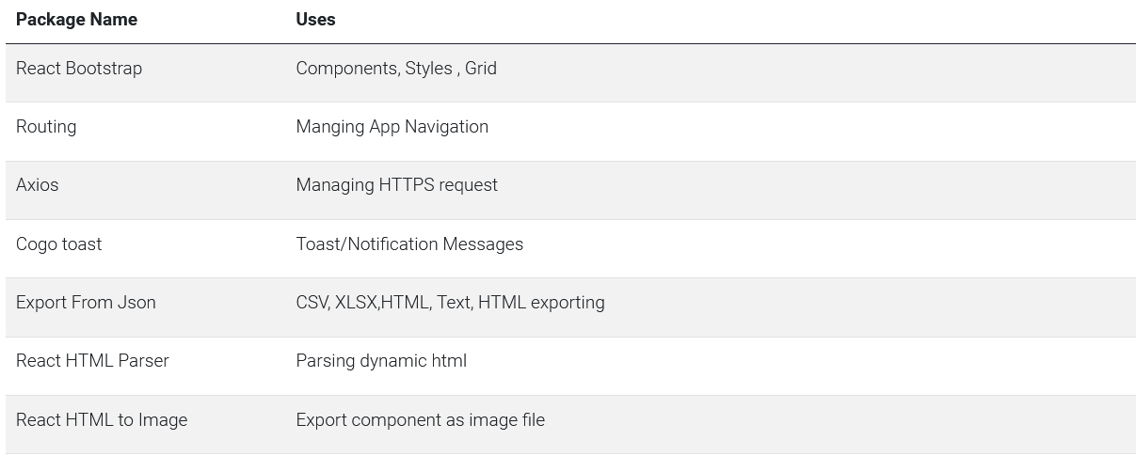
Zero to MERN Stack : Step 09
MERN Front End React Packages :

Slide 12
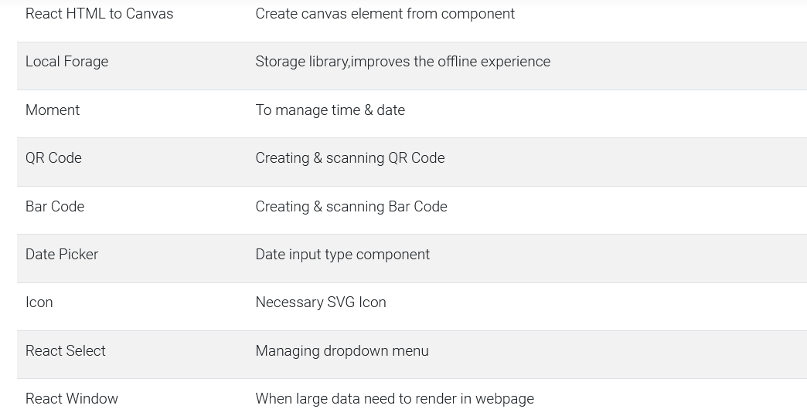
Zero to MERN Stack : Step 09
MERN Front End React Packages :

Slide 13
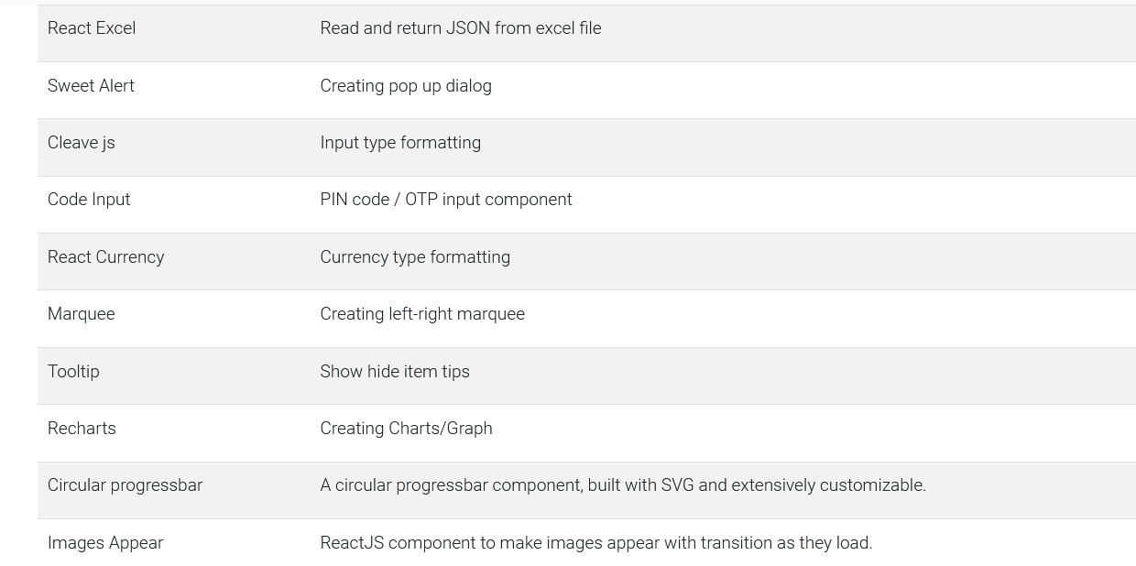
Zero to MERN Stack : Step 09
MERN Front End React Packages :

Slide 14
Zero to MERN Stack : Step 10 Final
Full Phase Project :
Entertainment OTT Platform
Ecommerce
Inventory Application

