Slide 1
Beyond Accuracy
A Clinical Validation Approach to CVD Prediction Using Machine Learning
Melissa Nooney
M.S. Data Science | Merrimack College | May 2026
Presented to: Clinical AI/ML Developers & Cardiologists
1

Slide 2
The Problem: When Accuracy Isn't Enough
Research Question
• Cardiovascular disease is the leading cause of death globally, accounting for 19.8 millions death annually(WHO, 2022)
• Gaps in detection include: socioeconomic constraints, underestimation of CV risk, and underuse of digital health such as AI based machine learning tools. (Dores et al, 2025)
• The ultimate cost of a missed diagnosis is death.
How should ML model performance be evaluated to assess clinically appropriate CVD risk given sensitivity/specificity tradeoffs?
Hypothesis & Prediction
Optimizing sensitivity reduces false negatives but increases false positives. Missed diagnosis risks patients' lives, while overcalling drives patient anxiety, costs, and erodes trust. The goal is to find the threshold where the tradeoff is defensible.
Cost-sensitive learning will improve performance, and ensemble methods will outperform Logistic Regression.
2

Slide 3
The Data: UCI Heart Disease Dataset
297
Patients
16
Features
45.9 %
CVD Present
1988
Cleveland Clinic
• Represents patients referred for cardiac stress testing
• Variables include demographic, clinical, and diagnostic measurements.
• 303 original rows, 6 rows with missing values removed
• Aging dataset
Response Variable
CVD Present vs Absent
Binary outcome — 1 = CVD Present, 0 = No CVD
This outcome was chosen because it links directly to the decision – does this patient have CVD- does it require intervention?
3

Slide 4
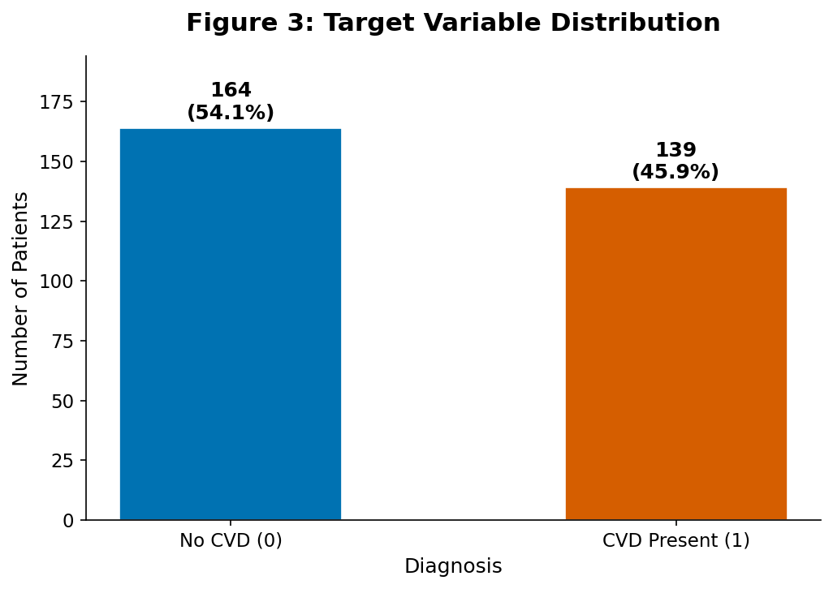
Data Preparation
Cleaning & Preprocessing
• 6 rows removed (MCAR confirmed)
• 72/28 stratified train/test split
• One-hot encoding for nominal variables
• Box-Cox transformation (chol, oldpeak)
• StandardScaler on continuous variables
• CSL selected over SMOTE
• Final dataset: 297 patients, 16 features
4

Slide 5
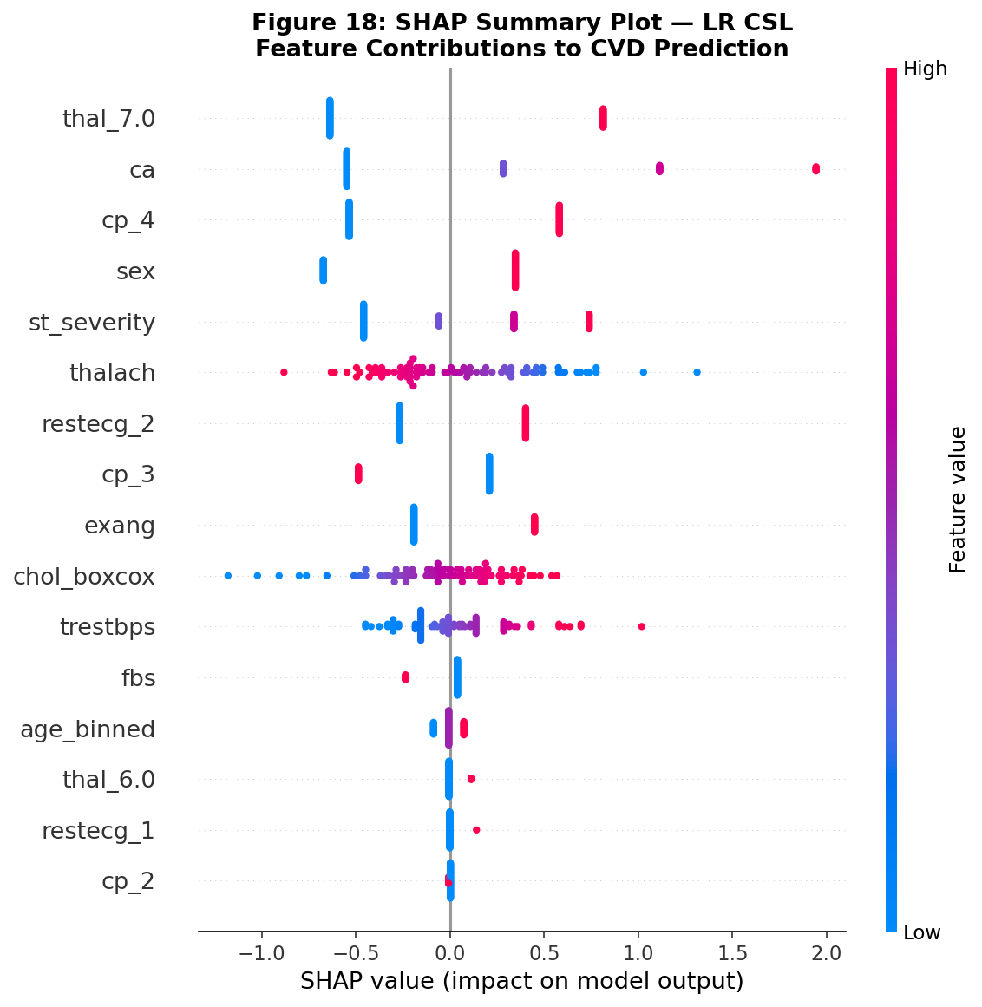
Clinical Feature Engineering: st_severity
Why We Built st_severity
oldpeak alone was zero-inflated and non-normal
Combined oldpeak + slope into a single clinically meaningful severity score
Based on ACC/AHA Exercise Testing Guidelines (Gibbons 1997, 2002)
Validated: CVD prevalence increases monotonically across severity categories
5

Slide 6
Our Modeling Approach
Logistic
Regression
Random
Forest
XGBoost
Support Vector
Machine
Interpretable baseline
Linear classifier
Established clinical standard
Ensemble method
Non-linear relationships
Feature importance
High performance
Gradient boosting
2-round tuning
Useful in small datasets
Margin maximization
Linear + RBF kernels
All models evaluated with: Cost-Sensitive Learning (CSL) • Stratified K-Fold Cross Validation • Clinical targets: Sensitivity ≥85%, Specificity ≥75%
References: Sensitivity & specificity as clinical metrics: Simon & Boring (1990), Clinical Methods, 3rd ed.
Clinical performance targets: Vyshnya et al. (2024), IEEE Open J Eng Med Biol, doi:10.1109/OJEMB.2023.3347479
6

Slide 7
What We Expected vs. What We Found
We Expected
What We Found
Ensemble models (RF, XGBoost) would outperform Logistic Regression
More complexity = better performance
Standard accuracy metrics would be sufficient to identify the best model
Logistic Regression outperformed all ensemble models
Simplicity won — consistent with clinical ML literature
Accuracy alone missed the full clinical story — threshold optimization was the key
→
7

Slide 8
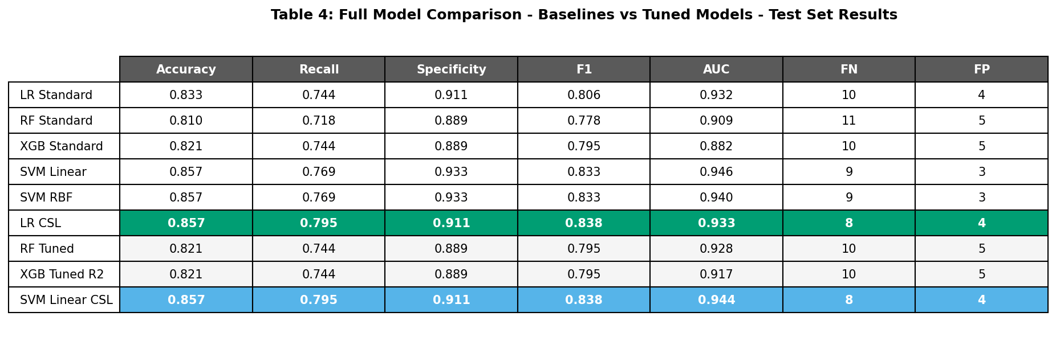
Model Comparison: All Models
.
8

Slide 9
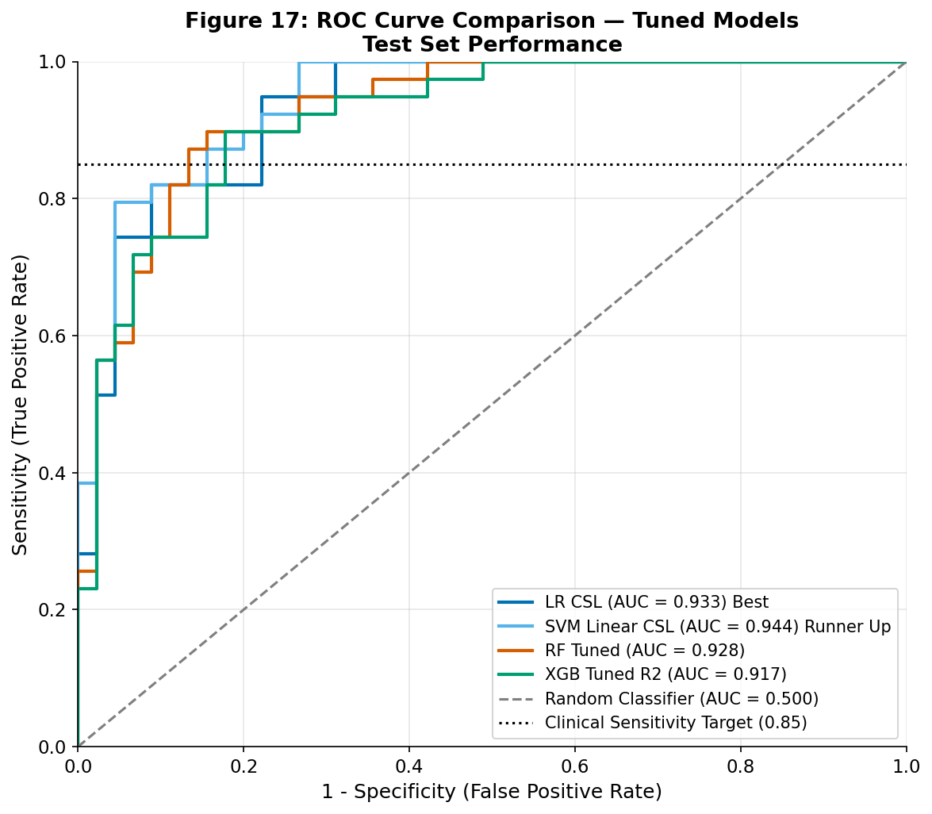
Model Discrimination: ROC Curves
Key Takeaways
• LR CSL & SVM Linear CSL highest AUC
• All models well above random classifier
• Dotted line = clinical sensitivity target (0.85)
• No model reaches target at default threshold — threshold optimization needed
9

Slide 10
The Problem With Default Thresholds
At the default threshold, our best model missed 8 out of 39 CVD patients.
Default Threshold: 0.50
Optimized Threshold: 0.25
A statistical convention
Not a clinical standard
Recall: 0.795 — below target
Clinically informed
Meets sensitivity target
Recall: 0.949 — only 2 missed
10

Slide 11
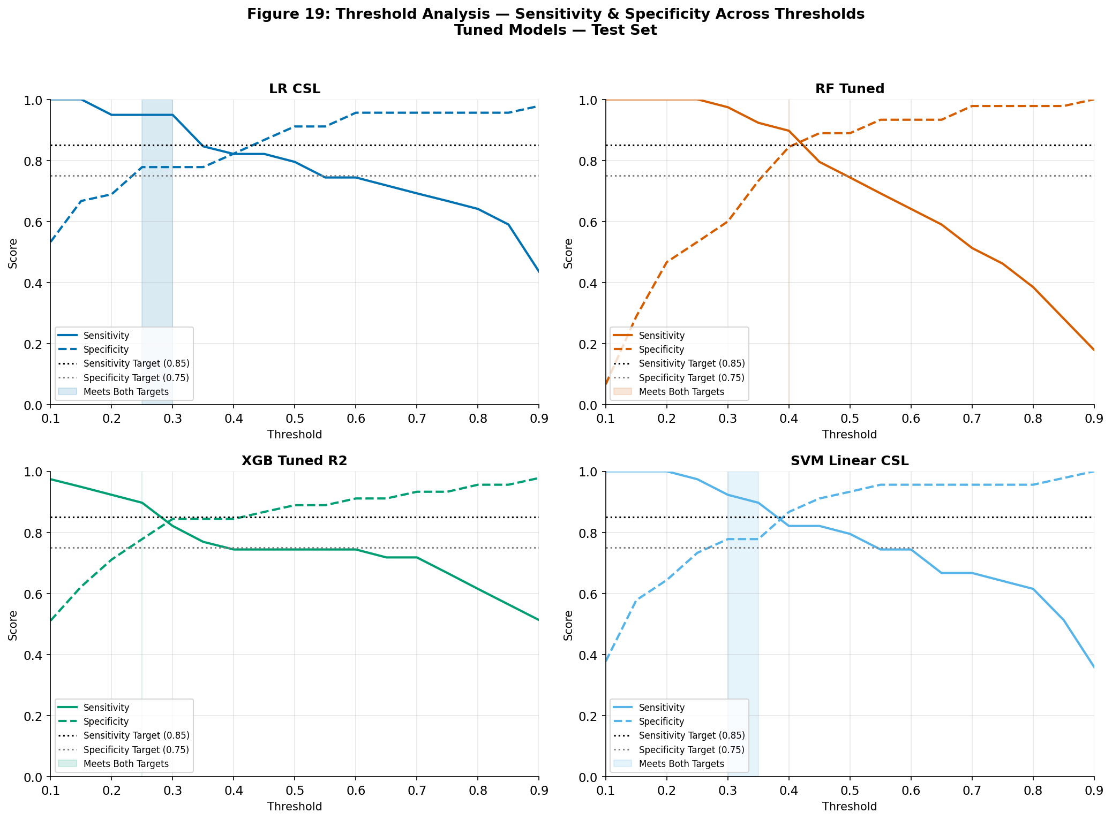
Finding the Right Threshold
Clinical Targets Met
LR CSL @ 0.25:
Sensitivity 0.949 | Only 2 missed
SVM Linear CSL @ 0.30:
Sensitivity 0.923 | 3 missed
RF Tuned @ 0.40:
Best sensitivity/specificity balance
All 4 models meet clinical targets with optimization
11

Slide 12
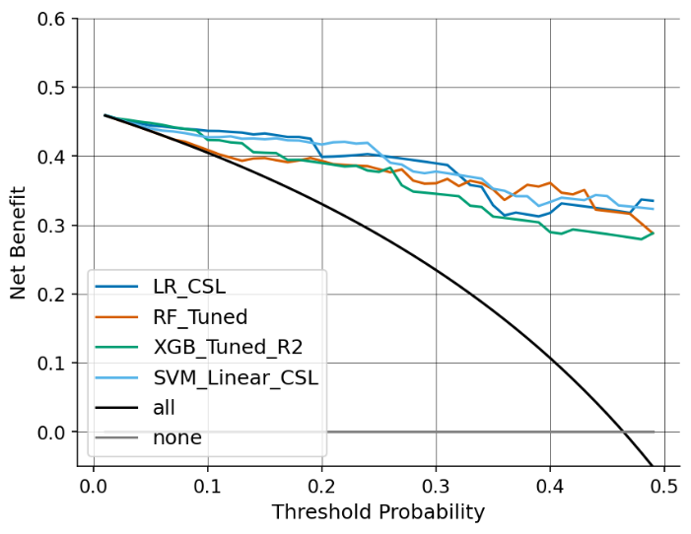
Is The Model Worth Using? Decision Curve Analysis
What This Means
Three lines on this chart:
• Treat nobody → net benefit = 0
• Treat everybody → declining curve
• Our models → above both
Using this model produces better patient outcomes than either alternative across all clinically relevant thresholds
12

Slide 13
Key Takeaways
1
Accuracy isn't enough
A model with 85.7% accuracy still missed 8 CVD patients at default settings. Clinical validation requires sensitivity, specificity, threshold analysis, and DCA together.
2
Simplicity won
Logistic Regression outperformed Random Forest and XGBoost — consistent with published literature on small clinical datasets (Christodoulou 2019).
3
Threshold optimization is clinical
At the optimized threshold of 0.25, LR CSL caught 94.9% of CVD cases. The threshold is a clinical decision, not a statistical default.
13

Slide 14
What You Should Know Before Using This Model
Small Sample
Not FDA Cleared
n=297 from a single institution in 1988. Results may not generalize to modern, diverse populations.
This model has not been validated for clinical deployment. It requires further external validation, regulatory review, and institutional approval.
Proxy Leakage
Dataset Age
Several features (ca, thal, st_severity) are measured during diagnostic testing — this is a classification tool, not a prospective risk predictor.
1988 data does not include modern biomarkers (high-sensitivity troponin, BNP) or contemporary ACC/AHA risk variables.
14

Slide 15
Recommendations & Next Steps
For Clinical AI Developers
For Cardiologists
• Validate on larger, modern dataset (n>10,000)
• Include contemporary biomarkers (troponin, BNP)
• External validation across multiple institutions
• Pursue FDA clearance pathway for clinical deployment
• Threshold of 0.25 recommended for screening contexts — flag patients with ≥25% predicted probability
• Model should support, not replace, clinical judgment
• Consider resource constraints when selecting threshold — RF Tuned at 0.40 offers better specificity if false alarms are costly
15

