Slide 1
PCB Tracking with Image Processing Techniques
Image Processing Final Project
Colin King & Matthew Noseworthy

Slide 2
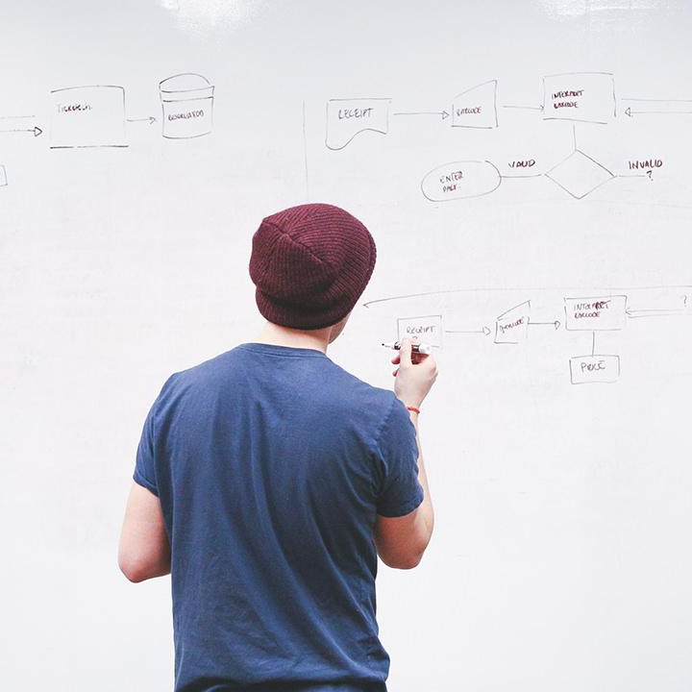
Overview
Our project’s goal was to locate a PCB within an image frame, in various background and lighting conditions.
This presentation will walk through our algorithm and briefly explain why each technique is utilised

Slide 3
The Algorithm
1
Let’s walk through the steps of the algorithm

Slide 4
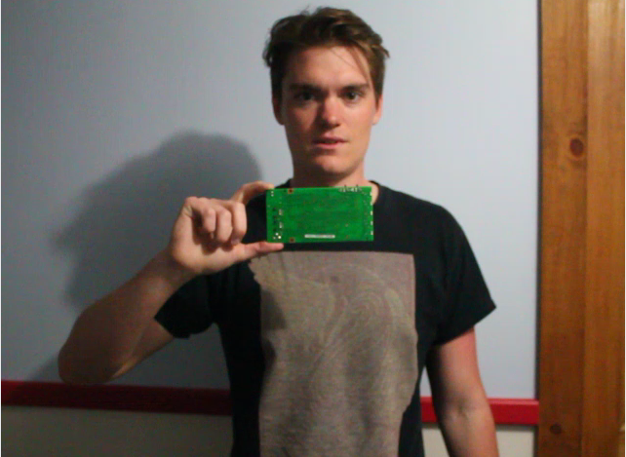
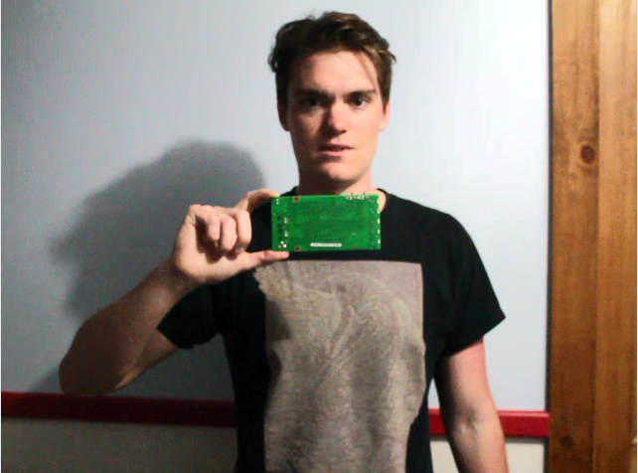
Histogram Equalization
Image is converted to YUV format
Histogram equalization performed on the Y channel, UV channels unaltered
Contrast enhanced without modifying hue

Slide 5
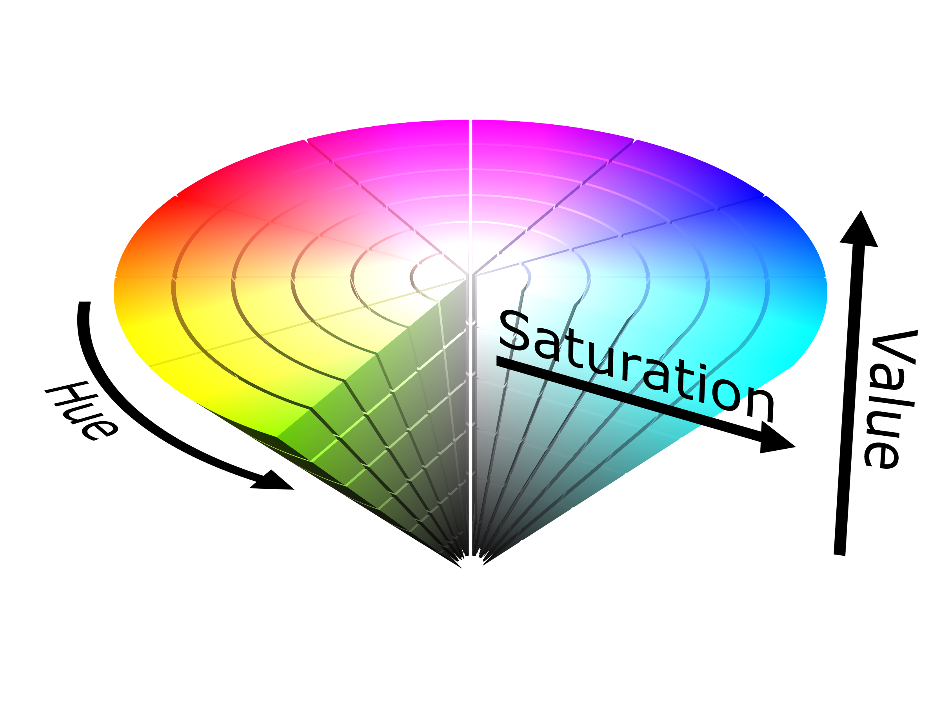
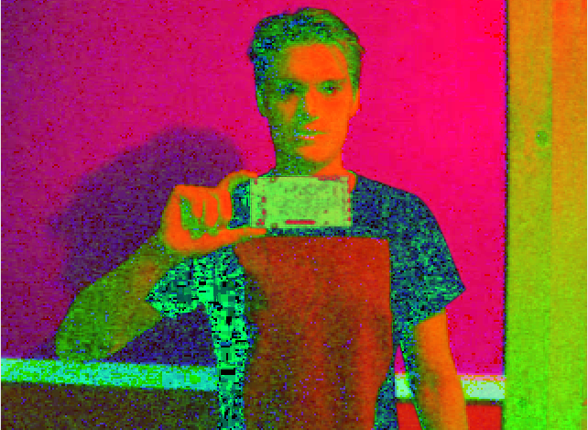
RGB to HSV Conversion
Our aim is to threshold a range of hue as well as saturation/brightness. RGB won’t suffice.
HSV has three channels: Hue, Saturation, and Value

Slide 6

Median Spatial Filter (Median Blur)
Reduces salt & pepper noise
Enhances thresholding performance

Slide 7
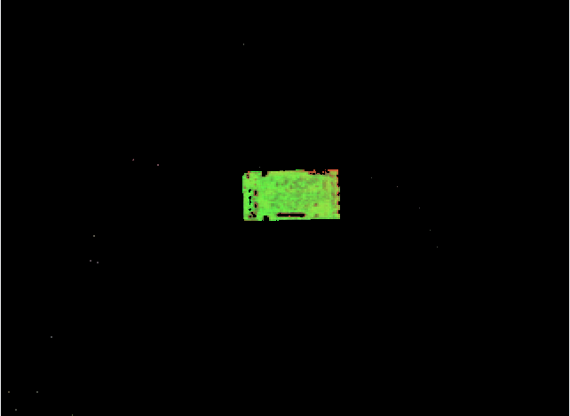
Thresholding
The goal is to remove all pixels that aren’t the PCB
Hue: 65-84 - removes everything except green
Saturation/Value: 70-255 – removes dark extrema

Slide 8


Double Morphological Operation
Closing first: Fills gaps in green region where components are on the board
Opening second: Eliminate environmental noise that passes through thresholding

Slide 9
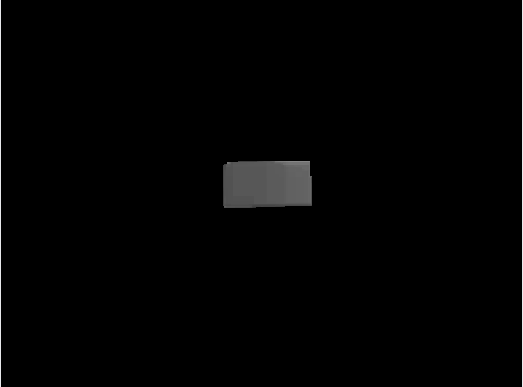
HSV to Grayscale
The HSV image still has distinct regions of hue difference that are detected as edges by Canny
Converting to grayscale reduces this effect

Slide 10

Canny Edge Detection
Frame contains only pixels from the PCB
Used industry standard sigma=0.33
Hysteresis Thresholds:
int(max(0, (1.0 + sigma) * v)) -> int(max(0, (1.0 - sigma) * v))

Slide 11
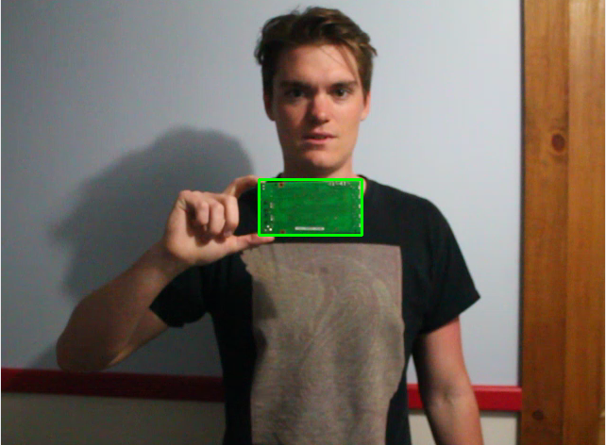
Contour Selection
Output from canny is a list of contours
For our application, we simply select the one with the largest area

Slide 12
Demos
2
Pre-recorded video throughput & live video feed

Slide 13

Place your screensot here
Video Demo
This demo runs a pre-recorded video of us moving a PCB around through the algorithm

Slide 14
Place your screenshot here
Live Demo
This demo captures frames from a connected camera, and runs them through the algorithm

Slide 15
References

Slide 16
THANKS!
Any questions?

