Slide 1
PCB Tracking with Image Processing Techniques
Image Processing Final Project
Colin King & Matthew Noseworthy

Slide 2
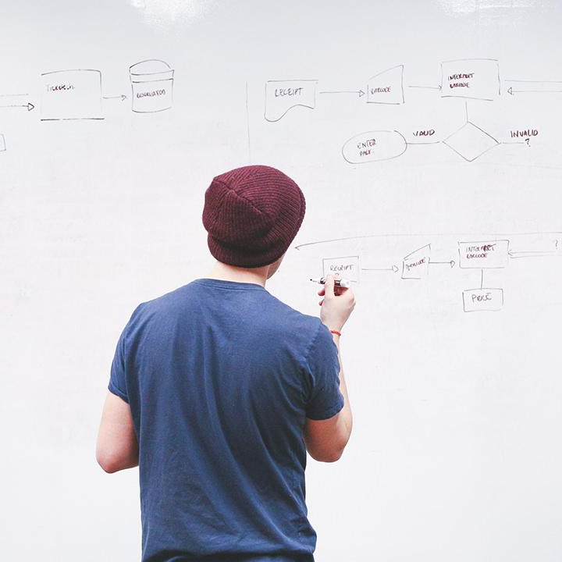
Overview
Our project’s goal was to locate a PCB within an image frame, in various background and lighting conditions.
This presentation will walk through our algorithm and briefly explain why each technique is utilised
Notes:
Matt: project goals
Colin: agenda

Slide 3
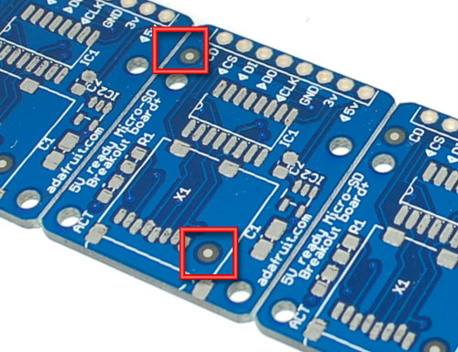
Background
Machine vision is used for PCB assembly and rework
Use Image Processing techniques to identify the PCB
This Photo by Unknown Author is licensed under CC BY-SA

Slide 4
The Algorithm
1
Let’s walk through the steps of the algorithm

Slide 5
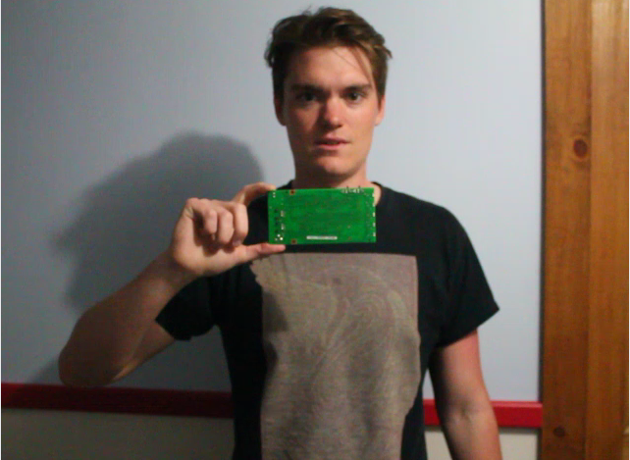
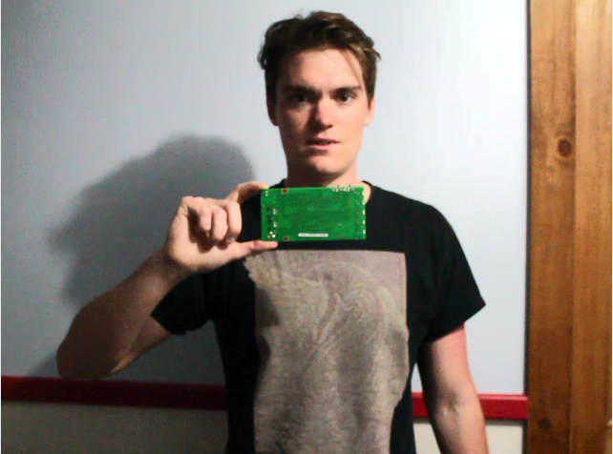
Histogram Equalization
Image is converted to YUV format
Histogram equalization performed on the Y channel, UV channels unaltered
Contrast enhanced without modifying hue
Notes:
Matt

Slide 6
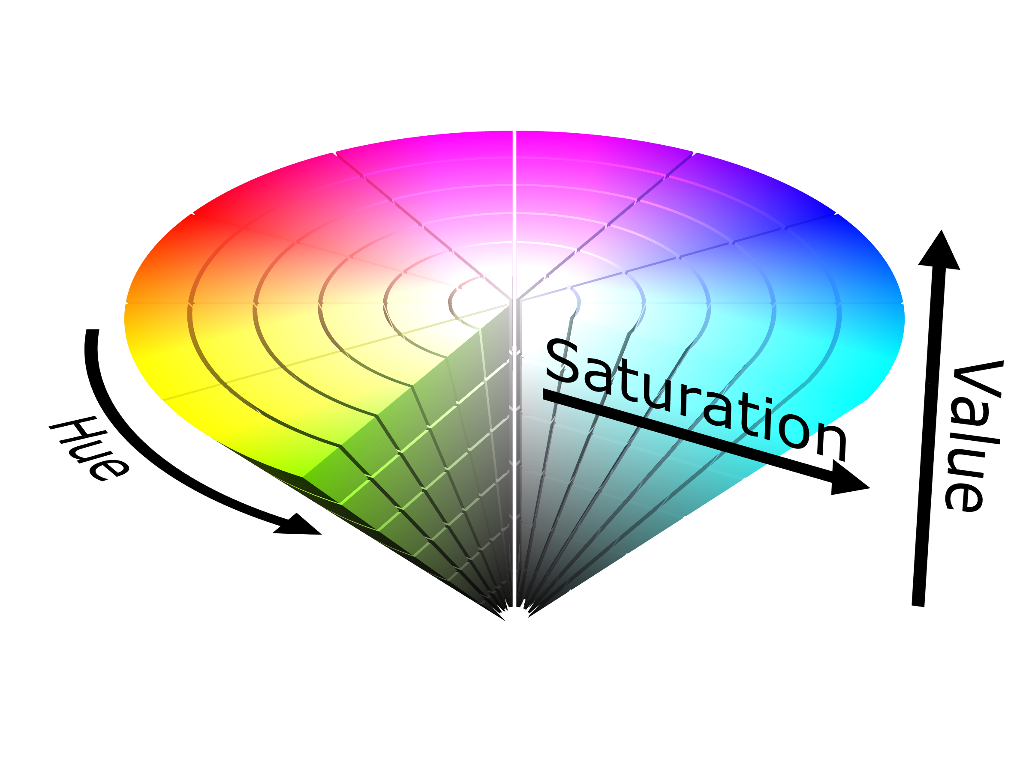
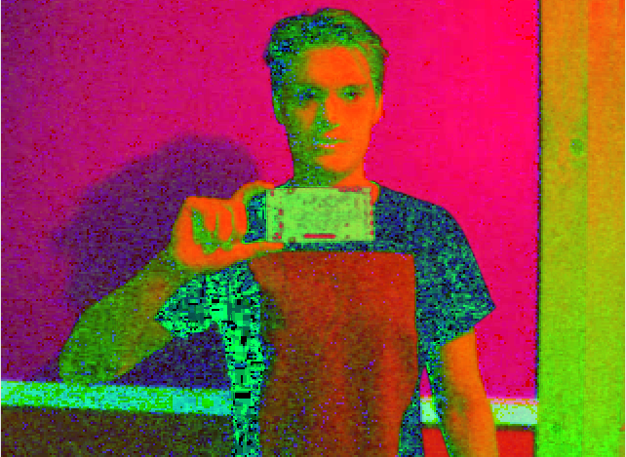
RGB to HSV Conversion
Our aim is to threshold a range of hue as well as saturation/brightness. RGB won’t suffice.
HSV has three channels: Hue, Saturation, and Value
Notes:
Colin

Slide 7
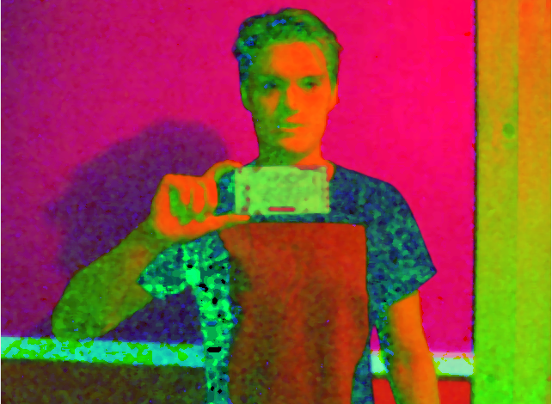
Median Spatial Filter (Median Blur)
Reduces salt & pepper noise
Enhances thresholding performance
Notes:
Matt

Slide 8
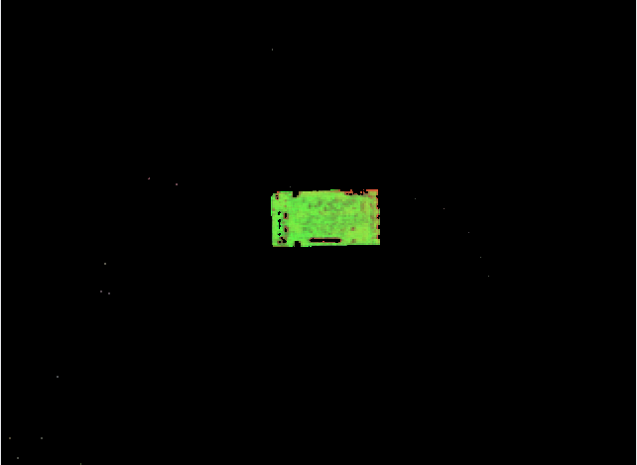
Thresholding
The goal is to remove all pixels that aren’t the PCB
Hue: 65-84 - removes everything except green
Saturation/Value: 70-255 – removes dark extrema
Notes:
Colin + Matt

Slide 9

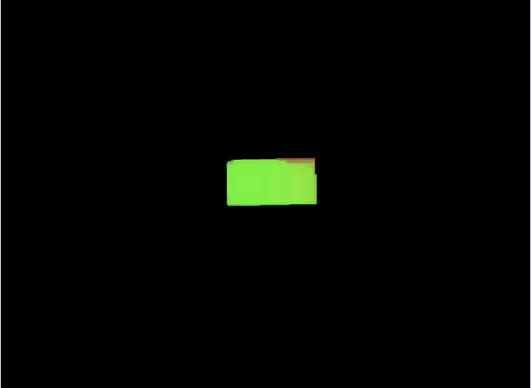
Double Morphological Operation
Closing first: Fills gaps in green region where components are on the board
Opening second: Eliminate environmental noise that passes through thresholding
Notes:
Colin + Matt

Slide 10
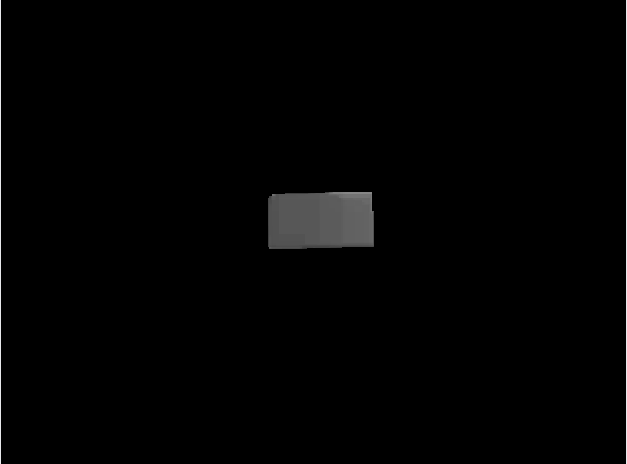
HSV to Grayscale
The HSV image still has distinct regions of hue difference that are detected as edges by Canny
Converting to grayscale reduces this effect
Notes:
Matt

Slide 11

Canny Edge Detection
Frame contains only pixels from the PCB
Used industry standard sigma=0.33
Hysteresis Thresholds:
int(max(0, (1.0 + sigma) * v)) -> int(max(0, (1.0 - sigma) * v))
Notes:
Colin

Slide 12
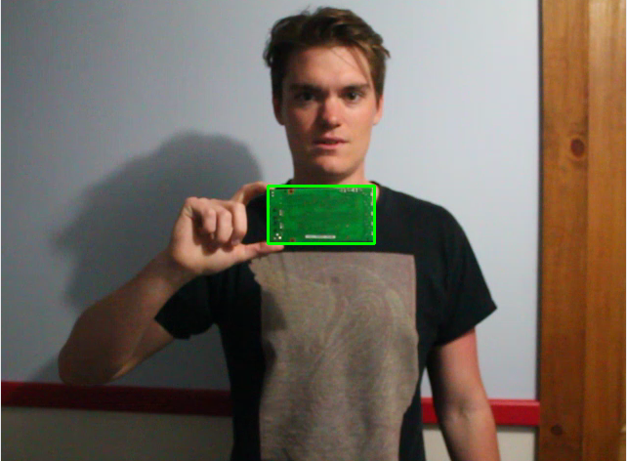
Contour Selection
Output from canny is a list of contours
For our application, we simply select the one with the largest area
Notes:
Matt

Slide 13
Demos
2
Pre-recorded video throughput & live video feed

Slide 14
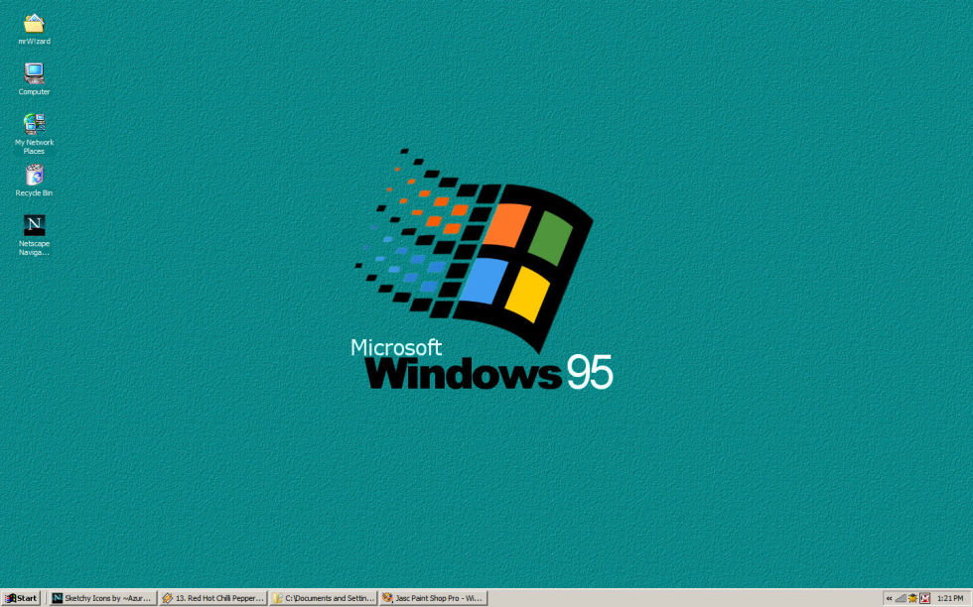
Place your screensot here
Video Demo
This demo runs a pre-recorded video of us moving a PCB around through the algorithm

Slide 15
Place your screenshot here
Live Demo
This demo captures frames from a connected camera, and runs them through the algorithm

Slide 16
References

Slide 17
THANKS!
Any questions?

