Slide 1

Presented by Deeksha, Dannysh, Ghazar and Nour.

Slide 2
List of Features
The client would be able to order food.
HomeCooks can add a new event.
See the different events on home page.
Each user can choose whether to be a homecook or just a client
HomeCooks can update the event.

Slide 3
Sprint Goal
The idea of making HomeCook Mobile Application is to make the home cooked food easily available for needed ones and give a chance to homemakers to earn. We used variety of features to make our application accessible.

Slide 4
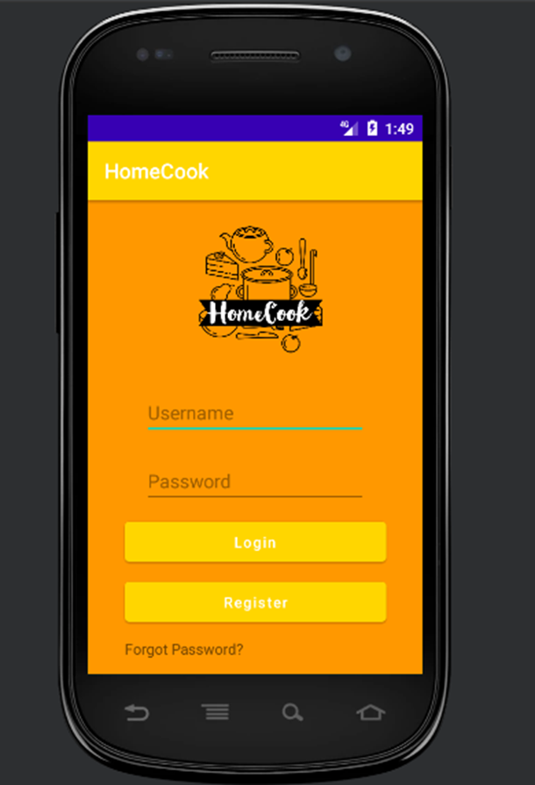
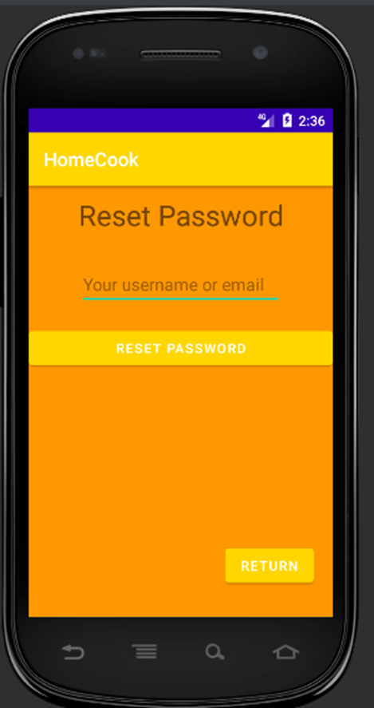

Slide 5

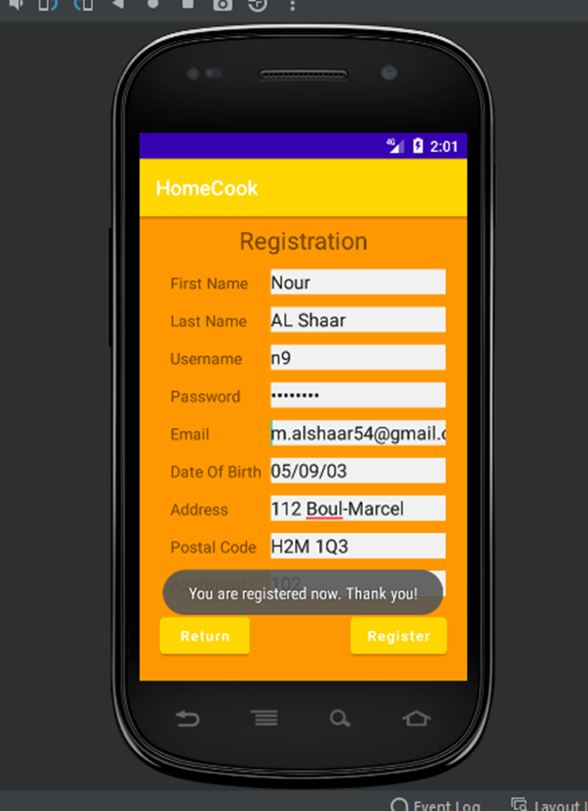
User Story 1
Title: Registration priority: 1
As: a first time user
I want to: register on the app
So that i can: become a registered user
Acceptance criteria
Given: that I opened the app for the first time
When: I click on “Register” button
Then: I will be redirected to a Register user interface

Slide 6
User Story 2
Title: Login priority: 2
As: a user
I want to: login
So that i can: use the app
Acceptance criteria
Given: I’m on the login page
When: I click on the login button
Then: i’ll be logged in to the app as a user

Slide 7
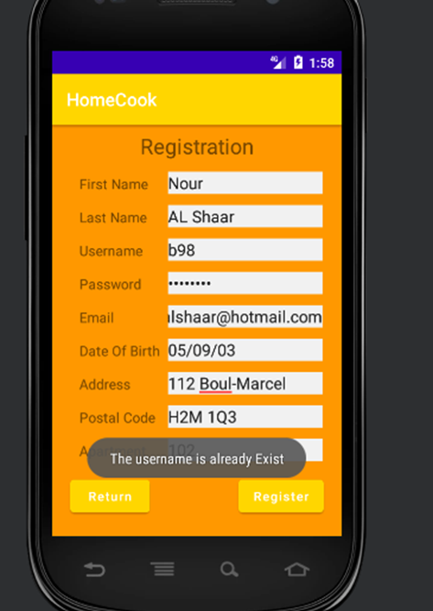
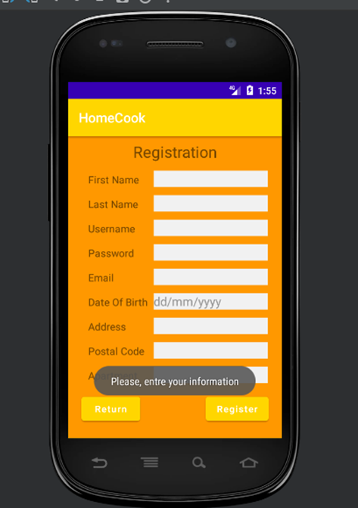
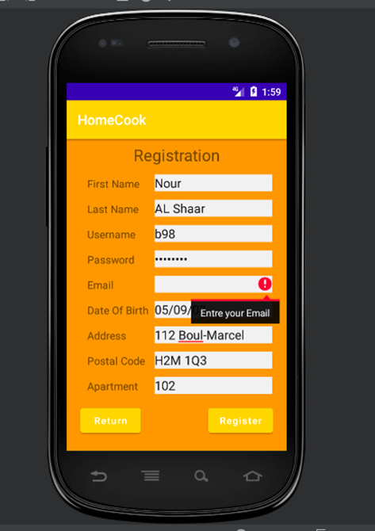
Validation

Slide 8
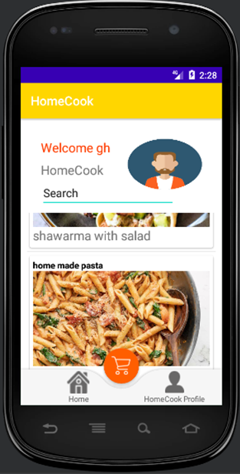
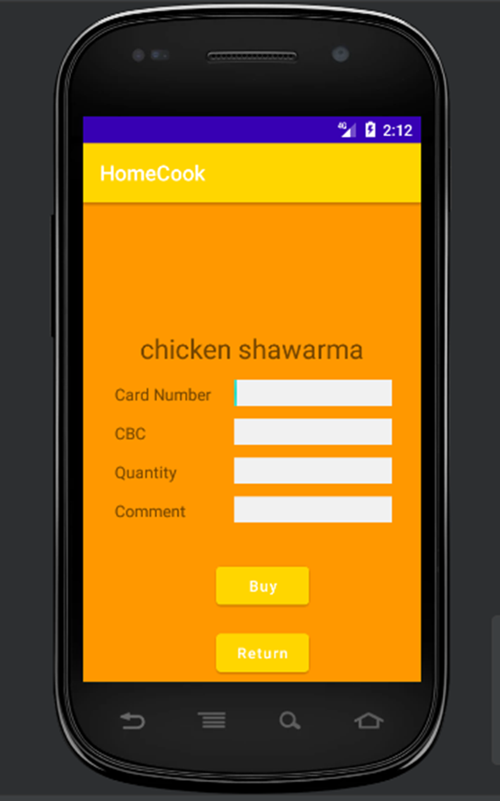
User Story 3
Title: User can buy food priority: 4
As: a client
I want to: buy the food that are available in the events
So that i can: get the food.
Acceptance criteria
Given: I am a registered client
When: I click on the buy button
Then: I will buy the meal and receive a receipt by email

Slide 9
User Story 4
Title: HomePage priority: 3
As: a user
I want to: be sent to the homepage after the registration and login
So that i can: use the functionality of the app
Acceptance criteria
Given: I am a user
When: I click on “login” button on the login page
Then: I’ll be sent to “Home page” so that I can use the app.

Slide 10
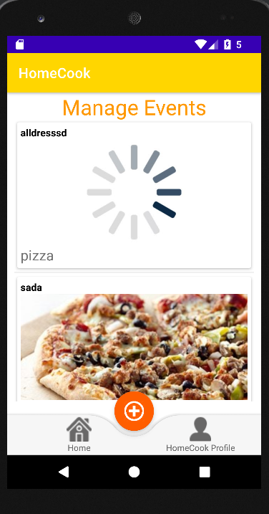
Title: Manage events priority: 3
As: a homeCook
I want to: manipulate Events
So that i can: add update delete events
Acceptance criteria
Given: I am a homecook
When: I click on “levent” button on the list
Then: I’ll be sent to add , update activities
User Story 5

Slide 11
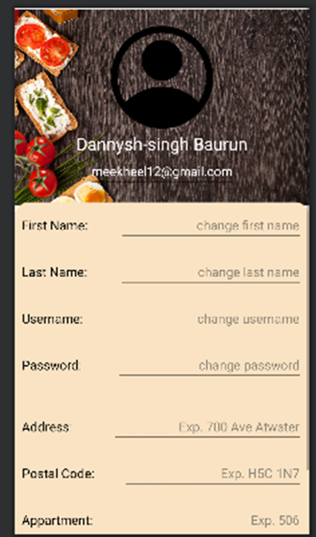
User Story 6
Title: Edit the user profile priority: 5
As: a user
I want to: be able to edit the information of my profile
So that i can: change my information
Acceptance criteria
Given: I am a user
When: I click on the image “my profile”
Then: I’ll be sent to “my Profile activity” so that I can edit the information

Slide 12
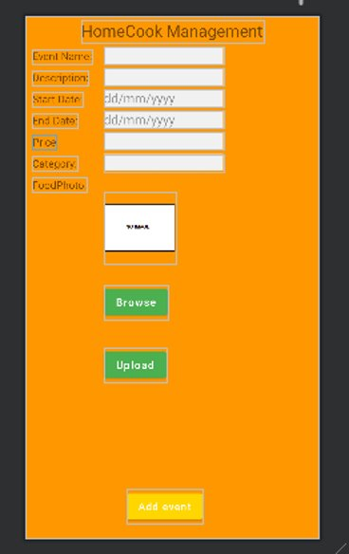
User Story 7
Title: Create an event priority: 6
As: a home cook
I want to: create a food event
So that i can: let everyone in my community know that I am selling food on that event
Acceptance criteria
Given: I am a registered home cook
When: I click on the button create event
Then: an event with all the necessary information will be created and posted on the home page.

Slide 13
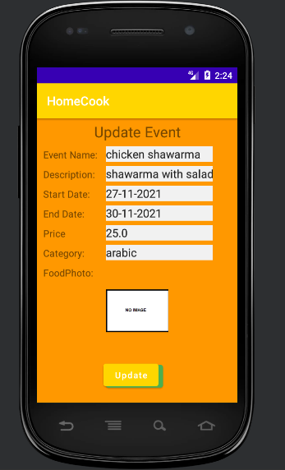
User Story 8
Title: Update events priority: 7
As: a HomeCook
I want to: be able to update the information of my events
So that i can: change the information of my events
Acceptance criteria
Given: I am a homeCook
When: I click on the events in “HomeCook Profile”
Then: I’ll be sent to “update event activity” so that I can edit the information of the event

Slide 14
List of tasks
Deeksha- Add Event Page And PowerPoint Presentation.
Ghazar-home activity and homecook profile page.
Dannysh -the update user profile and update events.
Noor - login , registration, and Payment Part.
We usually met after the class for our small discussions and tasks. And we tried to share the updates regularly and asked for help from each other when needed.

Slide 15
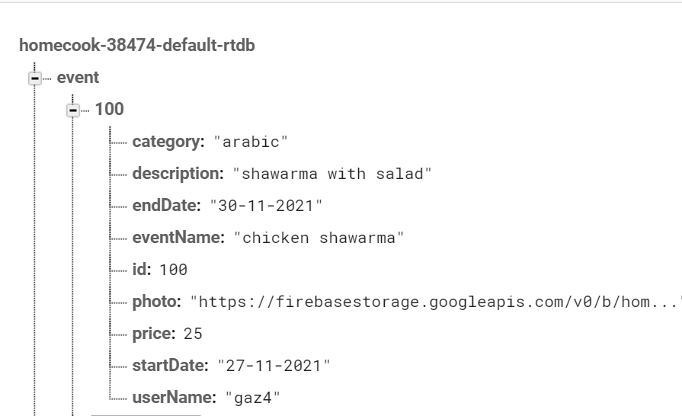
Database Diagrams

Slide 16
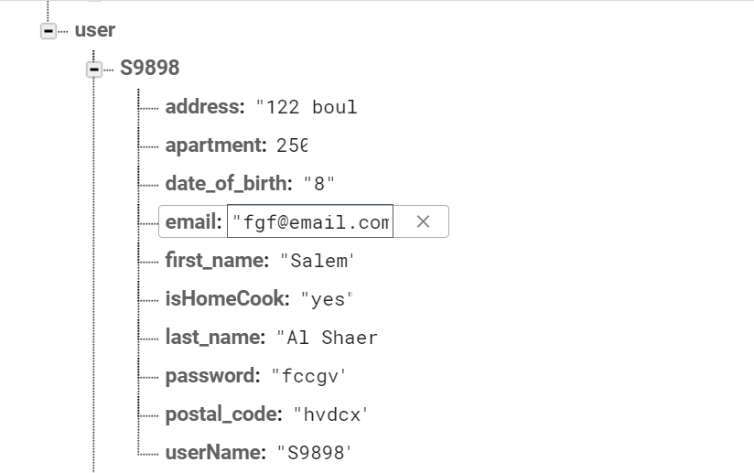
Database Diagram 2

Slide 17
Difficulties during the Project
Using github
Time management
Implementing the different version of the code
Team meeting every week

Slide 18
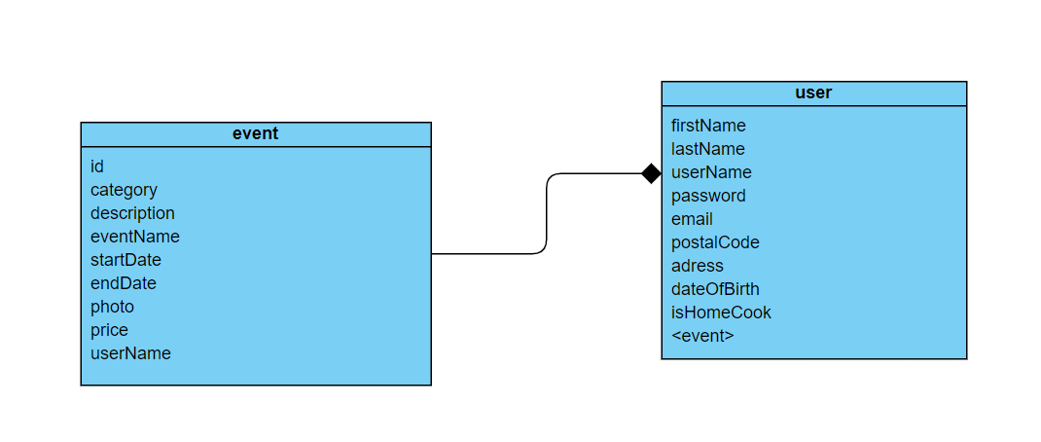

Slide 19
Items Went Well~~~
1: Registration
2:Login
3: Become a HomeCook
4: HomePage
5:Show Events on Home Page
6: Ordering Food
7: Updating User Data.
8: Update Events

Slide 20
Improvements to be made in future
We will try to add Switch button for User to become a HomeCook and update his profile.
User Can give feedback to the HomeCook.
We will Add a Search bar to search near-by events

Slide 21
Thank you for Watching!
Hope you liked it

