Slide 1

Fridge Temperature Warning modeling results
Maciej Nowicki

Slide 2
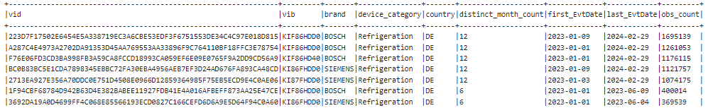
Data scope
Business problem:
refrigerator owners may be unaware of continuous temperature increase resulting from any issue that can lead to spoilage or melting of food.
proposed solution involves comprehensive fridge data analysis in order to understand data, abnormal rise of temperature detection and model predicting temperature for fridges witihin our scope.
Data scope:
based on initial data analysis findings from selected IOT devices there were selected available devices that tracked measured temperature inside fridges/freezers.
filter data period: <01/2023 – 02/2024> in order to include only months in which we have satisfactory amount of data per device with at least half year of data.
In the end devices that had too few data overall, temperature/doors data or very abnormal temperature distribution were removed from scope.
Data snapshot:
Sensitive
data

Slide 3
Steps
Exploratory analysis
Focus on measured temperature for fridges (which is crucial in terms of detecting abnormal temperature increase)
Determine influence and relationship between measured temperature and other features – setpoint & ambient temperatures and door openings
Test hipothesis like:
Temperature outside of fridge can influence temperature inside device
Frequent door openings or long time that doors are being open could rise temperaturę inside fridge
2. Feature selection
Calculating importance with random forest – which features seems to be the most important in terms of influencing measured temperature.
3. Predictive modeling
Using insights from data exploration and rf model create and choose best models that are predicting measured temperature itself
4. Validation of the predictive models
Validate models performance on validation set
5. Binary modeling - detecting abnormal temperature increase
Automatic labeling abnormal increase of temperature in our data
Create model to determine if abnormal temperature increase is present.
6. Evaluate results

Slide 4
1. Exploratory Analysis

Slide 5
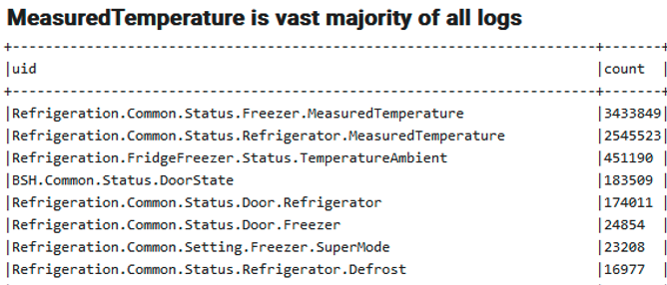
Available features selected based on number of occurences and relevancy:
Measured temperature of fridge/freezer
Temperature outside of device
Temperature set by user
Door status (open/closed)
Selected modes
others

Slide 6
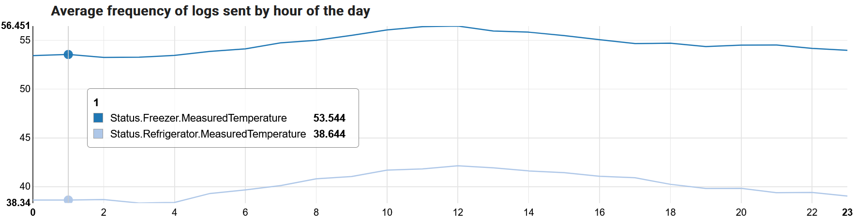
Measured temperature – general statistics
Roughly similar frequency over the day and night. Freezer sends temperature once a minute, refridgerator slightly less often.

Slide 7
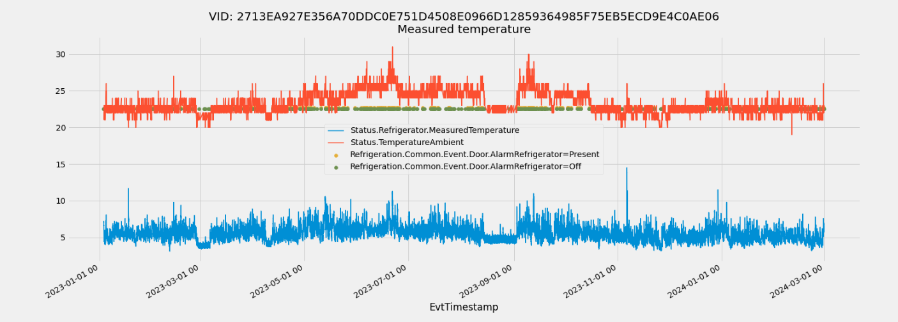
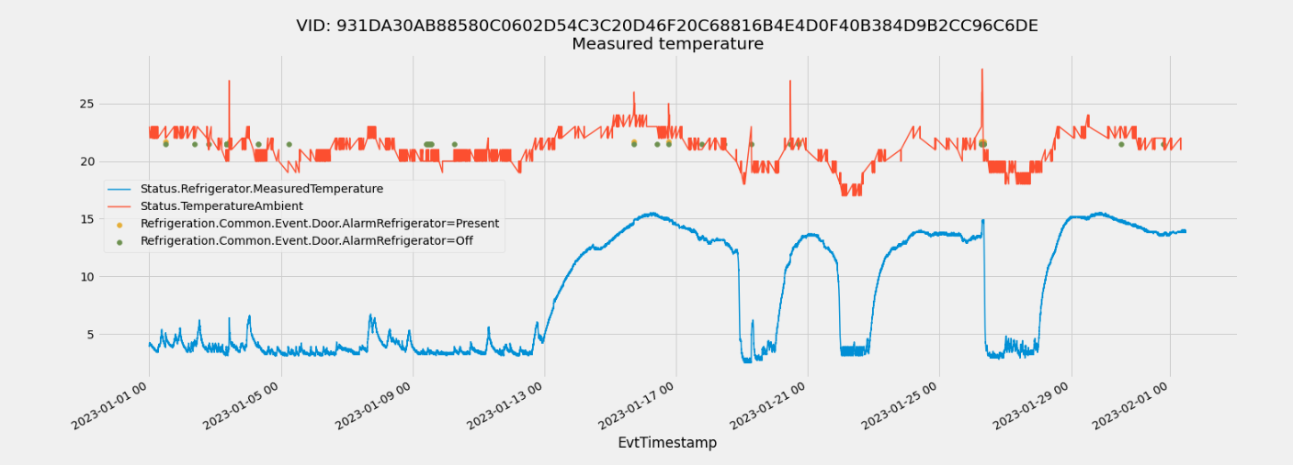
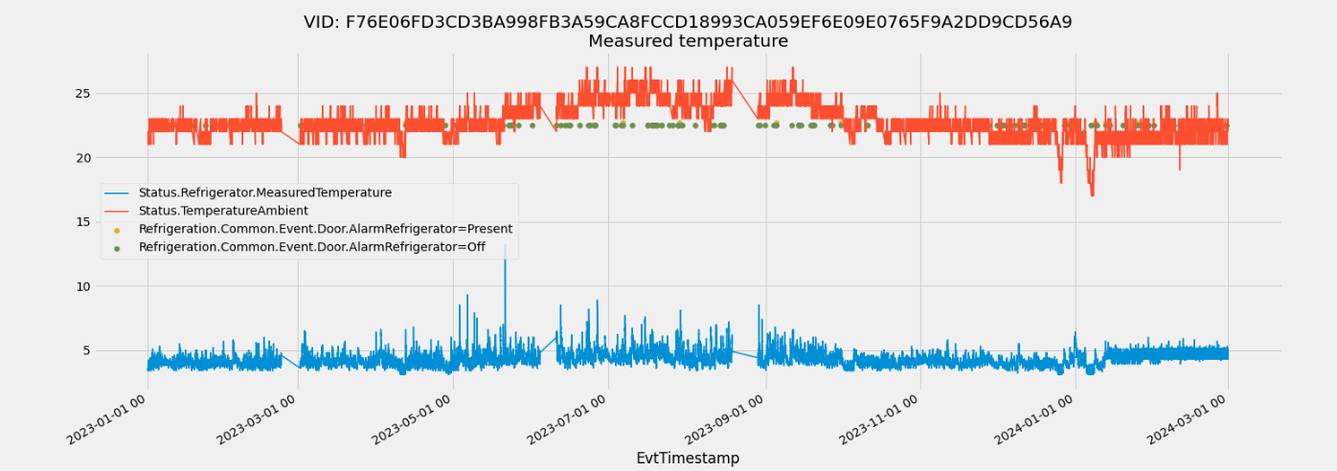
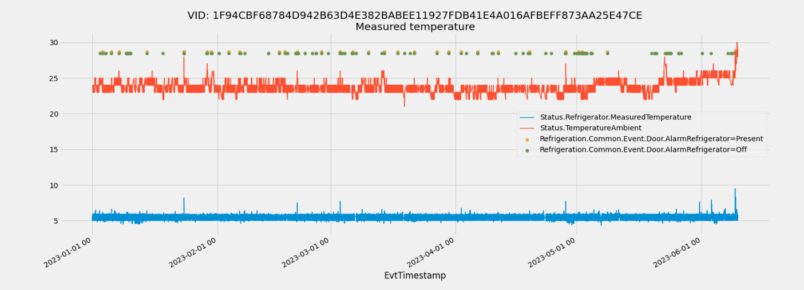
Fridge Measured x Ambient Temperature (corr: 0.24)

Slide 8
Fridge Setpoint temperatures changes analysis
Setpoint temperature changes (triggered by the user) for fridges:
vid | previous_setpoint_change | EvtTimestamp | next_setpoint_change | temp_average_before_change | setpoint_change_description | temp_average_after_change
931DA30AB88580C0602D54C3C20D46F20C68816B4E4D0F40B384D9B2CC96C6DE* | 01.01.2023 00:00 (first obs) | 15.01.2023 16:47 | 19.01.2023 06:47 | 4.61 | setpoint change from 4.0 to 3.0. | 8.39
931DA30AB88580C0602D54C3C20D46F20C68816B4E4D0F40B384D9B2CC96C6DE* | 15.01.2023 16:47 | 19.01.2023 06:47 | 19.01.2023 06:47 | 8.39 | setpoint change from 3.0 to 4.0. | null
931DA30AB88580C0602D54C3C20D46F20C68816B4E4D0F40B384D9B2CC96C6DE* | 19.01.2023 06:47 | 19.01.2023 06:47 | 19.01.2023 15:48 | null | setpoint change from 4.0 to 3.0. | 3.99
931DA30AB88580C0602D54C3C20D46F20C68816B4E4D0F40B384D9B2CC96C6DE* | 19.01.2023 06:47 | 19.01.2023 15:48 | 20.01.2023 07:10 | 3.99 | setpoint change from 3.0 to 4.0. | 4.66
931DA30AB88580C0602D54C3C20D46F20C68816B4E4D0F40B384D9B2CC96C6DE* | 19.01.2023 15:48 | 20.01.2023 07:10 | 20.01.2023 11:11 | 4.66 | setpoint change from 4.0 to 3.0. | 7.66
931DA30AB88580C0602D54C3C20D46F20C68816B4E4D0F40B384D9B2CC96C6DE* | 20.01.2023 07:10 | 20.01.2023 11:11 | 26.01.2023 06:56 | 7.66 | setpoint change from 3.0 to 4.0. | 7.65
931DA30AB88580C0602D54C3C20D46F20C68816B4E4D0F40B384D9B2CC96C6DE* | 20.01.2023 11:11 | 26.01.2023 06:56 | 26.01.2023 08:19 | 7.65 | setpoint change from 4.0 to 3.0. | 7.56
931DA30AB88580C0602D54C3C20D46F20C68816B4E4D0F40B384D9B2CC96C6DE* | 26.01.2023 06:56 | 26.01.2023 08:19 | 26.01.2023 08:19 | 7.56 | setpoint change from 3.0 to 5.0. | null
931DA30AB88580C0602D54C3C20D46F20C68816B4E4D0F40B384D9B2CC96C6DE* | 26.01.2023 08:19 | 26.01.2023 08:19 | 29.02.2024 23:59 (last obs) | null | setpoint change from 5.0 to 4.0. | 4.44
F76E06FD3CD3BA998FB3A59CA8FCCD18993CA059EF6E09E0765F9A2DD9CD56A9 | 01.01.2023 00:00 (first obs) | 12.01.2024 06:14 | 29.02.2024 23:59 (last obs) | 4.59 | setpoint change from 4.0 to 5.0. | 4.64
Often change of setpoint temperaure doesn’t translate into change of measured temperature.

Slide 9
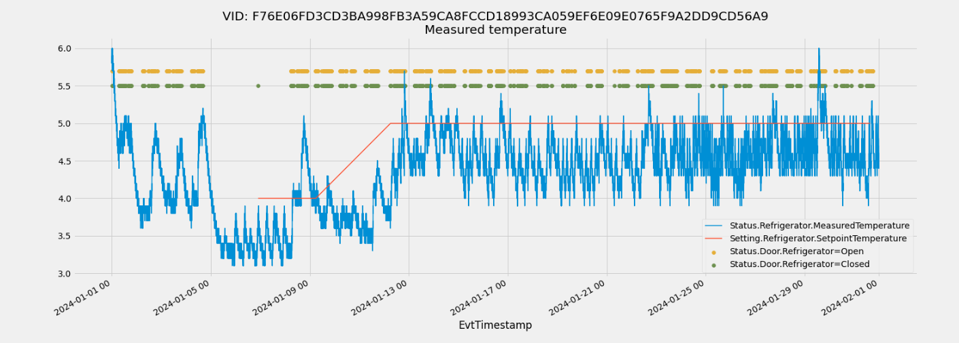

Slide 10
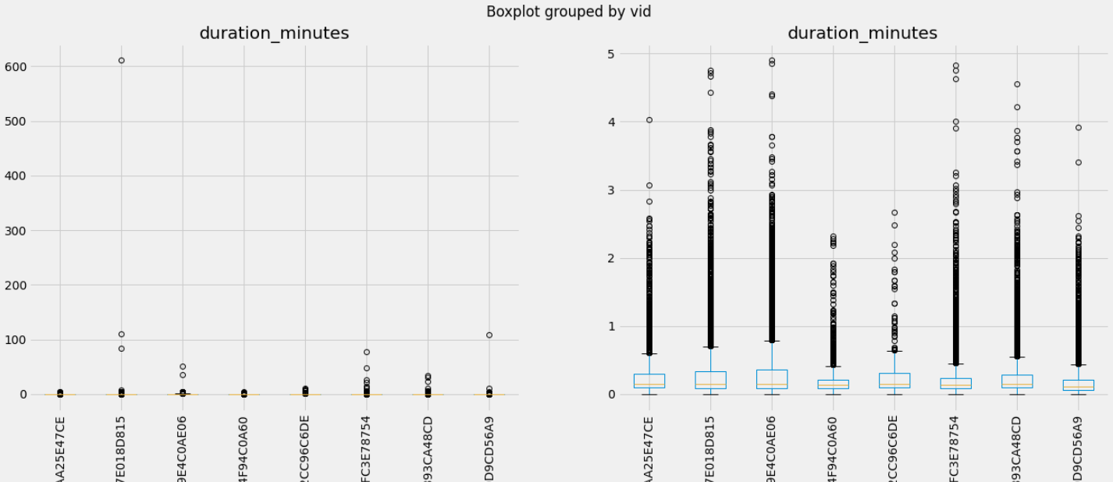
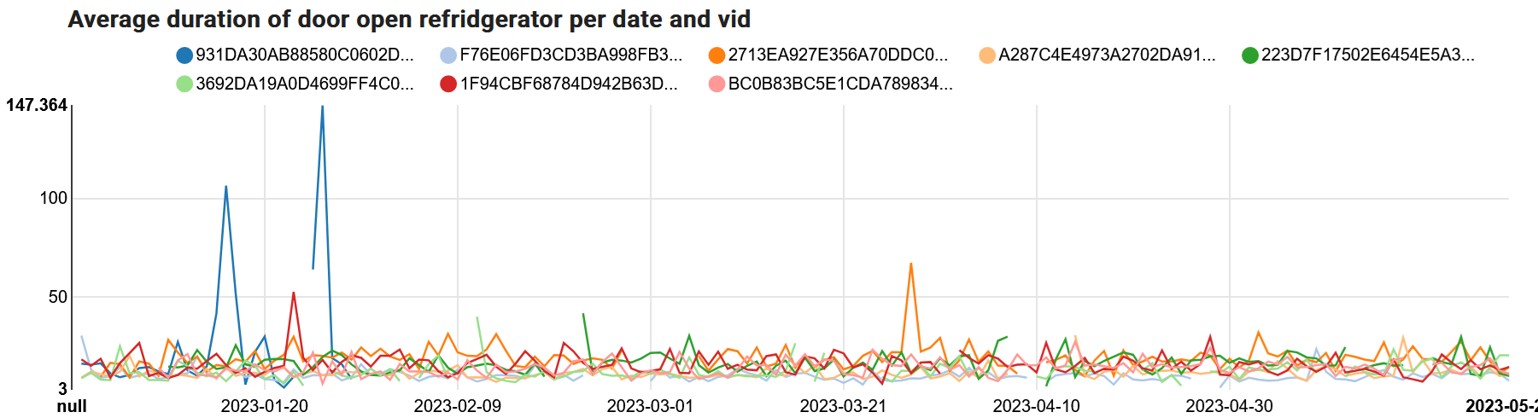
Average door open duration is 15 seconds, but there are also many cases where it’s above 2 minutes
Boxplot definition:
Rectangle contains 50% of data,
Yellow line is median,

Slide 11
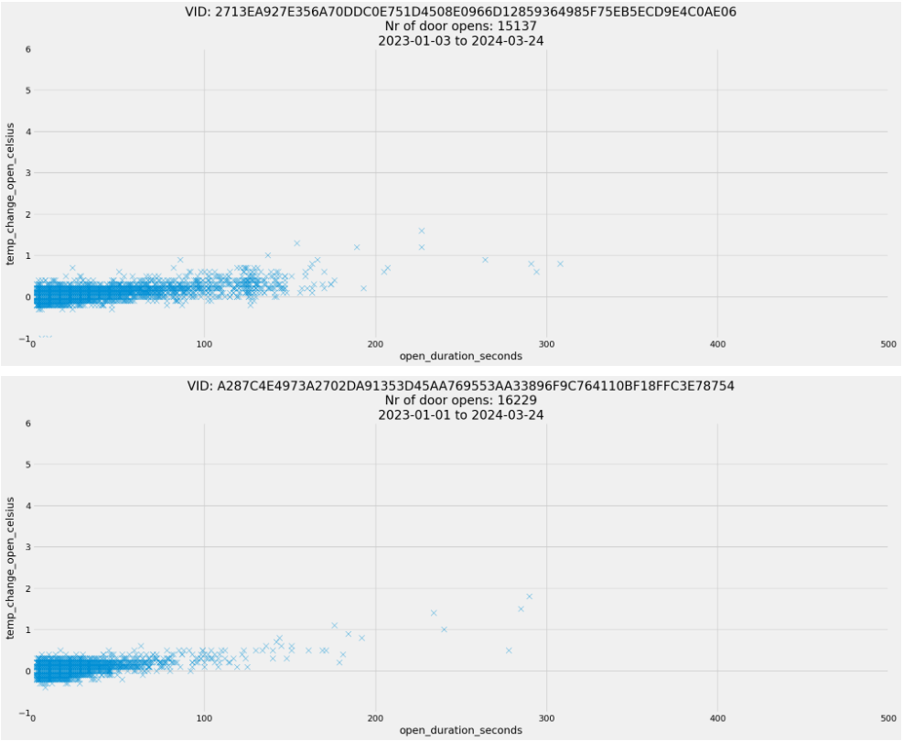
Duration of door opening vs temperature increase
Logic of calculation:
use latest measured temperature before opening and soonest after closing
if any of above does not exist (i.e. another door opening happened before measurement was made), ignore those openings
Insights:
Often the temperature change is negative (descreased), especially for short openings – which suggests that short openings do not have effect on temperature.
A slightly increasing trend is visible for all appliances
Temperature grows surprisingly little when door is open for several minutes

Slide 12
2. Feature selection – Random forest modeling

Slide 13
Random forest – feature importance analysis
Model without Measured Temperature lags:
Model with Measured Temperature lags:
Feature | Importance
Setting.Refrigerator.SetpointTemperature | 0.8251173670522227
Status.TemperatureAmbient | 0.11411798608960506
Event.Door.AlarmRefrigerator | 0.028346804284054353
DoorRefrigerator_duration | 0.026692038480331304
DoorRefrigerator_doorstate_OPEN | 0.003151116976895232
Status.Refrigerator.Defrost | 0.0025640298912829006
Setting.Refrigerator.SuperMode | 1.0657225608439116e-05
MODEL’S STATISTICS | VALUE
Mean Squared Error | 0.4178645958048998
R-squared | 0.7577910930117182
Feature | Importance
lag_Status.Refrigerator.MeasuredTemperature_last_5_minutes | 0.994527742499924
lag_Status.Refrigerator.MeasuredTemperature_last_15_minutes | 0.0010853636114075487
lag_Status.Refrigerator.MeasuredTemperature_last_10_minutes | 0.0008777376094133758
Status.TemperatureAmbient | 0.00065225673168333
DoorRefrigerator_duration | 0.0003376447145866479
Setting.Refrigerator.SetpointTemperature | 0.00030553952798073234
Event.Door.AlarmRefrigerator | 0.00010784212372899863
DoorRefrigerator_doorstate_OPEN | 9.090590151118924e-05
Status.Refrigerator.Defrost | 1.2826506448396026e-05
Setting.Refrigerator.SuperMode | 2.685738411486183e-07
MODEL’S STATISTICS | VALUE
Mean Squared Error | 0.0129773833086219711
R-squared | 0.9194334745147913
Random forest modeling assess the importance level of each variable in the model in terms of influencing dependent variable (MeasuredTemperature).
When taking only other variables into account the biggest importance has SetpointTemperature (82,5%) and TemperatureAmbient (11,4%). It is alligned with the correlation analysis, however from that stage we also know that there a very few occurences of SetpointTemperature changes in our data.
Model with lags of MeasuredTemperature – we get much better model in terms of statistics (lower MSE and higher R2). This model shows that the most important factor in terms of predicting MeasuredTemperature is its previous value (last 5-minute period). It basically assess all influnece to this factor.

Slide 14
3. Predictive modeling

Slide 15
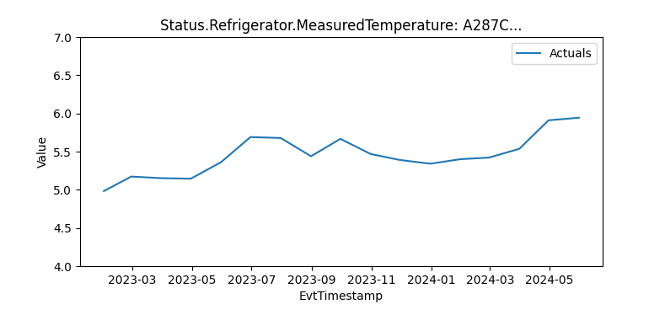
Data preparation for modeling
Time-series models requires equally distributed timestamps across the data. In order to achieve it we aggregated our input dataset in 5-minutes intervals.
Data were splitted per VID and predictions were made for every VID seperately.
Additionaly we extracted last available dates to perform validation of our data on entirely new (and not used during whole proces of training the models) datasets and be able to assess their quality
Data for predictive modeling were divided into:
training dataset: first 70% of observations per VID
test dataset: last 30% of observations per VID
validation dataset: new data: <03/2024 – middle of 05/2024>
train
test
validation

Slide 16
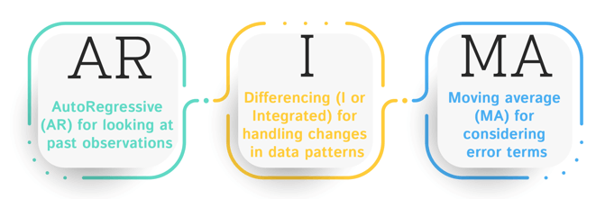

Models tested
In order to get best predictive model for each VID we tested 2 model types (ARIMA & PROPHET) with different combination of parameters (especially including/excluding sesonality). Than based on models performance statistics we chose models with least error value (MAE – mean absolute error).
ARIMA (Autoregressive Integrated Moving Average): time series forecasting model that combines autoregressive (AR), differencing (I), and moving average (MA) components.
PROPHET: forecasting model developed by Facebook that combines time series decomposition, trend modeling, and seasonality estimation.
models tested:
ARIMA – without seasonality and external variables (only lags for dependent variable)
SARIMA – with seasonality, but without external variables (only lags for dependent variable)
PROPHET – basic model without external variables (only lags for dependent variable)

Slide 17
Best models
vid | best_model_type | best_model_mae | mae_diff
1F94CBF68784D942B63D4E382BABEE11927FDB41E4A016AFBEFF873AA25E47CE | SARIMA | 0,244 | -0,000
A287C4E4973A2702DA91353D45AA769553AA33896F9C764110BF18FFC3E78754 | PROPHET | 0,243 | -0,081
3692DA19A0D4699FF4C068E85566193ECD0827C166CEFD6D6A9E5D64F94C0A60 | SARIMA | 0,261 | -0,029
F76E06FD3CD3BA998FB3A59CA8FCCD18993CA059EF6E09E0765F9A2DD9CD56A9 | ARIMA | 0,400 | 0,042
2713EA927E356A70DDC0E751D4508E0966D12859364985F75EB5ECD9E4C0AE06 | SARIMA | 0,731 | -0,167
BC0B83BC5E1CDA7898345EBBC72FA30EBA4956AEB7EF3D24AD676FA893CA48CD | SARIMA | 0,262 | -0,061
223D7F17502E6454E5A338719EC3A6CBE53EDF3F6751553DE34C4C97E018D815 | PROPHET | 0,318 | 0,063
Per ich VID we chose the model with lowest error (mae), above is the final list of predictive models. Average error across all models is 0.35 Celsius.
Overall these model while having pretty low on average temperature error – they don’t handle predicting bigger deviations/spikes of temperature as they rather oscilate around mean tempearature of an appliance.

Slide 18
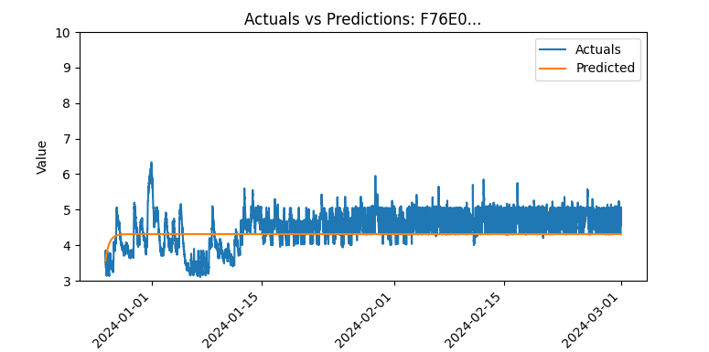
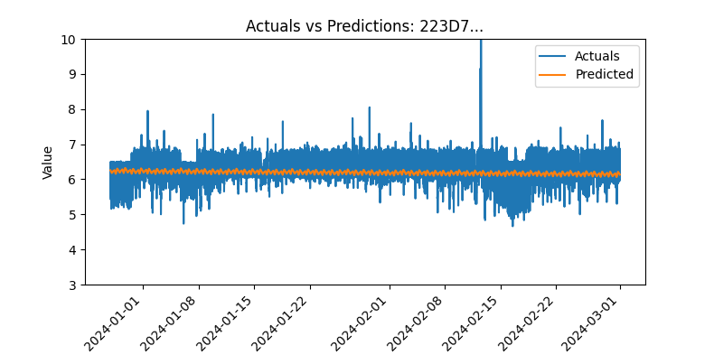
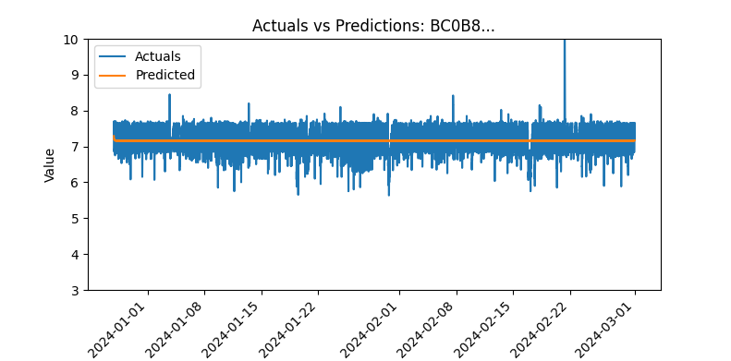
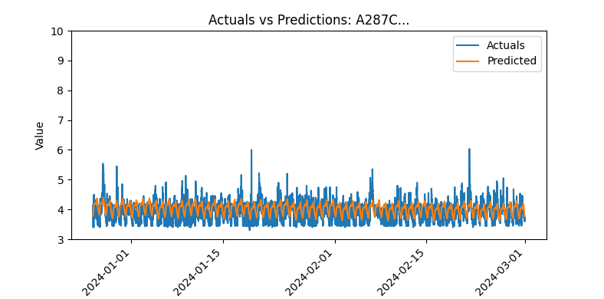
Best models per VID
VID: F76E06FD3CD3BA998FB3A59CA8FCCD18993CA059EF6E09E0765F9A2DD9CD56A9
model: ARIMA
mae: 0.4
VID: 223D7F17502E6454E5A338719EC3A6CBE53EDF3F6751553DE34C4C97E018D815
model: PROPHET
mae: 0.32
VID: A287C4E4973A2702DA91353D45AA769553AA33896F9C764110BF18FFC3E78754
model: PROPHET
mae: 0.24
VID: BC0B83BC5E1CDA7898345EBBC72FA30EBA4956AEB7EF3D24AD676FA893CA48CD
model: SARIMA
mae: 0.26

Slide 19
4. Validation of the predictive models

Slide 20
Models validation
train
test
validation
Validation is made on last available dates that wasn’t used during process of training the models.
Extracted period: <03/2024 – middle of 05/2024>
For 2 out of 7 VIDS we couldn’t make validation as there were no new data for them (even on test set their logs ended at 06/23):
’1F94CBF68784D942B63D4E382BABEE11927FDB41E4A016AFBEFF873AA25E47CE’
’3692DA19A0D4699FF4C068E85566193ECD0827C166CEFD6D6A9E5D64F94C0A60’

Slide 21
Models validation
vid | best_model_type | best_model_mae | VALIDATION_mae | mae_diff
1F94CBF68784D942B63D4E382BABEE11927FDB41E4A016AFBEFF873AA25E47CE | SARIMA | 0,244 | no new data
A287C4E4973A2702DA91353D45AA769553AA33896F9C764110BF18FFC3E78754 | PROPHET | 0,243 | 0,244 | 0,001
3692DA19A0D4699FF4C068E85566193ECD0827C166CEFD6D6A9E5D64F94C0A60 | SARIMA | 0,261 | no new data
F76E06FD3CD3BA998FB3A59CA8FCCD18993CA059EF6E09E0765F9A2DD9CD56A9 | ARIMA | 0,400 | 0,453 | 0,053
2713EA927E356A70DDC0E751D4508E0966D12859364985F75EB5ECD9E4C0AE06 | SARIMA | 0,731 | 0,696 | -0,035
BC0B83BC5E1CDA7898345EBBC72FA30EBA4956AEB7EF3D24AD676FA893CA48CD | SARIMA | 0,262 | 0,265 | 0,003
223D7F17502E6454E5A338719EC3A6CBE53EDF3F6751553DE34C4C97E018D815 | PROPHET | 0,318 | 0,291 | -0,027
Average error across best models on test set is 0.36 vs 0.39 Celsius on validation set. That indicates that models are performing similiarly well on completetly new set of data.
When comparing mae on test vs validaton set we can see that most VIDs have very similiar error (=< 0.05 degree difference).

Slide 22
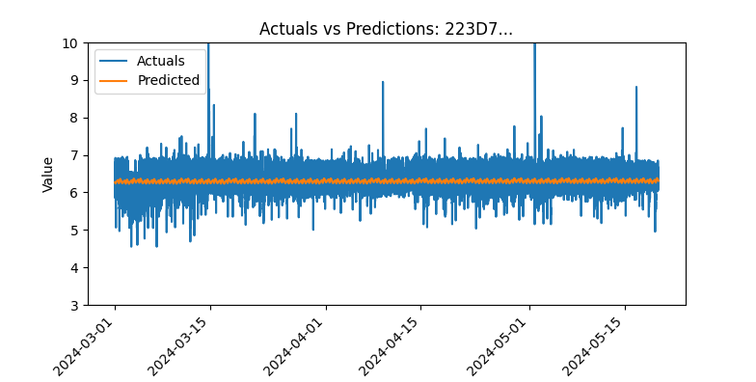
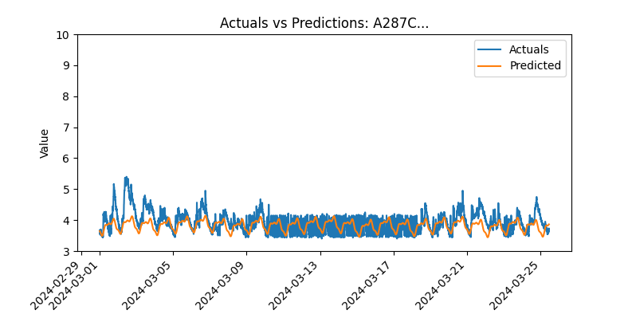
Models validation per VID
Test set
Validation set
VID: 223D7F1……
model: PROPHET
Mae on test: 0.32
Mae on validation: 0.29
VID: A287C4E4……
model: PROPHET
Mae on test: 0.24
Mae on validation: 0.24

Slide 23
5. Binary modeling - detecting abnormal temperature increase

Slide 24
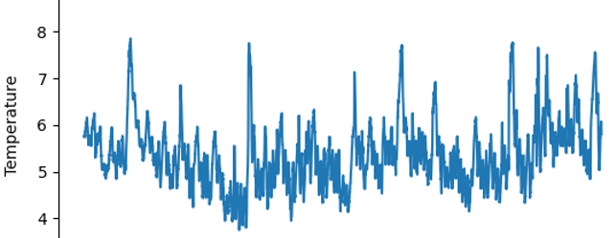
Binary modeling
Building classification model that will detect when there was an abnormal temperature increase (temperature higher than normal for this appliance)
At each time point model decides if temperature is an anomaly or not based on current and past data.
First step: generate training data for the model – mark abnormal data points semi-automatically using statistical methods
In general it is a challenge to get rid of natural oscilations in temperature since they are not regular for most vids
Several methods were tested
In the future, if we decide to proceed we should have an expert create (or inspect) the training data.

Slide 25
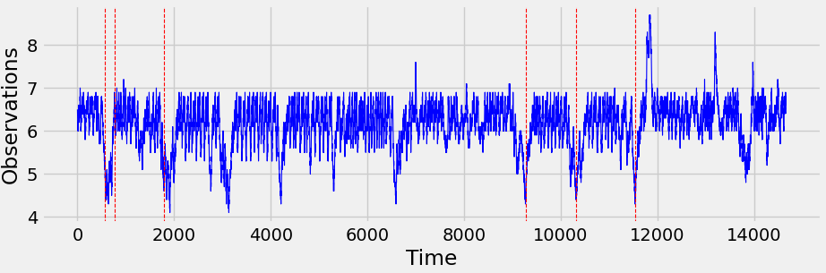
Binary modeling – data labeling
Changepoint detection in time series – detecting time point where distribution changes
CUSUM algorithm – detecting change in rolling average
Problem: our anomalies are too short to be reliably detected as distribution change considering natural oscilations of time series
Also it detects the moments when temperature returns to its normal pattern after anomalous period
Method rejected

Slide 26
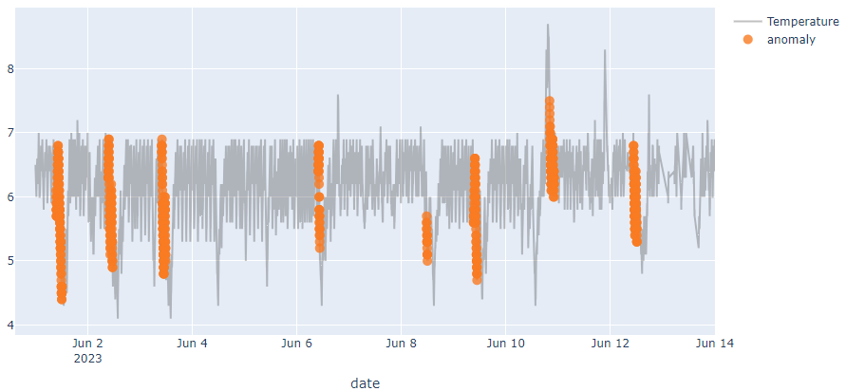
Binary modeling – data labeling
LevelShiftAD: detects shift of value level by tracking the difference between median values at two sliding time windows next to each other.
Problem: hard to select universal window size for all anomalies
Method rejected

Slide 27
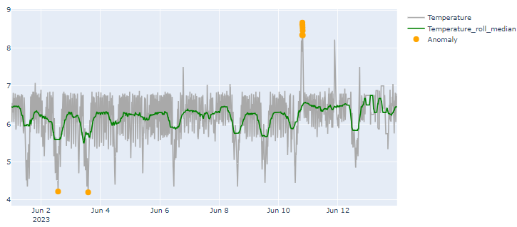
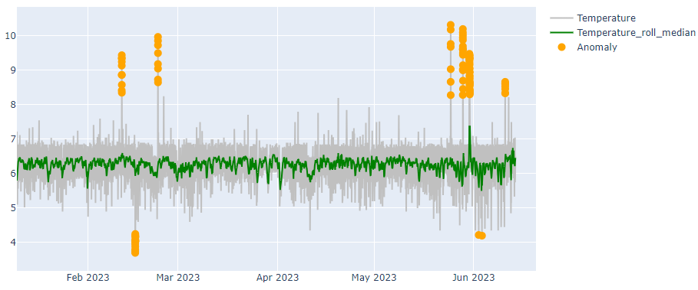
Binary modeling – data labeling
InterQuartileRangeAD model – selects treshold based on quartile
IQR=Q3−Q1 is the difference between 25% and 75% quantiles.
[Q1−c∗IQR,Q3+c∗IQR] is considered normal range and anything outside is anomaly
c=3.5
Method selected for training data creation.
simple and good method.
this itself could be used as method of detecting abnomal temperature increases, but it is only based on temperature values, other info not possible to include

Slide 28
Binary modeling
Several classic classification models were tested:
SVM, RandomForestClassifier, DecisionTreeClassifier, HistGradientBoostingClassifier
Because of data labeling method this is extremally easy problem for clasisfication models (if we provide them with temperature info)
Data aggregated in 5-minute windows. Train – test – validation split – same as in predictive modeling.
Input variables used:
Status.Refrigerator.MeasuredTemperature
Temperature_roll_median (10h)
Temperature_roll_mean (1h)
Status.TemperatureAmbient
Setting.Refrigerator.SetpointTemperature
DoorRefrigerator_duration
DoorRefrigerator_doorstate_OPEN

Slide 29
Evaluation metrics
We use precision and recall to make sure we control the level of both 1 type error and 2 type error.
​ | Precision​ | Recall​
Calculation​ | # correctly detected anomalies / all detected anomalies | # correctly detected anomalies / # of all actual anomalies
Explanation​ | With precision you can make sure you are not making too many wrong detections of anomalies. So high precision would mean that most examples where anomaly was detected is correct.​ | With recall you can make sure that you are not missing out on any anomalies. ​ So high recall would mean you have only missed a few anomalies.
​ |  | ​

Slide 30
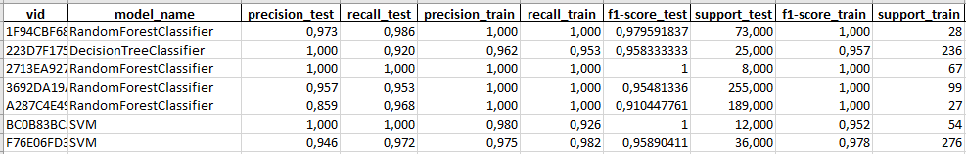
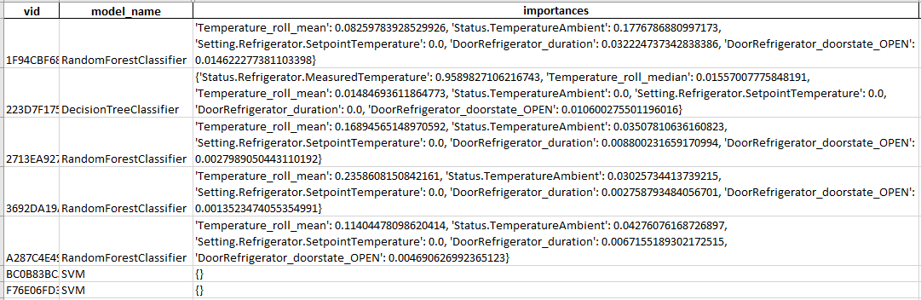
Best models

Slide 31
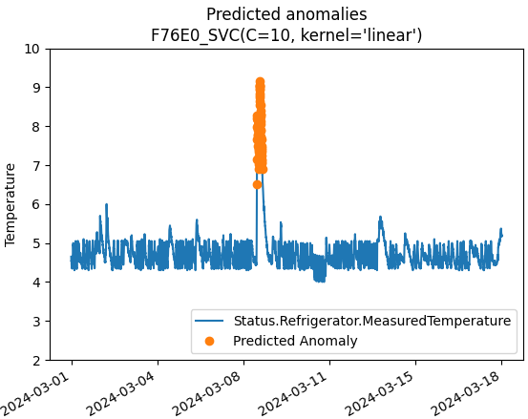
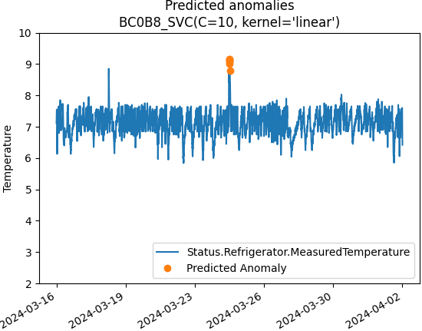
Predictions on new data

Slide 32
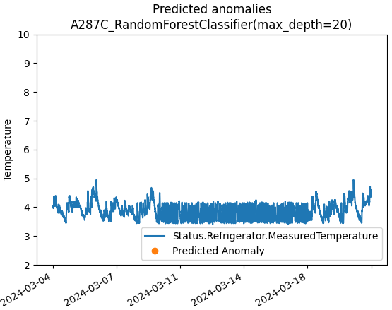
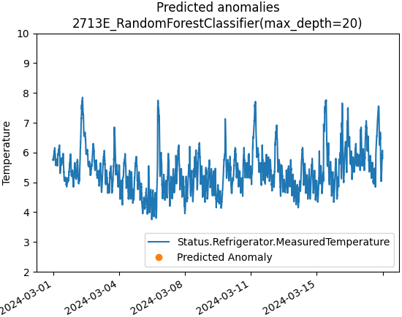
Predictions on new data

Slide 33
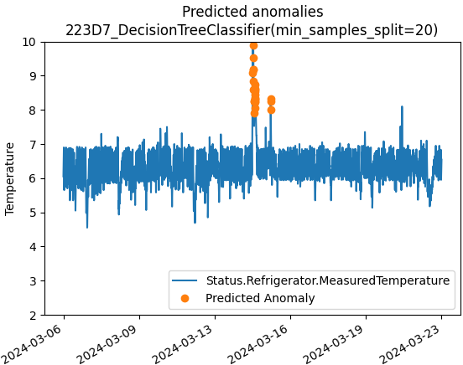
Predictions on new data

Slide 34
6. Conclusions

Slide 35
Conclusions
Temperature mainly depends on historical temperature measurements and does not depend on any other variables that we have in data (doors, setpoint and ambient seem to have minimal impacts)
Binary modeling:
Detecting abnormal increases of temperature is very possible and can be done with simple methods, but we need to validate the solution on manually labeled (or verified) data sample.
Predictive modeling:
Temperature prediction also possible, small error (around 0.3-0.4 Celcius on average) however this solution is unable to correctly predict abnormal temperature rises/spikes.
Next steps:
Expert–labeled dataset to tell us when the alerts are expected
There is a room for detecting reason for temperature increase too – but for that some simulated dataset is needed (someone putting hot pots in the fridge on specified time, etc.)

