Slide 1
Belief System Networks and Policy Learning
Matthew C. Nowlin, College of Charleston Kuhika Gupta, University of Oklahoma Hank Jenkins-Smith, University of Oklahoma

Slide 2
Motivation
Builds on work conceptualizing and measuring belief systems as networks
Examines policy-oriented learning in the context of belief system networks

Slide 3
Belief Systems
A set of interrelated and connected beliefs
According to the ACF belief systems are hierarchical
Type of belief
Notes:
IV: one type of belief -> DV: another type of belief
“Fuzzy” boundaries (e.g., deep vs policy core)
Instrument constituencies and deep core belief coalitions
Inconsistent findings

Slide 4
Belief Systems
A set of interrelated and connected beliefs
Belief systems as networks
Nodes are beliefs and edges are the correlations between beliefs
Centrality of beliefs

Slide 5
Belief Systems
Figure 1: Development of a Belief System Network

Slide 6
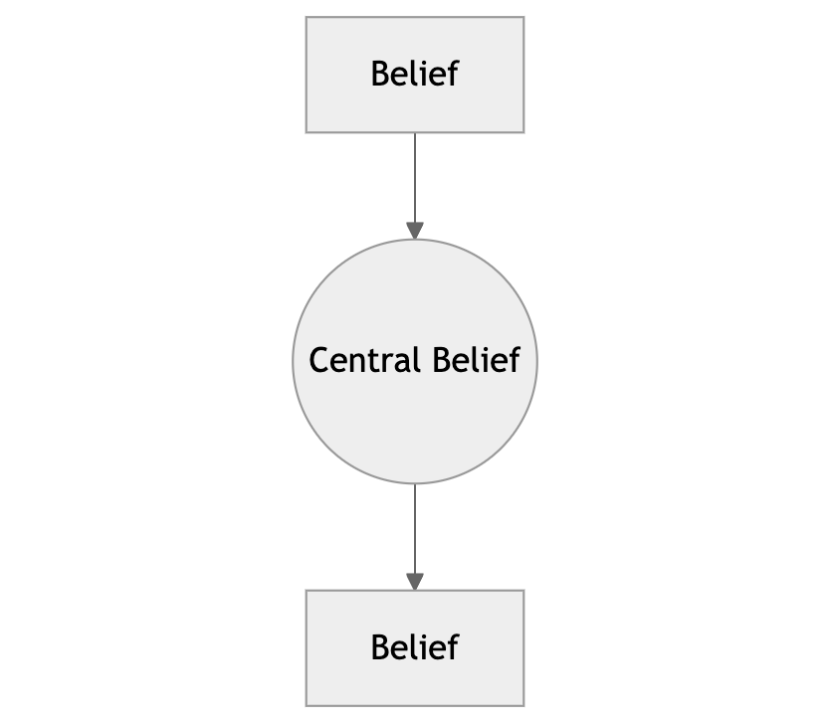
Belief System Centrality
Betweenness
Sits on the shortest path between nodes
Gatekeeper

Slide 7
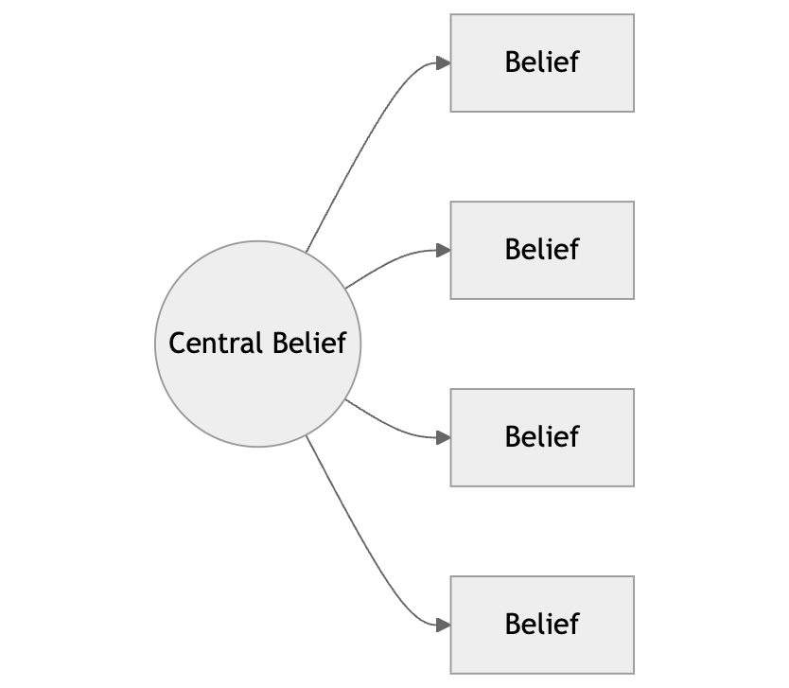
Belief System Centrality
Closeness
How close nodes are in the network
High in closeness means a shorter path to other nodes

Slide 8
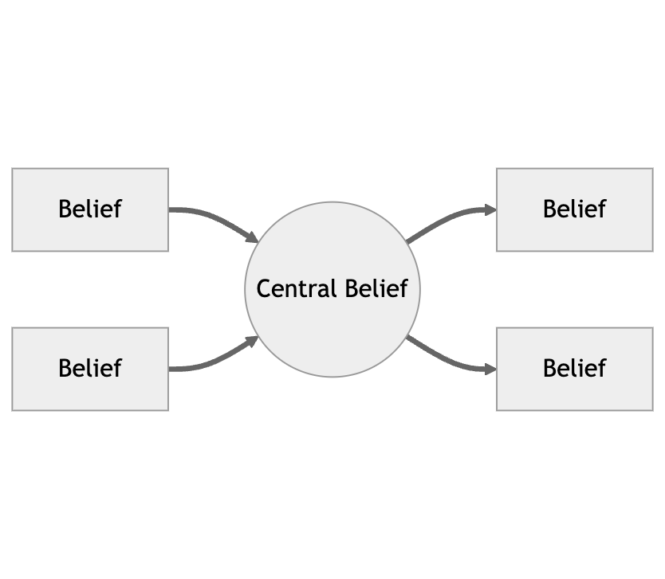
Belief System Centrality
Strength (Degree)
Degree is the total number of connections in an unweighted network
Strength is the sum of the weighted connections

Slide 9
Policy-Oriented Learning
Belief System Networks
Policy-oriented learning is changes in the belief system network
Structure of the network
Centrality of beliefs
Dynamic constraint

Slide 10
Nuclear Energy Beliefs
Deep core beliefs
Political ideology
Environmental concern
Energy concern
Policy core beliefs
Risks and benefits of nuclear energy
Secondary beliefs
Support for the construction of nuclear power plants

Slide 11
Data and Analysis
Pooled survey data from annual nationally representative samples of the US population collected from 2008-2023
26752
Compared belief system networks pre- and post-Fukushima

Slide 12
Measures: Deep Core
Ideology: self-placement 1 (strongly liberal) to 7 (stongly conservative) scale
Mean = 4.02
Environmental concern: combines two questions (fragility of nature, how threatened is the natural environment) into a 0 to 10 scale
Mean = 7.22
Energy concern: costs and availability of energy in the US on a 0 to 10 scale
Mean = 8.79

Slide 13
Measures: Policy Core
Risks and benefits of nuclear energy on a 0 to 10 scale
Risks
Plant accident (nrsk1)
Transportation accident (nrsk2)
Terrorist attack (nrsk4)
Weapon (nrsk4)
Benefits
No greenhouse gases (nben1)
Reliable power (nben2)
Energy independence (nben3)
Reduced environmental damage (nben4)

Slide 14
Measures: Secondary Beliefs
Nuclear power plants
Support for the construction of new nuclear power plants on a 1 (strongly oppose) to 7 (strongly support) scale
Mean = 4.022

Slide 15
Network Analysis
Beliefs are the nodes and the edges are partial correlation coefficients
Weighted by the strength of the partial correlations
Regularized using “least absolute shrinkage and selection operator” (LASSO)
Bootstrapping procedure to estimate centrality measures
Network Comparison Test

Slide 16
Results: Pre- and Post-Fukushima Beliefs
 | Beliefs | Pre-Fukushima Mean | Post-Fukushima Mean
Policy Core: Risks | Plant Accident | 6.24 | 6.56***
 | Transportation Accident | 6.25 | 6.47***
 | Terrorist Attack | 6.68 | 6.76+
 | Weapon | 5.66 | 6.04***
Policy Core: Benefits | No GHG | 7.04 | 6.8***
 | Reliable Power | 7.19 | 7***
 | Energy Independence | 7.368 | 7.05***
 | Reduced Environmental Damage | 7.13 | 6.95***
Secondary: More Plants | Support for more nuclear plants | 4.25 | 3.96***

Slide 17
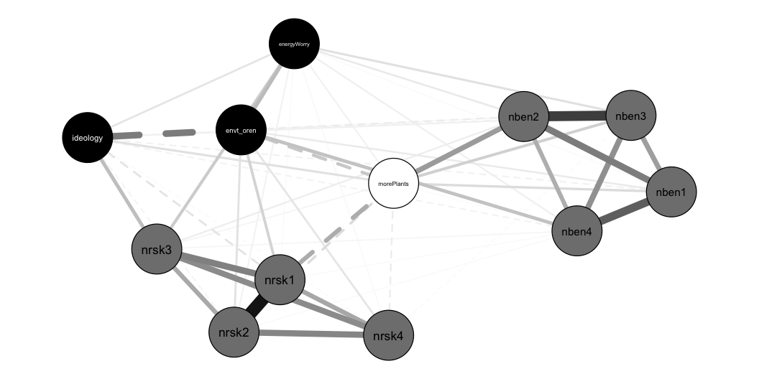
Results: Pre-Fukushima Network
Pre-Fukushima Nuclear Energy Belief System Network

Slide 18
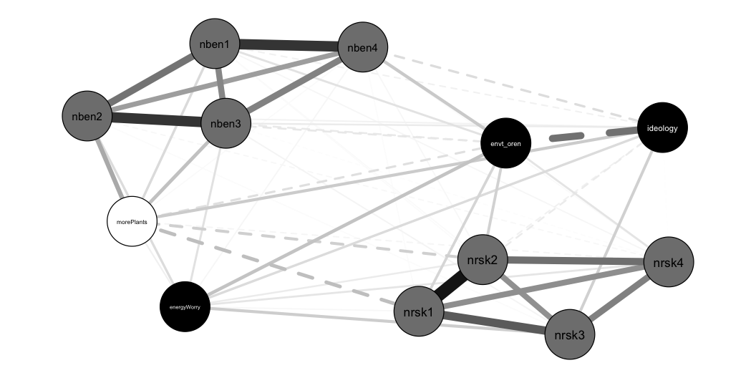
Results: Post-Fukushima Network
Post-Fukushima Nuclear Energy Belief System Network

Slide 19
Results: Network Comparison Test
Invariant Network Structure
M = 0.0701, p < 0.05
Different edge weights
nrsk1-nrsk2 (0.559 vs. 0.489)
ideology-nrsk3 (0.130 vs. 0.080)
envt-oren-morePlants (-0.111 vs. -0.055)
nrsk1-morePlants (-0.169 vs. -0.114)
nben2-morePlants (0.205 vs. 0.152)

Slide 20
Results: Network Comparison Test
Centrality measures
Strength centrality
Increase: envt-oren, nrsk1, nben2 (at p < 0.10), and morePlants
Decrease: nrsk4 (at p < 0.10) and nben1
Closeness centrality: all nodes significantly decreased
Betweenness centrality: no significant differences

Slide 21
Discussion
Belief system networks useful for the ACF
Belief system networks and learning
Some changes (weaker ties post-Fukushima, closeness centrality, strength centrality of some beliefs)
More uncertainty post-Fukushima
Lots more work to do

Slide 22
Thank you!

