Slide 1
Evidence-Based Policymaking
EVSS/PUBA 551: Research and Management in Environmental Organizations

Slide 2
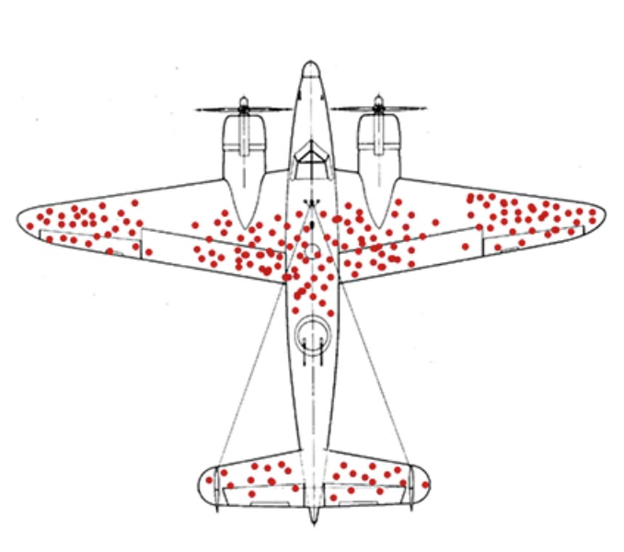

Slide 3
What is evidence-based policymaking?

Slide 4
EBPM: Definitions
Evidence-based policymaking is the process of using high-quality information to inform decisions that are made about government policies (Bipartisan Policy Center 2018, 3)
It involves:
Data collection
Data analysis
Evidence use

Slide 5
EBPM: Cairney
Two extreme views
Naive EBPM
Direct and unproblematic link between scientific evidence, policy decisions, and outcomes
Policy based evidence
Politics is so pathological that no decision is based on an appeal to scientific evidence if it gets in the way of politicians seeking election, or so messy that the evidence gets lost somewhere in the political process
How does Cairney define evidenced-based policymaking?

Slide 6
EBPM: Definitions (Cairney)
Policy:
the sum total of government action, from signals of intent to the final outcomes
Policymakers:
Elected and unelected (official and unofficial)
Actors = individuals and/or organizations (a group of people making decisions collectively)
Institutions (rules)
Evidence and scientific evidence:
Evidence is an argument or assertion backed by information
Scientific evidence describes information produced in a particular way

Slide 7
How would an ideal (or optimal) policymaking system function?

Slide 8
Ideal according to Cairney
The values of society are reflected in the values of policymakers
A small number of policymakers control the policy process from its center
Separate facts from values
Organizations are comprehensively rational
Policy is made in a linear way: e.g., stages

Slide 9
What goes wrong?
Any disconnect between evidence and policymaking is because of “politics” and “allows us to blame politicians for general failure and explain specific successes with reference to exceptional individuals in the scientific profession”

Slide 10
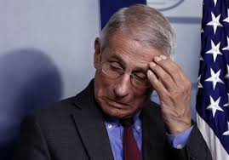
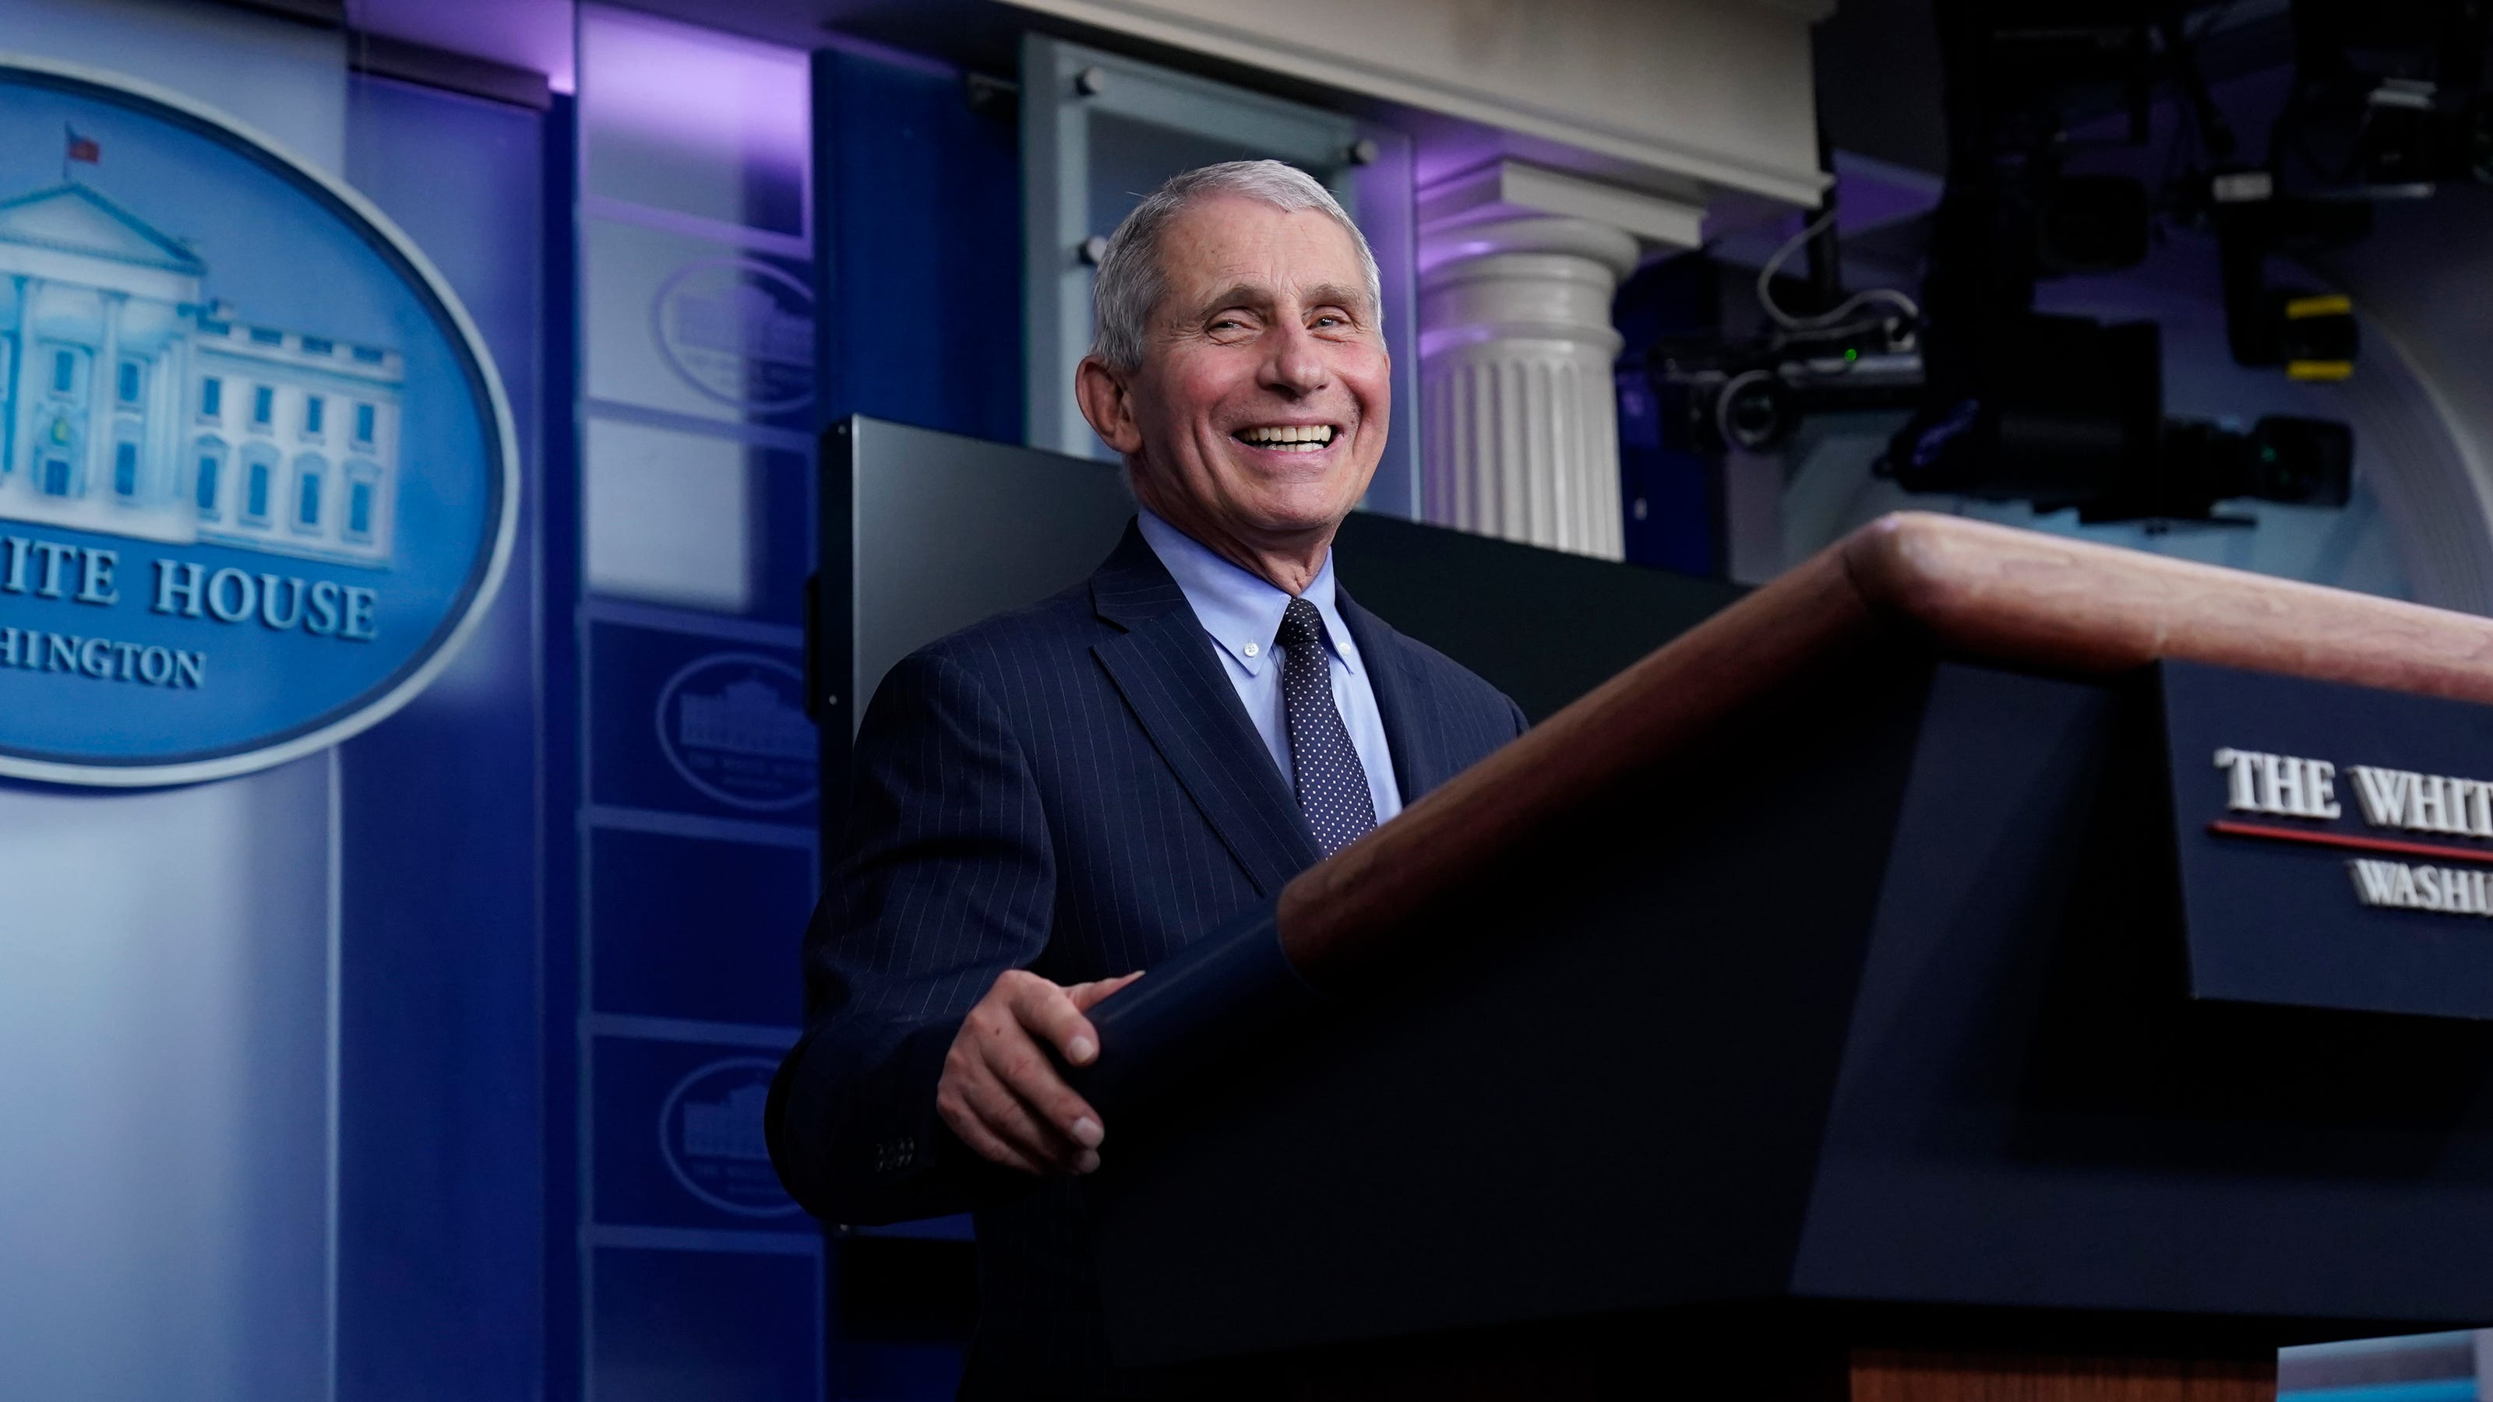

Slide 11
What goes wrong?
Supply of evidence
Hierarchy of evidence?
Demands for evidence
Notes:
Problems with the supply of evidence
Experts have the same cognitive limits as everyone else (but the iron rule)
Communication requires simplification
Hierarchy of evidence
Not always a clear scientific consensus
disagreement among scholars * Dem*
“the appearance of an evidence-policy gap is caused partly by a biased and romantic account of the supply of ‘the evidence’, in which scientists provide an objective account of a problem that cannot be ignored, and a consensus on how it should be solved. In practice, the evidence is contested, and the actors who identify problems may not be in a good position to supply the solutions.”
Demands for evidence
Policy actors may not pay attention or understand the “evidence”
for scientists evidence = research (the iron rule), but for policy actors evidence could be much broader, e.g., anecdotal
Bounded rationality and the need to make quick decisions
competition for policymaker attention
evidence is one part of the narrative
appearance of an evidence-policy gap results from the focus of one type of EBPM; clear convincing evidence first and problematic policy actors “politics” result in it not being used

Slide 12
EBPM and Policy Theory
The psychology of policymaking
How do you use information to make decisions?
Policy environment
Various policy theories
Notes:
policy environment
wide range of actors in a fragmented system
institutions: “rules, norms, practices and relationships that influence individual and collective behaviour”
networks / subsystems
ideas: policy solutions, values and beliefs, persuasion
context and events

Slide 13
Theories of the Policy Process
Notes:
Drawing on what you learned in EVSS/PUBA 602: Public Policy, describe at least one of the major theories or frameworks of the policy process (be sure and include and cite at least one source beyond the readings for this class) in about a paragraph. In one or two paragraphs describe how that theory or framework addresses the use of evidence in policymaking.

Slide 14
Theories of the Policy Process
Multiple Streams Approach
Punctuated Equilibrium Theory
The Social Construction of Target Populations
The Narrative Policy Framework
The Advocacy Coalition Framework
Studies of policy transfer, diffusion and learning
Complexity theory and complex systems

Slide 15
Policy-Oriented Learning
Enduring alterations of thought or behavioral intentions that result from experience and which are concerned with the attainment or revision of the precepts of the belief systems of individuals or of collectives (Sabatier and Jenkins-Smith 1993, 42)
Belief systems in the Advocacy Coalition Framework (ACF)
Deep core $→$ Policy core $→$ Secondary aspects

Slide 16
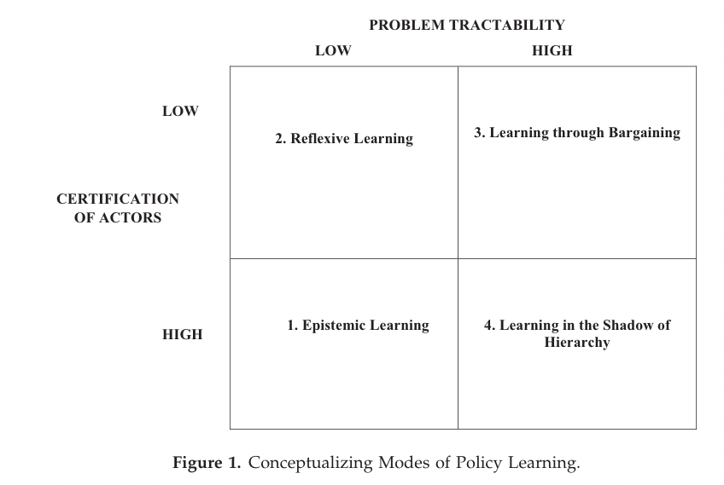
Policy Learning
- Dunlop and Radaelli (2018)

Slide 17
Conditions needed to minimize evidence-policy gap
It is possible to produce a scientific consensus based on an objective and comprehensive account of the relevant evidence
The policy process is centralized and power is held by a small number of policymakers
Scientific evidence is the sole source of knowledge for policymakers

Slide 18
Conditions needed to minimize evidence-policy gap
Policymakers understand the evidence in the same way as scientists
Policymakers have the motive and opportunity to turn the evidence into a solution that is consistent with, and a proportionate response to, the policy problem

Slide 19
In the real world …
Even if the evidence exists, it doesn’t tell you what to do
Demand for evidence does not match the supply
Policymakers make choices in a complex policymaking system in which the role of evidence is not always clear

Slide 20
What are some of the barriers associated with evidence-based policymaking?

Slide 21
Barriers
Current evidence on the nature of environmental problems, or the effectiveness of policy solutions, is often patchy
The evidence is not ‘packaged’ well. It needs to be easier to understand, ‘framed’ in a way that is attractive to policymakers, and/ or accompanied by realistic expectations for policy change

Slide 22
Barriers
Scientists do not engage well with policymakers, either in networks, academic-practitioner forums, or by using ‘knowledge brokers’
Broad differences in academic-policymaking cultures undermine the ability of scientists to engage in politics in a timely manner, or in a way that will maximize the impact of their findings

Slide 23
Is evidence-based policymaking a worthy goal? What “counts” as evidence?

Slide 24
Write down three take-aways from tonight

Slide 25
Next Time
Information Processing
Readings:
Workman, Samuel, Bryan D. Jones, and Ashley E. Jochim. 2009. “Information Processing and Policy Dynamics.” Policy Studies Journal 37(1): 75–92.
Jones, Bryan D. 2017. “Behavioral Rationality as a Foundation for Public Policy Studies.” Cognitive Systems Research 43: 63–75.
Maor, Moshe, Jale Tosun, and Andrew Jordan. 2017. “Proportionate and Disproportionate Policy Responses to Climate Change: Core Concepts and Empirical Applications.” Journal of Environmental Policy & Planning 19(6): 599–611.
DUE: Response paper 3

Slide 26
References
Bipartisan Policy Center. 2018. Evidenced-Based Policymaking Primer. Washington, D.C.: Bipartisan Policy Center.
Dunlop, Claire A., and Claudio M. Radaelli. 2018. “Does Policy Learning Meet the Standards of an Analytical Framework of the Policy Process?” Policy Studies Journal 46(s1): s48–68.
Sabatier, Paul A., and Hank C. Jenkins-Smith. 1993. Policy Change and Learning: An Advocacy Coalition Approach. Boulder, CO: Westview Press.

