Slide 1
Information Processing
EVSS/PUBA 551: Research and Management in Environmental Organizations

Slide 2
MPA Director Candidates
Eunice Akoto
Monday, February 6 at 5:30pm, Riley Center
Michael Craw
Wednesday, February 8 at 5:30pm, Riley Center
Michael Potter
Monday, February 13 at 5:30pm, Riley Center

Slide 3
Quick Refresher: Punctuated Equilibruim Theory

Slide 4
Briefly explain the information processing theory of policy dynamics

Slide 5
Information Processing
What is information?
Prioritization and supply
Issues
Institutions and jurisdiction
Delegation

Slide 6
Policy Learning

Slide 7
Policy-Oriented Learning
Enduring alterations of thought or behavioral intentions that result from experience and which are concerned with the attainment or revision of the precepts of the belief systems of individuals or of collectives (Sabatier and Jenkins-Smith 1993, 42)
Belief systems in the Advocacy Coalition Framework (ACF)
Deep core $→$ Policy core $→$ Secondary aspects

Slide 8
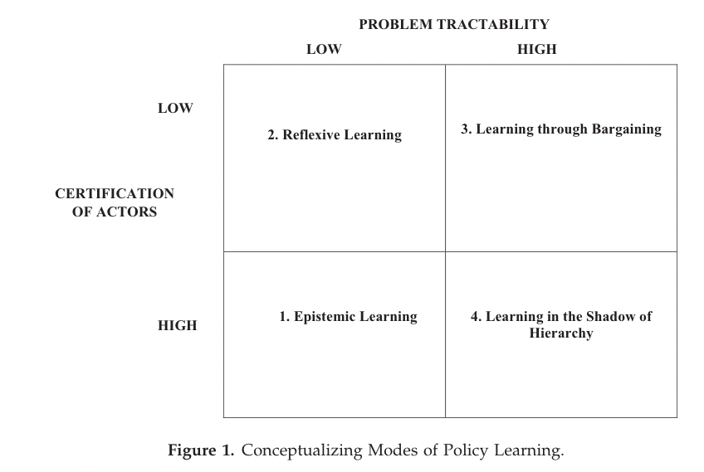
Policy Learning
- Dunlop and Radaelli (2018)

Slide 9
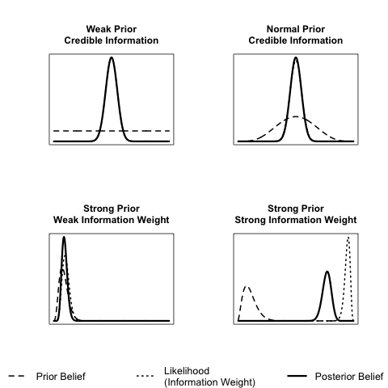
Policy Learning and Information Processing
Learning occurs as prior beliefs shift in the direction of the information
Learning is a function of the strength of the prior belief and the weight of the information
- Nowlin (2021)

Slide 10
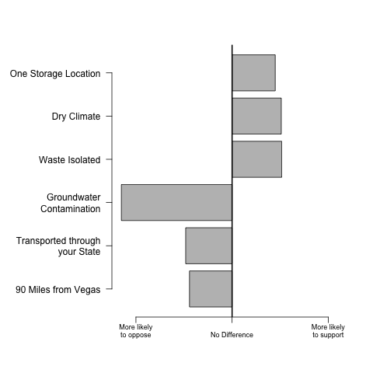
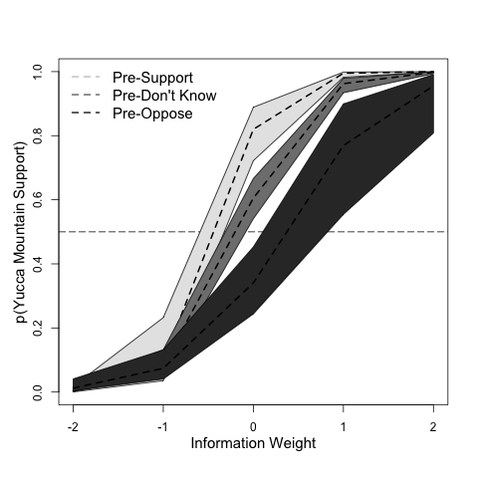
Policy Learning and Information Processing
- Nowlin (2021)

Slide 11
Two major insights in the Jones 2017 article

Slide 12
Behavioral Rationality
Comprehensive rationality
Bounded rationality
Behavioral organization theory
Problem space and solution space
Disproportionate information processing

Slide 13
Behavioral Rationality
Actors are behaviorally rational
Different dynamics can influence the problem space–understanding of the problem faced–and the solution space–the search and specification of alternatives to address that problem
The role of selective attention is critical in both problem definition and solution search
Emotional arousal is a dual-edged sword—it is critical in shifting the focus of attention, but it is also an essential component of cognition and hence reason

Slide 14
What is meant by “disproportionate policy response”

Slide 15
Policy Response
Proportionate vs disproportionate policy response
Factors that lead to a disproportionate policy response
Elements of policy design
Climate policy

Slide 16
What connections can we make between technocracy and democracy; evidenced-based policymaking; and information processing?
Notes:
delegation of information processing disrupts the demo - end; tech-means idea

Slide 17
Write down three take-aways from tonight

Slide 18
For Next Time
MEET AT THE RILEY CENTER AT 5:30 PM
Governance
Readings:
Partelow, Stefan et al. 2020. “Environmental Governance Theories: A Review and Application to Coastal Systems.” Ecology and Society 25(4).
Emerson, Kirk, Tina Nabatchi, and Stephen Balogh. 2012. “An Integrative Framework for Collaborative Governance.” Journal of Public Administration Research and Theory 22(1): 1–29.
Ostrom, Elinor. 2009. “A General Framework for Analyzing Sustainability of Social-Ecological Systems.” Science 325(5939): 419–22.
DUE: Response paper 4

Slide 19
References
Dunlop, Claire A., and Claudio M. Radaelli. 2018. “Does Policy Learning Meet the Standards of an Analytical Framework of the Policy Process?” Policy Studies Journal 46(s1): s48–68.
Jones, Bryan D. 2017. “Behavioral Rationality as a Foundation for Public Policy Studies.” Cognitive Systems Research 43: 63–75.
Nowlin, Matthew C. 2021. “Policy Learning and Information Processing.” Policy Studies Journal 49(4): 1019–39.
Sabatier, Paul A., and Hank C. Jenkins-Smith. 1993. Policy Change and Learning: An Advocacy Coalition Approach. Boulder, CO: Westview Press.

