Slide 1
Democracy and Technocracy
EVSS/PUBA 551: Research and Management in Environmental Organizations

Slide 2
Course Introduction

Slide 3
Course Information
This course is required for students in the concurrent MES/MPA program, and it is intended to be taken near the end of the program of study
While this course counts for elective credit, it should be thought of as the only core course for concurrent MES/MPA students
Notes:
no laptops

Slide 4
Course Information
The central question of this course: how is information and expert knowledge used for decision-making within and across organizations that address environmental issues?

Slide 5
Course Information
You should have had:
PUBA 600: Foundations of Public Sector Management and Leadership
EVSS 601/PUBA 536: Economic Theory for Policy Analysis
PUBA 601: Research and Quantitative Methods for Public Administration
EVSS/PUBA 602: Public Policy
EVSS 611: Graduate Core Seminar
EVSS 632: Social Science Methods in Environmental Studies

Slide 6
Course Information
There are 450 points possible for this course
Assignment & Possible Points
Response papers (10): 200 points total
Organizations and governance paper: 100 points
Knowledge development and use paper: 100 points
Participation: 50 points

Slide 7
Course Information
Part I: Foundations
Technocracy and Democracy
Evidence-Based Policymaking
Information Processing

Slide 8
Course Information
Part II: Governance and Organizations
Governance
Organizations and Public Management
Government Agencies
Nonprofits

Slide 9
Course Information
Part III: Knowledge and Decision-Making
Science and Policymaking
Policy Analysis
Benefit-Cost Analysis
Risk Analysis and Risk Perception
Co-Production of Knowledge
Deliberative Democracy

Slide 10
Week 1: Readings

Slide 11
The “Iron Rule”
How does science really work?
What is the iron rule of explanation?
What does the “iron rule” mean for bias in science?

Slide 12
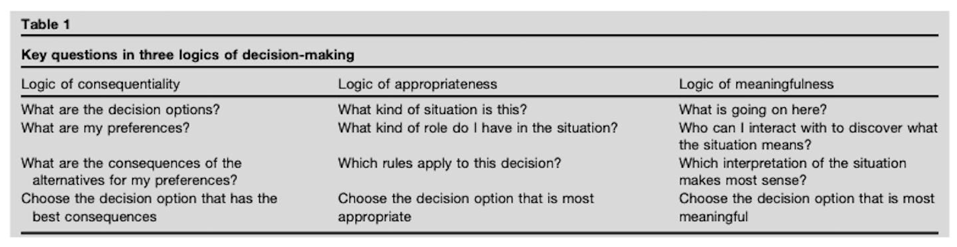
Three Logics of Decision-Making

Slide 13
Technocracy and Democracy

Slide 14
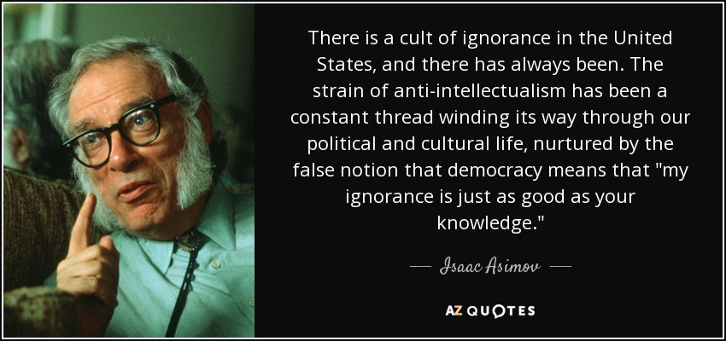

Slide 15
Is expertise dead?

Slide 16
How would you define technocracy?

Slide 17
Technocracy
A system of government characterized by high reliance on a small elite of technical experts, whose decisions about public policy are more influential than the desires of citizens (Birkland 2020, 9)
Within the policy sciences themselves lurk dangerous elitist and technocratic tendencies towards decidedly undemocratic ends and means (deLeon 1995, 888)
Advantages? Disadvantages?

Slide 18
Technocracy Scale
Scientists and technically trained experts, not the public, should make decisions about the applications of advanced technologies to address energy needs and environmental concerns
Those who are better informed and knowledgeable should have greater influence in policymaking
Technical issues are so complex that most people cannot contribute to reasonable policy choices
-Nowlin (2021)

Slide 19
Technocracy

Slide 20
How is democracy doing in the US?

Slide 21
Defining Democracy
That all members [of a polity] are to be treated (under the constitution) as if they were equally qualified to participate in the process of making decisions about the policies [the polity] will pursue (Dahl and Shapiro 2015, 37)
A system of government with regular, free and fair elections, in which all adult citizens have the right to vote and possess basic civil liberties such as freedom of speech and association (Levitsky and Ziblatt 2019, 6)
Two components: “political control,” means that political power is actually exercised by the people, and only by the people. “political equality” means that in the exercise of that power, citizens are equals (Gilley 2017, 13)

Slide 22
Technocracy and Democracy and Justice

Slide 23
What is justice from a democratic perspective?

Slide 24
Democratic Justice
A public policy is just from a democratic standpoint if it reflects a process in which all citizens, situated equally, or their duly elected representatives, have participated in the decision (Gilley 2017, 13)

Slide 25
What is justice from a technocratic perspective?

Slide 26
Technocratic Justice
… rooted in the principles of logical inquiry and rational choice. One way that technocracy is often expressed in the modern world is in the language of contemporary policy analysis. The norms and assumptions that define “good” policy from the policy analysis perspective can be easily identified: They should be feasible; evaluable; benefit more than they cost; be effective in addressing some problem; be reasonably certain of success; be well grounded in evidence; and be amenable to monitoring and evaluation (Gilley 2017, 13)

Slide 27
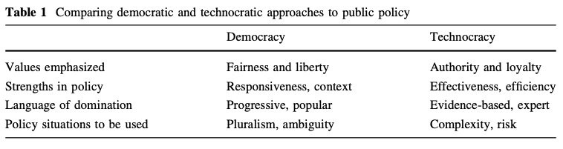
Democracy and Technocracy

Slide 28
How would you balance democracy and technocracy?

Slide 29
What are the three models of democratic expertise?
Notes:
ways in which expertise can be engaged

Slide 30
Democractic Expertise
Representative Expertise: citizen-expert relationship mediated through representative institutions
Participatory Expertise: citizens and experts interact directly through participatory processes
Associative Expertise: citizens and experts self-organize into groups

Slide 31
Write down three take-aways from tonight

Slide 32
Next Time
Evidence-Based Policymaking
Readings:
The Bipartisan Policy Center. Evidence-Based Policymaking Primer.
Cairney Blog: Evidence-Based Policymaking Resources
Cairney, Paul. 2016. The Politics of Evidence-Based Policy Making. Basingstoke: Palgrave Macmillan.
Chapter 1: read up to The structure of the book section
Chapter 2
Chapter 4
DUE: Response paper 2

Slide 33
References
Birkland, Thomas A. 2020. An Introduction to the Policy Process: Theories, Concepts, and Models of Public Policy Making. Fifth. New York, NY: Routledge.
Dahl, Robert A., and Ian Shapiro. 2015. On Democracy. Second. New Haven: Yale University Press.
deLeon, Peter. 1995. “Democratic Values and the Policy Sciences.” American Journal of Political Science 39(4): 886–905.
Gilley, Bruce. 2017. “Technocracy and Democracy as Spheres of Justice in Public Policy.” Policy Sciences 50(1): 9–22.
Levitsky, Steven, and Daniel Ziblatt. 2019. How Democracies Die. Reprint edition. New York, NY: Crown.
Nowlin, Matthew C. 2021. “Political Beliefs, Views About Technocracy, and Energy and Climate Policy Preferences.” Public Understanding of Science 30(3): 331–48.

