Slide 1
Governance
EVSS/PUBA 551: Research and Management in Environmental Organizations

Slide 2
What is governance?

Slide 3
Governance Definition
Governance generally refers to the means for achieving direction, control, and coordination of wholly or partially autonomous individuals or organizations on behalf of interests to which they jointly contribute
- Lynn, Heinrich, and Hill (2000), 235

Slide 4
Public Governance
Governance is constituted by the tasks the state performs for its citizens and the institutions that incentivize the performance of those tasks
- Bertelli (2012), 4

Slide 5
Public Governance
Governance is the regimes of laws, administrative rules, judicial rulings, and practices that constrain, prescribe, and enable government activity, where such activity is broadly defined as the production and delivery of publicly supported goods and services
– Lynn, Heinrich, and Hill (2000), 235

Slide 6
Theories of Governance
Polycentricity
Network governance
Collective action theory
Governmentality/environmentality
Multilevel goverance theory
Interactive governance theory
Adaptive governance
Evolutionary governance theory

Slide 7
Collabortive Governance
A governing arrangement where one or more public agencies directly engage non-state stakeholders in a collective decision-making process that is formal, consensus-oriented, and deliberative and that aims to make or implement public policy or manage public programs or assets.
- Ansell and Gash (2008), 544

Slide 8
Collabortive Governance
The processes and structures of public policy decision making and management that engage people constructively across the boundaries of public agencies, levels of government, and/or the public, private and civic spheres in order to carry out a public purpose that could not otherwise be accomplished
- Emerson, Nabatchi, and Balogh (2012), 2

Slide 9
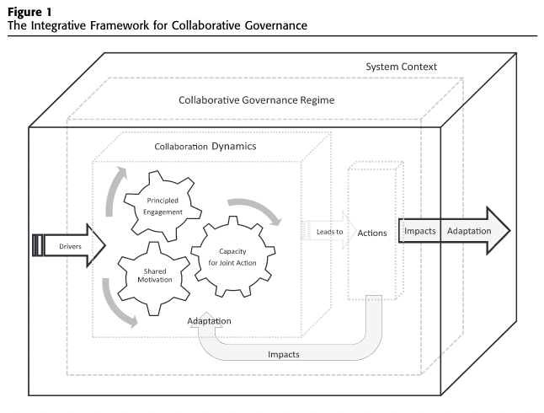
Collaborative Governance

Slide 10
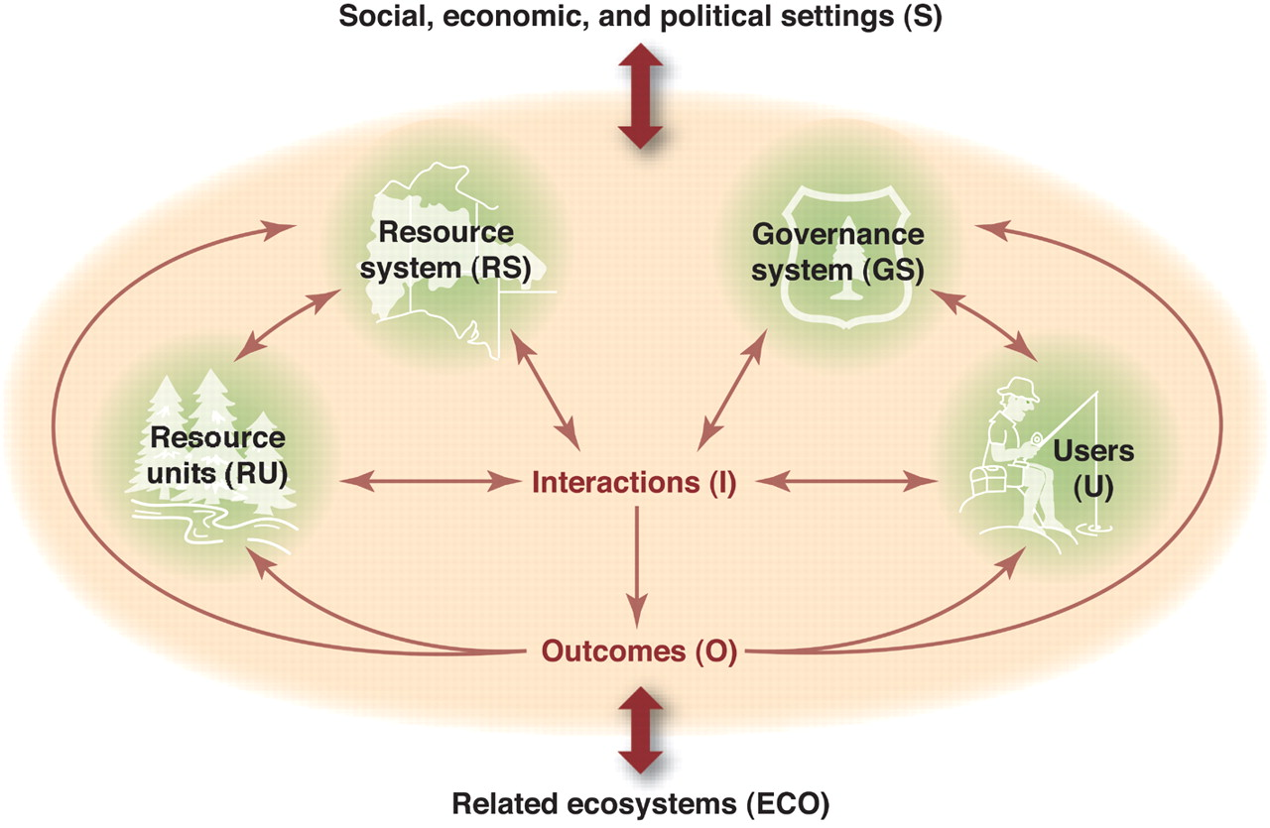
Social-Ecological Systems Framework

Slide 11
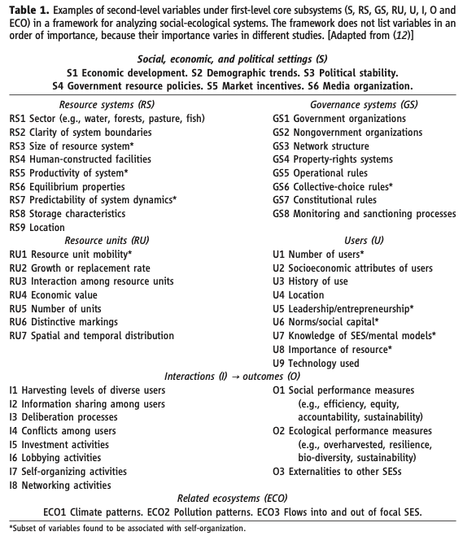
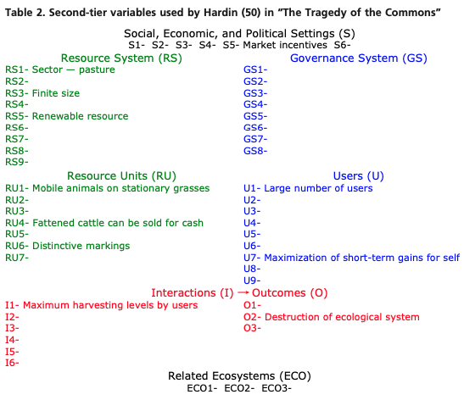
Social-Ecological Systems Framework

Slide 12
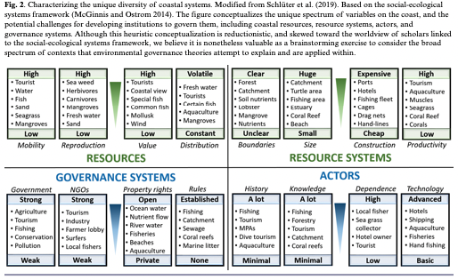
Social-Ecological Systems Framework
Notes:
from Partelow et al. (2020)

Slide 13
Social-Ecological Systems Framework
Governance systems
Government organizations
Nongovernment organizations
Network structure
Property-rights systems
Operational rules
Collective-choice rules
Constitutional rules
Monitoring and sanctioning processes

Slide 14
Let’s talk about your projects

Slide 15
Next Time
Organizations and Public Management
GUEST SPEAKER: Katharine Gerling
Readings:
Jones, Bryan D., Graeme Boushey, and Samuel Workman. 2006. “Behavioral Rationality and the Policy Processes: Toward A New Model of Organizational Information Processing.” In Handbook of Public Policy, eds. B. Guy Peters and Jon Pierre. London: SAGE Publications, 49–74.
Bourrier, Mathilde. 2011. “The Legacy of the High Reliability Organization Project.” Journal of Contingencies and Crisis Management 19(1): 9–13.
O’Toole, Laurence J., and Kenneth J. Meier. 2015. “Public Management, Context, and Performance: In Quest of a More General Theory.” Journal of Public Administration Research and Theory 25(1): 237–56.
DUE: Response paper 5

Slide 16
References
Ansell, Chris, and Alison Gash. 2008. “Collaborative Governance in Theory and Practice.” Journal of Public Administration Research and Theory 18(4): 543–71.
Bertelli, Anthony Michael. 2012. The Political Economy of Public Sector Governance. Cambridge: Cambridge University Press.
Emerson, Kirk, Tina Nabatchi, and Stephen Balogh. 2012. “An Integrative Framework for Collaborative Governance.” Journal of Public Administration Research and Theory 22(1): 1–29.
Lynn, Laurence E., Carolyn J. Heinrich, and Carolyn J. Hill. 2000. “Studying Governance and Public Management: Challenges and Prospects.” Journal of Public Administration Research and Theory 10(2): 233–62.
Partelow, Stefan, Achim Schlüter, Derek Armitage, Maarten Bavinck, Keith Carlisle, Rebecca Gruby, Anna-Katharina Hornidge, Martin Le Tissier, Jeremy Pittman, Andrew Song, Lisa Sousa, Natașa Văidianu, and Kristof Van Assche. 2020. “Environmental Governance Theories: A Review and Application to Coastal Systems.” Ecology and Society 25(4).

