Slide 1
Evolution of Environmental Policy
POLI 307: Environmental Policy

Slide 2
Environmental Controversy
The difficulty of collective action
Distributional conflicts over costs and benefits
The structure of the political and policymaking system
Science
Politicization of science
Scientific uncertainty
Values and value disputes

Slide 3
Environmental Policy
Four analytical frameworks (Salzman and Thompson Jr 2014)
Environmental rights
Humans have a right to environmental protection
Sustainable development
Balance between economic development and environmental protection
Utilitarianism and Cost-Benefit Analysis
Greatest good for the greatest number
The cost of environmental protection should not exceed the benefits to society
Notes:
use of these frameworks is informed by values

Slide 4
Environmental Policy
Four analytical frameworks
Environmental justice
Principle that all people and communities are entitled to equal protection of environmental and public health laws and regulations (Mohai, Pellow, and Roberts 2009)
Substantive: How the burdens of environmental harms are distributed
Procedural: Process by which environmental decisions are made
Environmental racism: Refers to any policy, practice, or directive that differentially affects or disadvantages (whether intended or unintended) individuals, groups, or communities based on race or color (Mohai, Pellow, and Roberts 2009)

Slide 5
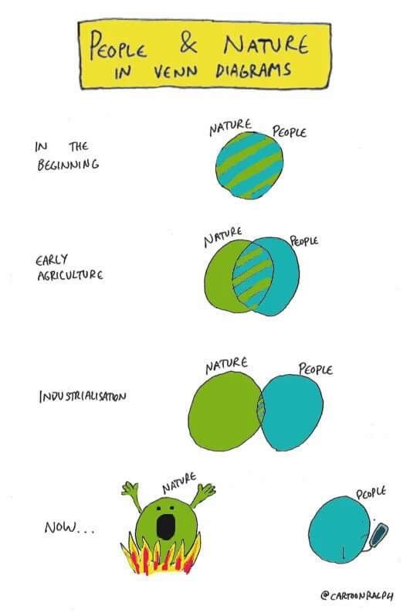
Environmental Policy Eras
Development era
Conservation era
Environmentalism era
Reform era
Stagnation and polarization

Slide 6
Development Era: 1800-1890

Slide 7
Development Era: 1800-1890
Economic growth and westward expansion
Overlap with the Industrial Revolution (1760-1840)
Mechanization and mass production
Urbanization: movement from farms to cities created separation from nature
Sanitation and the germ theory of disease
Little government regulation
Preservationist thinking

Slide 8
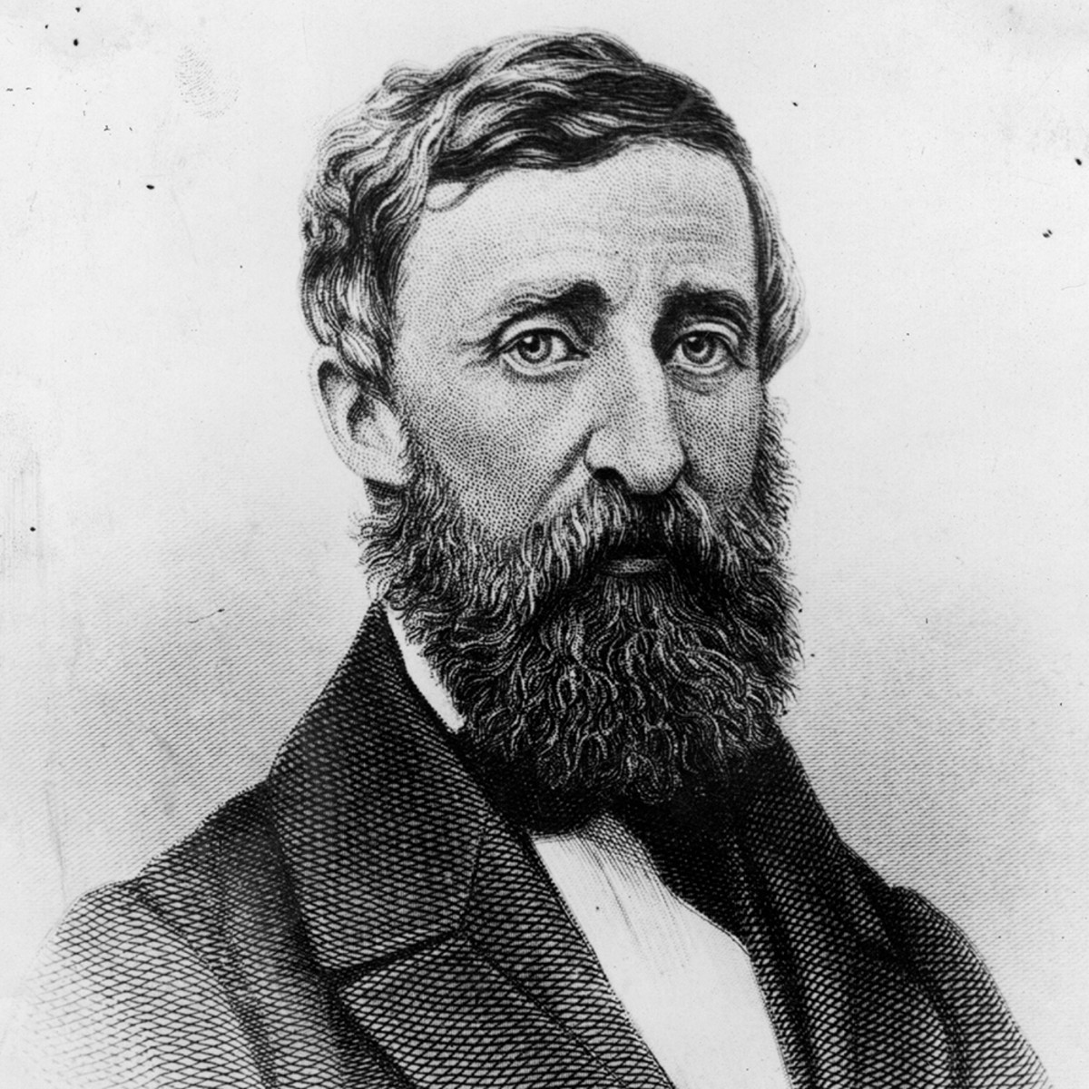
Preservationist
We need the tonic of wildness…At the same time that we are earnest to explore and learn all things, we require that all things be mysterious and unexplorable, that land and sea be indefinitely wild, unsurveyed and unfathomed by us because unfathomable. We can never have enough of nature
– Henry David Thoreau, Walden, 1854

Slide 9
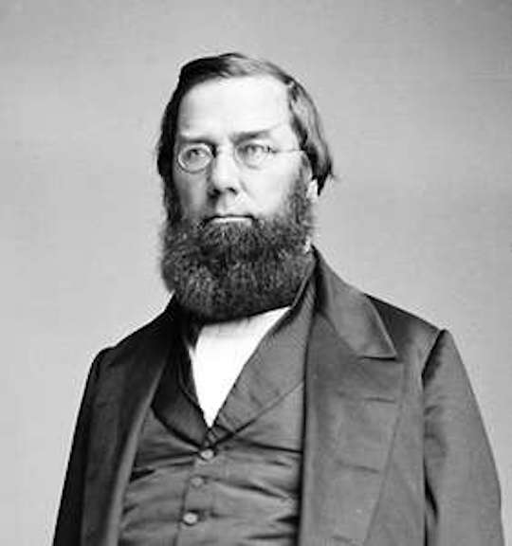
Preservationist
Man everywhere is a disturbing agent. Wherever he plants his foot, the harmonies of nature are turned to discords
– George Perkins Marsh, Man and Nature, 1864

Slide 10
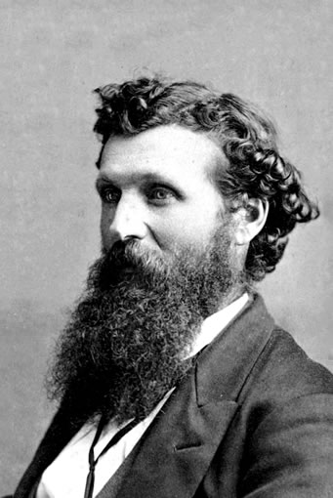
Preservationist
In every walk with nature one receives far more than he seeks
– John Muir
Father of the National Parks
Founded the Sierra Club in 1892
* But he was pretty racist

Slide 11
Development Era: 1800-1890
General Survey Act (1824)
Authorized the president to have surveys made of routes for transport roads and canals
Homestead Act (1862)
Permitted people to receive 160 acres of public lands if they lived on it and worked the land
General Mining Act (1872)
Allows mining claims on public property
Yellowstone National Park Protection Act (1872)
First national park

Slide 12

Notes:
Do not modify the notes in this section to avoid tampering with the Poll Everywhere activity. More info at polleverywhere.com/support Are you here today?
https://www.polleverywhere.com/multiple_choice_polls/lazCTrjamR3iuRwaJPBLp?state=opened&flow=Default&onscreen=persist

Slide 13
Conservation Era: 1890-1962

Slide 14
Conservation Era: 1890-1962
Progressive Era: 1890-1920
Stronger role for government
Conservation:
Limit excesses and encourage both businesses and individuals to use the nation’s vast natural resources more carefully through government regulation (Kline 2011, 61)

Slide 15
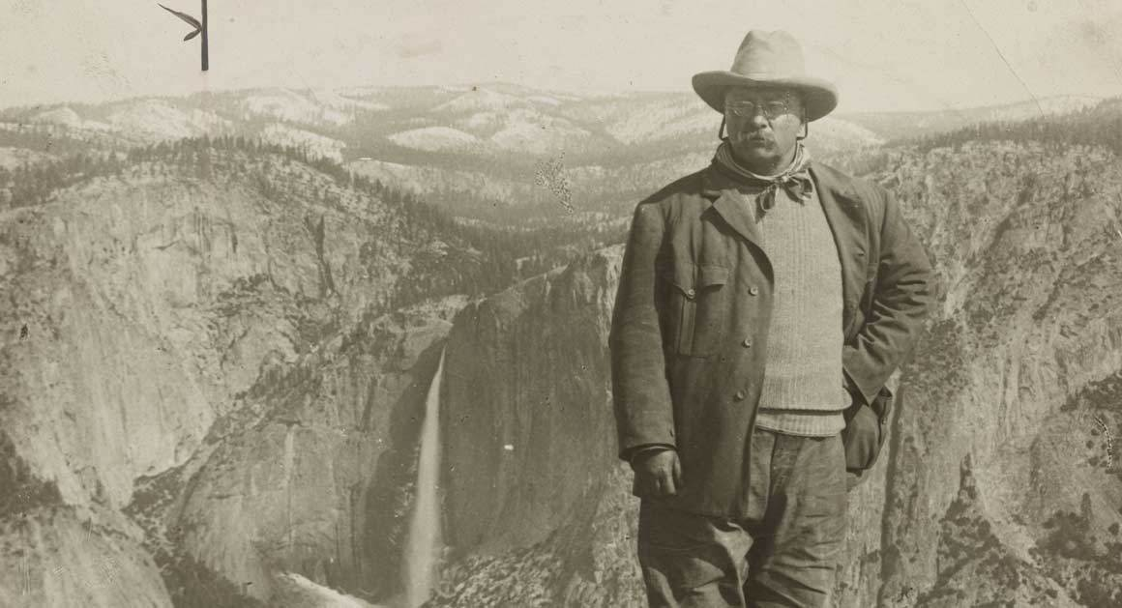
Conservation Era: 1890-1962
Wise forest protection does not mean the withdrawal of forest resources, whether of wood, water, or grass, from contributing their full share to the welfare of the people, but, on the contrary, gives the assurance of larger and more certain supplies. The fundamental idea of forestry is the perpetuation of forests by use. Forest protection is not an end of itself; it is a means to increase and sustain the resources of our country and the industries which depend on them

Slide 16
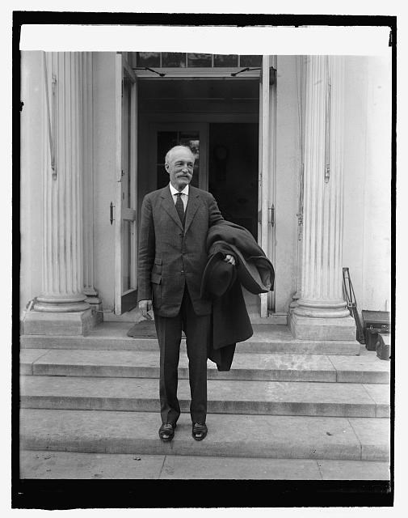
Conservation
Conservation means the wise use of the earth and its resources for the lasting good of men
– Gifford Pinchot
* But he was also pretty racist

Slide 17
Conservation
Three Major Tenets
Conservation is not the locking up of resources; it is their development and wise use
Conservation is the greatest good, for the greatest number, for the longest time
The federal pubic lands belong to all the people

Slide 18
Conservation Era: 1890-1962
1902: Bureau of Reclamation: water resource management
1905: Forest Service
1908: Grand Canyon national monument
1916: National Park Service
1933: Tennessee Valley Authority
1934: Taylor Grazing Act, limit overgrazing
1931-1936: Construction of Hoover Dam
1940: U.S. Fish and Wildlife Service
1946: Bureau of Land Management

Slide 19
Environmentalism Era: 1962-1980

Slide 20
Environmentalism Era: 1962-1980
The Great Broadening
Increase in government and policy in more areas of society
Ecology
Nature is a system based on interdependence and stability
Notes:
deep ecology: an environmental movement and philosophy which regards human life as just one of many equal components of a global ecosystem.

Slide 21
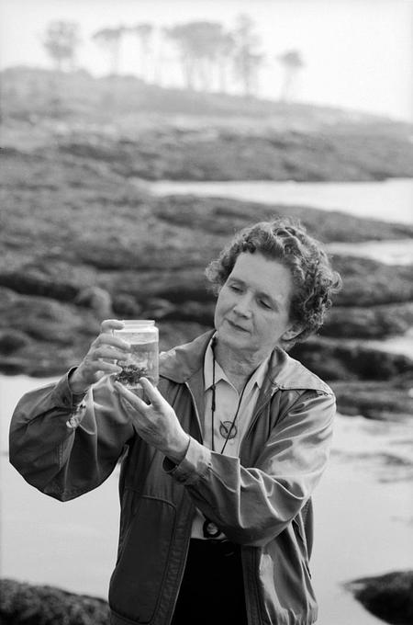
Rachel Carson
I contend, furthermore, that we have allowed these chemicals to be used with little or no advance investigation of their effect on soil, water, wildlife, and man himself. Future generations are unlikely to condone our lack of prudent concern for the integrity of the natural world that supports all life
– Rachel Carson, Silent Spring, 1962

Slide 22

Rachel Carson

Slide 23
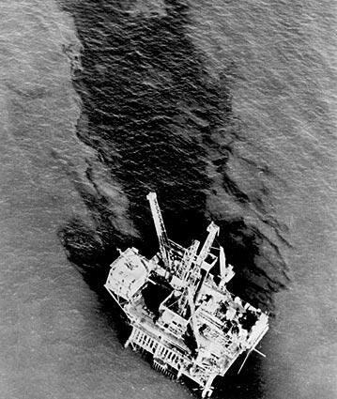
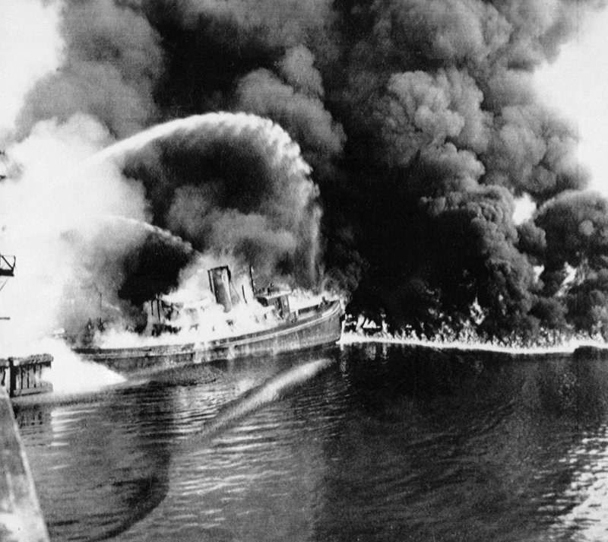
Focusing Events

Slide 24
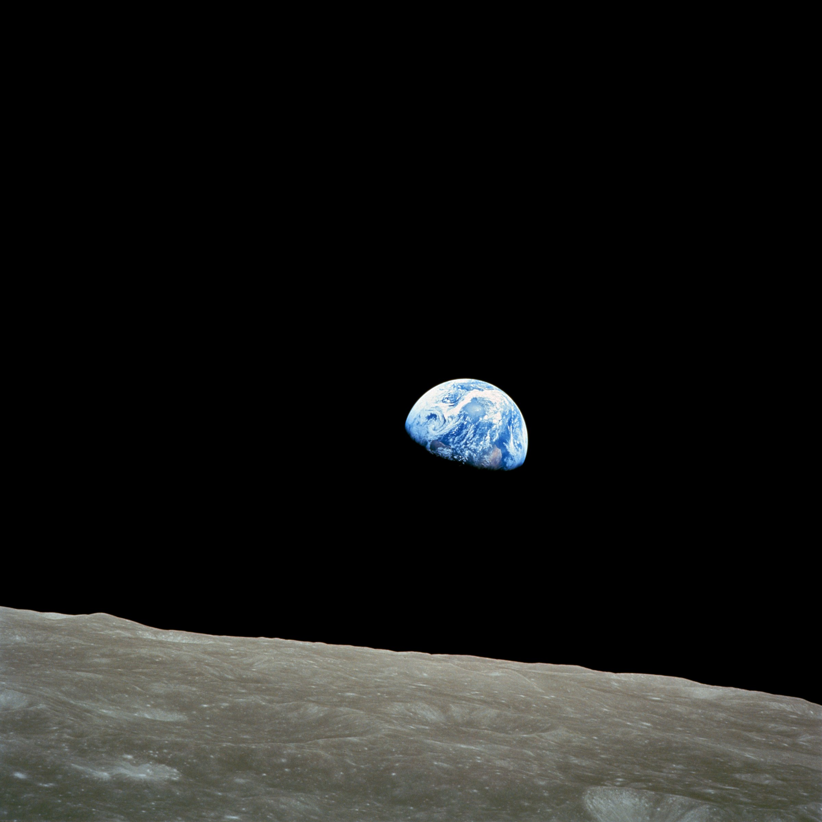
Earthrise

Slide 25
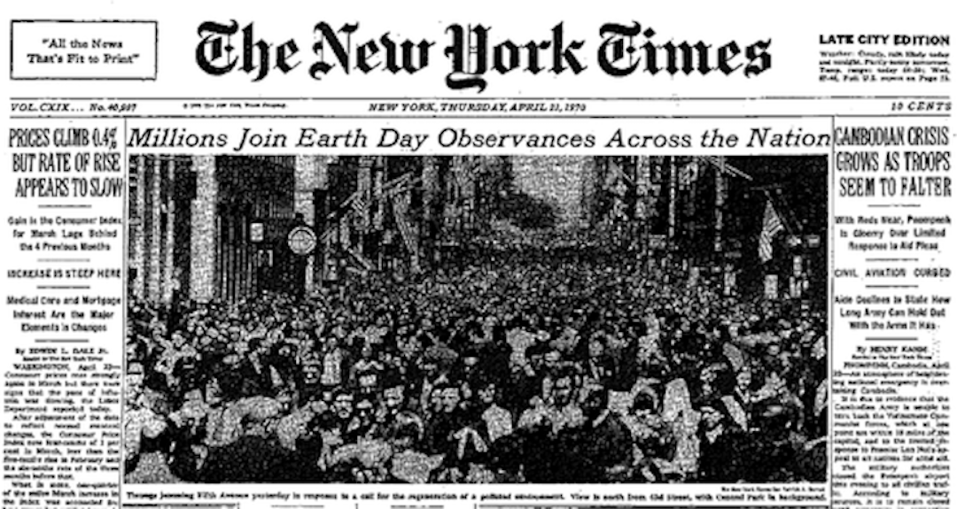
Earth Day

Slide 26
The Environmental Movement
Social movement
Rise of environmental movement organizations
Large-scale change through law and the “nationalization” of environmental legislation
Expansion of “rights”
Clean air, clean water, open spaces — these should be the birthright for every American (President Nixon)

Slide 27
Environmental Legislation 1962-1980
1969: National Environmental Policy Act
1970: Creation of the Environmental Protection Agency
1970: Clean Air Act Amendments
1972: The Water Pollution Control Act (The Clean Water Act)
1973: Endangered Species Act
1976: Resource Conservation and Recovery Act
1976: Toxic Substances Control Act
1980: Comprehensive Environmental Response Act
Established a “Superfund” for cleaning up old toxic and hazardous waste sites

Slide 28
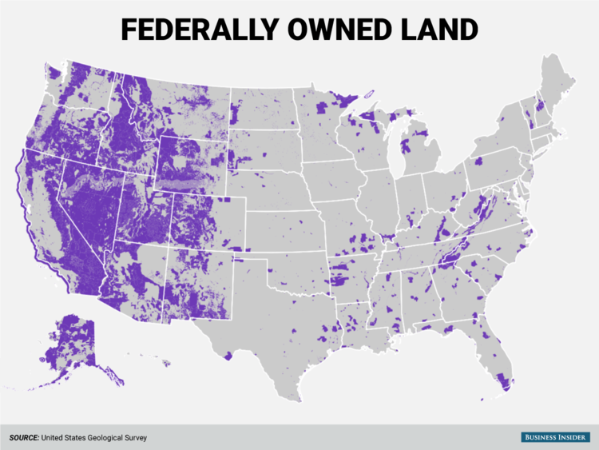
Backlash
Sagebrush Rebellion: Western states wanted more state and local control of federally owned land for grazing, off-road vehicle use, and other uses

Slide 29
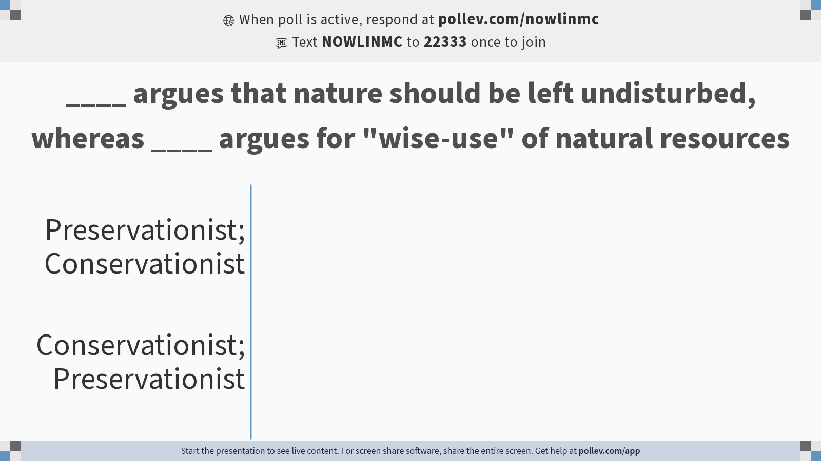
Notes:
Do not modify the notes in this section to avoid tampering with the Poll Everywhere activity. More info at polleverywhere.com/support ____ argues that nature should be left undisturbed, whereas ____ argues for "wise-use" of natural resources
https://www.polleverywhere.com/multiple_choice_polls/tdMzEXCvRff4AqTUy06T7?state=opened&flow=Default&onscreen=persist

Slide 30
Reform Era: 1980-2000

Slide 31
Reform Era: 1980-2000
Energy crisis and stagflation
Debate over the role of government broadly and in environmental policy specifically
Disintegration of the bipartisan consensus on the environment
Reagan presidency
Environmental protection at odds with economic growth
Budgetary cutbacks in environmental agencies
Regulatory reform

Slide 32
Stagnation and Polarization
No major federal environmental policy legislation since the Clean Air Act Amendments of 1990
But, 2020-2022 period
Increased partisan polarization
Distrust of governments ability to solve problems

Slide 33
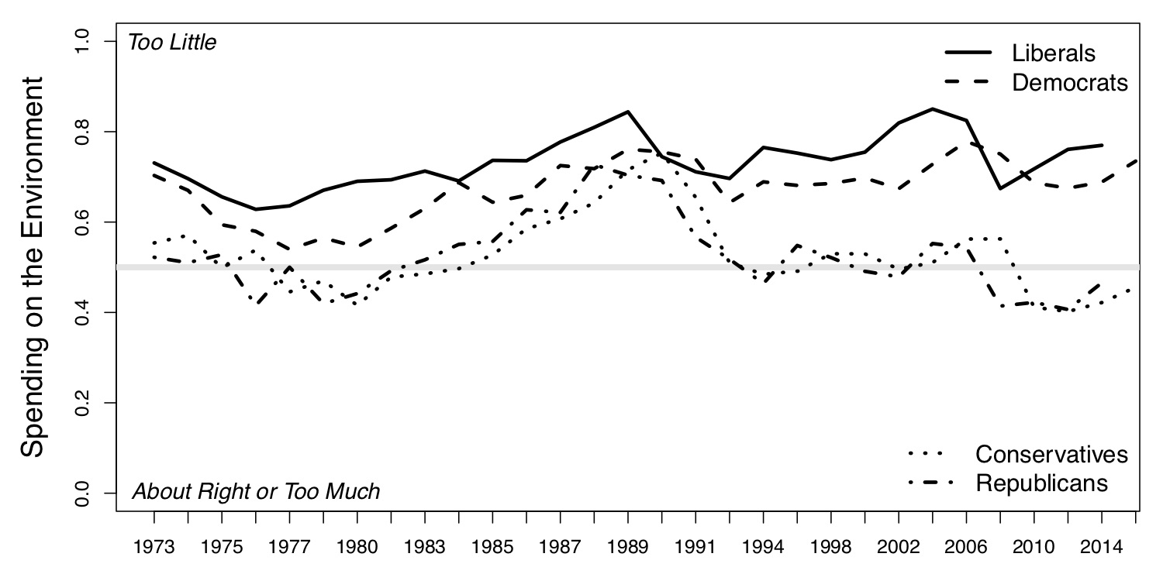
Polarization: The Public

Slide 34
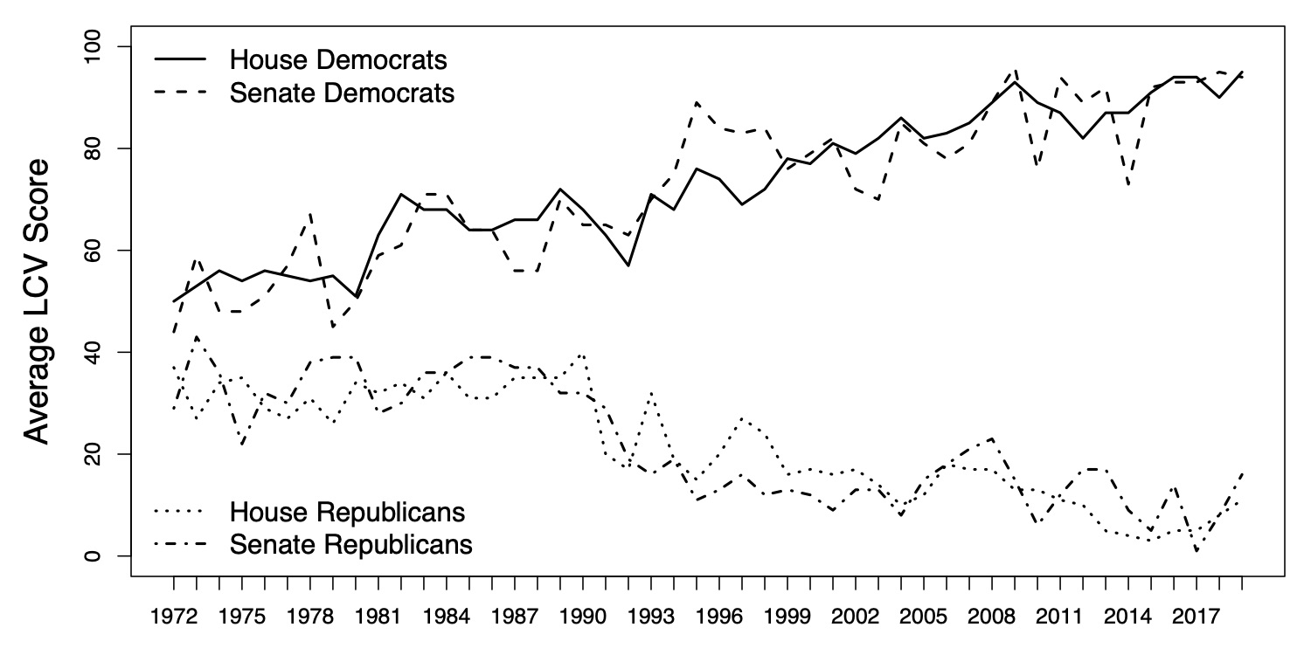
Polarization: US Congress

Slide 35
Stagnation: Environmental Protection Agency (EPA) Budget and Workforce

Slide 36
The Tradegy of the Commons

Slide 37
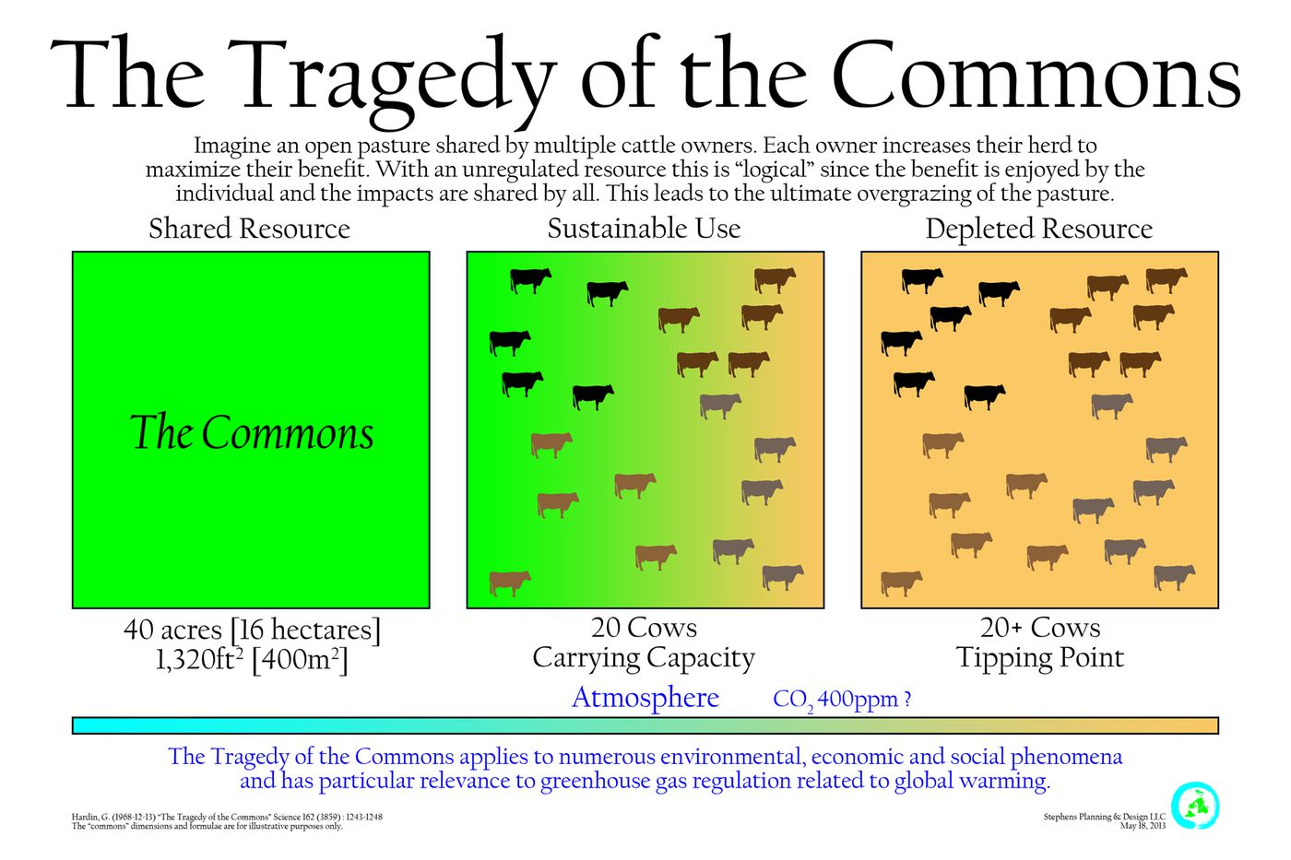

Slide 38
Commons
Shared land not owned by individuals but “shared in common.”
Rules of use set and enforced by the users
A broad set of resources, natural and cultural, that are shared by many people
Open-access: no shared property rights
Notes:
first definition from medieval europe

Slide 39
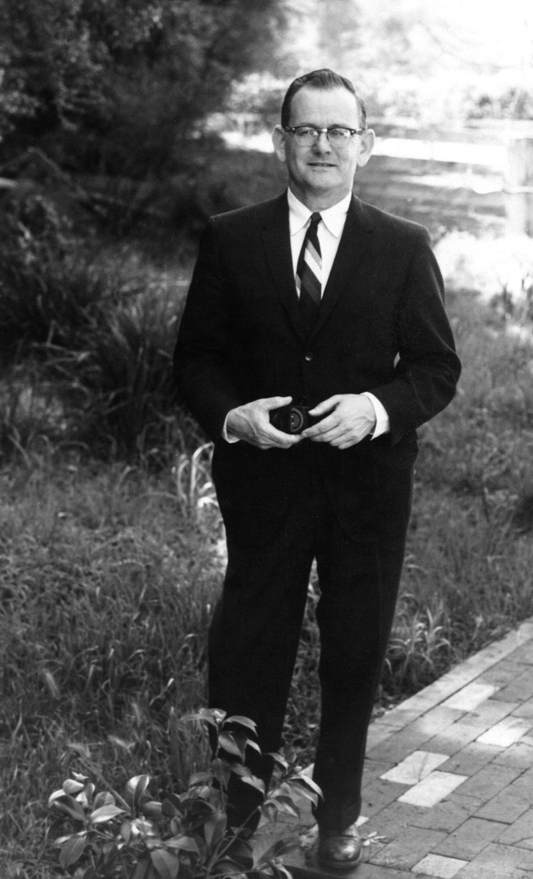
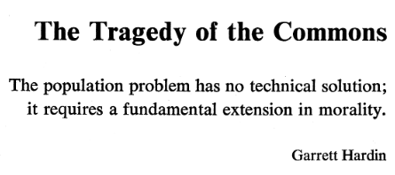
Hardin, Garrett. 1968. “The Tragedy of the Commons.” Science 162(3859): 1243–48.

Slide 40
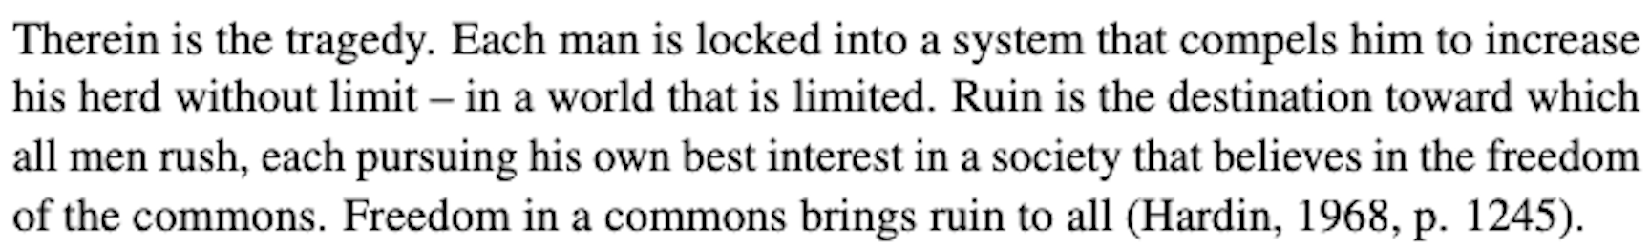
The Tradegy of the Commons
It follows that two options are available:
establish, monitor, and enforce private property rights
directly regulate the use of the commons either by taxing or directly restricting (e.g., licensing) its use

Slide 41
Critiques of Hardin
History wrong
Assumptions about human behavior
Implications of views about over population

Slide 42
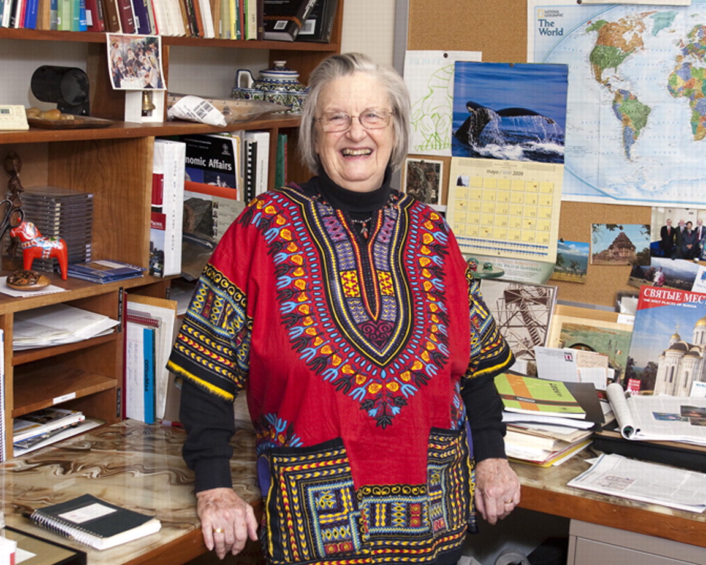
Elinor Ostrom
The most important lesson that needs wide dissemination is that simple panaceas offered for solving problems related to the commons—whether they are for government, private, or community ownership—may work in some settings but fail in others

Slide 43
References
Kline, Benjamin. 2011. First Along the River: A Brief History of the U.S. Environmental Movement. Fourth. Lanham, MD: Rowman & Littlefield.
Mohai, Paul, David Pellow, and J. Timmons Roberts. 2009. “Environmental Justice.” Annual Review of Environment and Resources 34(1): 405–30.
Salzman, James, and Barton H. Thompson Jr. 2014. Environmental Law and Policy. Fourth. St. Paul, MN: Foundation Press.

