Slide 1
Value Systems and Environmental Policy
POLI 307: Environmental Policy

Slide 2
Environmental Policy
Environmental Policy: government action related to the natural environment (Rinfret and Pautz 2019, 2)
Environmental Policymaking: a complex process that involves multiple actors across multiple decision-making venues

Slide 3
Why are environmental policy issues controversial? Why don’t we agree?

Slide 4
Environmental Issues
The difficulty of collective action
Distributional conflicts over costs and benefits
The structure of the political and policymaking system
Science
Politicization of science
Scientific uncertainty
Values and value disputes

Slide 5
Values
Determine ideas about what is morally right and wrong, and are typically resistant to change

Slide 6
Values
Abstract concepts and beliefs
Pertain to desirable end states or behaviors
Transcend specific situations
Guide selection or evaluation of behavior and events
Ordered by relative importance

Slide 7
Value System
Value systems are hierarchically structured

Slide 8
Value System
Core values:
Foundational values that span multiple policy domains
Political ideology, cultural worldviews

Slide 9
Value System
Environmental values:
The appropriate relationship between humanity and nature
Environmentalism

Slide 10
Value System
Policy attitudes:
Evaluations about particular policy issues
Climate change poses a significant risk

Slide 11
Core Values: Political Ideology
Ideas about the role of government in society
Liberal vs. Conservative
Stability vs change
Disagreement about the size, scope, and nature of government
Size: taxing and spending
Scope: public vs. private concerns
Nature: collective decision-making vs. imposed rules

Slide 12
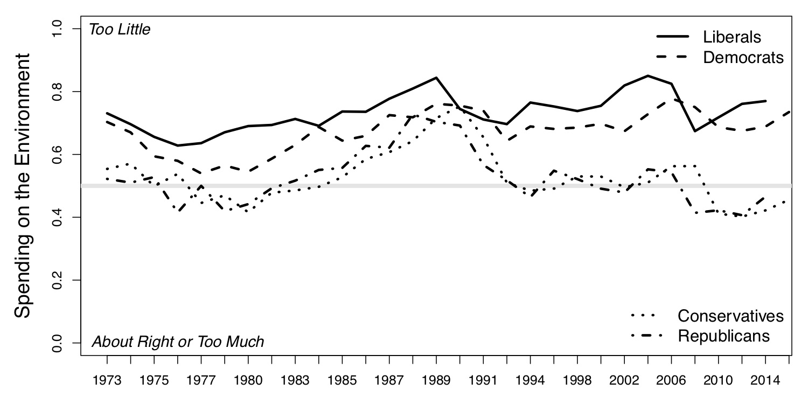
Spending on the Environment

Slide 13
Core Values: Political Ideology
The environment as a political issue has become increasing polarized across ideological beliefs
Solution aversion
If government regulation is the solution then there isn’t a problem
Elite driven
Elected officials
Energy and industry groups

Slide 14
Environmental Values
Early environmental values: Preservation and Conservation
Preservationist: Preserve and protect nature for its own sake
Conservation: Prudent use of natural resources
Contemporary conservation: contains strands of traditional preservationist and conservation ideas
Deep Ecology: humans are merely a part of the larger ecosystem, which should be protected without the consideration of harm to humans

Slide 15
Environmental Values: Environmentalists vs Development
New Ecological Paradigm scale
The balance of nature is very delicate and easily upset
Humans live on a planet with very limited room and resources
Humans are seriously abusing the environment
Humans will eventually learn enough about how nature works to be able to control it
The so-called ‘ecological crisis’ facing humankind has been greatly exaggerated
The Earth has plenty of natural resources if we just learn how to develop them

Slide 16

Environmental Values: Environmentalists vs Development
Cornucopians
Emphasis on economic growth and markets
Environmental restrictions limit economic well-being
High confidence in technological solutions
Individual liberty:
Environmentalists are “watermelons”

Slide 17
Why Watermelons?

Slide 18


Slide 19
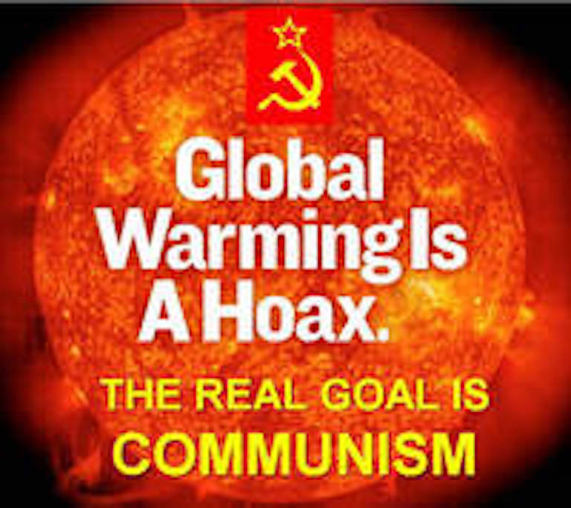

Slide 20
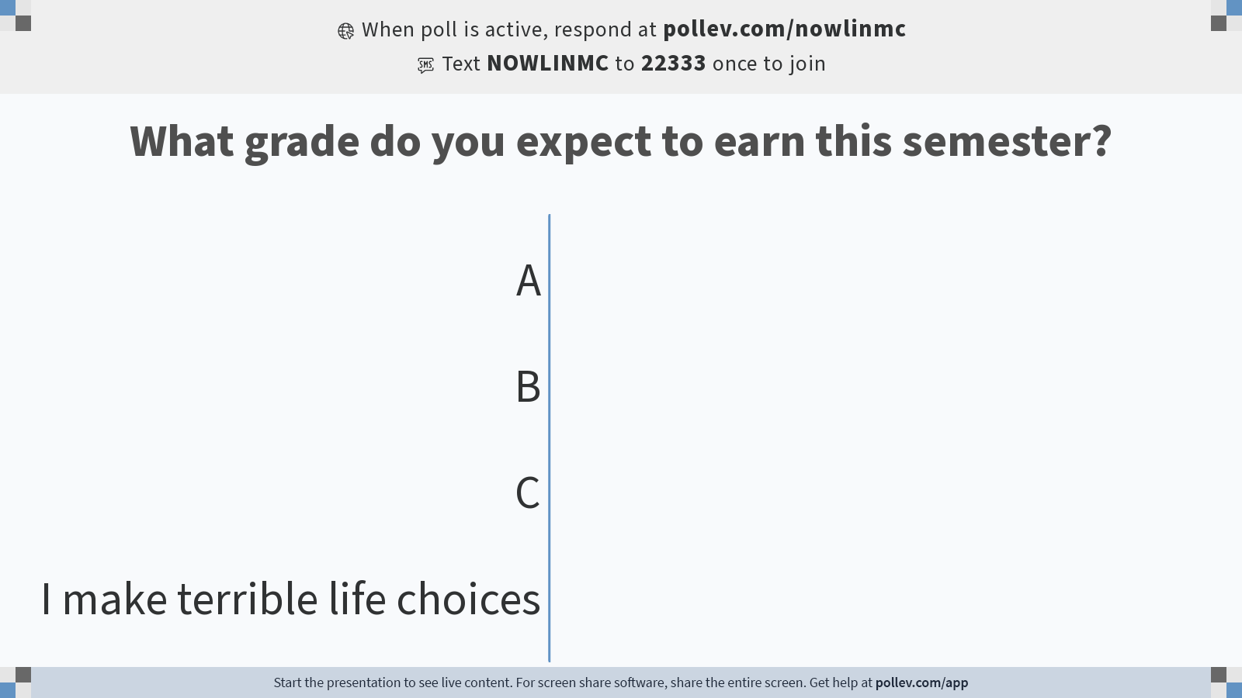
Notes:
Do not modify the notes in this section to avoid tampering with the Poll Everywhere activity. More info at polleverywhere.com/support What grade do you expect to earn this semester?
https://www.polleverywhere.com/multiple_choice_polls/qg59gLsRiDX8D1nMq9xNN?state=opened&flow=Default&onscreen=persist

Slide 21
Cultural Theory

Slide 22
Cultural Theory
Cultural theory is a core value
Values based on cultural bias, social relations, and ways of life
Cultural bias: Shared values and beliefs
Social relations: Patterns of interpersonal relations
Ways of life: Viable combinations of social relations and cultural bias

Slide 23
Cultural Theory
Ways of life (or cultural types or cultural worldviews) are captured by two cross-cutting dimensions; grid and group
Grid: Degree that an individual’s life is limited by externally imposed prescriptions; social regulation
Group: Degree that an individual is incorporated into bounded units
Combining the grid and group dimensions produce four viable ways of life or cultural types

Slide 24
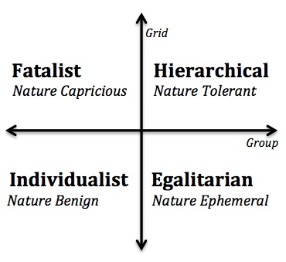
Cultural Theory
Hierarchical: Tight groups with clearly defined roles
Egalitarian: Group commitments and no social stratification
Individualist: Free competition among individuals and few group constraints
Fatalist: Little or no group attachments, yet choices are constrained by external forces

Slide 25
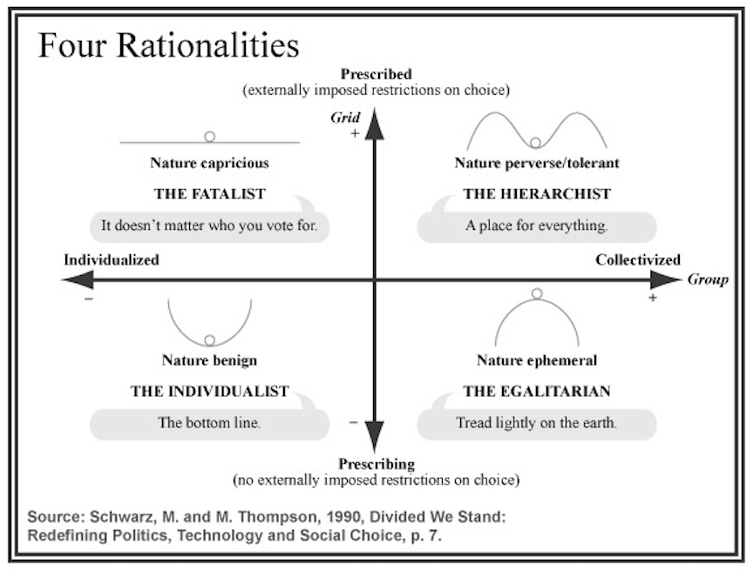

Slide 26
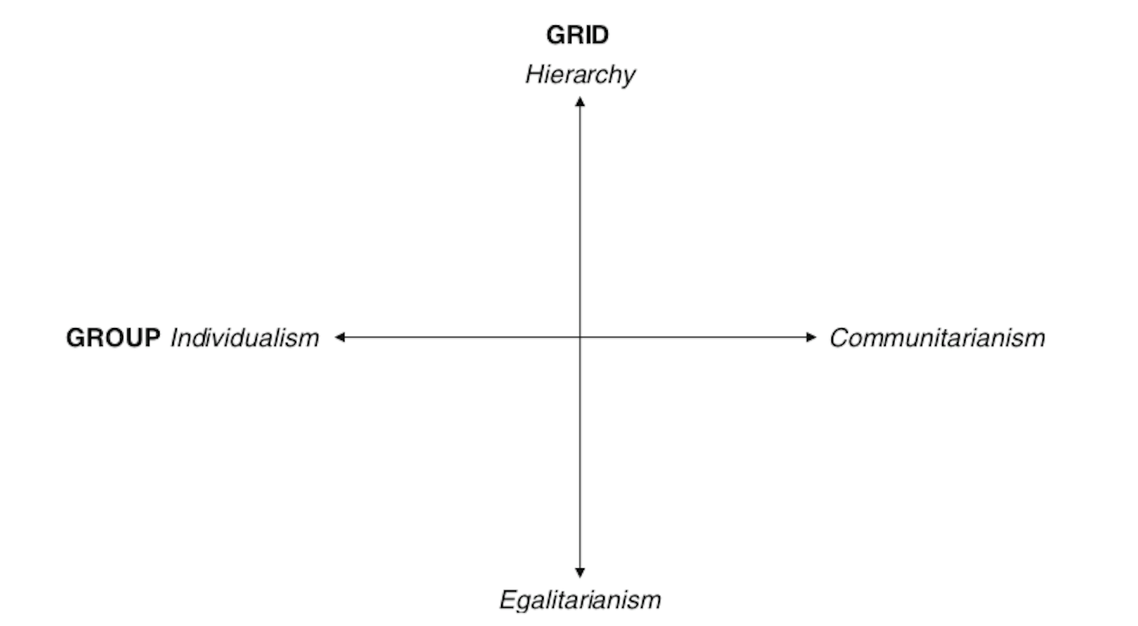
Cultural Cognition
Values and beliefs guide how people think about policy issues
Environmental policy debates are not about science as much as they are about opposing cultural values and worldviews through which that science is seen

Slide 27
Does increased knowledge reduce the polarization of views about climate change?

Slide 28
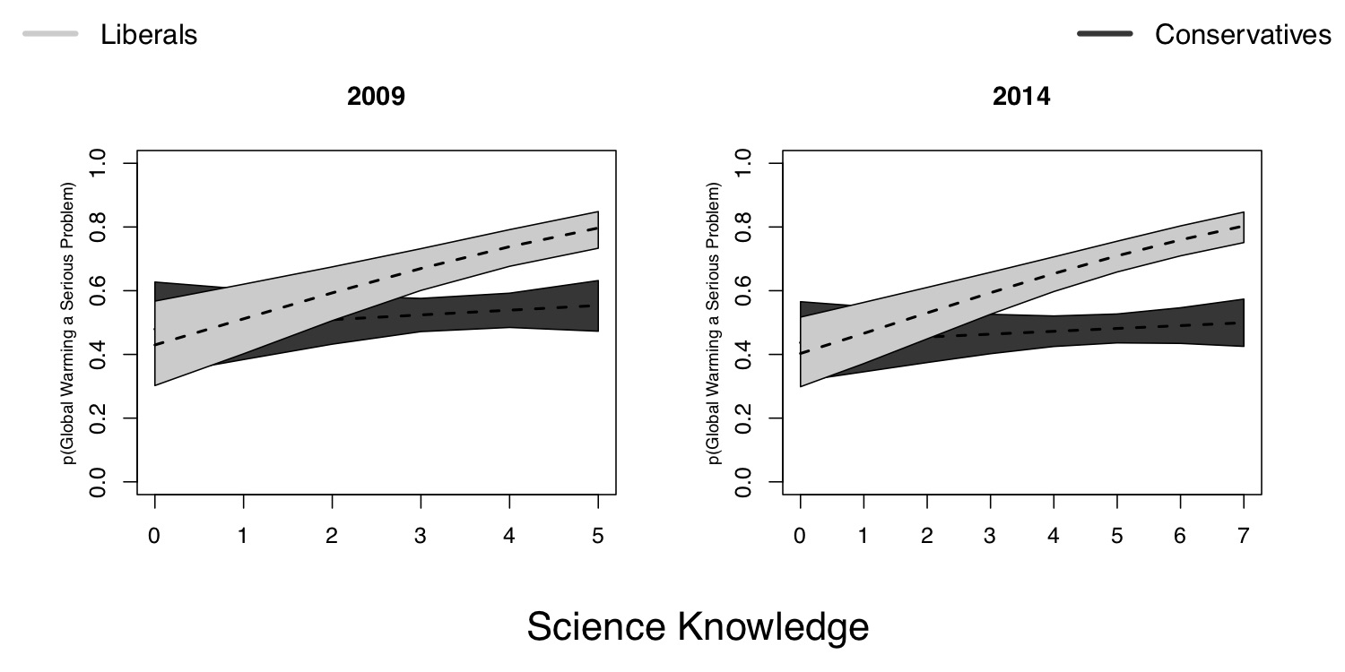

Slide 29
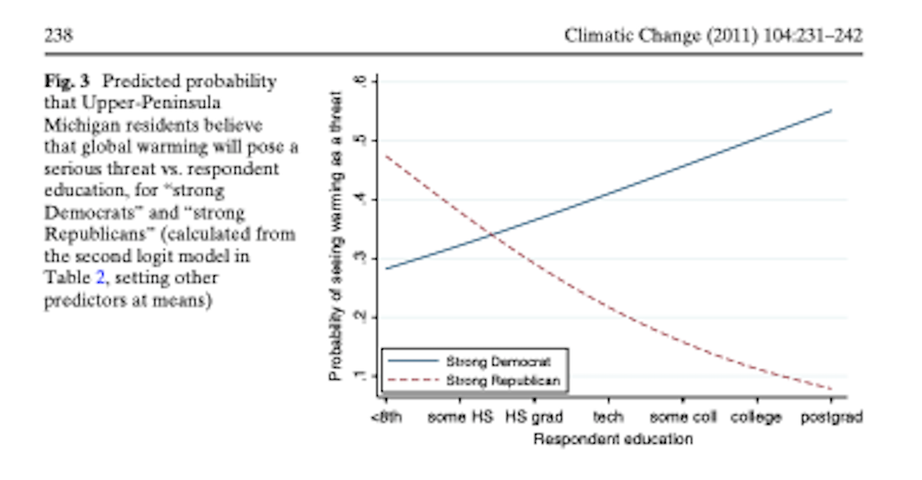

Slide 30
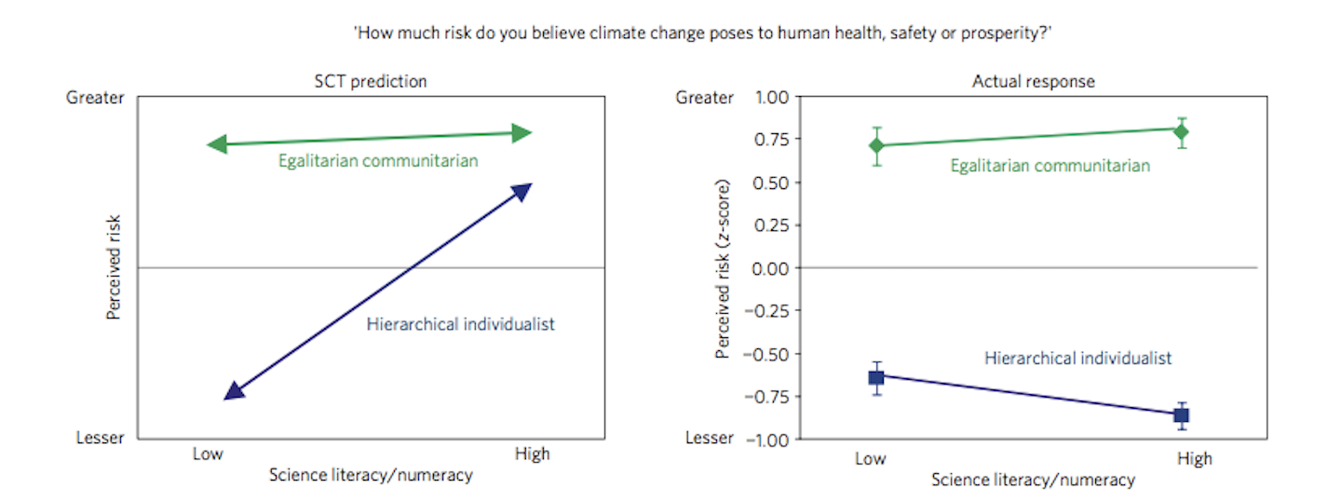

Slide 31
What? Why? How?

Slide 32
Mechanisms of Cultural Cognition
Cultural identity-protective cognition
Policy attitudes do not threaten an individual’s identity
Values are connected to identity
Culturally biased assimilation of information
Information is processed in a way that confirms values and prior beliefs
The “smarter” you are the better you are at aligning information with your values

Slide 33
Mechanisms of Cultural Cognition
Cultural availability
Events or information that matches beliefs more readily come to mind
Cultural credibility
Sources that match beliefs are more credible
Cultural-identity affirmation

Slide 34
References
Rinfret, Sara R., and Michelle C. Pautz. 2019. US Environmental Policy in Action. Second. New York, NY: Palgrave Macmillan.

