Slide 1
Course Introduction
POLI 307: Environmental Policy

Slide 2
How do we mangage natural resources in the US?

Slide 3
How should we mangage natural resources in the US?

Slide 4
Why are environmental issues controversial? Why don’t we agree?

Slide 5
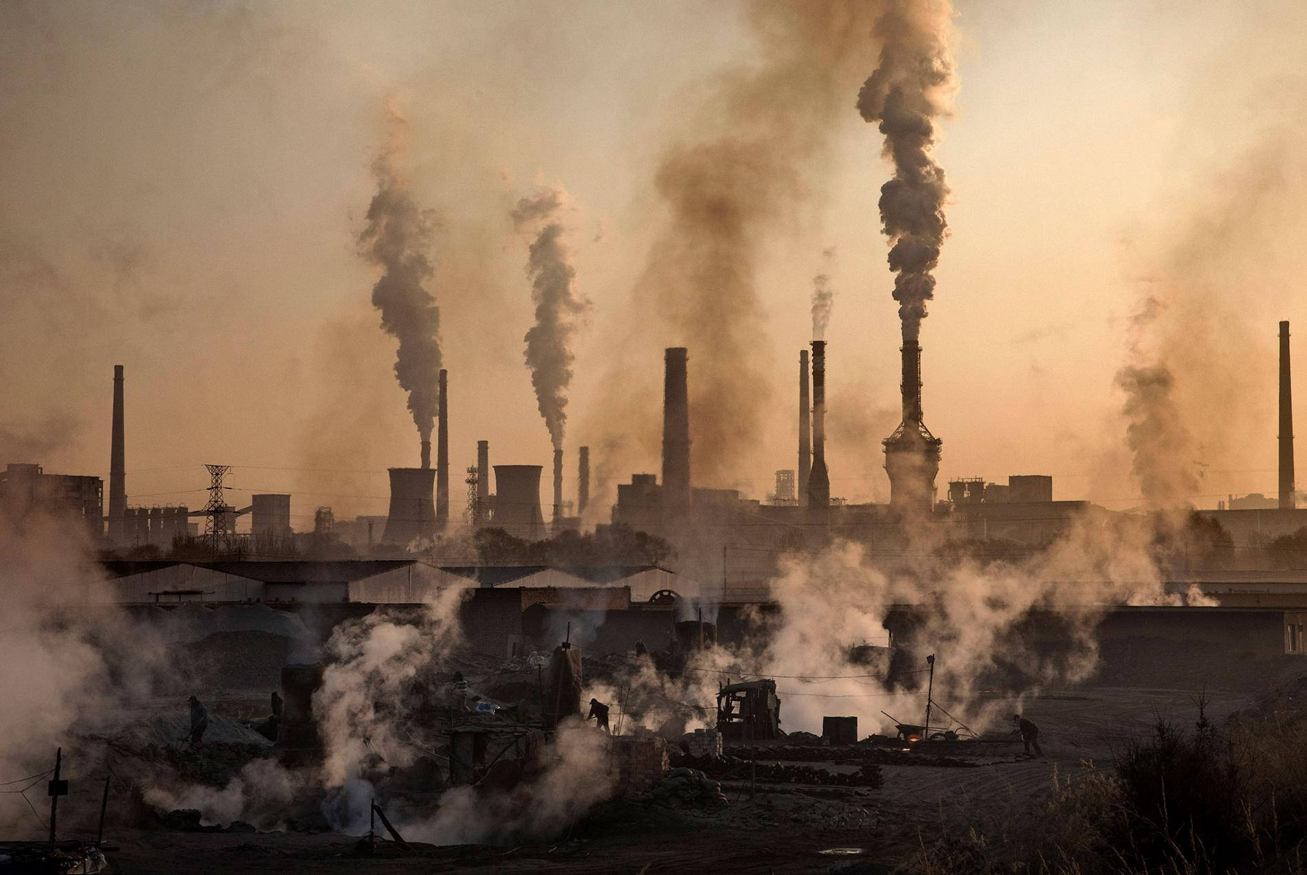
Notes:
image from national geographic: https://www.nationalgeographic.com/environment/2018/09/news-air-quality-brain-cognitive-function/
externatlity

Slide 6
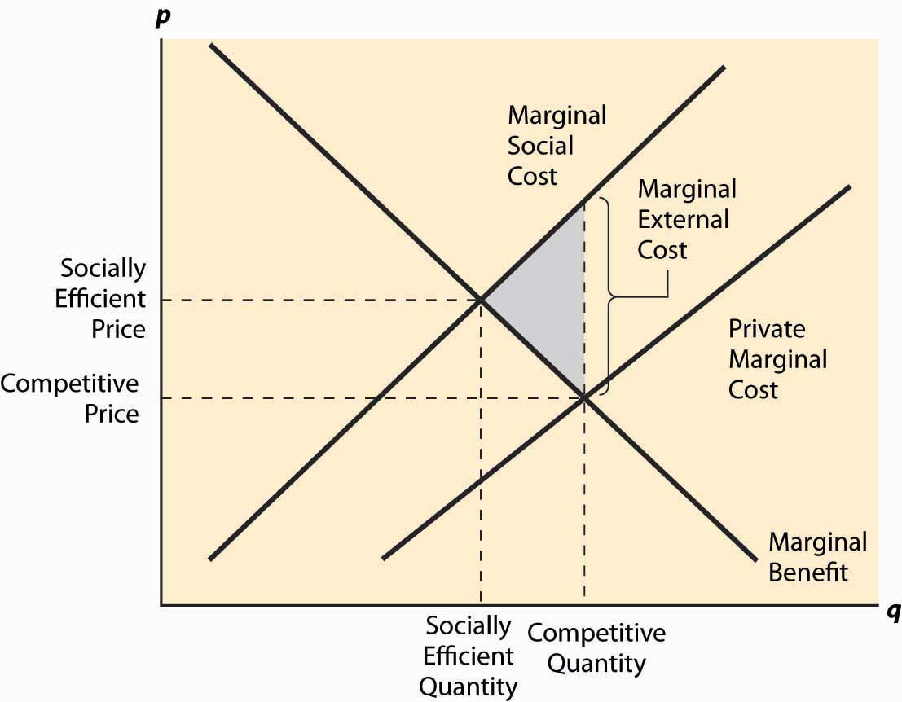
Externality
Externalities occur when the total costs and benefits are not captured by the price
Negative externalities: costs spread from buyers and sellers to society as a whole

Slide 7
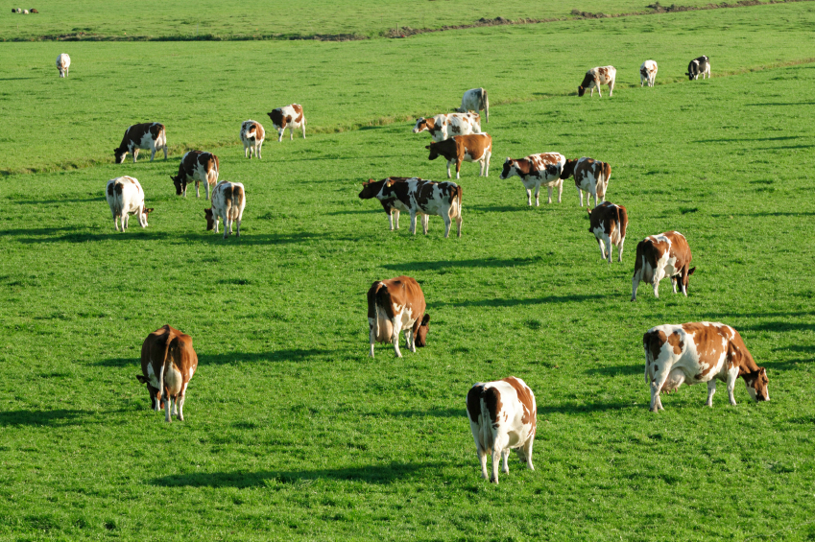

Slide 8
What is the Tragedy of the Commons?

Slide 9
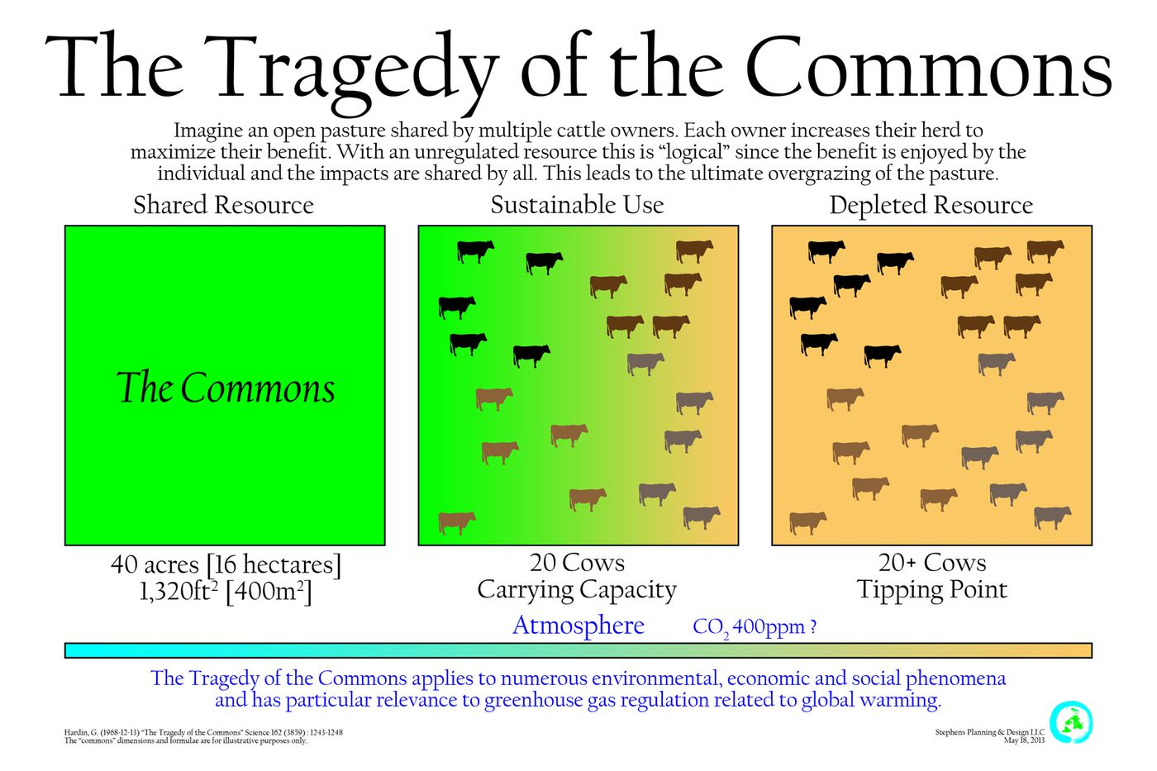

Slide 10
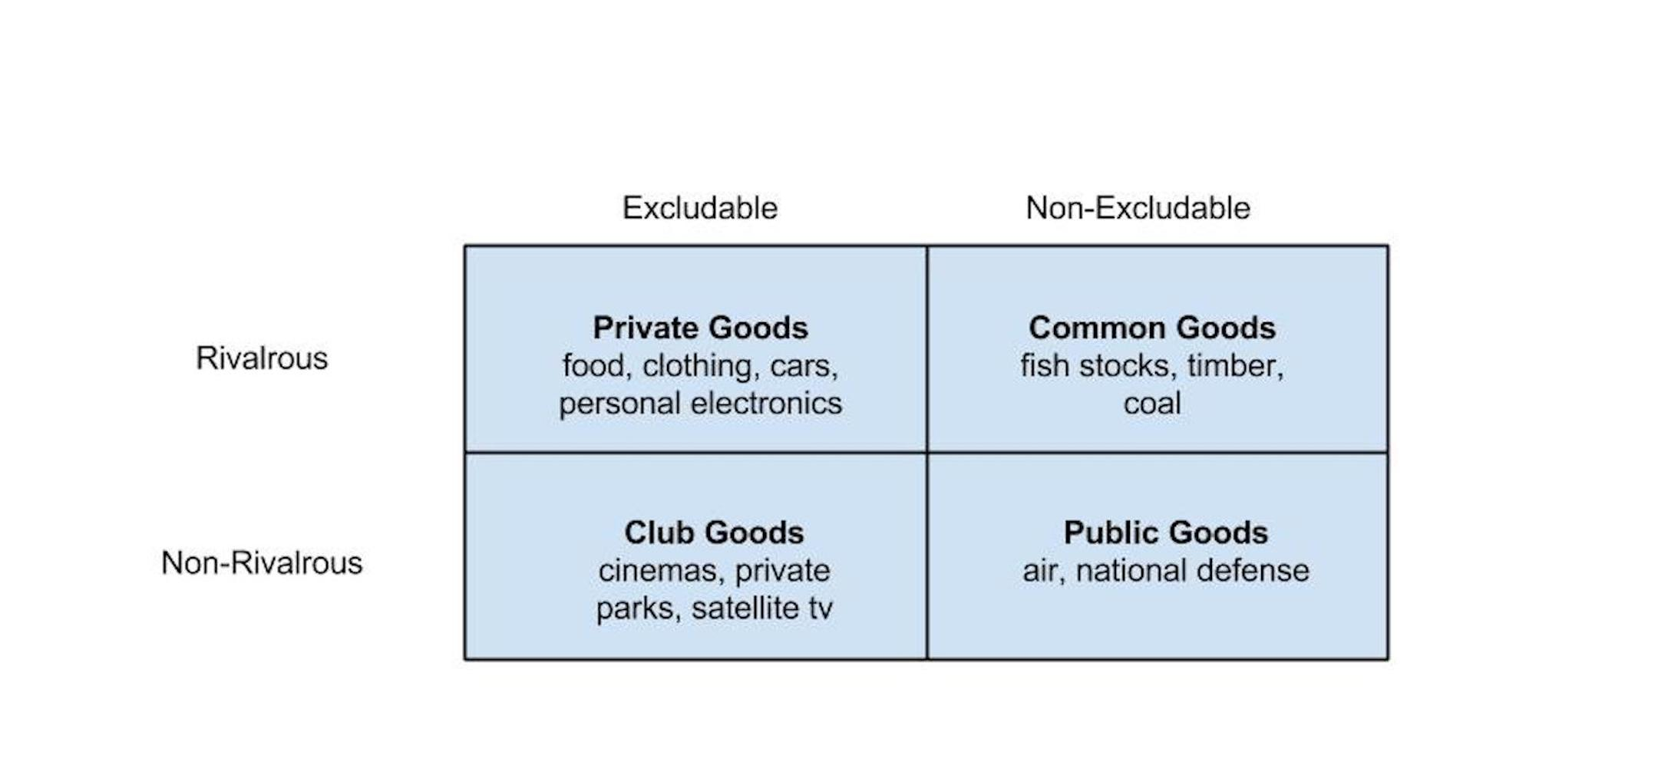
Tragedy of the Commons
A resource open to all may be over consumed
Common-pool goods are non-excludable and rivalrous

Slide 11
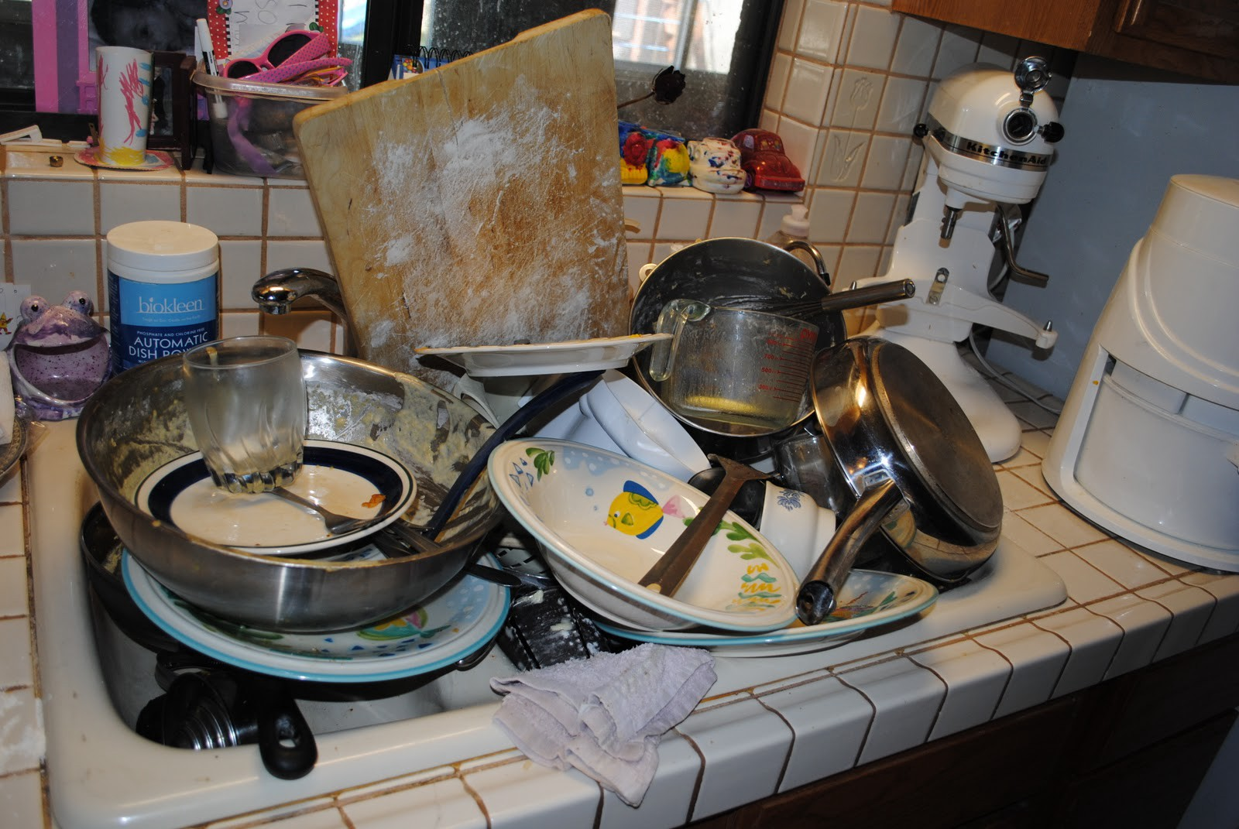

Slide 12
Hypothetical Group Work Question
You are assigned to do a group project for a class. Everyone in the group will receive the same grade regardless of their individual effort
Does everyone in the group do the same level of work?

Slide 13
What do each of the scenarios have in common?
Notes:
they are collective-action problems

Slide 14
Collective-Action Problems
Situations that arise when the goals of the individual conflict with those of the group
How do we address collective-action problems?
Institutions

Slide 15
Institutions
Institutions are the humanly devised constraints that structure political, economic, and social interaction
Institutions consist of both informal constraints (sanctions, taboos, customs, traditions, and codes of conduct), and formal rules (constitutions, laws, property rights)
Institutions can address some collective action problems, but can cause or exacerbate others

Slide 16
Institutions
Markets
Decentralized collection of buyers and sellers
Can arise from informal constraints
Governments
Produce and enforce formal rules
Make public policy

Slide 17
Environmental Policy
Environmental Policy: government action related to the natural environment
Environmental Policymaking: a complex process that involves multiple actors across multiple decision-making venues
Environmental policy is about making tough choices
Often these choices involve governments assigning (sometimes unintentionally) costs and benefits to individuals, groups, firms, and communities
Environmental Politics
Politics is about who gets what, where, and when
Distributive conflicts arise around the distribution of the costs and benefits of environmental policy
Environmental justice

Slide 18
Environmental Dilemmas
Clean or dirty air?
Air pollution has decreased since the 1970s, but what about climate change?
Is the water really drinkable?
Nonpoint source water pollution
Plants and animals
Trade-offs associated with habitat and species protection
Waste
Who wants a landfill next door?

Slide 19
Science and Environmental Policy
Notes:
To what extent should science be involved in the environmental policymaking process? (DSW)
–
How and in what ways do lawmakers respond to scientists who alert them to real and potential environmental problems? (DSW)

Slide 20
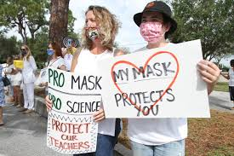
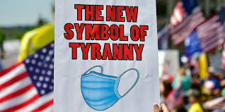
Science and Environmental Policy
Science is increasingly polarized

Slide 21
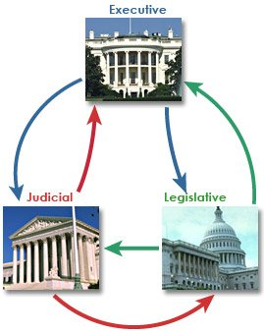
The Political System
Separate branches sharing power
Checks and balances
Authority is diffused across branches and the states

Slide 22
Values
Environmental policy conflicts are often conflicts about values
Core Values:
Cultural Worldviews
Political Beliefs (ideology and partisanship)
Environmental Values:
Preservation and Conservation
Environmentalism and Development

Slide 23
Next Week
Environmental Values and Value Conflicts
Readings (on OAKS)
Nowlin, Chap 4
Be ready to try out Poll Everywhere

