Slide 1
Environmental Policymaking: Process
POLI 307: Environmental Policy

Slide 2
Collective Action Problems
Situations that arise when the goals of the individual conflict with those of the group
Examples
Externalities
Common-pool goods
Dirty dishes
Slackers with group work

Slide 3
How are collective-action problems addressed?

Slide 4
Institutions
Institutions are the humanly devised constraints that structure political, economic, and social interaction
Institutions consist of both informal constraints (sanctions, taboos, customs, traditions, and codes of conduct), and formal rules (constitutions, laws, property rights)
Markets and Governments

Slide 5
Markets
Markets are decentralized institutions that promote voluntary exchange between buyers and sellers
Market rules
Medium of exchange
Way to communicate price
Property rights
Exchange provides gains from trade
Markets provide the most efficient allocation of resources

Slide 6
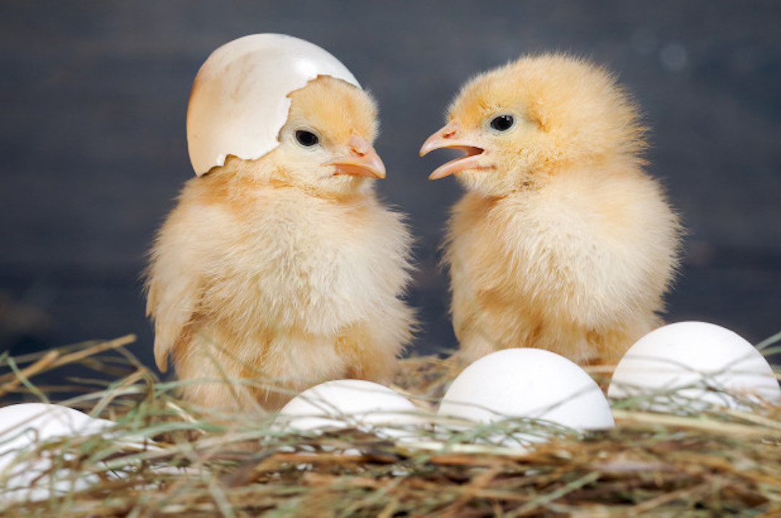
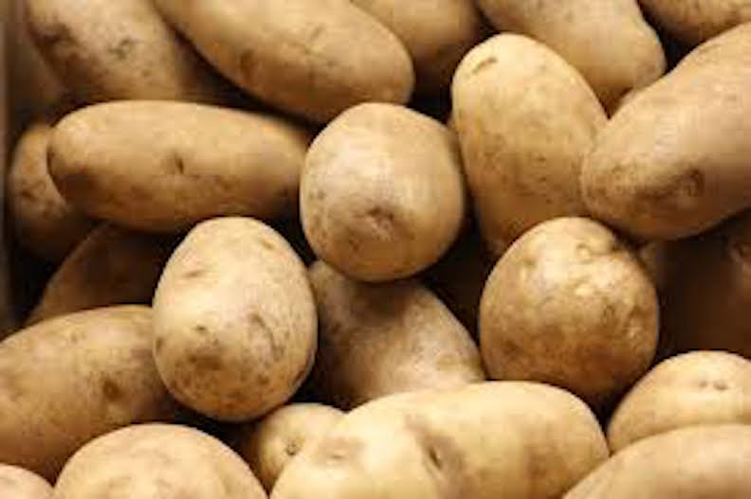
Two Households
Notes:
What can go wrong?

Slide 7
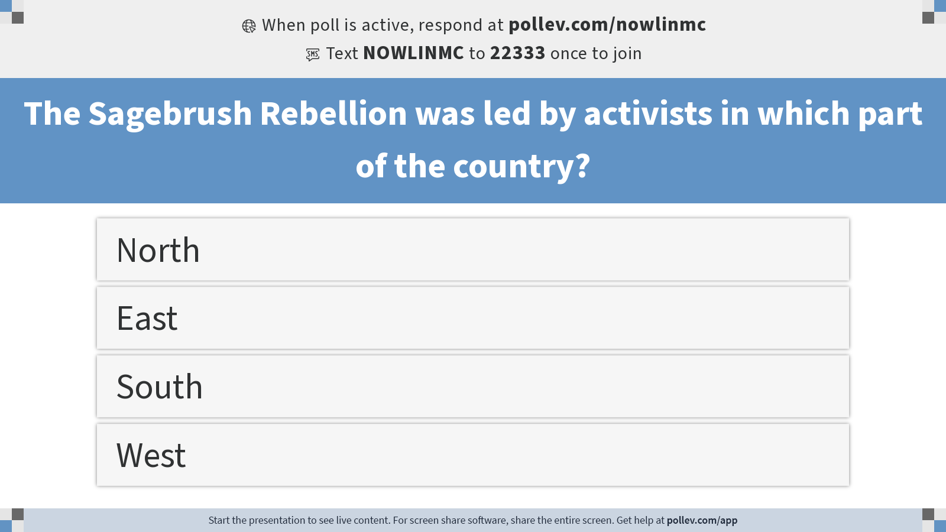
Notes:
Do not modify the notes in this section to avoid tampering with the Poll Everywhere activity. More info at polleverywhere.com/support The Sagebrush Rebellion was led by activists in which part of the country?
https://www.polleverywhere.com/multiple_choice_polls/9KbAfKE89BvQpVWB1hHBo?display_state=instructions&activity_state=opened&state=opened&flow=Instructor&onscreen=persist

Slide 8
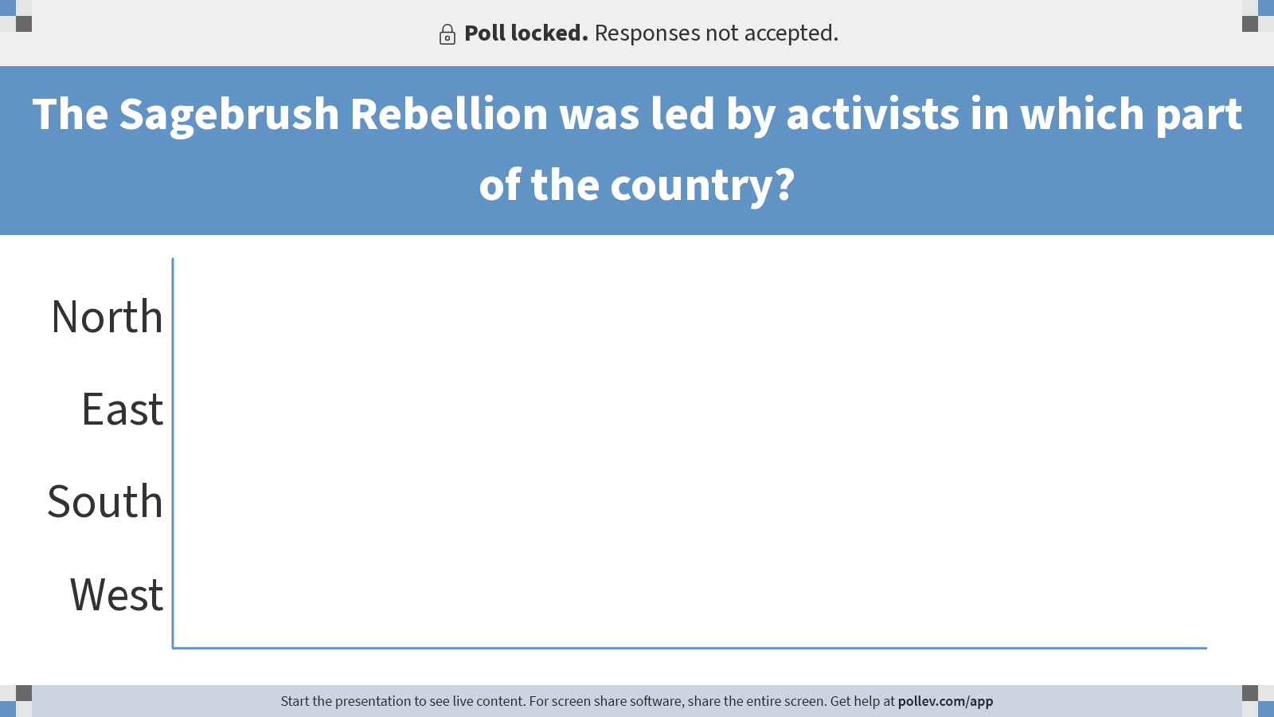
Notes:
Do not modify the notes in this section to avoid tampering with the Poll Everywhere activity. More info at polleverywhere.com/support The Sagebrush Rebellion was led by activists in which part of the country?
https://www.polleverywhere.com/multiple_choice_polls/9KbAfKE89BvQpVWB1hHBo?display_state=chart&activity_state=closed&state=closed&flow=Instructor&onscreen=persist

Slide 9

Notes:
Do not modify the notes in this section to avoid tampering with the Poll Everywhere activity. More info at polleverywhere.com/support The Sagebrush Rebellion was led by activists in which part of the country?
https://www.polleverywhere.com/multiple_choice_polls/9KbAfKE89BvQpVWB1hHBo?display_state=chart&activity_state=closed&display=correctness&state=closed&flow=Instructor&onscreen=persist

Slide 10
Market Failures

Slide 11
Examples of Market Failures
Externalities
Pollution
Common-pool goods
Open pasture
Public goods
Clean air
Insufficient competition
Monopolies
Asymmetric information
Used car

Slide 12
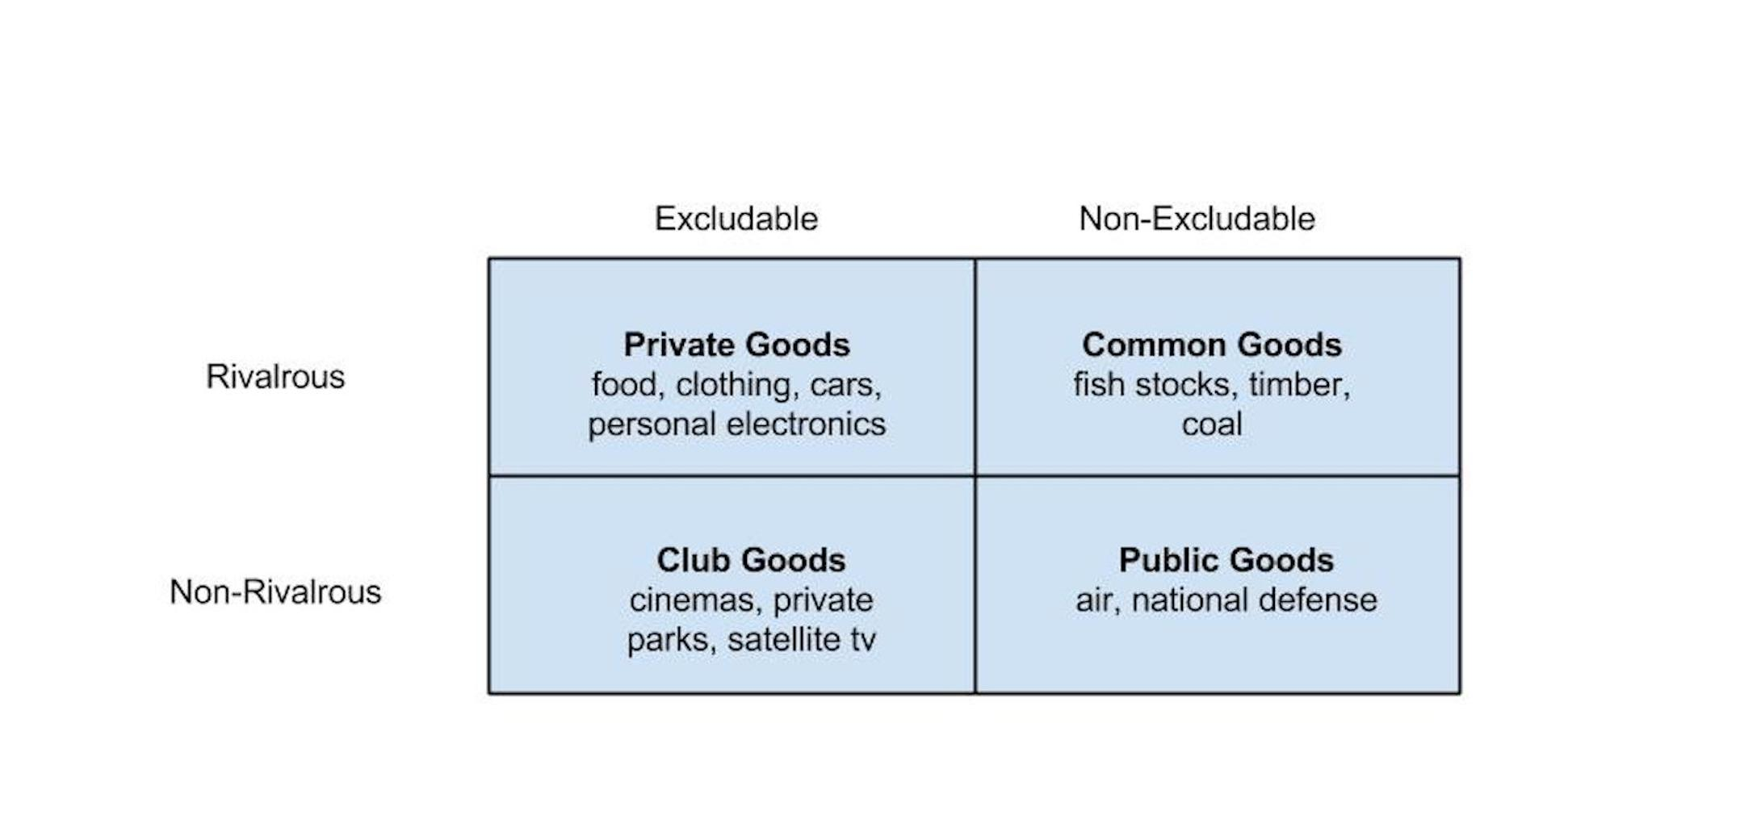
Types of Goods

Slide 13
Governments
Public Policy:
The outcomes of government processes that are aimed at alleviating a societal problem
What is the cause of the “problem”?

Slide 14
Governments
Environmental Policy: Government action (policy) related to the natural environment
Includes (among other things): Public lands and waters; wilderness; wildlife; pollution; ecosystem services; human health and safety; energy use; transportation; urban design and building standards; agriculture and food production; and human population growth
Environmental policies take multiple forms: Legislation, executive orders, agency rules and regulations, and court decisions

Slide 15
The Environmental Policymaking Process

Slide 16
The Environmental Policymaking Process
Context
Stages
Structural Factors

Slide 17
Context of Policymaking
Current Circumstances
Focusing events: Major events that galvanize attention on a particular issue such as a crisis or a disaster
Public opinion
Other priorities
Economic Conditions
Bad economy, less interest in other things

Slide 18
Context of Policymaking
Politics
Elections
Constituent/interest group support
Party support
Values and Culture
What is acceptable to the public (and others)

Slide 19
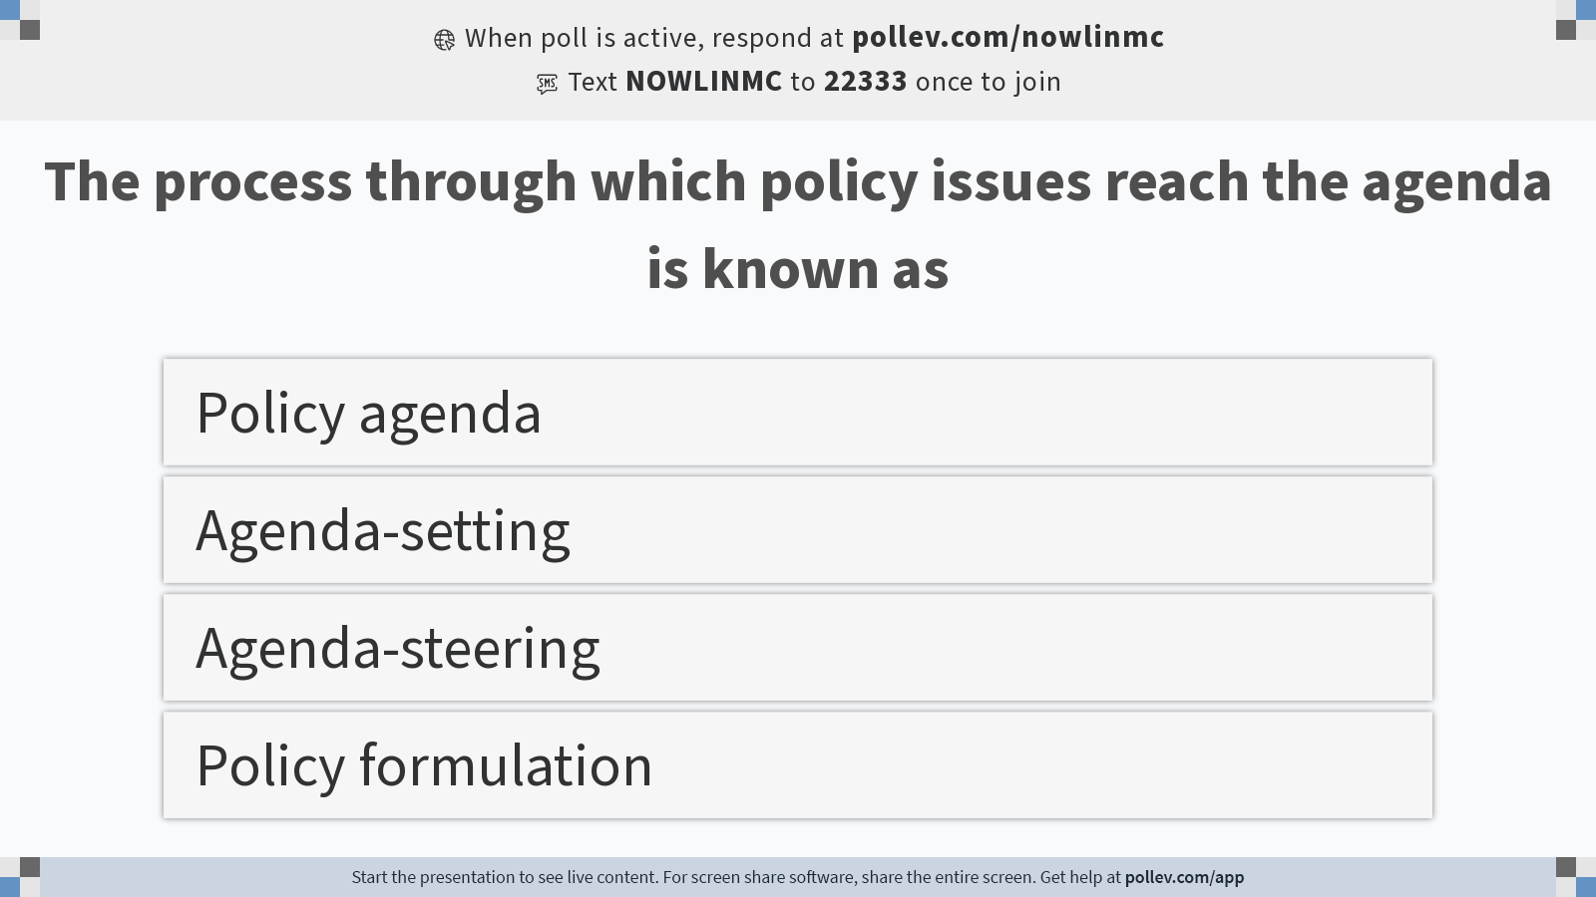
Notes:
Do not modify the notes in this section to avoid tampering with the Poll Everywhere activity. More info at polleverywhere.com/support The process through which policy issues reach the agenda is known as
https://www.polleverywhere.com/multiple_choice_polls/QxRWUHPMibne6gVyZbxfr?display_state=instructions&activity_state=opened&state=opened&flow=Instructor&onscreen=persist

Slide 20
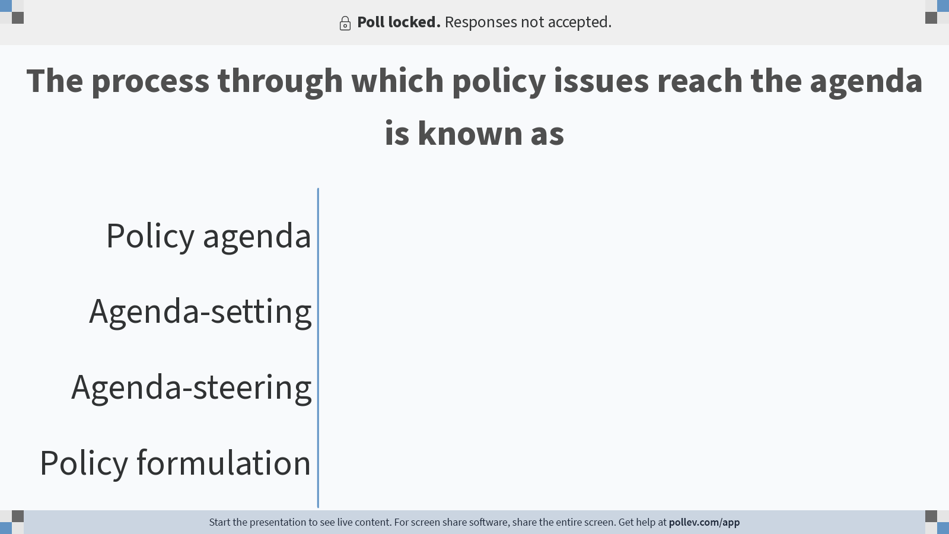
Notes:
Do not modify the notes in this section to avoid tampering with the Poll Everywhere activity. More info at polleverywhere.com/support The process through which policy issues reach the agenda is known as
https://www.polleverywhere.com/multiple_choice_polls/QxRWUHPMibne6gVyZbxfr?display_state=chart&activity_state=closed&state=closed&flow=Instructor&onscreen=persist

Slide 21

Notes:
Do not modify the notes in this section to avoid tampering with the Poll Everywhere activity. More info at polleverywhere.com/support The process through which policy issues reach the agenda is known as
https://www.polleverywhere.com/multiple_choice_polls/QxRWUHPMibne6gVyZbxfr?display_state=chart&activity_state=closed&display=correctness&state=closed&flow=Instructor&onscreen=persist

Slide 22
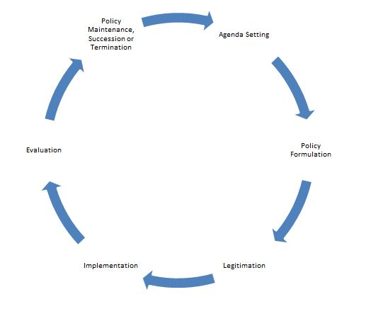
The Stages Model
Problem identification and definition
Agenda setting
Policy formulation
Policy legitimation
Policy implementation
Policy evaluation

Slide 23
The Stages Model
1. Problem identification and definition
Is something a problem
How is the problem understood
These are debated
Framing
Give meaning and context to information

Slide 24
The Stages Model
2. Agenda Setting
Policy agenda: The issues currently being addressed by the policymaking system
Agenda-setting: The process through which policy issues reach the agenda
Space on the agenda is finite and competitive

Slide 25
The Stages Model
2. Agenda Setting
Getting on the agenda = Gaining attention
Mobilization: individuals and organized groups bring attention to a problem
Focusing events
Policy entrepreneurs: individuals willing to invest resources into achieving a policy goal
Public “mood”: how concerned is the public about the problem?

Slide 26
The Stages Model
3. Policy Formulation
What should be done about a problem?
Involves technical analysis and politics
Policy design: The content of the policy
Policy goals
Policy instruments
Implementation structure

Slide 27
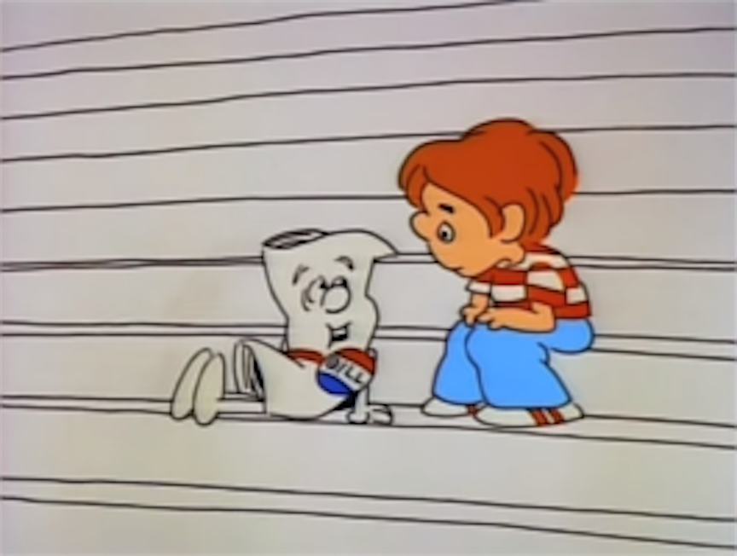
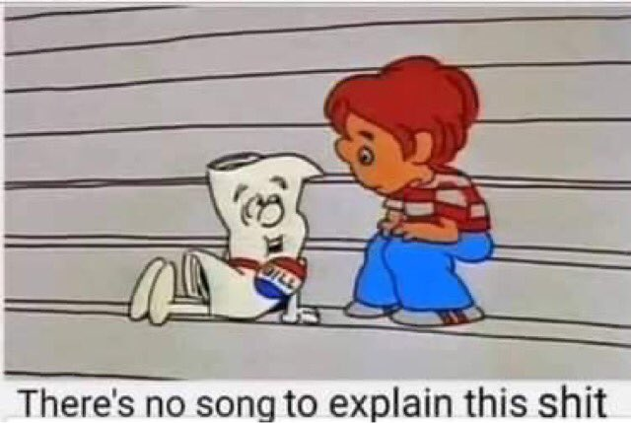
The Stages Model
4. Policy Legitimation
e.g., a proposed policy becomes law

Slide 28
The Stages Model
5. Policy Implementation
Process by which policies enacted by government are put into effect by the relevant agencies
Implementation often involves delegation
Agencies must define “swimmable” waters
Implementation often involves policy creation
EPA makes a regulation under the authority of the Clean Air Act

Slide 29
The Stages Model
6. Policy Evaluation
Measurement and assessment of policy and program effects, including successes and failures
Is a policy working?
Causality
How to measure
Where to get data?
Notes:
Was the Kyoto Protocol successful?

Slide 30
Structural Factors

Slide 31
Checks and Balances
 | Congress | President | Courts
Legislative | make laws | recommend laws, veto, regulations | review laws
Executive | override vetos, oversight | enforce and implement laws | review executive acts
Judicial | advise and consent | pardon, nominate judges | interpret laws

Slide 32
Structural Factors
Federalism
A system of government in which there is a national level of government with various sub-national governmental units
Fragmentation
Policymaking authority is diffused across the branches of government, the states, and civil society

Slide 33
Other Factors
Governmental tendencies that result from the context, process, and structural factors of policymaking
Incrementalism: small changes made over time
Reactionary: governments respond to problems rather than be proactive to prevent a problem
Pluralism: competition among different groups ensures that no single group will dominate government

