Slide 1
Environmental Policymaking: Institutions and Official Actors
POLI 307: Environmental Policy

Slide 2
Institutions
Institutions are the humanly devised constraints that structure political, economic, and social interaction
Institutions consist of both informal constraints (sanctions, taboos, customs, traditions, and codes of conduct), and formal rules (constitutions, laws, property rights)
Markets and Governments

Slide 3
Governments
Environmental Policy: Government action (policy) related to the natural environment
Environmental policies take multiple forms: Legislation, executive orders, agency rules and regulations, and court decisions
The Environmental Policymaking Process
Context
Stages
Structural Factors: Including governmental institutions

Slide 4
Official Actors

Slide 5
Official Actors
A participant in the policy process whose involvement is motivated or mandated by their official position in a government agency or office
In government
Elected officials and civil servants

Slide 6
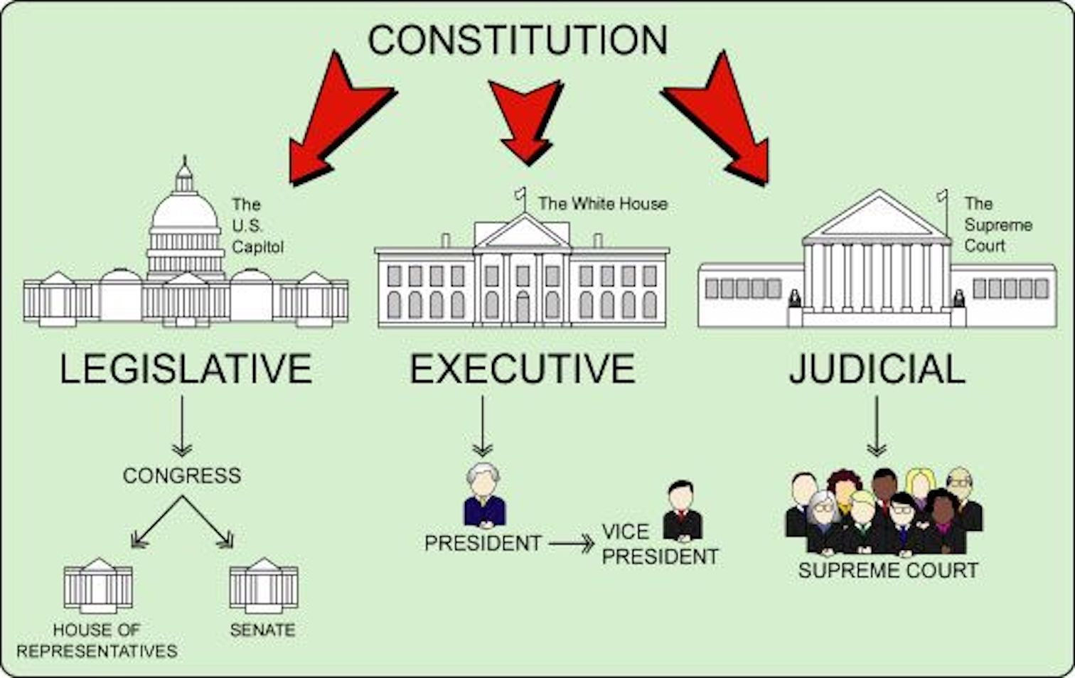

Slide 7
##
quiz q

Slide 8
Congress

Slide 9
Separation and Sharing of Powers
 | Congress | President | Courts
Legislative | make laws | recommend laws, veto, regulations | review law
Executive | override vetos, oversight | enforce and implement laws | review executive acts
Judicial | advise and consent | pardon, nominate judges | interpret laws

Slide 10
Congress: Legislation
How a bill becomes a law

Slide 11
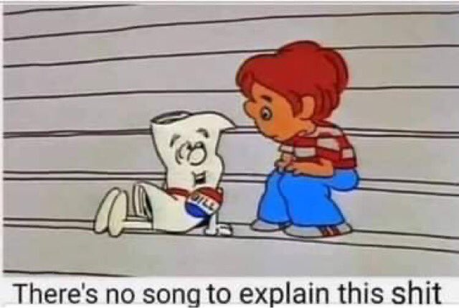
Introduced
Assigned to committee
Passes committee
Passes full chamber
Passes other chamber
Signed by the president

Slide 12
Congress: Committees and Sub-Committees
Hold hearings to gather information
Bills are amended in committee, but most die in committee
Chairs of committees are important party leaders
Create multiple access and veto points for policy actors

Slide 13
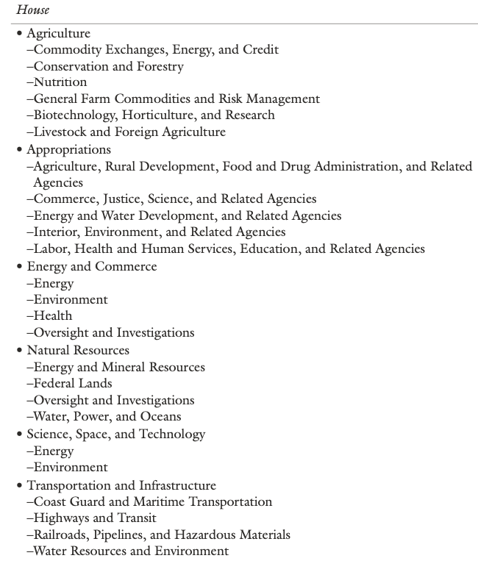
Congress: House Committees and Sub-Committees

Slide 14
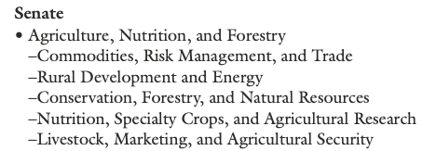
Congress: Senate Committees and Sub-Committees

Slide 15
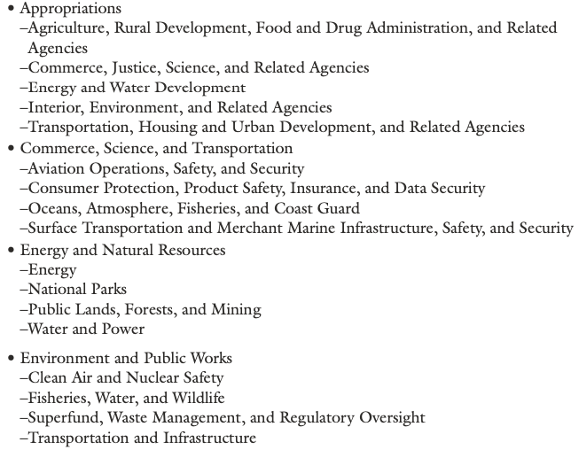

Slide 16
Congress: Environmental Legislation
Substantive legislation peaked during the environmentalism era
Incremental changes since the environmentalism era
Authorizing statues: legislation that becomes public law
Public law titles: subsections of larger bills (laws)
Appropriations: allocation of funding to agencies
Riders: attachments to appropriation bills

Slide 17
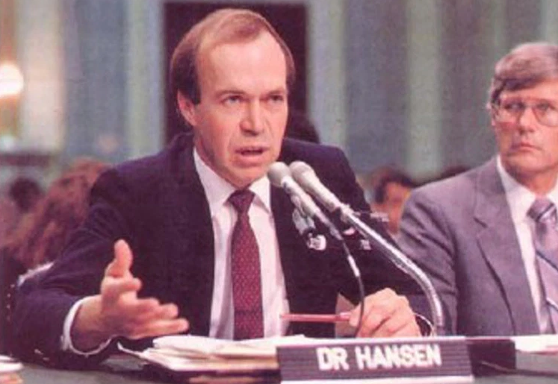
Congress: On the Congressional Agenda
I would like to draw three main conclusions. Number one, the earth is warmer in 1988 than at any time in the history of instrumental measurements. Number two, the global warming is now large enough that we can ascribe with a high degree of confidence a cause and effect relationship to the greenhouse effect. And number three, our computer climate simulations indicate that the greenhouse effect is already large enough to begin to effect the probability of extreme events such as summer heat waves
-James Hansen, 1988

Slide 18
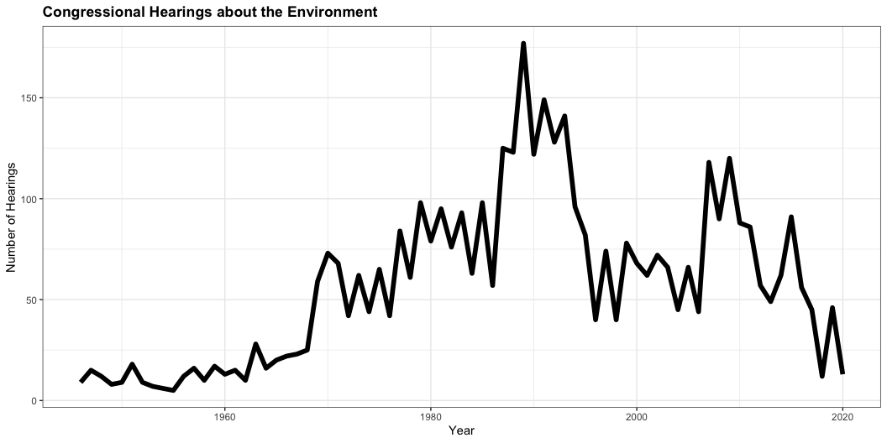
Congressional Hearings

Slide 19
Congressional Hearings
Steady increase during the environmentalism era
Big spike in mid-to late 1980’s
Response to Reagan
Ozone layer and climate change
Decline in legislative hearings and increase in oversight hearings

Slide 20
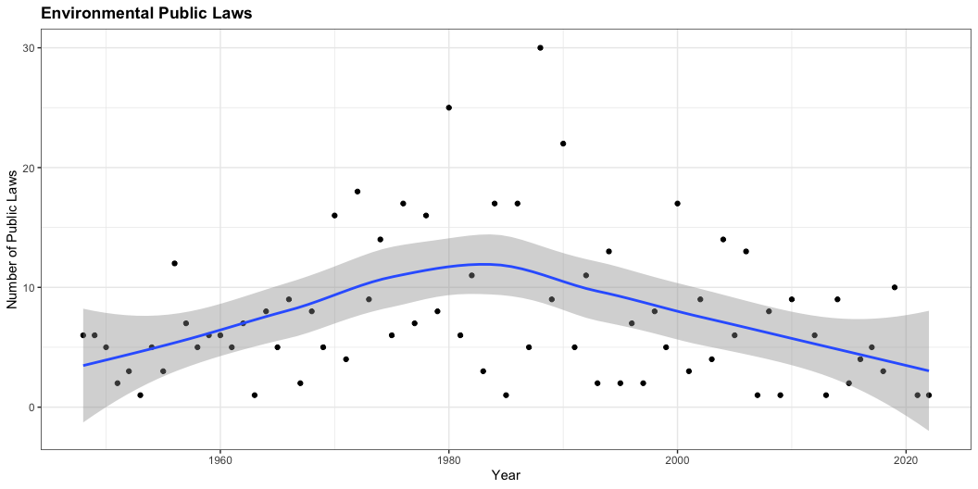
Environmental Legislation: Public Laws

Slide 21
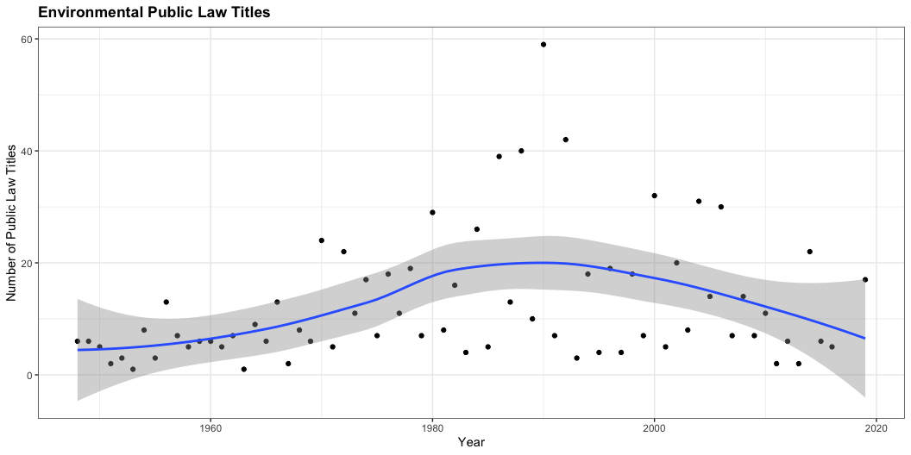
Environmental Legislation: Public Titles

Slide 22
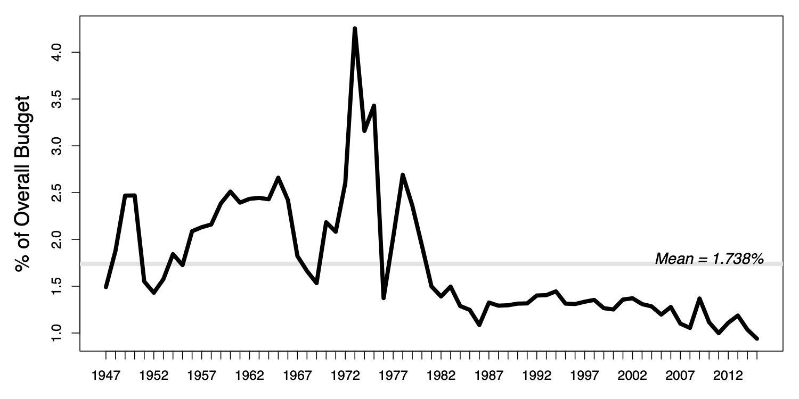
Environmental Budget Outlays

Slide 23
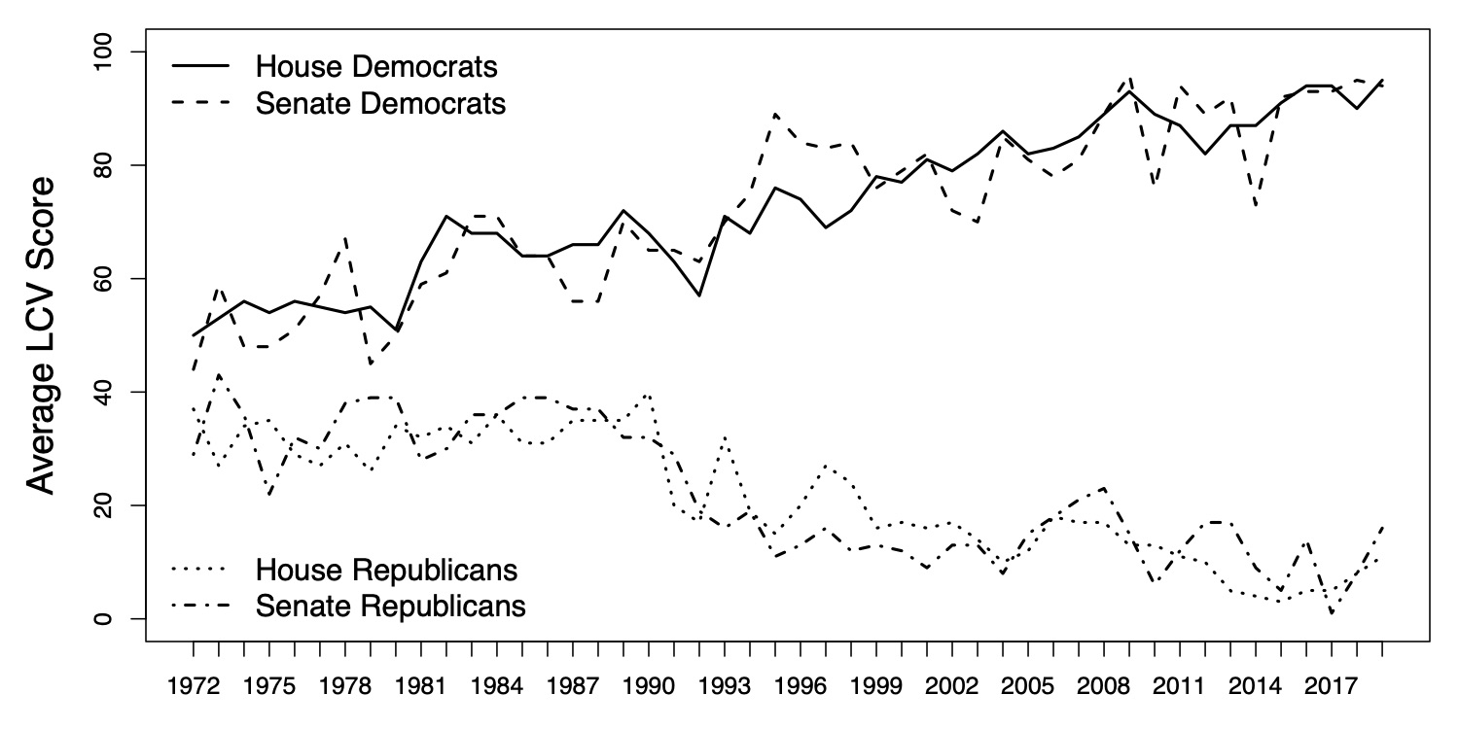
Polarization

Slide 24
Congressional Gridlock
Polarization
Separation of Powers
Complexity of environmental issues
Lack of public support
Interest groups
Lack of political leadership

Slide 25
The President

Slide 26
Separation and Sharing of Powers
 | Congress | President | Courts
Legislative | make laws | recommend laws, veto, regulations | review law
Executive | override vetos, oversight | enforce and implement laws | review executive acts
Judicial | advise and consent | pardon, nominate judges | interpret laws

Slide 27
Presidential Powers
Constitutional powers
Execute the law (“take care” clause)
Veto legislation
Make judicial and executive branch appointments
Implied powers
Proposal legislation and policy priorities to Congress
The president can (try to) influence others to act (the Bully Pulpit)

Slide 28
Presidential Powers
Direct policymaking
Executive Agreements: Agreements made between the US and a foreign government(s)
Executive Orders: An official means by which the president can instruct federal agencies on how to execute laws passed by Congress

Slide 29
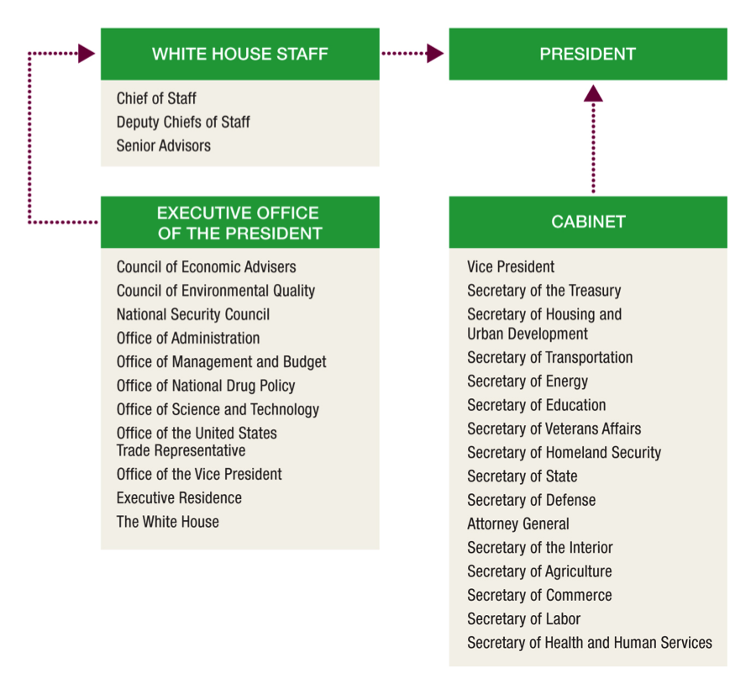
The Administrative Presidency
Chief Executive
Appointments
Policy coordination
Budget process
Executive branch agency and regulatory oversight

Slide 30
quiz

Slide 31
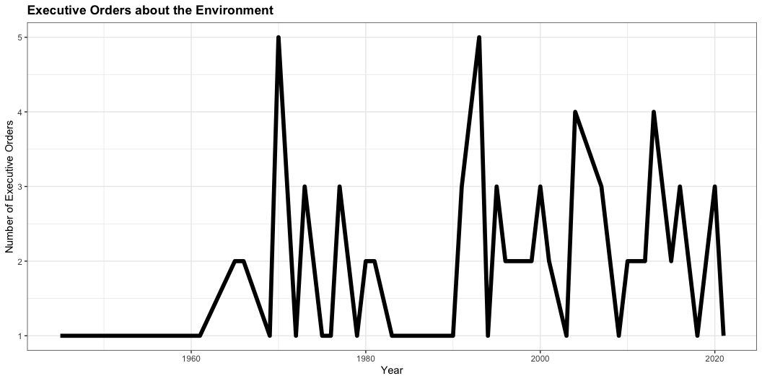
The Environmental Presidency: Executive Orders

Slide 32
The Environmental Presidency: Executive Orders
Democratic | Executive Orders
Johnson | 4
Carter | 9
Clinton | 22
Obama | 15
Biden | TBD
Republican | Executive Orders
Nixon | 13
Ford | 2
Reagan | 3
HW Bush | 4
W Bush | 8
Trump | 6

Slide 33
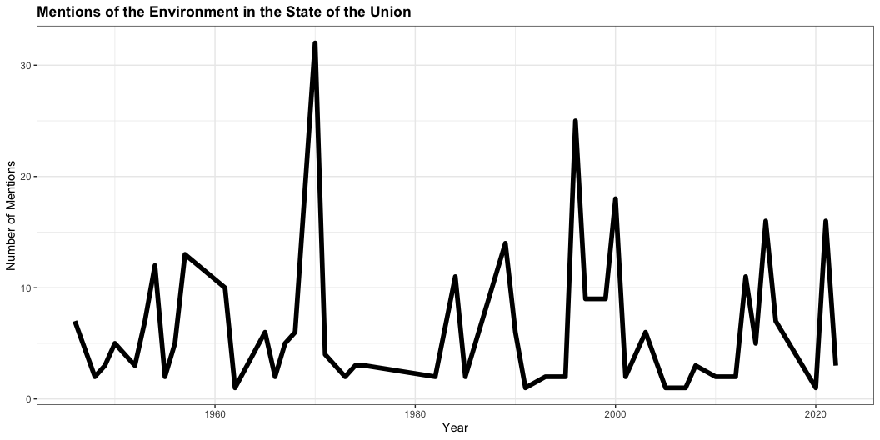
The Environmental Presidency: SOTU

Slide 34
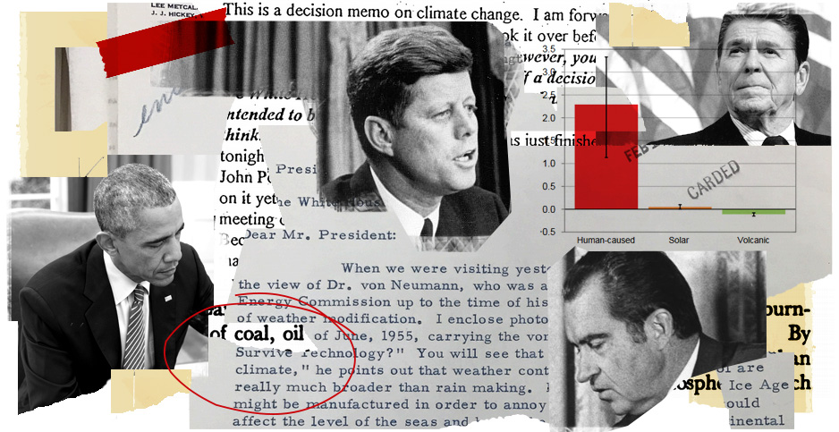
The Environmental Presidency
Opportunistic Leaders
Frustrated Underachievers
Rollback Advocates

Slide 35
The Environmental Presidency
Opportunistic Leaders
Frustrated Underachievers
Rollback Advocates
Nixon
Ford
Carter
Reagan
HW Bush
Clinton
W Bush
Obama
Trump
Biden

Slide 36
Environmental Bureaucracy

Slide 37
Environmental Bureaucracy
Bureaucracy
The complex structure of offices, tasks, rules, and principles of organization that are employed by all large-scale institutions to coordinate the work of their personnel

Slide 38
Environmental Bureaucracy
Bureaucracy
A mission defined by top officials
Fixed jurisdictions within the organization
Authority graded from top to bottom
Management by written documents
Management by career experts
Management by rules

Slide 39
Environmental Bureaucracy
Why Bureaucracy?
Bureaucratic organization enhances efficiency through division of labor and specialization
Bureaucracies allow governments to operate by allowing large-scale coordination of individuals working on a task

Slide 40
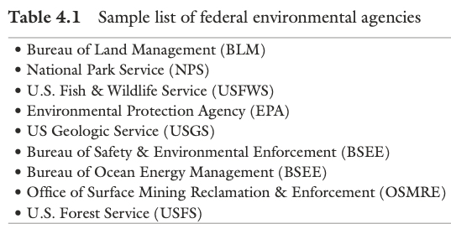
Environmental Bureaucracy
What agencies do
Implement policy
Interpret vague legislative language
Create regulations

Slide 41

Environmental Bureaucracy
The Environmental Protection Agency (EPA)
Initiated by President Nixon in 1970
Independent agency
Administrator appointed by President and confirmed by the Senate
Central agency responsible for implementing environmental policy
The mission of the EPA is to protect human health and the environment

Slide 42
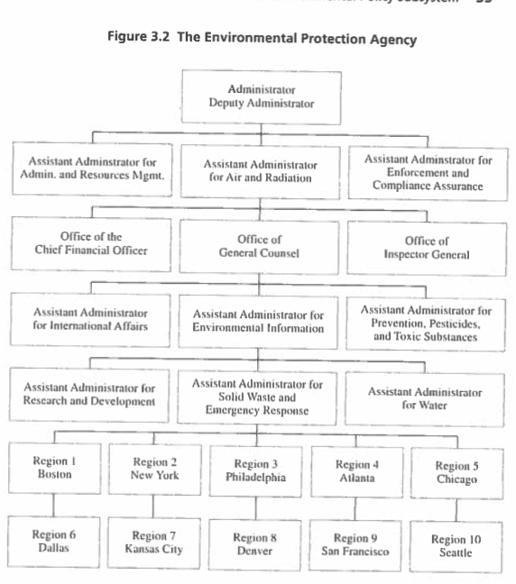
Environmental Bureaucracy
The Environmental Protection Agency (EPA)
Organized by media and geographic regions
Air and Radiation
Chemical Safety and Pollution Prevention
Land and Emergency Management
Water

Slide 43
Environmental Bureaucracy
The Environmental Protection Agency (EPA)
What the EPA Does
Develop and enforce regulations
Give grants
Study environmental issues
Public information

Slide 44
Environmental Bureaucracy: EPA Budget

Slide 45
The Courts

Slide 46
Separation and Sharing of Powers
 | Congress | President | Courts
Legislative | make laws | recommend laws, veto, regulations | review law
Executive | override vetos, oversight | enforce and implement laws | review executive acts
Judicial | advise and consent | pardon, nominate judges | interpret laws

Slide 47
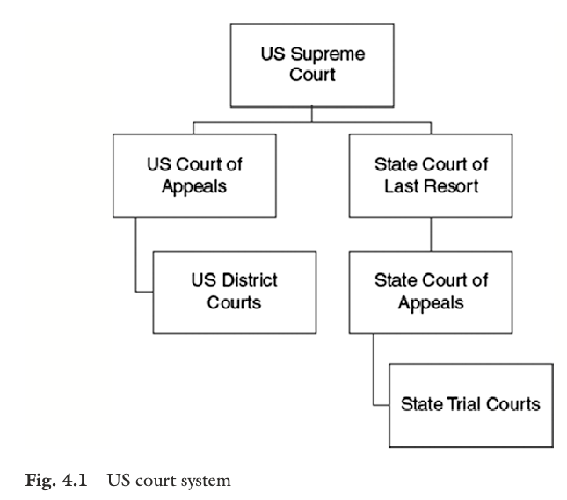
The US Court System
Dual Court System
Federal and state
Three types of law
Public
Criminal
Civil

Slide 48
The Courts: Judicial Review
The power of the courts to declare actions of the legislative and executive branches invalid or unconstitutional
Marbury v. Madison (1803)
The courts review environmental law and policy

Slide 49
The Courts and Environmental Policy
Sources of environmental law
Statutes (Legislation)
Executive orders
Administrative rules and regulations
Appellate court decisions
Previous court decisions
Stare decisis: the court tends to follow its previous decisions

Slide 50
The Courts and Environmental Policy
How Courts Shape Environmental Policy
Determine standing: The right to sue
To establish standing:
Injury-in-fact
Causation
Redressability

Slide 51
The Courts and Environmental Policy
How Courts Shape Environmental Policy
Interpret the law: determine intent
Standard of review: how much deference is given by the court
Chevron deference
Chevron v NRDC (1984)
Ambiguous language, reasonable interpretation, defer to agencies

