Slide 1
Federalism and Environmental Regulations
POLI 307: Environmental Policy

Slide 2
Federalism

Slide 3
Federalism
A system of constitutionally derived and apportioned authority where state and national government retain sovereignty yet at the same time are interdependent
Constitutional division of powers between the national and the state governments

Slide 4
Federalism
Preemption
Higher level government restricts authority of lower level government
The Tenth Amendment
The powers not delegated to the United States by the Constitution, nor prohibited by it to the States, are reserved to the States respectively, or to the people
National supremacy clause
Article VI, Section 2
National laws take preeminence over state laws

Slide 5

Notes:
Do not modify the notes in this section to avoid tampering with the Poll Everywhere activity. More info at polleverywhere.com/support Did you have a nice spring break?
https://www.polleverywhere.com/multiple_choice_polls/nJ6AfvN3qmIz8a4Nj85lO?display_state=instructions&activity_state=opened&state=opened&flow=Engagement&onscreen=persist

Slide 6

Notes:
Do not modify the notes in this section to avoid tampering with the Poll Everywhere activity. More info at polleverywhere.com/support Did you have a nice spring break?
https://www.polleverywhere.com/multiple_choice_polls/nJ6AfvN3qmIz8a4Nj85lO?display_state=chart&activity_state=opened&state=opened&flow=Engagement&onscreen=persist

Slide 7
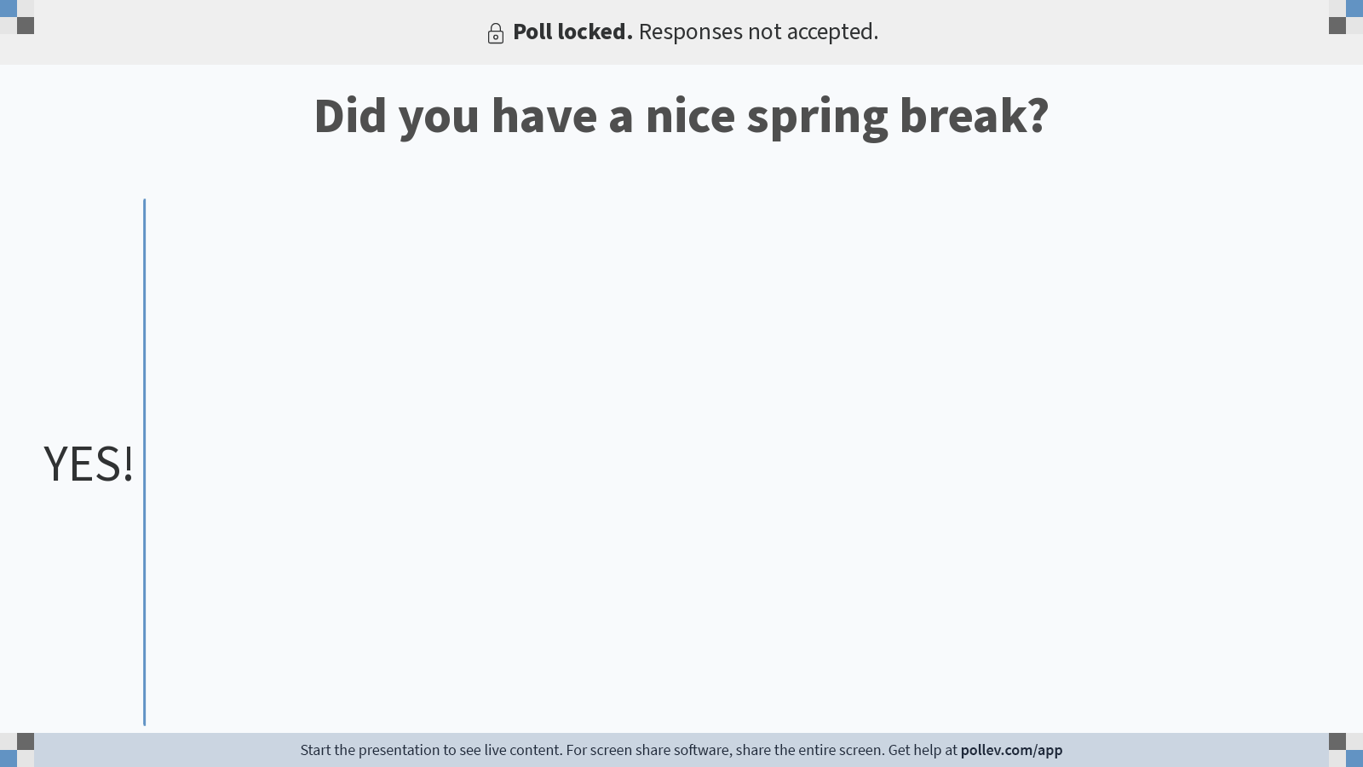
Notes:
Do not modify the notes in this section to avoid tampering with the Poll Everywhere activity. More info at polleverywhere.com/support Did you have a nice spring break?
https://www.polleverywhere.com/multiple_choice_polls/nJ6AfvN3qmIz8a4Nj85lO?display_state=chart&activity_state=closed&state=closed&flow=Engagement&onscreen=persist

Slide 8
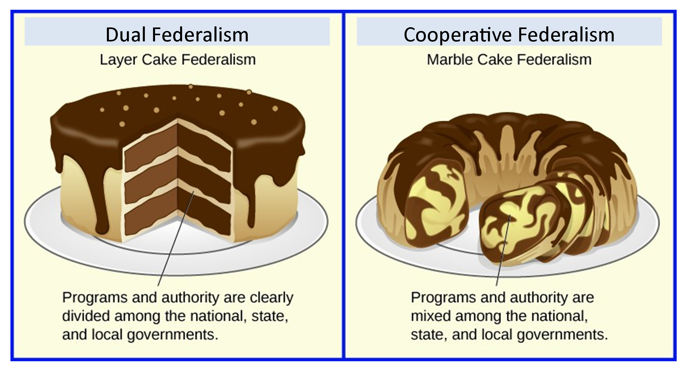
Federalism
Types of federalism
Dual federalism
Cooperative federalism
Compensatory federalism
Notes:
With cooperative federalism the federal government delegates authority to the states

Slide 9
Federalism Eras
The Common Law and Conservation Era: Pre-1945
States and the federal government had a shared interest in development
Shift to conservation in the late 1800s
Dual federalism: States and the federal government had distinct spheres of power over separate policy areas

Slide 10
Federalism Eras
Federal Assistance for State Environmental Problems: 1945–1962
Federal government promoted environmental protection by providing research and financial assistance to states and localities
Rising concern over pollution crossing state lines
Slow shift from dual to cooperative federalism

Slide 11
Federalism Eras
The Rise of the Modern Environmental Movement: 1962–1970
Focus on federal agencies
Erecting the Federal Regulatory Infrastructure: 1970–1980
Large number of federal environmental laws
Cooperative federalism: Federal laws with delegated implementation and enforcement authority to states

Slide 12
Federalism Eras
Extending and Refining Federal Regulatory Strategies: 1980–1990
Slow and uneven process of shifting more authority to states
Regulatory Recoil and Limits on Federal Power: 1991-Present
Reduction in regulatory burdens on states

Slide 13
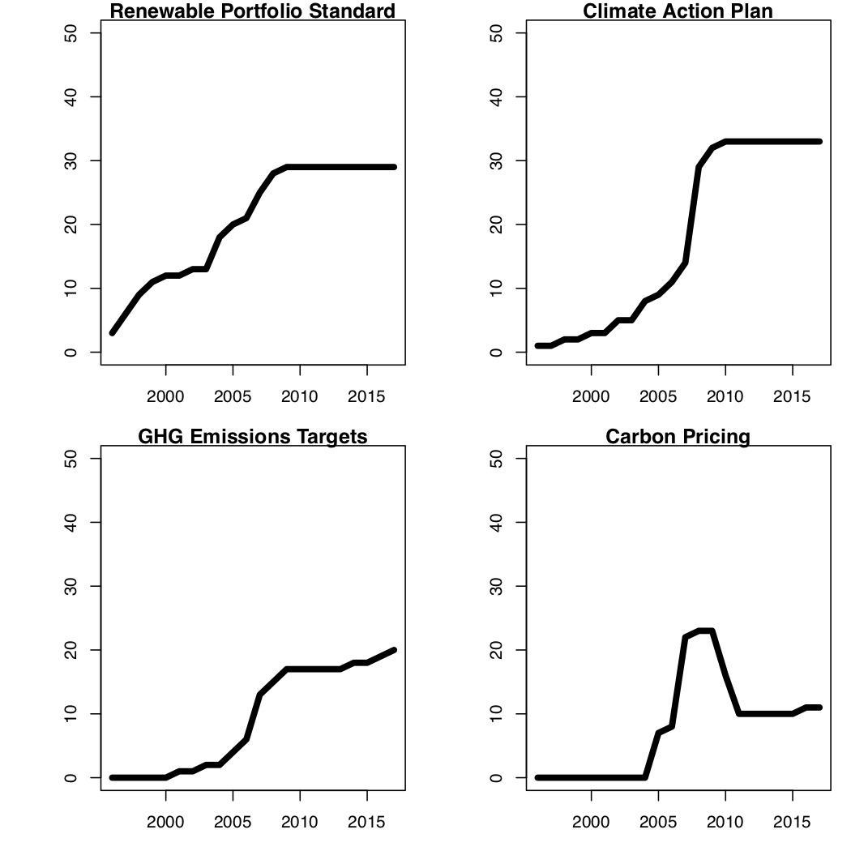
Federalism and Climate Change
Compensatory federalism: One level of government compensates for another level
States and Climate Policy
Renewable Portfolio Standards
Climate Action Plans
GHG Emission Targets
Carbon Pricing

Slide 14
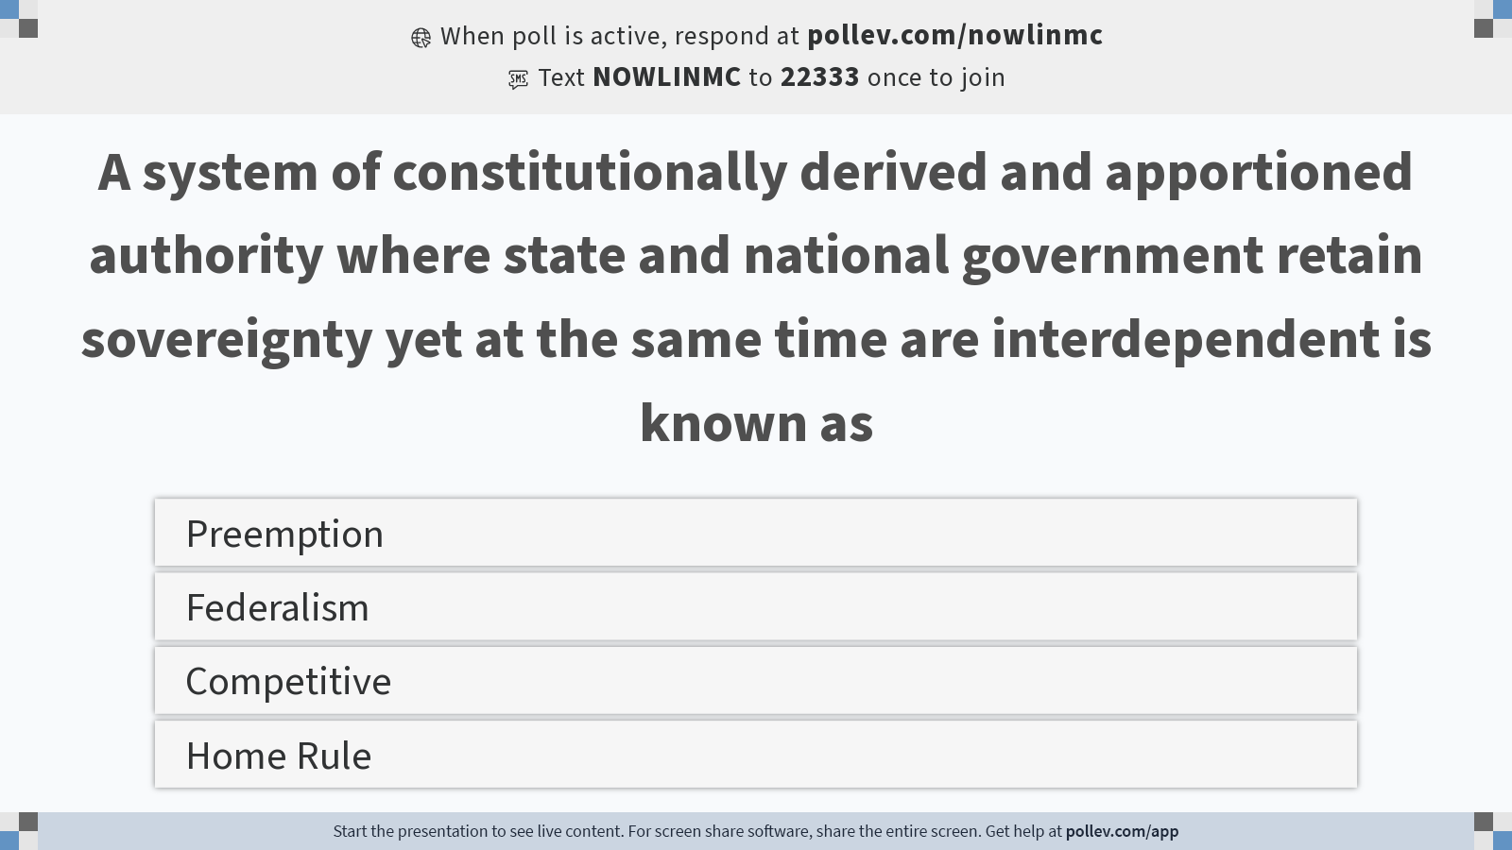
Notes:
Do not modify the notes in this section to avoid tampering with the Poll Everywhere activity. More info at polleverywhere.com/support A system of constitutionally derived and apportioned authority where state and national government retain sovereignty yet at the same time are interdependent is known as
https://www.polleverywhere.com/multiple_choice_polls/o5KF9LHP3e95GQqkn0BR3?display_state=instructions&activity_state=opened&state=opened&flow=Instructor&onscreen=persist

Slide 15
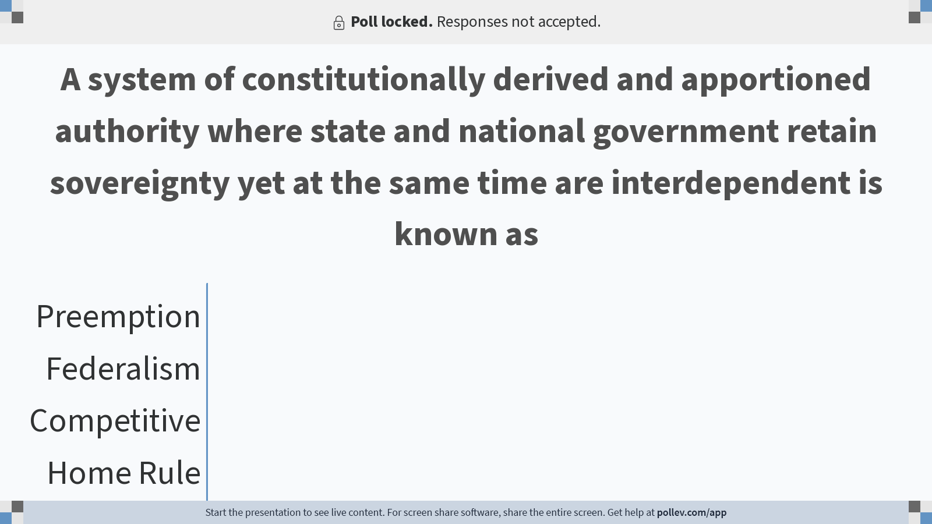
Notes:
Do not modify the notes in this section to avoid tampering with the Poll Everywhere activity. More info at polleverywhere.com/support A system of constitutionally derived and apportioned authority where state and national government retain sovereignty yet at the same time are interdependent is known as
https://www.polleverywhere.com/multiple_choice_polls/o5KF9LHP3e95GQqkn0BR3?display_state=chart&activity_state=closed&state=closed&flow=Instructor&onscreen=persist

Slide 16

Notes:
Do not modify the notes in this section to avoid tampering with the Poll Everywhere activity. More info at polleverywhere.com/support A system of constitutionally derived and apportioned authority where state and national government retain sovereignty yet at the same time are interdependent is known as
https://www.polleverywhere.com/multiple_choice_polls/o5KF9LHP3e95GQqkn0BR3?display_state=chart&activity_state=closed&display=correctness&state=closed&flow=Instructor&onscreen=persist

Slide 17
Environmental Policy Instruments

Slide 18
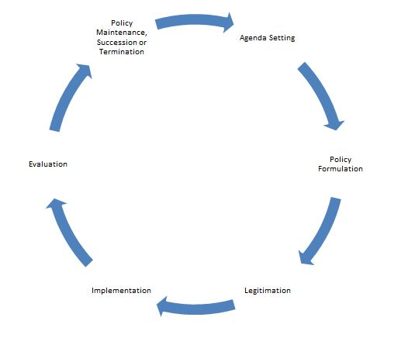
Instruments
The Stages Model
Problem identification and definition
Agenda setting
Policy formulation
Policy legitimation
Policy implementation
Policy evaluation

Slide 19
The Stages Model
3. Policy Formulation
What should be done about a problem?
Involves technical analysis and politics
Policy design: The content of the policy
Policy goals
Policy instruments
Implementation structure

Slide 20
Environmental Policy Instruments
The means of achieving policy goals
How can we reduce greenhouse gas emissions?

Slide 21
Environmental Policy Instruments
Four categories
Using markets
Creating markets
Using environmental regulations
Engaging the public
Carrots, sticks, (and sermons)
Delegated
Voluntary (“carrots”)
Mandated (“sticks”)

Slide 22
Environmental Policy Instruments
Sticks (Using environmental regulations)
Command-and-Control:
Command: Top-down standards (performance or technology)
Control: Substantive and procedural requirements, tight timetables, inspections, controls, penalties for noncompliance, and litigation
Oversight:
Higher level government monitors lower level government

Slide 23
Environmental Policy Instruments
Sticks (Using environmental regulations)
Technology Based:
Require a particular technology be used
Permits and Inspections
Permit: limit on volume and type of pollution that can be discharged
Inspections: ensure compliance

Slide 24
Environmental Policy Instruments
Sticks (Using environmental regulations)
Enforcement
Occurs at both the federal and state level
Unfunded Mandates
Requirements from the federal government without monetary assistance
Unfunded Mandates Reform Act of 1995

Slide 25
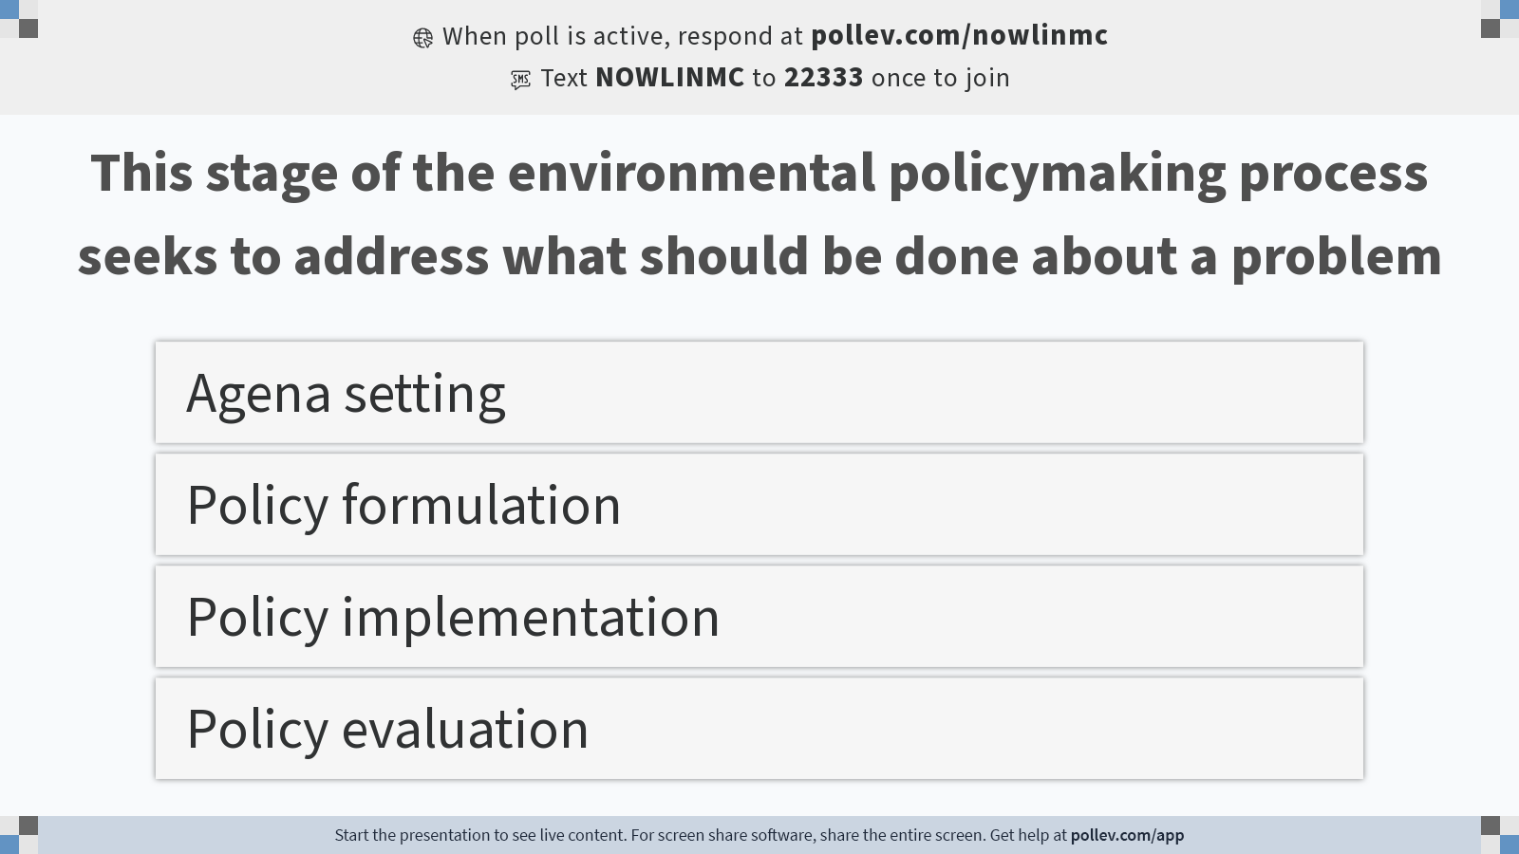
Notes:
Do not modify the notes in this section to avoid tampering with the Poll Everywhere activity. More info at polleverywhere.com/support This stage of the environmental policymaking process seeks to address what should be done about a problem
https://www.polleverywhere.com/multiple_choice_polls/1jHxlMdMEZdEEpZhsOujc?display_state=instructions&activity_state=opened&state=opened&flow=Instructor&onscreen=persist

Slide 26
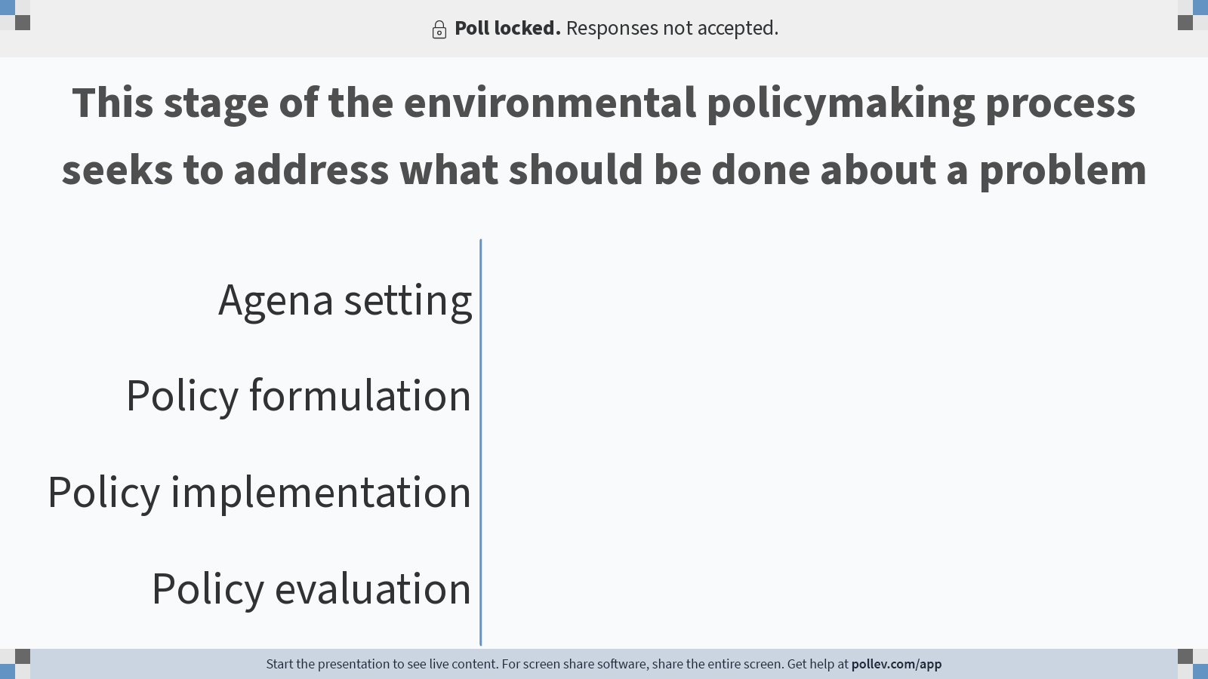
Notes:
Do not modify the notes in this section to avoid tampering with the Poll Everywhere activity. More info at polleverywhere.com/support This stage of the environmental policymaking process seeks to address what should be done about a problem
https://www.polleverywhere.com/multiple_choice_polls/1jHxlMdMEZdEEpZhsOujc?display_state=chart&activity_state=closed&state=closed&flow=Instructor&onscreen=persist

Slide 27

Notes:
Do not modify the notes in this section to avoid tampering with the Poll Everywhere activity. More info at polleverywhere.com/support This stage of the environmental policymaking process seeks to address what should be done about a problem
https://www.polleverywhere.com/multiple_choice_polls/1jHxlMdMEZdEEpZhsOujc?display_state=chart&activity_state=closed&display=correctness&state=closed&flow=Instructor&onscreen=persist

Slide 28
Environmental Policy Instruments
Carrots
Voluntary Compliance
Firms and other organizations have clear expectations and the incentives and resources
Bottom-up: firms may impose requirements on themselves to avoid government regulation
Greenwashing: firms appear more environmentally friendly than they actually are

Slide 29
Environmental Policy Instruments
Carrots
Public Education (Engaging the public; Sermons)
Provide information
Moral leadership
Preventive Efforts
Produce reduction targets
Technical Assistance
Grants and expertise

Slide 30
Environmental Policy Instruments
Carrots
Privatization
Contract out; waste disposal
Partnerships
Federal-state; public-private

Slide 31
Environmental Regulations

Slide 32
Environmental Regulations
The Stages Model
Problem identification and definition
Agenda setting
Policy formulation
Policy legitimation
Policy implementation
Policy evaluation

Slide 33
Environmental Regulations
5. Policy Implementation: Process by which policies enacted by government are put into effect by the relevant agencies
Implementation often involves delegation
Agencies must define “swimmable” waters
Implementation often involves policy creation
EPA makes a regulation under the authority of the Clean Air Act

Slide 34
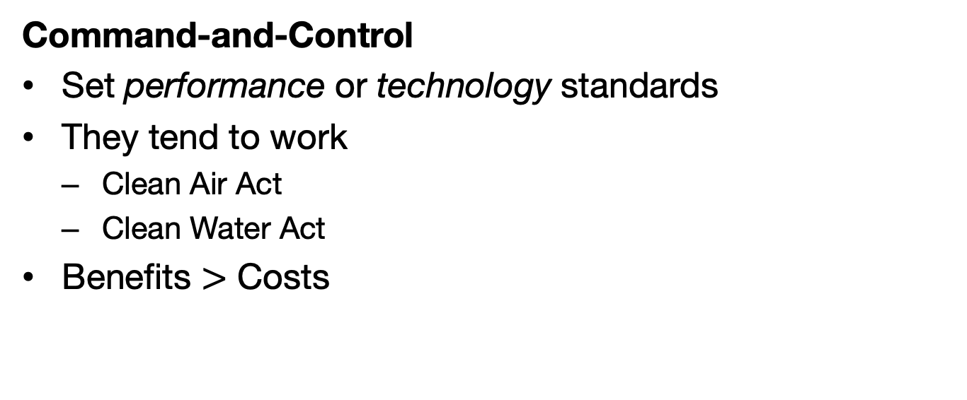
Environmental Regulations
Command-and-Control
Set performance or technology standards
They tend to work
Clean Air Act
Clean Water Act
Benefits $>$ Costs

Slide 35
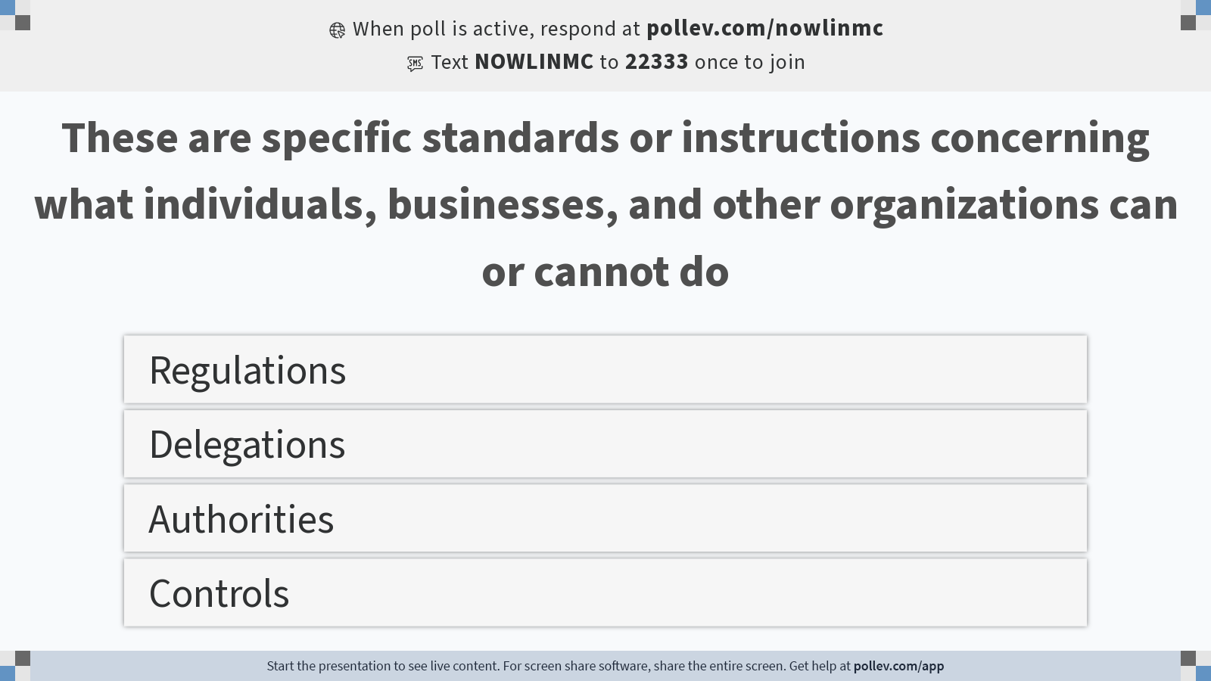
Notes:
Do not modify the notes in this section to avoid tampering with the Poll Everywhere activity. More info at polleverywhere.com/support These are specific standards or instructions concerning what individuals, businesses, and other organizations can or cannot do
https://www.polleverywhere.com/multiple_choice_polls/hDJ4qGTpaUWYNWMeseChI?display_state=instructions&activity_state=opened&state=opened&flow=Instructor&onscreen=persist

Slide 36
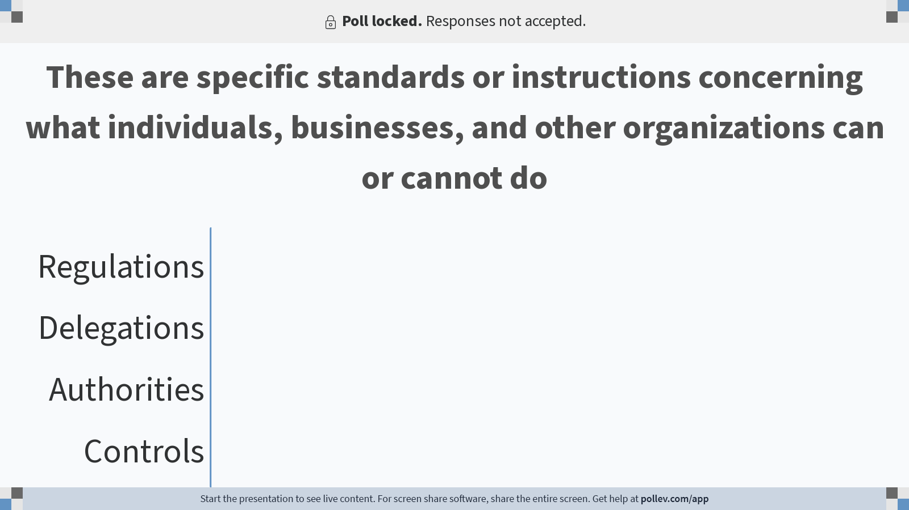
Notes:
Do not modify the notes in this section to avoid tampering with the Poll Everywhere activity. More info at polleverywhere.com/support These are specific standards or instructions concerning what individuals, businesses, and other organizations can or cannot do
https://www.polleverywhere.com/multiple_choice_polls/hDJ4qGTpaUWYNWMeseChI?display_state=chart&activity_state=closed&state=closed&flow=Instructor&onscreen=persist

Slide 37

Notes:
Do not modify the notes in this section to avoid tampering with the Poll Everywhere activity. More info at polleverywhere.com/support These are specific standards or instructions concerning what individuals, businesses, and other organizations can or cannot do
https://www.polleverywhere.com/multiple_choice_polls/hDJ4qGTpaUWYNWMeseChI?display_state=chart&activity_state=closed&display=correctness&state=closed&flow=Instructor&onscreen=persist

Slide 38
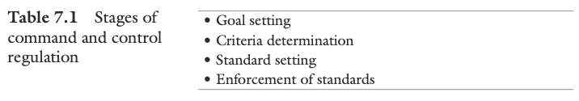
Environmental Regulations

Slide 39
Environmental Regulations
Goal Setting
Congress often sets broad goals that a law is designed to achieve
CWA: “swimmable” and “fishable” waters
Weighed against other social and economic considerations

Slide 40
Environmental Regulations
Criteria determination
What is “clear air?” What is “clean water?”
Requires extensive data collection and analysis
In the CAA and CWA public health was the only consideration

Slide 41
Environmental Regulations
Standard setting
Reflects the standards that are needed for “clean air” and/or “clean water”
Determinations about the level of pollution that is acceptable for public and environmental health
Performance or technology

Slide 42
Environmental Regulations
Enforcement of standards
Facilities are monitored and inspected
Reporting requirements

Slide 43
Environmental Regulations
Assumptions of command-and-control regulations
Top-down: Other stakeholders involved, but regulations come from government agencies
Government knows best: Has the information and expertise to make regulations
One-size-fits-all: Regulations are applied uniformly
Deterrence strategy: Facilities must comply or face consequences and absent regulation, facilities would pollute
Little incentive to improve: Facilities will meet the requirement, but not do any more to reduce pollution

Slide 44
Environmental Regulations
Command-and-control (federalism) in action
Regulatory structure: Rulemaking process occurs at the federal level, with implementation and enforcement delegated to the states
States collectively issue more than 90 percent of all environmental permits, complete more than 75 percent of all environmental enforcement actions, and rely on the federal government for less than 25 percent of their total funding on environmental and natural resource concerns

Slide 45
Environmental Regulations
Challenges of implementing command-and-control regulations
Politics and competing priorities
Environmental policy is both highly technical and highly political
Agencies are responsive to political control
Federalism
Adds complexity and coordination problems

Slide 46
Environmental Regulations
Challenges of implementing command-and-control regulations
Resource constraints
Agency capacity: budgets and personnel
Knowledge
Administrative structures and discretion
Internal factors
Organizational friction

Slide 47
Environmental Regulations
Regulatory capture
Occurs when regulators become beholden to those they attempt to regulate
Revolving door
Information asymmetries: companies may know more about their products than the regulators
Influence of interest groups

