Slide 1
Environmental Policymaking: Unofficial Actors
POLI 307: Environmental Policy

Slide 2
Unofficial Actors
Individuals and organizations that try to influence the actions of official actors (Congress, the president, the bureaucracy, and the courts) and the outcomes of elections
Outside government: unofficial actors do not have constitutionally or legally created incentives or mandates to be a part of the environmental policymaking process
But, they are still an important factor in environmental policymaking

Slide 3
Unofficial Actors
Political Parties
Interest Groups
The Public
Media

Slide 4
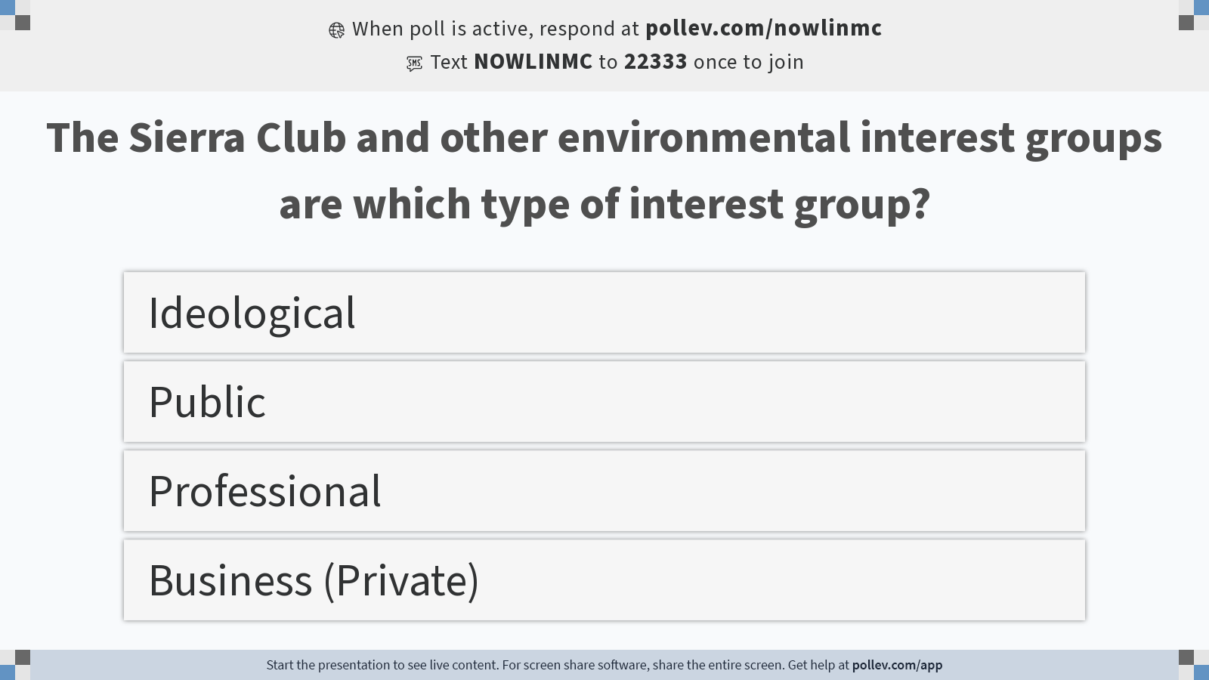
Notes:
Do not modify the notes in this section to avoid tampering with the Poll Everywhere activity. More info at polleverywhere.com/support The Sierra Club and other environmental interest groups are which type of interest group?
https://www.polleverywhere.com/multiple_choice_polls/kPbq9BdrHVPiii66PgEzT?display_state=instructions&activity_state=opened&state=opened&flow=Instructor&onscreen=persist

Slide 5
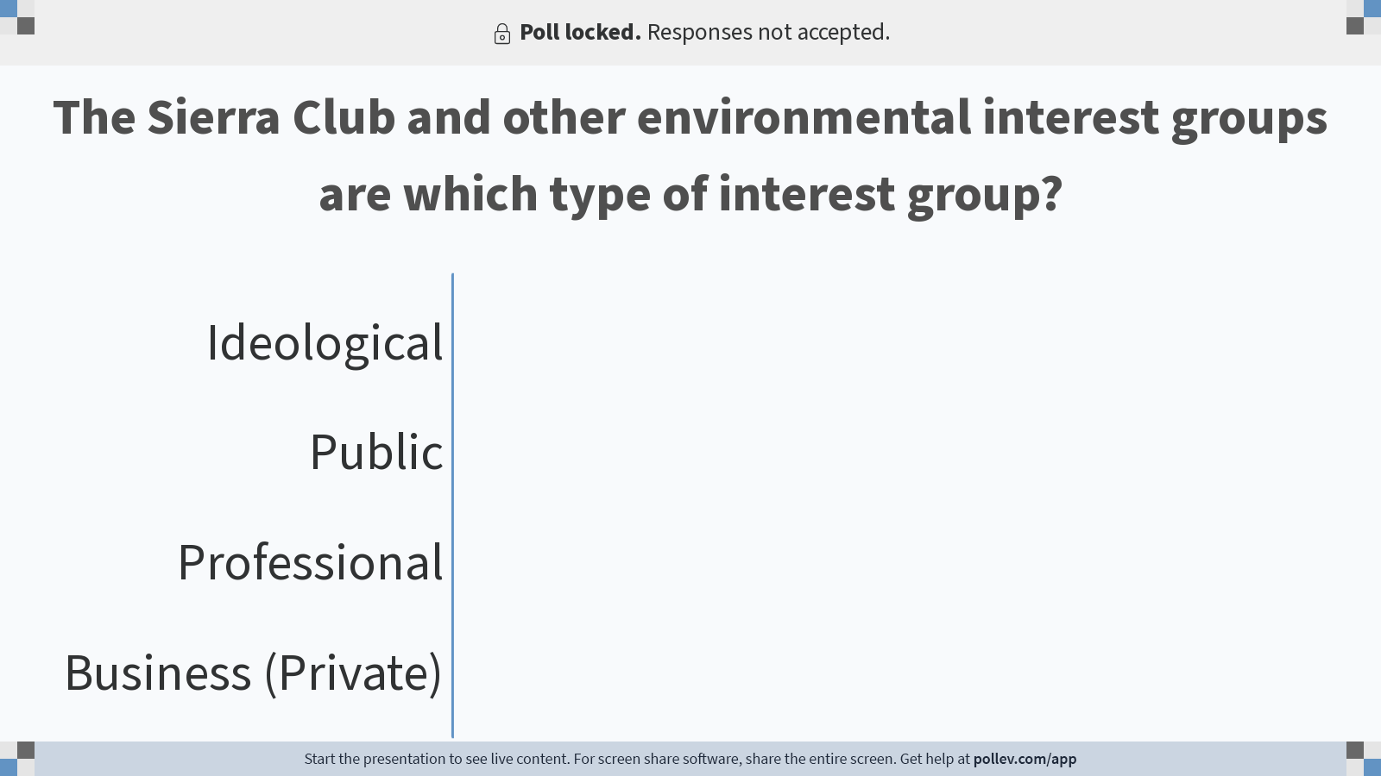
Notes:
Do not modify the notes in this section to avoid tampering with the Poll Everywhere activity. More info at polleverywhere.com/support The Sierra Club and other environmental interest groups are which type of interest group?
https://www.polleverywhere.com/multiple_choice_polls/kPbq9BdrHVPiii66PgEzT?display_state=chart&activity_state=closed&state=closed&flow=Instructor&onscreen=persist

Slide 6

Notes:
Do not modify the notes in this section to avoid tampering with the Poll Everywhere activity. More info at polleverywhere.com/support The Sierra Club and other environmental interest groups are which type of interest group?
https://www.polleverywhere.com/multiple_choice_polls/kPbq9BdrHVPiii66PgEzT?display_state=chart&activity_state=closed&display=correctness&state=closed&flow=Instructor&onscreen=persist

Slide 7
Political Parties

Slide 8
Political Parties
Groups of people with similar interests who work together to create and implement policies
Parties are broad coalitions
Three roles:
In government
As organizations
In the electorate

Slide 9
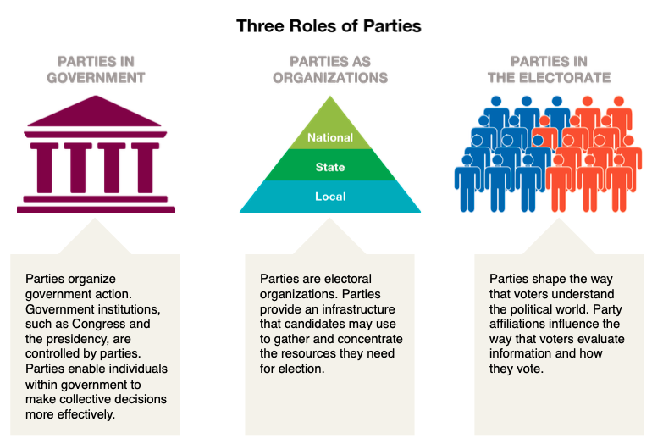

Slide 10
Political Parties
Polarization: Divergent views along ideological and/or partisan lines
The parties are fundamentally different

Slide 11
Political Parties
Democratic: Democratic ideology is more commonly associated with liberalism and an acceptance of government involvement in the political, economic, and social lives of people
Democrats are a coalition of groups making demands on government
Republican: Republican ideology argues for individual liberty as opposed to government interference. Its preference for small government coincides with a pro-business, free-market attitude and thus an aversion to government control
Republicans are ideologically homogeneous

Slide 12
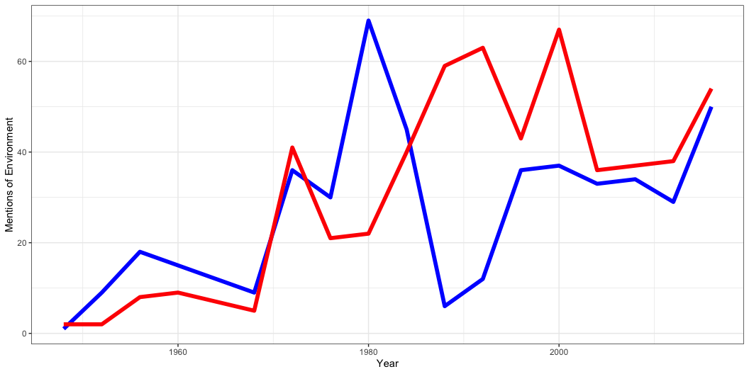
Party Platforms

Slide 13
Party Platforms
Democrats
1984: The environmental legacy of Ronald Reagan will be long-lasting damage that can never truly be undone
2020: We must lead the world in taking on the climate crisis, not deny the science and accelerate the damage
Republicans
1980: We strongly affirm that environmental protection must not become a cover for a “no-growth” policy and a shrinking economy
2016: The Environmental Protection Agency has rewritten laws to advance the Democrats’ climate change agenda

Slide 14
Interest Groups

Slide 15
Interest Groups
An organized group of individuals or organizations that makes policy-related appeals to government
Environmental policy
Business
Environmental groups (Public)
Labor
“Left” (labor) and “right” (business) coalitions have been successful in blocking climate action

Slide 16
Environmental Interest Groups
Mainstream
Sierra Club
Environmental Defense Fund
Greens
Greenpeace
Earth First!
Grassroots
Organized within local area
Climate change
Sunrise Movement

Slide 17
What Interest Groups Do
Pursue insider and outsider strategies
Insider: lobby government officials
Outsider: support candidates, mobilize members, protests

Slide 18
Interest Groups: Theories
Pluralism
Groups are mobilized in response to changes in society and/or the policymaking environment
Mobilization: The process by which people or groups motivated to take action, such as through lobbying, protest, or any other form of expression in response to an issue or problem

Slide 19
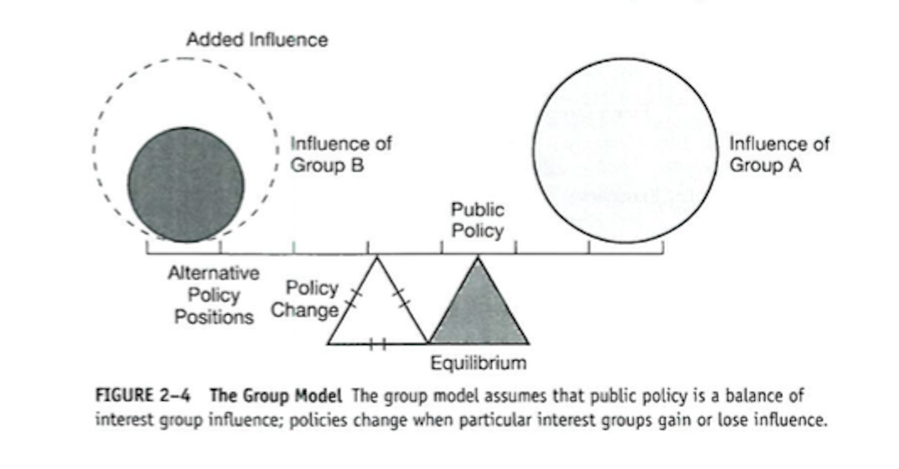
Interest Groups: Theories
Mobilization and Counter-Mobilization

Slide 20
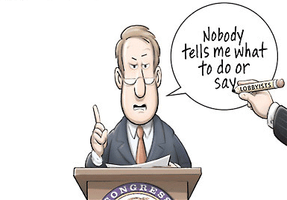
Interest Groups: Theories
Elitism
Policy demands flow downward from the elite not upwards from the public

Slide 21
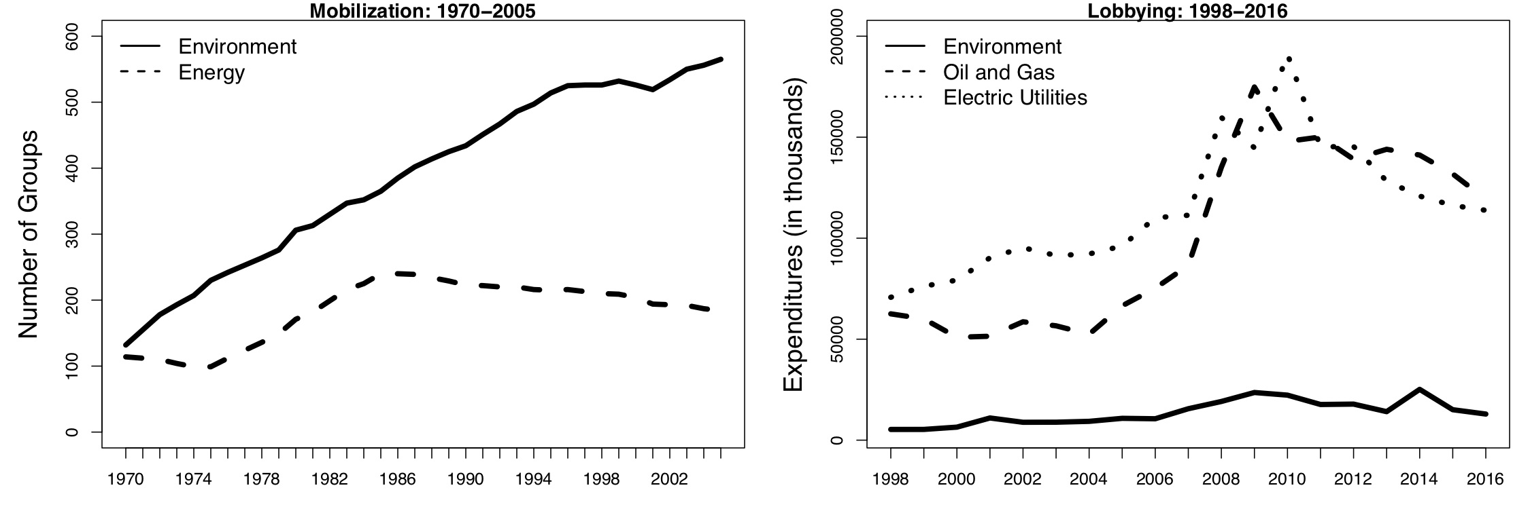
Interest Group Influence
Mobilization and Spending

Slide 22
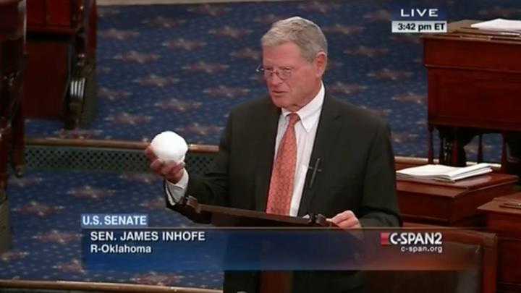
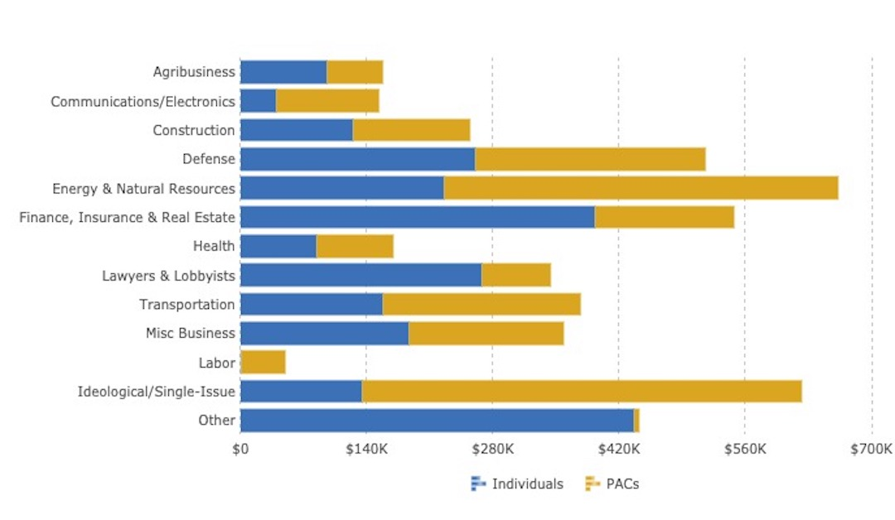
Interest Group Influence
Former Senator James Inhofe (R-Oklahoma)

Slide 23
Interest Group Influence
“It’s not only about the money, having money helps, but the other side will always have more and they don’t always win”
-Wesley Warren, Natural Resources Defense Council
On salient and contentious issues both sides tend to be well-resourced
Interest groups tend to support their friends and allies
But, business interests have an advantage when issues aren’t salient and they can be active in each stage of the process

Slide 24
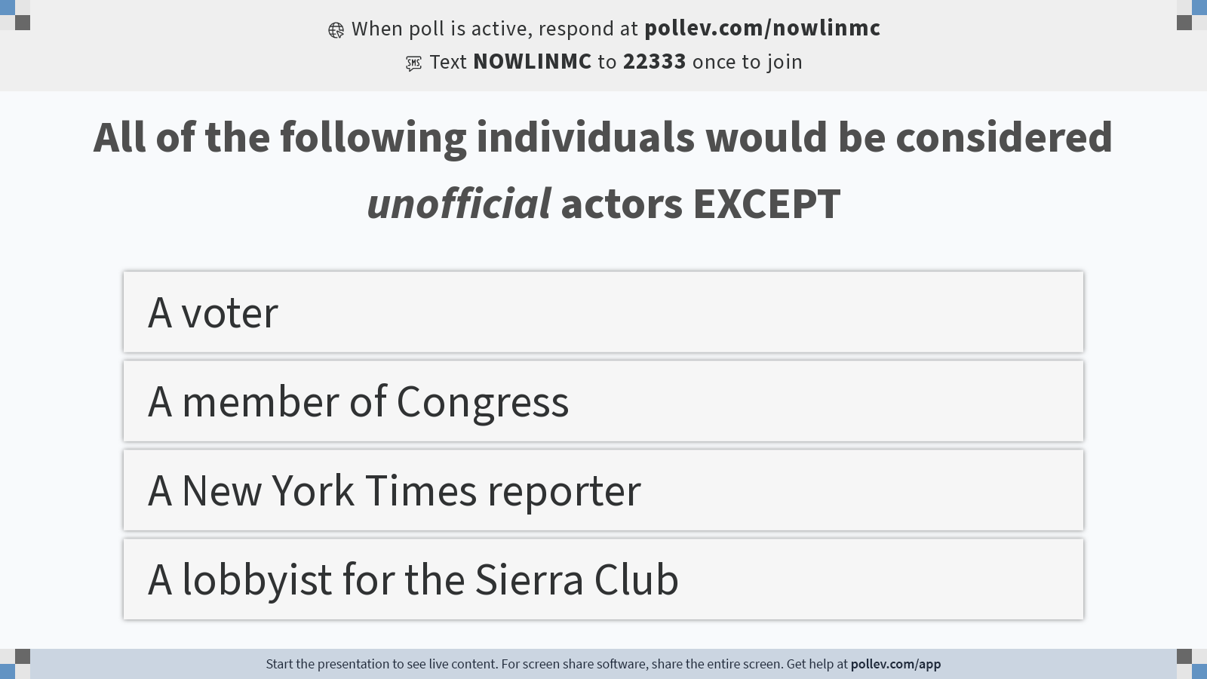
Notes:
Do not modify the notes in this section to avoid tampering with the Poll Everywhere activity. More info at polleverywhere.com/support All of the following individuals would be considered unofficial actors EXCEPT
https://www.polleverywhere.com/multiple_choice_polls/PKzzjlGaq2ODbMJWB7fFX?display_state=instructions&activity_state=opened&state=opened&flow=Instructor&onscreen=persist

Slide 25
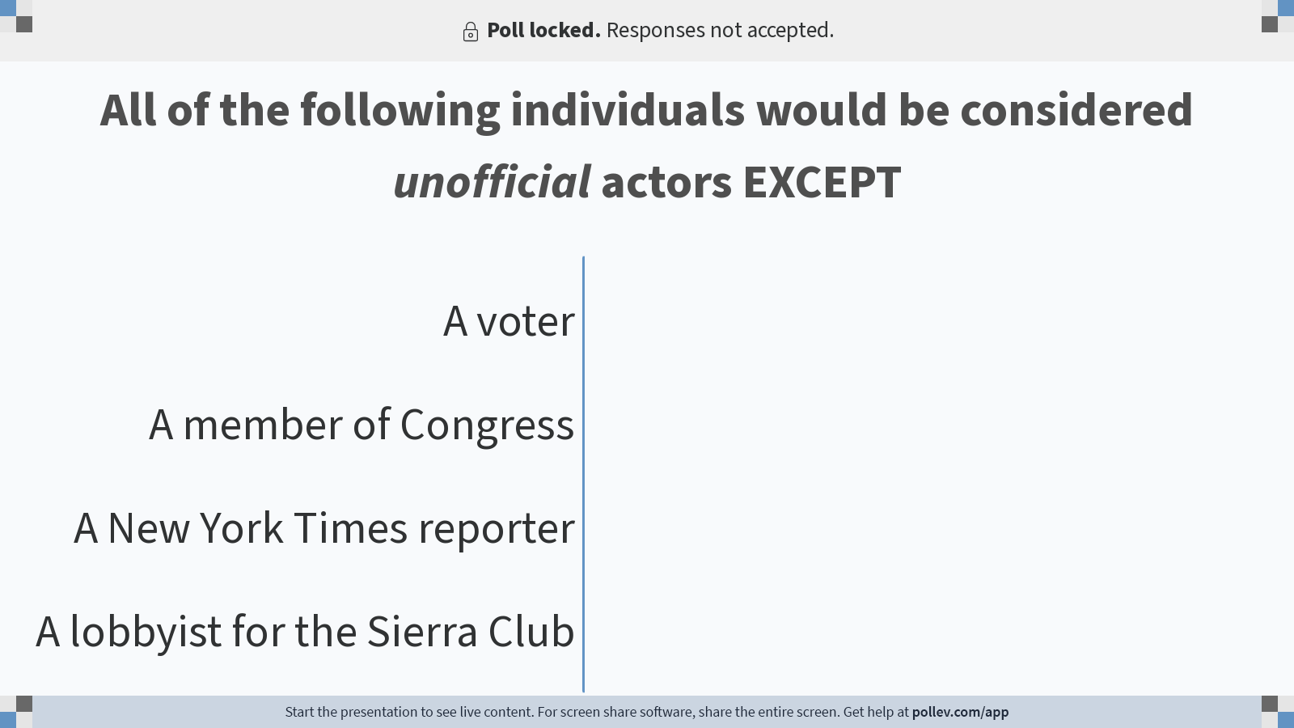
Notes:
Do not modify the notes in this section to avoid tampering with the Poll Everywhere activity. More info at polleverywhere.com/support All of the following individuals would be considered unofficial actors EXCEPT
https://www.polleverywhere.com/multiple_choice_polls/PKzzjlGaq2ODbMJWB7fFX?display_state=chart&activity_state=closed&state=closed&flow=Instructor&onscreen=persist

Slide 26

Notes:
Do not modify the notes in this section to avoid tampering with the Poll Everywhere activity. More info at polleverywhere.com/support All of the following individuals would be considered unofficial actors EXCEPT
https://www.polleverywhere.com/multiple_choice_polls/PKzzjlGaq2ODbMJWB7fFX?display_state=chart&activity_state=closed&display=correctness&state=closed&flow=Instructor&onscreen=persist

Slide 27
The Public

Slide 28
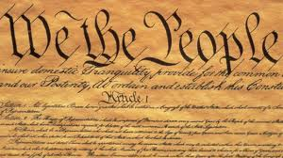
Public Opinion
Broad public support in favor of environmental protection provides legitimacy for those working on its behalf
Public opinion provides a foundation for government action

Slide 29
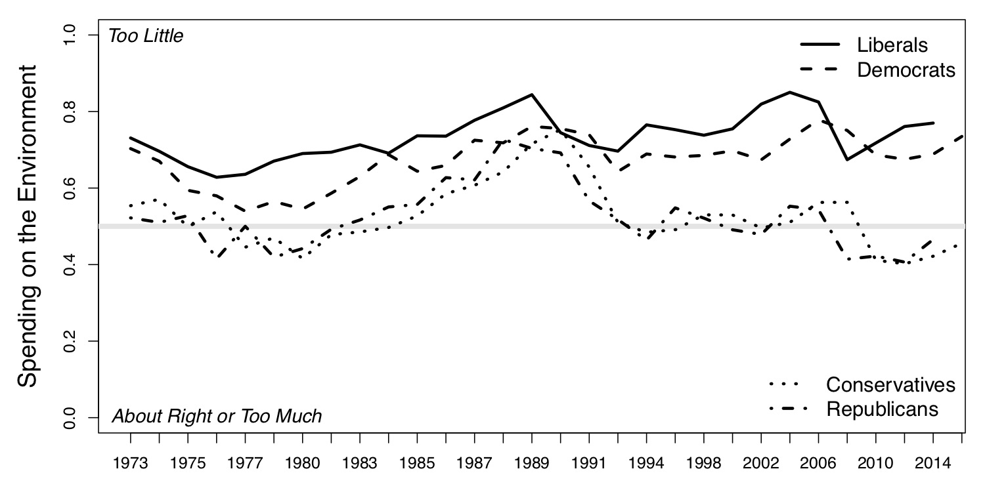
Public Opinion

Slide 30
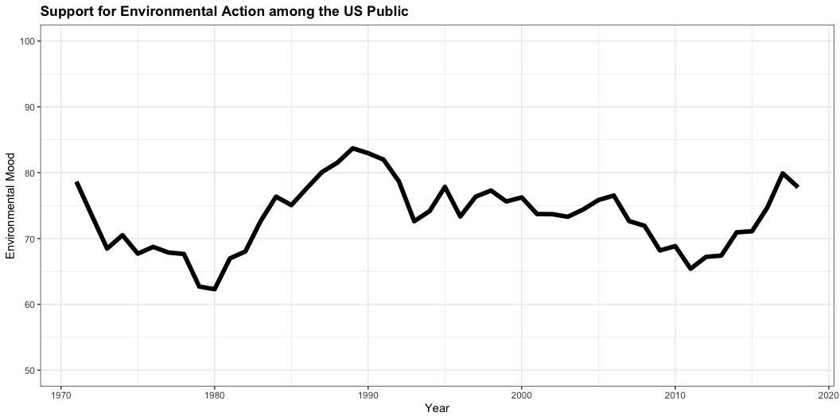
Public Opinion

Slide 31
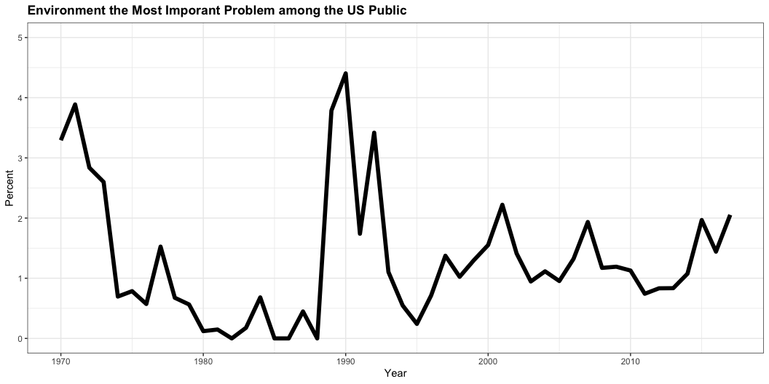
Public Opinion

Slide 32
Public Opinion

Slide 33
Public Opinion
The Paradox of Public Opinion on the Environment
In general, support for addressing environmental problems is high among the public, but other issues (the economy, healthcare) tend to be more important
Other issues crowd out the agenda, even as the public supports action on environmental issues

Slide 34
Public Opinion
Polarization
Following elite and party cues, the public is polarized over environmental issues
Thermostatic
Like a thermostat, public support for environmental policy increases (decreases) as government action on the environment decreases (increases)

Slide 35
The Media

Slide 36
The Media
Traditional media: Three different types
Broadcast: radio and television
Print: newspapers and magazines
Internet: websites of traditional sources
Alternative media
Social media
Data journalism
Activist or Clickivist?

Slide 37
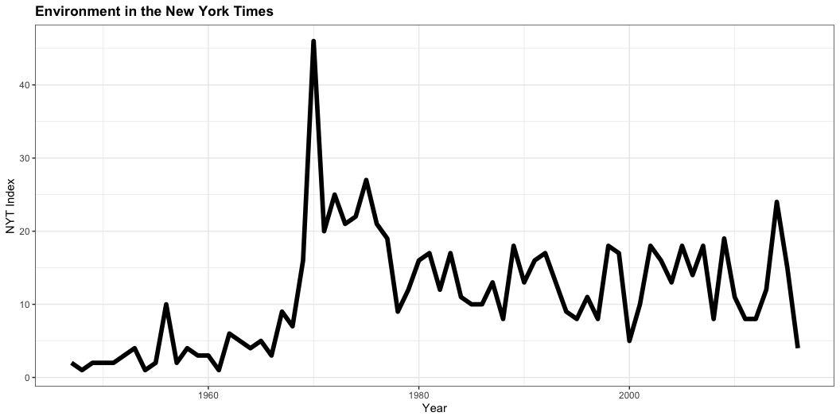
Media Attention to the Environment
Framing and priming
Complex science
Media ownership
“Both sides”

Slide 38
Policy Subsystems
Substantive issue alliances that cross institutional boundaries and include both governmental [official] and nongovernmental [unofficial] actors
Subsystems are organized around a policy domain
Policy domain: Substantive area of policy over which participants in policy making compete and compromise (e.g., air pollution, land management)

Slide 39
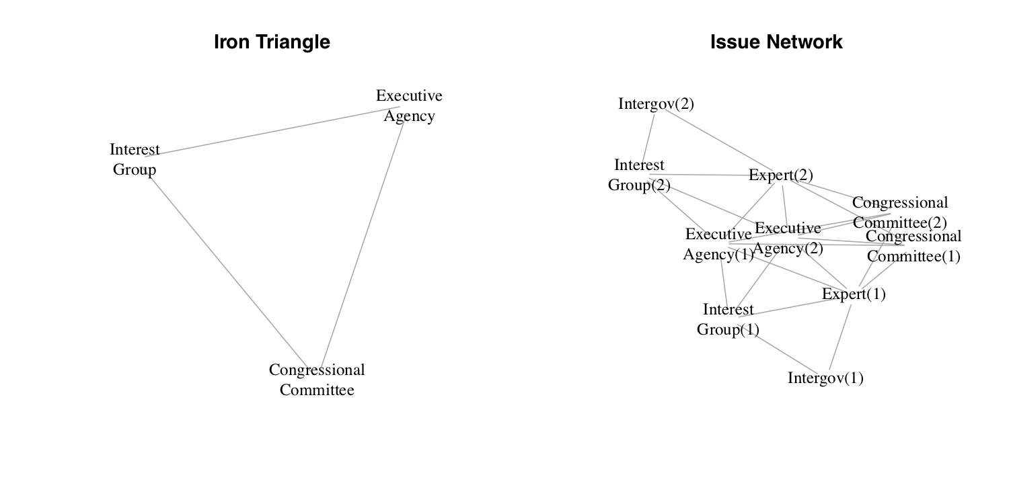
Policy Subsystems
Iron triangles and Issue networks

