Slide 1
Environmental Policymaking: Rulemaking
POLI 307: Environmental Policy

Slide 2
Environmental Policy
Environmental Regulations: Command-and-control
Environmentalism era
Market-based approaches
Reform era
Industrial policy
Policies designed to encourage and support growth in some sectors of the economy, typically manufacturing

Slide 3
Environmental Regulations

Slide 4
Environmental Regulations
Regulation: Specific standards or instructions concerning what individuals, businesses, and other organizations can or cannot do
Command-and-control
Command: set standards
Control: enforcement of standards

Slide 5
Environmental Regulations
A form of environmental policy made by executive branch agencies
Most consequential form of executive branch policymaking
The Take Care Clause
Regulations are made through the rulemaking process

Slide 6
Environmental Regulations
Rulemaking: The agency process of translating congressional legislation into specific, actionable rules * Rules must have statutory authority
Rulemaking authority
Is delegated to the executive branch agencies

Slide 7
Environmental Regulations: Delegation and Oversight
Delegation of Authority: Congress provides policymaking power to the executive branch (i.e., the bureaucracy or federal agencies)
Delegation and Accountability
The People $→$ Elected Officials $→$ Executive Branch Agencies (Bureaucrats)

Slide 8
Environmental Regulations: Delegation and Oversight
Why Delegate?
The bureaucracy has more expertise in these policy areas and more flexibility to make changes if necessary
“Shift the responsibility” of decision-making to the agencies
Blame avoidance

Slide 9
Environmental Regulations: Delegation and Oversight
Elected officials use various oversight and control mechanisms to manage the bureaucracy

Slide 10
Environmental Bureaucracy: Delegation and Oversight
President
Appointment of sympathetic agency heads
Regulatory review prior to final rule enactment
Executive orders
Changes in budget authority
Bureaucratic reorganization plans

Slide 11
Environmental Regulations: Delegation and Oversight
Congress
Authorization of agency
Legislative language restricting discretion
Budgetary control
Police patrol oversight: Active monitoring
Fire alarm oversight: React to complaints from citizens and/or interest groups

Slide 12
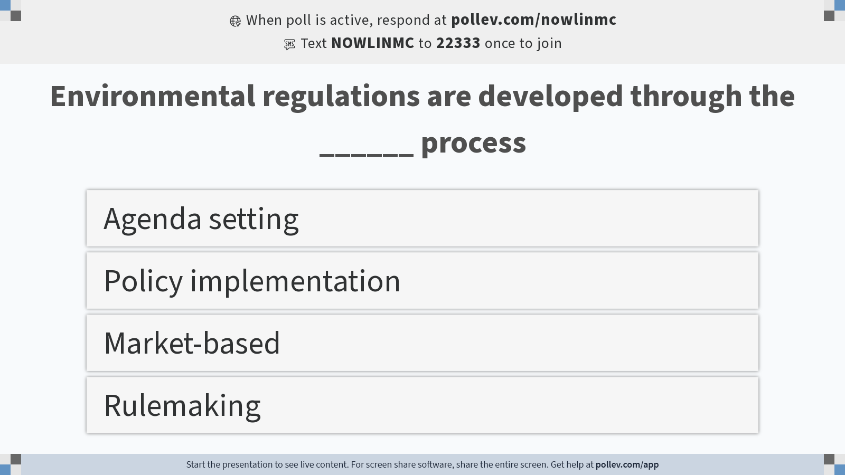
Notes:
Do not modify the notes in this section to avoid tampering with the Poll Everywhere activity. More info at polleverywhere.com/support Environmental regulations are developed through the ______ process
https://www.polleverywhere.com/multiple_choice_polls/9Ge84B7opEqKTxRAVpSFZ?display_state=instructions&activity_state=opened&state=opened&flow=Engagement&onscreen=persist

Slide 13
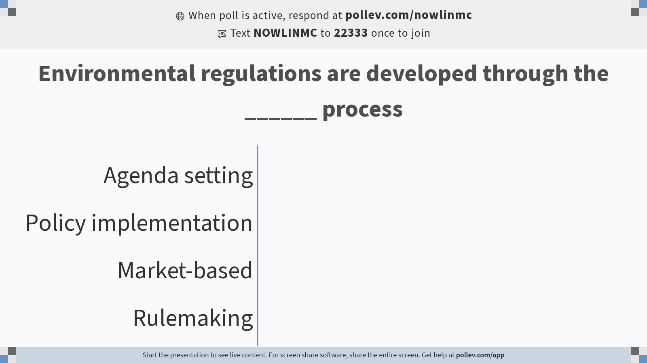
Notes:
Do not modify the notes in this section to avoid tampering with the Poll Everywhere activity. More info at polleverywhere.com/support Environmental regulations are developed through the ______ process
https://www.polleverywhere.com/multiple_choice_polls/9Ge84B7opEqKTxRAVpSFZ?display_state=chart&activity_state=opened&state=opened&flow=Engagement&onscreen=persist

Slide 14
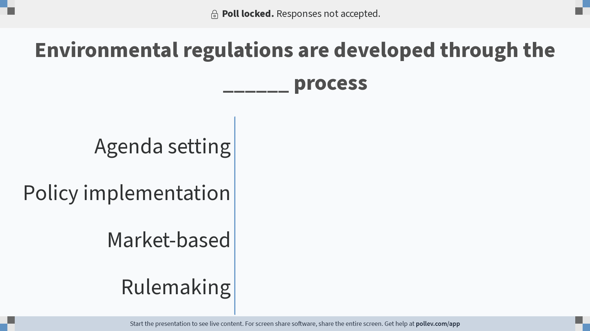
Notes:
Do not modify the notes in this section to avoid tampering with the Poll Everywhere activity. More info at polleverywhere.com/support Environmental regulations are developed through the ______ process
https://www.polleverywhere.com/multiple_choice_polls/9Ge84B7opEqKTxRAVpSFZ?display_state=chart&activity_state=closed&state=closed&flow=Engagement&onscreen=persist

Slide 15
The Rulemaking Process

Slide 16
The Administrative Procedures Act (1945)
The agency can only act within the limits set by statute
The APA established the procedures an agency must follow to promulgate binding rules and regulations
The agency must meet the following tests:
Be reasonable (sufficient factual support in the record)
Not be arbitrary or capricious
Not be an abuse of discretion
Involves various stages and requires opportunities for public involvement
Notes:
arbitrary: based on random choice or personal whim, rather than any reason or system
capricious: given to sudden and unaccountable changes of mood or behavior

Slide 17
Types of Rules
Formal rule: Formal hearings that resemble a courtroom proceeding
Informal rule (Notice and Comment): A quasi-legislative process that requires a public comment period
Negotiated rulemaking: Agency officials organize and participate in negotiations with stakeholders to develop a rule
Hybrid: Combines formal and informal

Slide 18
The Rulemaking Process
Stage 1: Pre-Proposal $→$ Stage 2: Notice and Comment $→$ Stage 3: Rule Finalization

Slide 19
The Rulemaking Process
Stage 1: Pre-Proposal
Gather technical, scientific, and economic information regarding why a rule is necessary, as well as how a rule should be developed
Benefit-cost analysis of significant rules

Slide 20
The Rulemaking Process
Stage 2: Notice and Comment
Publish a Notice of Proposed Rulemaking (NPRM) in the Federal Register
Comment period of 30 to 60 days
Regulations.gov

Slide 21
The Rulemaking Process
Stage 3: Rule Finalization
Final rule is published in the Federal Register
Agencies prepare for litigation

Slide 22
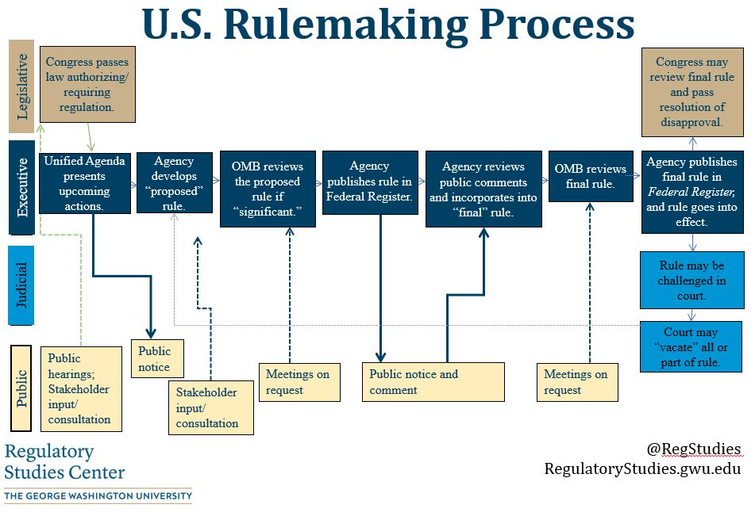

Slide 23
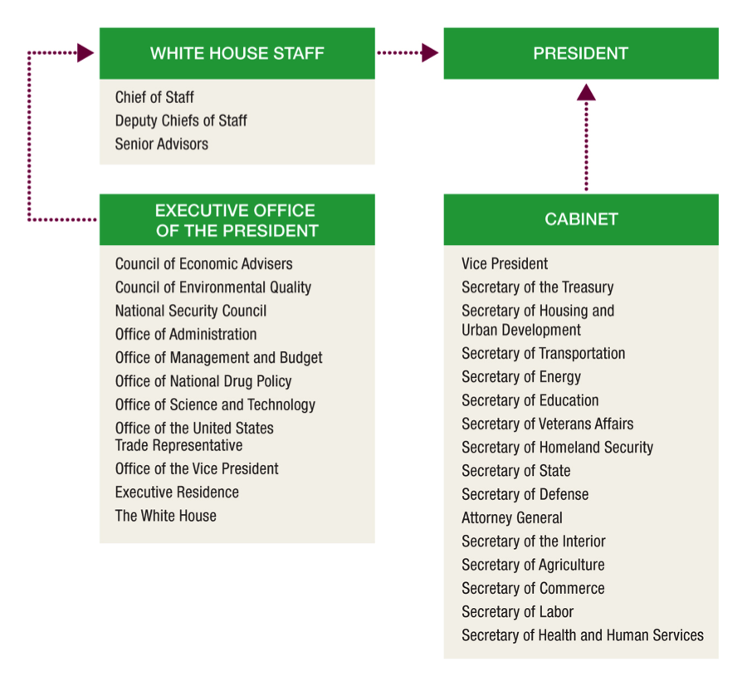
The Rulemaking Process
The Administrative Presidency
Office of Management and Budget (OMB)
Office of Information and Regulatory Affairs (OIRA)
Significant regulations must be reviewed by OIRA before publication

Slide 24
The Rulemaking Process
Significant Regulations
Economically significant
An annual effect on the economy of $100 million or more
Conflict with another agency
Raise novel legal or policy issues

Slide 25
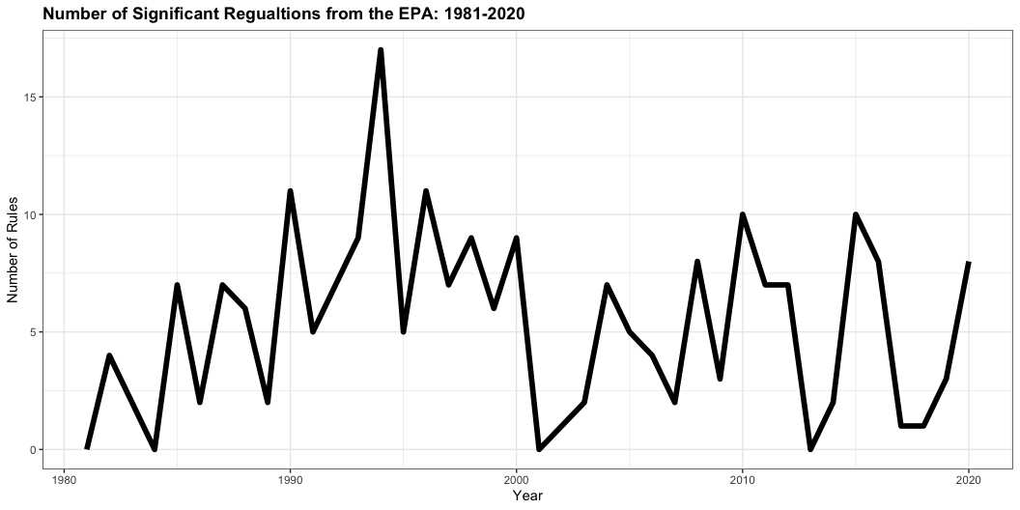
EPA Significant Regulations

