Slide 1
Market-Based Environmental Policy
POLI 307: Environmental Policy

Slide 2
Markets and Market Failures

Slide 3
Markets
A decentralized collection of buyers and sellers whose interactions determine the allocation of a good or a set of goods through exchange
Market rules
Medium of exchange
Way to communicate price
Property rights
Exchange provides gains from trade
When assumptions are met, markets provide the most efficient allocation of resources

Slide 4
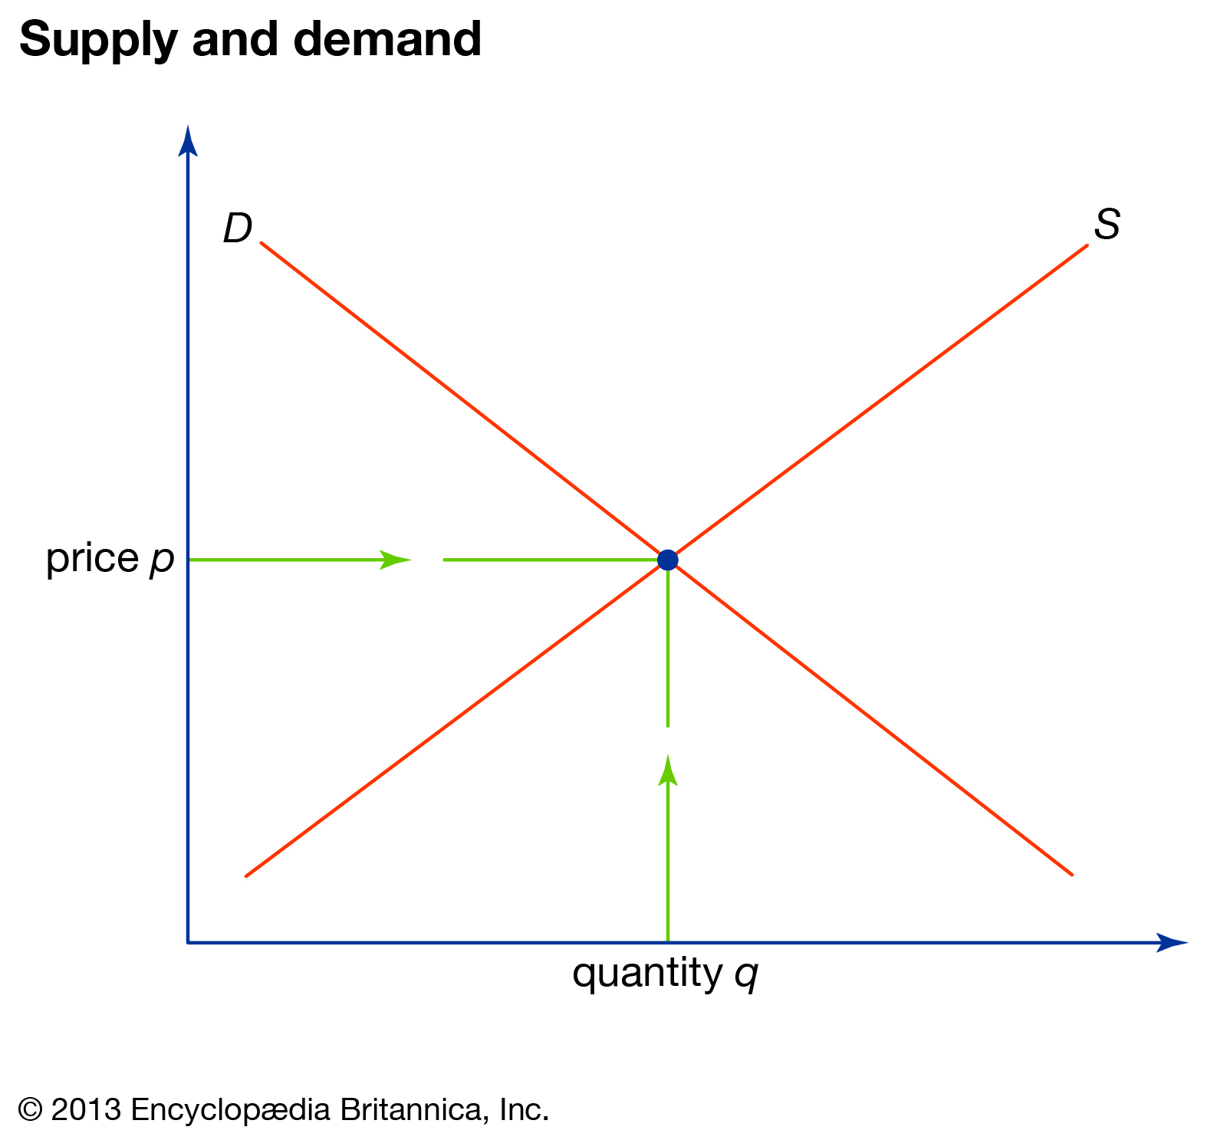
Markets
Assumptions
Perfect competition
Perfect information
Perfectly complete

Slide 5
Market Failures
Perfect competition
Insufficient competition: Monopolies
Perfect information
Asymmetric information: Used car
Perfectly complete
Externalities: Pollution
Common-pool goods
Open pasture
Public goods
Clean air

Slide 6
Market Failures
A market-failure means that markets are not providing the most efficient allocation of resources
Market-based policies are intended to address efficiency concerns

Slide 7
Market-Based Environmental Policy
Incorporate market principles into government policies
Polluters have an incentive to reduce their emissions
Decentralized as compared to command-and-control regulation
Two types
Using markets
Creating markets

Slide 8
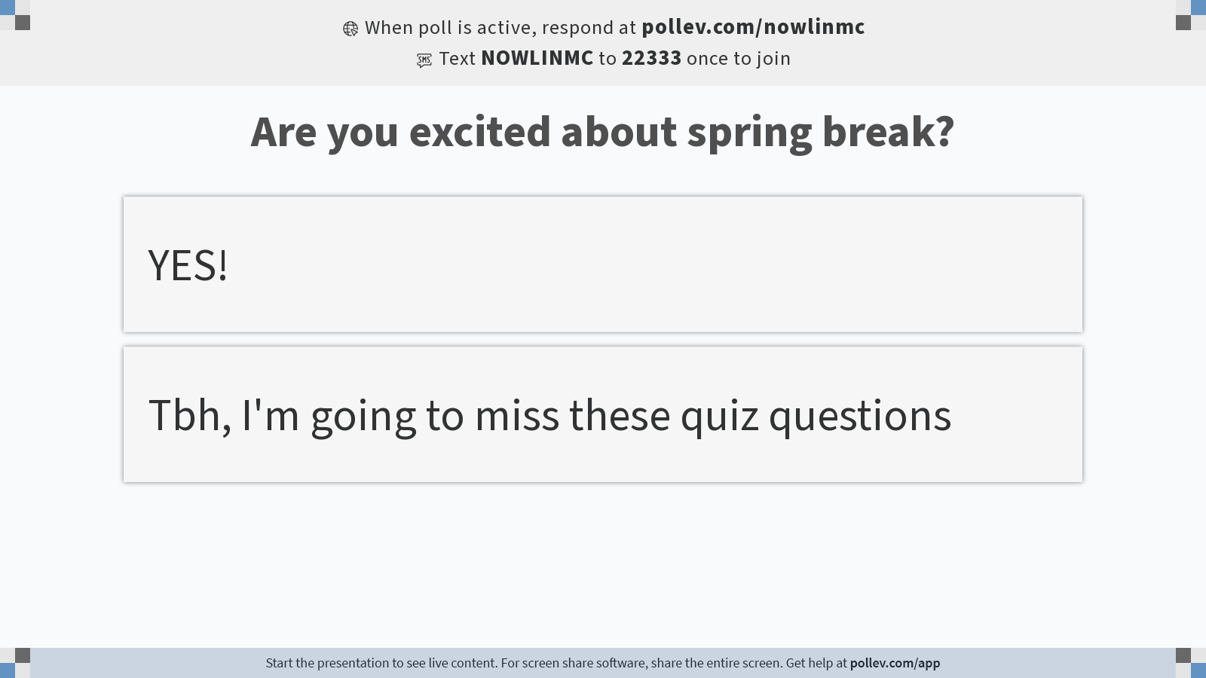
Notes:
Do not modify the notes in this section to avoid tampering with the Poll Everywhere activity. More info at polleverywhere.com/support Are you excited about spring break?
https://www.polleverywhere.com/multiple_choice_polls/Bfbh3gVchqPcstSxc9acW?display_state=instructions&activity_state=opened&state=opened&flow=Engagement&onscreen=persist

Slide 9
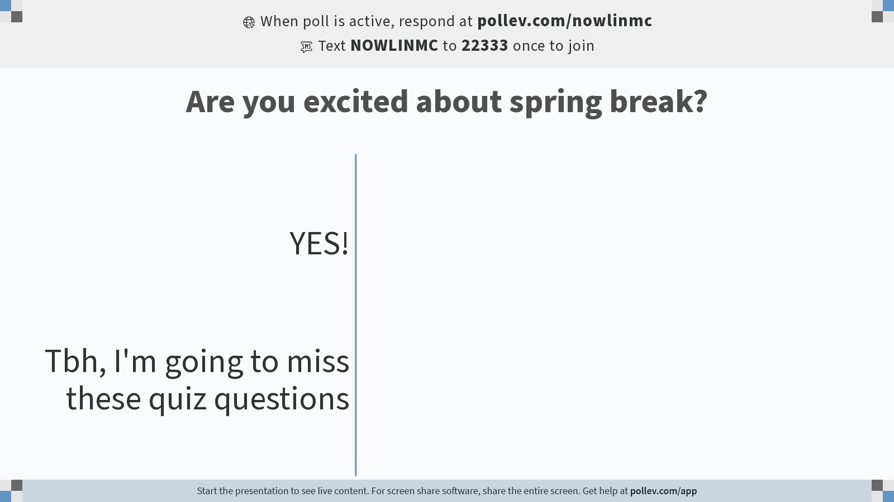
Notes:
Do not modify the notes in this section to avoid tampering with the Poll Everywhere activity. More info at polleverywhere.com/support Are you excited about spring break?
https://www.polleverywhere.com/multiple_choice_polls/Bfbh3gVchqPcstSxc9acW?display_state=chart&activity_state=opened&state=opened&flow=Engagement&onscreen=persist

Slide 10
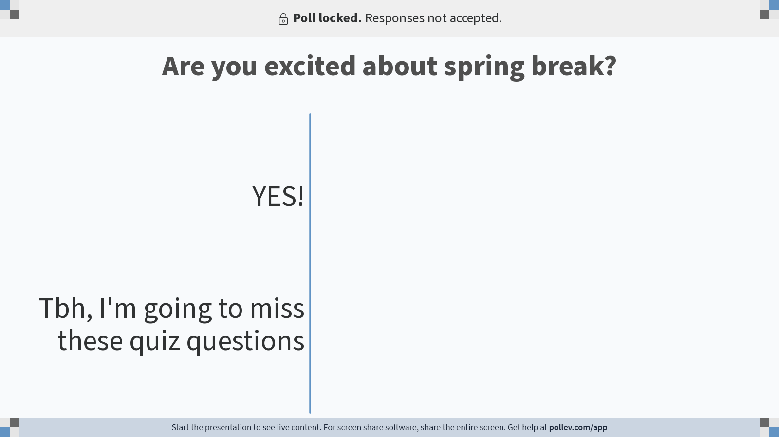
Notes:
Do not modify the notes in this section to avoid tampering with the Poll Everywhere activity. More info at polleverywhere.com/support Are you excited about spring break?
https://www.polleverywhere.com/multiple_choice_polls/Bfbh3gVchqPcstSxc9acW?display_state=chart&activity_state=closed&state=closed&flow=Engagement&onscreen=persist

Slide 11
Coase Theorem

Slide 12
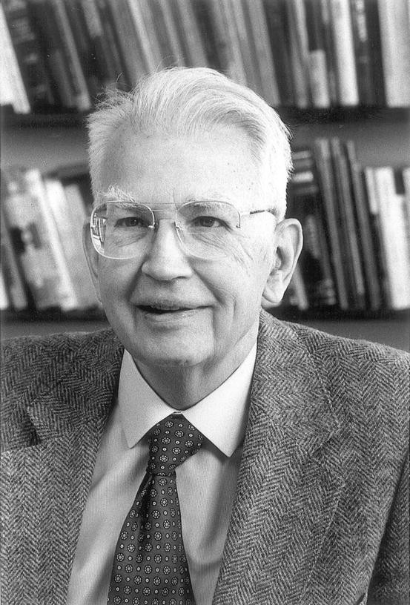
Coase Theorem
Private bargaining will result in the efficient resolution of negative externalities, without the need for government intervention, as long as property rights are fully allocated

Slide 13
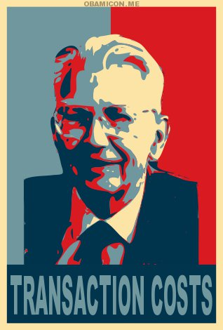
Coase Theorem
Works when transaction costs are low
Transaction costs: The costs associated with a transaction
Monitoring and enforcement

Slide 14
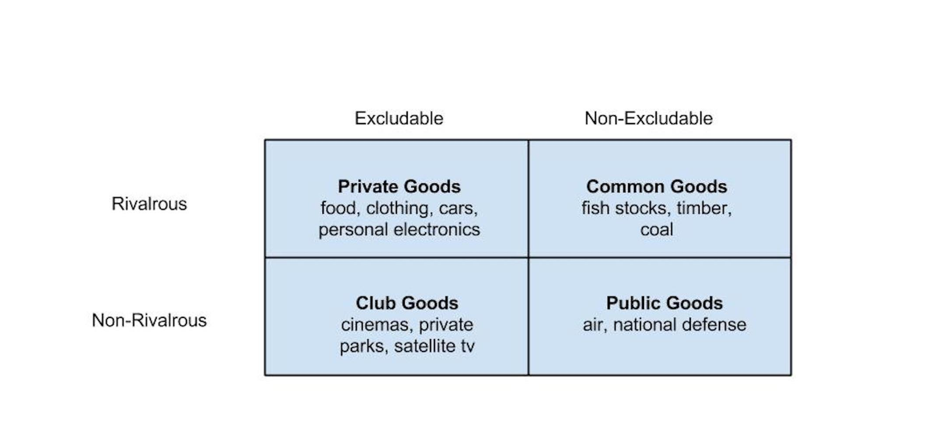
Coase Theorem
Property rights: Rights of individuals to own or control property including the right to use, transfer, or exclude
Non-excludable
Common-pool goods
Public goods

Slide 15
Coase Theorem
What can we take from Coase?
Importance of property rights and transaction costs
Self-organization among users can address common-pool resource problems (see Elinor Ostrom’s work)
Markets don’t fail, rather markets are missing
Government policy should address property rights and lessen transaction costs

Slide 16
Market-Based Environmental Policy

Slide 17
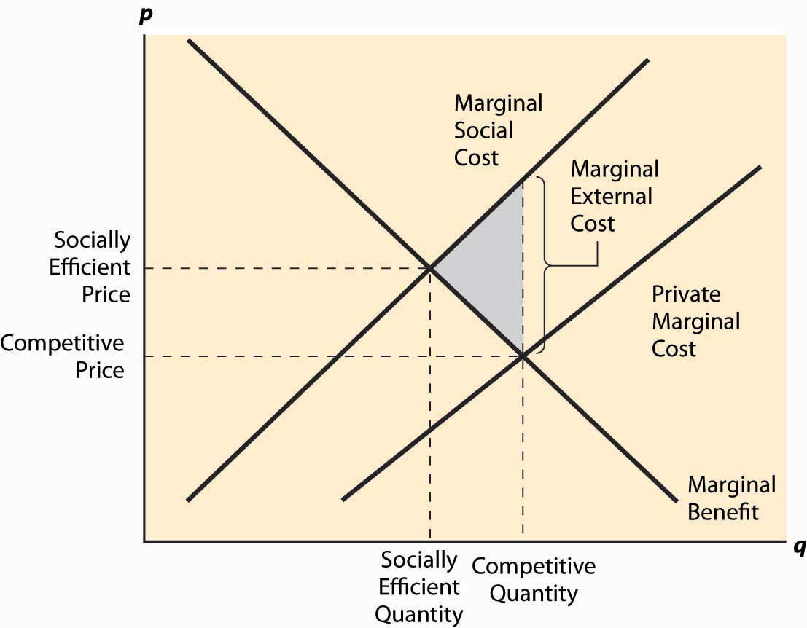

Market-Based Environmental Policy
Using markets: Getting the prices right
Externality
Social cost $>$ Private cost
Socially efficient outcome = Private cost + Tax
Internalize the externality

Slide 18
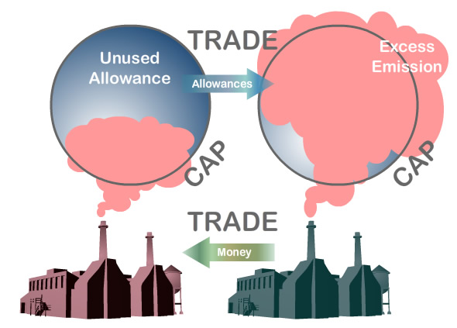
Market-Based Environmental Policy
Creating Markets: Creating property rights
Common-pool good = no property rights
Distribute allowances
Fishing quota
Cap-and-trade systems for pollution
Allowances create de-facto property rights

Slide 19
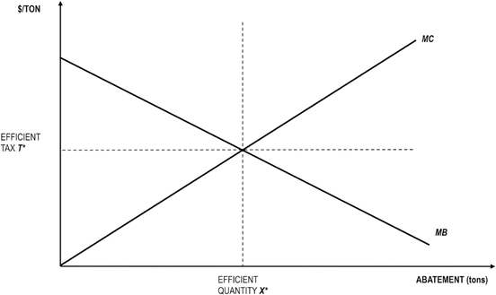
Market-Based Environmental Policy
Using and Creating markets: Filling in the missing demand curve
Marginal benefit of abatement = Demand curve
Public good = no demand
Notes:
the central problem, of course, is that such a demand curve never arises, because pollution control is a classic case of a public good. every individual, comparing the cost of paying for pollution control (borne entirely by herself ) with the benefit (shared by others), finds that it is in her self-interest not to contribute. But when everyone free rides, the market demand for pollution control effectively falls to zero.11 note that the “supply curve” for abatement already exists; it simply corresponds to the marginal cost of controlling pollution.the hitch is that no firm will supply a good whose price is zero.

Slide 20
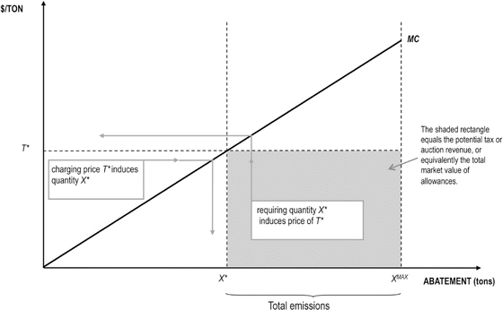
Market-Based Environmental Policy
Using and Creating markets: Filling in the missing demand curve
Policy sets the demand curve
Fixed quantity (X*)
Cap-and-trade
Fixed price (T*)
Tax
$/Ton is the same

Slide 21
Have a great spring break!!!!

