Slide 1
Flood Risk and the Public’s Willingness to Relocate
Matthew C. Nowlin, Ph.D.
Director, MPA Program
Associate Professor of Political Science
College of Charleston

Slide 2
Motivation
What influences public support for a property buyout program?
Climate change is likely to cause migration and retreat from vulnerable areas
  Increased flooding
Expanding property buyout programs are one approach being considered by governments to manage migration

Slide 3
Buyout Program
Federal Emergency Management Agency (FEMA)
  Hazard Mitigation Grant Program (HMGP)
Department of Housing and Urban Development (HUD)
South Carolina Office of Resilience
  Funding from HUD Community Development Block Grant-Mitigation (CDBG-MIT)
  Voluntary
  Residential properties in a floodplain

Slide 4
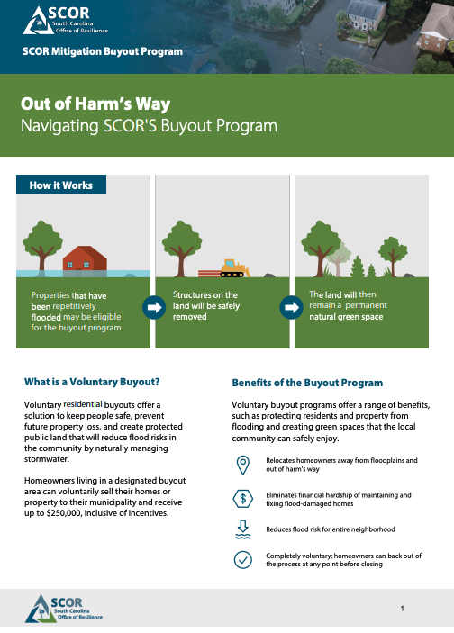
Public Support for Buyout Program
Potential Factors
Flood risk
Community factors
Individual factors

Slide 5
Data and Analysis

Slide 6
Survey
Residents of South Carolina
  Recruited by Cloud Research
  November - December 2023
  n = ~500
Flood days treatment
  Random draw from 7-200 days of disruptive flooding
  Support for buyout program pre-and-post flood days treatment

Slide 7
Measures
Property Buyout
Property buyouts are a policy for reducing risk to people and communities from severe storms, flooding, wildfires, and other extreme events. Buyouts also reduce costs to homeowners, insurance companies, and the government for rebuilding after events. In a buyout program, the government purchases private properties including homes and businesses that are damaged or at risk. Participating property owners must then relocate.

Slide 8
Measures
Property Buyout
On a scale from 1 to 7, with 1 being strongly oppose and 7 being strongly support, please indicate your support for a property buyout program in South Carolina. In this program the federal government would purchase homes and businesses in South Carolina that have been damaged or at risk from natural disasters and the owners would need to move.
Average support = 4.17 on the 1 to 7 scale

Slide 9
Measures
Flood Risk
Concern over flooding in local area, 0 to 10 scale
  Average concern = 5.302
Flood experience, 0 = never experienced a flood, 1 = experienced a flood
  34% of respondents

Slide 10
Measures
Community Factors
Satisfaction with community infrastructure (local government services, drinking water, roads, sewer*), 1 to 5 scale
  Average satisfaction = 2.78
  Cronbach’s $α$ = 0.69
Perceived community resilience and disaster response, 1 to 7 scale
  Average = 4.54
  Cronbach’s $α$ = 0.89

Slide 11
Measures
Community Factors
Live in a coastal county, 0 = no, 1 = yes
  27% of respondents
Bridging social capital, 1 to 5 scale
  Average = 2.47
  Cronbach’s $α$ = 0.87

Slide 12
Measures
Individual Factors
Bonding social capital, 1 to 5 scale
  Average = 2.59
  Cronbach’s $α$ = 0.79
Political ideology, 1 (very liberal) to 7 (very conservative) scale
  Average = 4.2

Slide 13
Measures
Individual Factors
Homeowner, 0 = no, 1 = yes
  60% of respondents
Time at current residence, 1 to 4 scale
  less than 1 year = 1
  1-5 years = 2
  6-10 years = 3
  11+ years = 4
  Average = 2.75

Slide 14
Results

Slide 15
Results: Baseline Buyout Support
Coefficient plots, grouped by factors
  Flood risk
  Community
  Individuals
Results shown control for all variables including demographics (age, gender, race/ethnicity, education, income)

Slide 16
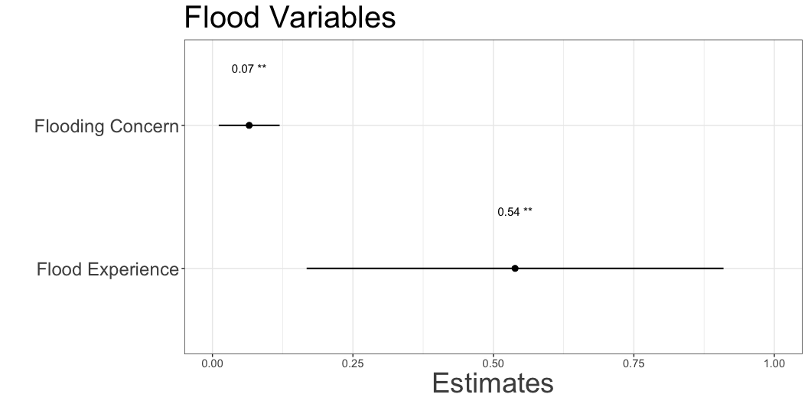
Results: Baseline Buyout Support

Slide 17
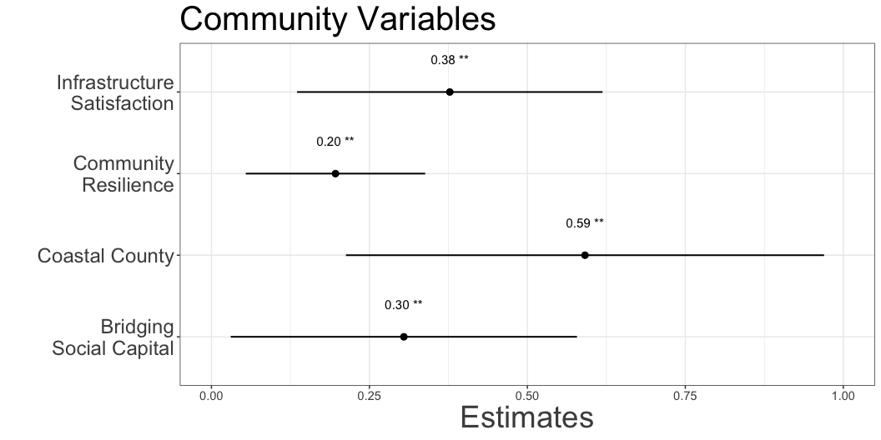
Results: Baseline Buyout Support

Slide 18
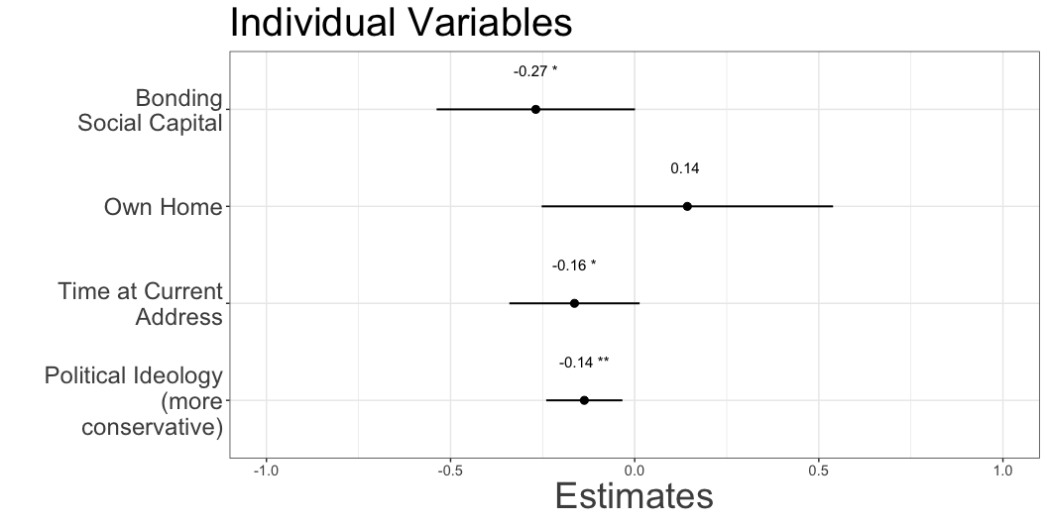
Results: Baseline Buyout Support

Slide 19
Results: Flood Days and Buyout Support
Homeowners and renters
  Homeowner willing to accept buyout, 1 (very unlikely) to 7 (very likely) scale
  Renters support for buyout program
Results shown control for all variables including baseline buyout support and demographics (age, gender, race/ethnicity, education, income)

Slide 20
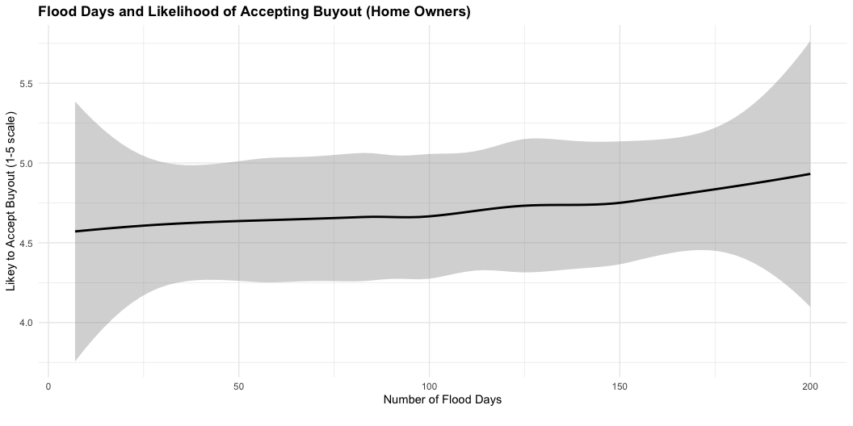
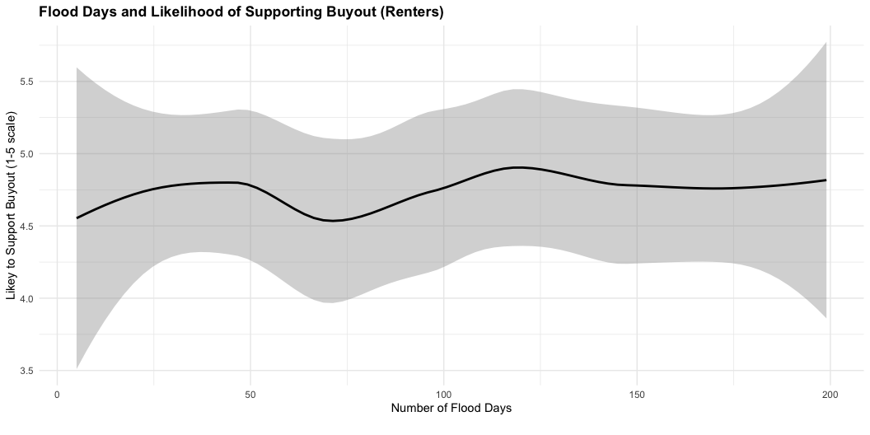
Results: Flood Days and Buyout Support

Slide 21
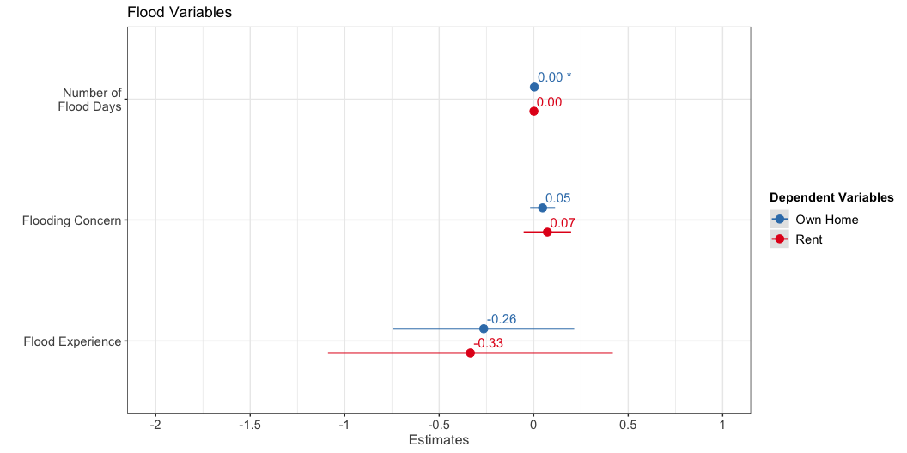
Results: Post-Buyout Support

Slide 22
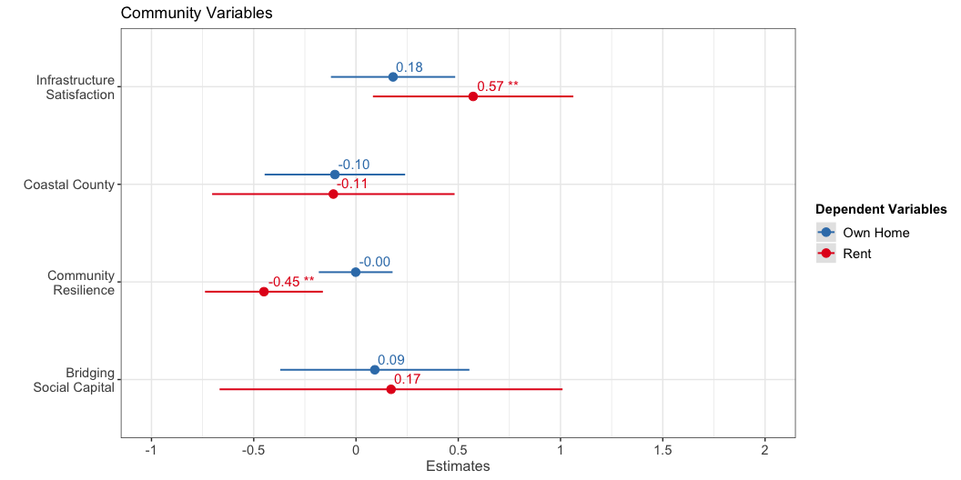
Results: Post-Buyout Support

Slide 23
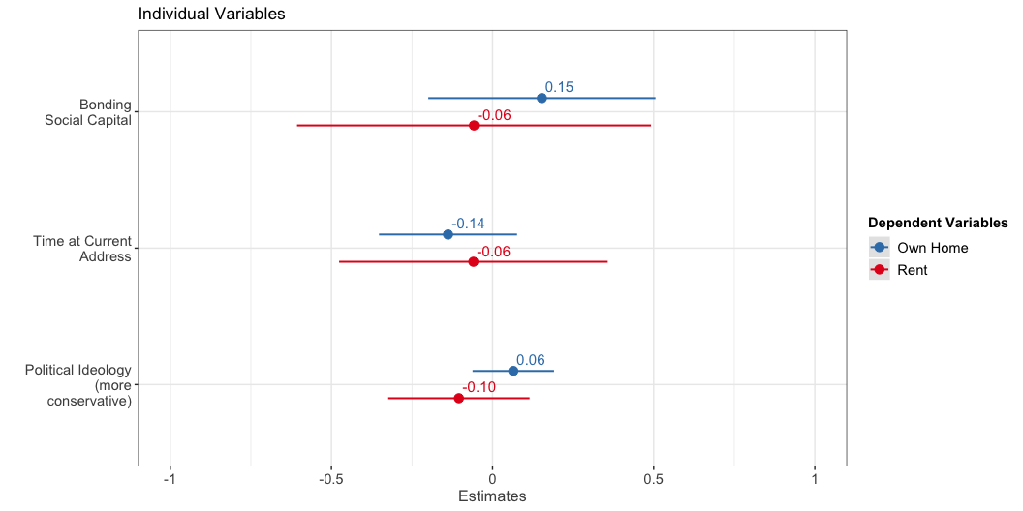
Results: Post-Buyout Support

Slide 24
Discussion
Baseline support
Flood risk (concern and experience)
Community factors
  Increased community satisfaction (infrastructure, resilience, bridging social capital) associated with increased support
  Coastal county residents more supportive than others
Individual factors
  Increased bonding social capital, longer at current address, and more politically conservative associated with decreased support

Slide 25
Discussion
Post-support
Homeowners
  Increased flood days associated with small increase in likelihood of accepting a buyout
Renters
  Infrastructure satisfaction associated with increased support
  Less perceived community resilience associated with increased support

Slide 26
Comments and Questions
Matthew C. Nowlin
Director, MPA Program
Associate Professor,
Dept. of Political Science
College of Charleston
nowlinmc@cofc.edu

