Slide 1
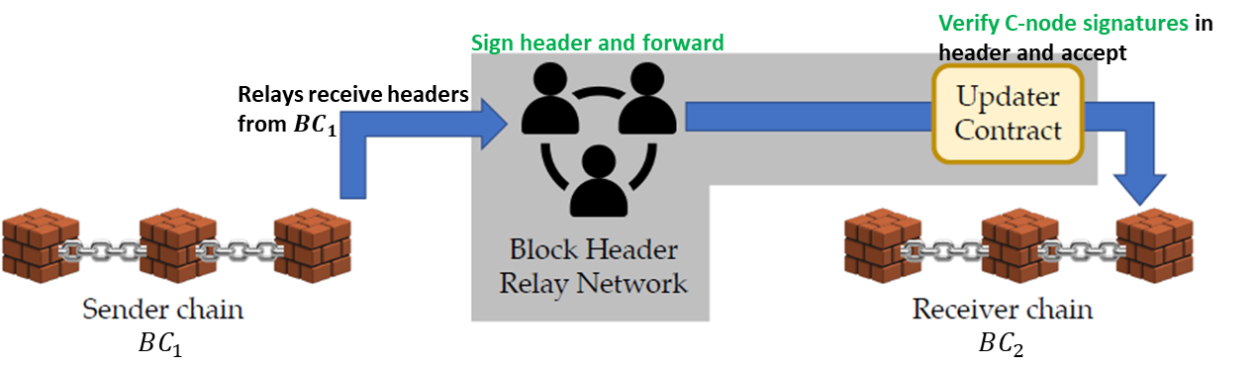
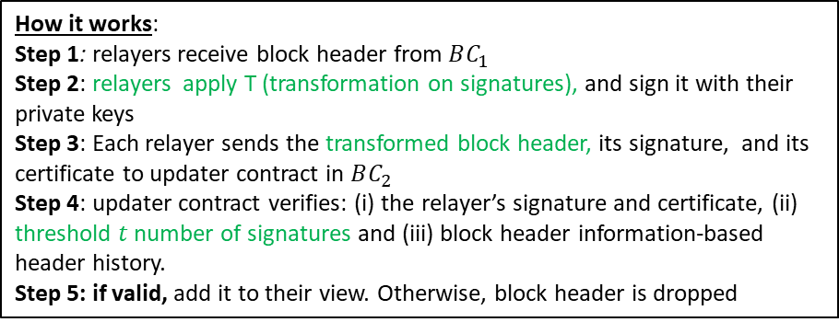
sigBridge: Signature of consensus-based bridge with probabilistic verification
Our approach:
use the signatures of the consensus protocol of sender’s chain for block header verification instead of ZKP
use a probabilistic verification algorithm by receiver’s smart contract
Figure: sigBridge design. The shaded components belongs to core bridge functionality with green.
sigBridge components:
Relay network: a set of nodes that are registered to both blockchains
transfers block headers from sender chain to receiver chain’s contract following sender’s consensus rule.
Updater SC: deployed in the receiver’s chain
stores the consensus rules of the remote chain
probabilistically checks the signatures on the block header based on the remote consensus rule
How it works:
Step 1: relayers receive block header from $BC_{1}$
Step 2: relayers apply T (transformation on signatures), and sign it with their private keys
Step 3: Each relayer sends the transformed block header, its signature, and its certificate to updater contract in $BC_{2}$
Step 4: updater contract verifies: (i) the relayer’s signature and certificate, (ii) threshold $t$ number of signatures and (iii) block header information-based header history.
Step 5: if valid, add it to their view. Otherwise, block header is dropped

Slide 2
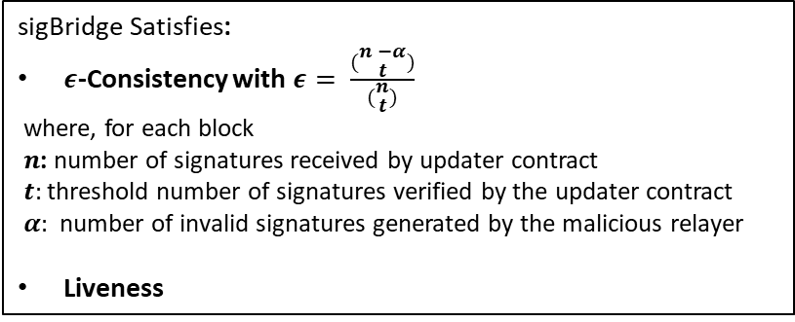
Threat model:
Security Assumptions:
relay nodes that can be fully malicious. They can-
modify, forge, or drop messages
try to participate in message-passing without registration
underlying blockchains are secure, i.e., consistent and live
at least one honest relay node exists in the system
signature schemes used is unforgeable
Security guarantees:
sigBridge Satisfies:
$ε$-Consistency with $ε= \frac{(\begin{aligned}n −α \\ t\end{aligned})}{(\begin{aligned}n \\ t\end{aligned})}$
where, for each block
$n$: number of signatures received by updater contract
$t:$threshold number of signatures verified by the updater contract
$α:$ number of invalid signatures generated by the malicious relayer
Liveness

