Slide 1
WEB DEVELOPMENT INTERNSHIP
StockPilot – Smart Inventory Management System
Presented by: Abdul Rahman M
Register Number: 810023205312
Department of Information Technology
University College of Engineering, BIT Campus
Anna University, Trichy – 620024
Internship Organization: Fantasy Solution, Trichy
Duration: 01 June – 30 June 2026

Slide 2
Company & Internship Overview
Fantasy Solution – Web Development Internship
Organization: Fantasy Solution, Trichy
Address: No. 16, Samnath Plazza, Third Floor, Melapudur, Trichy – 620001
Duration: One month (30 days)
Internship domain: Web Development
Focus: Web page structure, styling, responsiveness, interactivity, UI/UX, and supporting web technologies
PROJECT
StockPilot – Smart Inventory Management System
Course: CS3711 – Summer Internship
StockPilot – Internship Presentation
2

Slide 3
Internship Objectives & Training
Understand the web development lifecycle
Learn HTML, CSS, and JavaScript fundamentals
Develop responsive, mobile-friendly interfaces
Understand UI/UX design and accessibility
Study CSS frameworks such as Bootstrap and Foundation
Learn website performance, security, SEO, and analytics
Gain introductory knowledge of CMS, JDBC, and SQL
HTML
CSS
JavaScript
Bootstrap
SQL
StockPilot – Internship Presentation
3

Slide 4
Problem Statement & Project Objectives
Problem Statement
Project Objectives
Manual stock and sales records are slow and error-prone
Low or empty stock is noticed too late
Product, supplier, and sales data are scattered across places
No simple way to estimate next week's demand for reordering
Keep product and supplier records in one web application
Track stock additions, reductions, and sales with before/after quantities
Record sales and update stock automatically
Show low-stock alerts on a dashboard
Generate daily, monthly, and product-wise reports with CSV export
Provide AI demand predictions with risk levels for reorder decisions
StockPilot – Internship Presentation
4

Slide 5
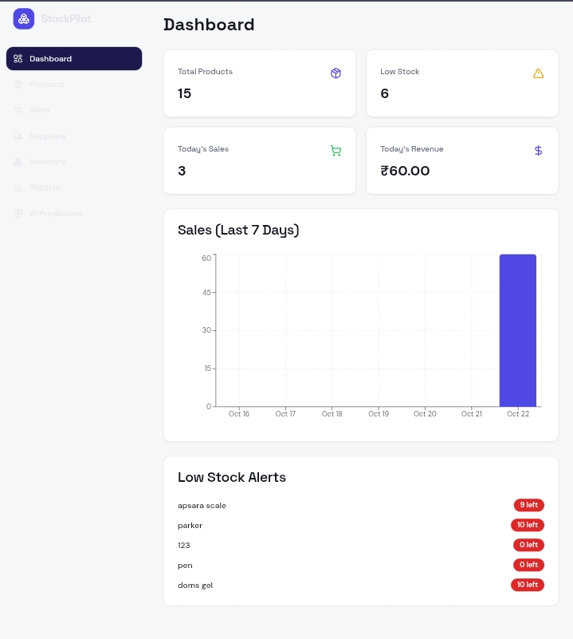
Project Overview & Dashboard
StockPilot brings product records, sales, suppliers, stock changes, reports, and demand prediction features into one interface.
15
6
Total Products
Low Stock
3
₹60.00
Today's Sales
Today's Revenue
Also shown: seven-day sales chart and low-stock alerts
StockPilot – Internship Presentation
5

Slide 6
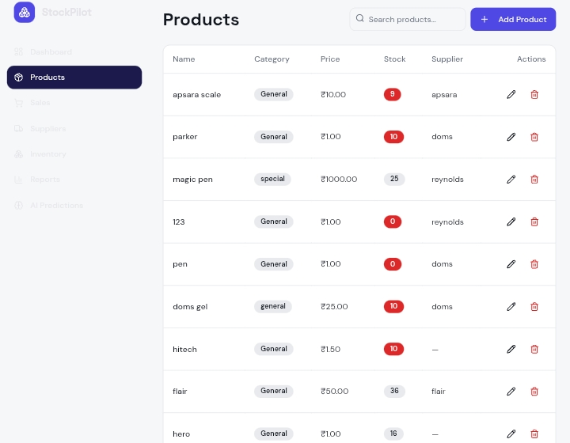
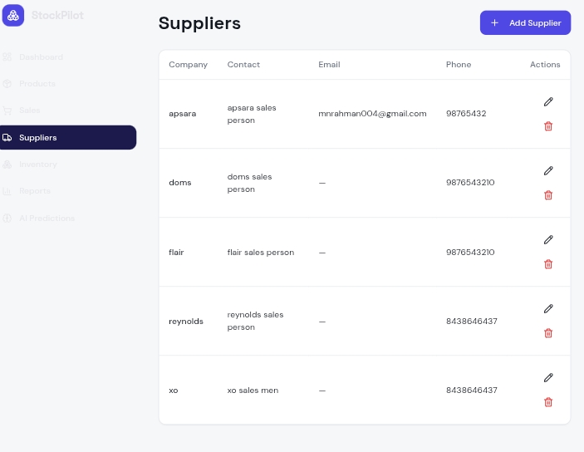
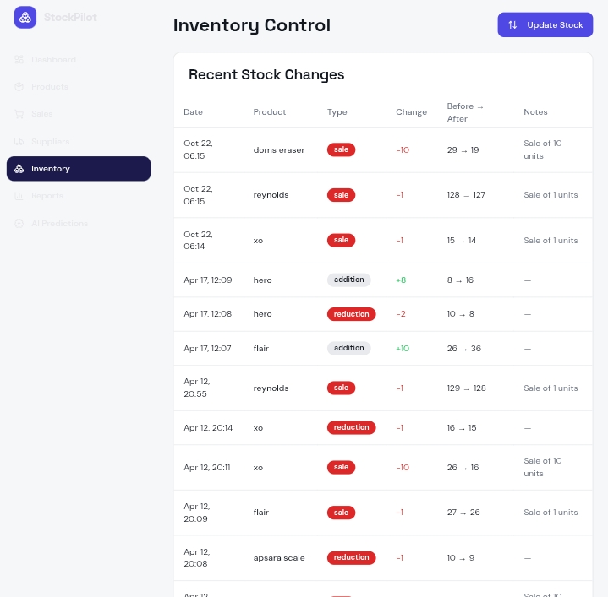
Product, Supplier & Inventory Management
Product Management
Add, search, edit, and delete products
View category, price, stock quantity, and supplier
Supplier Management
Maintain supplier company and contact details
Products
Suppliers
Inventory Control
Track stock additions, reductions, and sales
View previous and updated quantities
Inventory Control
StockPilot – Internship Presentation
6

Slide 7
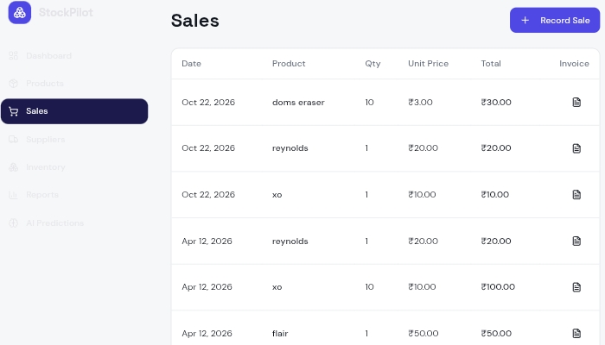
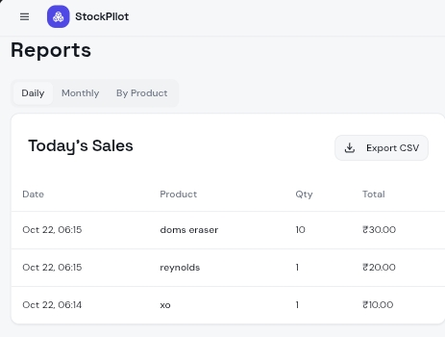
Sales, Reports & Data Export
Sales Management
Record product sales and quantities
Display unit price and total sales amount
Track inventory changes linked to sales
Reports
Sales
Daily reports
Monthly reports
Product-wise reports
CSV export for spreadsheet analysis
Reports (Daily)
StockPilot – Internship Presentation
7

Slide 8
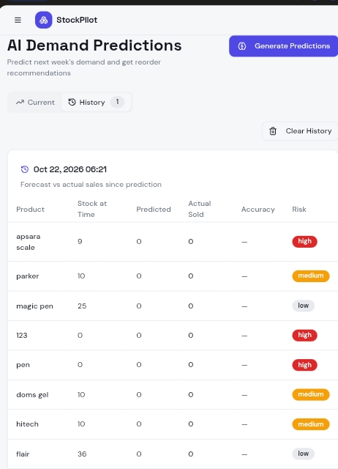
AI Demand Predictions
The application includes an AI Demand Predictions interface intended to:
Predict demand for the following week
Display current stock and predicted quantities
Show risk levels to support reorder decisions
Maintain prediction history
Compare predicted demand with actual sales
AI Demand Predictions – History view
StockPilot – Internship Presentation
8

Slide 9
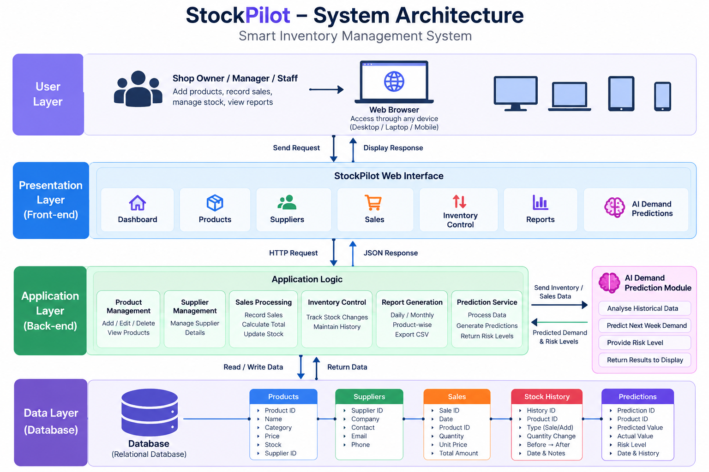
System Design & Architecture
Conceptual architecture of StockPilot
StockPilot – Internship Presentation
9

Slide 10
Development Workflow & Learning Outcomes
Plan
Design
Develop
Test
Review
Key Learning Outcomes
Future Improvements
HTML, CSS, and JavaScript fundamentals
Responsive design and UI/UX principles
Frameworks and reusable interface components
Accessibility, performance, and security awareness
Introductory CMS, SEO, analytics, JDBC, and SQL
How inventory workflows are organized in a web app
Validate demand predictions using more historical data
Improve access control and data backup
Strengthen input validation and testing
StockPilot – Internship Presentation
10

Slide 11
Conclusion
The one-month internship at Fantasy Solution provided practical exposure to web development concepts and professional development workflows. StockPilot shows how product management, supplier records, sales tracking, inventory control, reporting, and demand prediction can be presented through a unified web interface.
Thank You
Abdul Rahman M
Department of Information Technology
University College of Engineering, BIT Campus, Anna University, Trichy
Project: https://ai-ims-nine.vercel.app/
11

