Slide 1

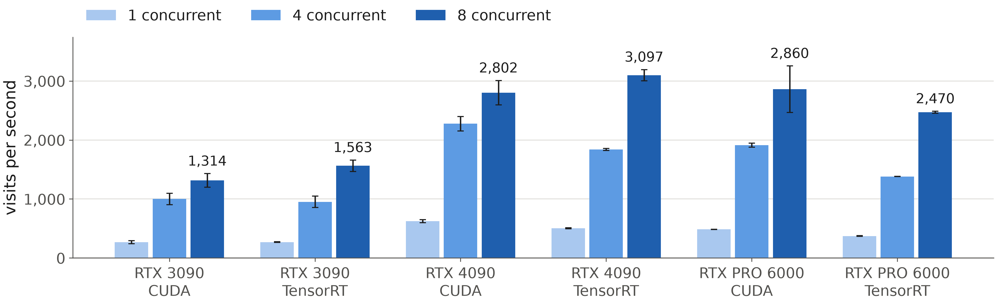
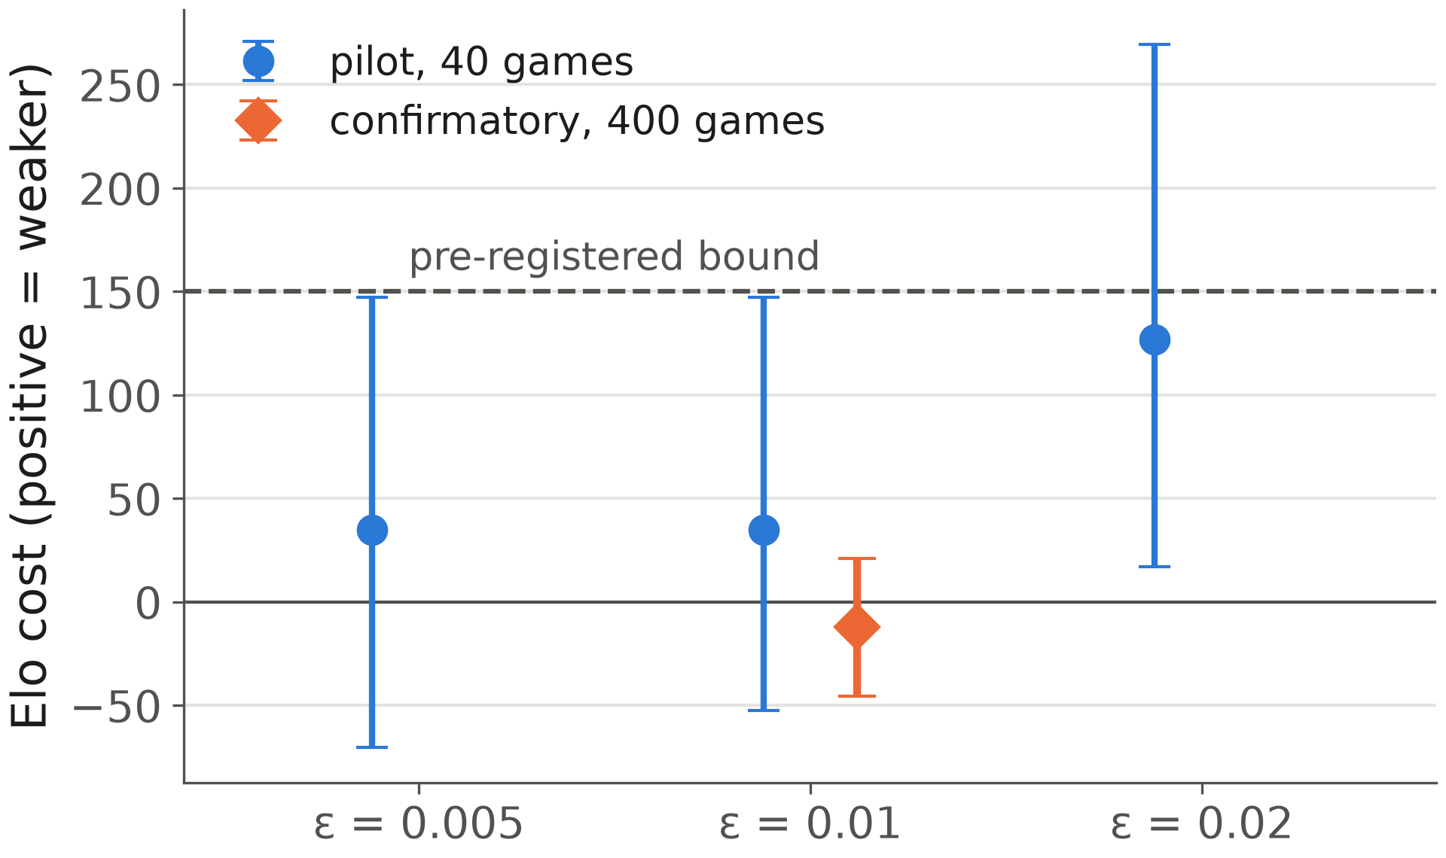
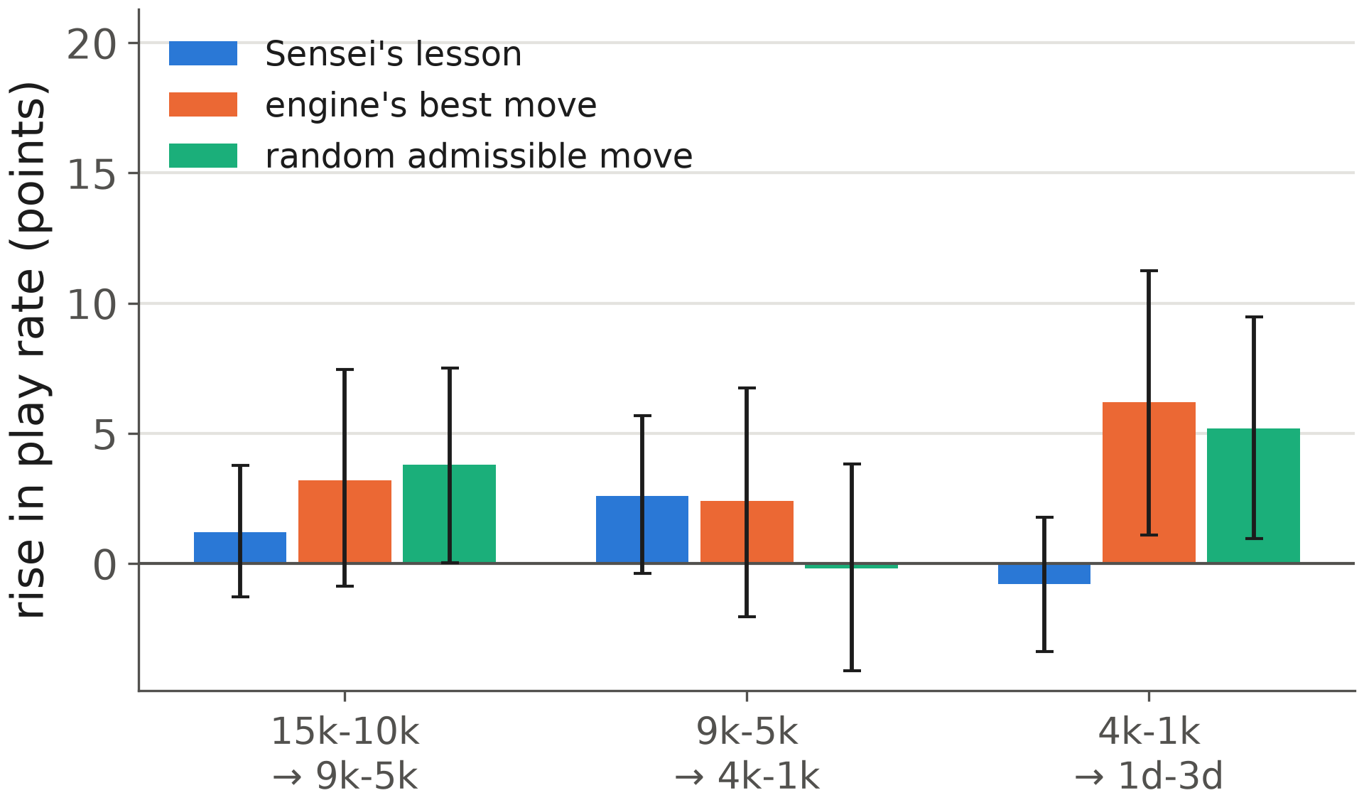
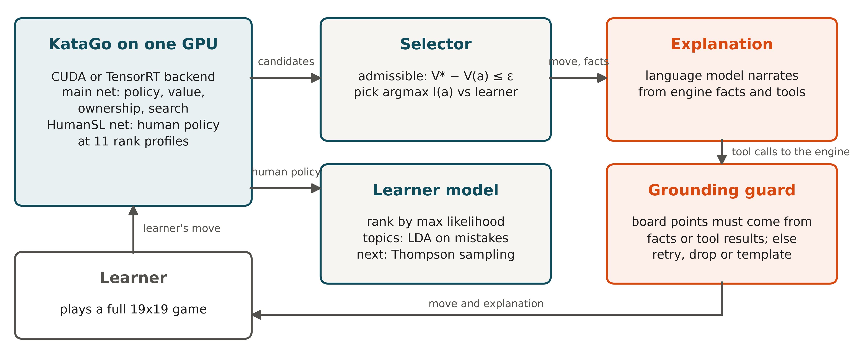
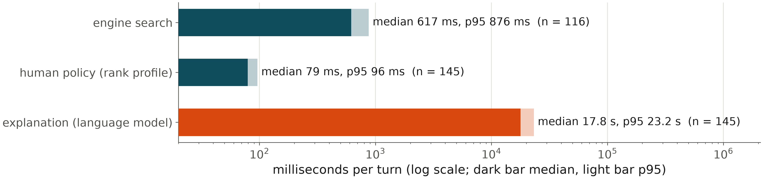
Teaching Moves Under a Strength Bound: A GPU-Accelerated Go Coaching Agent and Its Pre-Registered Evaluation
Siu Hin Ng (Institute of Information Science, Academia Sinica, Taiwan) Code and results: https://github.com/mnsh0409/sensei-go-coach
1
Problem Statement and Goal
3
Application of NVIDIA Technology
4
Benchmarking Methods
Strong Go engines return the best move. A learner needs the most instructive move, one they would not have found, from a coach that still plays well.
Goal: select moves for teaching value under an explicit winrate-loss bound ε, explain them from engine evidence only, and measure the strength cost and the lesson relevance with a pre-registered protocol.
Compute: one evaluation needs about 96,646 searches of 200 visits (400 games); every learner move needs 11 rank-profile queries for rank estimation; the engine part of a coaching turn should stay under a second.
KataGo analysis engine on NVIDIA GPUs with the CUDA and TensorRT backends (b18c384nbt networks); one engine process serves 8 concurrent games through asynchronous JSON queries; going from 1 to 8 concurrent queries raised engine throughput 4.9× on the same GPU.
Rank estimation scores each learner move under 11 HumanSL rank profiles, one cached human-policy query each (69 ms per query on the NVIDIA GeForce RTX 3090).
The 400 pre-registered games at 200 visits per move finished in 1.2 h on one NVIDIA GeForce RTX 3090 with 8 games in flight: 328 games per hour.
Pre-registered before any run (configs/prereg.yaml); every result file records the commit, net SHA-256, analysis config, GPU, driver, CUDA, backend and concurrency.
C1, strength cost: Sensei against the raw engine at equal visits, 200 openings × 2 colors, paired bootstrap over openings; ε fixed by a pilot rule (largest pilot ε scoring ≥ 0.35).
C2, lesson relevance: 591 public games from after the HumanSL release, four rank bands; uplift U_{k} = P_{k+1}(played s_{k}) − P_{k}(played s_{k}); game-clustered bootstrap; best move and random admissible move as descriptive baselines.
C3, curriculum in simulation: 50 simulated learners over 20 sessions; Thompson sampling against round robin, greedy, uniform and an oracle.
2
Approach
Engine: KataGo main network (policy π_{E}, winrate V, ownership) and the HumanSL network (rank-conditioned human policy π_{L}).
Selector: among reliable candidates with V* − V(a) ≤ ε, choose the argmax of I(a) = π_{E}(a) · log[(π_{E}(a) + δ) / (π_{L}(a) + δ)], the pointwise contribution of a to KL(π_{E} ‖ π_{L}).
Explanation: a language model narrates from tool results only (candidates, evaluations, variations); a guard rejects any coordinate absent from tool output.
Learner model: rank by maximum likelihood over HumanSL profiles; weakness topics by LDA over move-situation tokens; discounted Thompson sampling chooses the next target topic.
GPU | Backend | Driver / CUDA | Visits / s, 8 concurrent (95% CI) | analyze p50, 1 query (ms)
RTX 3090 | CUDA | 610.88 / 13.3 | 1,314 ± 116 | 691
RTX 3090 | TensorRT | 610.88 / 13.3 | 1,563 ± 96 | 711
RTX 4090 | CUDA | 535.309.01 / 12.2 | 2,802 ± 206 | 304
RTX 4090 | TensorRT | 535.309.01 / 12.2 | 3,097 ± 96 | 400
RTX PRO 6000 | CUDA | 590.44.01 / 13.1 | 2,860 ± 395 | 418
RTX PRO 6000 | TensorRT | 590.44.01 / 13.1 | 2,470 ± 16 | 547
5
Results and Outcomes
-12
1.00
83%
Elo strength cost at ε = 0.01
95% CI -45 to 21
uplift U, percentage points
95% CI 0.03 to 1.95
of the oracle gap closed (simulation)
95% CI 80% to 85%
Table 1. scripts/bench_engine.py, mean and 95% CI over 5 runs: 50 fixed positions, 200 visits, the same nets and analysis config everywhere. KataGo 1.18.0 builds: cuda12.8-cudnn9.8, trt10.9-cuda12.8.
Figure 4 (left). Strength cost by ε in the pilot and at ε* in the confirmatory run, with 95% CIs. Figure 5 (right). Rise in play rate from one band to the next, with 95% CIs, for Sensei's lesson and two baselines.
Figure 2. Visits per second at 1, 4 and 8 concurrent queries, by GPU and backend.
Teaching cost no measurable strength (-12 Elo; pre-registered limit 150).
Lessons rise across bands at a rate not distinguishable from a random admissible move: relevance beyond move quality is not shown.
All 400 games ran on one GPU in 1.2 h; TensorRT reached 0.9× to 1.2× the CUDA throughput.
Figure 1. One KataGo process serves the selector, the rank estimator and the explanation tools; the language model never chooses moves.
References. D. J. Wu, Accelerating self-play learning in Go, 2019; KataGo Human SL network, katagotraining.org, 2024. R. McIlroy-Young et al., Aligning superhuman AI with human behavior: chess as a model system (Maia), KDD 2020. MATILDA: engine-agnostic search with human policy guidance, arXiv 2606.25176, 2026. Policies of multiple skill levels for better strength estimation in games, arXiv 2505.00279, 2025. D. Blei, A. Ng, M. Jordan, Latent Dirichlet allocation, JMLR 2003. D. Russo et al., A tutorial on Thompson sampling, 2018.
Figure 3. Median and p95 per component of a live coaching turn over the two recorded games; the explanation is a remote language-model call.
Notes:
Poster skeleton. Every {{token}} is replaced by poster/render_poster.py from results/*.json and logs/turns.jsonl; figure slots are replaced by the PNGs that eval/poster_figures.py writes to poster/figures/ at 300 dpi. Export: File > Export > PDF, 300 dpi, no compression. No NVIDIA logos or branding on the poster.

