Slide 1
Quantum utility and error mitigation
2D Ising model as an example
Hisham Mansour

Slide 2
Project description
In this project the following paper served as guidance:
Evidence for the utility of quantum computing before fault tolerance. Nature, 615(7950), 596-600
This paper discusses the experimental evidence for the utility of quantum computing before achieving fault tolerance.
The authors conducted experiments on a 127-qubit superconducting quantum processor, demonstrating that it can accurately measure expectation values for quantum circuits at a scale beyond what is feasible with brute-force classical computation.
This suggests that quantum computing can offer advantages even in the current, noisy era, prior to the development of fully fault-tolerant quantum computers.

Slide 3
Project description cont.
The study focuses on running quantum circuits related to the time evolution of a 2D transverse-field Ising model. These circuits involve significant entanglement, making them challenging for classical methods to simulate accurately.
The authors argue that this work provides a foundational tool for the realization of near-term quantum applications, showing that current quantum processors can be reliable enough to perform meaningful computations at scales unattainable by classical methods.
Reference: Kim, Y., Eddins, A., Anand, S., Wei, K. X., van den Berg, E., Rosenblatt, S., Nayfeh, H., Wu, Y., Zaletel, M., Temme, K., & Kandala, A. (2023). Evidence for the utility of quantum computing before fault tolerance. Nature, 615(7950), 596-600. https://doi.org/10.1038/s41586-023-06096-3

Slide 4
Quantum algorithm
The algorithm chosen is a hybrid quantum-classical algorithm.
The parametric quantum circuit consists of gates that encode the problem to be solved.
These gates have parameters that need to be optimized.
The optimization of these parameters is done with a classical optimizer.
In this Project classiq’s QAOA was used (Quantum Approximate Optimization Algorithm).

Slide 5
Using the algorithm on the 2D Ising model
The QAOA lends itself to solving combinatorial optimization problems.
The Ising model is such a combinatorial optimization problem. Since it can be exactly solved for one and two dimensions, it is suitable for validating the utility of any quantum algorithm applied to them.
The base 2D-Ising model is derived from the 1D version displayed in the classiq-library on github (authored by Amir Naveh):
https://github.com/Classiq/classiq-library/library/blob/main/applications/physical_systems/ising_model/ising_model.ipynb

Slide 6
2D Ising model
The Ising model is a pivotal concept in physics, originally developed to describe interactions between atomic spins in a lattice.
The Ising model is defined by a Hamiltonian that captures the energy of a system based on the interactions between neighboring spins.
Its formulation as a Quadratic Unconstrained Binary Optimization (QUBO) problem allows it to be mapped onto various NP-hard challenges, such as the traveling salesman problem or protein folding.
Using the Classiq platform, we demonstrate how the Ising model can be transformed into an optimization problem suitable for quantum computation.

Slide 7
2D Ising model (2)
We build a 2D Ising model, which is a widely-used model for understanding the interactions of spins on a lattice. Each spin in this model can be either +1 or -1, representing two possible states.
The Ising model describes how these spins interact with each other and with an external magnetic field. Specifically, you will define two key parameters:
Interaction Coupling (J): This parameter controls how strongly neighboring spins influence each other. If ( J ) is positive, the spins tend to align in the same direction (ferromagnetic interaction). If ( J ) is negative, the spins prefer to align in opposite directions (antiferromagnetic interaction).
Magnetic Field (h): This parameter represents an external magnetic field that affects each spin individually, encouraging them to align with the field.

Slide 8
Implementation
The QUAO from classiq builds our quantum circuit and uses an optimizer to find the optimal circuit parameters. This optimized circuit should help us find the minimal energy configuration of our 2D Ising model.
Calculating the exact ground state energy for a 2D Ising model using brute-force enumeration involves iterating over all possible spin configurations for a 2D grid. Given the exponential growth in the number of configurations, this approach is feasible only for small grids.

Slide 9
Trotterization
Trotterization is a method in quantum computing used to approximate the evolution of complex quantum systems. It simplifies the process by breaking down the system's evolution into smaller, manageable steps.
lthough it introduces some errors, these can be reduced by increasing the number of steps, making the simulation more accurate.
A trotterized version of the 2D Ising model was implemented in this project.

Slide 10
Zero Noise Extrapolation (ZNE)
ZNE is a technique to mitigate errors by extrapolating results from noisy quantum computations to an ideal, noiseless scenario:
Procedure:
Run Experiments at Various Noise Levels: Increase the noise level intentionally in your quantum system and run the quantum algorithm.
Collect Data: Measure the results for different noise levels.
Extrapolate to Zero Noise: Use statistical methods to fit the data and extrapolate to estimate the result in a noiseless scenario.
Concept:
ZNE assumes that the relationship between the noise level and the error in the results is known or can be modeled. By systematically increasing the noise and observing how the results change, you can estimate the results that would be obtained with zero noise.

Slide 11
ZNE(2)
Noise Handling:
Adding noise directly to the cost function is a simple approximation. In real implementations, you may need more sophisticated methods to account for errors and noise.
Linear Fit:
The ZNE extrapolation uses a linear fit of noise scales to estimate the noiseless energy.
We'll use the suzuki_trotter function from Classiq to add Hamiltonian evolution.
To integrate the 2D Ising model with Suzuki-Trotter decomposition, add random noise, and then apply Zero Noise Extrapolation (ZNE) to mitigate the noise and show improvement, we follow these steps:

Slide 12
Implement Zero Noise Extrapolation
Zero-noise extrapolation is a technique used to mitigate noise by running the quantum circuit at different noise levels and extrapolating the results to zero noise.
To simulate noise, we added random perturbations to the coefficients of the Pauli terms
Running Optimization using QAOA for both noisy and noise-free cases. Then perform zero-noise extrapolation. mitigate this added noise.

Slide 13
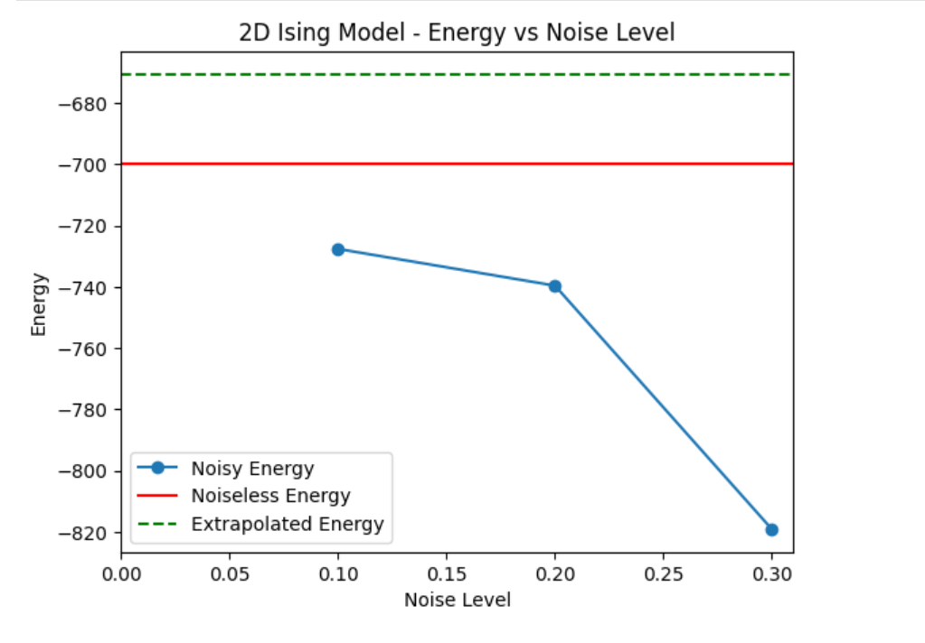
ZNE: Result

Slide 14
Conclusion and Outlook
With proper error mitigation techniques quantum algorithms can arrive at meaningful results despite the current shortcomings of quantum hardware.
Trotterization is also a useful tool to solve otherwise intractable problems.
This project could be extended to using real IBM hardware with its inherent noise profiles to further examine the algorithm used in this Project.

