Slide 1


Slide 2
Software required for Web Designing and Development
Server :
XAMPP : Abbreviation ( X-os, Apache, Mysql, Php )
WAMPP : Abbreviation (Windows, Apache, Mysql, Php)
LAMPP :Abbreviation (Linux, Apache, Mysql, Php)

Slide 3
Difference Between XAMPP,WAMPP,LAMPP
XAMPP | WAMPP | LAMPP
This is a cross platform software which works on windows, linux & mac | Similar to XAMPP but Works only on windows operating System | Works only on Linux Operating system
How to Save File : xampp->htdocs->create new folder -> save file | How to save file : wampp ->www->create new folder ->save file | How to save file : var ->www->create new folder ->save file

Slide 4
How to Install Xampp
Click XAMPP for Windows. It's a grey button near the bottom of the page. .
Double-click the downloaded file. This file should be named something like xampp-win32-7.2.
Click Yes when prompted.
Click Next.
Select aspects of XAMPP to install.
Click Next.
Select an installation location.
Click OK.

Slide 5
How to Install Wampp
Step 1: Download WAMP.
Step 2: Configuration. Just press next. ...
Step 3: Configuration. Selcet "I accept" and Press next. ...
Step 4: Configuration. Select where you want to save it. ...
Step 5: Configuration. Select drive where to install
Step 6: Configuration. Select next
Step 7: Configuration. Click on install
Step 8: Configuration. Select Next
Step 9 : Finished

Slide 6
How to Install Lampp
Search on Google “ how to install lamp”
It will give you the step wise commands
Do the process sequentially in command prompt

Slide 7
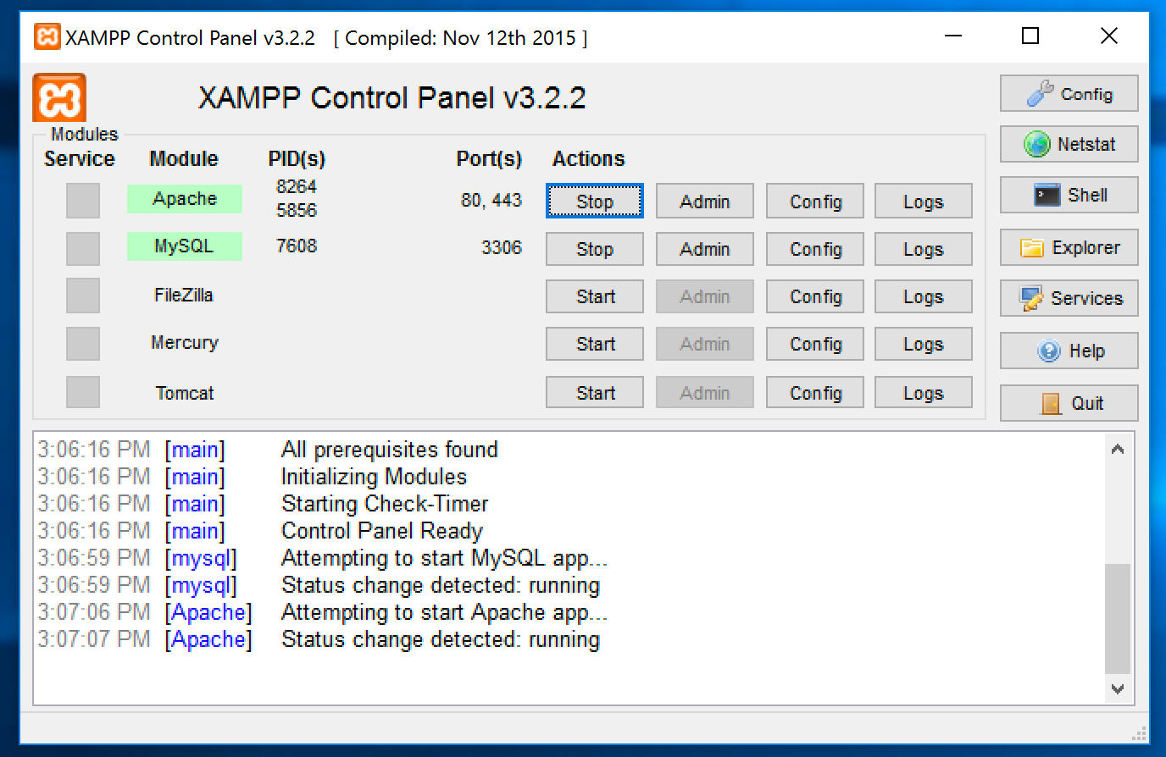
How to Start XAMPP Server

Slide 8
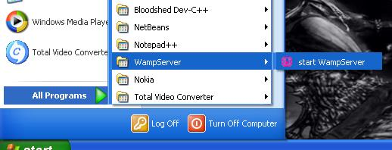
How to start WAMPP Server

Slide 9
How to Start LAMPP Server
By typing the command "sudo opt/lampp/lampp start" in the Command Prompt

Slide 10




Text Editor Software's for coding
Adobe Dreamviewer Sublime
Notepad++ Bracket

Slide 11
How to run files on browser
Open browser
Type in Url – localhost/folder name/filename/

Slide 12


