Slide 1

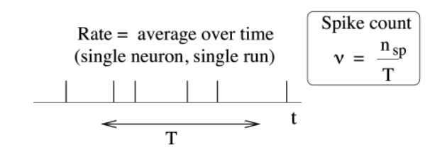
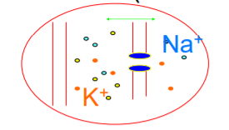
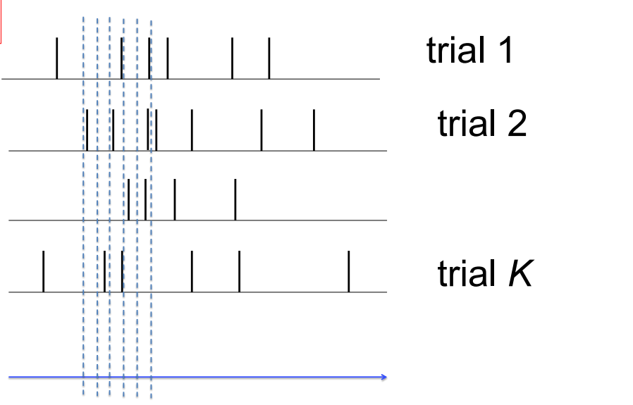
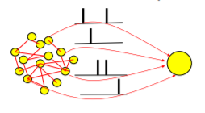
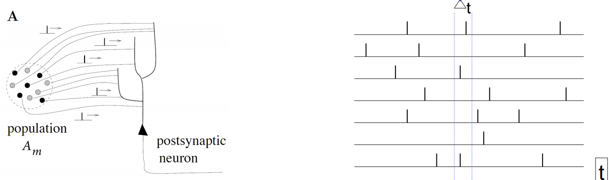
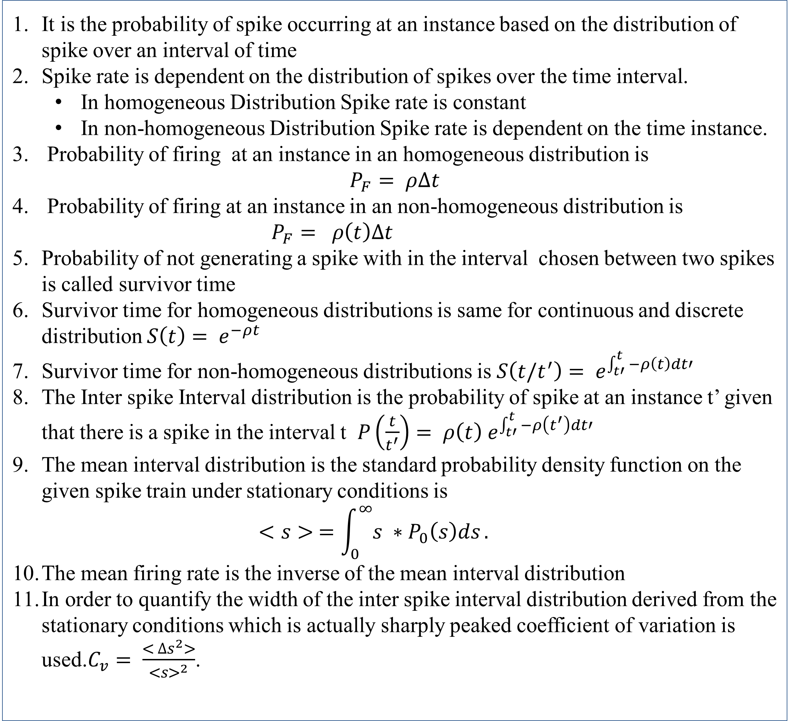
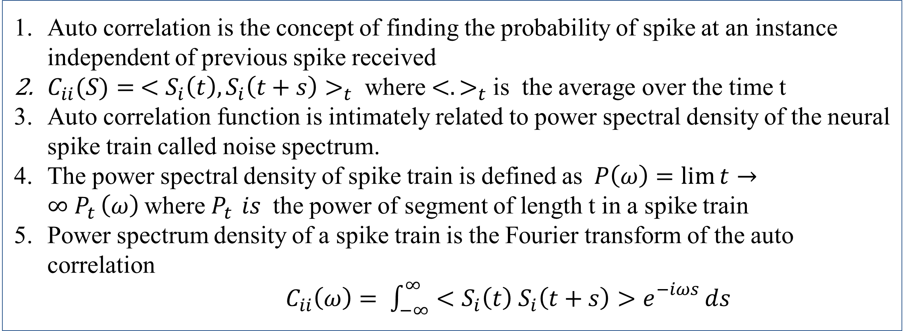
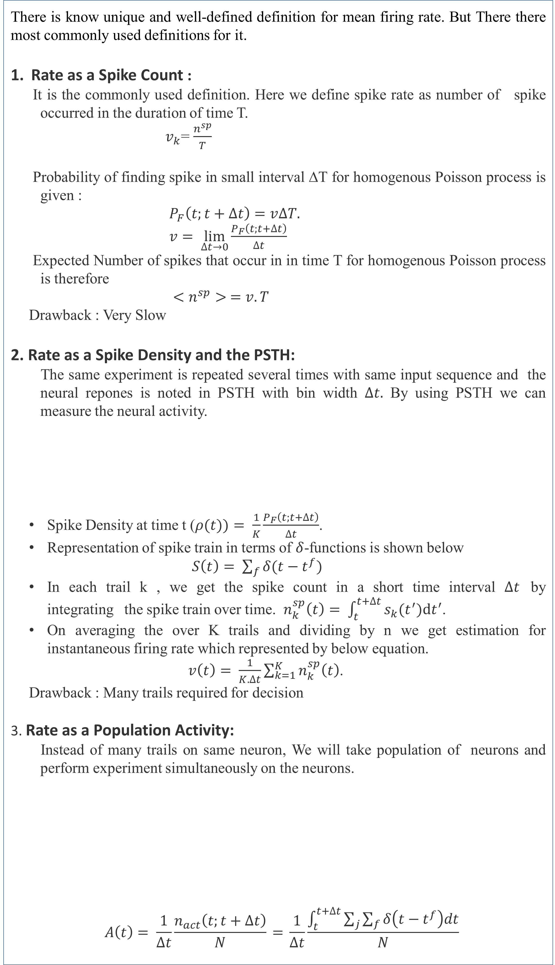
Quantitative Measures to Understand Spiking Neural Networks
Birla institute of technology and science (BITS) , Pilani
K K Birla Goa Campus
Department of Computer Science & Information Systems
Supervised by
Prof. Basabdatta Sen Bhattacharya
Pavirala Ranga Sai Rohith
M.Eng Computer Science
Mandadapu Naga Sai Sandilya
M.Eng Computer Science
Abstract
Mean Firing Rates
Standard existing models like Integrate-and-fire models and HH models are deterministic and generate the spike train that looks regular when driven by a constant stimulus. But a neuron activity in vivo recording shows a high degree of irregularity . A neuron in sensory cortex in vivo give neural recording different for one trail to another and some neurons emits spontaneous spikes even without any external stimulus due to this there is voltage fluctuations and gives large degree of variation in inter spike intervals. To mimic LIF models as unpredictability of neural recording, we need to add the noise to them. In order to achieve this , we should have proper quantification for variability of neuronal spike trains. There is no unique and well-defined Mean firing Rate. There are there definitions for it which is described in the poster. We use Inter Spike interval (ISI) to study neural variability.
There is know unique and well-defined definition for mean firing rate. But There there most commonly used definitions for it.
Rate as a Spike Count :
It is the commonly used definition. Here we define spike rate as number of spike occurred in the duration of time T.
$v_{k}$= $\frac{n^{sp}}{T}$
Probability of finding spike in small interval ∆T for homogenous Poisson process is given :
$P_{F}\left(t;t+∆t\right)=v∆T.$
$v= \lim_{∆t→0}{\frac{P_{F}\left(t;t+∆t\right)}{∆t}}$
Expected Number of spikes that occur in in time T for homogenous Poisson process is therefore
$<n^{sp}> =v.T$
Drawback : Very Slow
2. Rate as a Spike Density and the PSTH:
The same experiment is repeated several times with same input sequence and the neural repones is noted in PSTH with bin width $∆t.$ By using PSTH we can measure the neural activity.
Spike Density at time t ($ρ(t))= \frac{1}{K}\frac{P_{F}\left(t;t+∆t\right)}{∆t}$.
Representation of spike train in terms of $δ$-functions is shown below
$S\left(t\right)= \sum_{f}{δ(t−t^{f})}$
In each trail k , we get the spike count in a short time interval $∆t$ by integrating the spike train over time. $n_{k}^{sp}\left(t\right)= \int_{t}^{t+∆t}{s_{k}{(t}^{′}})dt^{′}$.
On averaging the over K trails and dividing by n we get estimation for instantaneous firing rate which represented by below equation.
$v\left(t\right)= \frac{1}{K.∆t}\sum_{k=1}^{K}{n_{k}^{sp}\left(t\right)}$.
Drawback : Many trails required for decision
3. Rate as a Population Activity:
Instead of many trails on same neuron, We will take population of neurons and perform experiment simultaneously on the neurons.
$$A\left(t\right)= \frac{1}{∆t}\frac{n_{act}\left(t;t+∆t\right)}{N}\text{ = }\frac{1}{∆t}\frac{\int_{t}^{t+∆t}{\sum_{j}{\sum_{f}{δ\left(t−t^{f}\right)dt}}}}{N}$$
Source of Variability
There are two sources of noise
Intrinsic Noise:
The noise inside the individual neuron
Finite number of channels
Finite Temperature.
2. Extrinsic Noise:
The noise that is caused due to spikes arrived from the pre-synaptic neurons which are beyond the scope of experimentalists for prediction
Network noise can be minimized by isolation of neuron
Spikes that are produced by fluctuation input current is more reliable than step current.
Coefficient of Variation
It is the probability of spike occurring at an instance based on the distribution of spike over an interval of time
Spike rate is dependent on the distribution of spikes over the time interval.
In homogeneous Distribution Spike rate is constant
In non-homogeneous Distribution Spike rate is dependent on the time instance.
Probability of firing at an instance in an homogeneous distribution is
$$P_{F}= ρ∆t$$
Probability of firing at an instance in an non-homogeneous distribution is
$P_{F}= ρ\left(t\right)∆t$
Probability of not generating a spike with in the interval chosen between two spikes is called survivor time
Survivor time for homogeneous distributions is same for continuous and discrete distribution $S\left(t\right)= e^{−ρt}$
Survivor time for non-homogeneous distributions is $S\left(t/t^{′}\right)= e^{\int_{t′}^{t}{−ρ\left(t\right)dt′}}$
The Inter spike Interval distribution is the probability of spike at an instance t’ given that there is a spike in the interval t $P\left(\frac{t}{t^{′}}\right)= ρ\left(t\right) e^{\int_{t′}^{t}{−ρ\left(t^{′}\right)dt′}}$
The mean interval distribution is the standard probability density function on the given spike train under stationary conditions is
$$<s> =\int_{0}^{∞}{{s ∗P}_{0}\left(s\right)ds}.$$
The mean firing rate is the inverse of the mean interval distribution
In order to quantify the width of the inter spike interval distribution derived from the stationary conditions which is actually sharply peaked coefficient of variation is used.$C_{v}= \frac{< ∆s^{2}>}{{<s>}^{2}}$.
Auto Correlation and Noise Spectrum
Auto correlation is the concept of finding the probability of spike at an instance independent of previous spike received
$C_{ii}(S)= {<S_{i}\left(t\right),S_{i}\left(t+s\right)>}_{t}$ where ${<.>}_{t}$is the average over the time t
Auto correlation function is intimately related to power spectral density of the neural spike train called noise spectrum.
The power spectral density of spike train is defined as$P\left(ω\right)=\lim{t}→∞ P_{t }\left(ω\right)$where $P_{t }is$ the power of segment of length t in a spike train
Power spectrum density of a spike train is the Fourier transform of the auto correlation
$C_{ii}\left(ω\right)= \int_{−∞}^{∞}{<S_{i}\left(t\right) S_{i}\left(t+s\right)>e^{\begin{aligned}−iωs \\ \end{aligned}}ds}$
Contact
Submitted in partial fulfillment of Research Practice
M Naga Sai Sandilya
Mail id: h20200054@goa.bits.pilani.ac.in
P Ranga Sai Rohith
Mail id: h20200047@goa.bits-pilani.ac.in
References
W. Gerstner, W.M. Kistler, R. Naud and L. Paninski, Neuronal Dynamics: from single neurons to networks and models of cognition. Ch. 7,8: Cambridge, 2014

