Slide 1

If shippo then that
An integration of shippo with ifttt
Creators:
Adolfo Schneider – adolfosrs@gmail.com
Taís Bellini – tais38@gmail.com
Thom Morais - thommorais@gmail.com

Slide 2
What is it?
If Shippo Then That is an integration of Shippo’s new Tracking API with IFTTT.
It uses the Maker Channel to listen to our application and create a Trigger whenever
Shippo informs an update on the item status.
The application can be accessed here and it’s usage is explained in the interface.
The code can be reviewed here: https://github.com/taisbellini/ifShippoThenThat

Slide 3
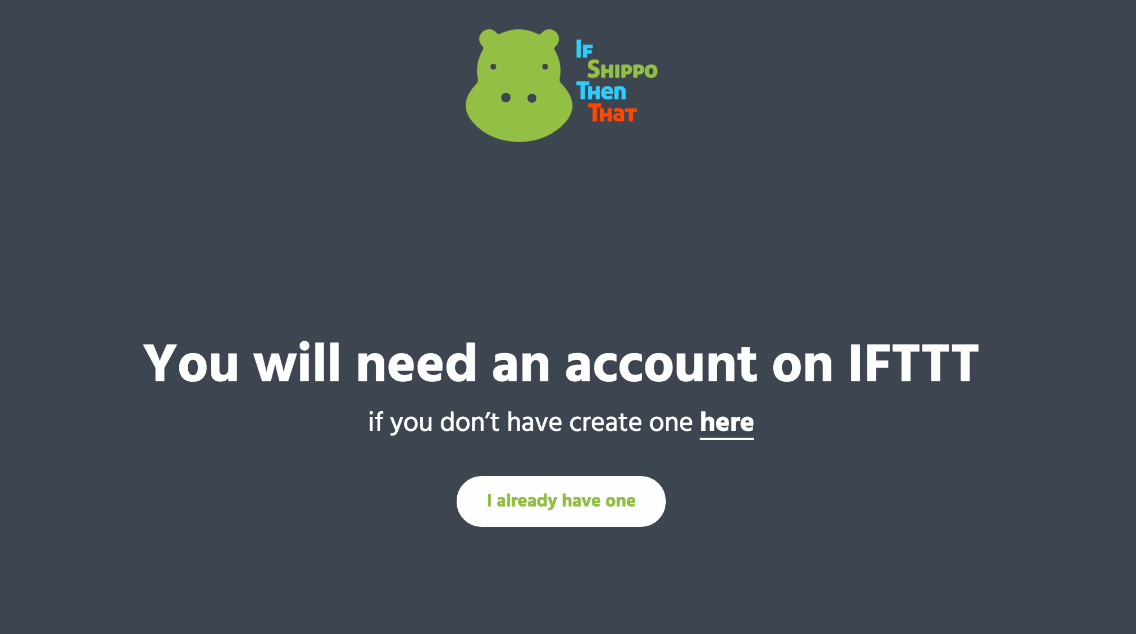
SCREENSHOTS

Slide 4
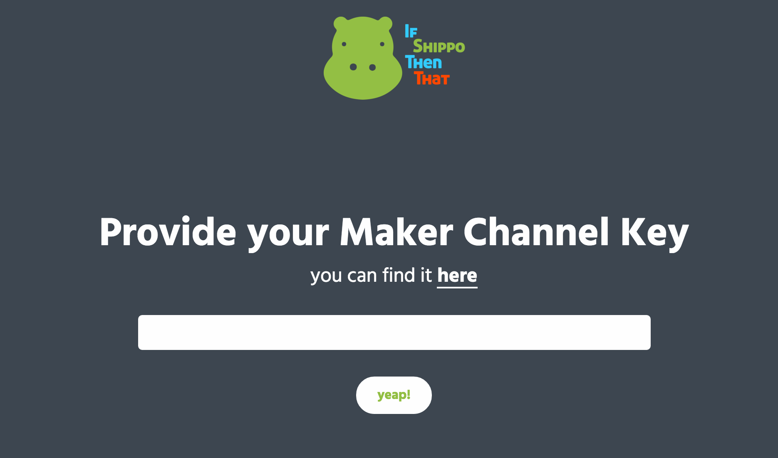
SCREENSHOTs

Slide 5
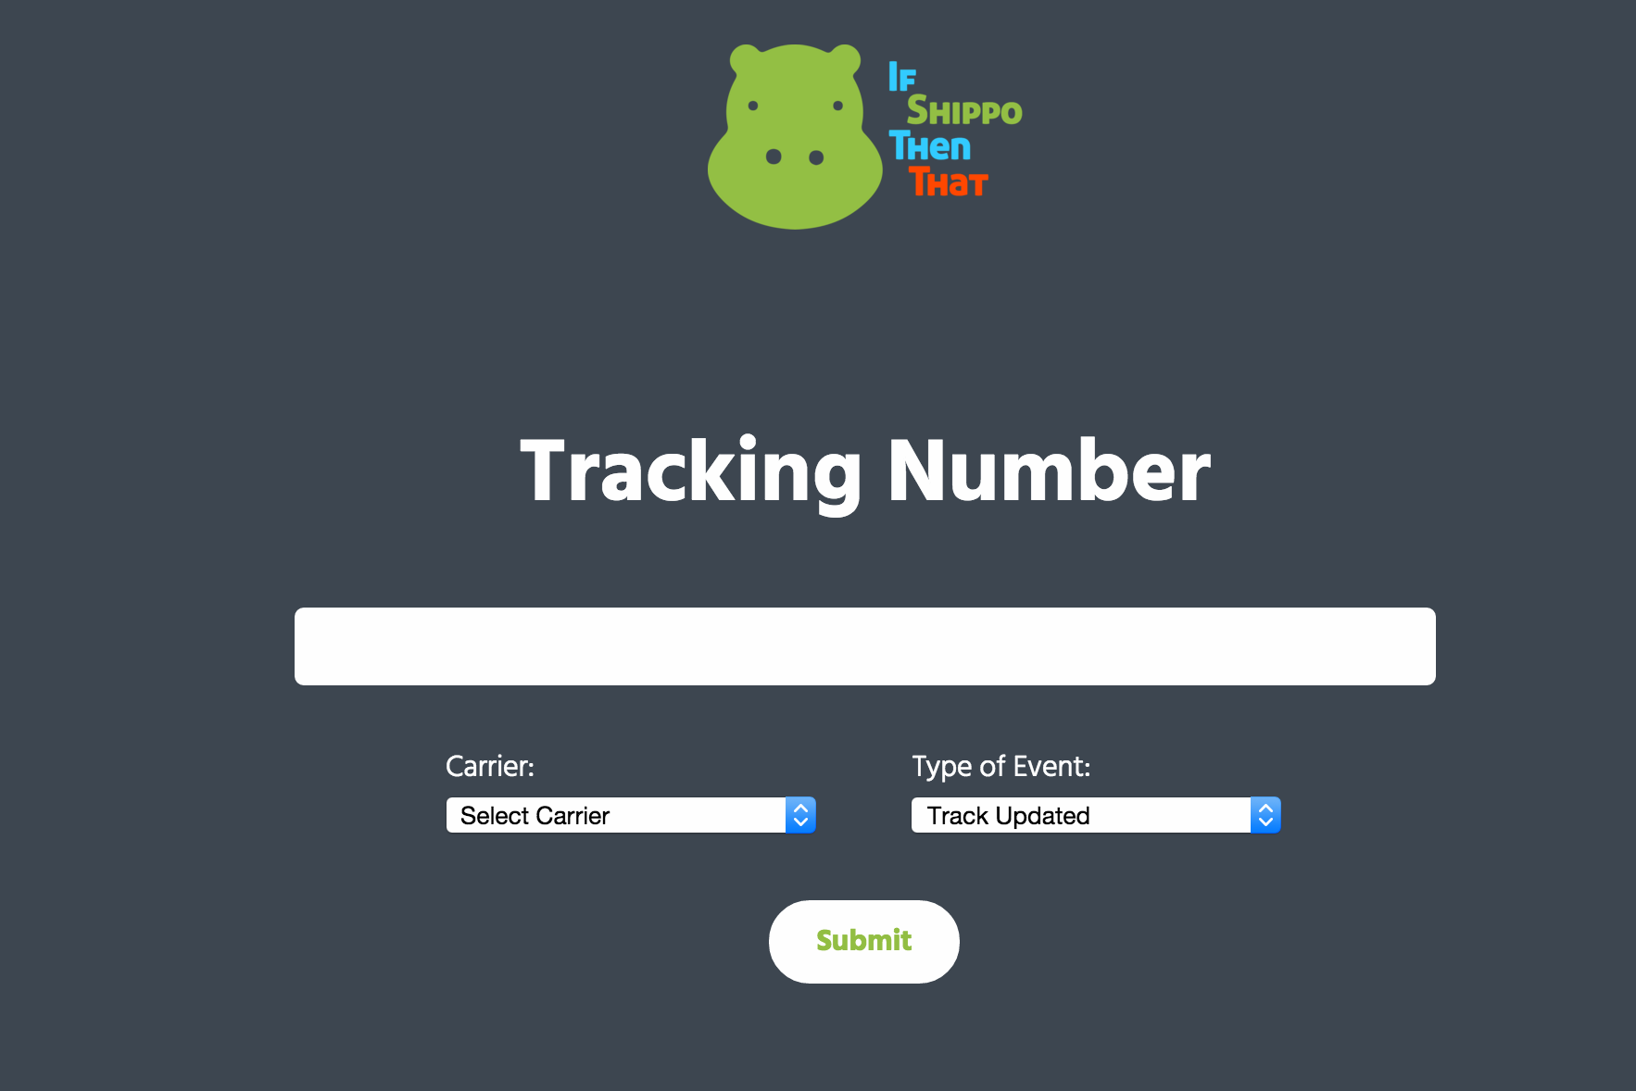
SCREENSHOTS

Slide 6
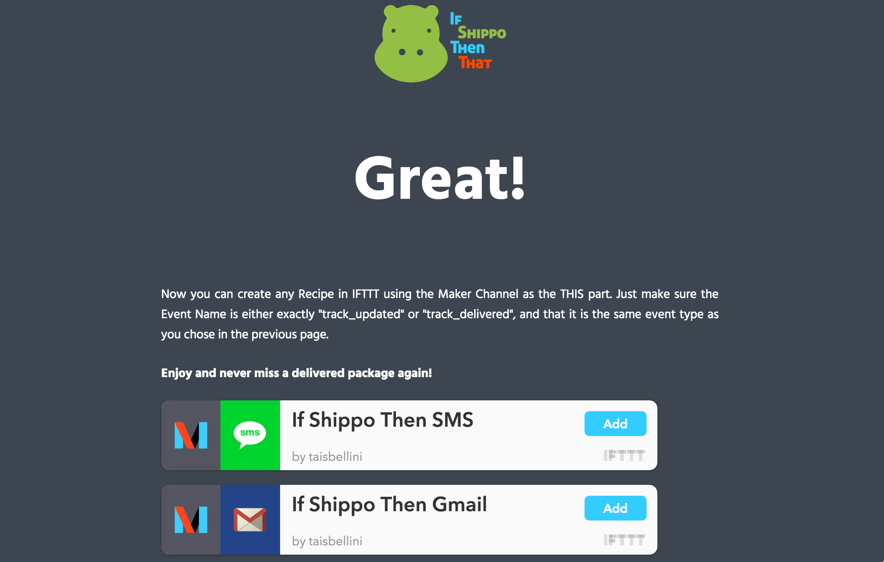
SCREENSHOTS

Slide 7
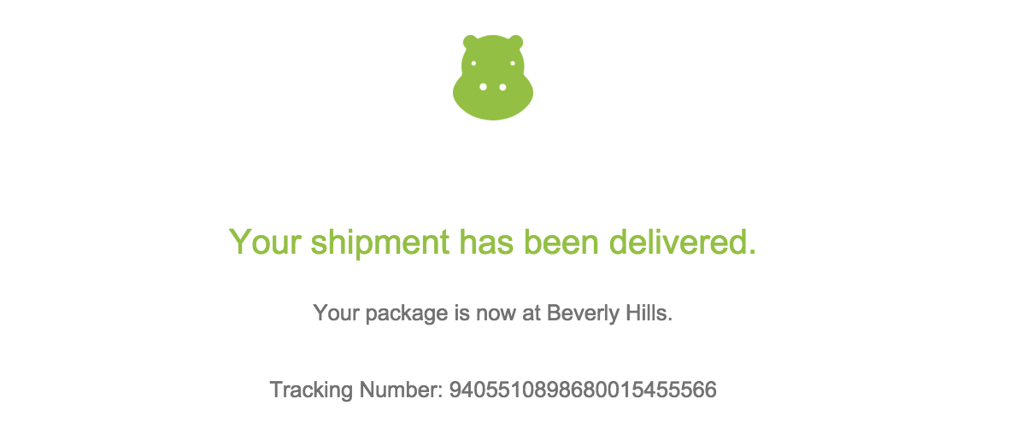
SCREENSHOTS
Example of notification received using this Recipe: https://ifttt.com/recipes/384912-if-shippo-then-gmail

