Slide 1
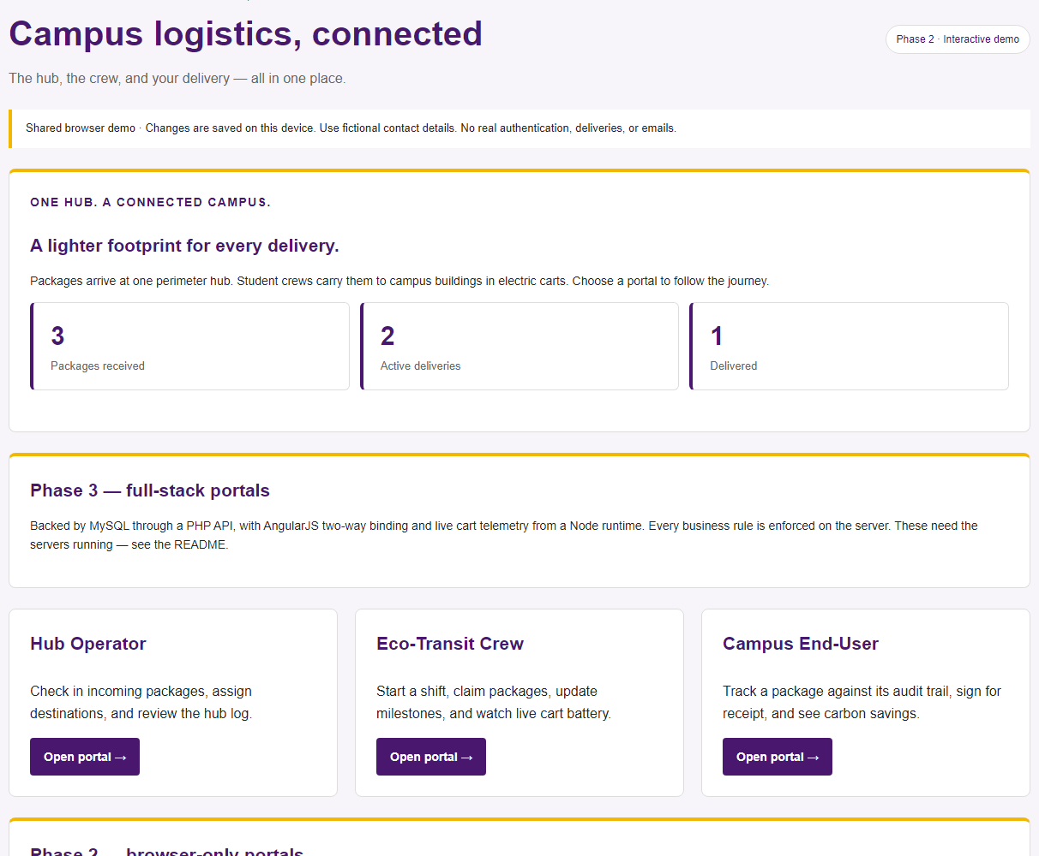
MNSU-CampusEco
Campus package
delivery,
now on a server.
The same three portals, with the data
and the rules moved to a database.
CIS 483 · Technical Presentation 2 · November 16, 2026
Misgana Kebede · Clement Mbuyi · Yonatan Alemayehu · Emran Abatemam
1 / 13
Notes:
Phase 2 ran entirely in the browser. Phase 3 moves the data into MySQL and the rules onto the server. Same three portals, same workflow, different authority. Ten minutes, so we move quickly and the demo carries the middle.

Slide 2
The four components, and where they are
Frontend
Three portals bound with ng-model. Every read and write is an AJAX call carrying JSON.
1
Slides 6, 7, 9
AngularJS 1.8.3
Node.js backend
Live cart telemetry, a server-sent event stream and a dispatch alert queue on port 3000.
2
Slide 8
Zero-dependency runtime
Backend server
Nine REST endpoints over PDO. Prepared statements, bcrypt, sessions, role checks.
3
Slide 5
PHP 8.3
Relational database
Eight normalised tables. The constraints enforce the business rules themselves.
4
Slide 4
MySQL 8.0
All four are built and running. Slide 10 shows how they fit together.
2 / 13
Notes:
These are the four components asked for. Say up front that all four exist and run, then spend the time on the demo rather than on describing them.

Slide 3
WHAT CHANGED SINCE PRESENTATION 1
The browser asks. The server decides.
Phase 2 checked the rules in JavaScript and saved the result to localStorage. Anyone who opened developer tools could edit that data, and the rules went with it. Each rule now has a second copy the user cannot reach.
Rule | Phase 2 enforced it with | Phase 3 enforces it with
Duplicate tracking number | JavaScript comparison | UNIQUE index on the table
Cart needs 20% battery | if statement before the claim | Checked inside a locked transaction
Only the assigned courier | Compared two strings | Session identity matched to the row
Loaded → En Route → Delivered | Array index arithmetic | Rejected server-side with a 409
One receipt per package | Checked a field was empty | UNIQUE index on receipts
3 / 13
Notes:
This is the whole phase in one slide. The browser keeps its copy for instant feedback; the right-hand column is what actually decides.

Slide 4
COMPONENT 4 · RELATIONAL DATABASE · MYSQL 8.0
Eight tables, normalised
users
destinations
Accounts, roles, hashed passwords
Campus buildings, split out of packages
vehicles
couriers
Electric carts and battery levels
Driver codes linked to accounts
packages
transit_events
The delivery record itself
Every status change, with a timestamp
receipts
preferences
One per package — enforced by UNIQUE
Recipient delivery choices
The schema enforces the rules, not just the shape: UNIQUE on tracking and on receipts, CHECK constraints bounding weight, dimensions, battery and the ECO-#### driver format, and foreign keys on every reference.
4 / 13
Notes:
Third normal form. Destination is a foreign key, not a repeated string. History is its own table, which is what makes the recipient timeline a real audit trail rather than a field we overwrite.

Slide 5
COMPONENT 3 · BACKEND SERVER · PHP 8.3
Nine endpoints, and what guards them
REST endpoints
Prepared statements
Values go to MySQL separately from the SQL text. Emulation is off, so the protection is real rather than apparent.
auth.php
packages.php
Hashed passwords
claims.php
bcrypt through password_hash, checked with password_verify. A plain password is never stored or compared.
milestones.php
track.php
Session hardening
receipts.php
The session id is regenerated on login, and a failed login gives one message whether the user or the password was wrong.
fleet.php
metrics.php
Least privilege
destinations.php
The API connects as campuseco_app, which can read and write rows and nothing else. Never as root.
JSON in, JSON out. Real status codes:
401, 403, 404, 409.
5 / 13
Notes:
Four security requirements, each a line or two of PHP done correctly, each easy to get wrong in a way that still looks like it works. Emulated prepared statements are the subtle one.

Slide 6
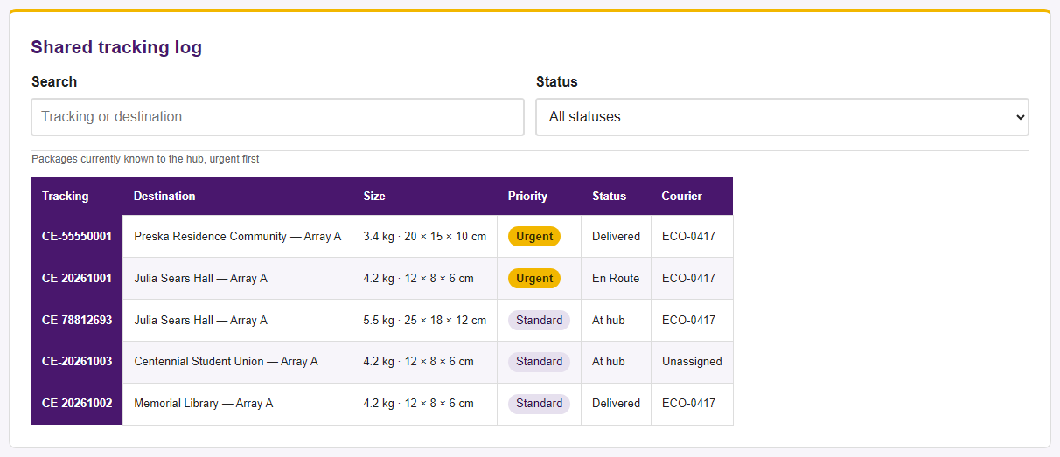
COMPONENT 1 · FRONTEND · ANGULARJS
Hub Operator: bound to the database
ng-model binds each field to the model
Check-in writes a row to MySQL
Search and status re-query as you type
Totals counted by the database
Duplicates refused by the UNIQUE index
6 / 13
Notes:
Demo: check a package in, watch it appear. Then check the same number in again - the refusal comes from the database, not from JavaScript. Type in the search box to show the list following the input.

Slide 7
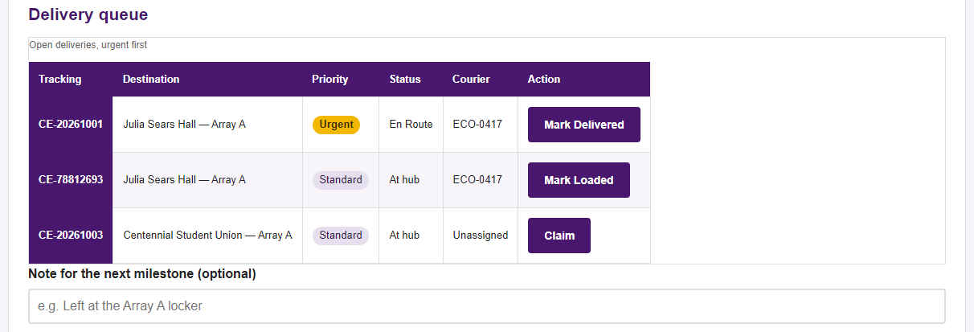
COMPONENT 1 · FRONTEND · ANGULARJS
Eco-Transit Crew: rules you cannot skip
A cart under 20% cannot claim
Only the assigned courier can advance
Statuses must run in order
Two claims at once resolve to one winner
The claim runs inside a transaction that locks the cart and the package row, so the battery check and the assignment cannot be separated by a second request arriving in between.
7 / 13
Notes:
Demo: pick cart-03 at 19% and try to claim - refused by the server. Switch to cart-01 and it works. Then try to jump straight to Delivered.

Slide 8
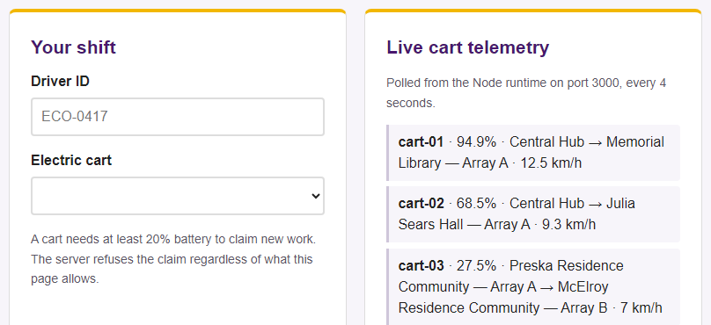
COMPONENT 2 · NODE.JS BACKEND
A second server, for what changes every second
Battery, stop and speed, refreshed live
A background task raises its own alerts
Server-sent events push without polling
Zero npm dependencies — plain Node http
Ten concurrent requests, all 200
Why two backends rather than one?
A battery reading that changes every two seconds is not a record worth keeping. PHP and MySQL hold what must survive a restart; Node carries what only matters right now. They never write to the same place, so neither can corrupt the other.
8 / 13
Notes:
The low-battery warning on screen was raised by the background task on its own, not by anything we clicked. That is the part worth pointing at.

Slide 9
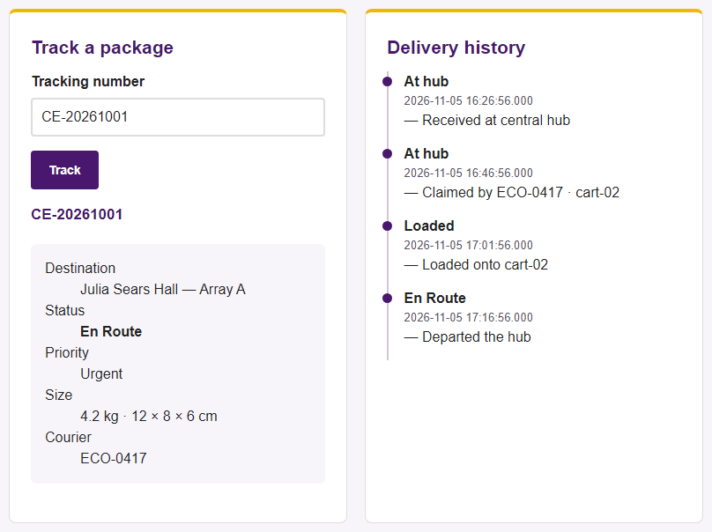
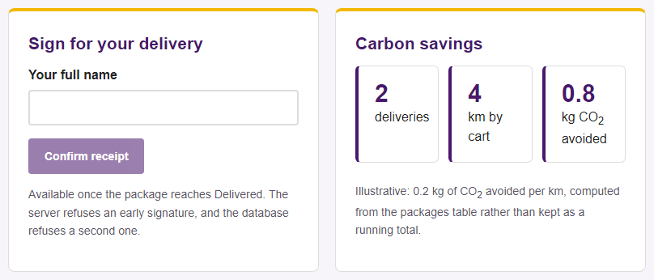
COMPONENT 1 · FRONTEND · ANGULARJS
Campus End-User: a real audit trail
Every row is a transit_events record
Timestamps to the millisecond
Nothing is overwritten, so the history is complete
Signing is refused before Delivered, and refused twice
Carbon is computed from the table each time, never stored
Carbon is illustrative at 0.20 kg per km, not measured emissions.
9 / 13
Notes:
In Phase 2 the history was an array inside the saved package. Here it is its own table, so a status change appends a row and nothing is ever rewritten.

Slide 10
How the four components work together
Component 1
Component 3
Component 4
Browser
PHP 8.3
MySQL 8.0
→
→
AngularJS binds the
forms and lists
Validates, authorises,
runs the transaction
Stores it and enforces
the constraints
AJAX · JSON
SQL
Component 2 · Node.js runtime, port 3000
The browser also polls this directly for live cart battery and position. It runs alongside PHP rather than behind it, because this data is never written to the database.
One delivery claim touches all four: Angular sends JSON, PHP checks the battery and the caller inside a locked transaction, MySQL enforces the constraints, and the courier screen refreshes from the telemetry runtime.
10 / 13
Notes:
If there is one slide to land, it is this one - the professor asked specifically how the components work together. Walk one claim through all four.

Slide 11
DOES IT ACTUALLY HOLD?
Every rule, tested against the running stack
What we tried | What the server did
Duplicate tracking number | Refused — 409
Weight of 900 kg | Refused — 400
Claim on a cart at 19% | Refused — needs 20%
Second claim on one package | Refused — already assigned
Skip straight to Delivered | Refused — 409
Another driver advancing it | Refused — 403
Signing twice | Refused — UNIQUE
Check in while signed out | Refused — 401
9 of 9
negative tests rejected by MySQL directly, with no PHP involved
4 of 4
Phase 2 model tests still passing
10
concurrent telemetry requests, all 200
11 / 13
Notes:
Run against the live API and a live database, not asserted from reading the code. The nine direct-to-MySQL tests matter most: the rule survives even if someone bypasses our PHP entirely.

Slide 12
WHAT WENT WRONG
Three bugs worth keeping
Every destination lookup failed
Reseeding needed root
A long demo showed three flat carts
The MySQL client read our seed file in the Windows console code page, so each em-dash was stored double-encoded. Nothing errored; the insert succeeded and the query simply matched nothing.
TRUNCATE requires the DROP privilege, which our restricted application account deliberately does not have.
Simulated batteries drained about 12% a minute, so a runtime left on before class would read near zero by the time we presented.
FIX
FIX
FIX
Pinned the charset with SET NAMES utf8mb4 and compared the stored bytes against what an em-dash should be.
Switched to DELETE, which works inside the grants the account already holds.
Slowed the drain and added a charging cycle, so the fleet recovers and still crosses the threshold.
12 / 13
Notes:
The first one is the interesting one, and worth telling if there is time. Nothing errored - we only found it by comparing stored bytes.

Slide 13
Where Phase 3 landed
ALL FOUR COMPONENTS DELIVERED
NEXT — PRODUCTION VERIFICATION
AngularJS frontend across three portals
Node.js telemetry runtime
PHP backend, nine REST endpoints
MySQL, eight normalised tables
Every Phase 2 rule now enforced server-side
Automated browser tests for the full-stack pages
Recipient accounts scoped to their own packages
Swap telemetry polling for the event stream
Deployment notes and load checks
github.com/mnsu-campuseco/mnsu-campuseco · tagged phase-3
Thank you — questions welcome.
13 / 13
Notes:
Phase 3 is committed and tagged. The repository has the full history and the README has the setup a marker needs from an empty database.

